Slide 1
DecisionTree_score
Test_size = 0.1

Slide 2
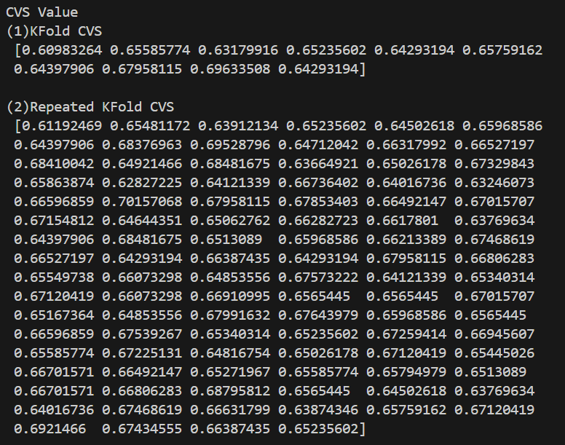

Slide 3
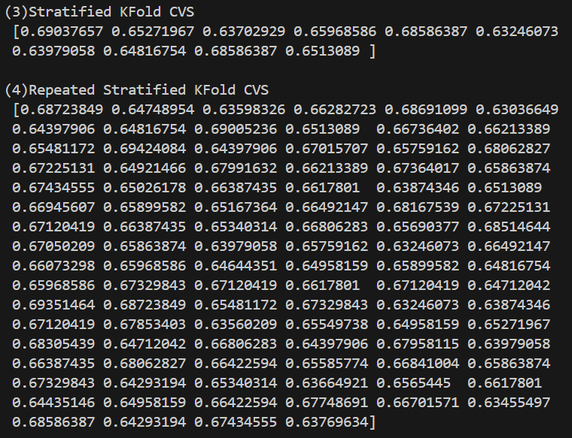

Slide 4
DecisionTree
Test_size = 0.2

Slide 5
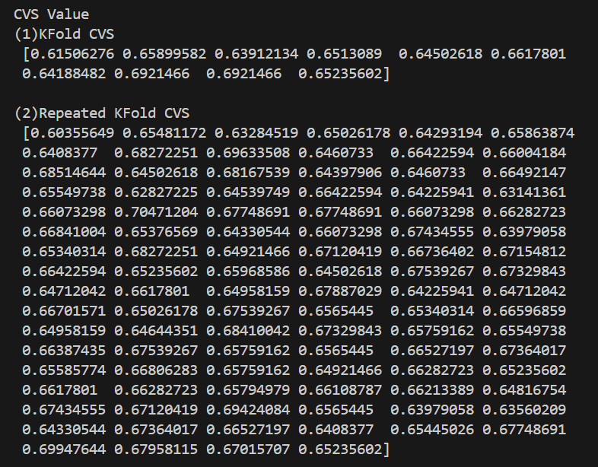

Slide 6
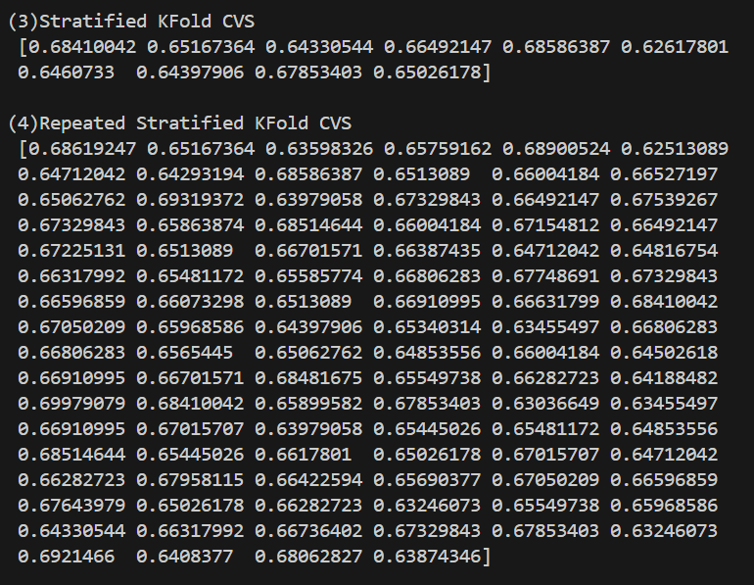

Slide 7
DecisionTree
Test_size = 0.3

Slide 8
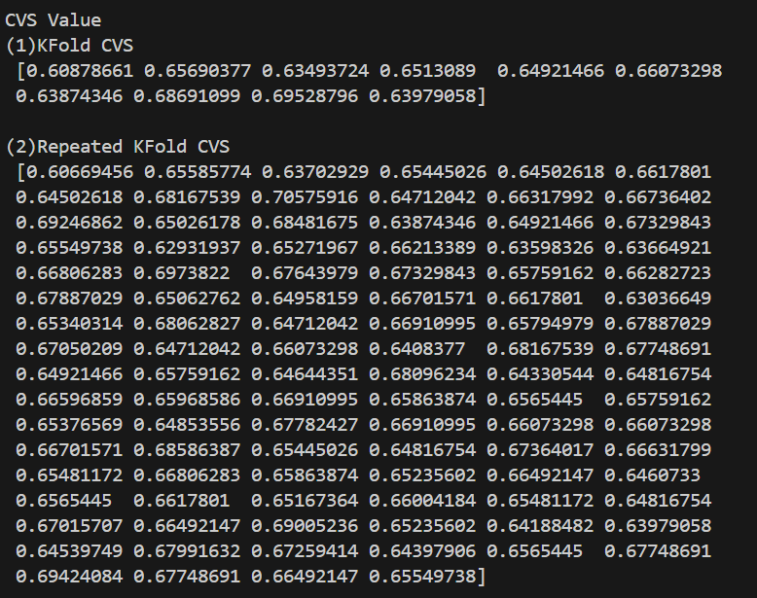

Slide 9
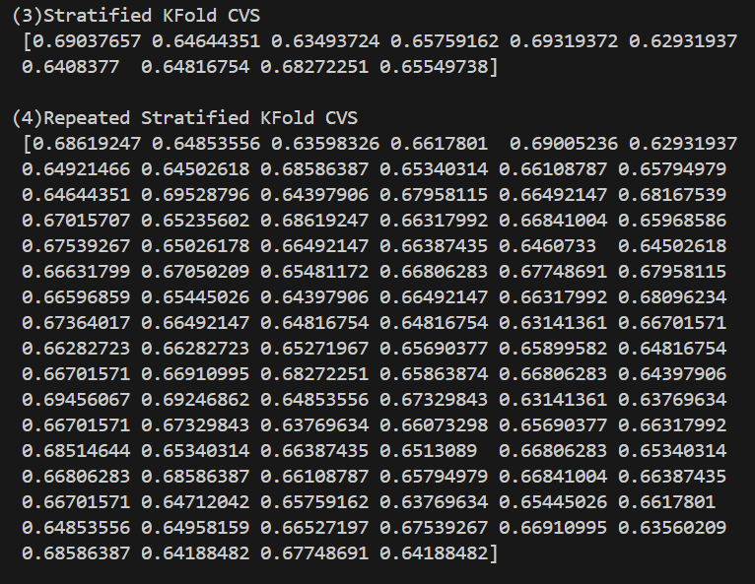

Slide 10
DecisionTree
Test_size = 0.4

Slide 11
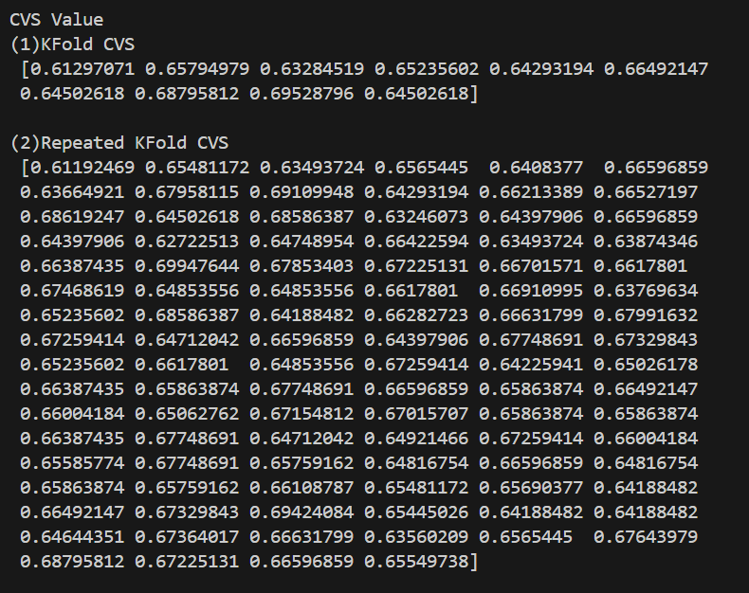

Slide 12
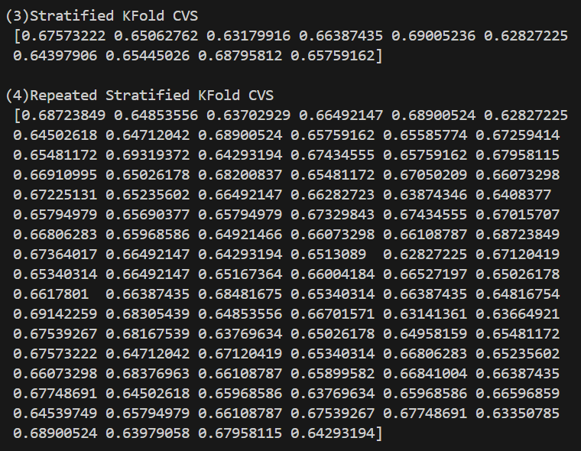

Slide 13
DecisionTree
Test_size = 0.5

Slide 14
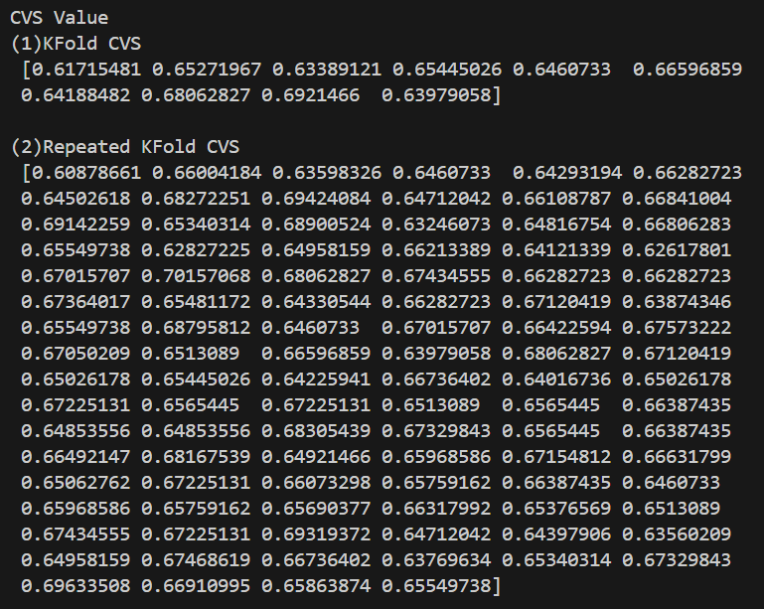

Slide 15
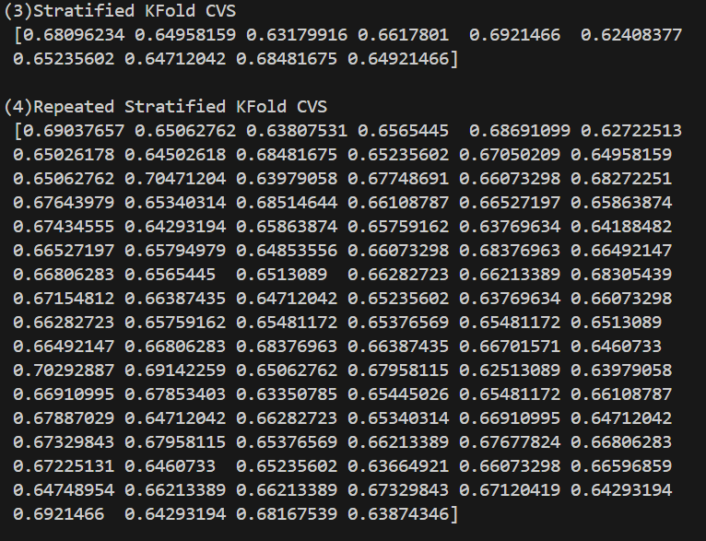

Slide 16
DecisionTree_one-hot
Test_size = 0.1

Slide 17
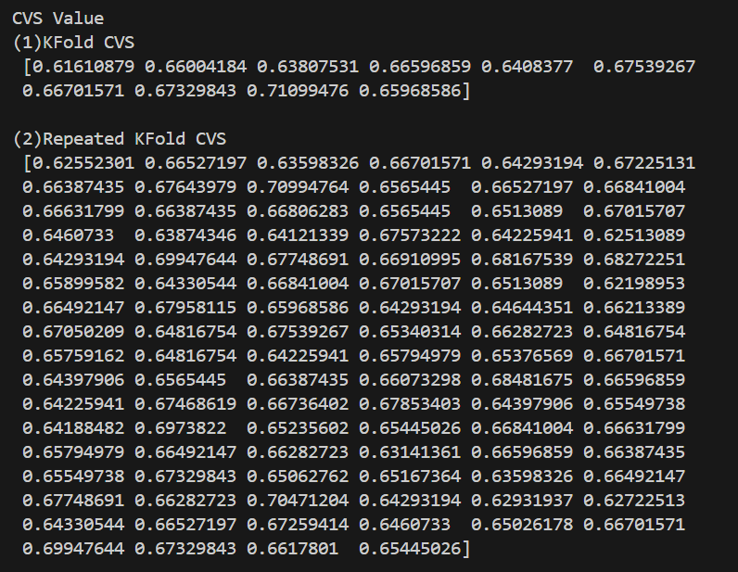

Slide 18
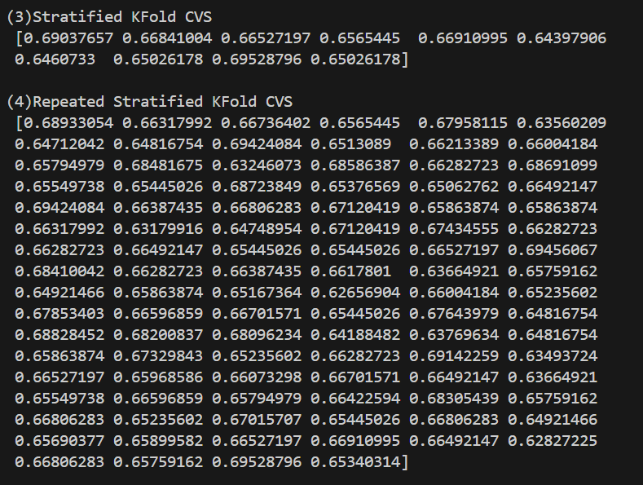

Slide 19
DecisionTree_one-hot
Test_size = 0.2

Slide 20
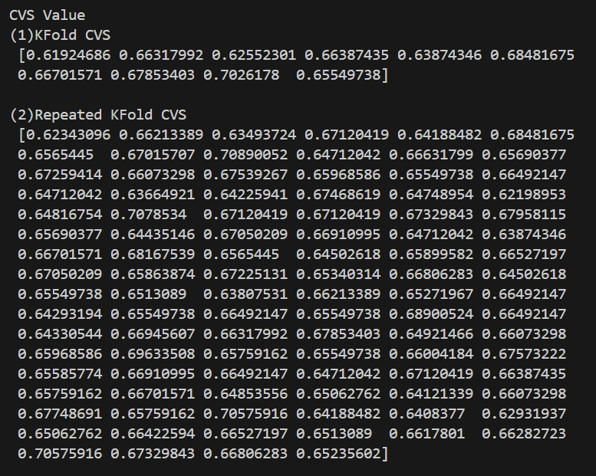

Slide 21
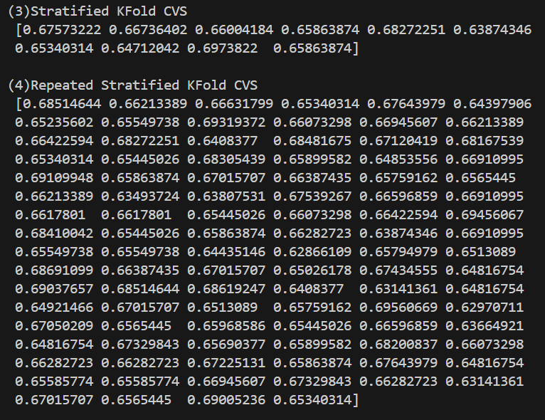

Slide 22
DecisionTree_one-hot
Test_size = 0.3

Slide 23
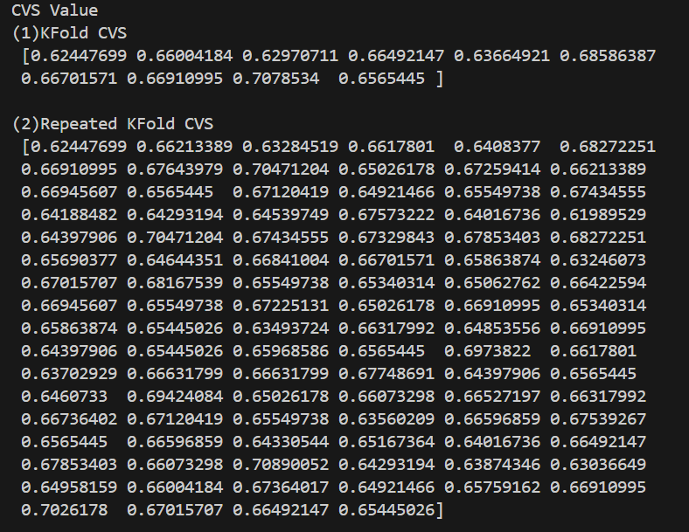

Slide 24
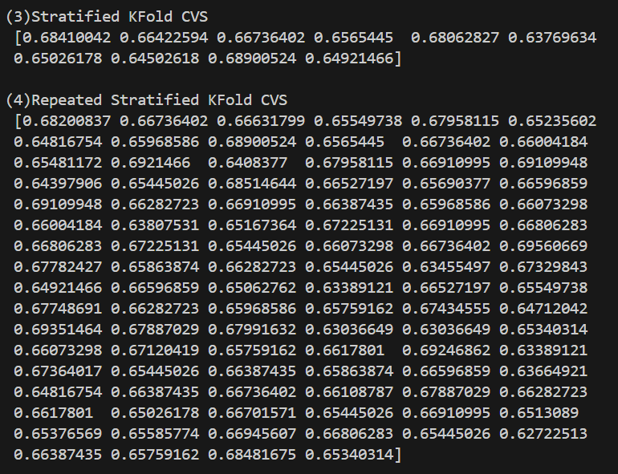

Slide 25
DecisionTree_one-hot
Test_size = 0.4

Slide 26
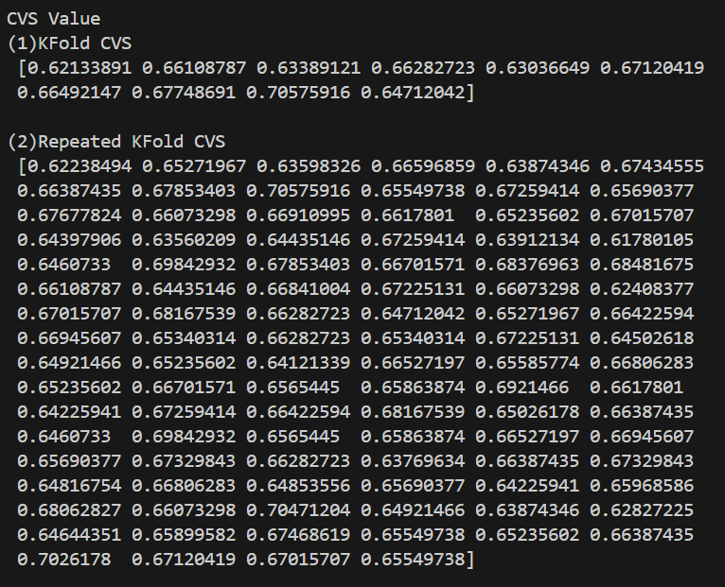

Slide 27
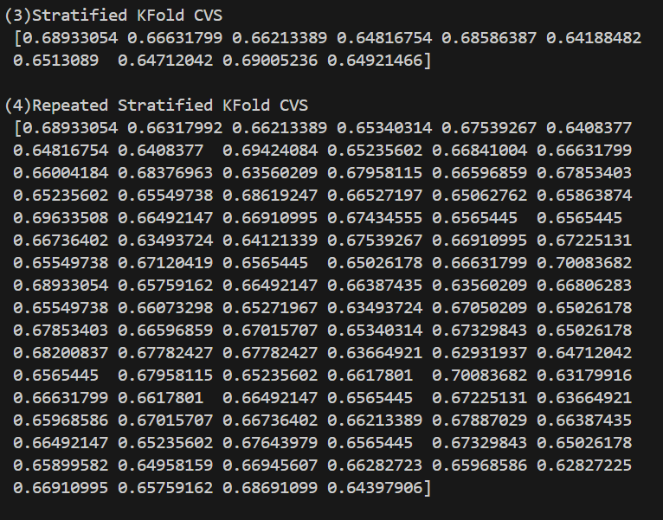

Slide 28
DecisionTree_one-hot
Test_size = 0.5

Slide 29
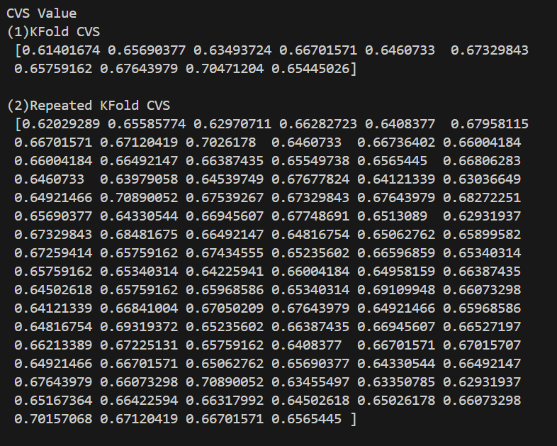

Slide 30
