Slide 1
DecisionTree_score
Test_size = 0.1

Slide 2
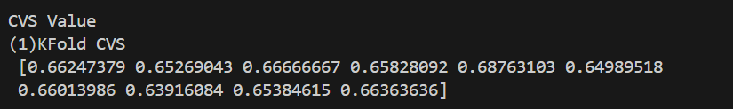

Slide 3
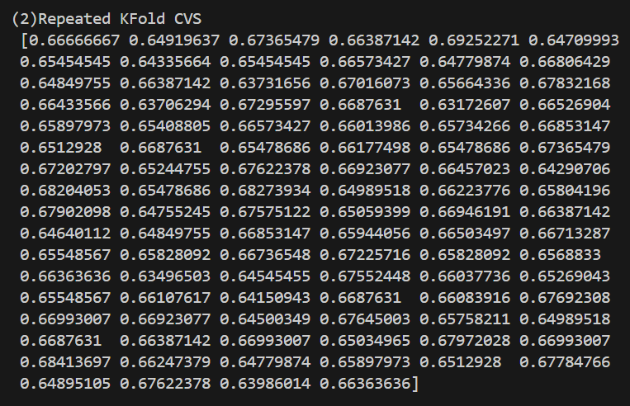

Slide 4
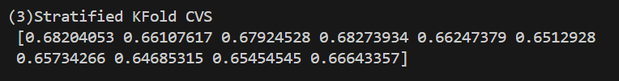

Slide 5
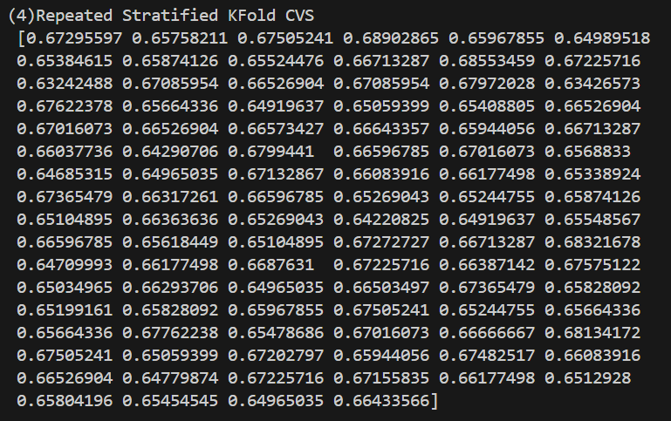

Slide 6
DecisionTree
Test_size = 0.2

Slide 7
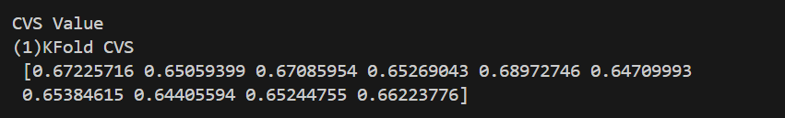

Slide 8
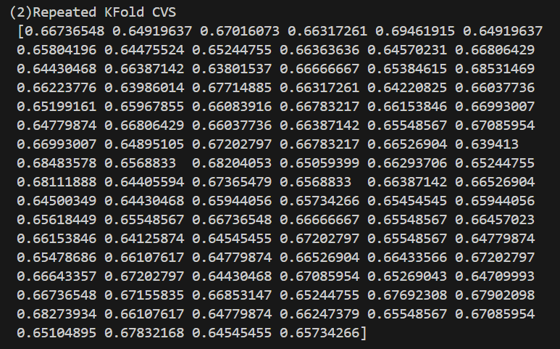

Slide 9


Slide 10
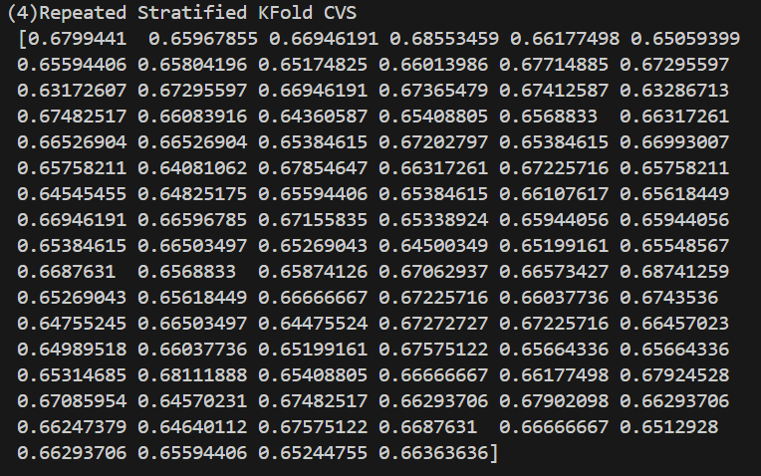

Slide 11
DecisionTree
Test_size = 0.3

Slide 12
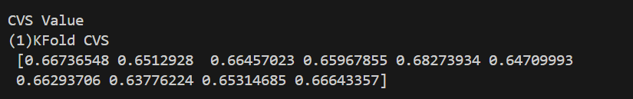

Slide 13
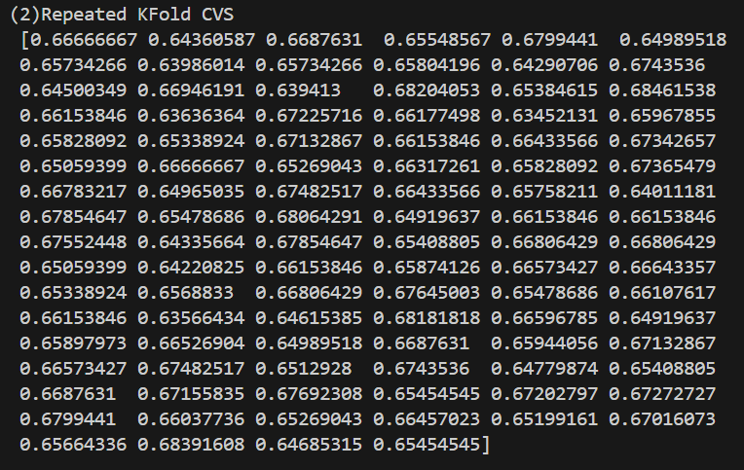

Slide 14
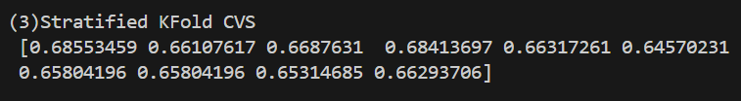

Slide 15
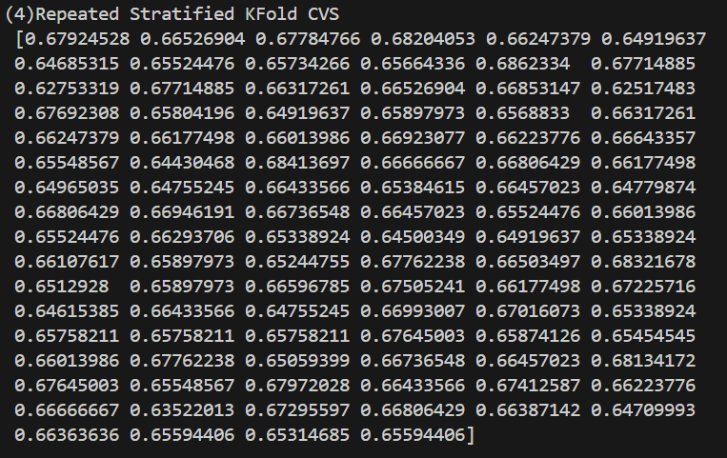

Slide 16
DecisionTree
Test_size = 0.4

Slide 17
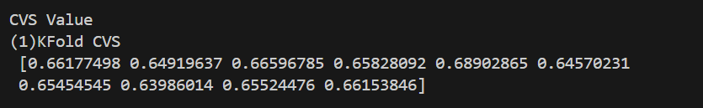

Slide 18
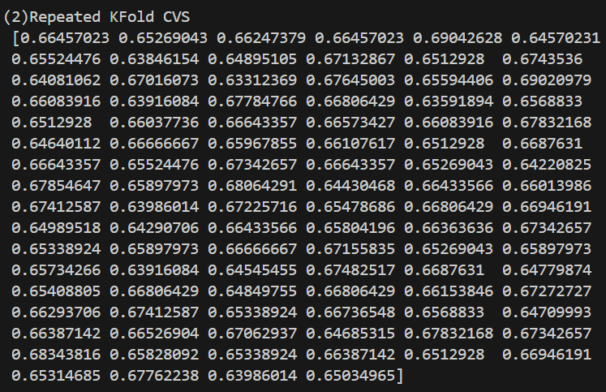

Slide 19


Slide 20
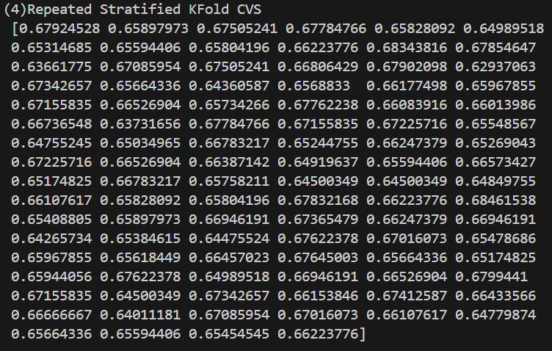

Slide 21
DecisionTree
Test_size = 0.5

Slide 22
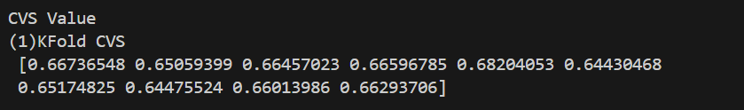

Slide 23
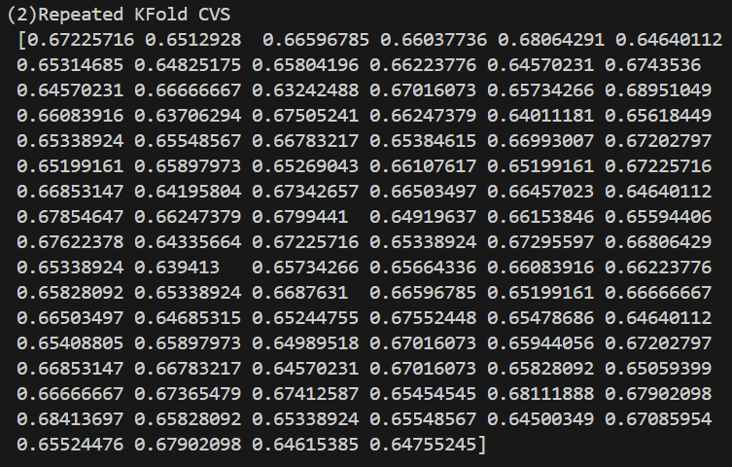

Slide 24


Slide 25
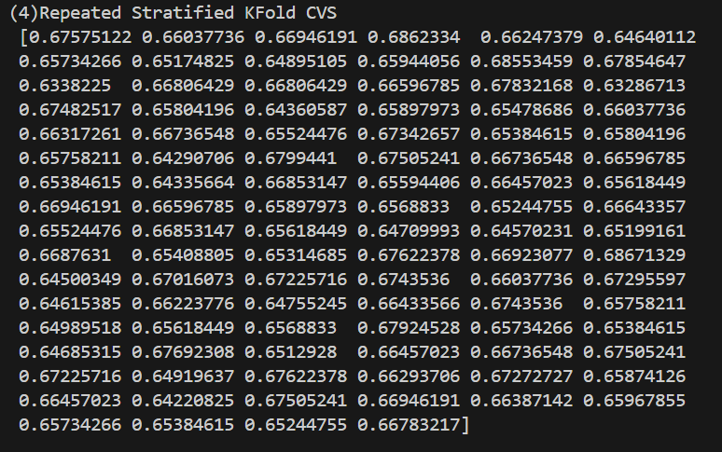

Slide 26
DecisionTree_one-hot
Test_size = 0.1

Slide 27
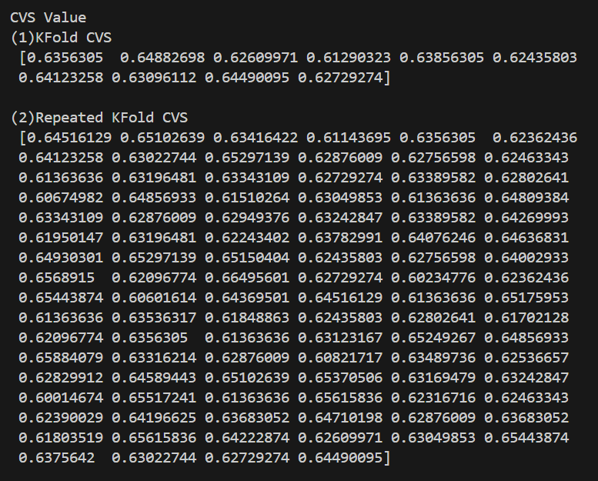

Slide 28
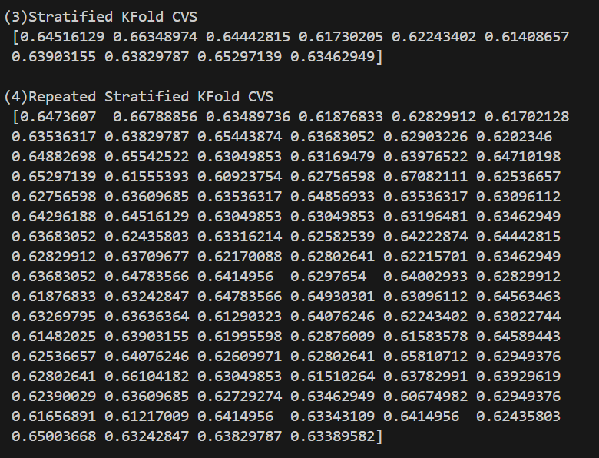

Slide 29
DecisionTree_one-hot
Test_size = 0.2

Slide 30
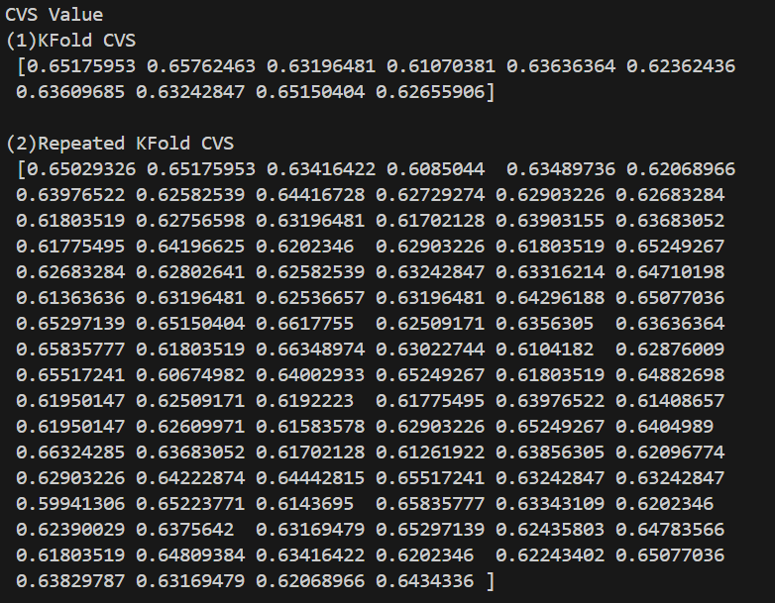

Slide 31
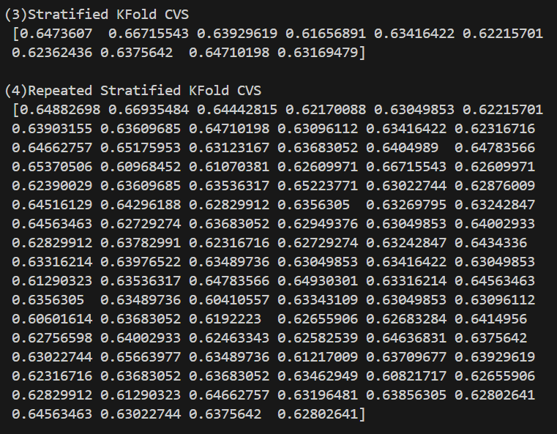

Slide 32
DecisionTree_one-hot
Test_size = 0.3

Slide 33
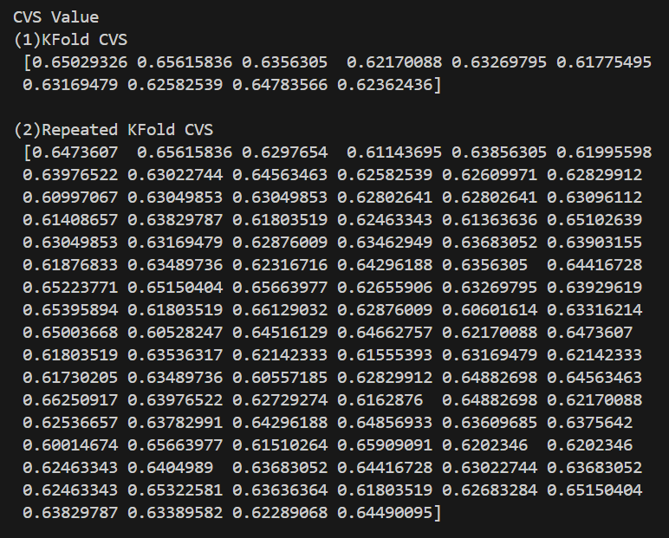

Slide 34
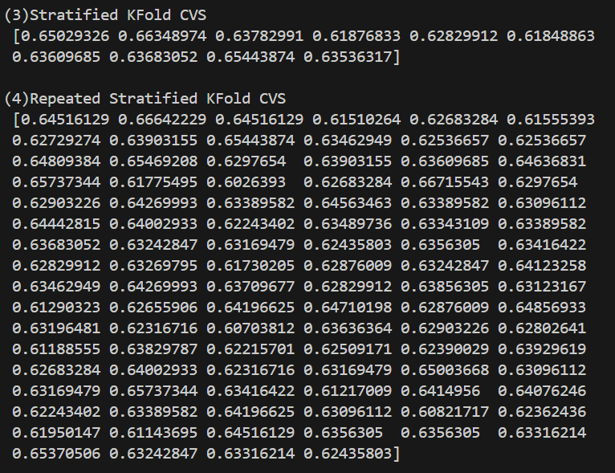

Slide 35
DecisionTree_one-hot
Test_size = 0.4

Slide 36
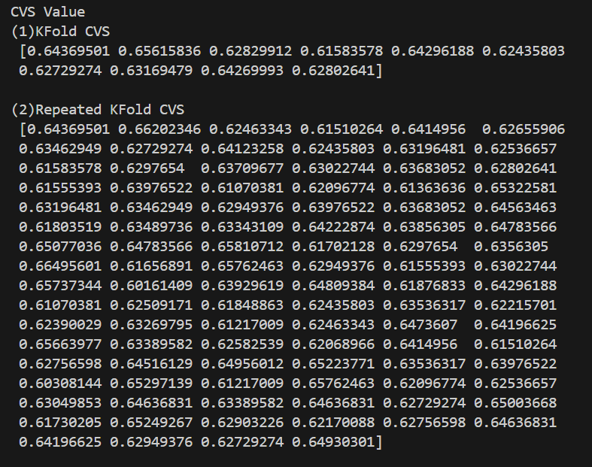

Slide 37
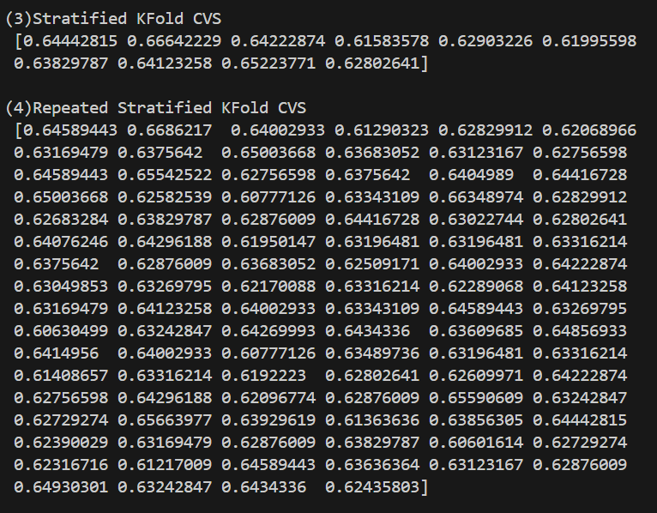

Slide 38
DecisionTree_one-hot
Test_size = 0.5

Slide 39
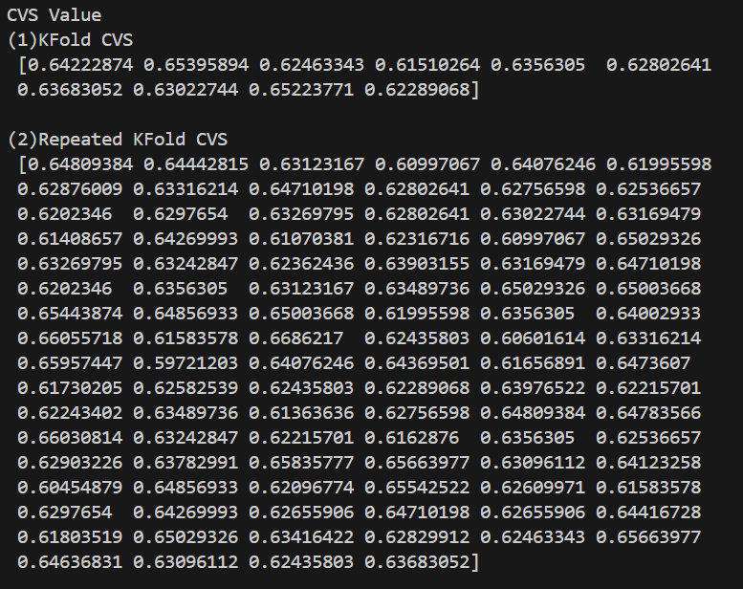

Slide 40
