Slide 1
Opening Ports on Azure VMs

Slide 2
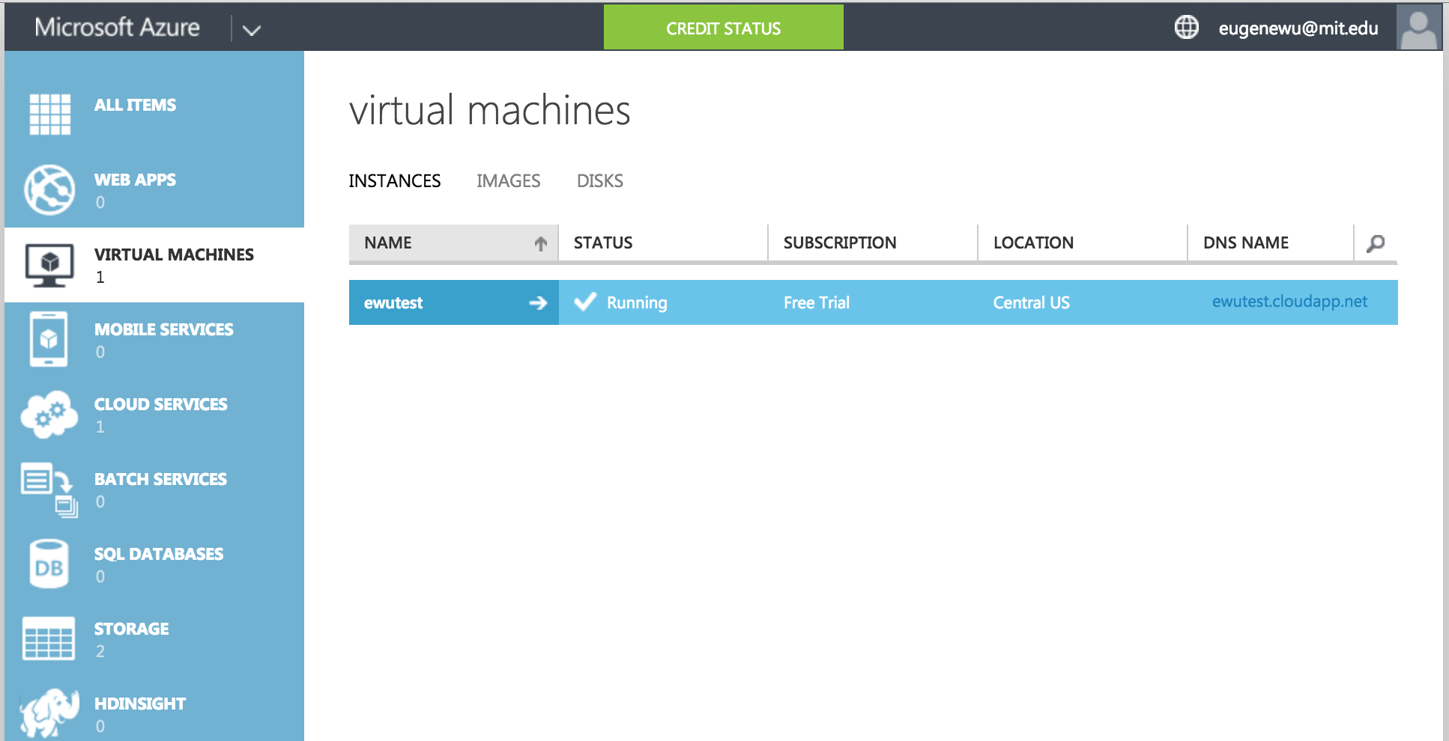
Click on your VM

Slide 3
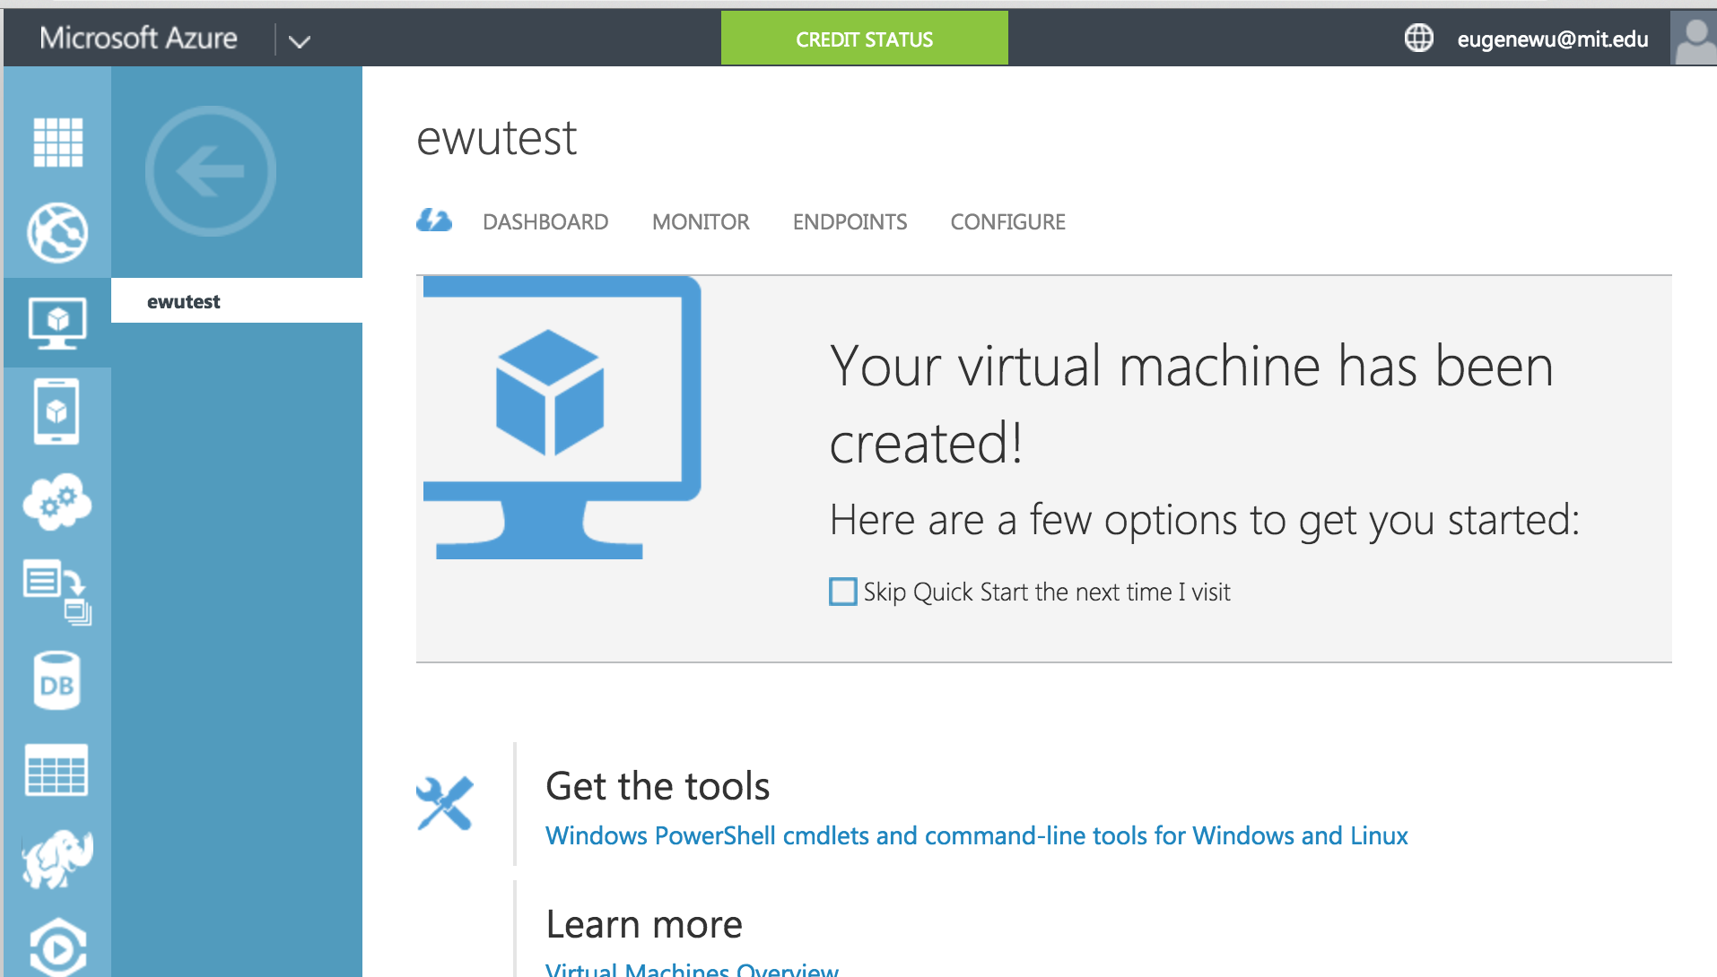
Click on “endpoints”

Slide 4
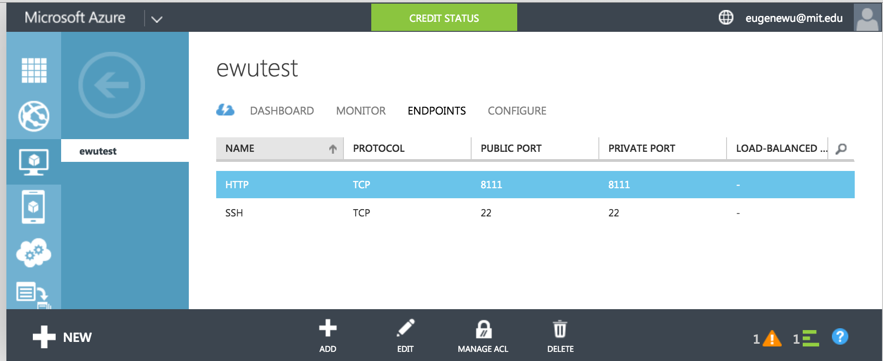
Click “Add”

Slide 5
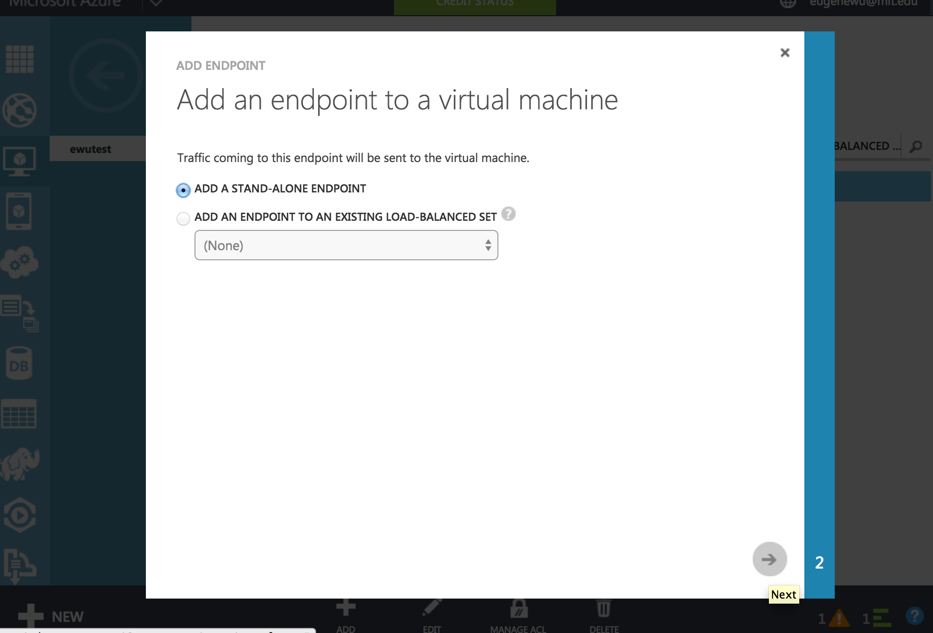
Select “Add a stand-alone endpoint”
and click the next arrow in the bottom right

Slide 6
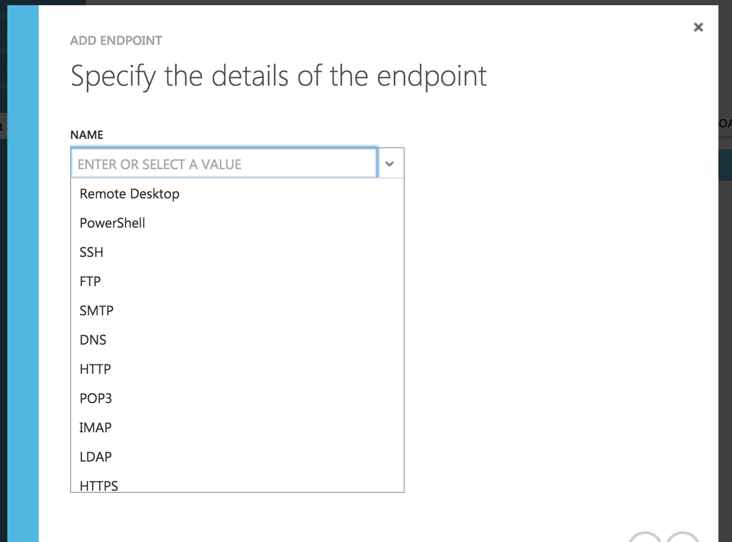
Pick a name for your port.
Any name works, just remember it

Slide 7
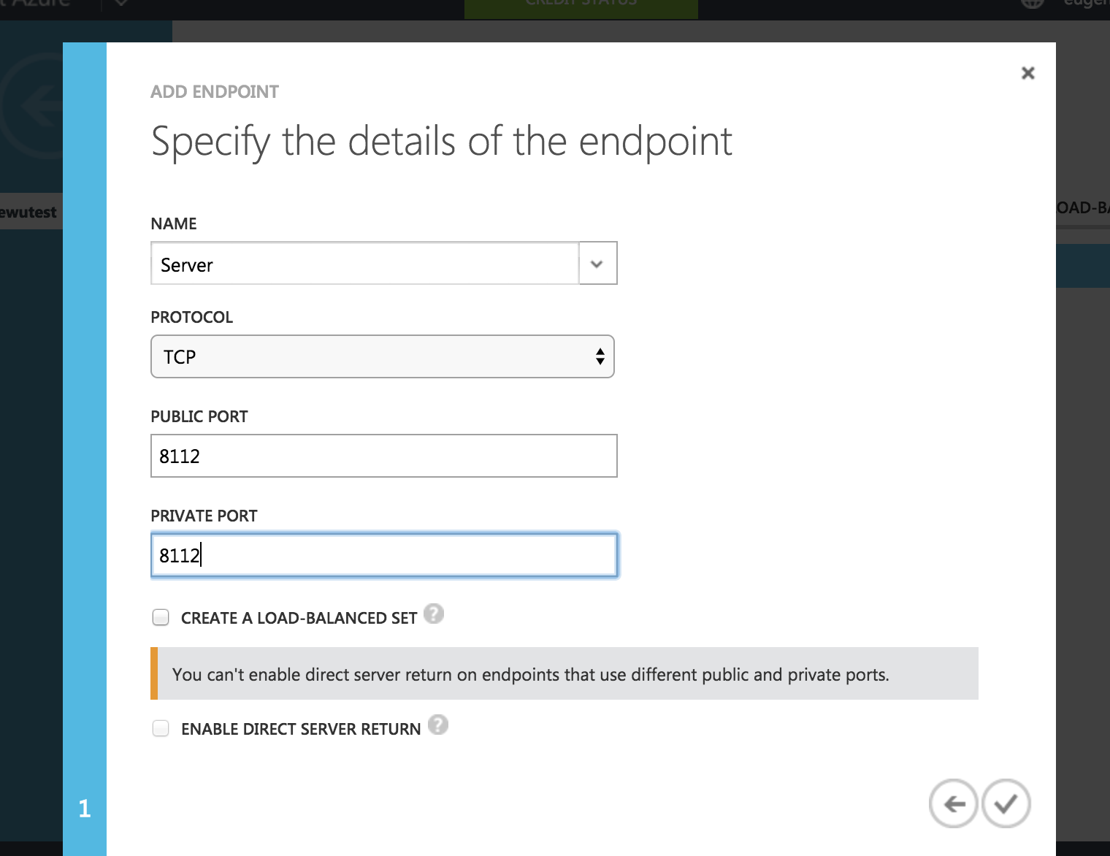

Set Public & Private Port to the same value (e.g., 8111)
This is the port you set for your web app
e.g., ewutest.cloudapp.net:8111

Slide 8
Test it
Test that the port is open by going to your home directory and typing
python –m SimpleHTTPServer <portnumber>
This runs a webserver that lists files in the directory it is run in.
Go to the URL and check that it shows the directory listing

Slide 9
Do the same to setup an end point for postgres
name: “Postgres” (actual name doesn’t matter much)
public port: 5432
private port: 5432

