Slide 1
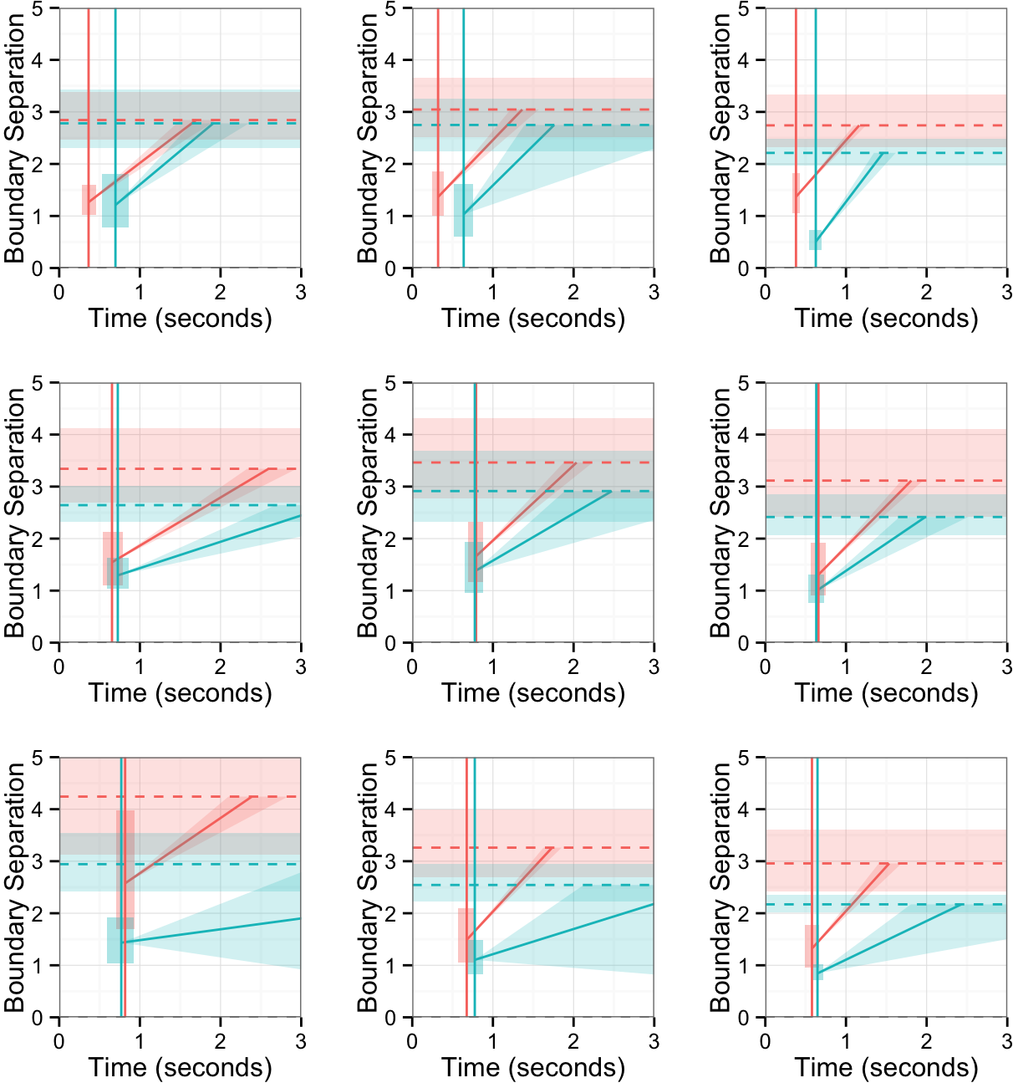
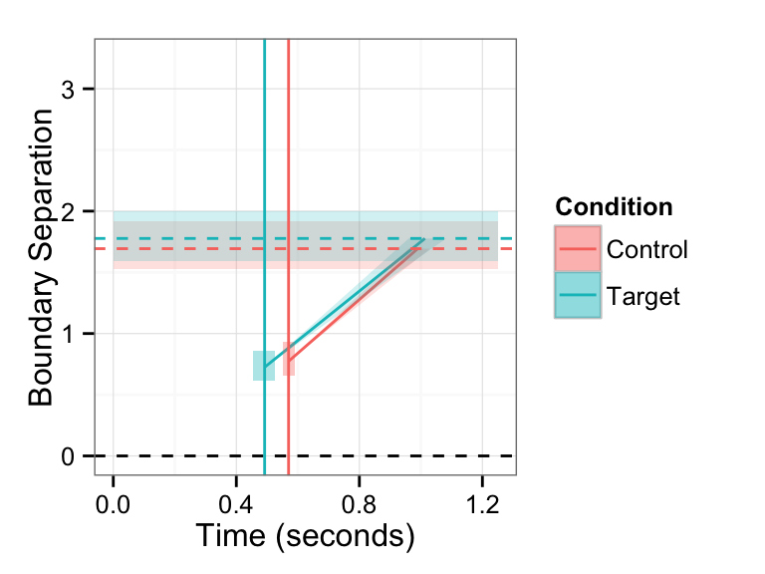
4-year-olds
5-year-olds
6-year-olds
Inhibition
Implicature
Negation

Slide 2
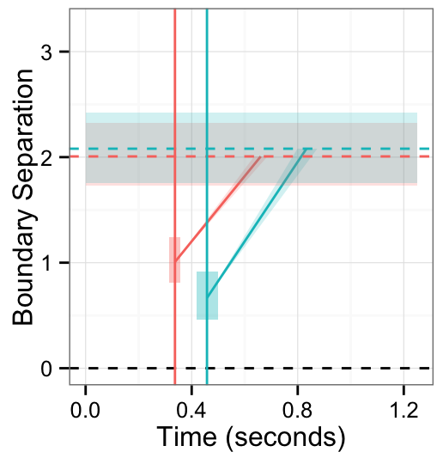
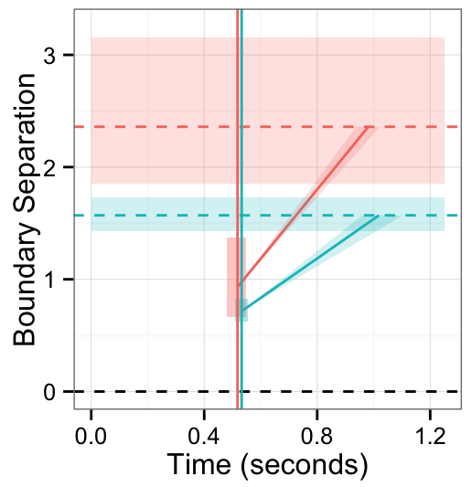
Inhibition
Implicature
Negation

