Slide 1
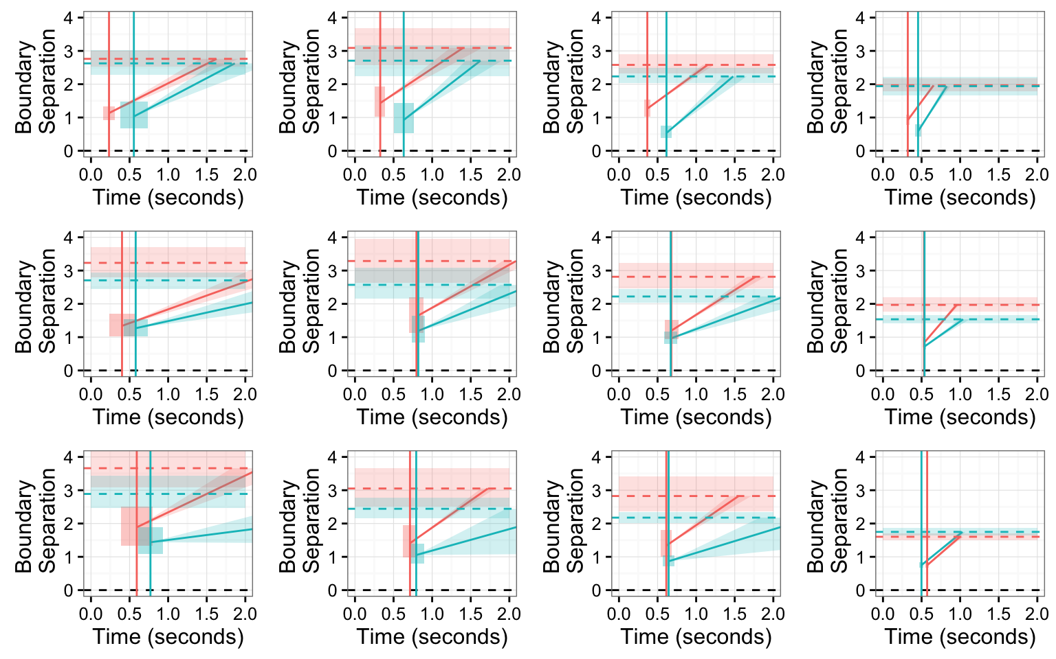
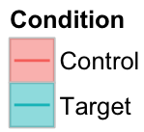
4-year-olds
5-year-olds
6-year-olds
Adults
Inhibition
Trial Type:
Implicature
Negation

Slide 2
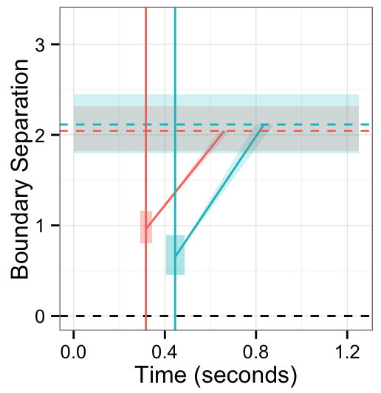
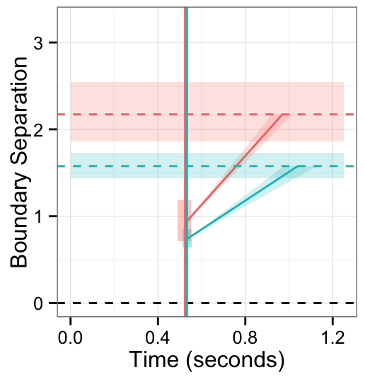
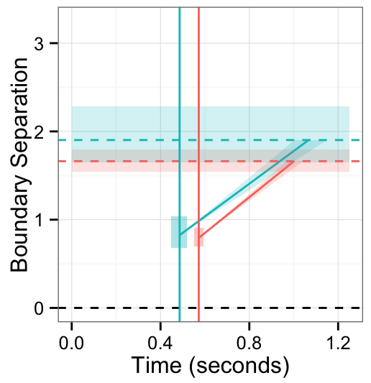
Inhibition
Implicature
Negation
Trial Type:

Slide 3
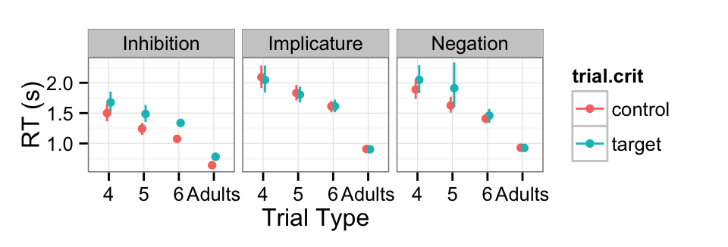
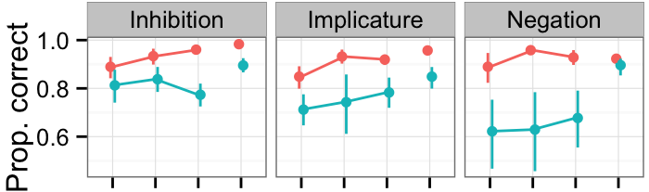
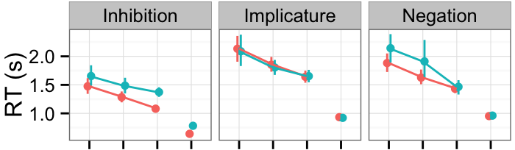
Trial Type:
Control
Target
4 years
5 years
6 years
Adults
4 years
5 years
6 years
Adults
4 years
5 years
6 years
Adults
Age Group

