Slide 1
AI HEALTHCARE ANALYTICS AGENT
(Automated Patient & Healthcare Operations Insights System)
-Ekta Grewal

Slide 2

AGENDA
Business Problem
Project Objectives
Solution Architecture
Technology Stack
Healthcare Data Sources & Data Model
Workflow Implementation in n8n
Healthcare KPI Analytics & Anomaly Detection
Patient & Department Performance
AI-Powered Healthcare Operations Analysis
Business Value & Benefits
Live Demonstration & Project Resources
Conclusion & Key Achievements

Slide 3
PROBLEM STATEMENT
Healthcare organizations generate large volumes of patient and operational data every day, making continuous monitoring and analysis increasingly challenging.
Key Challenges
Manual healthcare KPI monitoring and reporting
Delayed identification of patient-volume and operational trends
Limited visibility across departments and hospital operations
Time-consuming analysis of admissions, billing and clinical records
Healthcare insights often require significant analyst effort
Increasing data volume across multiple related tables
Business Need
An intelligent AI-powered solution that can automatically:
Monitor healthcare KPIs
Analyze patient and department trends
Detect operational anomalies
Answer healthcare operations questions
Generate clear management insights
Support faster data-driven decisions

Slide 4
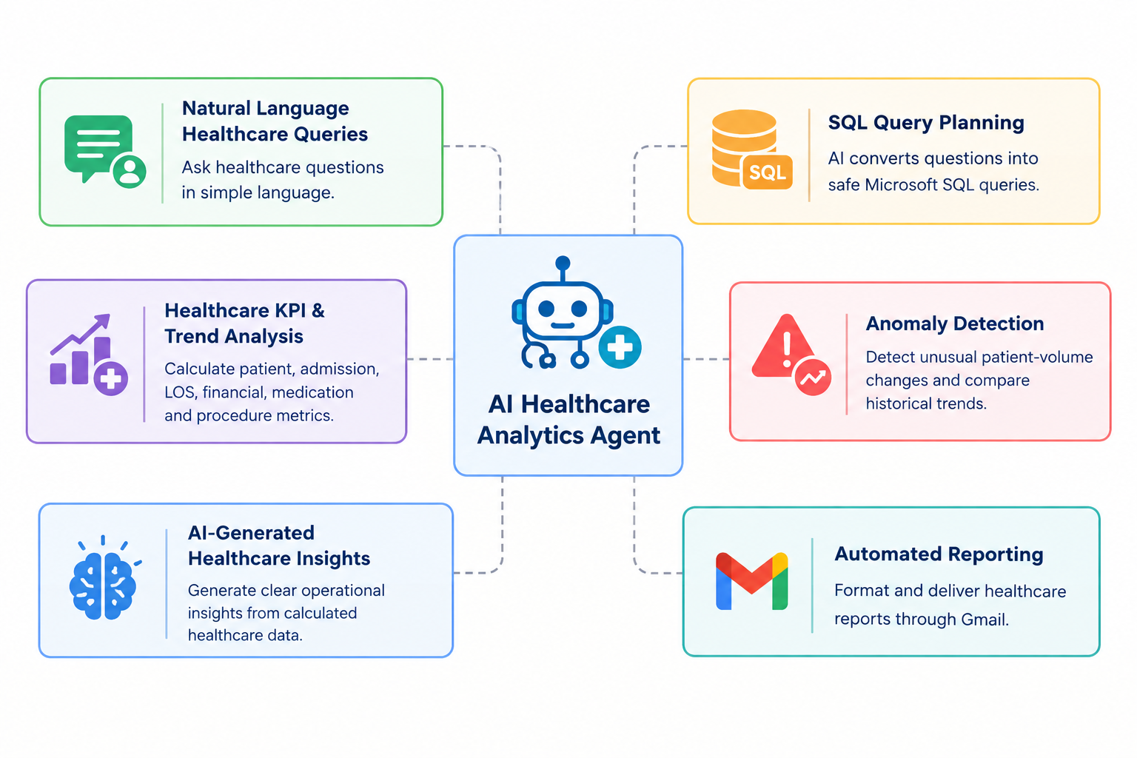
PROJECT OBJECTIVES
To develop an AI-powered Healthcare Analytics Agent that automatically queries healthcare data, analyzes patient and operational KPIs, detects trends and anomalies, and delivers clear insights to healthcare management teams.
Key Objectives
Healthcare KPI Automation
Patient & Department Trend Analysis
Anomaly Detection
AI-Generated Operational Insights
Natural-Language Healthcare Queries
Automated Reporting & Visualization

Slide 5
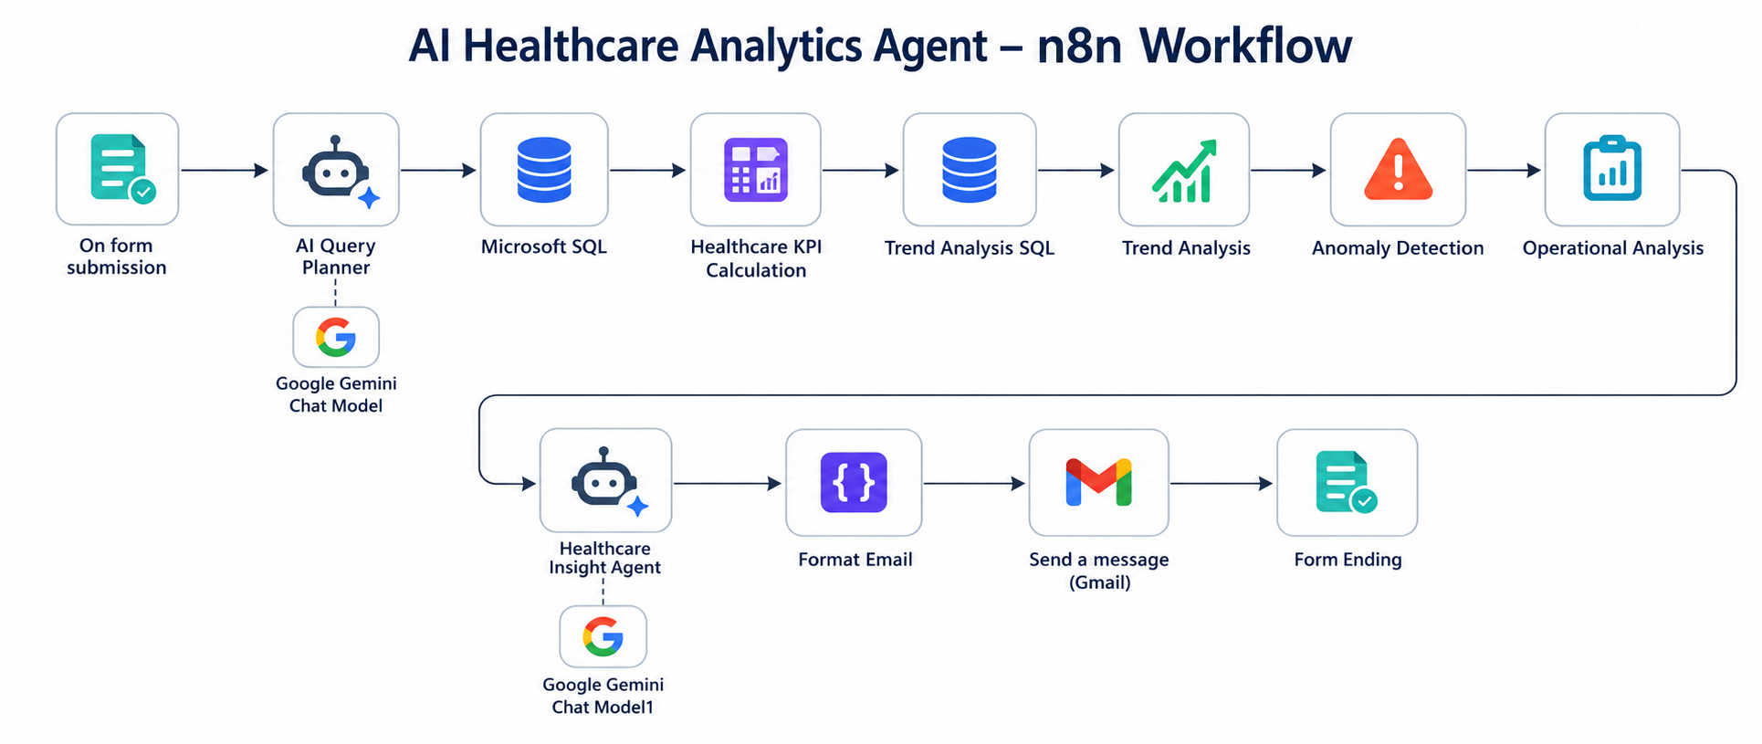
SOLUTION ARCHITECTURE
Key Components:
Healthcare Form, Microsoft SQL Server, SQL Query Planner, KPI & Trend Engine, AI Healthcare Insight Agent, Gmail

Slide 6
TECHNOLOGY STACK
🟠 n8n Local
Workflow Automation & Deployment
📜 JavaScript
Data Processing & KPI Logic
✉️ Gmail
Automated Healthcare Report Delivery
📝 n8n Form Trigger
Natural-Language Healthcare Questions
🤖 Google Gemini
AI Query Planning & Insight Generation
🗄️ Microsoft SQL Server
Healthcare Data Storage & Querying
🏥 Healthcare Dataset
Patients & Operational Records

Slide 7
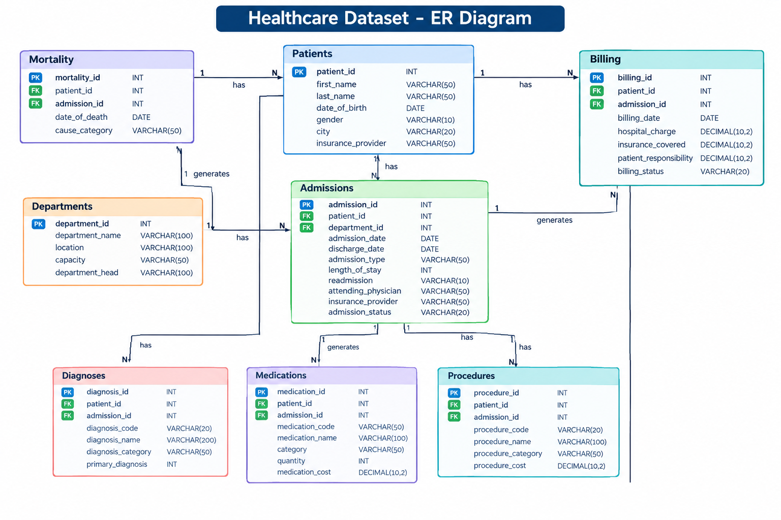
HEALTHCARE DATA SOURCES & DATA MODEL

Slide 8
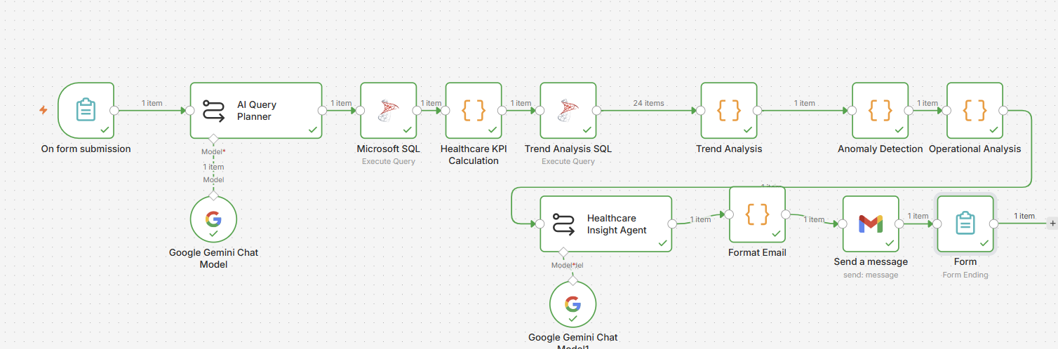
WORKFLOW IMPLEMENTATION IN N8N
Key Workflow Features:
End-to-End Healthcare Analytics Automation, Dynamic SQL Query Generation, Multi-Table Healthcare Analysis, Patient & Department KPI Analysis, Trend & Anomaly Detection, AI-Powered Answers, Automated Gmail Reporting

Slide 9
HEALTHCARE KPI ANALYTICS & ANOMALY DETECTION
Key KPI’s Generated
Patient Volume
Admission Volume
Average Length of Stay
Department Patient Volume
Monthly Patient Trends
Hospital Charges
Medication Usage
Anomaly Detection Rules
Monthly patient-volume baseline
Upper and lower threshold analysis
Highest / lowest patient-volume detection
Month-over-month trend comparison
Operational anomaly flagging
Historical comparison across 24 months
Automated Analysis Flow:
Healthcare Data ➜ SQL Query Planning ➜ SQL Execution ➜ KPI Calculation ➜ Trend Analysis ➜ Anomaly Detection ➜ AI Insight Generation

Slide 10
PATIENT & DEPARTMENT PERFORMANCE
Patient & Department Performance
Total Patients
Patient Volume by Department
Highest Patient-Volume Department
Monthly Patient Trends
Average Length of Stay
Readmission Analysis
Department Capacity Visibility
Clinical & Operational Intelligence
Most Frequently Used Medicines
Most Common Diagnoses
Monthly Hospital Charges
Procedure Cost Analysis
Mortality Records
Billing Performance
Healthcare Trend Monitoring
Business Value:
Provides centralized visibility into patient flow and healthcare operations, enabling management teams to identify trends faster, compare departments, monitor KPIs, and support data-driven operational decisions.

Slide 11
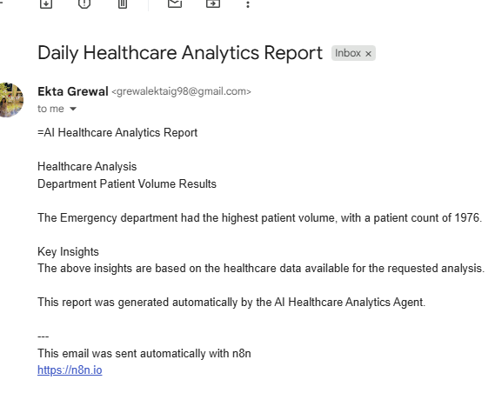
AI-POWERED HEALTHCARE ANALYSIS
AI Generated Outputs
Direct Answers to Healthcare Questions
Key Operational Insights
Monthly Trend Findings
Department Comparisons
Anomaly Explanations
Management-Friendly Summaries
AI Role
Generates clear healthcare operations answers by transforming SQL results, KPI calculations, trend analysis and anomaly findings into management-friendly summaries using Google Gemini.
Business Value:
Converts complex healthcare database results into simple, management-friendly insights without requiring users to manually write SQL queries or interpret raw database outputs.

Slide 12
BUSINESS VALUE & BENEFITS
Operational Benefits
Automated Healthcare KPI Monitoring
Reduced Manual Analysis Effort
Faster Patient Trend Detection
Department Performance Visibility
Automated Healthcare Reporting
Centralized Healthcare Analytics
Strategic Benefits
Faster Operational Decision-Making
AI-Powered Healthcare Insights
Improved Management Visibility
Scalable Healthcare Analytics
Data-Driven Resource Planning
Better Understanding of Patient Demand
Business Impact
The AI Healthcare Analytics Agent automates SQL analysis, KPI calculations, trend analysis, anomaly detection, and AI-generated reporting.

Slide 13
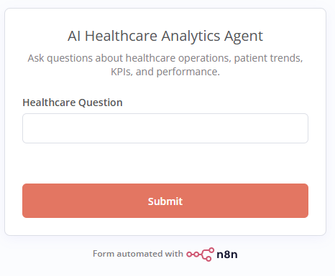
LIVE DEMONSTRATION & PROJECT RESOURCES
Project Resources
n8n Healthcare Analytics Form
  AI Healthcare Analytics Agent Workflow
Microsoft SQL Server Healthcare Database
  Synthetic Healthcare Dataset
Healthcare KPI & Trend Analysis
  Automated Gmail Reporting
Project Presentation
All outputs shown in this project are generated automatically through the n8n healthcare analytics workflow using the connected Microsoft SQL Server healthcare database and AI analysis pipeline.

Slide 14
CONCLUSION & KEY ACHIEVEMENTS
Successfully Developed
AI Healthcare Analytics Agent
End-to-End n8n Workflow Automation
Dynamic SQL Query Planning
Healthcare KPI Analytics Engine
Trend Analysis & Anomaly Detection
AI-Powered Insight Generation
Business Outcomes Delivered
Automated Healthcare KPI Monitoring
Faster Patient Trend Identification
Department Performance Visibility
Reduced Manual SQL Analysis
AI-Powered Operational Insights
Automated Email Reporting
The AI Healthcare Analytics Agent successfully automates the healthcare operations analytics lifecycle by transforming structured hospital data into actionable insights, trend analysis, anomaly findings, and management-friendly answers through an AI-powered n8n workflow.

Slide 15
THANK YOU!

