Slide 1
Instructions for Visualization and Analysis Demos
You have 3 minutes to present – be ready to share your screen, practice first. We can only offer you one opportunity to present. Present your slides in “Slide Show” mode. Presentations will take place during the module Tutorial slots (see Announcements for links to join the Tutorials via Teams).
The next few slides give you all the alternatives for how to present your Visualizations. You will select only one as fits your RQ. Before presenting DELETE all text (and instructions) that you do not use (including this slide). You can then enlarge your selection, so it is clearly visible on the slide.
Appointment slots will appear on Canvas soon (calendar-7com1079-24). Sign up early. When space runs out, we cannot issue any further slots for this week. If you do not turn up for your slot you will not be given another opportunity. Ideally, all the group members should attend but select one person to present. DO NOT SIGN UP unless once of your group can attend and present. You will not be graded on this.
We look forward to giving you feedback. If your group is not presenting, still attend the tutorial as the feedback will help you too.
At this point we assume you are using your allocated datasets (see RQ coursework spec). Any changes to the Kaggle.Data.world csv/xlxs file you make such as merges, grouping, or size reduction must be done via an R script, not manually, not in excel.

Slide 2

Visualization and Analysis – Tutorial Presentation for Feedback Date: 25/11/2024
Group Id: A284 Name of Student Presenting: Edwin Kipleting

Slide 3
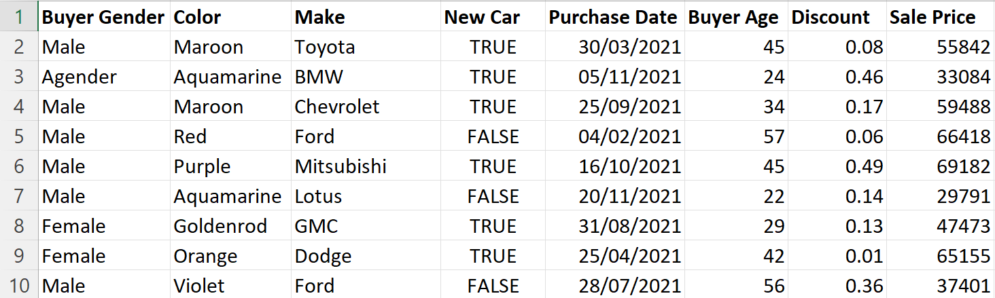
We are using the dataset DS242 to answer our Research Question “ Is there a correlation between sale price and buyer age of cars in Japan?” ¹
The dataset has 11001 rows and the variables we use are sale price(dependent variable) and buyer age(independent variable).

Slide 4
1. A scatterplot to include the linear trendline (ensuring your dependent variable is on the y-axis) 2. A histogram to include the normal curve overlay. The histogram plots data from your dependent variable only. Clearly label you axes to include variable name and units of measurement. Include a title to give your plot/visualization a context.
1. Where your research question asks about Correlation: Include two visualizations
Correlation analyses how an ordinal/interval dependent var correlates to an ordinal/interval independent variable

Slide 5
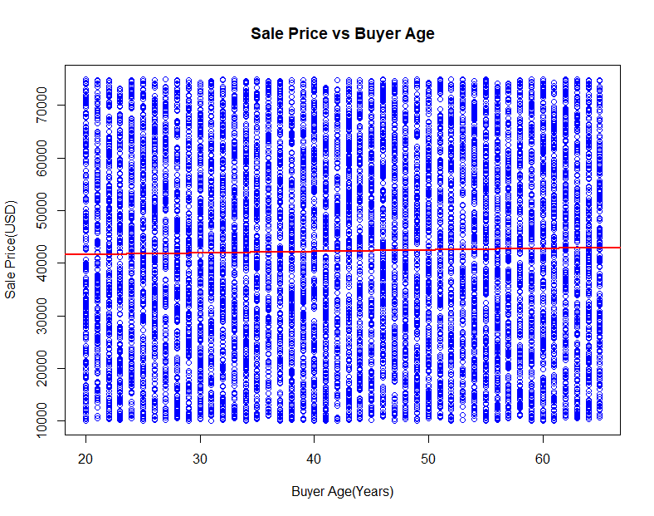
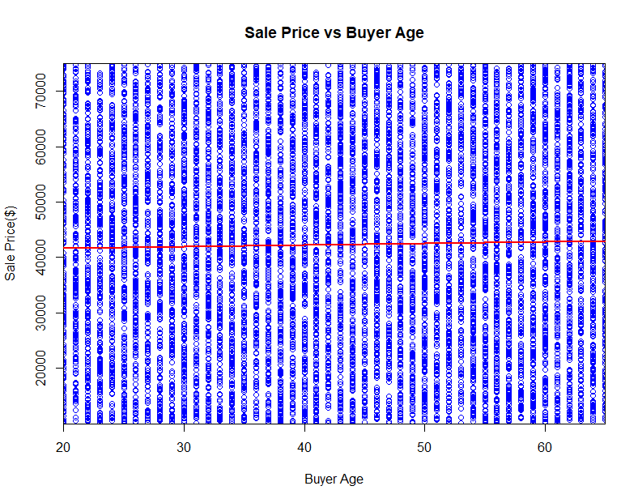

Slide 6
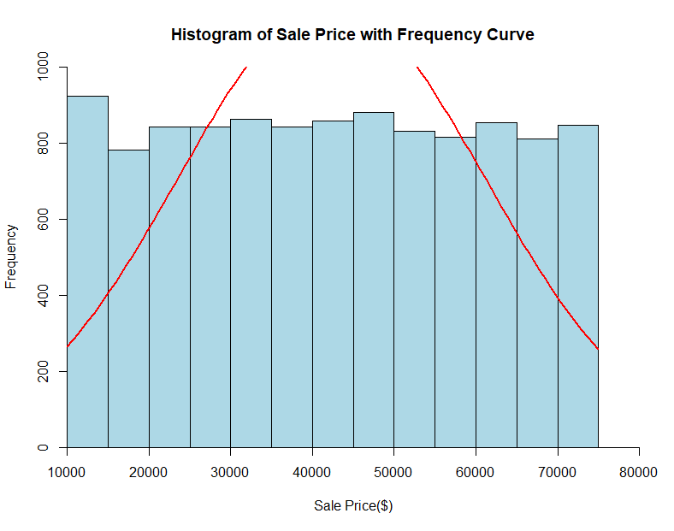
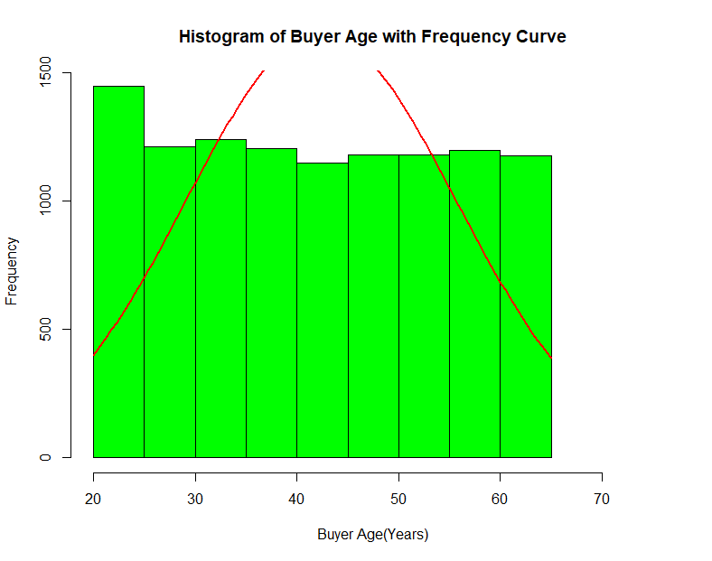

Slide 7
Only attempt this Analysis part of the demo if you have completed your Visualization(s). Otherwise end your demo after the Visualization for feedback.
Part 2: Analysis (building on your Visualizations)

Slide 8
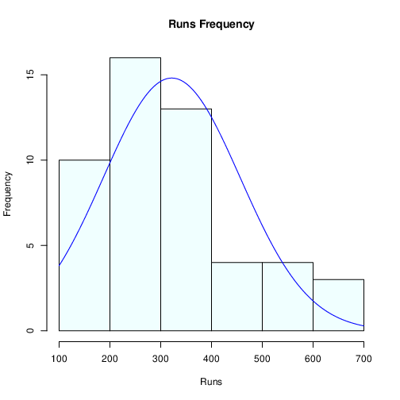
Here is a Histogram showing the frequencies of our dependent variable to include the normal curve overlay.
Our RQ asks about Correlation
For example:
Choose one:
1. The blue normal curve overlay follows the contours of the underlying data, so for our analysis we will use a parametric test for correlation: Pearson’s r
OR
The normal curve overlay does not follow the shape of the underlying data, so for our analysis we use the non-parametric test for correlation that does not assume normality: Spearman’s Rho or Kendal’s Tau
The example here is borderline, in terms of shape, so when in doubt choose the non-parametric equivalent.
8
Notes:
8

Slide 9
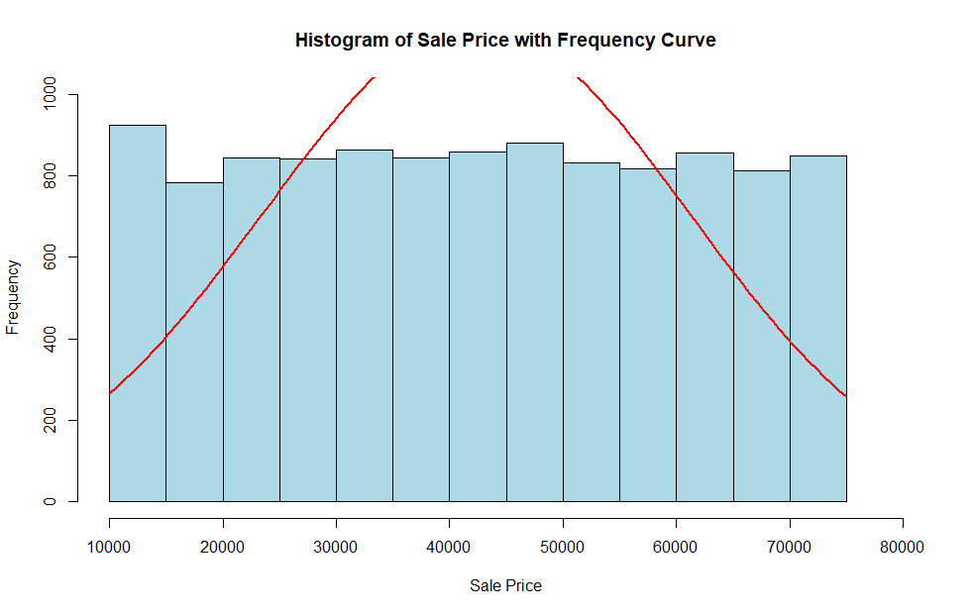

Slide 10
The normal curve overlay does not follow the shape of the underlying data, so for our analysis we use the non-parametric test for correlation that does not assume normality: Spearman’s Rho

Slide 11
R Script and Results (For ALL types of test) – The Analysis
PRE 7COM1079-2022 Student Group No: ?????
11
Include a snippet of the R code you use to calculate your test statistic.
Give the value of the test statistic.
Tell us the p-value. Is it > or < 0.05?
Is the result significant?
Do you accept or reject the null hypothesis?
What does the result actually mean in the wider context of learning something useful / answering your RQ?
Notes:
11

Slide 12
R Script and Results (For ALL types of test) – The Analysis
PRE 7COM1079-2022 Student Group No: ?????
12
library(readr)car_sales<-read.csv("Car Sales.csv")
# Create a histogram with frequencies (freq = TRUE)
h <- hist(car_sales$Sale.Price,
xlim = c(10000, 80000),
ylim = c(0,1000),
freq = TRUE, # Use frequencies on y-axis
main = "Histogram of Sale Price with Frequency Curve",
xlab = "Sale Price($)",
col = "lightblue",
border = "black")
# Create a sequence of x values for the trendline
x <- seq(min(car_sales$Sale.Price),
max(car_sales$Sale.Price),
length = 100)
# Compute the frequency curve (using a density estimate and adjusting for the histogram bin width)
y <- dnorm(x, mean = mean(car_sales$Sale.Price),
sd = sd(car_sales$Sale.Price)) * length(car_sales$Sale.Price) * diff(h$mids[1:2])
# Plot the frequency curve (normal distribution)
lines(x, y, col = "red", lwd = 2)
# Create a histogram with frequencies (freq = TRUE)
h1 <- hist(car_sales$Buyer.Age,
freq = TRUE, # Use frequencies on y-axis
main = "Histogram of Buyer Age with Frequency Curve",
xlab = "Buyer Age",
col = "green",
xlim = c(min(car_sales$Buyer.Age), max(car_sales$Buyer.Age) + 10),
border = "black")
# Create a sequence of x values for the trendline
x1 <- seq(min(car_sales$Buyer.Age),
max(car_sales$Buyer.Age),
length = 100)
# Compute the frequency curve (using a density estimate and adjusting for the histogram bin width)
y1 <- dnorm(x1, mean = mean(car_sales$Buyer.Age),
sd = sd(car_sales$Buyer.Age)) * length(car_sales$Buyer.Age) * diff(h1$mids[1:2])
# Plot the frequency curve (normal distribution)
lines(x1, y1, col = "red", lwd = 2)
#the data looks non-normal
#extra test to determine the normality of the data#shapiro test
test_for_sale_price <- shapiro.test(car_sales$Sale.Price[1:5000])
test_for_sale_price
#print(paste("Shapiro-Wilk test for Sale.Price:", test_for_sale_price))
test_for_buyer_age_normality <- shapiro.test(car_sales$Buyer.Age[1:5000])
test_for_buyer_age_normality
#print(paste("Shapiro-Wilk test for Buyer Age normality:", test_for_buyer_age_normality))
#ks-test for large dataset
ks_test <- ks.test(car_sales$Sale.Price, "pnorm", mean(car_sales$Sale.Price), sd(car_sales$Sale.Price))
print(ks_test)
#from the additional tests, we can confirm that our data columns have a non-normal distribution
#correlation test
cor_test<-cor(car_sales$`Buyer.Age`, car_sales$`Sale.Price`, method = "spearman")
cor_test
plot(car_sales$Buyer.Age, car_sales$Sale.Price,
main="Sale Price vs Buyer Age",
col = "blue",
xlab="Buyer Age",
ylab="Sale Price($)")
abline(lm(car_sales$Sale.Price ~ car_sales$Buyer.Age), col="red", lwd=2)
#the scatter plot shows no correlation between sales price and buyer age
#we can do further analysis into other independent variables to determine sales price
head(car_sales,2)
Notes:
12

