Slide 1
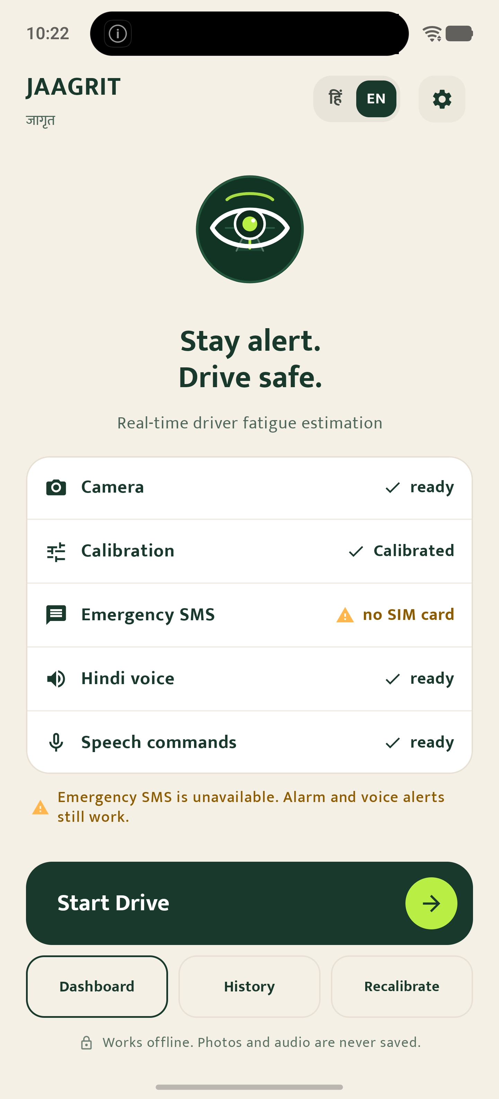
JAAGRIT जागृत
Engages before it alarms.
Completely offline.
Real-time driver alertness assistant running locally on the iQOO 15.
100% OFFLINE
18 ms VISION
GRADUATED LADDER
JAAGRIT / जागृत • iQOO 15 (Snapdragon 8 Elite) • 100% Offline [01 / 18]
Notes:
[SPOKEN SCRIPT - ~40 words]:
Good morning judges. This is Jaagrit. An offline Android driver alertness assistant built for the iQOO 15 that sits on the dashboard, estimates driver fatigue in real time, and talks you awake before sounding the alarm.
[HINDI ANCHOR]:
सजग रहें, सुरक्षित चलें — पूरी तरह ऑन-डिवाइस, बिना इंटरनेट।

Slide 2
THE REALITY OF THE ROAD
Drowsiness does not announce itself — it arrives in silence.
01
Micro-sleep is stealthy
Fatigue accumulates quietly over hours. A driver doesn't realize their alertness has eroded until the first involuntary 2-second eye closure.
02
Buzzers trigger too late
Traditional cab hardware screams only after a driver is asleep. The shock causes panic, road swerving, and drivers routinely unplug them.
03
Highway blind spots
Cloud-dependent fleet monitoring fails precisely when needed most: remote highway corridors with zero cellular data connectivity.
JAAGRIT / जागृत • iQOO 15 (Snapdragon 8 Elite) • 100% Offline [02 / 18]
Notes:
[SPOKEN SCRIPT - ~40 words]:
Drowsiness doesn't announce itself. On dark highways between midnight and dawn, alertness drains gradually. By the time a traditional buzzer screams, a truck has traveled fifty meters blind. Drivers hate loud buzzers and unplug them. We need prevention, not just panic.
[HINDI ANCHOR]:
नींद आने से पहले ही चेतावनी ज़रूरी है — चिल्लाने वाले अलार्म बहुत देर कर देते हैं।

Slide 3
THE JAAGRIT SOLUTION
Three pillars that turn an everyday phone into a guardian.
PILLAR 1
Continuous Vision (18 ms)
Tracks Eye Aspect Ratio (EAR) and head posture at 24.8 FPS directly on the phone's CPU, without network latency or external sensors.
PILLAR 2
Graduated Ladder (L1–L5)
Engages early with friendly spoken check-ins while fatigue builds. Reserves high-decibel alarms, family audio, and SMS for true emergencies.
PILLAR 3
Zero-Cloud Privacy (0 Bytes)
100% on-device operation. No camera frames or voice recordings ever touch storage or the cloud. Tested in complete airplane mode.
JAAGRIT / जागृत • iQOO 15 (Snapdragon 8 Elite) • 100% Offline [03 / 18]
Notes:
[SPOKEN SCRIPT - ~40 words]:
Jaagrit solves this with three principles. First, continuous on-device vision running in eighteen milliseconds per frame. Second, a graduated ladder that talks first and alarms last. And third, total privacy: zero bytes leave the phone, and photos never touch disk.
[HINDI ANCHOR]:
तीन सिद्धांत: तेज़ ऑन-डिवाइस विज़न, पाँच चरणों की सीढ़ी, और शत-प्रतिशत ऑफ़लाइन सुरक्षा।

Slide 4
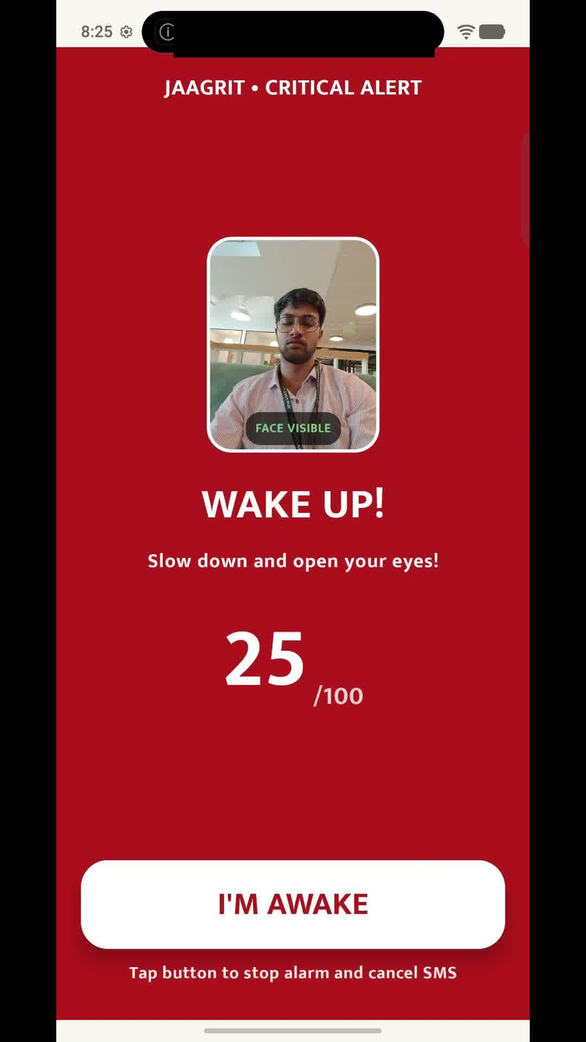
GRADUATED ESCALATION
A five-stage intervention ladder that steps in gradually.
L1
Early Warning: Blink rate +20% or 2 yawns → Spoken friendly question (TTS Hindi)
L2
Active Engagement: PERCLOS ≥ 0.12 (60 s) → Spoken cognitive question; latency tracked
L3
Direct Alert: Eyes closed ≥ 2.5 s → Loud siren + urgent Hindi phrase + vibration
L4
Family Voice: No response 10 s after L3 → Pre-recorded child/family voice clip
L5
Emergency SOS: No response 20 s after L4 → GPS emergency SMS sent over cellular radio
JAAGRIT / जागृत • iQOO 15 (Snapdragon 8 Elite) • 100% Offline [04 / 18]
Notes:
[SPOKEN SCRIPT - ~40 words]:
Here is the heart of Jaagrit: the graduated ladder. At level one, a conversational check. At level two, a simple cognitive question to gauge reaction speed. If eyes close for two and a half seconds, Level Three fires instantly. If there is no response, Level Four plays a family voice. After twenty seconds, Level Five sends an emergency SMS with GPS.
[HINDI ANCHOR]:
हल्की बातचीत से शुरू होकर, परिवार की आवाज़ और आपातकालीन एसएमएस तक।

Slide 5
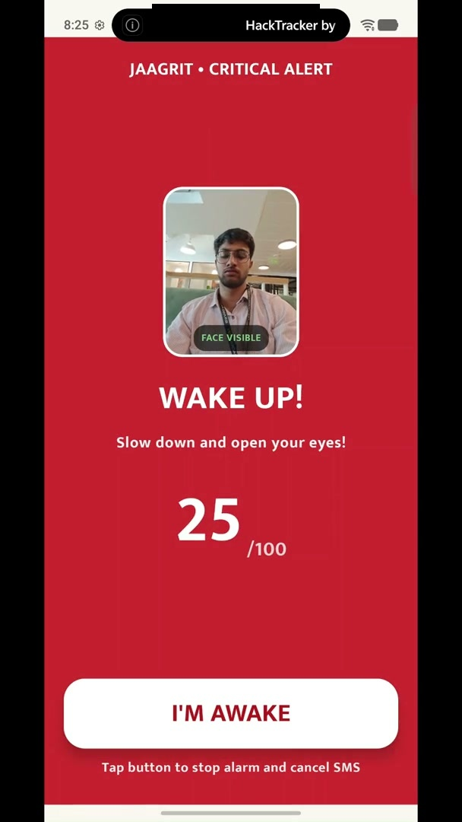
LIVE PROOF & DEMO BACKUP
From subtle drowsiness to critical intervention in real time.
01. Normal Monitoring (98/100)
Green UI tracks facial landmarks continuously at 24.8 FPS. Zero CPU stutter or frame lag.
02. Drowsiness Detected (35/100)
Driver simulates eye closure. High PERCLOS (56%) immediately penalizes heuristic score into amber 'Fatigued'.
03. Critical L3 Trigger (2.5 s)
2,500 ms sustained closure immediately trips Level 3. Full-bleed red screen, alarm on USAGE_ALARM stream, and urgent Hindi TTS.
04. Instant Hands-Free Recovery
Eyes open for ≥ 3.0 s OR tapping the big 'I'M AWAKE' button silences alarm and cancels pending SMS.
JAAGRIT / जागृत • iQOO 15 (Snapdragon 8 Elite) • 100% Offline [05 / 18]
Notes:
[SPOKEN SCRIPT - ~40 words]:
Let's watch it happen. When my eyes close during a fatigue event, the PERCLOS metric drops my score to thirty-five. The moment two point five seconds elapse, Level Three triggers: high-contrast red flash, max-volume alarm, and urgent Hindi voice. Tapping 'I'm Awake' or opening eyes immediately cancels the alert.
[HINDI ANCHOR]:
दो दशमलव पाँच सेकंड आँखें बंद — और सिस्टम तुरंत 'जागो' का अलर्ट देता है।
*** [NOW SWITCH TO LIVE PHONE DEMO ON iQOO 15] ***

Slide 6
PERSONAL CALIBRATION & ACCURACY
Learned from the driver's own face, not a generic average.
18 ms
Inference Latency
Snapdragon 8 Elite CPU
24.8 FPS
Camera Pipeline Rate
Continuous real-time flow
How Personal Calibration Works
Statistical Medians (D4): Uses medians across open/closed eyes, MAR, and response time — completely immune to single-frame outliers.
Custom Midpoint Threshold: Threshold = ClosedMedian + 0.5 × (OpenMedian − ClosedMedian). Automatically adapts to thick spectacles and narrow eye profiles.
Relative Dashboard Tilt (D18): Normalizes against the 7–9° dashboard mount tilt, so looking at road mirrors never triggers false head-droop alarms.
5.6x
Separation Dynamic Range
0.34 Open vs 0.06 Closed EAR
< 34°C
Sustained Phone Temp
Throttling threshold: 42°C
JAAGRIT / जागृत • iQOO 15 (Snapdragon 8 Elite) • 100% Offline [06 / 18]
Notes:
[SPOKEN SCRIPT - ~40 words]:
Every driver has different eyes, posture, and glasses. Jaagrit runs a short calibration before driving. We take the statistical median of open and closed eyes, yielding a five-point-six times dynamic separation. We also calibrate neutral dashboard tilt, preventing false alerts when glancing at road mirrors.
[HINDI ANCHOR]:
हर ड्राइवर की आँखें अलग होती हैं — हमारा कैलिब्रेशन हर चेहरे के हिसाब से सीमा तय करता है।

Slide 7
THE SAFETY NET (LEVEL 5)
Automated SOS with live GPS when a driver is unresponsive.
Verified SMS Template
ALERT: Driver may be unresponsive while driving.
Last alert: 10:37:32 AM
Alerts in this trip: 1
Location: 28.5450° N, 77.1926° E
— Sent by Jaagrit (automated safety alert)
Sent strictly via cellular GSM radio. Works with zero data plan or cloud server.
Failsafe Design Principles
Pre-Drive Readiness Check: The app checks cellular SIM and GPS before departure. In airplane mode, it explicitly warns the driver that SMS is offline.
False-Positive Circuit Breaker: If >3 alerts are dismissed in 10 minutes, the app suggests recalibration rather than escalating to emergency contacts.
Any Awake Action Cancels: Tapping 'I'M AWAKE' or keeping eyes open for 3 seconds instantly halts the pending Level 5 SMS countdown.
JAAGRIT / जागृत • iQOO 15 (Snapdragon 8 Elite) • 100% Offline [07 / 18]
Notes:
[SPOKEN SCRIPT - ~40 words]:
If a driver suffers an emergency and doesn't respond to the alarm or family voice after thirty seconds, Level Five triggers. An automated SMS with GPS coordinates is sent directly over cellular radio. It requires no mobile internet and costs pennies.
[HINDI ANCHOR]:
यदि चालक कोई प्रतिक्रिया नहीं देता, तो जीपीएस लोकेशन के साथ आपातकालीन संदेश तुरंत भेजा जाता है।

Slide 8
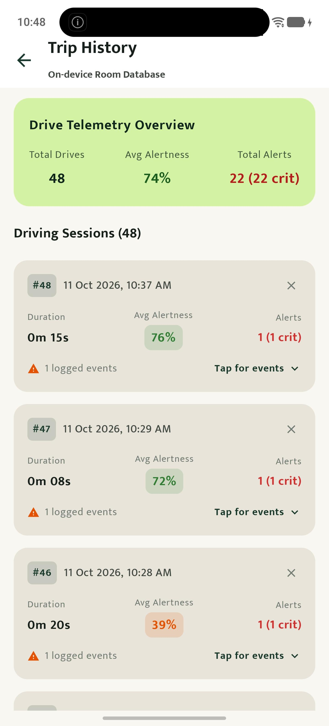
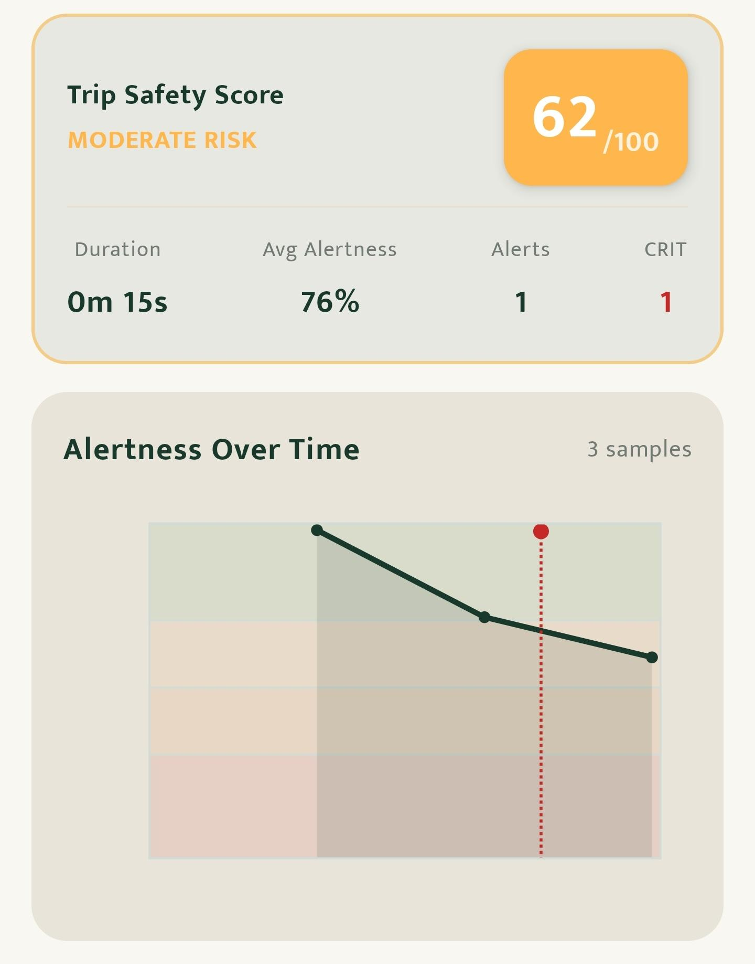
FLEET PROOF & OFFICE KIT
Complete trip telemetry stored locally and shared seamlessly.
Office Kit Fleet Transfer
Offline Database: On-device Room database logs 48 real trips with alertness telemetry sampled every 5 seconds.
PDF Report Export: One-page visual PDF generated via Android PdfDocument and saved to Download/Jaagrit/.
Instant Laptop Mirror: Fleet managers mirror the dashboard and transfer reports in seconds via Office Kit — zero cloud portal required.
JAAGRIT / जागृत • iQOO 15 (Snapdragon 8 Elite) • 100% Offline [08 / 18]
Notes:
[SPOKEN SCRIPT - ~40 words]:
Every drive is cataloged in an on-device Room database. Here you see our real test log of forty-eight drives. Jaagrit scores trip safety, visualizes the alertness curve, and generates a one-page PDF report. Fleet managers can transfer this report to their laptop in seconds using Office Kit.
[HINDI ANCHOR]:
यात्रा का पूरा डेटा स्थानीय डेटाबेस में सुरक्षित रहता है और बिना इंटरनेट पीडीएफ़ में एक्सपोर्ट होता है।

Slide 9
COGNITIVE PREVENTION (L1/L2)
Engaging the driver's brain before their eyes close.
Level 1: Spoken Openers
Spoken Hindi check-in:
"भाई, बहुत देर हो गई। घर पे कौन इंतज़ार कर रहा है?"
• Natural conversational tone under 8 seconds
• 60-second cooldown between prompts
• 2 ignored openers → 5-minute polite backoff
• "चुप रहो" silences the companion for 2 minutes
Level 2: Cognitive Latency Test
Spoken mental check:
"सौ में से तीस घटा। कितना बचा?"
• Measures response latency against calibration
• Latency > 2x baseline confirms creeping fatigue
• Microphone locked during active alarms (L3+)
• 4 fallback touch buttons ensure zero distraction
JAAGRIT / जागृत • iQOO 15 (Snapdragon 8 Elite) • 100% Offline [09 / 18]
Notes:
[SPOKEN SCRIPT - ~40 words]:
True safety starts before the eyes close. At Level One and Two, Jaagrit speaks short, natural Hindi questions and simple mental arithmetic. It measures the driver's response latency. If latency doubles, fatigue is confirmed. And during loud alarms, the microphone stays locked to prevent audio distortion.
[HINDI ANCHOR]:
अलार्म बजाने से पहले, हल्की दिमागी बातचीत से ड्राइवर को जाग्रत रखा जाता है।

Slide 10
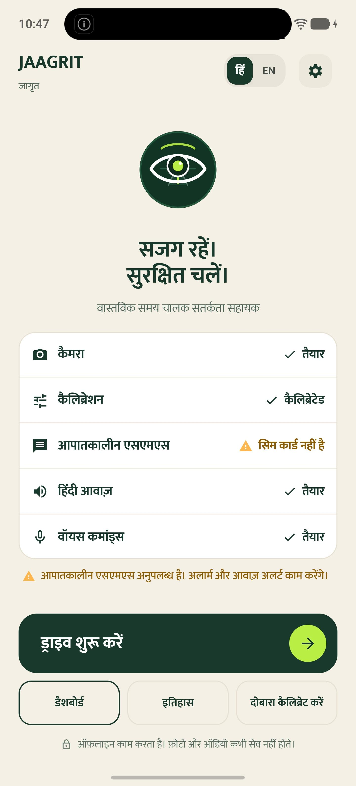
BILINGUAL & PRIVATE
Designed for Indian drivers: Hindi first, zero cloud compromise.
Zero-Cloud Guarantee
INTERNET Stripped in Manifest: android.permission.INTERNET is removed with tools:node="remove" — proven by automated security tests.
Offline Hindi Voice: Uses Google Android offline TTS Hindi engine installed locally. Zero network queries.
No Face Storage: Camera frames are analyzed in ephemeral RAM and instantly discarded. Zero image files on disk.
No Account Required: No driver sign-up, phone binding, or fleet surveillance subscriptions.
JAAGRIT / जागृत • iQOO 15 (Snapdragon 8 Elite) • 100% Offline [10 / 18]
Notes:
[SPOKEN SCRIPT - ~40 words]:
Jaagrit was designed specifically for Indian commercial drivers. The entire interface and voice guidance toggle between English and natural Hindi. Crucially, the app requests zero internet permissions. Drivers don't have to worry about surveillance, cellular data consumption, or privacy leaks.
[HINDI ANCHOR]:
पूरी तरह हिंदी और अंग्रेज़ी में, बिना किसी सर्वर या इंटरनेट की निर्भरता के।

Slide 11
TECHNICAL DEPTH & AUDIT
Engineered for resilience: clean architecture and verified audit fixes.
CameraX
KEEP_ONLY_LATEST
Front Camera
MediaPipe
FaceLandmarker
18 ms on CPU
FatigueEngine
Pure Kotlin
Zero Android APIs
Ladder
5-Level Logic
Injected Clock
Action Handlers
TTS / Siren /
SMS / Office PDF
Independent Code Audit (AUDIT-001)
• Vulnerability Found: Mixed time bases between system uptime (frames) and epoch time (engine ticks) caused timing miscalculations.
• Fix Implemented: Injected a single monotonic Clock (elapsedRealtime) across the entire engine.
• Verified with 8 dedicated regression unit tests in AuditRegressionTest.kt.
198 Unit Tests • 0 Failures
• 27 Test Suites covering vision, engine, ladder, SMS, and reports.
• Pure Kotlin engine: runs anywhere without Android emulator dependencies.
• Pipeline UI-Independence: Vision engine is decoupled from Compose Activity, ready to run in an Android Foreground Service.
JAAGRIT / जागृत • iQOO 15 (Snapdragon 8 Elite) • 100% Offline [11 / 18]
Notes:
[SPOKEN SCRIPT - ~40 words]:
Under the hood, Jaagrit separates vision from Android lifecycle. Our pure-Kotlin fatigue engine has zero Android imports, tested across one hundred ninety-eight unit tests. During an independent architectural audit, we caught and fixed a subtle clock-drift bug with dedicated regression tests. This system is rock-solid.
[HINDI ANCHOR]:
स्वतंत्र कोड ऑडिट और एक सौ अट्ठानवे यूनिट टेस्ट्स द्वारा प्रमाणित आर्किटेक्चर।

Slide 12
TRANSPARENCY & ROADMAP
Engineering honesty: operational boundaries and what's next.
Honest Operational Limits
Low Ambient Light: Relies on phone screen at max brightness (UI-4) as fill light; pitch-black truck cabins require ambient cabin lighting.
Dark Sunglasses: Obscures eye landmarks; system gracefully shifts primary reliance to head-droop angle and vocal checkpoints.
Extreme Head Angles: Tracking degrades beyond 30° yaw/roll.
Medical Disclaimer: Jaagrit estimates alertness heuristically — it does not claim medical diagnosis or guarantee accident immunity.
The Roadmap Ahead
Android Foreground Service: Move the decoupled vision pipeline to a background foreground service to support split-screen Google Maps navigation.
Dual-Camera Support: Integrate rear camera for road-lane departure detection alongside driver facial monitoring.
Two-Way Office Kit Depot Sync: Automatic check-in report push to depot dispatcher laptops over local Wi-Fi pairing.
JAAGRIT / जागृत • iQOO 15 (Snapdragon 8 Elite) • 100% Offline [12 / 18]
Notes:
[SPOKEN SCRIPT - ~40 words]:
We believe in engineering honesty. Jaagrit estimates alertness; it does not claim medical diagnosis. Dark sunglasses and pitch-black cabins reduce eye tracking accuracy, falling back to head droop. Our next milestone moves the pipeline into a Foreground Service to support Google Maps navigation.
[HINDI ANCHOR]:
हम सतर्कता का अनुमान लगाते हैं, कोई मेडिकल दावा नहीं करते — ईमानदारी ही हमारी ताक़त है।

Slide 13
JAAGRIT / जागृत
Stay alert. Drive safe.
Commercial drivers are the backbone of India's economy.
They deserve protection on the phone they already own.
18 ms Vision Engine • 5-Stage Graduated Ladder • 100% Offline & Private
OPEN REPOSITORY & LIVE PHONE DEMO
github.com/eka1357/Jaagrit
iQOO 15 (Snapdragon 8 Elite) • Direct APK • Office Kit Mirror Ready
JAAGRIT / जागृत • iQOO 15 (Snapdragon 8 Elite) • 100% Offline [13 / 18]
Notes:
[SPOKEN SCRIPT - ~40 words]:
Commercial drivers are the backbone of our economy. They deserve safety technology that works with them, respects their privacy, and protects them on every dark highway. That is Jaagrit. Thank you, and I look forward to your questions.
[HINDI ANCHOR]:
सजग रहें, सुरक्षित चलें। धन्यवाद!

Slide 14
Q&A DEFENSE
Appendix: Detection accuracy under hostile edge conditions.
Spectacles & Glare: Tested with clear glasses. Isotropic pixel-space EAR preserves a 5.6x separation gap. Personal calibration absorbs lens refractions into the driver's custom baseline.
Night & Dim Cabins: The app enforces maximum display brightness (UI-4) and keeps the screen on, utilizing the phone display as an active fill-light for the driver's face.
Road Vibration & Shaking: MediaPipe FaceLandmarker operates at 24.8 FPS in live-stream mode with face-loss glitch tolerance of 300 ms, preventing momentary bumps from corrupting closure timers.
Mirror Glances vs True Nods: Head-pitch droop threshold is calculated relative to calibrated neutral dashboard tilt (7–9°), avoiding false triggers during routine mirror checks.
JAAGRIT / जागृत • iQOO 15 (Snapdragon 8 Elite) • 100% Offline [A14 / 18]
Notes:
[SPOKEN SCRIPT - ~40 words]:
Q&A backup on camera robustness, glasses, and night illumination.

Slide 15
Q&A DEFENSE
Appendix: Why an uncompromising on-device architecture?
Deterministic Sub-500 ms Latency: Highway safety cannot tolerate cloud API round-trips. Analyzing frames locally on the Snapdragon 8 Elite guarantees instant 18 ms decisions.
Highway Cellular Blackspots: Thousands of kilometers of Indian national highways lack reliable 4G/5G data. A safety app that stops working in tunnels or ghats is lethal.
Zero Biometric Liability: Drivers fiercely resist continuous video streaming into employer cloud dashboards. Keeping all computations ephemeral in RAM earns driver adoption.
Zero Cloud Infrastructure Cost: Scales infinitely across millions of commercial vehicles without running massive GPU inference clusters or monthly cloud bills.
JAAGRIT / जागृत • iQOO 15 (Snapdragon 8 Elite) • 100% Offline [A15 / 18]
Notes:
[SPOKEN SCRIPT - ~40 words]:
Q&A backup on why on-device processing was strictly chosen over cloud APIs.

Slide 16
Q&A DEFENSE
Appendix: Defending against driver distraction and cognitive load.
Silence During Normal Driving: The companion never speaks during normal alert driving (L0). It intervenes strictly when biological fatigue metrics cross cautionary bands.
Strict Microphone Isolation During Sirens: During Level 3, 4, and 5 alarms, the microphone is blocked. This eliminates acoustic siren echo and driver speech recognition failures.
One-Word Immediate Silencing: The driver can speak "chup raho" or tap anywhere to silence conversational check-ins for 2 minutes without disabling passive eye monitoring.
Glanceable Minimal UI: The driver UI features only a high-contrast state numeral and color word. No telemetry graphs or complex dials compete for eye gaze.
JAAGRIT / जागृत • iQOO 15 (Snapdragon 8 Elite) • 100% Offline [A16 / 18]
Notes:
[SPOKEN SCRIPT - ~40 words]:
Q&A backup proving why the app reduces distraction rather than causing it.

Slide 17
Q&A DEFENSE
Appendix: Adapting for two-wheelers, helmets, and vehicle types.
Commercial Cabs, Buses & Trucks (Primary)
Optimal environment: phone sits firmly in a dashboard cradle 40–80 cm from the driver at windshield height, capturing full facial mesh.
Two-Wheeler Visor Challenges
Full-face helmets with tinted visors block eye landmark extraction. Jaagrit's architecture falls back gracefully to head posture pitch and vocal response latency.
Extreme Road Vibrations
Motorcycle handlebar mounts impart severe vibrations; our frame glitch filter ignores brief landmark drops (<300 ms) to prevent accidental triggers.
JAAGRIT / जागृत • iQOO 15 (Snapdragon 8 Elite) • 100% Offline [A17 / 18]
Notes:
[SPOKEN SCRIPT - ~40 words]:
Q&A backup on commercial truck geometry vs motorcycle helmet constraints.

Slide 18
Q&A DEFENSE
Appendix: Graceful degradation without SIM or cellular signal.
Pre-Drive Readiness Honesty
Live screenshot proof: When no SIM card is present or airplane mode is enabled, the Home screen checklist flags 'no SIM card' with clear yellow status.
Core Safety Functions Remain 100% Active
Emergency SMS is strictly an auxiliary Level 5 backup. Levels 1 through 4 (TTS voice, generated siren tone, family clip, vibration) operate entirely offline without radio.
Crash-Proof Telephony Layer
The SMS dispatcher handles missing permissions, airplane mode, and carrier transmission failures gracefully without throwing unhandled exceptions.
JAAGRIT / जागृत • iQOO 15 (Snapdragon 8 Elite) • 100% Offline [A18 / 18]
Notes:
[SPOKEN SCRIPT - ~40 words]:
Q&A backup demonstrating that the app never crashes or degrades core safety when SIM is missing.

