Slide 1

Submitted By:
Submitted To:
ekaansh vaish-2115000388
Astitva chitre-2115000240
Ashish ojha-2115000222
vivek kumar-2115001143
Ms. Ruchi gupta

Slide 2
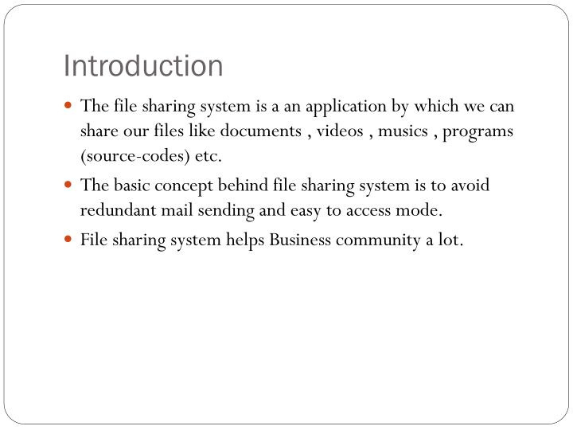

Slide 3
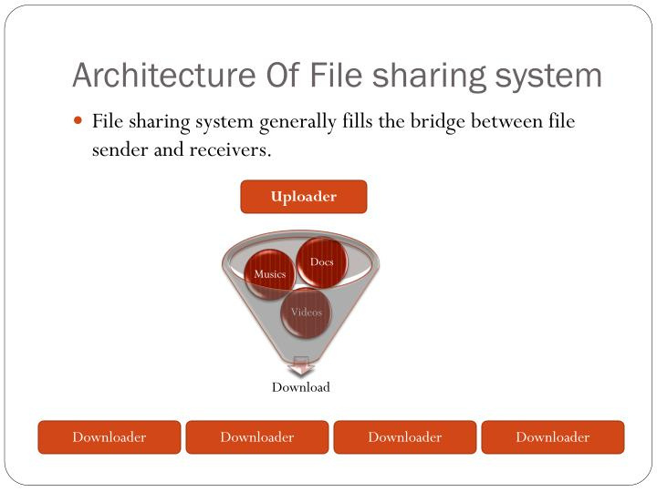

Slide 4
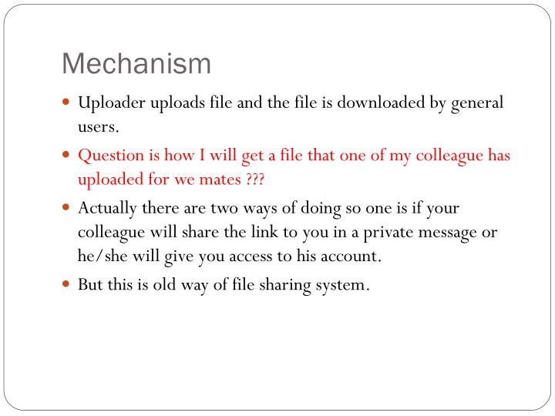

Slide 5
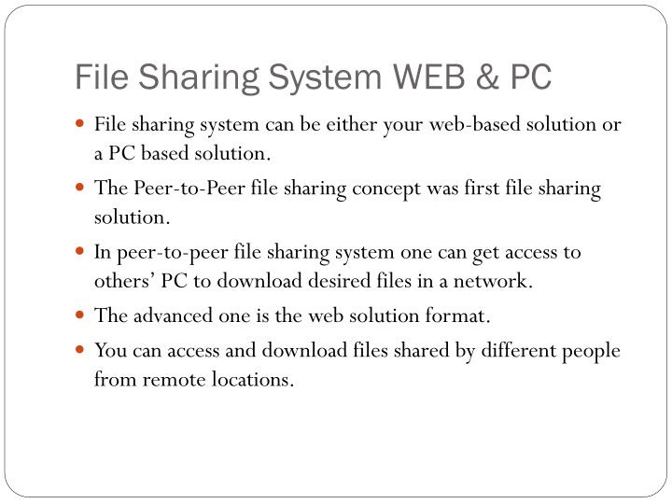

Slide 6
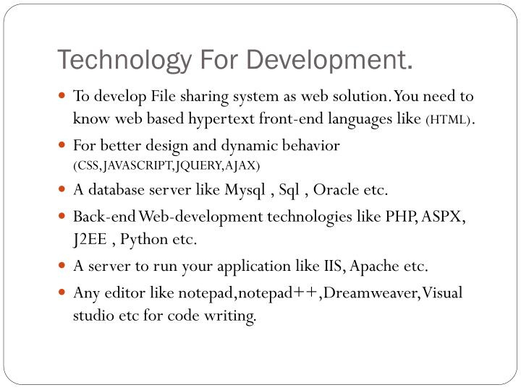

Slide 7
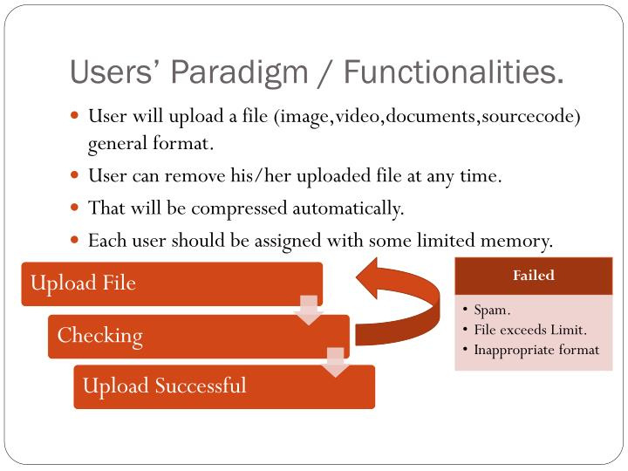

Slide 8
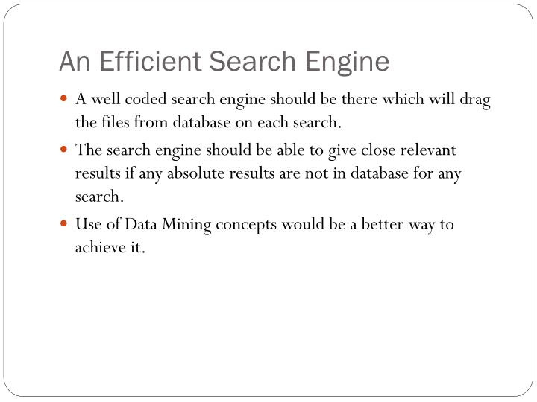

Slide 9
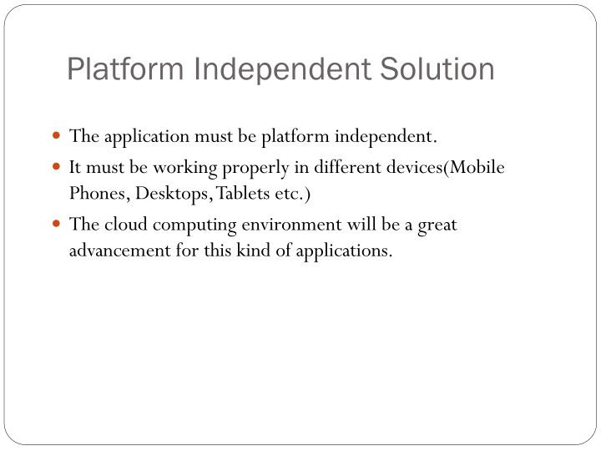

Slide 10
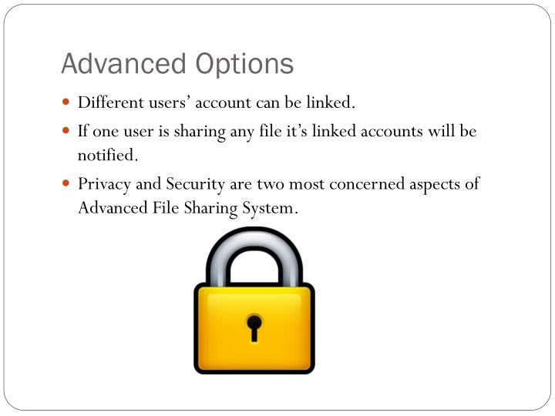

Slide 11
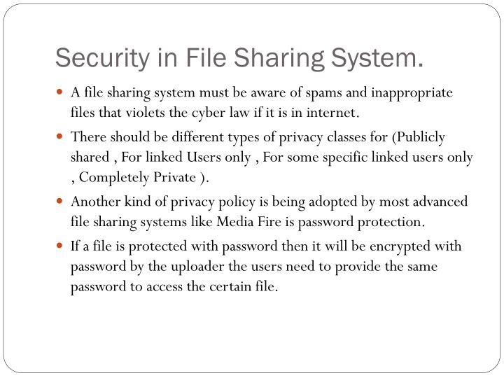

Slide 12
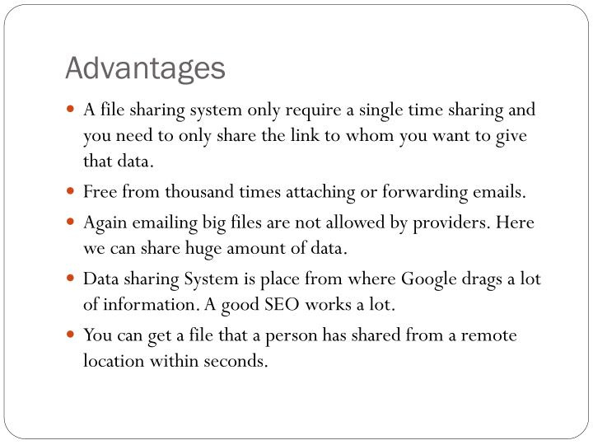

Slide 13
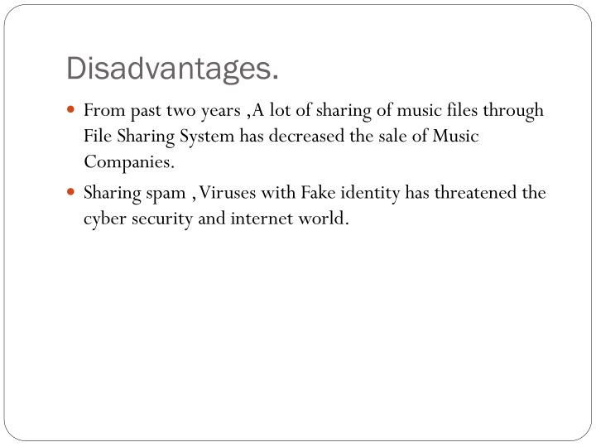

Slide 14

OUTPUT

Slide 15
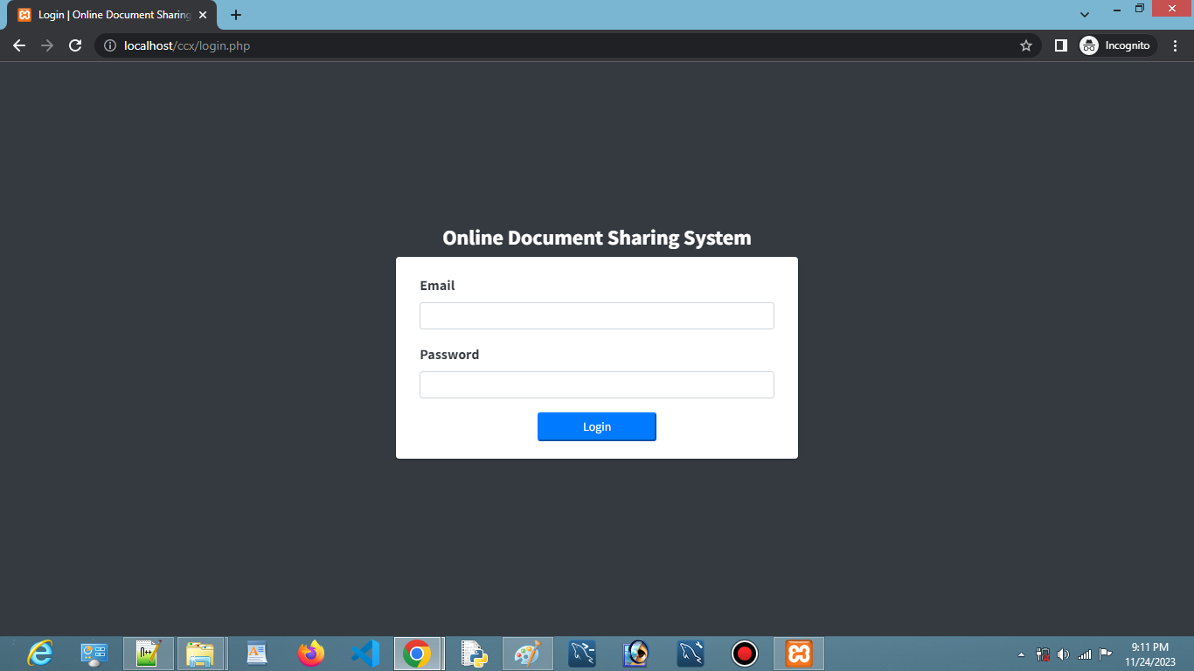
..
Login

Slide 16
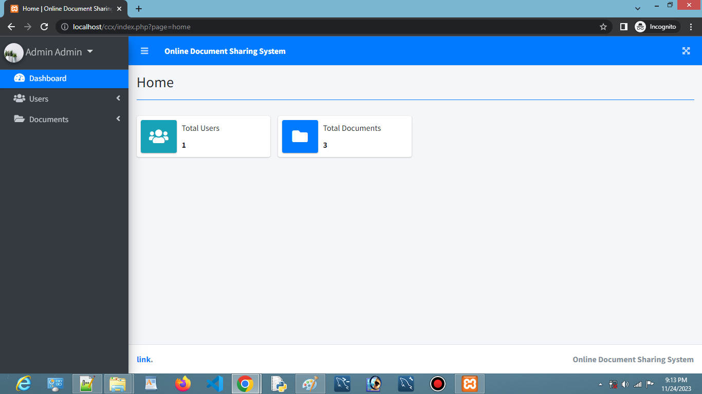
..
MAIN

Slide 17
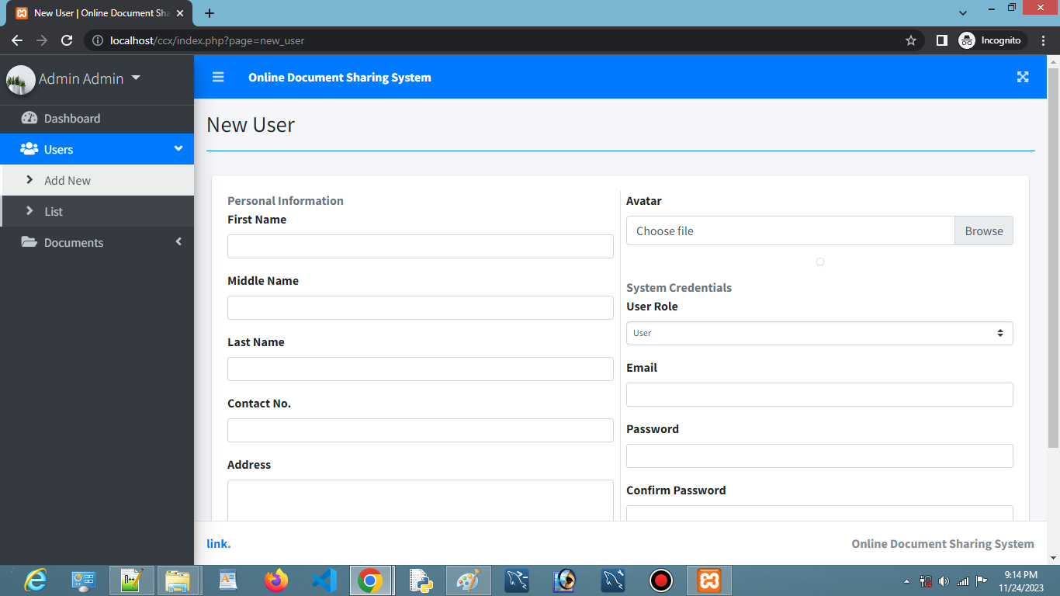
..
New User

Slide 18
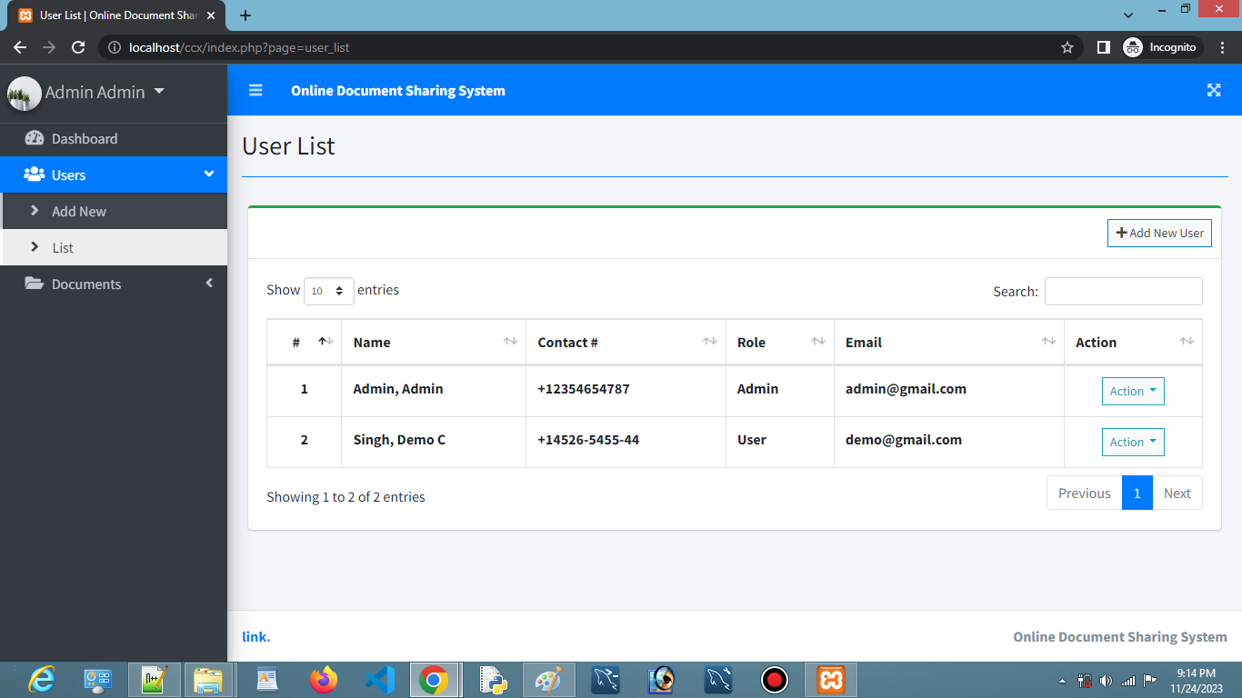
..
USER LIST

Slide 19
..
USER LIST

Slide 20
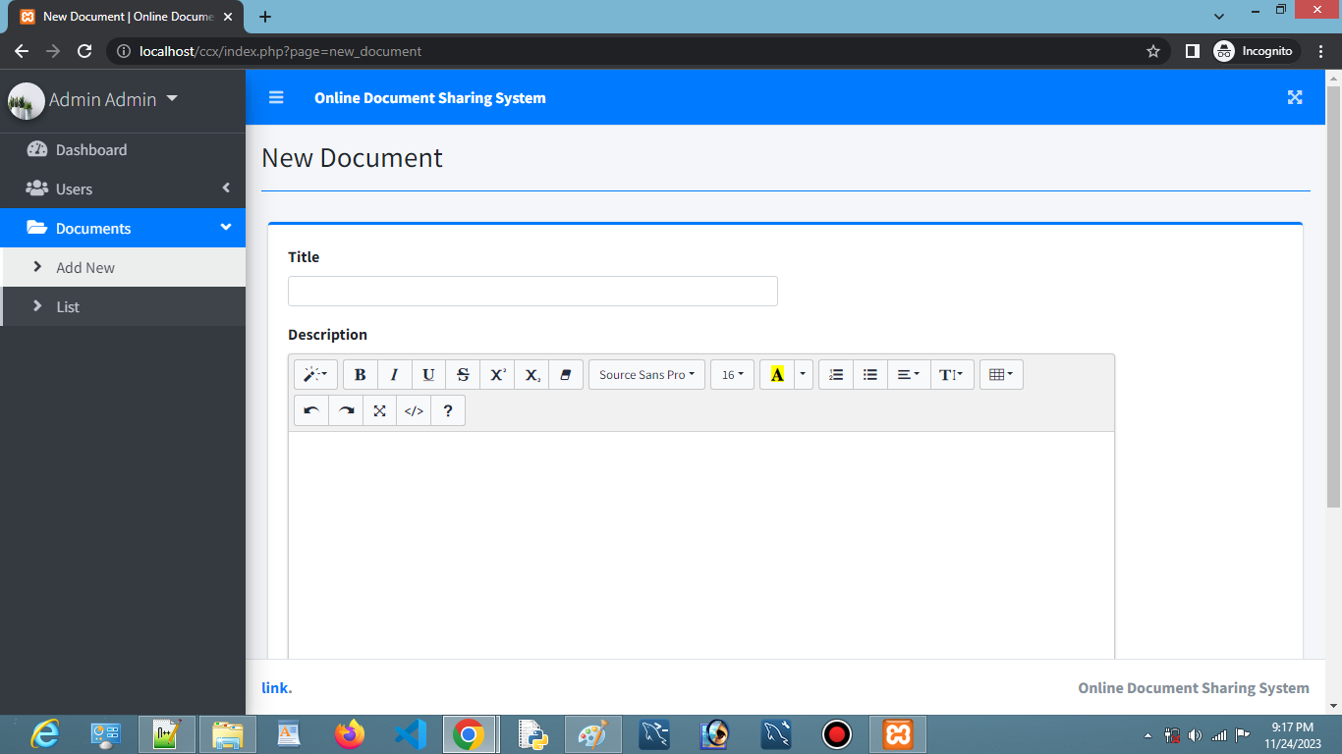
..
NEW DOCUMENT

Slide 21
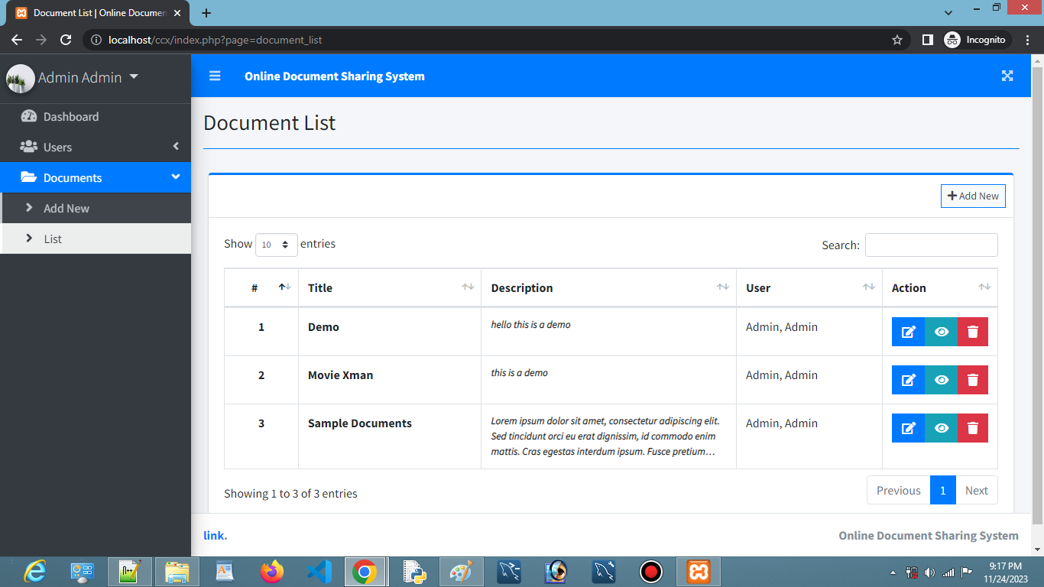
..
DOCUMENT LIST

Slide 22


