Slide 1
Introduction to Probability and Statistics
Spring 2025
Ergun Kacar

Slide 2
What is statistics
The term statistics can refer to numerical facts such as averages, medians, precents, and index numbers that help us understand a variety of business and economic situations.
Statistics can also refer to the art and science of collecting, analyzing, presenting, and interpreting data.

Slide 3
Data and Data Sets
Data are the facts and figures collected, analyzed, and summarized for presentation and interpretation.
All the data collected in a particular study are referred to as the data set for the study.
We will be using various types of data sets!

Slide 4
Elements, Variables, and Observations
Elements are the entities on which data are collected.
A variable is a characteristic of interest for the elements.
The set of measurements obtained for a particular element is called an observation.
A data set with n elements contains n observations.
The total number of data values in a complete data set is the number of elements multiplied by the number of variables.

Slide 5
Car Example
.
Variables
Element
Names
Observation
Data Set
 | Car | MPG | Weight | Drive_Ratio | Horsepower | Displacement | Cylinders | Country
0 | Buick Estate Wagon | 16.9 | 4.360 | 2.73 | 155 | 350 | 8 | U.S.
1 | Ford Country Squire Wagon | 15.5 | 4.054 | 2.26 | 142 | 351 | 8 | U.S.
2 | Chevy Malibu Wagon | 19.2 | 3.605 | 2.56 | 125 | 267 | 8 | U.S.
3 | Chrysler LeBaron Wagon | 18.5 | 3.940 | 2.45 | 150 | 360 | 8 | U.S.
4 | Chevette | 30.0 | 2.155 | 3.70 | 68 | 98 | 4 | U.S.

Slide 6
Categorical and Quantitative Data
Data can be further classified as being categorical or quantitative.
The statistical analysis that is appropriate depends on whether the data for the variable are categorical or quantitative.
In general, there are more alternatives for statistical analysis when the data are quantitative.

Slide 7
Categorical Data
Labels or names used to identify an attribute of each element
Often referred to as qualitative data
Use either the nominal or ordinal scale of measurement
Can be either numeric or nonnumeric
Appropriate statistical analyses are rather limited

Slide 8
Quantitative Data
Quantitative data indicate how many or how much:
discrete, if measuring how many
continuous, if measuring how much
Quantitative data are always numeric.
Ordinary arithmetic operations are meaningful for quantitative data.

Slide 9
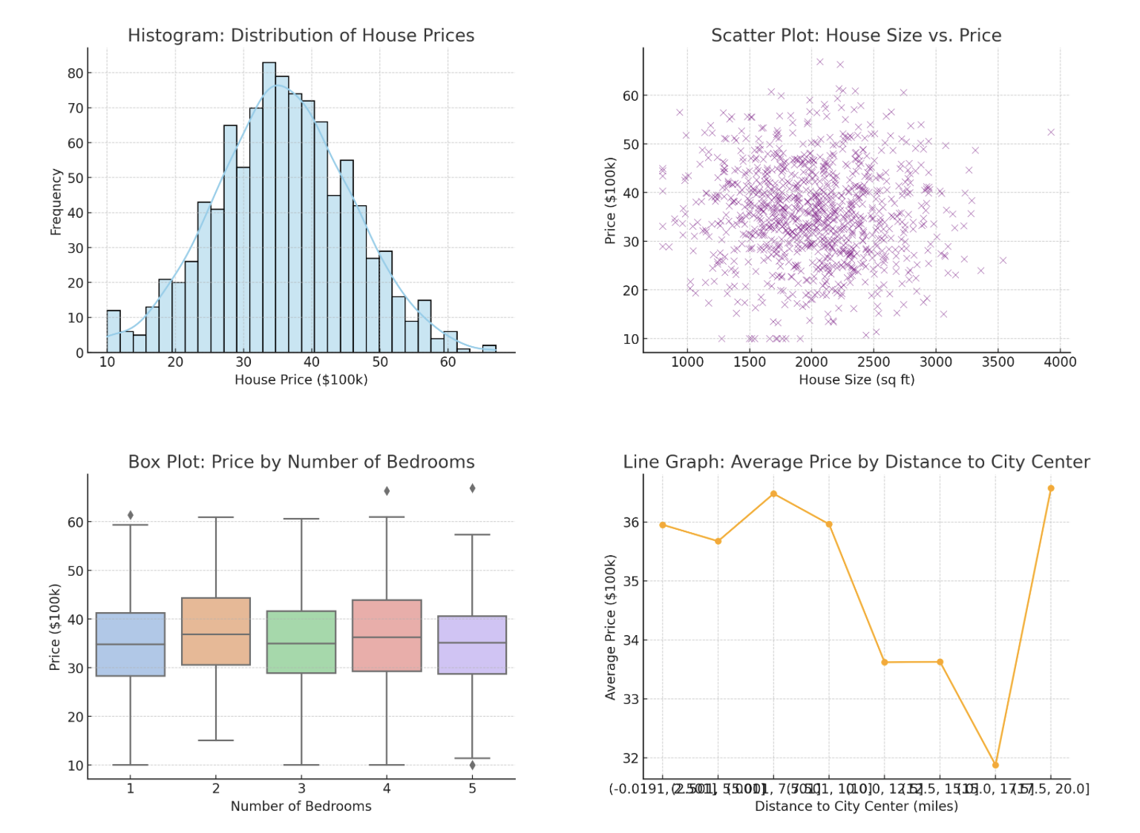
Common Quantitative data graphs

Slide 10
Histogram
The common graphical display of quantitative data is a histogram.
The variable of interest is placed on the horizontal axis.
A rectangle is drawn above each class interval with its height corresponding to the interval’s frequency, relative frequency, or percent frequency.
Unlike a bar graph, a histogram has no natural separation between rectangles of adjacent classes.

Slide 11
Statistical Inference
Population: The set of all elements of interest in a particular study
Sample: A subset of the population
Statistical inference: The process of using data obtained from a sample to make estimates and test hypotheses about the characteristics of a population
Census: Collecting data for the entire population
Sample survey: Collecting data for a sample

Slide 12
Computers and Statistical Analysis
Today, data scientists, analysts, and statisticians all different software packages/platforms to perform the statistical computations required with large amounts of data.
Other than Python, most common tools/platforms are
R
STATA
SAS
Matlab (Octave)
And still Excel!

Slide 13
Ethical Guidelines for Statistical Practice
In a statistical study, unethical behavior can take a variety of forms including:
Improper sampling
Inappropriate analysis of the data
Development of misleading graphs
Use of inappropriate summary statistics
Biased interpretation of the statistical results
You should strive to be fair, thorough, objective, and neutral as you collect, analyze, and present data.
As a consumer of statistics, you should also be aware of the possibility of unethical behavior by others.

Slide 14
Measures of Location
Mean
Median
Mode
Percentiles
Quartiles
Weighted Mean
Geometric Mean
If the measures are computed for data from a sample, they are called sample statistics.
If the measures are computed for data from a population, they are called population parameters.
A sample statistic is referred to as the point estimator of the corresponding population parameter.

Slide 15

MEAN
Perhaps the most important measure of location is the mean.
The mean provides a measure of central location.
The mean of a data set is the average of all the data values.
The sample mean $\overline{x}$ is the point estimator of the population mean μ.

Slide 16
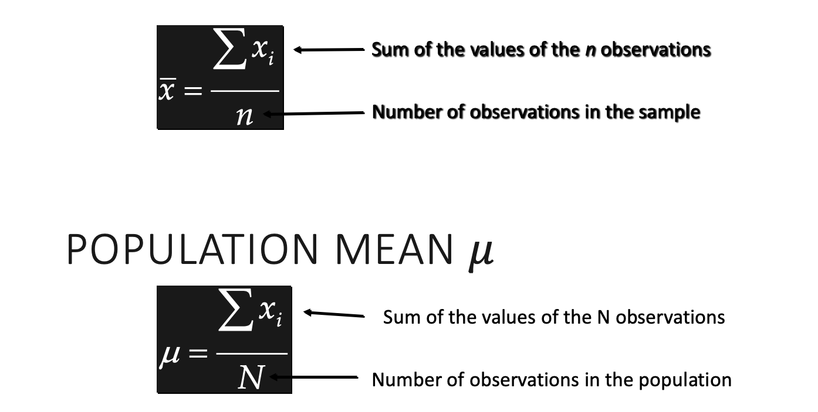

Sample Mean $\overline{x}$

Slide 17
Weighted Mean
In some instances, the mean is computed by giving each observation a weight that reflects its relative importance.
The choice of weights depends on the application.
The weights might be the number of credit hours earned for each grade, as in GPA.
In other weighted mean computations, quantities such as pounds, dollars, or volume are frequently used.

Slide 18
Weighted Mean (Cont…)
If data is from
a population,
μ replaces x.
Numerator:
sum of the weighted
data values
Denominator:
sum of the
weights
where:
x_{i} = value of observation i
w_{i} = weight for observation i

Slide 19
Median
The median of a data set is the value in the middle when the data items are arranged in ascending order.
Whenever a data set has extreme values, the median is the preferred measure of central location.
The median is the measure of location most often reported for annual income and property value data.
A few extremely large incomes or property values can inflate the mean.

Slide 20
Median (Cont…)
For an odd number of observations:
the median is the middle value = 19
For an even number of observations, the median is the average of the middle two values.
26
18
27
12
14
27
19
7 observations
12
14
18
19
26
27
27
in ascending order

Slide 21
Median (Cont…)
Example: Apartment Rents
Data is in ascending order. Number of samples is even.
Averaging the 35th and 36th data values:
Median = (475 + 475)/2 = 475

Slide 22
Geometric Mean
The geometric mean is calculated by finding the nth root of the product of n values.
It is often used in analyzing growth rates in financial data (where using the arithmetic mean will provide misleading results).
It should be applied anytime you want to determine the mean rate of change over several successive periods (be it years, quarters, weeks, . . .).
Other common applications include: changes in populations of species, crop yields, pollution levels, and birth and death rates.
…
…

Slide 23
Mode
The mode of a data set is the value that occurs with greatest frequency.
The greatest frequency can occur at two or more different values.
If the data have exactly two modes, the data are bimodal.
If the data have more than two modes, the data are multimodal.
450 occurred most frequently (7 times). Hence, mode =450

Slide 24
Range
The range of a data set is the difference between the largest and smallest data values.
It is the simplest measure of variability.
It is very sensitive to the smallest and largest data values.
Range = 615– 425 = 190

Slide 25
Interquartile Range
The interquartile range of a data set is the difference between the third quartile and the first quartile.
It is the range for the middle 50% of the data.
It overcomes the sensitivity to extreme data values.
Example: Apartment Rents
3rd Quartile (Q3) = 525
1st Quartile (Q1) = 445
Interquartile Range = Q3 - Q1 = 525 - 445 =80

Slide 26
Variance
The variance is a measure of variability that utilizes all the data.
It is based on the difference between the value of each observation (x_{i}) and the mean (x for a sample, μ for a population).
The variance is useful in comparing the variability of two or more variables.
The variance is the average of the squared differences between each data value and the mean.
The variance is computed as follows:
for a sample for a population

Slide 27
Standard Deviation
The standard deviation of a data set is the positive square root of the variance.
It is measured in the same units as the data, making it more easily interpreted than the variance.

Slide 28
Probability
Probability is a numerical measure of the likelihood that an event will occur.
Probability values are always assigned on a scale from 0 to 1.
A probability near zero indicates an event is quite unlikely to occur.
A probability near one indicates an event is almost certain to occur.
Increasing Likelihood of Occurrence
0
.5
1
Probability:
unlikely to occur
The occurrence of the event is just as likely as it is unlikely
almost certain to occur

Slide 29
Statistical Experiments
In statistics, the notion of an experiment differs somewhat from that of an experiment in the physical sciences.
In statistical experiments, probability determines outcomes.
Even though the experiment is repeated in exactly the same way, an entirely different outcome may occur.
For this reason, statistical experiments are sometimes called random experiments.

Slide 30
An Experiment and Its Sample Space
An experiment is any process that generates well-defined outcomes.
The sample space for an experiment is the set of all experimental outcomes.
An experimental outcome is also called a sample point.
Experiment
Toss a coin
Inspection a part
Conduct a sales call
Roll a die
Play a football game
Experiment Outcomes
Head, tail
Defective, non-defective
Purchase, no purchase
1, 2, 3, 4, 5, 6
Win, lose, tie

Slide 31
Basic Requirements for Assigning Probabilities
The probability assigned to each experimental outcome must be between 0 and 1, inclusively.
where: E_{i} is the ith experimental outcome and P(E_{i}) is its probability
The sum of the probabilities for all experimental outcomes must equal 1.
where: n is the number of experimental outcomes
0 < P(E_{i}) < 1 for all i
P(E₁) + P(E₂) + . . . + P(E_{n}) = 1

Slide 32
Some Basic Relationships of Probability
There are some basic probability relationships that can be used to compute the probability of an event without knowledge of all the sample point probabilities.
Complement of an Event
Union of Two Events
Intersection of Two Events
Mutually Exclusive Events

Slide 33
Complement of an Event
The complement of event A is defined to be the event consisting of all sample points that are not in A.
The complement of A is denoted by A^{c}.
Sample
Space S
Event A
A^{c}
Venn
Diagram

Slide 34
Union of Two Events
The union of events A and B is the event containing all sample points that are in A or B or both.
The union of events A and B is denoted by A ∪ B.
Sample
Space S
Event A
Event B

Slide 35
Intersection of Two Events
The intersection of events A and B is the set of all sample points that are in both A and B.
The intersection of events A and B is denoted by A ∩ Β.
Sample
Space S
Event A
Event B
Intersection of A and B

Slide 36
Addition Law
The addition law provides a way to compute the probability of event A, or B, or both A and B occurring.
The law is written as:
P(A ∪ B) = P(A) + P(B) − P(A ∩ B)
Try calculating P(M ∪ C) using for Bradley Investments example
P(M ∪ C) = P(M) + P(C) − P(M ∩ C)

Slide 37
Mutually Exclusive Events
Two events are said to be mutually exclusive if the events have no sample points in common.
Two events are mutually exclusive if, when one event occurs, the other cannot occur.
If events A and B are mutually exclusive, P(A ∩ B) = 0 and hence
P(A ∪ B) = P(A) + P(B)
Sample
Space S
Event A
Event B

Slide 38
Conditional Probability
The probability of an event given that another event has occurred is called a conditional probability.
The conditional probability of A given B is denoted by P(A|B).
A conditional probability is computed as follows:

Slide 39
Multiplication Law
The multiplication law provides a way to compute the probability of the intersection of two events.
The law is written as:
Try calculating P(M ∩ C) for Bradley investments example using
P(M ∩ C) = P(M)P(M|C)
P(A ∩ B) = P(B)P(A|B)

Slide 40
Independent Events
If the probability of event A is not changed by the existence of event B, we would say that events A and B are independent.
Two events A and B are independent if:
P(A|B) = P(A) or P(B|A) = P(B)
Multiplication Law for Independent Events
P(A ∩ B) = P(A)P(B)
If P(A ∩ B) ≠ P(A)P(B), then we can say that A and B are NOT independent. Try it with Bradley Investments example

Slide 41
Mutual Exclusiveness and Independence
Do not confuse the notion of mutually exclusive events with that of independent events.
Two events with nonzero probabilities cannot be both mutually exclusive and independent.
If one mutually exclusive event is known to occur, the other cannot occur.; thus, the probability of the other event occurring is reduced to zero (and they are therefore dependent).
Two events that are not mutually exclusive, might or might not be independent.

Slide 42
Bayes’ Theorem
Often, we begin probability analysis with initial or prior probabilities.
Then, from a sample, special report, or a product test we obtain some additional information.
Given this information, we calculate revised or posterior probabilities.
Bayes’ theorem provides the means for revising the prior probabilities.
Prior
Probabilities
New
Information
Application
of Bayes’
Theorem
Posterior
Probabilities

Slide 43
Bayes’ Theorem
To find the posterior probability that event Ai will occur given that event B has occurred, we apply Bayes’ theorem.
Bayes’ theorem is applicable when the events for which we want to compute posterior probabilities are mutually exclusive and their union is the entire sample space.

Slide 44
Random Variables
A random variable is a numerical description of the outcome of an experiment.
A discrete random variable may assume either a finite number of values or an infinite sequence of values.
A continuous random variable may assume any numerical value in an interval or collection of intervals.

Slide 45
Discrete Random Variable with a Finite Number of Values
Example with a finite number of values: JSL Appliances
Let x = number of TVs sold at the store in one day, where x can take on 5 values (0, 1, 2, 3, 4)
We can count the TVs sold, and there is a finite upper limit on the number that might be sold (which is the number of TVs in stock).
Example with an infinite number of values: JSL Appliances
We can count the customers arriving, but there is “almost” no finite upper limit on the number that might arrive.

Slide 46
Discrete Probability Distributions
The probability distribution for a random variable describes how probabilities are distributed over the values of the random variable.
We can describe a discrete probability distribution with a table, graph, or formula.
Two types of discrete probability distributions will be introduced.
First type uses the rules of assigning probabilities to experimental outcomes to determine probabilities for each value of the random variable.
Second type uses a special mathematical formula to compute the probabilities for each value of the random variable.

Slide 47
Discrete Probability Distributions (Cont…)
The probability distribution is defined by a probability function, denoted by f(x), that provides the probability for each value of the random variable.
The required conditions for a discrete probability function are:
There are three methods for assign probabilities to random variables: the classical method, the subjective method, and the relative frequency method.
f(x) > 0
Σf(x) = 1

Slide 48
Variance and Standard Deviation
The variance summarizes the variability in the values of a random variable.
The variance is a weighted average of the squared deviations of a random variable from its mean.
The weights are the probabilities.
The standard deviation, σ, is defined as the positive square root of the variance.
Var(x) = σ ² = Σ(x - μ)²f(x)

Slide 49
Binomial Probability Distribution
Our interest is in the number of successes occurring in the n trials.
We let x denote the number of successes occurring in the n trials.
p is the probability of a success on one trial
Binomial Probability Function (the probability of x successes in n trials)
Number of experimental
outcomes providing exactly
x successes in n trials
Probability of a particular
sequence of trial outcomes
with x successes in n trials

Slide 50
Binomial Probabilities and Cumulative Probabilities
Statisticians have developed tables that give probabilities and cumulative probabilities for a binomial random variable.
These tables can be found in some statistics textbooks.
Of course, we will use our computers not those tables to calculate probabilities.

Slide 51
Binomial Probability Distribution
Expected Value
Variance
Standard Deviation
E(x) = μ = np
Var(x) = σ ² = np(1 − p)

Slide 52
Poisson Probability Distribution
A Poisson distributed random variable is often useful in estimating the number of occurrences over a specified interval of time or space
It is a discrete random variable that may assume an infinite sequence of values (x = 0, 1, 2, . . . ).
Examples:
the number of knotholes in 14 linear feet of pine board
the number of vehicles arriving at a toll booth in one hour
Bell Labs used the Poisson distribution to model the arrival of phone calls.

Slide 53
Poisson Probability Distribution Cont…)
Two Properties of a Poisson Experiment
The occurrence or nonoccurrence in any interval is independent of the occurrence or nonoccurrence in any other interval.
The probability of an occurrence is the same for any two intervals of equal length.
Poisson Probability Function
x = the number of occurrences in an interval
f(x) = the probability of x occurrences in an interval
μ= mean number of occurrences in an interval
e = 2.71828

Slide 54
Poisson Probability Distribution Cont…)
Poisson Probability Function
Since there is no stated upper limit for the number of occurrences, the probability function f(x) is applicable for values x = 0, 1, 2, … without limit.
In practical applications, x will eventually become large enough so that f(x) is approximately zero and the probability of any larger values of x becomes negligible.

Slide 55
Continuous Probability Distributions
A continuous random variable can assume any value in an interval on the real line or in a collection of intervals.
It is not possible to talk about the probability of the random variable assuming a particular value.
P(X=a)=0
Instead, we talk about the probability of the random variable assuming a value within a given interval.
P(a<X<b)

Slide 56
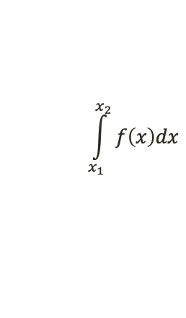

Continuous Probability Distributions
The probability of the random variable assuming a value within some given interval from x₁ to x₂ is defined to be the area under the graph of the probability density function between x₁ and x₂.
Uniform
f (x)
Normal
f (x)
Exponential
f (x)
x₁
x₂
x
x₁
x₂
x
x₁
x₂
x
$$\int_{x_{1}}^{x_{2}}{f\left(x\right)dx}$$

Slide 57
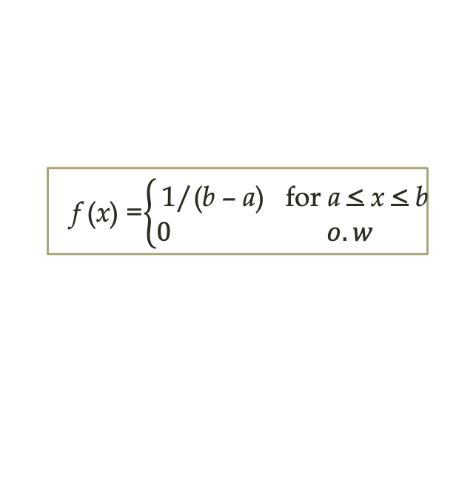
Uniform Probability Distribution
A random variable is uniformly distributed whenever the probability is proportional to the interval’s length.
The uniform probability density function is:
where a = smallest value the variable can assume
b = largest value the variable can assume
f (x) =$\left\{\begin{aligned}\text{1/(}\text{b}\text{ – }\text{a}\text{) }\text{for} \text{a} \text{<} \text{x} \text{<} \text{b} \\ 0 o.w \end{aligned}\right.$
f (x)
Uniform
x
a
b

Slide 58
Uniform Probability Distribution
Expected Value of x
Variance of x
E(x) = (a + b)/2
Var(x) = (b - a)²/12

Slide 59
Normal Probability Distribution
The normal probability distribution is the most important distribution for describing a continuous random variable.
It is widely used in statistical inference.
It has been used in a wide variety of applications including:
Heights of people
Rainfall amounts
Test scores
Scientific measurements

Slide 60

Normal Probability Distribution
Normal Probability Density Function
$$xεR (−∞<x<∞)$$
μ = mean
σ = standard deviation
π = 3.14159
e = 2.71828

Slide 61
Properties of normal Distribution
The distribution is symmetric; its skewness measure is zero.
The entire family of normal probability distributions is defined by its mean μ and its standard deviation σ.
Mean = Median = Mode
x
Mean μ

Slide 62
Properties of normal Distribution
The mean can be any numerical value: negative, zero, or positive.
For fixed σ, if μ changes, the whole shape shifts along the x-axis but the shape of the curve doesn’t change
The standard deviation (σ) determines the width of the curve: larger values result in wider, flatter curves.
σ = 15
σ = 25
x

Slide 63
the Empirical rule
68.26% of values of a normal random variable are within ±1 standard deviations of its mean.
95.44% of values of a normal random variable are within ±2 of standard deviations its mean.
99.72% of values of a normal random variable are within ±3 of standard deviations its mean.

Slide 64
Standard Normal Probability Distribution
A random variable having a normal distribution with a mean of 0 and a standard deviation of 1 is said to have a standard normal probability distribution.
The letter z is used to designate the standard normal random variable.
We can think of Z as a measure of the number of standard deviations X is from μ.
σ = 1
z
0

Slide 65
Point Estimation
Point estimation is a form of statistical inference.
In point estimation we use the data from the sample to compute a value of a sample statistic that serves as an estimate of a population parameter.
We refer to $\overline{x}$ as the point estimator of the population mean μ.
s is the point estimator of the population standard deviation σ.
$\overline{p}$ is the point estimator of the population proportion p.

Slide 66
Practical Advice
The target population is the population we want to make inferences about.
The sampled population is the population from which the sample is actually taken.
Whenever a sample is used to make inferences about a population, we should make sure that the targeted population and the sampled population are in close agreement.

Slide 67

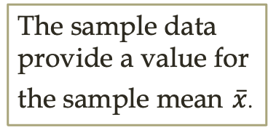
Sampling Distribution of $\overline{x}$
Process of Statistical Inference
Population
with mean
μ = ?
A simple random sample
of n elements is selected
from the population.
The value of $\overline{x}$ is used to
make inferences about
the value of μ.
The sample data
provide a value for
the sample mean $\overline{x}$.

Slide 68

Sampling Distribution of $\overline{x}$(Cont…)
The sampling distribution of $\overline{x}$is the probability distribution of all possible values of the sample mean $\overline{x}$.
Expected value of $\overline{x}$ is equal to population mean
When the expected value of the point estimator equals the population parameter, we say the point estimator is unbiased.
E($\overline{x}$) = μ

Slide 69
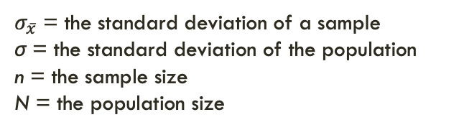
Sampling Distribution of $\overline{x}$(Cont…)
We will use the following notation to define the standard deviation of the sampling distribution of.
$σ_{\overline{x}}$ = the standard deviation of a sample
σ = the standard deviation of the population
n = the sample size
N = the population size

Slide 70
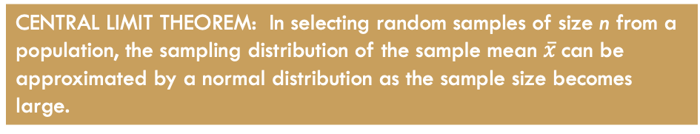
Central Limit Theorem
When the population from which we are selecting a random sample does not have a normal distribution, the central limit theorem is helpful in identifying the shape of the sampling distribution of.
CENTRAL LIMIT THEOREM: In selecting random samples of size n from a population, the sampling distribution of the sample mean $\overline{x}$can be approximated by a normal distribution as the sample size becomes large.

Slide 71
Hypothesis Testing
Hypothesis testing can be used to determine whether a statement about the value of a population parameter should or should not be rejected.
The null hypothesis, denoted by H₀, is a tentative assumption about a population parameter.
The alternative hypothesis, denoted by H_{a}, is the against what is stated in the null hypothesis.
The hypothesis testing procedure uses data from a sample to test the two competing statements indicated by H₀ and H_{a}.

Slide 72
Developing Null and Alternative Hypotheses
It is not always obvious how the null and alternative hypotheses should be formulated.
Care must be taken to structure the hypotheses appropriately so that the test conclusion provides the information the researcher wants.
The context of the situation is very important in determining how the hypotheses should be stated.
In some cases it is easier to identify the alternative hypothesis first. In other cases the null is easier.
Correct hypothesis formulation will take practice.

Slide 73
Alternative Hypothesis as a Research Hypothesis
Many applications of hypothesis testing involve an attempt to gather evidence in support of a research hypothesis.
In such cases, it is often best to begin with the alternative hypothesis and make it the conclusion that the researcher hopes to support.
The conclusion that the research hypothesis is true is made if the sample data provide sufficient evidence to show that the null hypothesis can be rejected.

Slide 74
Alternative Hypothesis as a Research Hypothesis
Example | Alternative Hypothesis | Null Hypothesis
A new teaching method is developed that is believed to be better than the current method | The new teaching method is better | The new method is no better than the old method
A new sales force bonus plan is developed in an attempt to increase sales | The new bonus plan increase sales | The new bonus plan does not increase sales
A new drug is developed with the goal of lowering blood pressure more than the existing drug. | The new drug lowers blood pressure more than the existing drug. | The new drug does not lower blood pressure more than the existing drug.

Slide 75
Null Hypothesis as an Assumption to be Challenged
We might begin with a belief or assumption that a statement about the value of a population parameter is true.
We then using a hypothesis test to challenge the assumption and determine if there is statistical evidence to conclude that the assumption is incorrect.
In these situations, it is helpful to develop the null hypothesis first.
Example: The label on a soft drink bottle states that it contains 67.6 fluid ounces.
Null Hypothesis: The label is correct. μ ≥ 67.6 ounces.
Alternative Hypothesis: The label is incorrect. μ < 67.6 ounces.

Slide 76
Summary of Forms for Null and Alternative Hypotheses about a Population Mean
The equality part of the hypotheses always appears in the null hypothesis.
In general, a hypothesis test about the value of a population mean μ must take one of the following three forms (where μ₀ is the hypothesized value of the population mean).
One-tailed
(lower-tail)
One-tailed
(upper-tail)
Two-tailed

Slide 77
Null and Alternative Hypotheses Example
Example: Metro EMS
A major west coast city provides one of the most comprehensive emergency medical services in the world. Operating in a multiple hospital system with approximately 20 mobile medical units, the service goal is to respond to medical emergencies with a mean time of 12 minutes or less.
The director of medical services wants to formulate a hypothesis test that could use a sample of emergency response times to determine whether or not the service goal of 12 minutes or less is being achieved.

Slide 78
Null and Alternative Hypotheses Example (Cont…)
H₀: μ < 12
The emergency service is meeting the response goal; no follow-up action is necessary.
The emergency service is not meeting the response goal; appropriate follow-up action is necessary.
H_{a}: μ > 12
where: μ = mean response time for the population of medical emergency requests

Slide 79
Type I Error
Because hypothesis tests are based on sample data, we must allow for the possibility of errors.
A Type I error is rejecting H₀ when it is true.
The probability of making a Type I error when the null hypothesis is true as an equality is called the level of significance.
Applications of hypothesis testing that only control the Type I error are often called significance tests.

Slide 80
Type II Error
A Type II error is accepting H₀ when it is false.
It is difficult to control for the probability of making a Type II error.
Statisticians avoid the risk of making a Type II error by using “do not reject H₀” and not “accept H₀”.

Slide 81
Type I and Type II Errors
Population Condition
H₀ True
(m < 12)
H₀ False
(m > 12)
Conclusion
Do Not reject H₀
(Conclude m < 12)
Correct
Decision
Type II Error
Reject H₀
(Conclude m > 12)
Type I Error
Correct
Decision

Slide 82
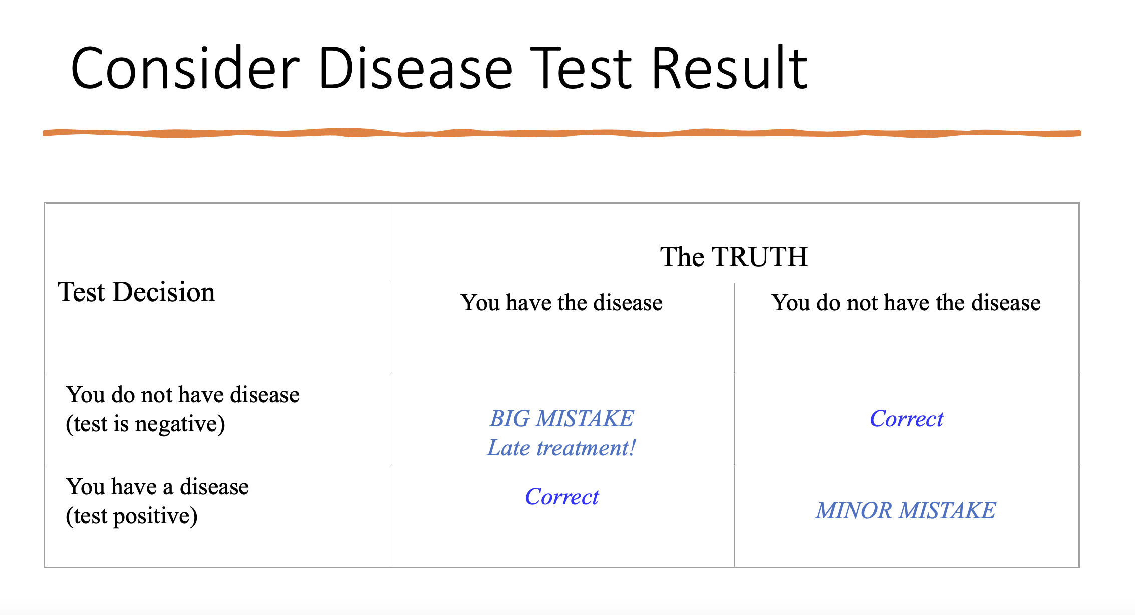

Slide 83
Example:
According to Mars, Inc., 20% of all M&Ms produced are blue. Based on your experience, you think that the percent of blue M&Ms in a bag is usually more than 20%. Use sample data from one bag of M&Ms to perform a hypothesis test for the population proportion. You will test your hypothesis that the proportion of blue M&Ms is greater than 20%.

Slide 84
Example:
According to Mars, Inc., 20% of all M&Ms produced are blue. Based on your experience, you think that the percent of blue M&Ms in a bag is usually more than 20%. Use sample data from one bag of M&Ms to perform a hypothesis test for the population proportion. You will test your hypothesis that the proportion of blue M&Ms is greater than 20%.
The null and alternate hypotheses would be written as:
H₀ : p = .20
H_{a} : p > .20
H_{a} is written with a > symbol because you are testing whether the proportion of blue M&Ms is greater than 20%. Note that this is a one-sided test.

Slide 85
Example:
A sleep study collected data from a random sample of 45 college students and recorded the hours of sleep on a particular night for each student. The mean hours of sleep for the students in the sample was 7.29 hours. Published data has indicated that the nightly hours of sleep for the general population is normally distributed with a mean of 7.75 hours and a population standard deviation of 1.44 hours. The sleep study wants to test if college students get a different number of average hours of sleep per night than the general population.

Slide 86
Example:
A sleep study collected data from a random sample of 45 college students and recorded the hours of sleep on a particular night for each student. The mean hours of sleep for the students in the sample was 7.29 hours. Published data has indicated that the nightly hours of sleep for the general population is normally distributed with a mean of 7.75 hours and a population standard deviation of 1.44 hours. The sleep study wants to test if college students get a different number of average hours of sleep per night than the general population.
The null and alternate hypotheses would be written as:
H₀: µ = 7.75
H_{a}: µ ≠ 7.75
Notes: Null hypotheses are ALWAYS written using an equals sign (=). Alternate hypotheses should not include an equals sign. Because the sleep study is testing if college students get a “different” amount of sleep, H_{a} is written with ≠ . If the study tested if students get “more” or “less” sleep, would use a one-sided (> or <) alternate hypothesis.

Slide 87

THANK YOU!

