Slide 1
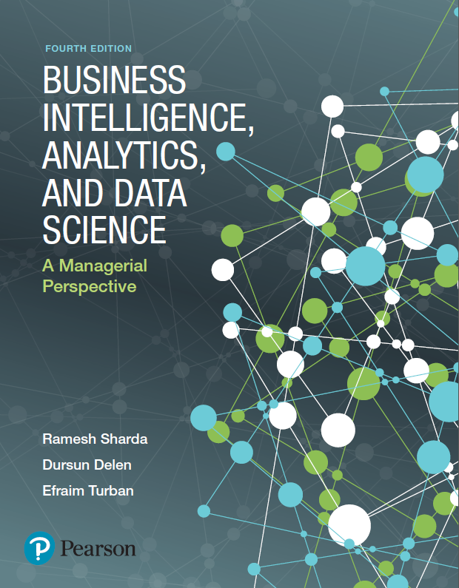
Business Intelligence, Analytics, and Data Science: A Managerial Perspective
Fourth Edition
Chapter 8
Future Trends, Privacy and Managerial Considerations in Analytics
Slides in this presentation contain hyperlinks. JAWS users should be able to get a list of links by using INSERT+F7
Copyright © 2018, 2014, 2011 Pearson Education, Inc. All Rights Reserved
Notes:
If this PowerPoint presentation contains mathematical equations, you may need to check that your computer has the following installed:
1) MathType Plugin
2) Math Player (free versions available)
3) NVDA Reader (free versions available)

Slide 2
Learning Objectives (1 of 2)
8.1 Explore some of the emerging technologies that may impact analytics, business intelligence (B I), and decision support
8.2 Describe the emerging Internet of Things (I o T) phenomenon, potential applications, and the I o T ecosystem
8.3 Describe the current and future use of cloud computing in business analytics
8.4 Describe how geospatial and location-based analytics are assisting organizations

Slide 3
Learning Objectives (2 of 2)
8.5 Describe the organizational impacts of analytics applications
8.6 List and describe the major ethical and legal issues of analytics implementation
8.7 Identify key characteristics of a successful data science professional

Slide 4
Opening Vignette
Analysis of Sensor Data Helps Siemens Avoid Train Failures
Discussion Questions
In industrial equipment such as trains, what parameters might one measure on a regular basis to estimate the equipment’s current performance and future repair needs?
How would weather data be useful in analyzing a train’s equipment status?
Estimate how much data you might collect in one month using, say, 1,000 sensors on a train. Each sensor might yield 1 K B data per second.
How would you propose to store such data sets?

Slide 5
Internet of Things (I o T) (1 of 2)
I o T is an area with explosive growth
Connecting physical world to the Internet
Social Network versus I o T
human-to-human vs. machine-to-machine
Enablers: sensors and sensing devices
Example
Self driving cars
Fitness trackers
Smartbin – trash detectors detecting fill levels
Smart refrigerators, and other appliances

Slide 6
Internet of Things (I o T) (2 of 2)
By 2020, besides computing and communication devices (tablets, phones, and P Cs), another 38B things will be connected to the Internet
Reasons for incredible growth in I o T:
Hardware – smaller, affordable, more powerful
Availability of B I tools – more capable and cheaper
Emergence of new and innovative use cases
There isn’t a universal agreement on the term I o T
Web of Things
Internet of Systems, …

Slide 7
Application Case 8.1
SilverHook Powerboats Uses Real-Time Data Analysis to Inform Racers and Fans
Questions for Discussion
What type of information might the sensors on a race boat generate that would be important for the racers to know? What about for the fans?
Which other sports might benefit from similar technologies?
What technological challenges might you face in building such systems?

Slide 8
Application Case 8.2
Rockwell Automation Monitors Expensive Oil and Gas Exploration Assets
Questions for Discussion
What type of information would likely be collected by an oil and gas drilling platform?
Does this application fit the three V’s of Big Data (volume, variety, velocity)? Why or why not?
Which other industries could use similar operational measurements and dashboards?

Slide 9
I o T Technology Infrastructure
I o T related technology components can be divided into four major blocks:
1. Hardware
physical devices, sensors, and actuators
2. Connectivity
Collecting and sending sensory data to the cloud
3. Software
Integrating, and processing data for patterns
4. Applications
Creating context specific alerts, actionable insight

Slide 10
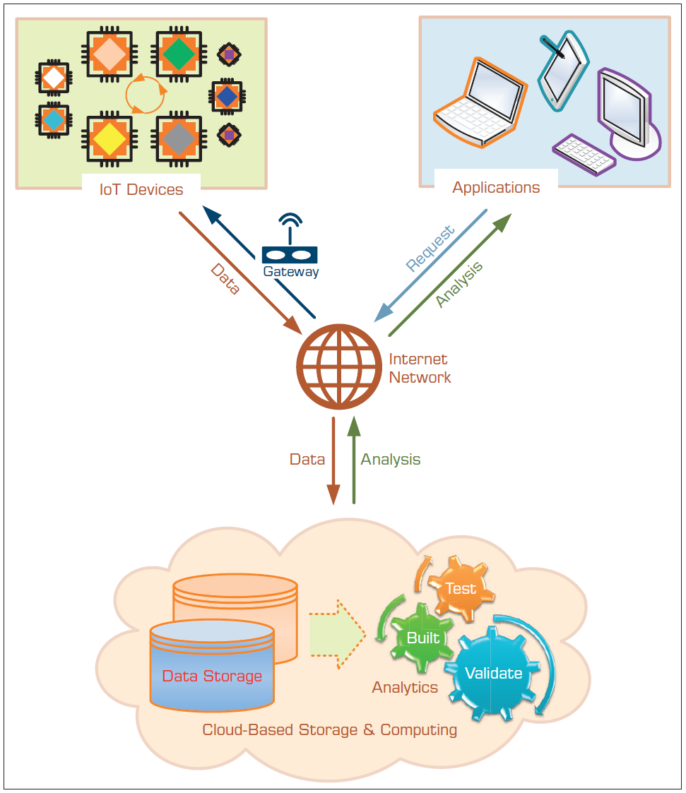
Building Blocks of I o T Technology Infrastructure

Slide 11
R F I D Sensors (1 of 2)
R F I D: radio-frequency identification
One of the earliest/disruptive sensor technologies
Part of a family of automatic identification technologies
Including ubiquitous barcodes and magnetic strips
The goal is to use radio-frequency waves to accurately and quickly identify objects
Use of R F I D is led/promoted by large retailers
Wal-Mart, Target, Dillard's

Slide 12
R F I D Sensors (2 of 2)
How does R F I D work?
Tag – a circuit attached to the product to be identified
Interrogator (i.e., reader) – with antennas and a computer to detect objects, store the data, and take due actions
Tags can be passive or active
Passive tag – small, inexpensive, no power source
Active tag – larger, more expensive, has power source
Which one is better?
Retail uses passive tags, others may use active tags
R F I D + Sensors can be used for perishable goods

Slide 13
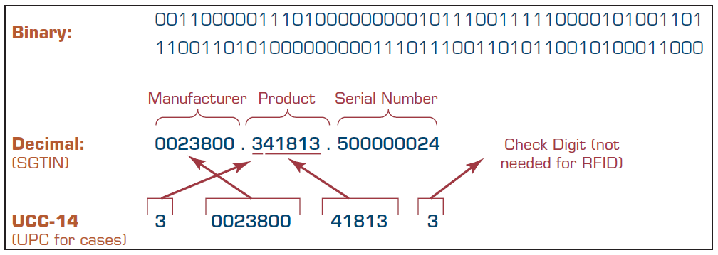
Data Representation in R F I D
Data representation for a given application domain
For Retail: Electronic Product Code (E P C)
R F I D tags contain 96 bits of data

Slide 14
Fog Computing
Data produced by I o T is huge in size (problem)
Fog computing is to address the issue by
Proposing fog nodes to process the data close to IoT
Fog nodes – any device including routers or switches
Table 8.1 Difference between Fog Nodes and a Cloud Platform
Fog Nodes | Cloud Platform
Receive data from I o T devices | Receives and aggregates data from fog nodes
Run I o T real-time analytics in millisecond response time | Analysis is performed on huge amounts of business data and can take hours or weeks
Data Center/Cloud → Fog Device → Physical Device (i.e., sensors that generate the data)

Slide 15
Other I o T Considerations
I o T Platforms – many large companies are in it
Amazon A W S I o T, Microsoft Azure I o T Suite, Predix I o T, Platform by General Electric (G E), I B M Watson I o T solutions, and Teradata Unified Data Architecture
I o T Start-up Ecosystem
Many start-up companies are emerging in the field of I o T
Examples include Sigfox, 3D Robotics, Canary, Athos, Greenwave, Jawbone, FreedomPop, Razer, and Ring
Fitbit – one of the most successful I o T startups
See Figure 8.3 for a pictorial representation of I o T Ecosystem

Slide 16
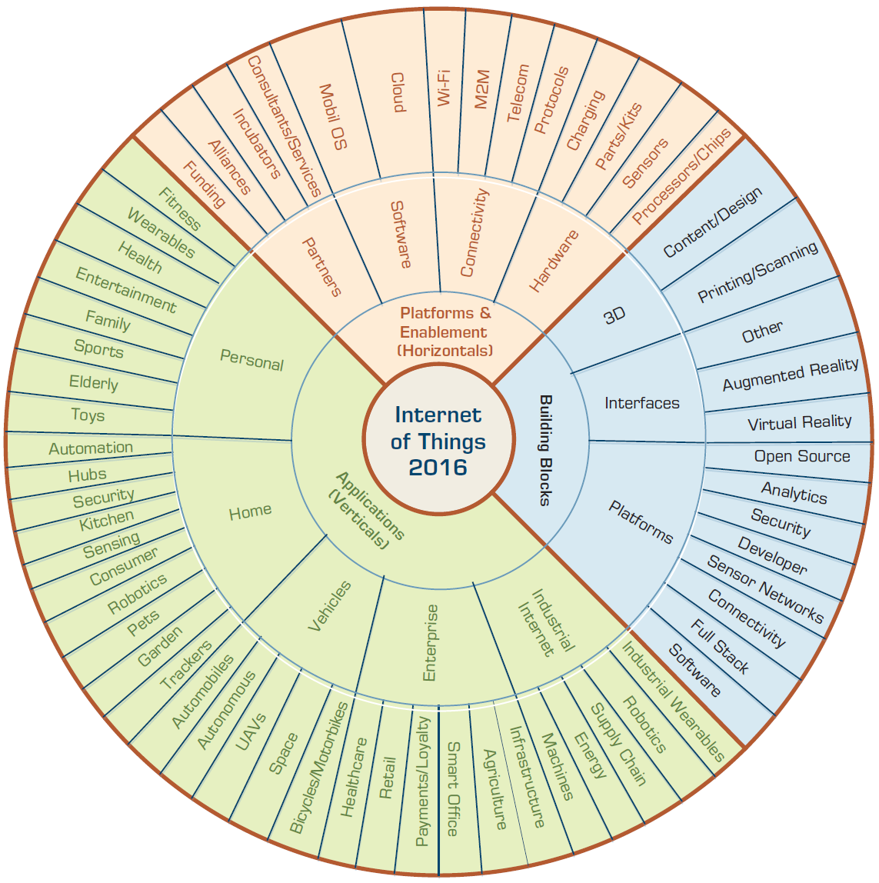
Internet of Things (I o T) Ecosystem

Slide 17
Managerial Considerations in the Internet of Things
Organizational Alignment
Interoperability Challenges
Security
Emerging growth of I o T and its potential to help us achieve the vision of smart cities, smart grid, smart anything

Slide 18
Cloud Computing and Business Analytics
A style of computing in which dynamically scalable and often virtualized resources are provided over the Internet.
Users need not have knowledge of, experience in, or control over the technology infrastructures in the cloud that supports them.
Cloud computing = utility computing, application service provider grid computing, on-demand computing, software-as-a-service (S a a S), …
Cloud = Internet
Related “-as-a-services”: infrastructure-as-a-service (I a a S), platforms-as-a-service (P a a S)

Slide 19
Cloud Computing Example (1 of 2)
Web-based e-mail → cloud computing application
Stores the data (e-mail messages)
Stores the software (e-mail programs)
Centralized hardware/software/infrastructure
Centralized updates/upgrades
Access from anywhere via a Web browser
e.g., Gmail
Web-based general application = cloud application
Google Docs, Google Spreadsheets, Google Drive,…
Amazon.com’s Web Services

Slide 20
Cloud Computing Example (2 of 2)
Cloud computing is used in
e-commerce, B I, C R M, S C M, …
Business model
Pay-per-use
Subscribe/pay-as-you-go
Companies that offer cloud-computing services
Google, Yahoo!, Salesforce.com
I B M, Microsoft (Azure)
Sun Microsystems/Oracle

Slide 21
Cloud Computing and Service-Oriented Thinking
Service-oriented thinking is one of the fastest-growing paradigms today
Toward building agile data, information, and analytics capabilities as services
Service orientation + D S S/B I
Component-based service orientation fosters
Reusability, Substitutability, Extensibility, Scalability, Customizability, Reliability, Low Cost of Ownership, Economy of Scale,…

Slide 22
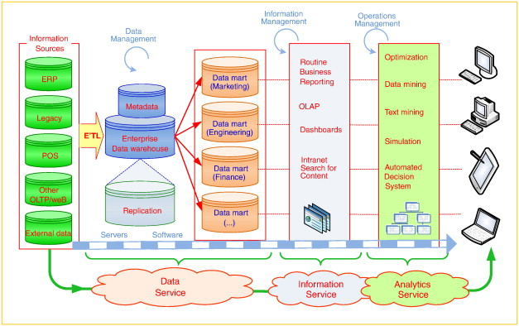
Service-Oriented D S S/B I

Slide 23
Variations of Service-Oriented Architecture and the Cloud
Data as a Service (D a a S)
Software as a Service (S a a S)
Platform as a Service (P a a S)
Infrastructure as a Service (I a a S)
…
Why so many .a a S is emerging?

Slide 24
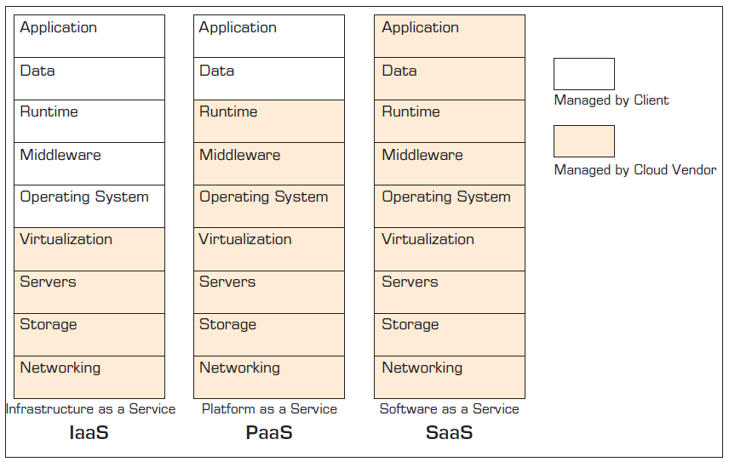
Different Types of Cloud Offerings

Slide 25
Essential Technologies for Cloud Computing
Virtualization
Creation of a virtual version of something like an operating system or server
Example: logical division of a hard drive to create two separate hard drives in a computer
Levels of virtualization
Network virtualization
Storage virtualization
Server virtualization
Relates to which cloud service is employed

Slide 26
Cloud Deployment Models
Private cloud
Public cloud
Hybrid cloud
Which cloud model is good for you?
Major cloud platform providers in analytics:
Amazon Elastic Beanstalk
I B M Bluemix
Microsoft Azure
Google App Engine
OpenShift

Slide 27
Representative Analytics as a Service Offering
Teradata - Aster Analytics as a Service
I B M Watson Analytics
MineMyText.com
S A S Visual Analytic and Visual Statistics
Tableau
Showflake
Predix by General Electric
→ Most of these have free/restricted/trial offerings

Slide 28
Illustrative Analytics Applications Employing the Cloud Infrastructure (1 of 2)
M D Anderson Cancer Center Utilizes Cognitive Computing Capabilities of I B M Watson to Give Better Treatment to Cancer Patients
Public School Education in Tacoma, Washington, Uses Microsoft Azure Machine Learning to Predict School Dropouts
Dartmouth-Hitchcock Medical Center Provides Personalized Proactive Healthcare Using Microsoft Cortana Analytics Suite

Slide 29
Illustrative Analytics Applications Employing the Cloud Infrastructure (2 of 2)
Mankind Pharma Uses I B M Cloud Infrastructure to Reduce Application Implementation Time by 98%
Gulf Air Uses Big Data to Get Deeper Customer Insight
Chime Enhances Customer Experience Using Snowflake

Slide 30
Location-Based Analytics (1 of 3)
Geospatial Analytics
Geocoding
Visual maps
Postal codes
Latitude & Longitude
Enables aggregate view of a large geographic area
Integrate “where” into customer view

Slide 31
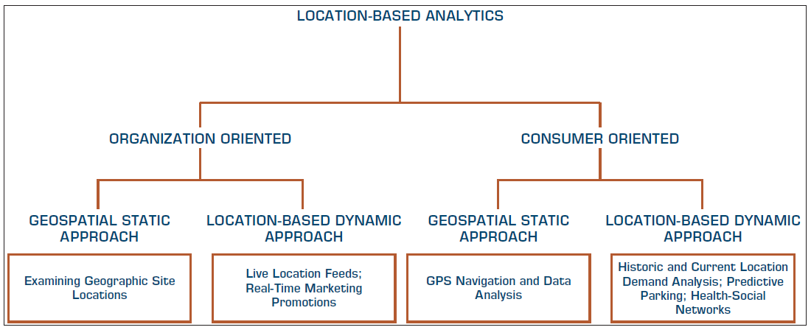
Location-Based Analytics (2 of 3)

Slide 32
Location-Based Analytics (3 of 3)
Location-based databases
Geographic Information System (G I S)
Used to capture, store, analyze, and manage the data linked to a location
Combined with integrated sensor technologies and global positioning systems (G P S)
Location Intelligence (L I)?
Interactive maps that further drill down to data/information details about any location

Slide 33
Use of Location-Based Analytics
Retailers – location + demographic details combined with other transactional data can help …
determine how sales vary by population level
assess locational proximity to other competitors and their offerings
assess the demand variations and efficiency of supply chain operations
analyze customer needs and complaints
better target different customer segments
…

Slide 34
G I S Applications
In addition to business/retail applications, G I S based analytics are being used in
Agricultural applications
Crime analysis
Disease spread prediction
For more applications, look at
esri.com (producer of Arc G I S)
grindgis.com
L I can be combined with weather and environmental data to create a richer data/information infrastructure

Slide 35
Application Case 8.4
Great Clips Employs Spatial Analytics to Shave Time in Location Decisions
Questions for Discussion
How is geospatial analytics employed at Great Clips?
What criteria should a company consider in evaluating sites for future locations?
Can you think of other applications where such geospatial data might be useful?

Slide 36
Application Case 8.5
Starbucks Exploits G I S and Analytics to Grow Worldwide
Questions for Discussion
What type of demographics and G I S information would be relevant for deciding on a store location?
It has been mentioned that Starbucks encourages its customers to use its mobile app. What type of information might the company gather from the app to help it better plan operations?
Will the availability of free Wi-Fi at Starbucks’ stores provide any information to Starbucks for better analytics?

Slide 37
A Multimedia Exercise in Analytics Employing Geospatial Analytics
Go To Teradata University Network (T U N)
Find the B S I Case video on “The Case of the Dropped Mobile Calls”
Watch the video via T U N or at YouTube youtube.com/watch?v=4WJR_Z3exw4
Also, look at the slides at slideshare.net/teradata/bsi-teradata-the-case-of-the-dropped-mobile-calls
Discuss the case

Slide 38
Real-Time Location Intelligence
Many devices are constantly sending out their location information
Cars, airplanes, ships, mobile phones, cameras, navigation systems, …
G P S, Wi-Fi, R F I D, cell tower triangulation
Reality mining?
Real-time location information = real-time insight
Path Intelligence (pathintelligence.com)
Footpath – movement patterns within a city or store
How to use such movement information

Slide 39
Application Case 8.6
Quiznos Targets Customers for Its Sandwiches
Questions for Discussion
How can location-based analytics help retailers in targeting customers?
Research similar applications of location-based analytics in the retail domain.

Slide 40
Analytics Applications for Consumers
Explosive growth of the apps industry
i O S, Android, Windows, Blackberry, Amazon, …
Directly used by consumers (not businesses)
Enabling consumers to become more efficient
Interesting Examples
CabSense – finding a taxi in New York City
Rating of street corners; interactive maps, …
Park P G H – finding a parking spot
Downtown Pittsburgh, Pennsylvania
App industry is already 25B in size and growing (wsj.com/apps)

Slide 41
Issues of Legality, Privacy, and Ethics (1 of 3)
Legal issues to consider
What is the value of an expert opinion in court when the expertise is encoded in a computer?
Who is liable for wrong advice (or information) provided by an intelligent application?
What happens if a manager enters an incorrect judgment value into an analytic application?
Who owns the knowledge in a knowledge base?
Can management force experts to contribute their expertise?

Slide 42
Issues of Legality, Privacy, and Ethics (2 of 3)
Privacy - The right to be left alone and the right to be free from unreasonable personal intrusions
Collecting information about individuals
How much is too much?
Mobile User Privacy
Location-based analysis/profiling
Homeland Security and Individual Privacy
Recent Issues in Privacy and Analytics
“What They Know” about you (wsj.com/wtk)
Rapleaf (rapleaf.com), X + 1 (xplusone.com), Bluecava (bluecava.com), reputation.com, sociometric.com...
Who owns our private data?

Slide 43
Issues of Legality, Privacy, and Ethics (3 of 3)
Ethics in Decision Making and Support
Electronic surveillance
Software piracy
Invasion of individuals’ privacy
Use of proprietary databases
Use of knowledge and expertise
Accessibility for workers with disabilities
Accuracy of data, information, and knowledge
Protection of the rights of users
Accessibility to information
Personal use of corporate computing resources
… more in the book

Slide 44
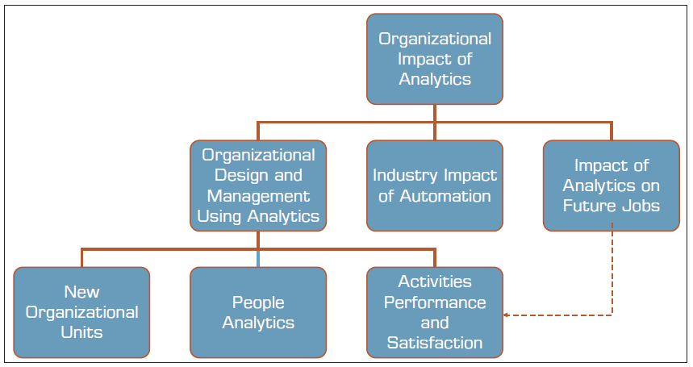
Impacts of Analytics in Organizations (1 of 2)
Analytics revolution → Cultural transformation

Slide 45
Impacts of Analytics in Organizations (2 of 2)
New Organizational Units
B I department
Data science department
Redesign of an Organization through the Use of Analytics
People analytics
H R analytics
Analytics Impact on Managers’ Activities, Performance, and Job Satisfaction
Data/fact/analytics driven decision

Slide 46
Potential Impacts of Analytics on Managers
Less expertise/experience is requirement
Faster decision making (augmented with analytics)
Less reliance on experts and analysts (data rules!)
Power is being redistributed among managers
Support for complex decisions makes them faster to develop and be of better quality
Information needed for high-level decision making is expedited or even self-generated
Automation of routine decisions or phases in the decision-making process may eliminate some managers

Slide 47
Impacts of Analytics in Organizations
Industrial Restructuring
A I, analytics, and cognitive computing can change the industry in a fundamental way
Automation’s Impact on Jobs
Data science and A I will change the nature of human jobs (another wave of automation is in the horizon)
Unintended Effects of Analytics
Social and long-term effects of the models
“Weapons of Math Destruction: How Big Data Increases Inequality and Threatens Democracy”

Slide 48
Data Scientist as a Profession
“The Sexiest Job of the 21st Century”
Thomas H. Davenport and D. J. Patil
Harvard Business Review, October 2012
Data Scientist = Big Data guru
One with skills to investigate Big Data
Very high salaries, very high expectations
Where do Data Scientists come from?
M.S./Ph.D. in M I S, C S, I E,… and/or Analytics
There is not a specific degree program for D S!
P E, P M L, … D S P (Data Science Professional)

Slide 49
Skills That Define a Data Scientist

Slide 50
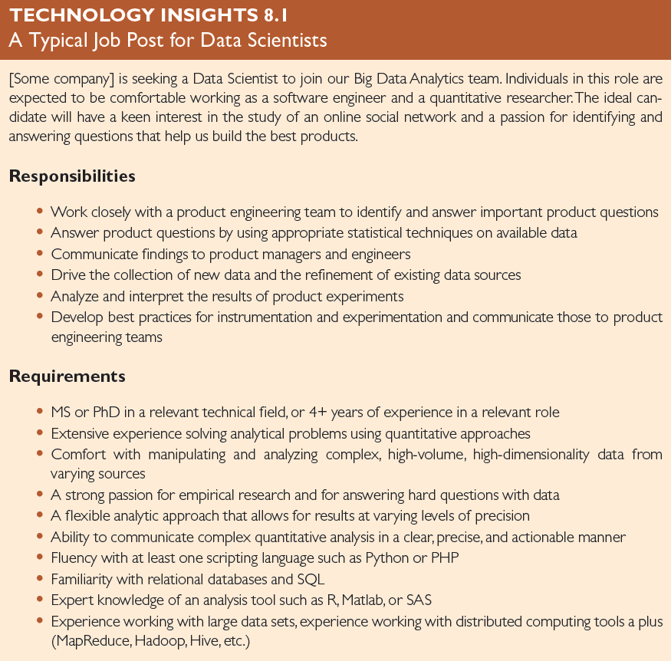
A Typical Job Post for Data Scientist

Slide 51
Statements about Data Scientists
Data scientists turn Big Data into big value, delivering products that delight users and insight that informs business decisions.
A data scientist is not only proficient in working with data, but also appreciates data itself as an invaluable asset.
By 2020 there will be 4.5 million new data scientist jobs, of which only one-third will be filled because of the lack of people available to fill them.
Today’s data scientists are the quants of the financial markets of the 1980s.

Slide 52
End of Chapter 8
Questions / Comments

Slide 53

Copyright

