Slide 1
ML Problem Statement - Predicting Garbage Collector Invocation
Team Name:yoKnockers
Institute:Indian Institute of Technology Guwahati

Slide 2
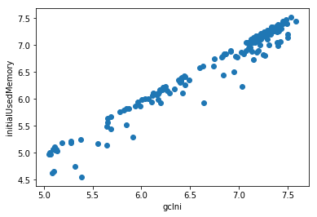
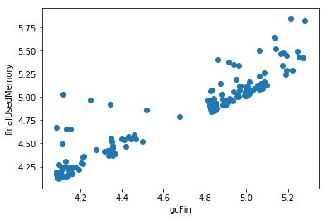
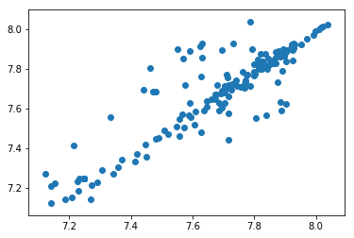
Plottings Made
GcTotalMemory was plotted on x axis and initialUsedMemory+initialFreeMemory was plotted on y axis.The plot shows good relationship between the 2 variables.
The gcInitialMemory was plotted in x axis with initialUsedMemory. The plot shows us that there is a good
linear relationship between the 2 variabes.
The gcFinalMemory was plotted in x axis with finalUsedMemory. The plot shows us that there is a good
linear relationship between the 2 variabes.

Slide 3
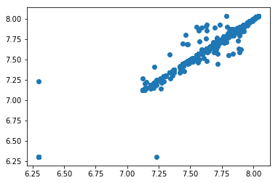
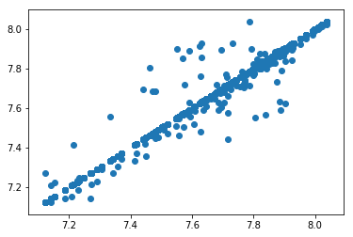
The finalUsedMemory+finalFreeMemory was plotted in x axis with initialUsedMemory+initialFreeMemory.
The plot shows us that there is a good
linear relationship between the 2 variables.
We can see 3 outliers
The finalUsedMemory+finalFreeMemory was plotted in x axis with initialUsedMemory+initialFreeMemory. The plot shows us that there is a good linear relationship between the 2 variabes after we remve those see 3 outliers.

Slide 4
Approximations Used:
Following approximations were made:
gcInitialMemory = initialUsedMemory
GcFinalMemory = finalUsedMemory
GcTotalMemory = finalUsedMemory+finalFreeMemory = initialUsedMemory + initialFreeMemory
Assumptions Used:
We were required to print the memory free after every query is served but he heading of that column was given as initialFreeMemory which we take it as finalFreeMemory

Slide 5
MODELS USED
LOGISTIC REGRESSION:
Following the plots and approximations we predicted:
gcInitialMemory using linear regression with initialUsedMemory
finalUsedMemory using linear regression with resources+initialUsedMemory
gcTotalMemory using linear regression with initialUsedMemory+initialFreeMemory
FinalFreeMemory using linear regression with initialFreeMemory+initialUsedMemory-finalUsedMemory

Slide 6
XGBOOST
Xgboost was used to determine the ‘gcRun’. We gave parameters to xgboost as: ‘resources’, ‘initialMemoryUsed’, ‘initialMemoryFree’, ‘cpuTimeTaken’.
We chose this model as the output was not in linearly related to the parameters. We confirmed this creating a cross validation set and checking the accuracy of a linear model such as logistic regression, linear SVM( both hard-margin and soft-margin). The result came to be very poor. We also tried SVM with ‘rbf’ kernel, which wasn’t much an improvement from the linear models.
So we applied Xgboost was the best among the other models due to the nonlinear relationship between taget and parameters. Xgboost being an ensemble method has the added advantage of not being overfitted easily while preserving the accuracy.

Slide 7
Strategy for deciding the results
To predict ‘gcRun’:
We used the xgboost to predict ‘gcRun’. We supplied ‘resources’ feature to the xgboost algorithm by saved value of resources that we obtained from the training set. Eg: token_53 had ‘resources’ as 0.047545312750000325 which was obtained from training set.
To predict ‘initialFreeMemory’:
We computed initialFreeMemory as previous query’s finalFreeMemory
We computed initialUsedMemory as previous query’s finalUsedMemory
We computed gcInitialMemory as initialFreeMemory of same query
We computed gcTotalMemory as initialFreeMemory+initialUsedMemory of same query
We computed finalUsedMemory as resources+initialUsedMemory of same query
We computed finalFreeMemory as initialFreeMemory+initialUsedMemory-finalUsedMemory of same query
This finalFreeMemory then becomes the output for that query as the initialFreeMemory

