Slide 1
Optimal Bidding

Slide 2
Public:292862 Private:500672
+91 820 956 7841

Slide 3
Task
Our aim was to minimise the electricity bill for a gated community, by making bids for the delivery of electricity in the day ahead market.
The gated community receives its energy from the day ahead market, a solar plant, a battery which stores excess electricity and the DISCOM (at a fixed per unit cost)

Slide 4
Problem Constraints
The actual demand of all consumers must be fulfilled at any cost from one of the four sources
Order of preference of sources:
Solar plant > Day ahead market > Battery > DISCOM
Battery has certain efficiency, a limited charging and discharging capacity

Slide 5
Problem Assumption
The battery can charge to its full capacity of 25KWh and discharge to a zero state of charge
In a block, the battery charges automatically when the supply from the solar plant and the electricity market exceeds the demand and vice versa
The efficiency of the battery and the inverter is fixed at 80% and 100% respectively.
The market is large enough that the effect of the bid made by the community on the market prices is negligible

Slide 6
Goals
We have two major goals
Accurately predict the energy available from the solar plant, the actual price and demand
Use the battery to lower the bill by buying more electricity when the prices are low and less when the prices are higher

Slide 7
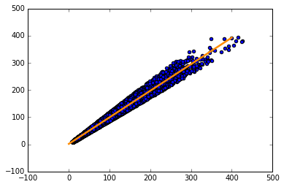
Visualisation
Demand actual vs Demand predictions

Slide 8
Solar actual vs Solar predictions

Slide 9
Price actual vs Price predictions

Slide 10
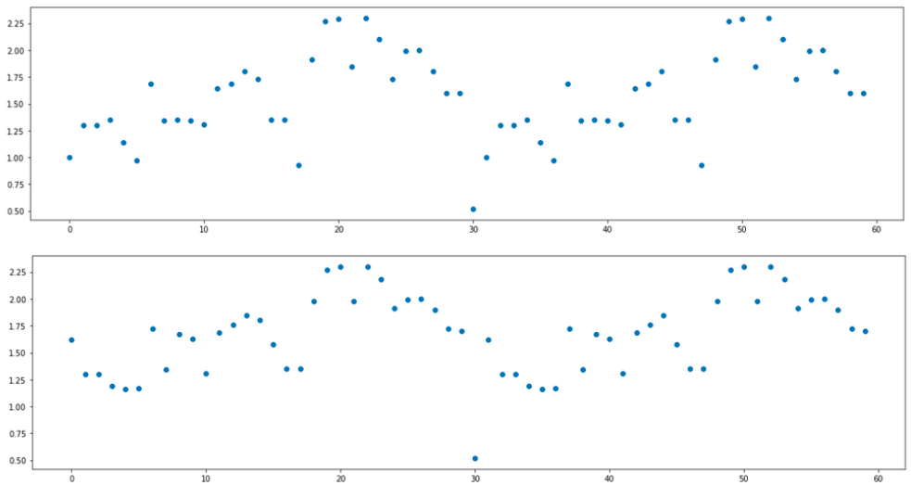
Periodicity of prices

Slide 11
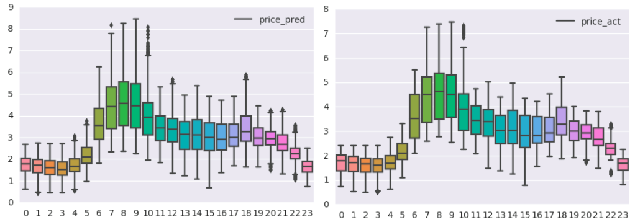
Variation of prices in a day

Slide 12
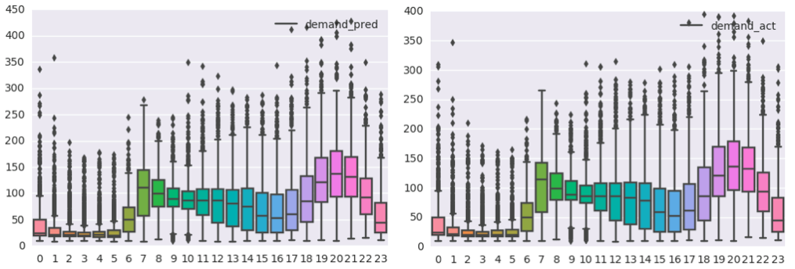
Variation of demand in a day

Slide 13
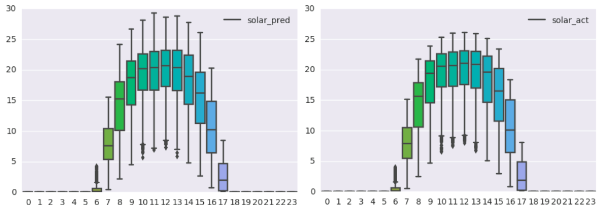
Variation of solar in a day

Slide 14
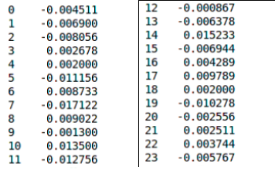
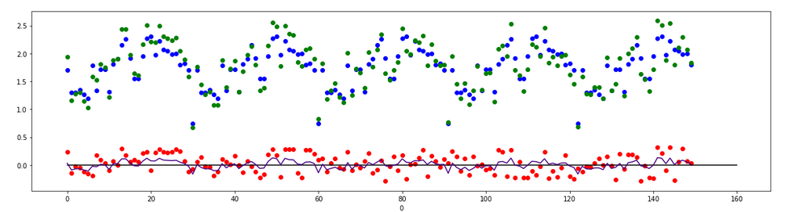
Mean of actual price - Mean of predicted price for all hours
Time series of actual price and predicted price and their difference

Slide 15
Hypothesis
Linear reg might be suitable as seen from the linear nature of the plot between the oracle predictions and actual values for all 3 features
KNN might be suitable as there is repetition in the price and solar datasets
Time series analysis may be beneficial in increasing the accuracy of price and solar
R2 score might not be enough as our final objective is to minimise the bill

Slide 16
Modelling
We tried a grid search on sklearn linear regression models for all 3 features
We tried making 24 models for each hour in a given day
We also tried ravelling the data and making a single model for each feature
We found that KNN Regressors on solar and price perform better than linear models
The grid search suggested that ElasticNetCV will be suitable for predicting demand and KNNRegressor for price and solar

Slide 17
Cross validation
We used KFold cross validation with 18 folds on the training data to obtain optimal hyper-parameters.
We found using 4 and 9 nearest neighbours for price and solar respectively gave the most accurate results
We also found that passing all the prices of a day at once (24 feature) for predicting using KNN increased performance
However we soon realised that R2 scores alone weren’t sufficient for building a good model, so we made our own scoring script which allowed us to experiment with additional parameters further and avoid overfitting on the leaderboard and training data

Slide 18
Over estimating the prices was logically better than underestimating the prices as losing the bid increases the penalty exponentially. So in order to win the bids maximum times we added the standard deviation of the difference between the actual and predicted prices where the difference was greater then 0. Through cross validation we also found that adding 0.34 to this price decreases the score further
Now for the prices above 7 we clip them to 6.8 as we would be getting electricity at 7 through DISCOM in worst case

Slide 19
Battery Modelling
Since there was no data for training the action of battery in a block, we solved problems based on battery charging on small data on pen and paper.
We found some patterns while solving those problem and formulated an algorithm which efficiently computed the action of battery given all the prices of the blocks

Slide 20
Battery Performance on sample data
Yellow - No charge
Green - Charge
Red - Discharge

Slide 21
Battery Algorithm
The algorithm is recursive in nature
Step 1: Arrange the prices of blocks in an array
Step2: Find the maxima and minima prices in the array
Step 2.1: If the min pos<max pos:
If while charging at min if the battery value>=0:
If while discharging at max the battery value<=25:
Charge at min and discharge at max
Step 2.2: If the min pos > max pos:
Count charge till max pos and store it in variable, say X.
Check if we charge at this min, there are at most X discharging points between max and min positions
Step 3: If none of Step 2.1 and Step 2.2 are satisfied then jump to Step 2 by finding the next minima point
Step 4: The process repeated until a block is classified as a block to be charged , discharged or no action.

Slide 22
Thank You

