Slide 1

Auto-SCMA: Learning Codebook for Sparse Code Multiple Access using Machine Learning
Indian Institute Of Technology Guwahati | Department of Electronics and Electrical Engineering
Ekagra Ranjan*, Ameya Vikram*, Dr. A. Rajesh, Prof. P.K Bora

Slide 2
Background
Mobile communication multiple access techniques:
Orthogonal Multiple Access Techniques, e.g., CDMA, OFDMA:
Number of users <= number of orthogonal resources
Orthogonal allocation of resources to each user
Non-Orthogonal Multiple Access Techniques, e.g., LDS, SCMA
Number of users > number of orthogonal resources
No constraint of orthogonality
Sparse Code Multiple Access (SCMA):
Makes use of sparsity of resource allocation to users to enable a Message Passing Algorithm (MPA) decoder of feasible complexity at the receiver.

Slide 3
SCMA
J independent users, K orthogonal resources and M-ary symbols where J > K. For illustrations that follow: J=6 users, K=4 resources, M=4 symbols.
Input Symbol
Sparse Codeword Mapping
Channel
MPA decoding
Decoded Symbol
x_{j}
c_{j}
h_{j}c_{j} + n
x̂_{j}

Slide 4
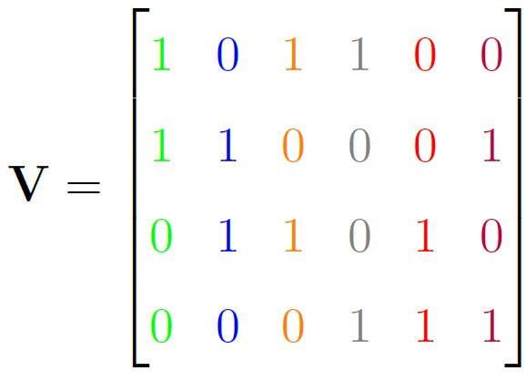
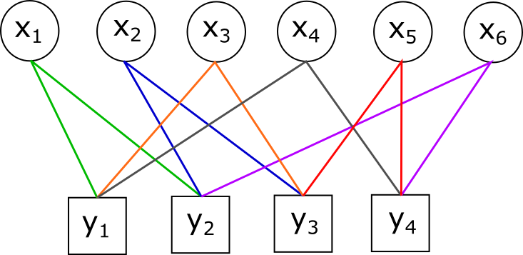
SCMA: Factor Graph
Factor Graph V, denotes the resource allocation in a sparse manner and determines the complexity of MPA decoders. Connections from each user is denoted by different colors.

Slide 5
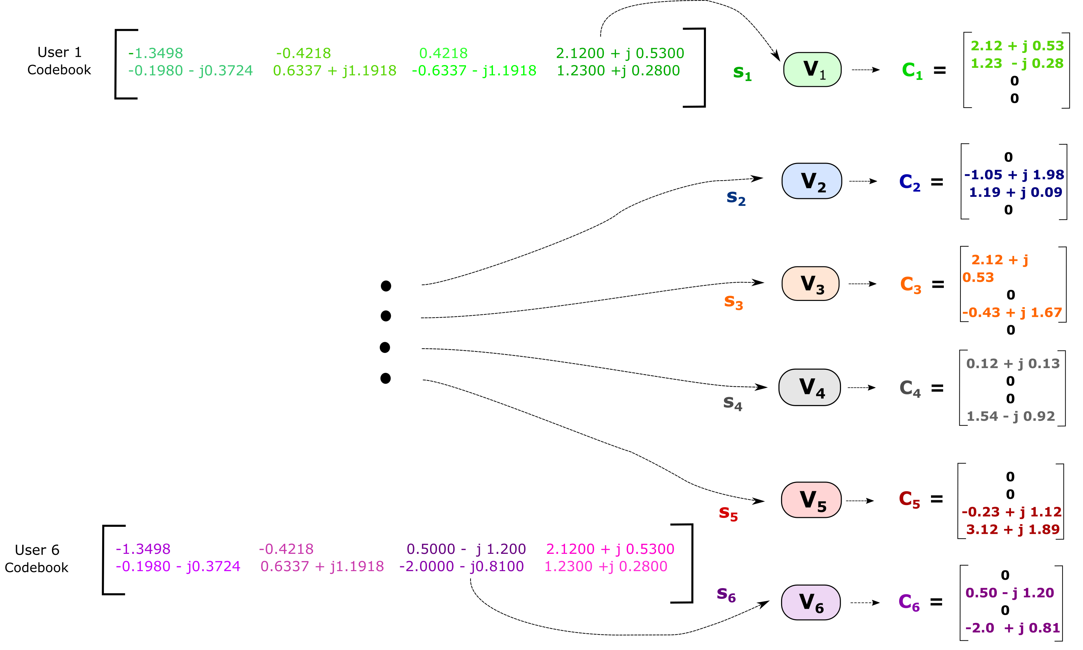
SCMA: Encoding
Factor graph V maps codewords to a sparse higher dimension.

Slide 6
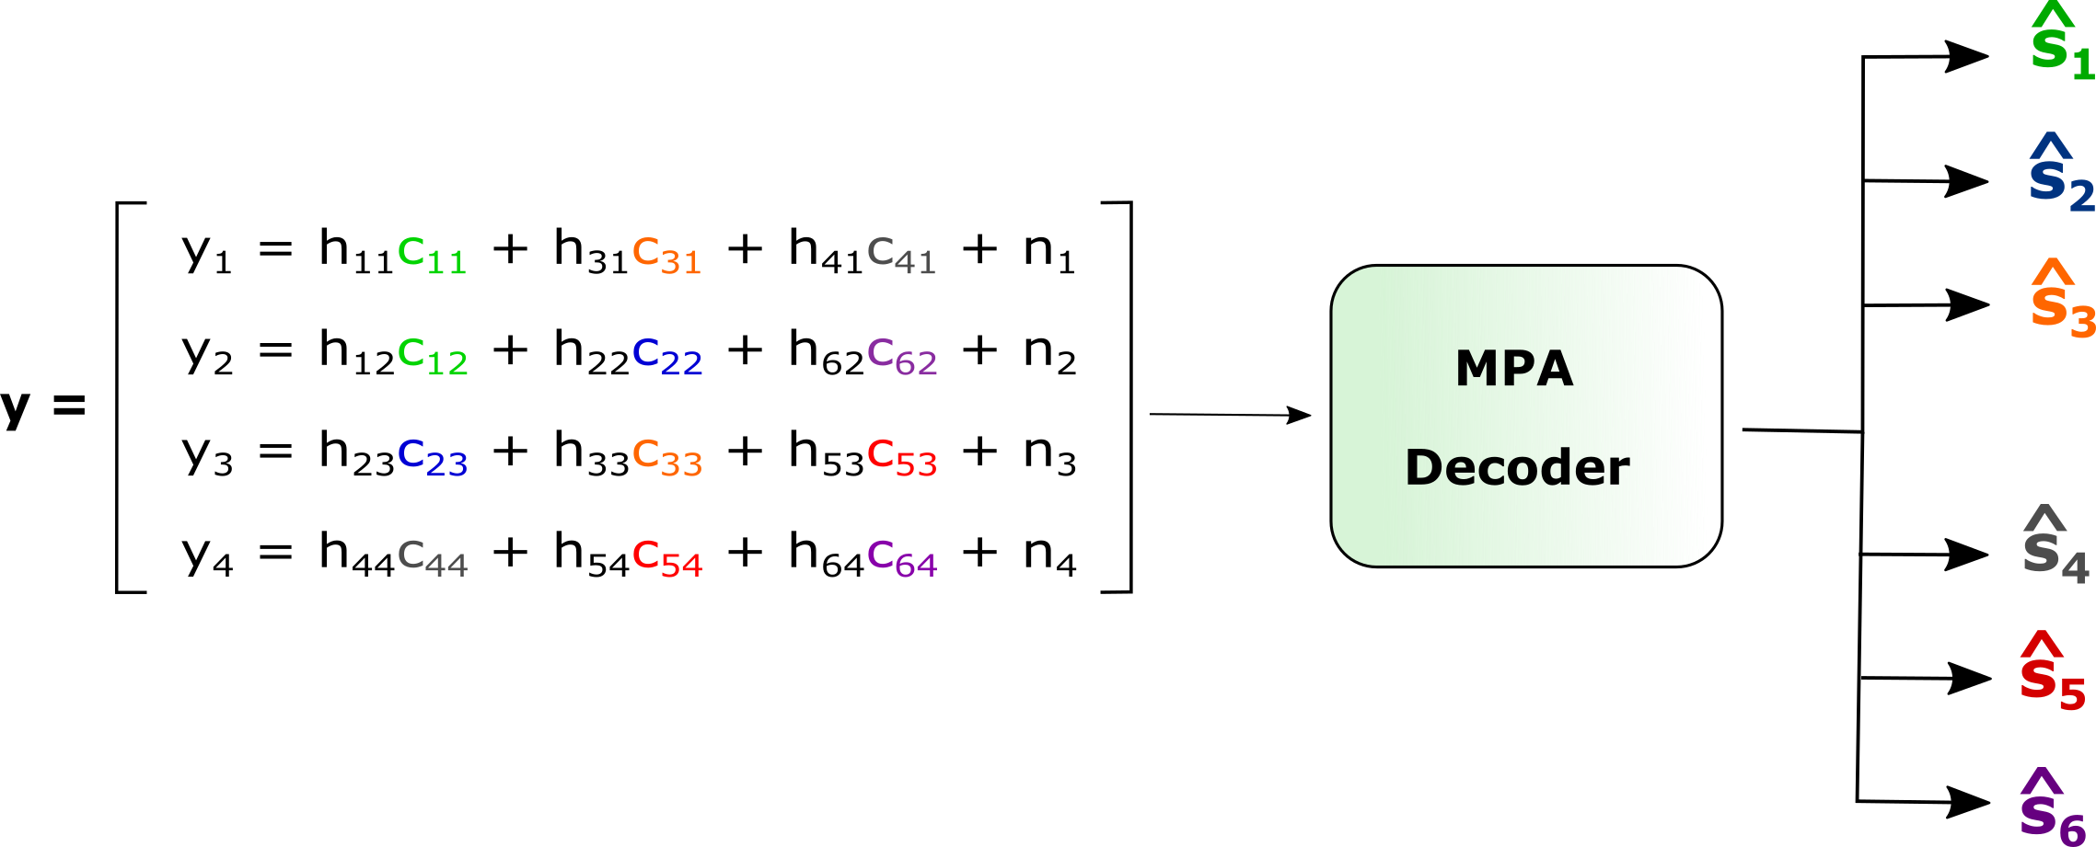
SCMA: Decoding
The MPA decoder uses y obtained from channel to decode the user symbols.

Slide 7
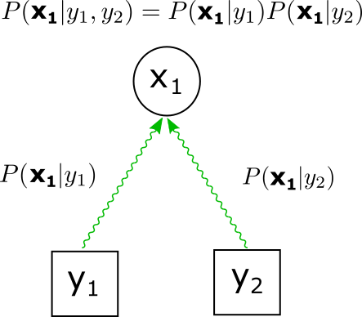
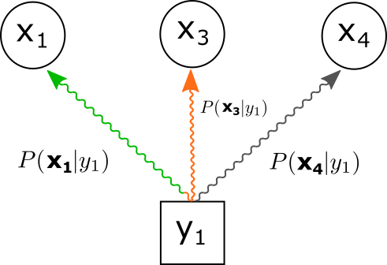
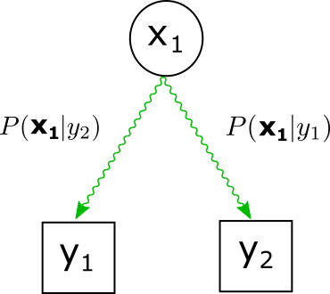
SCMA Decoding: MPA
Resource nodes and user nodes iteratively pass messages to each other to update their belief. Finally, the output probability of users’ symbols is obtained from the messages coming to it from resources.
Resource to User
User to Resource
Output

Slide 8
Drawbacks of Conventional SCMA
Hand crafted codebook:
No specific procedure of codebook design
Based on heuristics to large extent
Requires a lot of time and effort for any new system configuration
Decoder independent codebook design: Does not utilize any knowledge about the decoder to reduce error rates
Notes:
Find better word for hand-designed codebook

Slide 9
Machine Learning in SCMA
By modelling the communication system with a set of parameters :
Learn the codebook without any human intervention
Codebook design can take advantage of the decoder characteristic
Previous works using machine learning for SCMA :
D-SCMA [1]: Uses a DNN autoencoder.
Significantly lower error rate on AWGN channel
Compute and memory intensive decoder (> 1 million operations)
DNN-MPA [2]: Adds trainable weights to the edges of factor graph
Decoder complexity similar to MPA
Marginal improvements of SCMA (on AWGN)
[1]: Minhoe Kim et. al. Deep learning-aided scma.IEEE Communications Letters, 22(4):720–723, 2018
[2]: Chao Lu et. al.. An enhanced scma detector enabled by deep neural network. IEEE/CIC International Conference on Communications in China (ICCC), pages 835–839. IEEE, 2018

Slide 10
Auto-SCMA
(Automatic SCMA)

Slide 11
Auto-SCMA: Motivation
Problems:
Current Machine Learning based decoders perform better than MPA on AWGN channel but fail to generalize on Rayleigh fading channel.
MPA works effectively on Rayleigh fading channel but needs hand-crafted codebook
Proposed Solution (Auto-SCMA):
Uses MPA decoder
Based on crucial observation that all the operations in MPA are differentiable
Uses gradient descent algorithm to obtain a codebook with MPA decoder
Works on Rayleigh fading channel while learning the codebook automatically from data

Slide 12
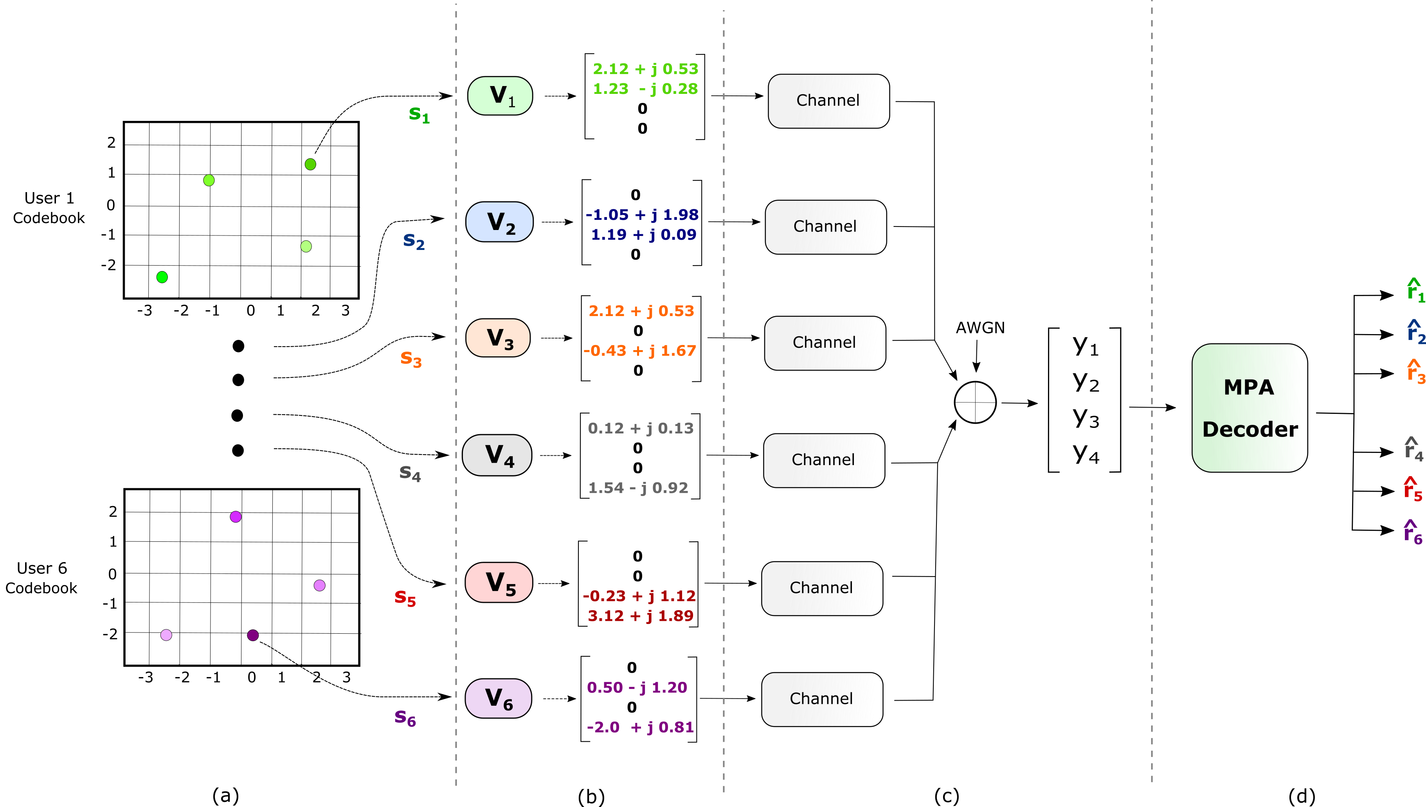
Auto-SCMA: Forward Pass / Inference

Slide 13
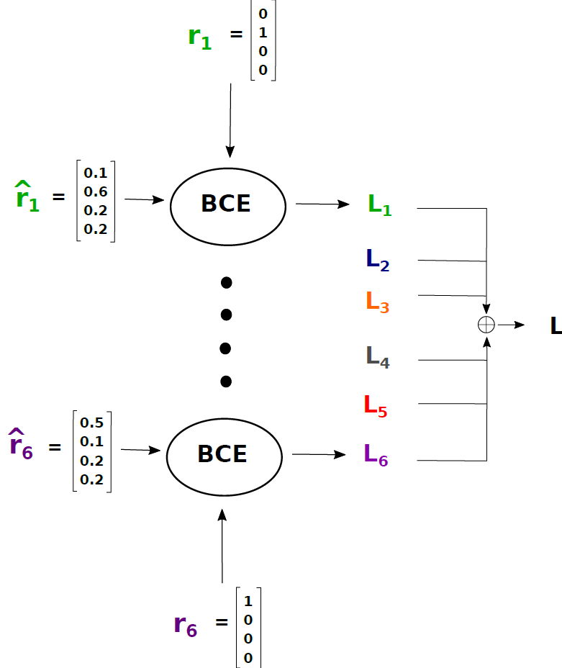
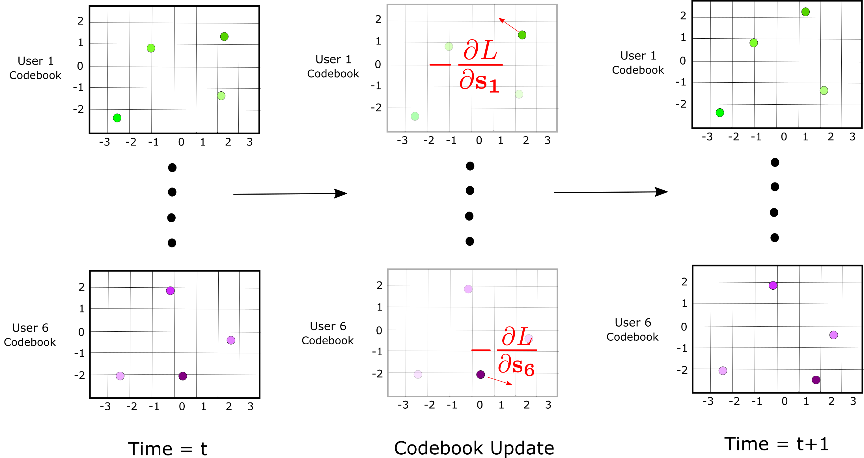
Auto-SCMA: Backward Pass
Loss Calculation
Codebook Update using Gradient Descent

Slide 14
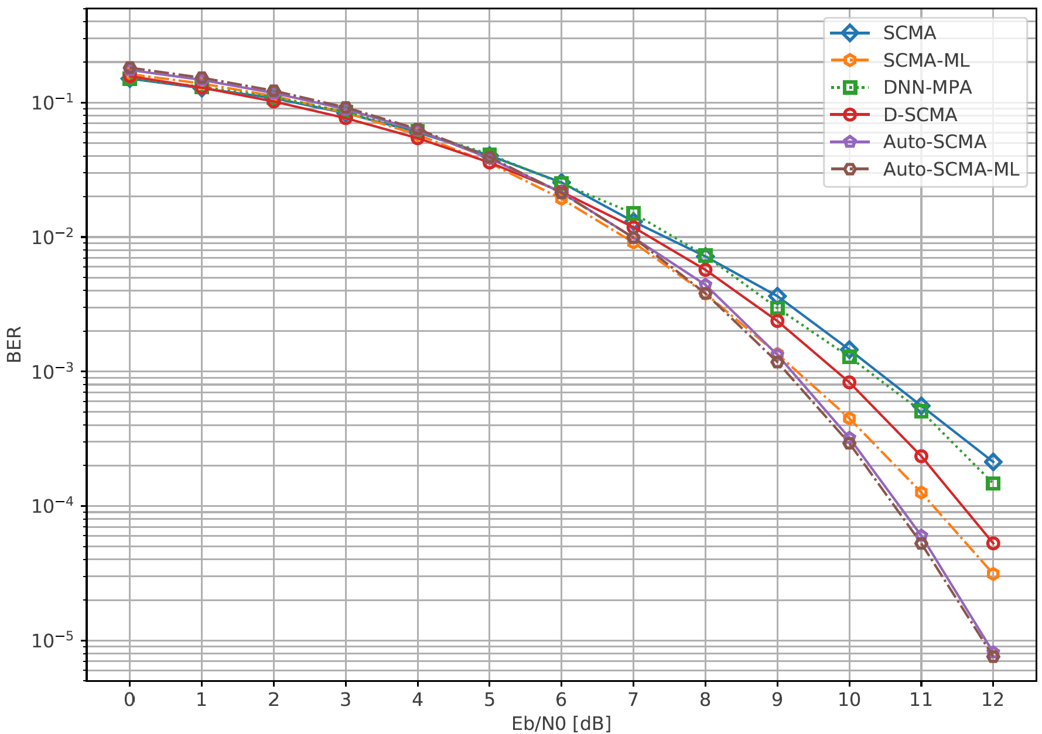
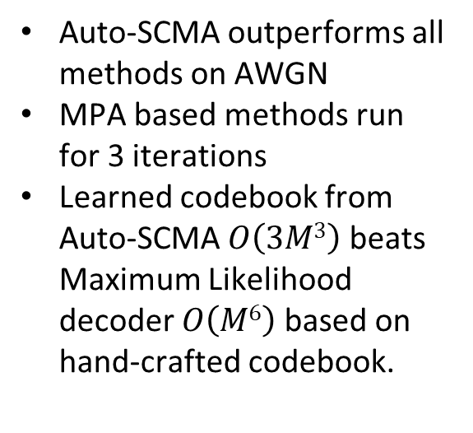
Auto-SCMA: Results (AWGN Channel)
Auto-SCMA outperforms all methods on AWGN
MPA based methods run for 3 iterations
Learned codebook from Auto-SCMA $O\left(3M3\right)$ beats Maximum Likelihood decoder $O\left(M6\right)$ based on hand-crafted codebook.

Slide 15
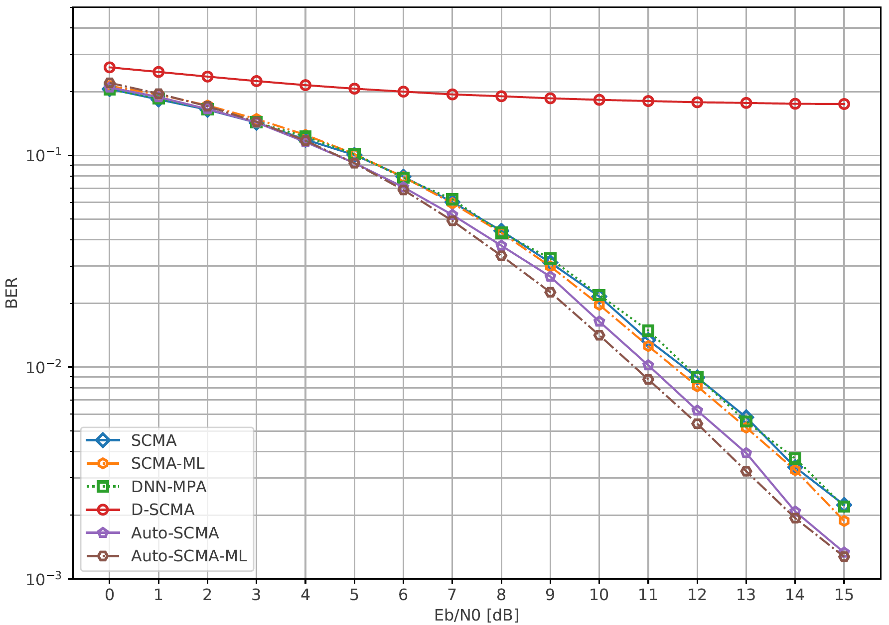
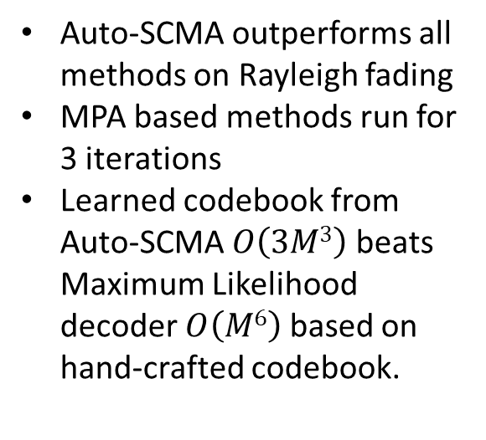
Auto-SCMA: Results (Rayleigh fading Channel)
Auto-SCMA outperforms all methods on Rayleigh fading
MPA based methods run for 3 iterations
Learned codebook from Auto-SCMA $O\left(3M3\right)$ beats Maximum Likelihood decoder $O\left(M6\right)$ based on hand-crafted codebook.

Slide 16
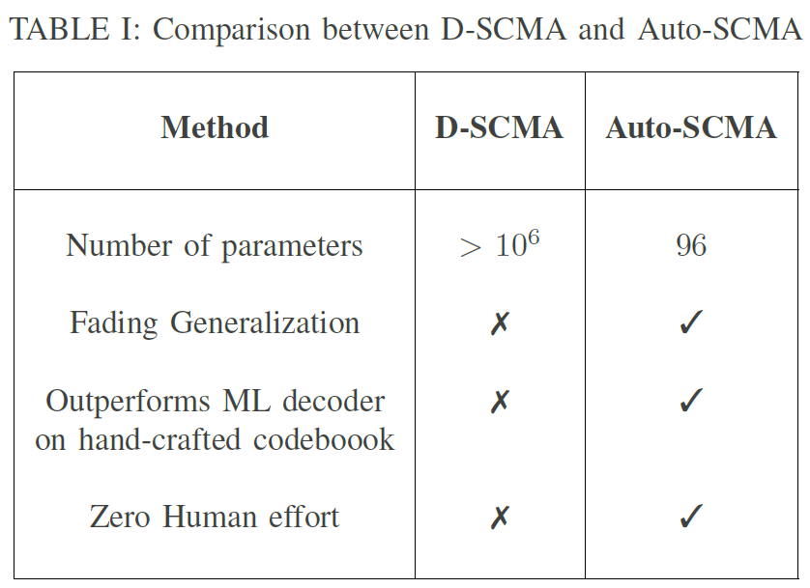
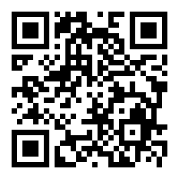
Summary
Learns an effective codebook automatically from data using gradient descent
Generalizes on both AWGN and Rayleigh fading channels
Improves the conventional SCMA without increasing the runtime complexity
Zero human effort in code book designing for arbitrary system requirements
Outperforms ML-decoder when the codebook was hand-crafted
Code will be available soon on github.com/ekagra-ranjan/Auto-SCMA

