Slide 1
Cryptography and Network Security
Chapter 12
Fifth Edition
by William Stallings
Lecture slides by Lawrie Brown
Notes:
Lecture slides by Lawrie Brown for “Cryptography and Network Security”, 5/e, by William Stallings, Chapter 12 – “Message Authentication Codes”.

Slide 2
Chapter 12 – Message Authentication Codes
At cats' green on the Sunday he took the message from the inside of the pillar and added Peter Moran's name to the two names already printed there in the "Brontosaur" code. The message now read: “Leviathan to Dragon: Martin Hillman, Trevor Allan, Peter Moran: observe and tail.” What was the good of it John hardly knew. He felt better, he felt that at last he had made an attack on Peter Moran instead of waiting passively and effecting no retaliation. Besides, what was the use of being in possession of the key to the codes if he never took advantage of it?
—Talking to Strange Men, Ruth Rendell
Notes:
Opening quote.

Slide 3

Message Authentication
message authentication is concerned with:
  protecting the integrity of a message
  validating identity of originator
  non-repudiation of origin (dispute resolution)
will consider the security requirements
then three alternative functions used:
  hash function (see Ch 11)
  message encryption
  message authentication code (MAC)
Notes:
One of the most fascinating and complex areas of cryptography is that of message authentication and the related area of digital signatures. We now consider how to protect message integrity (ie protection from modification), as well as confirming the identity of the sender. Generically this is the problem of message authentication, and in eCommerce applications is arguably more important than secrecy. Message Authentication is concerned with: protecting the integrity of a message, validating identity of originator, & non-repudiation of origin (dispute resolution). There are three types of functions that may be used to produce an authenticator: a hash function, message encryption, message authentication code (MAC). Hash functions, and how they may serve for message authentication, are discussed in Chapter 11. The remainder of this section briefly examines the remaining two topics. The remainder of the chapter elaborates on the topic of MACs.

Slide 4











Message Security Requirements
disclosure
traffic analysis
masquerade
content modification
sequence modification
timing modification
source repudiation
destination repudiation
Notes:
In the context of communications across a network, the attacks listed above can be identified, with more detail given in the text. The first two requirements techniques (Disclosure: Release of message contents; and Traffic analysis: Discovery of the pattern of traffic between parties) belong in the realm of message confidentiality, and are handled using the encryption already discussed. Measures to deal with items 3 through 6 (Masquerade: Insertion of messages into the network from a fraudulent source; Content modification: of the contents of a message; Sequence modification: to a sequence of messages between parties; and Timing modification: Delay or replay of messages) are generally regarded as message authentication. Mechanisms for dealing specifically with item 7 (Source repudiation: Denial of transmission of message by source) come under the heading of digital signatures. Generally, a digital signature technique will also counter some or all of the attacks listed under items 3 through 6. Dealing with item 8 (Destination repudiation: Denial of receipt of message by destination) may require a combination of the use of digital signatures and a protocol designed to counter this attack.
In summary, message authentication is a procedure to verify that received messages come from the alleged source and have not been altered. Message authentication may also verify sequencing and timeliness. A digital signature is an authentication technique that also includes measures to counter repudiation by the source.

Slide 5

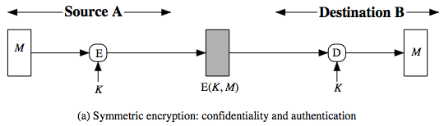

Symmetric Message Encryption
encryption can also provides authentication
if symmetric encryption is used then:
  receiver know sender must have created it
  since only sender and receiver now key used
  know content cannot of been altered
  if message has suitable structure, redundancy or a checksum to detect any changes
Notes:
Message encryption by itself can provide a measure of authentication. The analysis differs for symmetric and public-key encryption schemes.
If use symmetric encryption, If no other party knows the key, then confidentiality is provided. As well, symmetric encryption provides authentication as well as confidentiality, since only the other party can have encrypted a properly constructed message (Stallings Figure 12.1a). Here, the ciphertext of the entire message serves as its authenticator, on the basis that only those who know the appropriate keys could have validly encrypted the message. This is provided you can recognize a valid message (ie if the message has suitable structure such as redundancy or a checksum to detect any changes).

Slide 6
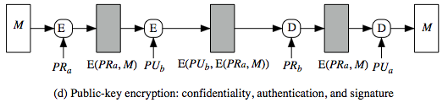
Public-Key Message Encryption
if public-key encryption is used:
  encryption provides no confidence of sender
    since anyone potentially knows public-key
  however if
    sender signs message using their private-key
    then encrypts with recipients public key
    have both secrecy and authentication
  again need to recognize corrupted messages
  but at cost of two public-key uses on message
Notes:
With public-key techniques, can use a digital signature which can only have been created by key owner to validate the integrity of the message contents. To provide both confidentiality and authentication, A can encrypt M first using its private key, which provides the digital signature, and then using B's public key, which provides confidentiality (Stallings Figure 12.1d). The disadvantage of this approach is that the public-key algorithm, which is complex, must be exercised four times rather than two in each communication.

Slide 7



Message Authentication Code (MAC)
generated by an algorithm that creates a small fixed-sized block
  depending on both message and some key
  like encryption though need not be reversible
appended to message as a signature
receiver performs same computation on message and checks it matches the MAC
provides assurance that message is unaltered and comes from sender
Notes:
An alternative authentication technique involves the use of a secret key to generate a small fixed-size block of data, known as a cryptographic checksum or MAC that is appended to the message. This technique assumes that two communicating parties, say A and B, share a common secret key K. A MAC function is similar to encryption, except that the MAC algorithm need not be reversible, as it must for decryption.

Slide 8
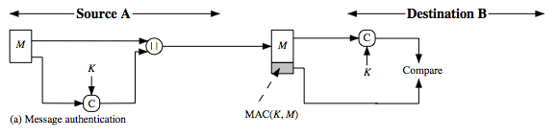
Message Authentication Code
a small fixed-sized block of data
  generated from message + secret key
  MAC = C(K,M)
  appended to message when sent
Notes:
An alternative authentication technique involves the use of a secret key to generate a small fixed- size block of data, known as a cryptographic checksum or MAC that is appended to the message. This technique assumes that two communicating parties, say A and B, share a common secret key K. When A has a message to send to B, it calculates the MAC as a function of the message and the key: MAC = C(K, M). The message plus MAC are transmitted to the intended recipient. The recipient performs the same calculation on the received message, using the same secret key, to generate a new MAC. The received MAC is compared to the calculated MAC (Stallings Figure 12.4a). If we assume that only the receiver and the sender know the identity of the secret key, and if the received MAC matches the calculated MAC, then the receiver is assured that the message has not been altered, is from the alleged sender, and if the message includes a sequence number then the receiver can be assured of the proper sequence because an attacker cannot successfully alter the sequence number. A MAC function is similar to encryption. One difference is that the MAC algorithm need not be reversible, as it must for decryption. In general, the MAC function is a many-to-one function.

Slide 9
Message Authentication Codes
as shown the MAC provides authentication
can also use encryption for secrecy
  generally use separate keys for each
  can compute MAC either before or after encryption
  is generally regarded as better done before
why use a MAC?
  sometimes only authentication is needed
  sometimes need authentication to persist longer than the encryption (eg. archival use)
note that a MAC is not a digital signature
Notes:
The process depicted on the previous slide provides authentication but not confidentiality, because the message as a whole is transmitted in the clear. Confidentiality can be provided by performing message encryption either after (see Stallings Figure 12.4b) or before (see Stallings Figure 12.4c) the MAC algorithm. In both these cases, two separate keys are needed, each of which is shared by the sender and the receiver. Typically, it is preferable to tie the authentication directly to the plaintext, so the method of Figure 12.4b is used. Can use MAC in circumstances where just authentication is needed (or needs to be kept), see text for examples (e.g. such as when the same message is broadcast to a number of destinations; when one side has a heavy load and cannot afford the time to decrypt all incoming messages; or do not need to keep messages secret, but must authenticate messages). Finally, note that the MAC does not provide a digital signature because both sender and receiver share the same key.

Slide 10
MAC Properties
a MAC is a cryptographic checksum
  MAC = C_{K}(M)
  condenses a variable-length message M
  using a secret key K
  to a fixed-sized authenticator
is a many-to-one function
  potentially many messages have same MAC
  but finding these needs to be very difficult
Notes:
A MAC (also known as a cryptographic checksum, fixed-length authenticator, or tag) is generated by a function C. The MAC is appended to the message at the source at a time when the message is assumed or known to be correct. The receiver authenticates that message by re-computing the MAC.
The MAC function is a many-to-one function, since potentially many arbitrarily long messages can be condensed to the same summary value, but don’t want finding them to be easy (see text for discussion)!

Slide 11
Requirements for MACs
taking into account the types of attacks
need the MAC to satisfy the following:
  knowing a message and MAC, is infeasible to find another message with same MAC
  MACs should be uniformly distributed
  MAC should depend equally on all bits of the message
Notes:
In assessing the security of a MAC function, we need to consider the types of attacks that may be mounted against it. Hence it needs to satisfy the listed requirements.
The first requirement deals with message replacement attacks, in which an opponent is able to construct a new message to match a given MAC, even though the opponent does not know and does not learn the key.
The second requirement deals with the need to thwart a brute-force attack based on chosen plaintext.
The final requirement dictates that the authentication algorithm should not be weaker with respect to certain parts or bits of the message than others.

Slide 12
Security of MACs
like block ciphers have:
brute-force attacks exploiting
  strong collision resistance hash have cost 2^{m/2}
    128-bit hash looks vulnerable, 160-bits better
  MACs with known message-MAC pairs
    can either attack keyspace (cf key search) or MAC
    at least 128-bit MAC is needed for security
Notes:
Just as with symmetric and public-key encryption, we can group attacks on hash functions and MACs into two categories: brute-force attacks and cryptanalysis.
A brute-force attack on a MAC is a more difficult undertaking than a brute-force attack on a hash function because it requires known message-tag pairs. The strength of a hash function against brute-force attacks depends solely on the length of the hash code produced by the algorithm, with cost O(2^m/2). A brute-force attack on a MAC has cost related to min(2^k, 2^n), similar to symmetric encryption algorithms. It would appear reasonable to require that the key length and MAC length satisfy a relationship such as min(k, n) >= N, where N is perhaps in the range of 128 bits.

Slide 13
Security of MACs
cryptanalytic attacks exploit structure
  like block ciphers want brute-force attacks to be the best alternative
more variety of MACs so harder to generalize about cryptanalysis
Notes:
As with encryption algorithms, cryptanalytic attacks on hash functions and MAC algorithms seek to exploit some property of the algorithm to perform some attack other than an exhaustive search. The way to measure the resistance of a hash or MAC algorithm to cryptanalysis is to compare its strength to the effort required for a brute-force attack. That is, an ideal hash or MAC algorithm will require a cryptanalytic effort greater than or equal to the brute-force effort. There is much more variety in the structure of MACs than in hash functions, so it is difficult to generalize about the cryptanalysis of MACs. Further, far less work has been done on developing such attacks.

Slide 14
Keyed Hash Functions as MACs
want a MAC based on a hash function
  because hash functions are generally faster
  crypto hash function code is widely available
hash includes a key along with message
original proposal:
  KeyedHash = Hash(Key|Message)
  some weaknesses were found with this
eventually led to development of HMAC
Notes:
In recent years, there has been increased interest in developing a MAC derived from a cryptographic hash function, because they generally execute faster in software than symmetric block ciphers, and because code for cryptographic hash functions is widely available. A hash function such as SHA was not designed for use as a MAC and cannot be used directly for that purpose because it does not rely on a secret key. There have been a number of proposals for the incorporation of a secret key into an existing hash algorithm, originally by just pre-pending a key to the message. Problems were found with these earlier, simpler proposals, but they resulted in the development of HMAC.

Slide 15


HMAC Design Objectives
use, without modifications, hash functions
allow for easy replaceability of embedded hash function
preserve original performance of hash function without significant degradation
use and handle keys in a simple way.
have well understood cryptographic analysis of authentication mechanism strength
Notes:
RFC 2104 lists the following design objectives for HMAC:
• To use, without modifications, available hash functions. In particular, hash functions that perform well in software, and for which code is freely and widely available.
• To allow for easy replaceability of the embedded hash function in case faster or more secure hash functions are found or required.
• To preserve the original performance of the hash function without incurring a significant degradation.
• To use and handle keys in a simple way.
• To have a well understood cryptographic analysis of the strength of the authentication mechanism based on reasonable assumptions about the embedded hash function.

Slide 16
HMAC
specified as Internet standard RFC2104
uses hash function on the message:
  HMAC_{K}(M)= Hash[(K⁺ XOR opad) ||
  Hash[(K⁺ XOR ipad) || M)] ]
  where K⁺ is the key padded out to size
  opad, ipad are specified padding constants
overhead is just 3 more hash calculations than the message needs alone
any hash function can be used
  eg. MD5, SHA-1, RIPEMD-160, Whirlpool
  . It involves hashing padded versions of the key concatenated with the message, and then with another outer hash of the result prepended by another padded variant of the key.
Notes:
The idea of a keyed hash evolved into HMAC, designed to overcome some problems with the original proposals. It involves hashing padded versions of the key concatenated with the message, and then with another outer hash of the result prepended by another padded variant of the key. The hash function need only be used on 3 more blocks than when hashing just the original message (for the two keys + inner hash). HMAC can use any desired hash function, and has been shown to have the same security as the underlying hash function. Can choose the hash function to use based on speed/security concerns.

Slide 17
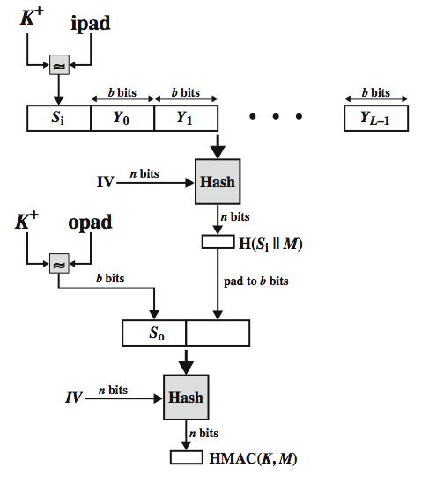
HMAC Overview
Notes:
Stallings Figure 12.5 illustrates the overall operation of HMAC:
HMAC_{K} = Hash[(K⁺ XOR opad) || Hash[(K⁺ XOR ipad) || M)]
where:
K⁺ is K padded with zeros on the left so that the result is b bits in length
ipad is a pad value of 36 hex repeated to fill block
opad is a pad value of 5C hex repeated to fill block
M is the message input to HMAC (including the padding specified in the embedded hash function)
Note that the XOR with ipad results in flipping one-half of the bits of K. Similarly, the XOR with opad results in flipping one-half of the bits of K, but a different set of bits. In effect, pseudorandomly generated two keys from K. HMAC should execute in approximately the same time as the embedded hash function for long messages. HMAC adds three executions of the hash compression function (for Si, So, and the block produced from the inner hash). A more efficient implementation is possible by precomputing the internal hash function on (K⁺ XOR opad) and (K⁺ XOR ipad) and inserting the results into the hash processing at start & end. With this implementation, only one additional instance of the compression function is added to the processing normally produced by the hash function. This is especially worthwhile if most of the messages for which a MAC is computed are short.

Slide 18




HMAC Security
proved security of HMAC relates to that of the underlying hash algorithm
attacking HMAC requires either:
  brute force attack on key used
  birthday attack (but since keyed would need to observe a very large number of messages)
choose hash function used based on speed verses security constraints
Notes:
The appeal of HMAC is that its designers have been able to prove an exact relationship between the strength of the embedded hash function and the strength of HMAC. The security of a MAC function is generally expressed in terms of the probability of successful forgery with a given amount of time spent by the forger and a given number of message-MAC pairs created with the same key. Have two classes of attacks: brute force attack on key used which has work of order 2^n; or a birthday attack which requires work of order 2^(n/2) - but which requires the attacker to observe 2^n blocks of messages using the same key - very unlikely. For a hash code length of 128 bits, this requires 2⁶⁴ observed blocks (2⁷² bits) generated using the same key. On a 1-Gbps link, one would need to observe a continuous stream of messages with no change in key for about 150,000 years in order to succeed. So even MD5 is still secure for use in HMAC given these constraints.

Slide 19
Using Symmetric Ciphers for MACs
can use any block cipher chaining mode and use final block as a MAC
Data Authentication Algorithm (DAA) is a widely used MAC based on DES-CBC
  using IV=0 and zero-pad of final block
  encrypt message using DES in CBC mode
  and send just the final block as the MAC
    or the leftmost M bits (16≤M≤64) of final block
but final MAC is now too small for security
Notes:
In this section, we look at two MACs that are based on the use of a block cipher mode of operation. We begin with an older algorithm, the Data Authentication Algorithm (DAA), a widely used though now obsolete MAC based on DES-CBC (next slide). However this suffers from being too small for acceptable use today.

Slide 20
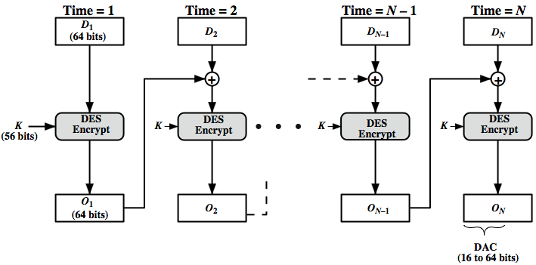
Data Authentication Algorithm
Notes:
The Data Authentication Algorithm, based on DES, has been one of the most widely used MACs for a number of years. The algorithm is both a FIPS publication (FIPS PUB 113) and an ANSI standard (X9.17). However, security weaknesses in this algorithm have been discovered and it is being replaced by newer and stronger algorithms. The algorithm is shown here in Stallings Figure 12.7, and can be defined as using the cipher block chaining (CBC) mode of operation of DES, with an initialization vector of zero, and 0-pad of the final block if needed. Resulting MAC can be 16-64 bits of the final block. But this is now too small for security.

Slide 21
CMAC
previously saw the DAA (CBC-MAC)
widely used in govt & industry
but has message size limitation
can overcome using 2 keys & padding
thus forming the Cipher-based Message Authentication Code (CMAC)
adopted by NIST SP800-38B
Notes:
The Data Authentication Algorithm cipher-based MAC has been widely adopted in government and industry. Has been shown to be secure, with the following restriction. Only messages of one fixed length of mn bits are processed, where n is the cipher block size and m is a fixed positive integer. This limitation can be overcome using multiple keys, which can be derived from a single key. This refinement has been adopted by NIST as the cipher-based message authentication code (CMAC) mode of operation, for use with AES and triple DES. It is specified in NIST Special Publication 800-38B.

Slide 22
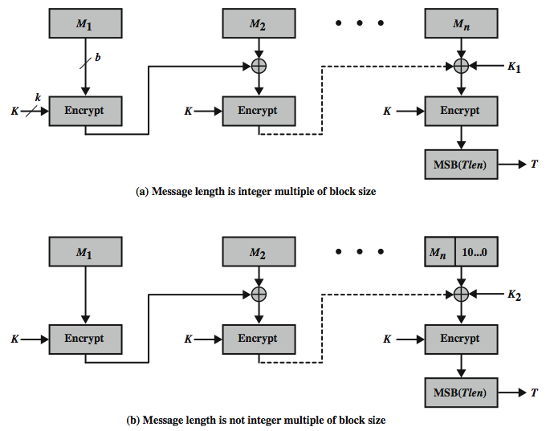
CMAC Overview
Notes:
Stallings Figure 12.8 shows the structure of CMAC. It uses the blocksize of the underlying cipher (ie 128-bits for AES or 64-bits for triple-DES). The message is divided into n blocks M1..Mn, padded if necessary. The algorithm makes use of a k-bit encryption key K and an n-bit constant K1 or K2 (depending on whether the message was padded or not). For AES, the key size k is 128,192, or 256 bits; for triple DES, the key size is 112 or 168 bits. The two constants K1 & K2 are derived from the original key K using encryption of 0 and multiplication in GF(2^n), as detailed in the text.

Slide 23
Authenticated Encryption
simultaneously protect confidentiality and authenticity of communications
  often required but usually separate
approaches
  Hash-then-encrypt: E(K, (M || H(M))
  MAC-then-encrypt: E(K2, (M || MAC(K1, M))
  Encrypt-then-MAC: (C=E(K2, M), T=MAC(K1, C)
  Encrypt-and-MAC: (C=E(K2, M), T=MAC(K1, M)
decryption /verification straightforward
but security vulnerabilities with all these
Notes:
Authenticated encryption (AE) is a term used to describe encryption systems that simultaneously protect confidentiality and authenticity (integrity) of communications. Many applications and protocols require both forms of security, but until recently the two services have been designed separately. [BLAC05] discussed four common approaches to providing both confidentiality and encryption for a message M:
• HtE: Hash-then-encrypt. First compute the cryptographic hash function over M as h = H(M). Then encrypt the message plus hash function: E(K, (M || h)
• MtE: MAC-then-encrypt. Use two keys. First authenticate the plaintext by computing the MAC value as T = MAC(K1, M). Then encrypt the message plus tag: E(K2, (M || T) cf SSL/TLS
• EtM: Encrypt-then-MAC. Use two keys. First encrypt the message to yield the ciphertext C = E(K 2, M). Then authenticate the ciphertext with T = MAC(K1, C) to yield the pair (C, T) cf IPsec
• E&M: Encrypt-and-MAC. Use two keys. Encrypt the message to yield the ciphertext C = E(K 2, M). Authenticate the plaintext with T = MAC(K1, M) to yield the pair (C, T). These operations can be performed in either order. cf SSH
Both decryption and verification are straightforward for each approach. There are security vulnerabilities with all of these approaches.

Slide 24
Counter with Cipher Block Chaining-Message Authentication Code (CCM)
NIST standard SP 800-38C for WiFi
variation of encrypt-and-MAC approach
algorithmic ingredients
  AES encryption algorithm
  CTR mode of operation
  CMAC authentication algorithm
single key used for both encryption & MAC
Notes:
The CCM mode of operation was standardized by NIST specifically to support the security requirements of IEEE 802.11 WiFi wireless local area networks (Chapter 17), but can be used in any networking application requiring authenticated encryption. CCM is a variation of the encrypt-and-MAC approach to authenticated encryption. It is defined in NIST SP 800-38C. The key algorithmic ingredients of CCM are the AES encryption algorithm (Chapter 5), the CTR mode of operation (Chapter 6), and the CMAC authentication algorithm (Section 12.6). A single key K is used for both encryption and MAC algorithms.

Slide 25
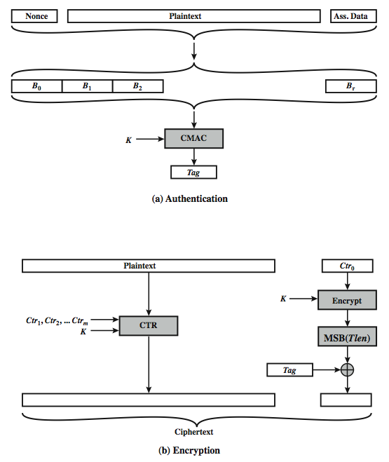
CCM Operation
Notes:
Stallings Figure 12.9 illustrates the operation of CCM. For authentication, the input includes the nonce, the associated data, and the plaintext. This input is formatted as a sequence of blocks B0 through Br. The first block contains the nonce plus some formatting bits that indicate the lengths of the N, A, and P elements. This is followed by zero or more blocks that contain A, followed by zero of more blocks that contain P. The resulting sequence of blocks serves as input to the CMAC algorithm, which produces a MAC value with length Tlen, which is less than or equal to the block length (Figure 12.9a). For encryption, a sequence of counters is generated that must be independent of the nonce. The authentication tag is encrypted in CTR mode using the single counter Ctr0. The Tlen most significant bits of the output are XORed with the tag to produce an encrypted tag. The remaining counters are used for the CTR mode encryption of the plaintext (Figure 6.7). The encrypted plaintext is concatenated with the encrypted tag to form the ciphertext output (Figure 12.9b). CCM is a relatively complex algorithm. Note that it requires two complete passes through the plaintext, once to generate the MAC value, and once for encryption. Further, the details of the specification require a tradeoff between the length of the nonce and the length of the tag, which is an unnecessary restriction. Also note that the encryption key is used twice with the CTR encryption mode, once to generate the tag and once to encrypt the plaintext plus tag. Whether these complexities add to the security of the algorithm is not clear. In any case, two analyses of the algorithm conclude that CCM provides a high level of security.

Slide 26
Galois/Counter Mode (GCM)
NIST standard SP 800-38D, parallelizable
message is encrypted in variant of CTR
ciphertext multiplied with key & length over in (2¹²⁸) to generate authenticator tag
have GMAC MAC-only mode also
uses two functions:
  GHASH - a keyed hash function
  GCTR - CTR mode with incremented counter
Notes:
The Galois/Counter Mode (GCM) mode of operation, standardized by NIST in NIST SP 800-38D, is designed to be parallelizable so that it can provide high throughput with low cost and low latency. In essence, the message is encrypted in variant of CTR mode. The resulting ciphertext is multiplied with key material and message length information over GF(2¹²⁸) to generate the authenticator tag. The standard also specifies a mode of operation that supplies the MAC only, known as GMAC. The GCM mode makes use of two functions: GHASH, which is a keyed hash function: and GCTR, which is essentially the CTR mode with the counters determined by a simple increment by one operation.

Slide 27
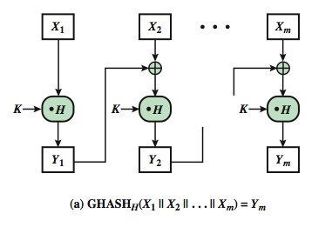
GCM Functions
Notes:
GHASH_{H}(X) takes a input the hash key H and a bit string X such that len(X) = 128m bits for some positive integer m and produces a 128-bit MAC value. The function may be specified as shown in Stallings Figure 12.10a. The GHASH H(X) function can be expressed as:
(X₁ • H^{m} ) XOR (X₂ • H^{m–1} ) XOR ... XOR (X_{m–1} • H² ) XOR (X_{m} • H)
where • designates multiplication in GF(2¹²⁸ )
This formulation has desirable performance implications. If the same hash key is to be used to authenticate multiple messages, then the values H², H³ can be precalculated one time for use with each message to be authenticated. Then, the blocks of the data to be authenticated (X₁, X₂, … X_{m}) can be processed in parallel, because the computations are independent of one another.

Slide 28
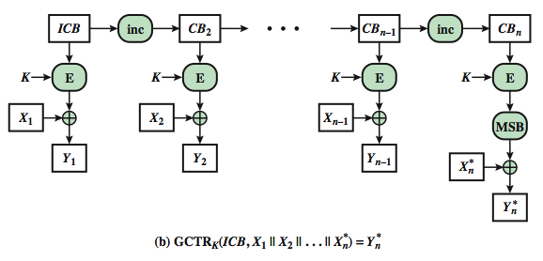
GCM Functions
Notes:
GCTR_{K}(ICB, X) takes a input a secret key K and a bit string X arbitrary length and returns a ciphertext Y of bit length len(X). The function may be specified as as shown in Stallings Figure 12.10b. Here the inc₃₂(S) function increments the rightmost 32 bits of S by 1 mod 2³², and the remaining bits are unchanged. Note that the counter values can be quickly generated and that the encryption operations can be performed in parallel.

Slide 29
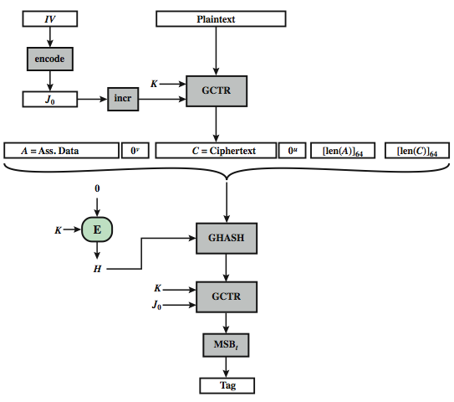
GCM Mode Overview
Notes:
We can now define the overall authenticated encryption function as shown in Stallings Figure 12.11. The input consists of a secret key K, an initialization vector IV, a plaintext P, and additional authenticated data A that will be authenticated but not encrypted. In step 1, the hash key is generated by encrypting a block of all zeros with the secret key K. In step 2, the pre-counter block (J₀) is generated from the IV. In particular, when the length of the IV is 96 bits, then the padding string 0³¹ || 1 is appended to the IV to form the pre-counter block. Otherwise, the IV is padded with the minimum number of 0 bits, possibly none, so that the length of the resulting string is a multiple of 128 bits (the block size); this string in turn is appended with 64 additional ‘0’ bits, followed by the 64-bit representation of the length of the IV, and the GHASH function is applied to the resulting string to form the pre-counter block.
Thus, GCM is based on the CTR mode of operation, and adds a MAC that authenticates both the message and additional data that requires only authentication. The function that computes the hash uses only multiplication in a Galois field. This choice was made because the operation of multiplication is easy to perform within a Galois field and is easily implemented in hardware. CTR- based authenticated encryption is the most efficient mode of operation for high-speed packet networks. The GCM mode meets a high level of security requirements.

Slide 30
Pseudorandom Number Generation (PRNG) Using Hash Functions and MACs
essential elements of PRNG are
  seed value
  deterministic algorithm
seed must be known only as needed
can base PRNG on
  encryption algorithm (Chs 7 & 10)
  hash function (ISO18031 & NIST SP 800-90)
  MAC (NIST SP 800-90)
Notes:
The essential elements of any pseudorandom number generator (PRNG) are a seed value and a deterministic algorithm for generating a stream of pseudorandom bits. If the algorithm is used as a pseudorandom function (PRF) to produce a required value, such as a session key, then the seed should only be known to the user of the PRF. If the algorithm is used to produce a stream encryption function, then the seed has the role of a secret key that must be known to the sender and the receiver. We noted in Chapters 7 and 10 that, because an encryption algorithm produces an apparently random output, it can serve as the basis of a (PRNG). Similarly, an hash function or MAC produces apparently random output and can be used to build a PRNG. Both ISO standard 18031 (Random Bit Generation) and NIST SP 800-90 (Recommendation for Random Number Generation Using Deterministic Random Bit Generators) define an approach for random number generation using a cryptographic hash function. SP 800-90 also defines a random number generator based on HMAC. We look at these two approaches in turn.

Slide 31
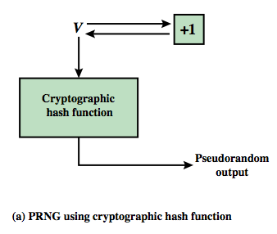
PRNG using a Hash Function
hash PRNG from SP800-90 and ISO18031
  take seed V
  repeatedly add 1
  hash V
  use n-bits of hash as random value
secure if good hash used
Notes:
Stallings Figure 12.12a shows the basic strategy for a hash-based PRNG specified in SP 800-90 and ISO 18031. The algorithm takes as input: V = seed; seedlen = bit length of V >= k + 64, where k is a desired security level expressed in bits; n = desired number of output bits. The algorithm uses the cryptographic hash function H with an hash value output of outlen bits. The basic operation of the algorithm is:
m = ceil(n/outlen)
data = V
W = the null string
for i = 1 to m
w_{i} = H(data)
W = W || w_{i}
data = (data + 1) mod 2^{seedlen}
return leftmost n bits of W
Thus, the pseudorandom bit stream is w 1 || w2 || … || wm, with the final block truncated if required. The SP 800-90 specification also provides for periodically updating V to enhance security. The specification also indicates that there are no known or suspected weaknesses in the hash- based approach for a strong cryptographic hash algorithm, such as SHA-2.

Slide 32
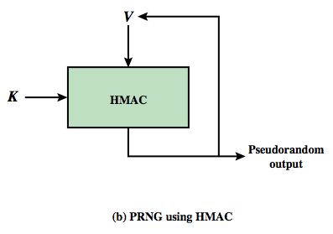
PRNG using a MAC
MAC PRNGs in SP800-90, IEEE 802.11i, TLS
  use key
  input based on last hash in various ways
Notes:
Although there are no known or suspected weaknesses in the use of a cryptographic hash function for a PRNG as shown on the previous slide, a higher degree of confidence can be achieved by using a MAC. Almost invariably, HMAC is used for constructing a MAC-based PRNG. For the MAC based approach, there are two inputs, a key K and a seed V. In effect, the combination of K and V form the overall seed for the PRNG specified in SP 800-90. Stallings Figure 12.12b shows the basic structure of the PRNG mechanism. Stallings Figure 12.13 shows the logic for 3 HMAC PRNG’s. Note that the key remains the same for each block of output, and in SP 800-90 the data input for each block is equal to the tag output of the previous block. The IEEE 802.11i form uses a counter for enhanced security. The TLS form uses two MAC uses per output block. The SP 800-90 specification also provides for periodically updating K and V to enhance security. The SP 800-90 logic is:
m = ceil(n/outlen)
w₀ = V
W = the null string
for i = 1 to m
w_{i} = MAC(K, w_{i-1})
W = W || w_{i}
data = (data + 1) mod 2^{seedlen}
return leftmost n bits of W

Slide 33
Summary
have considered:
  message authentication requirements
  message authentication using encryption
  MACs
  HMAC authentication using a hash function
  CMAC authentication using a block cipher
  Pseudorandom Number Generation (PRNG) using Hash Functions and MACs
Notes:
Chapter 12 summary.

