Slide 1
Cryptography and Network Security
Chapter 15
Fifth Edition
by William Stallings
Lecture slides by Lawrie Brown
Notes:
Lecture slides by Lawrie Brown for “Cryptography and Network Security”, 5/e, by William Stallings, Chapter 15 – “User Authentication”.

Slide 2
Chapter 15 – User Authentication
We cannot enter into alliance with neighboring princes until we are acquainted with their designs.
—The Art of War, Sun Tzu
Notes:
Opening quote.

Slide 3
User Authentication
fundamental security building block
  basis of access control & user accountability
is the process of verifying an identity claimed by or for a system entity
has two steps:
  identification - specify identifier
  verification - bind entity (person) and identifier
distinct from message authentication
Notes:
This chapter examines some of the authentication functions that have been developed to support network-based use authentication. In most computer security contexts, user authentication is the fundamental building block and the primary line of defense. User authentication is the basis for most types of access control and for user accountability. RFC 2828 defines user authentication as the process of verifying an identity claimed by or for a system entity. An authentication process consists of two steps:
Identification step: Presenting an identifier to the security system. (Identifiers should be assigned carefully, because authenticated identities are the basis for other security services, such as access control service.)
Verification step: Presenting or generating authentication information that corroborates the binding between the entity and the identifier.”
In essence, identification is the means by which a user provides a claimed identity to the system; user authentication is the means of establishing the validity of the claim. Note that user authentication is distinct from message authentication.

Slide 4
Means of User Authentication
four means of authenticating user's identity
based one something the individual
  knows - e.g. password, PIN
  possesses - e.g. key, token, smartcard
  is (static biometrics) - e.g. fingerprint, retina
  does (dynamic biometrics) - e.g. voice, sign
can use alone or combined
all can provide user authentication
all have issues
Notes:
There are four general means of authenticating a user's identity, which can be used alone or in combination:
• Something the individual knows: Examples includes a password, a personal identification number (PIN), or answers to a prearranged set of questions.
• Something the individual possesses: Examples include electronic keycards, smart cards, and physical keys. This type of authenticator is referred to as a token.
• Something the individual is (static biometrics): Examples include recognition by fingerprint, retina, and face.
• Something the individual does (dynamic biometrics): Examples include recognition by voice pattern, handwriting characteristics, and typing rhythm.
All of these methods, properly implemented and used, can provide secure user authentication. However, each method has problems. An adversary may be able to guess or steal a password. Similarly, an adversary may be able to forge or steal a token. A user may forget a password or lose a token. Further, there is a significant administrative overhead for managing password and token information on systems and securing such information on systems. With respect to biometric authenticators, there are a variety of problems, including dealing with false positives and false negatives, user acceptance, cost, and convenience.

Slide 5
Authentication Protocols
used to convince parties of each others identity and to exchange session keys
may be one-way or mutual
key issues are
  confidentiality – to protect session keys
  timeliness – to prevent replay attacks
Notes:
An important application area is that of mutual authentication protocols. Such protocols enable communicating parties to satisfy themselves mutually about each other's identity and to exchange session keys. This topic was examined in Chapter 14. There, the focus was key distribution. We return to this topic here to consider the wider implications of authentication. Central to the problem of authenticated key exchange are two issues: confidentiality and timeliness. To prevent masquerade and to prevent compromise of session keys, essential identification and session key information must be communicated in encrypted form. This requires the prior existence of secret or public keys that can be used for this purpose. The second issue, timeliness, is important because of the threat of message replays.

Slide 6
Replay Attacks
where a valid signed message is copied and later resent
  simple replay
  repetition that can be logged
  repetition that cannot be detected
  backward replay without modification
countermeasures include
  use of sequence numbers (generally impractical)
  timestamps (needs synchronized clocks)
  challenge/response (using unique nonce)
Notes:
Replay Attacks are where a valid signed message is copied and later resent. Such replays, at worst, could allow an opponent to compromise a session key or successfully impersonate another party. At minimum, a successful replay can disrupt operations by presenting parties with messages that appear genuine but are not. [GONG93] lists the examples above of replay attacks.
Possible countermeasures include the use of:
• sequence numbers (generally impractical since must remember last number used with every communicating party)
• timestamps (needs synchronized clocks amongst all parties involved, which can be problematic)
• challenge/response (using unique, random, unpredictable nonce, but not suitable for connectionless applications because of handshake overhead)

Slide 7
One-Way Authentication
required when sender & receiver are not in communications at same time (eg. email)
have header in clear so can be delivered by email system
may want contents of body protected & sender authenticated
Notes:
One application for which encryption is growing in popularity is electronic mail (e-mail). The very nature of electronic mail, and its chief benefit, is that it is not necessary for the sender and receiver to be online at the same time. Instead, the e-mail message is forwarded to the receiver’s electronic mailbox, where it is buffered until the receiver is available to read it. The "envelope" or header of the e-mail message must be in the clear, so that the message can be handled by the store-and-forward e-mail protocol, such as the Simple Mail Transfer Protocol (SMTP) or X.400. However, it is often desirable that the mail-handling protocol not require access to the plaintext form of the message, because that would require trusting the mail- handling mechanism. Accordingly, the e-mail message should be encrypted such that the mail- handling system is not in possession of the decryption key. A second requirement is that of authentication. Typically, the recipient wants some assurance that the message is from the alleged sender.

Slide 8
Using Symmetric Encryption
as discussed previously can use a two-level hierarchy of keys
usually with a trusted Key Distribution Center (KDC)
  each party shares own master key with KDC
  KDC generates session keys used for connections between parties
  master keys used to distribute these to them
Notes:
A two-level hierarchy of symmetric encryption keys can be used to provide confidentiality for communication in a distributed environment.
Usually involves the use of a trusted key distribution center (KDC). Each party in the network shares a secret master key with the KDC. The KDC is responsible for generating session keys, and for distributing those keys to the parties involved, using the master keys to protect these session keys.

Slide 9
Needham-Schroeder Protocol
original third-party key distribution protocol
for session between A B mediated by KDC
protocol overview is:
  1. A->KDC: ID_{A} || ID_{B} || N₁
  2. KDC -> A: E(K_{a},[K_{s}||ID_{B}||N₁|| E(K_{b},[K_{s}||ID_{A}])])
  3. A -> B: E(K_{b}, [K_{s}||ID_{A}])
  4. B -> A: E(K_{s}, [N₂])
  5. A -> B: E(K_{s}, [f(N₂)])
Notes:
The Needham-Schroeder Protocol is the original, basic key exchange protocol, as was shown in Stallings Figure 14.3 (previous chapter). Used by 2 parties who both trusted a common key server, it gives one party the info needed to establish a session key with the other. Note that since the key server chooses the session key, it is capable of reading/forging any messages between A&B, which is why they need to trust it absolutely!
Note that all communications is between A&KDC and A&B, B&KDC don't talk directly (though indirectly a message passes from KDC via A to B, encrypted in B's key so that A is unable to read or alter it). Other variations of key distribution protocols can involve direct communications between B&KDC.

Slide 10
Needham-Schroeder Protocol
used to securely distribute a new session key for communications between A & B
but is vulnerable to a replay attack if an old session key has been compromised
  then message 3 can be resent convincing B that is communicating with A
modifications to address this require:
  timestamps in steps 2 & 3 (Denning 81)
  using an extra nonce (Neuman 93)
Notes:
There is a critical flaw in the protocol, as shown. The message in step 3 can be decrypted, and hence understood, supposedly only by B. But if an opponent, X, has been able to compromise an old session key, then X can impersonate A and trick B into using the old key by simply replaying step 3. Admittedly, this is a much more unlikely occurrence than that an opponent has simply observed and recorded step 3. It can however be corrected by either using timestamps, or an additional nonce, with respective advantages and limitations, see text for discussion.
This example emphasises the need to be extremely careful in codifying assumptions, and tracking the timeliness of the flow of info in protocols. Designing secure protocols is not easy, and should not be done lightly. Great care and analysis is needed.

Slide 11
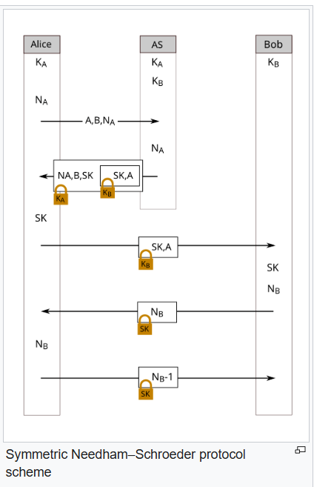
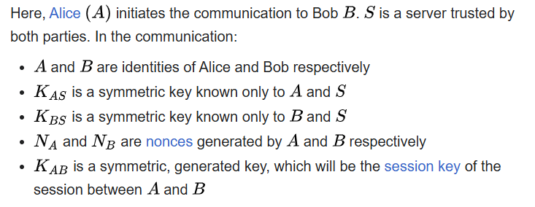

Slide 12
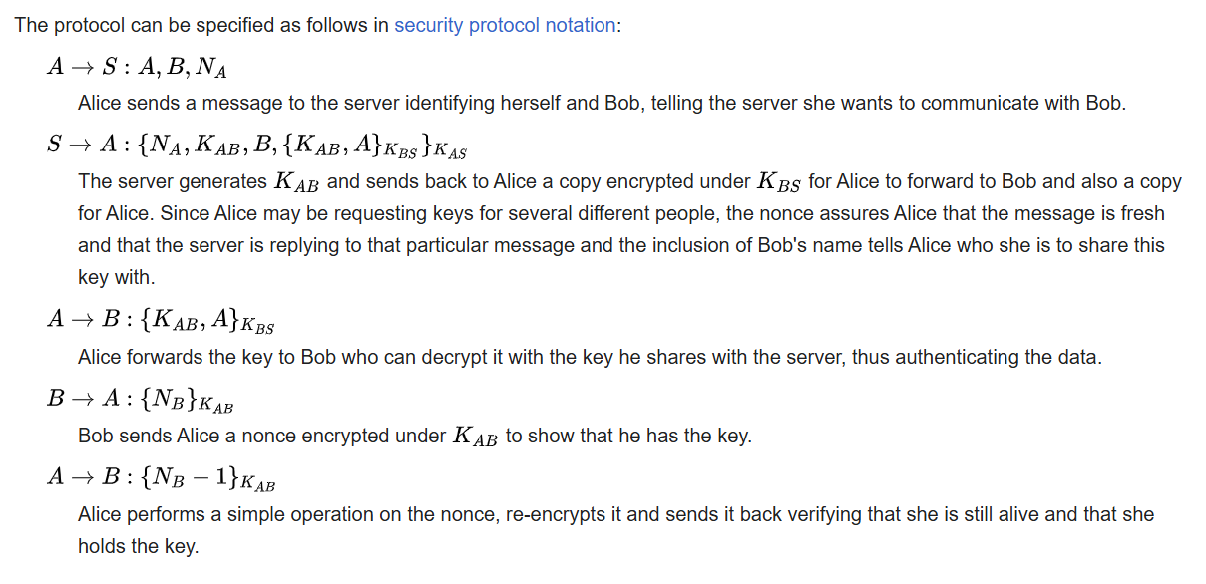

Slide 13
One-Way Authentication
use refinement of KDC to secure email
  since B no online, drop steps 4 & 5
protocol becomes:
  1. A->KDC: ID_{A} || ID_{B} || N₁
  2. KDC -> A: E(K_{a}, [K_{s}||ID_{B}||N₁ || E(K_{b},[K_{s}||ID_{A}])])
  3. A -> B: E(K_{b}, [K_{s}||ID_{A}]) || E(K_{s}, M)
provides encryption & some authentication
does not protect from replay attack
Notes:
With some refinement, the KDC strategy illustrated in Stallings Figure 14.3 (previous chapter) is a candidate for securing electronic mail. Because we wish to avoid requiring that the recipient (B) be on line at the same time as the sender (A), steps 4 and 5 must be eliminated. For a message with content M, the sequence is as shown. This approach guarantees that only the intended recipient of a message will be able to read it. It also provides a level of authentication that the sender is A. As specified, the protocol does not protect against replays. Some measure of defense could be provided by including a timestamp with the message. However, because of the potential delays in the e-mail process, such timestamps may have limited usefulness.

Slide 14
Kerberos
trusted key server system from MIT
provides centralised private-key third-party authentication in a distributed network
  allows users access to services distributed through network
  without needing to trust all workstations
  rather all trust a central authentication server
two versions in use: 4 & 5
Notes:
Kerberos is an authentication service developed as part of Project Athena at MIT, and is one of the best known and most widely implemented trusted third party key distribution systems.
Kerberos provides a centralized authentication server whose function is to authenticate users to servers and servers to users. Unlike most other authentication schemes, Kerberos relies exclusively on symmetric encryption, making no use of public-key encryption. Two versions of Kerberos are in common use: v4 & v5.

Slide 15
Kerberos Requirements
its first report identified requirements as:
  secure
  reliable
  transparent
  scalable
implemented using an authentication protocol based on Needham-Schroeder
Notes:
In a more open environment, in which network connections to other machines are supported, an approach that requires the user to prove his or her identity for each service invoked, and also require that servers prove their identity to clients, is needed to protect user information and resources housed at the server. Kerberos supports this approach, and assumes a distributed client/server architecture that employs one or more Kerberos servers to provide an authentication service. The first published report on Kerberos [STEI88] listed the following requirements:
• Secure: A network eavesdropper should not be able to obtain the necessary information to impersonate a user. More generally, Kerberos should be strong enough that a potential opponent does not find it to be the weak link.
• Reliable: For all services that rely on Kerberos for access control, lack of availability of the Kerberos service means lack of availability of the supported services. Hence, Kerberos should be highly reliable and should employ a distributed server architecture, with one system able to back up another.
• Transparent: Ideally, the user should not be aware that authentication is taking place, beyond the requirement to enter a password.
• Scalable: The system should be capable of supporting large numbers of clients and servers. This suggests a modular, distributed architecture.
To support these requirements, Kerberos is a trusted third-party authentication service that uses a protocol based on that proposed by Needham and Schroeder which was discussed earlier in this chapter.

Slide 16
Kerberos v4 Overview
a basic third-party authentication scheme
have an Authentication Server (AS)
  users initially negotiate with AS to identify self
  AS provides a non-corruptible authentication credential (ticket granting ticket TGT)
have a Ticket Granting server (TGS)
  users subsequently request access to other services from TGS on basis of users TGT
using a complex protocol using DES
Notes:
The core of Kerberos is the Authentication and Ticket Granting Servers – these are trusted by all users and servers and must be securely administered. The protocol includes a sequence of interactions between the client, AS, TGT and desired server. Version 4 of Kerberos makes use of DES, in a rather elaborate protocol, to provide the authentication service. Viewing the protocol as a whole, it can be difficult to see the need for the many elements contained therein. The text contains more detailed discussion about the development of and need for the components of the final v4 protocol.

Slide 17
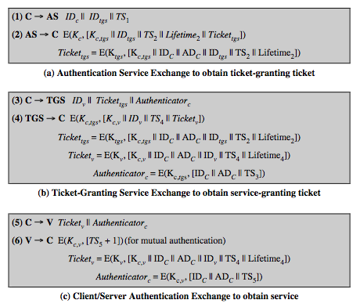
Kerberos v4 Dialogue
Notes:
The full Kerberos v4 authentication dialogue is shown here from Stallings Table 15.1, divided into 3 phases. The justification for each item in the messages is given in Stallings Table 15.2.
First, consider the problem of captured ticket-granting tickets and the need to determine that the ticket presenter is the same as the client for whom the ticket was issued. An efficient way of doing this is to use a session encryption key to secure information. Table 15.1a shows the technique for distributing the session key. Note that several additional pieces of information have been added to this first phase of the dialogue. Message (1) includes a timestamp, so that the AS knows that the message is timely. Message (2) includes several elements of the ticket in a form accessible to C. This enables C to confirm that this ticket is for the TGS and to learn its expiration time. Note that the ticket does not prove anyone's identity but is a way to distribute keys securely. It is the authenticator that proves the client's identity. Because the authenticator can be used only once and has a short lifetime, the threat of an opponent stealing both the ticket and the authenticator for presentation later is countered. C then sends the TGS a message that includes the ticket plus the ID of the requested service (message 3). The reply from the TGS, in message (4), follows the form of message (2). C now has a reusable service-granting ticket for V. When C presents this ticket, as shown in message (5), it also sends an authenticator. The server can decrypt the ticket, recover the session key, and decrypt the authenticator. If mutual authentication is required, the server can reply as shown in message (6)

Slide 18
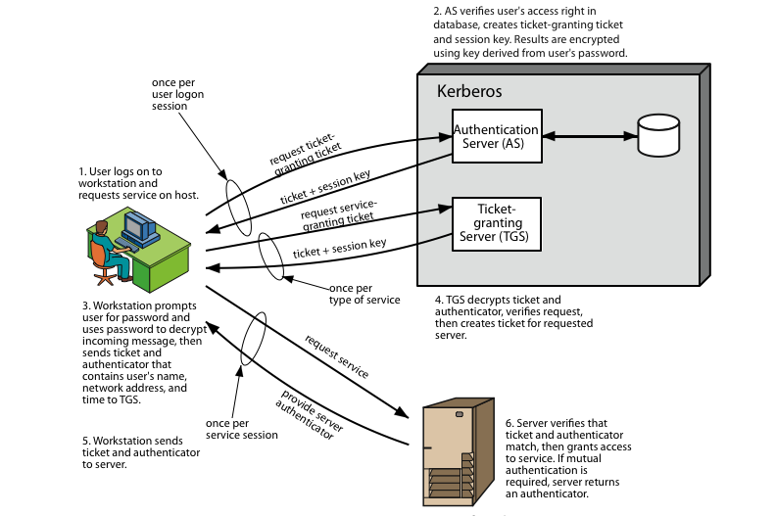
Kerberos 4 Overview
Notes:
Stallings Figure 15.1 diagrammatically summarizes the Kerberos v4 authentication dialogue, with 3 pairs of messages, for each phase listed previously.

Slide 19
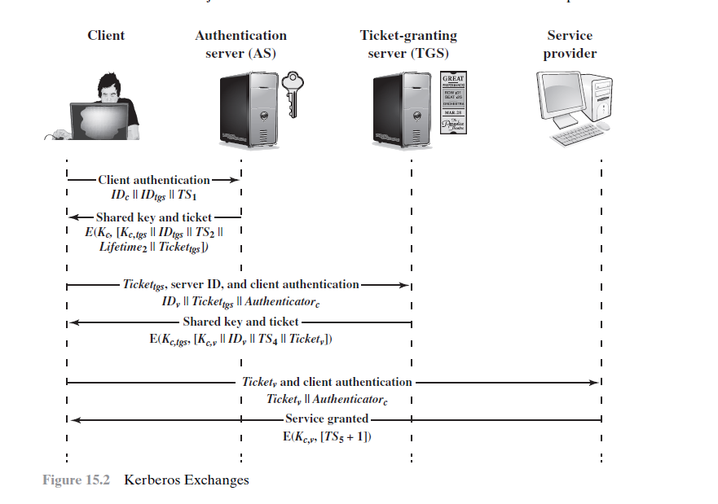

Slide 20
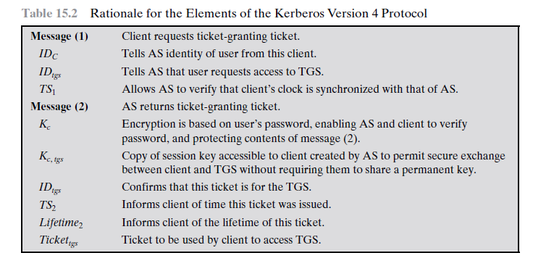
Authentication Service Exchange

Slide 21
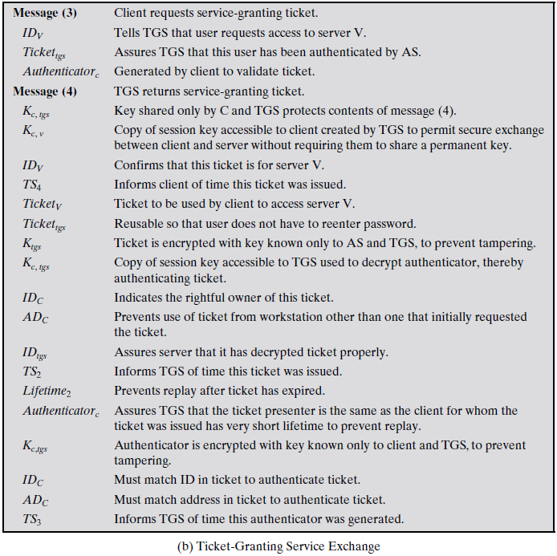

Slide 22
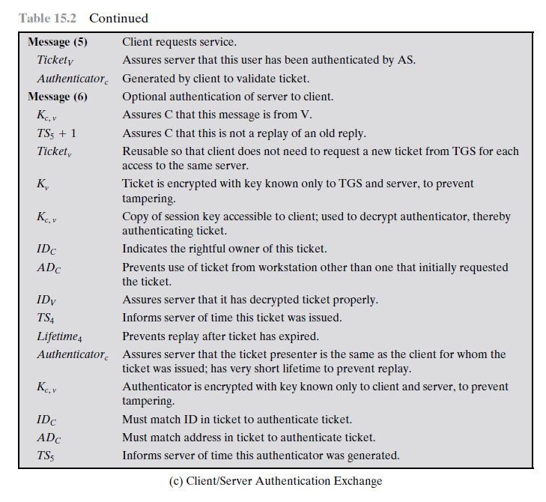

Slide 23
Kerberos Realms
a Kerberos environment consists of:
  a Kerberos server
  a number of clients, all registered with server
  application servers, sharing keys with server
this is termed a realm
  typically a single administrative domain
if have multiple realms, their Kerberos servers must share keys and trust
Notes:
A full-service Kerberos environment consisting of a Kerberos server, a number of clients, and a number of application servers is referred to as a Kerberos realm. A Kerberos realm is a set of managed nodes that share the same Kerberos database, and are part of the same administrative domain. If have multiple realms, their Kerberos servers must share keys and trust each other.

Slide 24
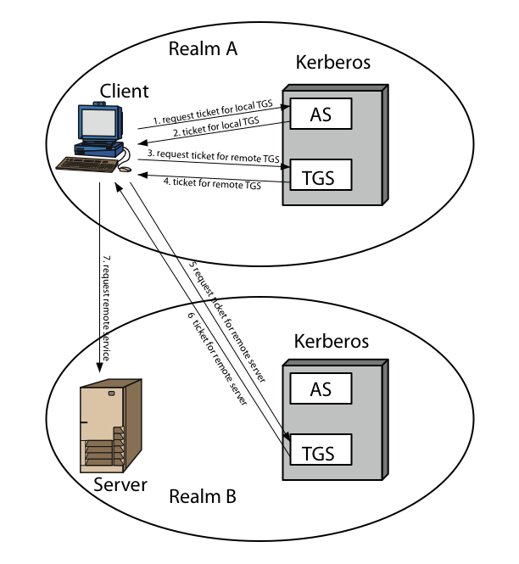
Kerberos Realms
Notes:
Stallings Figure 15.2 shows the authentication messages where service is being requested from another domain. The ticket presented to the remote server indicates the realm in which the user was originally authenticated. The server chooses whether to honor the remote request. One problem presented by the foregoing approach is that it does not scale well to many realms, as each pair of realms need to share a key.

Slide 25
Kerberos Version 5
developed in mid 1990’s
specified as Internet standard RFC 1510
provides improvements over v4
  addresses environmental shortcomings
    encryption alg, network protocol, byte order, ticket lifetime, authentication forwarding, interrealm auth
  and technical deficiencies
    double encryption, non-std mode of use, session keys, password attacks
Notes:
Kerberos Version 5 is specified in RFC 1510 and provides a number of improvements over version 4 in the areas of environmental shortcomings and technical deficiencies, in areas as noted. See Stallings Table 14.3 for details of the Kerberos v5 authentication dialogue.

Slide 26
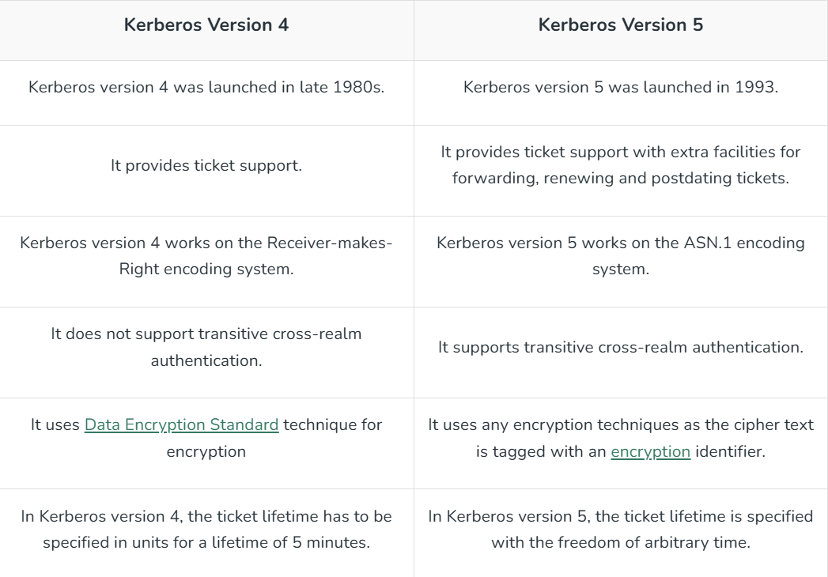

Slide 27
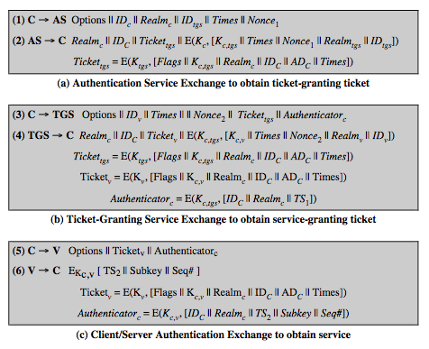
Kerberos v5 Dialogue
Notes:
The basic Kerberos version 5 authentication dialogue is shown here from Stallings Table 15.3. First, consider the authentication service exchange.
Message (1) is a client request for a ticket-granting ticket.
Message (2) returns a ticket-granting ticket, identifying information for the client, and a block encrypted using the encryption key based on the user's password. This block includes the session key to be used between the client and the TGS.
Now compare the ticket-granting service exchange for versions 4 and 5. See that message (3) for both versions includes an authenticator, a ticket, and the name of the requested service. In addition, version 5 includes requested times and options for the ticket and a nonce, all with functions similar to those of message (1). The authenticator itself is essentially the same as the one used in version 4. Message (4) has the same structure as message (2), returning a ticket plus information needed by the client, the latter encrypted with the session key now shared by the client and the TGS. Finally, for the client/server authentication exchange, several new features appear in version 5, such as a request for mutual authentication. If required, the server responds with message (6) that includes the timestamp from the authenticator. The flags field included in tickets in version 5 supports expanded functionality compared to that available in version 4. Stallings Table 15.4 summarizes the flags that may be included in a ticket., with discussion of details in the text.

Slide 28
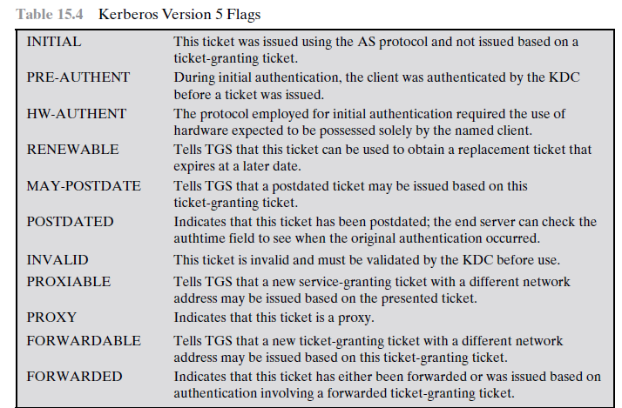

Slide 29
