Slide 1
BIG DATA
SPARK CORE - PART 2
Notes:
Welcome to the second part of Apache Spark Core training

Slide 2
SPARK ETL
Notes:
In the first chapter of this part we are going to talk about ETL and what Spark supports out-of-the-box for it

Slide 3
What is ETL?
Extract
Extracts Data from the source system
Cleansing
Detect and corrupt or inaccurate records
Transform
Apply functions to conform data to a standard dimensional schema
Load
Load the data into the Target Storage for consumption
Process
Load the data from the data ,art into the cube for browsing
Notes:
ETL stands for Extract-Transform-Load and it is a process of how data is loaded from the source system to the target System.
For example, there is a retail store which has different departments like sales, marketing, logistics etc. Each of them is handling the customer information independently, and the way they store that data is quite different. The sales department have stored it by customer’s name, while marketing department by customer id.
Now if they want to check the history of the customer and want to know what the different products he/she bought owing to different marketing campaigns; it would be very tedious.
The solution is to use a Data warehouse to store information from different sources in a uniform structure using ETL.
Although ETL stands for Extract, Transform and Load, sometimes we include Cleansing here as well. Sometimes people say they build ECL process, meaning that they are going to have Extraction, Cleansing and Loading.

Slide 4




Extraction & data loading
Notes:
The purpose of Extraction step is:
Identify Data Source(s)
Determine the Frequency and number of Generations planned to be kept
Determine the Format of data to be extracted
Determine the Size of data to be extracted
Similarly, the purpose of Data Loading is:
Identify Target System(s)
Determine the Frequency and number of Generations planned to be kept
Determine the Format of the data to load
Determine the Size of the data to load

Slide 5
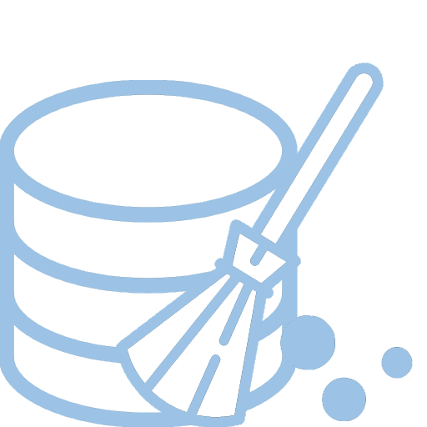




Cleansing
Notes:
The purpose of Data Cleansing:
Cleaning, which is removing the data which we think are not complete and make no sense for us
Validation, as we might be interested in correct data only
Filtering, as we might not need some of the data, or decide that some data just add noise…
Correction, as an opposite to the cleaning of incomplete data, we may try to “correct” them if there is a way
Deduplication, sometimes we might get same data twice, and this is not always good to have them duplicated

Slide 6




Transformations
Notes:
Some of the Data Transformations:
Data Type Conversion
Data Joining / Combining
Data Aggregation
Data Encryption

Slide 7

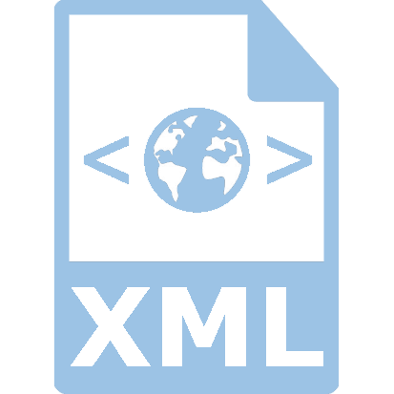
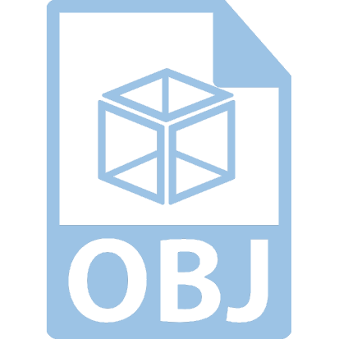



File formats
Notes:
Apache Spark supports a large number of file formats, which are increasing with every release of Spark. With Apache Spark release 2.0, the following file formats are supported out of the box:
Text Files
JSON Files
CSV/TSV Files
Sequence Files
Object Files

Slide 8
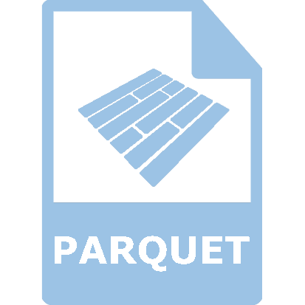
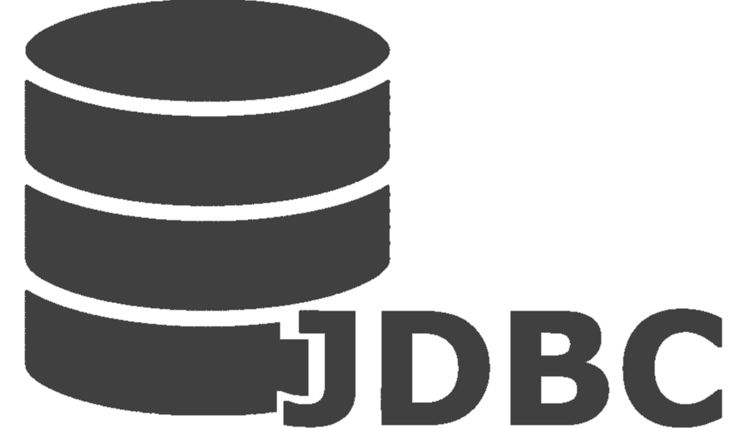

Structured data and databases
Notes:
Spark supports reading from a variety of data sources.
Apache Parquet is a common columnar format that is supported by many other data processing systems. Spark SQL provides support for both reading and writing Parquet files that automatically preserves the schema of the original data. When writing Parquet files, all columns are automatically converted to be nullable for compatibility reasons. Parquet's design was based on Google's Dremel paper and is considered to be one of the best performing data formats in a
number of scenarios.
Hive is a data warehousing infrastructure based on Hadoop. Hive provides SQL-like capabilities to work with data on Hadoop. Traditional SQL queries must be implemented in the MapReduce Java API to execute SQL applications and queries over distributed data. Hive provides the necessary SQL abstraction to integrate SQL-like queries (HiveQL) into the underlying Java without the need to implement queries in the low-level Java API.
Spark supports reading and writing data stored in Apache Hive. You would need to configure Hive with Apache Spark.
JDBC: Spark allows the use of JDBC to connect to a wide variety of databases. Of course the data access via JDBC is relatively slow compared to native database utilities.
SOURCES:
https://spark.apache.org/docs/latest/sql-programming-guide.html
https://en.wikipedia.org/wiki/Apache_Hive
Learning Apache Spark 2

Slide 9
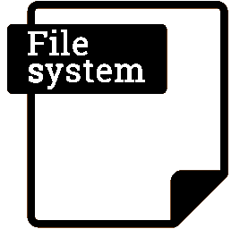


File systems
Notes:
In Production environment, it will be extremely rare that you will be working on a local filesystem and chances are high that you will be working on distributed file systems such as HDFS and Amazon S3
Hadoop Distributed File System (HDFS) is a distributed, scalable, and portable filesystem written in Java for Hadoop framework. Spark allows you to read data from HDFS in a very similar way that you would read from a typical filesystem, with the only difference being pointing towards the NameNode and the HDFS port.
S3 stands for Simple Storage Service, an online storage service provided by Amazon Web Services. The core principles of S3 include scalability, high-availability, low-latency, and low-pricing. S3 provides amazing speed when your cluster is inside Amazon EC2, but the performance can be a nightmare if you are accessing large amounts of data over public Internet
SOURCES:
- Laerning Apache Spark 2

Slide 10
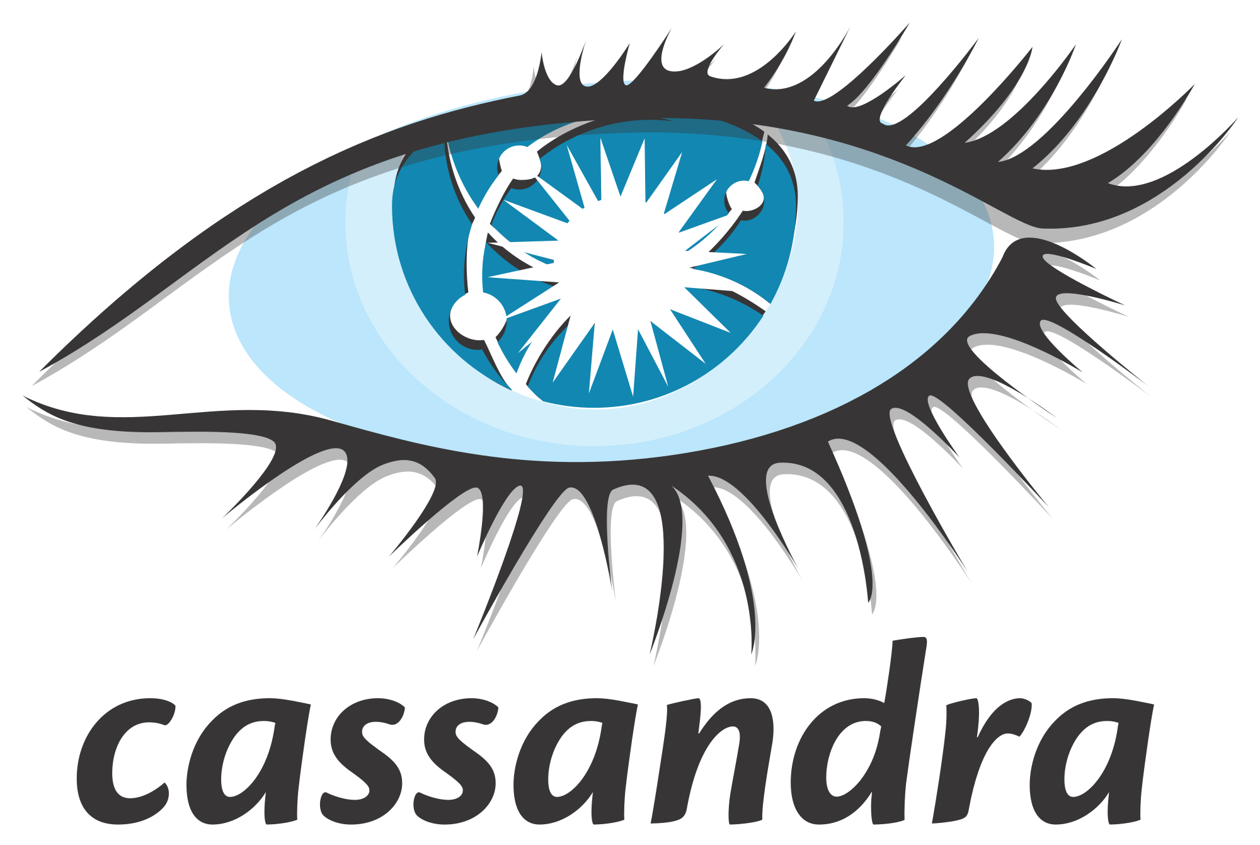



NoSQL
Notes:
A NoSQL (originally referring to non SQL, non relational or not only SQL) database provides a mechanism for storage (https://en.wikipedia.org/wiki/Computer_data_storage) and retrieval (https://en.wikipedia.org/wiki/Data_retrieval) of data which is modeled in means other than the tabular relations used in Relational databases (https://en.wikipedia.org/wiki/Relational_database). NoSQL is a relatively new approach to data management and has been quite popular. The core challenges addressed by No SQL include scalability and performance issues for big data problems. It is important to understand that No SQL databases can often be accessed through SQL, but generally provide API level access to their data structures, which can be exceedingly fast. In addition to that the data might be organized in key/value pairs rather than standard database tables and columns.
The most popular No SQL databases include:
Cassandra
Hbase
MongoDB
Solr
Spark has an integration with all of them
SOURCES:
- Learnig Apache Spark 2

Slide 11
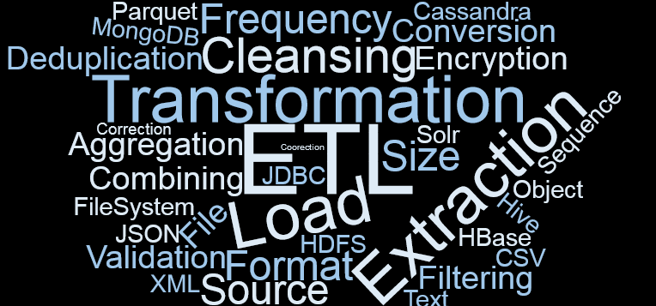
Summary
Notes:
You’ve just learned what ETL is and what Spark offers to support that processing flow.

Slide 12
DATASETS AND DATAFRAMES

Slide 13
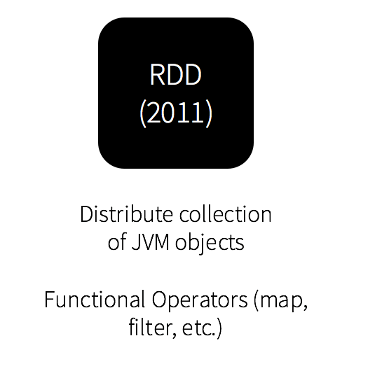
History of Spark APIs
Notes:
The RDD (Resilient Distributed Dataset) API has been in Spark since the 1.0 release. This interface will be familiar to any developers who have worked through the standard Spark tutorials. From a developer’s perspective, an RDD is simply a set of Java or Scala objects representing data.
The RDD API provides many transformation methods, such as map(), filter(), and reduce() for performing computations on the data. Each of these methods results in a new RDD representing the transformed data. However, these methods are just defining the operations to be performed and the transformations are not performed until an action method is called. Examples of action methods are collect() and saveAsObjectFile().
SOURCES:
- http://www.agildata.com/apache-spark-rdd-vs-dataframe-vs-dataset/

Slide 14
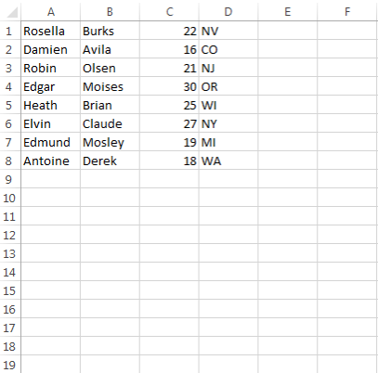
Test CSV file
Notes:
Assume we have a CSV file with people information like first name, last name, age and state person lives in.

Slide 15
Utility classes
package com.epam.sample.spark.utils import scala.io.Source object PersonData { def read(): Seq[Person] = Source.fromInputStream(getClass.getClassLoader.getResourceAsStream("people.csv")) .getLines().map(line => { val parts: Array[String] = line.split(",") Person(parts(0), parts(1), parts(2).toInt, parts(3)) }).toSeq } case class Person(first: String, last: String, age: Int, state: String)
Notes:
Let’s create an utility object to read data from that csv file and convert it to Person case class

Slide 16
RDD example
package com.epam.sample.spark import com.epam.sample.spark.utils.PersonData import org.apache.spark.{SparkConf, SparkContext} object ScalaRDDExample { def main(args: Array[String]) { val conf = new SparkConf()
.setMaster("local[*]") .setAppName("ScalaRDDExample") val sc = new SparkContext(conf) // load initial RDD val rdd = sc.parallelize(PersonData.read()) // verbose syntax println("Under 21") rdd.filter(p => p.age < 21) .foreach(println) // concise syntax println("Over 21") rdd.filter(_.age > 21) .foreach(println) // terminate spark context sc.stop() } }
Notes:
Let’s build an application to filter out people above and beyond 21 separately. First off we can remind how RDD processing looks like.
The main advantage of RDDs is that they are simple and well understood because they deal with concrete classes, providing a familiar object-oriented programming style with compile-time type-safety. For example, given an RDD containing instances of Person we can filter by age by referencing the age attribute of each Person object:
rdd.filter(_.age > 21)
The main disadvantage to RDDs is that they don’t perform particularly well. Whenever Spark needs to distribute the data within the cluster, or write the data to disk, it does so using Java serialization by default (although it is possible to use Kryo as a faster alternative in most cases). The overhead of serializing individual Java and Scala objects is expensive and requires sending both data and structure between nodes (each serialized object contains the class structure as well as the values). There is also the overhead of garbage collection that results from creating and destroying individual objects.
SOURCES:
- http://www.agildata.com/apache-spark-rdd-vs-dataframe-vs-dataset/

Slide 17
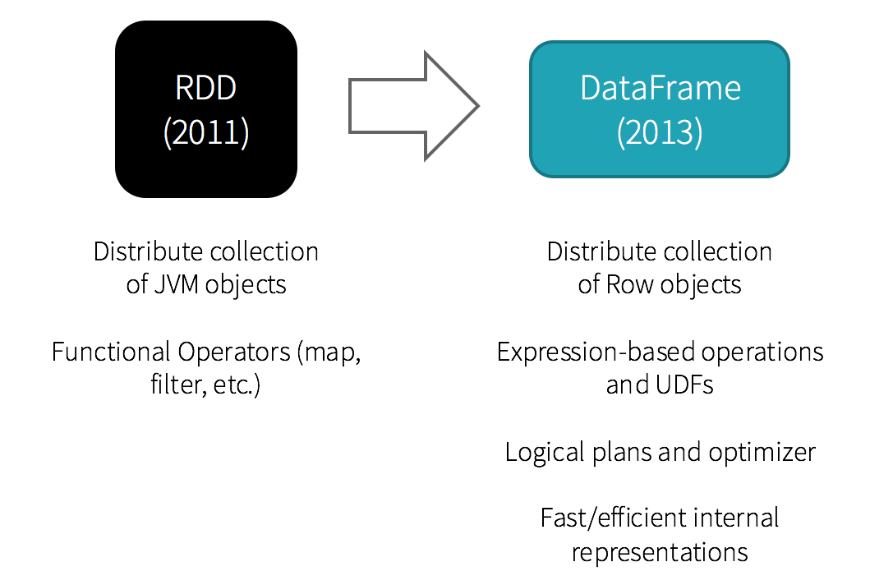
DataFrame introduction
Notes:
Spark 1.3 introduced a new DataFrame API as part of the Project Tungsten initiative which seeks to improve the performance and scalability of Spark. The DataFrame API introduces the concept of a schema to describe the data, allowing Spark to manage the schema and only pass data between nodes, in a much more efficient way than using Java serialization. There are also advantages when performing computations in a single process as Spark can serialize the data into off-heap storage in a binary format and then perform many transformations directly on this off-heap memory, avoiding the garbage-collection costs associated with constructing individual objects for each row in the data set. Because Spark understands the schema, there is no need to use Java serialization to encode the data.
The DataFrame API is radically different from the RDD API because it is an API for building a relational query plan that Spark’s Catalyst optimizer can then execute. The API is natural for developers who are familiar with building query plans, but not natural for the majority of developers. The query plan can be built from SQL expressions in strings or from a more functional approach using a fluent-style API.
SOURCES:
- http://www.agildata.com/apache-spark-rdd-vs-dataframe-vs-dataset/

Slide 18
What is DataFrame?
A DataFrame is a distributed collection of data organized into named columns. It is conceptually equivalent to a table in a relational database or a data frame in R/Python, but with richer optimizations under the hood.
Notes:
DataFrame is a distributed collection of data organized into named columns. It is conceptually equivalent to a table in a relational database or a data frame in R/Python, but with richer optimizations under the hood.

Slide 19
DataFrame example
package com.epam.sample.spark import com.epam.sample.spark.utils.PersonData import org.apache.spark.sql.SparkSession object ScalaDataFrameExample { def main(args: Array[String]) { val spark = SparkSession.builder .master("local[*]") .appName("SparkDataFrameExample") .getOrCreate() // load initial DataFrame val df = spark.createDataFrame(PersonData.read()) // verbose syntax println("Under 21") df.filter("age < 21") .collect .foreach(println) // concise syntax println("Over 21") df.filter(df.col("age").gt(21)) .collect .foreach(println) // terminate spark context spark.stop() } }
Notes:
Example: Filter by attribute with DataFrame:
SQL Style:
df.filter("age > 21");
Expression builder style:
df.filter(df.col("age").gt(21));
Because the code is referring to data attributes by name, it is not possible for the compiler to catch any errors. If attribute names are incorrect then the error will only be detected at runtime, when the query plan is created.
Another downside with the DataFrame API is that it is very scala-centric and while it does support Java, the support is limited. For example, when creating a DataFrame from an existing RDD of Java objects, Spark’s Catalyst optimizer cannot infer the schema and assumes that any objects in the DataFrame implement the scala. Product interface. Scala case classes work out the box because they implement this interface.
SOURCES:
- http://www.agildata.com/apache-spark-rdd-vs-dataframe-vs-dataset

Slide 20
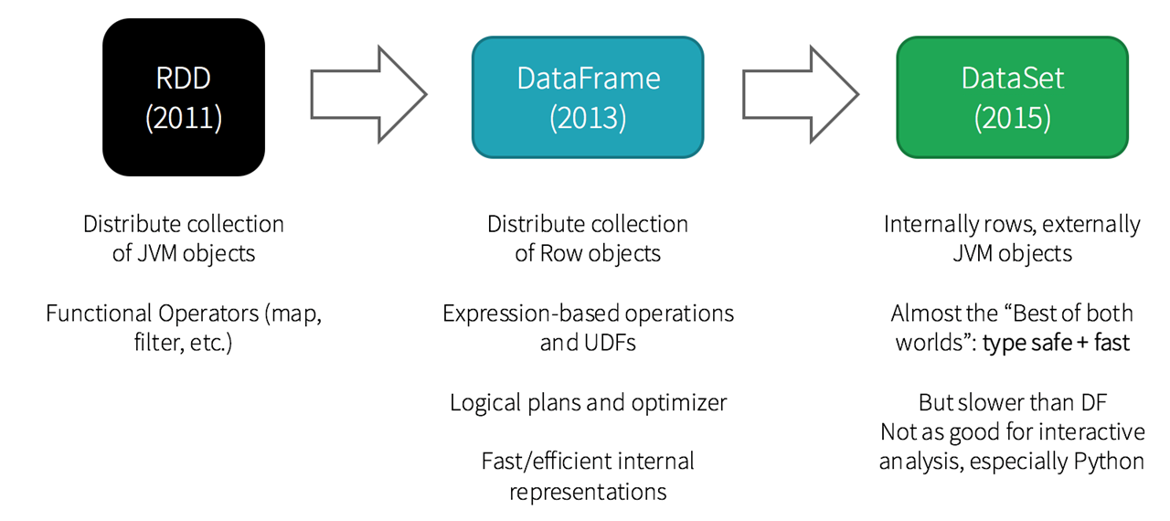
DataSet introduction
Notes:
The Dataset API, released as an API preview in Spark 1.6, aims to provide the best of both worlds; the familiar object-oriented programming style and compile-time type-safety of the RDD API but with the performance benefits of the Catalyst query optimizer. Datasets also use the same efficient off-heap storage mechanism as the DataFrame API.
When it comes to serializing data, the Dataset API has the concept of encoders which translate between JVM representations (objects) and Spark’s internal binary format. Spark has built-in encoders which are very advanced in that they generate byte code to interact with off-heap data and provide on-demand access to individual attributes without having to de-serialize an entire object. Spark does not yet provide an API for implementing custom encoders, but that is planned for a future release.
Additionally, the Dataset API is designed to work equally well with both Java and Scala. When working with Java objects, it is important that they are fully bean-compliant. In writing the examples to accompany this article, we ran into errors when trying to create a Dataset in Java from a list of Java objects that were not fully bean-compliant.
SOURCES:
- http://www.agildata.com/apache-spark-rdd-vs-dataframe-vs-dataset/

Slide 21
What is DataSet?
A DataSet is a strongly typed collection of domain-specific objects that can be transformed in parallel using functional or relational operations. Each Dataset also has an untyped view called a DataFrame, which is a Dataset of Row.
Notes:
Dataset is a strongly typed collection of domain-specific objects that can be transformed in parallel using functional or relational operations. Each Dataset also has an untyped view called a DataFrame, which is a Dataset of Row.
With Apache Spark 2 there are really only two programmatic APIs now; RDD and Dataset. For backwards compatibility, DataFrame still exists but is just a synonym for a Dataset.
SOURCES:
- http://www.agildata.com/apache-spark-2-0-api-improvements-rdd-dataframe-dataset-sql/

Slide 22
DataSet example
package com.epam.sample.spark import com.epam.sample.spark.utils.PersonData import org.apache.spark.sql.SparkSession object ScalaDataSetExample { def main(args: Array[String]) { val spark = SparkSession.builder .master("local[*]") .appName("SparkDataSetExample") .getOrCreate() // load initial RDD import spark.implicits._ val dataset = spark.createDataset(PersonData.read()) // verbose syntax println("Under 21") dataset.filter(p => p.age < 21) .collect .foreach(println) // concise syntax println("Over 21") dataset.filter(_.age > 21) .collect .foreach(println) // terminate spark context spark.stop() } }
Notes:
Transformations with the Dataset API look very much like the RDD API and deal with the Person class rather than an abstraction of a row:
dataset.filter(_.age < 21);
Despite the similarity with RDD code, this code is building a query plan, rather than dealing with individual objects, and if age is the only attribute accessed, then the rest of the object’s data will not be read from off-heap storage.
SOURCES:
- http://www.agildata.com/apache-spark-rdd-vs-dataframe-vs-dataset/

Slide 23
Spark API examples at glance
package com.epam.sample.spark import com.epam.sample.spark.utils.PersonData import org.apache.spark.{SparkConf, SparkContext} object ScalaRDDExample { def main(args: Array[String]) { val conf = new SparkConf()
.setMaster("local[*]") .setAppName("ScalaRDDExample") val sc = new SparkContext(conf) // load initial RDD val rdd = sc.parallelize(PersonData.read()) // verbose syntax println("Under 21") rdd.filter(p => p.age < 21) .foreach(println) // concise syntax println("Over 21") rdd.filter(_.age > 21) .foreach(println) // terminate spark context sc.stop() } }
package com.epam.sample.spark import com.epam.sample.spark.utils.PersonData import org.apache.spark.sql.SparkSession object ScalaDataFrameExample { def main(args: Array[String]) { val spark = SparkSession.builder .master("local[*]") .appName("SparkDataFrameExample") .getOrCreate() // load initial DataFrame val df = spark.createDataFrame(PersonData.read()) // verbose syntax println("Under 21") df.filter("age < 21") .collect .foreach(println) // concise syntax println("Over 21") df.filter(df.col("age").gt(21)) .collect .foreach(println) // terminate spark context spark.stop() } }
package com.epam.sample.spark import com.epam.sample.spark.utils.PersonData import org.apache.spark.sql.SparkSession object ScalaDataSetExample { def main(args: Array[String]) { val spark = SparkSession.builder .master("local[*]") .appName("SparkDataSetExample") .getOrCreate() // load initial RDD import spark.implicits._ val dataset = spark.createDataset(PersonData.read()) // verbose syntax println("Under 21") dataset.filter(p => p.age < 21) .collect .foreach(println) // concise syntax println("Over 21") dataset.filter(_.age > 21) .collect .foreach(println) // terminate spark context spark.stop() } }
Notes:
Let’s have one more look at all the possible ways to deal with data processing using different Spark Abstractions.

Slide 24
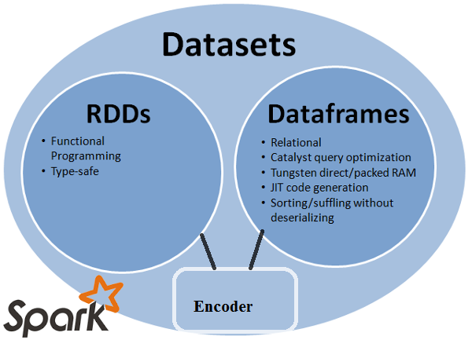
Comparing Spark API conceptions
Notes:
Spark is moving from unstructured computation (RDDs) towards structured computation because of many performance optimizations it allows . Data frame was a step in direction of structured computation but was not developer friendly in terms of compile time safety, lambda functions. Finally Dataset is the unification of DataFrame and RDD to bring the best abstraction out of two. Going forward developers should only be concerned about DataSet while DataFrame and RDD will be discouraged to use. But its always better to be aware of the legacy for better understanding of internals.
SOURCES:
https://www.linkedin.com/pulse/apache-spark-rdd-vs-dataframe-dataset-chandan-Prakash

Slide 25
Comparing Spark APIs
 | RDD | DataFrame | DataSet
Spark release | Spark 1.0 | Spark 1.3 | Spark 1.6
Data formats | structured / unstructured | structured / unstructured | structured / unstructured
Data representation | JVM objects | Row objects | Row on top of JVM objects
Optimization | no | catalyst optimizer | DataFrame catalyst optimizer
Serialization | Java serialization | off-heap serialization | off-heap serialization + encoders
Efficiency / Memory use | reduced | improved (off-heap memory) | improved (off-heap memory; on-demand access)
Compile-time safety | yes | lack | yes
Interoperability | DataFrame / DataSet | no | RDD / DataFrame
Lazy evaluation | yes | yes | yes
Programming language | Scala, Java, Python, R | Scala, Java, Python, R | Scala, Java
Schema projection | manually | automatically | automatically
Aggregation | slower | faster | faster
Notes:
Here we can see all the differences between Spark Abstractions. Most important ones are:
How data gets represented: RDD is a JVM object, while DataFrame stored data in off-heap memory and treats them as Row objects, DataSet still stores everything in off-heap memory, but translates to JVM objects when needed;
RDD can be always converted to both DataFrame and DataSet; same for DataSet, it also can be converted to both RDD and DataFrame; DataFrame cannot be converted to anything else;
Note, that Python and R have no compile-time type-safety, so they only have untyped APIs, namely DataFrames;

Slide 26
When to use?
RDD
Dataset
On unstructured data, like streams
When data manipulation involves constructs of functional programming
The data access and processing is free of schema impositions
Require low-level transformations and actions
High-degree safety at runtime
Take advantage of typed JVM objects
Take advantage of the Catalyst optimizer
Save space
Faster execution
DataSet / DataFrame
DataFrame
Rich semantics
High-level abstractions
Domain-specific APIs
Processing of high-level operations (i.e. filters maps)
Use columnar access and lambda functions on semi-structured data
Low-level functionality
Tight control
Notes:
So when we would like to use RDDs? Consider the following scenarios or common use cases for RDD:
you want low-level transformation and actions and control on your dataset;
your data is unstructured, such as media streams or streams of text;
you want to manipulate your data with functional programming constructs than domain specific expressions;
you don’t care about imposing a schema, such as columnar format, while processing or accessing data attributes by name or column;
you can forgo some optimization and performance benefits available with DataFrames and Datasets for structured and semi-structured data.
When should we use DataFrames or Datasets?
if you want rich semantics, high-level abstractions, and domain specific APIs, use DataFrame or Dataset;
if your processing demands high-level expressions, filters, maps, aggregation, averages, sum, SQL queries, columnar access and use of lambda functions on semi-structured data, use DataFrame or Dataset;
if you want higher degree of type-safety at compile time, want typed JVM objects, take advantage of Catalyst optimization, and benefit from Tungsten’s efficient code generation, use Dataset;
if you want unification and simplification of APIs across Spark Libraries, use DataFrame or Dataset;
if you are a R user, use DataFrames;
if you are a Python user, use DataFrames and resort back to RDDs if you need more control.
Previously, before Spark 2 there was a difference between DataSet and DataFrame, so we had a choice, but now as we learned DataFrame is a special kind of DataSet, and starting from Spark 2.0 we opt to use DataSet only.
SOURCES:
https://dzone.com/articles/the-dominant-apis-of-spark-datasets-dataframes-and
https://databricks.com/blog/2016/07/14/a-tale-of-three-apache-spark-apis-rdds-dataframes-and-datasets.html

Slide 27
Structured API
Spark Core
Core abstraction and processing engine
Scala
Java
Python
R
Structured APIs
Datasets
Dataframes
SQL
Low level APIs
Distributed variables
RDDs
Notes:
The Structured APIs are the fundamental abstraction that you will leverage to write the majority of your data flows. Spark has two notions of “structured” collections: DataFrames and Datasets. Let’s define what they both represent.
To the user, DataFrames and Datasets are (distributed) tables like collections with well-defined rows and columns. Each column must have the same number of rows as all the other columns (although you can use null to specify the lack of a value) and columns have type information that must be consistent for every row in the collection. To Spark, DataFrames and Datasets represent immutable, lazily-evaluated plans that specify what operations to apply to data residing at a location to generate some output. When we perform an action on a DataFrame we instruct Spark to perform the actual transformations and return the result. These represent plans of how to manipulate rows and columns to compute the user’s desired result.
SOURCES:
- Spark. The Definitive Guide.

Slide 28
Schema
package com.epam.sample.spark import org.apache.spark.sql.SparkSession object StructuredAPISchema { def main(args: Array[String]): Unit = { val spark = SparkSession.builder .master("local[*]") .appName("StructuredAPISchemaExample") .getOrCreate() val df = spark.read.format("csv").load("C:\\spark\\data\\batch\\people.csv") df.printSchema() print(df.schema) spark.stop() } }
Rosella,Burks,22,NV Damien,Avila,16,CO Robin,Olsen,21,NJ Edgar,Moises,30,OR Heath,Brian,25,WI Elvin,Claude,27,NY Edmund,Mosley,19,MI Antoine,Derek,18,WA
root
|-- _c0: string (nullable = true)
|-- _c1: string (nullable = true)
|-- _c2: string (nullable = true)
|-- _c3: string (nullable = true)
StructType(StructField(_c0,StringType,true), StructField(_c1,StringType,true), StructField(_c2,StringType,true), StructField(_c3,StringType,true))
Notes:
In order to define rows and columns, we should talk about schemas. A schema defines the column names and types of a DataFrame.
In this example we read our csv file with people’s data, then print schema using printSchema method and simply printing an object which represents schema.
To read csv file we tell Spark what format it is so Spark can do all the job for us. There is also a short cut, instead of using format(“csv”).load construction, we could simply use csv method pointing to the file we need. But here we wanted to show a generic approach.
Please note, csv is a type-less format, so our Schema tells us that all the data inside is a String data

Slide 29
JSON schema
package com.epam.sample.spark import org.apache.spark.sql.SparkSession object StructuredAPISchema { def main(args: Array[String]): Unit = { val spark = SparkSession.builder .master("local[*]") .appName("StructuredAPISchemaExample") .getOrCreate() val df = spark.read.format("json").load("C:\\spark\\data\\batch\\people.json") df.printSchema() print(df.schema) spark.stop() } }
{ "first_name": "Rosella", "last_name": "Burks", "age": 22, "state": "NV" } { "first_name": "Damien", "last_name": "Avila", "age": 16, "state": "CO" } { "first_name": "Robin", "last_name": "Olsen", "age": 21, "state": "NJ" } { "first_name": "Edgar", "last_name": "Moises", "age": 30, "state": "OR" } { "first_name": "Heath", "last_name": "Brian", "age": 25, "state": "WI" } { "first_name": "Elvin", "last_name": "Claude", "age": 27, "state": "NY" } { "first_name": "Edmund", "last_name": "Mosley", "age": 19, "state": "MI" } { "first_name": "Antoine", "last_name": "Derek", "age": 18, "state": "WA" }
root
|-- age: long (nullable = true)
|-- first_name: string (nullable = true)
|-- last_name: string (nullable = true)
|-- state: string (nullable = true)
StructType(StructField(age,LongType,true), StructField(first_name,StringType,true), StructField(last_name,StringType,true), StructField(state,StringType,true))
Notes:
Now we do exactly the same, but use json format. Did you notice, that our json is not exactly a correct json file, but pseudo-json? Apache Spark knows how to treat this kind of json data, and note, that now all is correct, age is an integer data (long to be more precisely). This is because json has data types, not everything is treated as pure Strings there.

Slide 30
Schema definition
// ...
val peopleSchema = new StructType(Array( StructField("first_name", StringType, nullable = true), StructField("last_name", StringType, nullable = true), StructField("age", LongType, nullable = true), StructField("state", StringType, nullable = true) )) val df = spark.read.format("csv") .schema(peopleSchema) .load("C:\\spark\\data\\batch\\people.csv") df.printSchema() print(df.schema) // ...
Rosella,Burks,22,NV Damien,Avila,16,CO Robin,Olsen,21,NJ Edgar,Moises,30,OR Heath,Brian,25,WI Elvin,Claude,27,NY Edmund,Mosley,19,MI Antoine,Derek,18,WA
root
|-- first_name: string (nullable = true)
|-- last_name: string (nullable = true)
|-- age: long (nullable = true)
|-- state: string (nullable = true)
StructType(StructField(first_name,StringType,true), StructField(last_name,StringType,true), StructField(age,LongType,true), StructField(state,StringType,true))
Notes:
So what can we do if Sparks reads some of our data in wrong format? We can define a Schema manually, and apply it, like we do here: we specifically say that there are few columns, and age column is a long. With nullable parameter we can let Spark know if a specific column can be null or not, to make it simple in this example we allow everything to be null.
Then we not just read a file, we read using a specific Schema (the one we created), and do you see? Age indeed is a long value now. Fantastic!

Slide 31
Back to people sampling
// ...
// load initial DataFrame val peopleSchema = new StructType(Array( StructField("first_name", StringType, nullable = true), StructField("last_name", StringType, nullable = true), StructField("age", StringType, nullable = true), StructField("state", StringType, nullable = true) )) val df = spark.read.format("csv") .schema(peopleSchema) .load("C:\\spark\\data\\batch\\people.csv") // verbose syntax println("Under 21") df.select( df.col("first_name").as("Name"), col("last_name").as("Surname"), expr("age as Years").cast("int"), lit(1).as("something") ).where("Years < 21")
.orderBy("Years") .collect .foreach(row => println(row)) // ...
// ... // load initial DataFrame val df = spark.createDataFrame(PersonData.read()) // verbose syntax println("Under 21") df.filter("age < 21") .collect .foreach(row => println(row)) // ...
Under 21
[Damien,Avila,16,CO]
[Edmund,Mosley,19,MI]
[Antoine,Derek,18,WA]
Under 21
[Damien,Avila,16,1]
[Antoine,Derek,18,1]
[Edmund,Mosley,19,1]
Notes:
As we go, we are able to improve an example we showed before. We do not need an utility class to read csv and convert it to Person, we can throw it away, and apply a schema to our CSV data file.

Slide 32
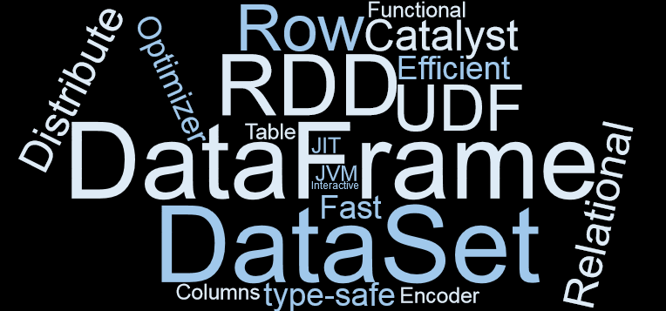
Summary
Notes:
In this chapter you have learned:
What DataFrames and Datasets are
What are the differences between various Spark Abstractions
What Structured API is

Slide 33
SPARK DEPLOYMENT

Slide 34
Spark deployment models
Spark SQL
Structured Data
Spark Sreaming
Real-time
Mllib & Spark ML
Machine Learning
GraphX
Graph Processing
Spark Core
Core abstraction and processing engine
Scala
Java
Python
SQL
R
Standalone Scheduler
YARN
Hadoop Cluster Manager
Kubernetes
(experimental)
Local Scheduler
Mesos
Notes:
We already talked about Spark Components, now it is a time to clarify more on Schedulers Spark supports:
Local scheduler
Standalone Scheduler
YARN
Mesos
Kubernetes

Slide 35
Spark submit command line
The entry point for your application (e.g. apache.spark.example.SparkPi)
./bin/spark-submit \
--class <main-class> \
--master <master-url> \
--deploy-mode <deploy-mode> \
--conf <key>=<value> \
... # other options
<application-jar> \
[application-arguments]
The master URL for the cluster
Whether to deploy your driver on worker nodes (cluster) or locally (client)
This is the path to your fat JAR file. The URL should be visible to all nodes in your cluster
These are any possible arguments that you pass to your application
Notes:
First of all, let’s talk about spark app submission. Here you can see a short command line to submit spark application. spark-submit expects couple of arguments:
main-class, which is an entry point for our application
master-url, which is spark master url
deploy-mode, whether to deploy our driver on worker nodes (cluster) or locally (client)
application-jar, which is a path to the jar with our Spark application
some arguments we would like to be passed to our spark application

Slide 36
Spark Submit Command Line Basic Options
CLI option | Spark property | Environment variable | Description | Internal property | default
--class
--master | spark.master | MASTER | Master URL. Defaults to (e.g. spark://23.195.26.187:7077) | master | local[*]
--deploy-mode | spark.submit.deployMode | DEPLOY_MODE | Whether to deploy your driver on the worker nodes (cluster) or locally as an external client (client) |  | client
--conf |  |  | Arbitrary Spark configuration property in key=value format | sparkProperties
application-jar |  |  | Path to a bundled jar including your application and all dependencies. The URL must be globally visible inside of your cluster, for instance, an hdfs:// path or a file:// path that is present on all nodes
application-arguments |  |  | Arguments passed to the main method of your main class, if any
Notes:
Here you can see basic spark submission command line options, their meaning and default values.

Slide 37
Spark Submit Command Line Options
CLI option | Spark property | Environment variable | Description | Internal property | default
--executor-memory | spark.executor.memory | SPARK_EXECUTOR_MEMORY | An executor’s memory | executorMemory | 512m
--executor-cores | spark.executor.cores | SPARK_EXECUTOR_CORES | The number of executor CPU cores | executorCores | 1
--total-executor-cores | spark.cores.max |  |  | totalExecutorCores | none
--driver-memory | spark.driver.memory | SPARK_DRIVER_MEMORY | The driver’s memory | driverMemory
--driver-cores | spark.driver.cores |  |  | driverCores
--driver-java-options | spark.driver.extraJavaOptions |  | The driver’s JVM options | driverExtraJavaOptions
--files | spark.files |  |  | files
--verbose |  |  |  | verbose
--jars | spark.jars |  | A list of jar files to be placed in the working directory of your application | jars
--name | spark.app.name | SPARK_YARN_APP_NAME (YARN only) | A human-readable name for your application | name
Notes:
Except for already mentioned options, there are much more; here we see some of the options which help us to control memory and cores used; we can also pass some files, extra jars, and even give a human readable name to our application.

Slide 38
Master URLs
Master URL | Meaning
local | Run Spark locally with one worker thread (i.e. no parallelism at all)
local[K] | Run Spark locally with K worker threads (ideally, set this to the number of cores on your machine)
local[K,F] | Run Spark locally with K worker threads and F maxFailures
local[*] | Run Spark locally with as many worker threads as logical cores on your machine
local[*,F] | Run Spark locally with as many worker threads as logical cores on your machine and F maxFailures
spark://HOST:PORT | Connect to the given Spark standalone cluster master
spark://HOST1:PORT1,HOST2:PORT2 | Connect to the given Spark standalone cluster with standby masters with Zookeeper
mesos://HOST:PORT | Connect to the given Mesos cluster. To submit with --deploy-mode cluster
yarn | Connect to a YARN cluster in client or cluster mode depending on the value of --deploy-mode. The cluster location will be found based on the HADOOP_CONF_DIR or YARN_CONF_DIR variable.
k8s://HOST:PORT | Connect to a Kubernetes cluster in cluster mode. The HOST and PORT refer to the Kubernetes API Server. It connects using TLS by default. In order to force it to use an unsecured connection, you can use k8s://http://HOST:PORT.
Notes:
There are many different ways to set master url. All depends on what our Scheduler is. In simplest case, we use a local scheduler, then we have many options on how to schedule out resources locally: we can limit it to one thread, assign a specific number of threads, or give all the possible cores.
We can set spark standalone master, whose port by default is 7077
Mesos uses 5050 by default; if Mesos uses Zookeeper then we use mesos://zk://....
We can also pass Kubernetes as a master scheduler. Note that Kubernetes client mode is not supported, but planned for future releases.

Slide 39
Local mode
Local Machine
Spark: master=local[4]
Driver, core 1
Worker, core 2
Executor 1
Worker 2, core 3
Worker 3, core 4
Executor 2
Executor 3
Notes:
Spark local mode (or pseudo-cluster) is a non-distributed single-JVM deployment mode. Spark spawns all the execution components - driver, executor, LocalSchedulerBackend, and master - in the same single JVM. The default parallelism is the number of threads as specified in the master URL. This is the only mode where a driver is used for execution.
The local mode is very convenient for testing, debugging or demonstration purposes as it requires no earlier setup to launch Spark applications.
Tasks are not re-executed on failure in local mode (unless local-with-retries master URL is used).

Slide 40
Cluster Scheduling Architectures
Notes:
Before talking about cluster managers, let’s step back a bit and talk about what cluster manager is and its possible implementations.
A cluster manager provides centralized management of a cluster, enabling streamlined deployment of core services over the cluster and their subsequent monitoring. There are couple of ways how scheduler can work:
Monolithic – a single scheduler process runs on one machine, and assigns tasks to machines. All workloads are handled by the same scheduler, and all tasks run through the same scheduling logic.
Drawbacks:
It is quite reasonable to expect a scheduler to treat long-running service jobs and batch analytics jobs differently.
Since different applications have different needs, supporting them all keeps adding features to the scheduler, increasing the complexity of its logic and implementation.
The order in which the scheduler processes tasks becomes an issue: queueing effects (e.g., head-of-line blocking) and backlog can become an issue unless the scheduler is carefully designed.
Two-level scheduling architectures address this problem by separating the concerns of resource allocation and task placement. This allows the task placement logic to be tailored towards specific applications, but also maintains the ability to share the cluster between them. Drawbacks:
Priority preemption (higher priority tasks kick out lower priority tasks) becomes difficult to implement: in an offer-based model, the resources occupied by running tasks aren't visible to the upper-level schedulers; in a request-based model, the lower-level resource manager must understand the preemption policy (which may be application-dependent).
Schedulers are unable to consider interference from running workloads that may degrade resource quality (e.g., "noisy neighbors" that saturate I/O bandwidth), since they cannot see them.
Application-specific schedulers care about many different aspects of the underlying resources, but their only means of choosing resources is the offer/request interface with the resource manager. This interface can easily become quite complex.
Shared-state architectures address this by moving to a semi-distributed model, in which multiple replicas of cluster state are independently updated by application-level schedulers. After the change is applied locally, the scheduler issues an optimistically concurrent transaction to update the shared cluster state. This transaction may fail, of course: another scheduler may have made a conflicting change in the meantime. Drawbacks:
they must work with stale information (unlike a centralized scheduler)
They may experience degraded scheduler performance under high contention (although this can apply to other architectures as well).
Although Spark supports different schedulers, there has been no supported Shared State Scheduler …
SOURCES:
http://www.bigdatapatterns.org/mechanisms/cluster_manager
http://www.firmament.io/blog/scheduler-architectures.html
https://www.cl.cam.ac.uk/research/srg/netos/camsas/blog/2016-03-09-scheduler-architectures.html

Slide 41
Standalone cluster manager
Slave
Worker
Memory
Core 1
Worker
Memory
Core 1
Master
Master
…
Memory
Core 1
History Server
…
Worker
Memory
Core 1
…
Worker
Memory
Core 1
…
Memory
Core 1
Notes:
The Spark Standalone cluster manager is a simple cluster manager available as part of the Spark distribution. It has HA for the master, is resilient to worker failures, has capabilities for managing resources per application, and can run alongside of an existing Hadoop deployment and access HDFS (Hadoop Distributed File System) data. The distribution includes scripts to make it easy to deploy either locally or in the cloud on Amazon EC2.
Standalone cluster manager follows Monolithic Scheduler Architecture and uses a simple FIFO scheduler for applications. By default, each application uses all the available nodes in the cluster. The number of nodes can be limited per application, per user, or globally. Other resources, such as memory, cpus, etc. can be controlled via the application’s SparkConf object.
For standalone clusters, Spark currently supports two deploy modes. In client mode, the driver is launched in the same process as the client that submits the application. In cluster mode, however, the driver is launched from one of the Worker processes inside the cluster, and the client process exits as soon as it fulfills its responsibility of submitting the application without waiting for the application to finish.
SOURCES:
http://progexc.blogspot.com/2015/09/hacking-and-bending-spark-standalones.html
https://spark.apache.org/docs/latest/spark-standalone.html

Slide 42
Hadoop YARN
Client node
Resource Manager node
Node Manager node
Application client
1
ResourceManager
2
NodeManager
3
Container
Node Manager node
1 - Submit YARN Application
2 – Start Container
3 – Launch Container
4 – Allocate Resources (heartbeat)
5 – Start Container
6 – Launch Container
5
NodeManager
4
Application Process
6
Container
Application Process
Notes:
Hadoop YARN, a distributed computing framework for job scheduling and cluster resource management, has HA for masters and slaves, support for Docker containers in non-secure mode,
YARN manager is a Two-Level Scheduler Architecture with limited implementation (YARN kind of shares features of Monolithic and Two-Level architectures).
Application-level logic cannot choose resources (unless it requests much more that it needs from the resource manager), but it can only place application-level "tasks" to pre-existing containers that represent cluster-level tasks. This is a good fit for a system like Hadoop MapReduce, in which application-level tasks (maps and reduces) must be assigned to a dynamic collection of workers in an application-specific way (e.g., optimized for data locality and per-job). It is less suited to building a more general, multi-application scheduler on top – for example, a service scheduler like the "Marathon" framework for Mesos.
YARN is optimized for scheduling Hadoop jobs, which are historically (and still typically) batch jobs with long run times. This means that YARN was neither designed for long-running services, nor for short-lived interactive queries (like small and fast Spark jobs), and while it’s possible to have it schedule other kinds of workloads, this is not an ideal model. The resource demands, execution model, and architectural demands of MapReduce are very different from those of long-running services, such as web servers or SOA applications, or real-time workloads like those of Spark or Storm. Also, YARN was designed for stateless batch jobs that can be restarted easily if they fail. It does not handle running stateful services like distributed file systems or databases. While YARN’s monolithic scheduler could theoretically evolve to handle different types of workloads (by merging new algorithms upstream into the scheduling code), this is not a lightweight model to support a growing number of current and future scheduling algorithms.
SOURCES:
https://www.safaribooksonline.com/library/view/hadoop-the-definitive/9781491901687/ch04.html
https://www.oreilly.com/ideas/a-tale-of-two-clusters-mesos-and-yarn

Slide 43
Spark client deployment with YARN
YARN Container
Spark Application Master
YARN Resource Manager
Client
Resource request / reply
Launch application
Spark Driver
Issue Application Commands
Launch Spark Executor
YARN NodeManager
YARN Container
YARN Container
Spark Task
Spark Executor
Spark Executor
Notes:
There are two deploy modes that can be used to launch Spark applications on YARN. In cluster mode, the Spark driver runs inside an application master process which is managed by YARN on the cluster, and the client can go away after initiating the application
SOURCES:
- https://spark.apache.org/docs/latest/running-on-yarn.html

Slide 44
Spark client deployment with YARN
Client application
YARN Container
Spark Application Master
YARN Resource Manager
Spark Driver
Application commands
Resource request / reply
Issue Application Commands
Launch Spark Executor
YARN NodeManager
YARN Container
YARN Container
Spark Task
Spark Executor
Spark Executor
Notes:
In client mode, the driver runs in the client process, and the application master is only used for requesting resources from YARN.
So YARN supports client and cluster deployment models. To choose which one to use we need to understand where we are comparing to the Spark Cluster:
In the same network (so client model can be good: the driver is launched directly within the spark-submit process which acts as a client to the cluster)
Out of the cluster network (cluster model can fit better to minimize network latency between the drivers and the executors and it is less vulnerable to remote disconnects crashing the driver and the entire spark job)
SOURCES:
https://spark.apache.org/docs/latest/running-on-yarn.html
https://banzaicloud.com/blog/spark-k8s-scheduler/

Slide 45
Spark submit cluster with YARN
2
Client
YARN Resource Manager
YARN Container
Host
1
YARN NodeManager
Spark Application Master
6
Spark Driver
7
1 - Submit Application
2 - Launch Application Master
3 - Run Driver
4, 5 - Request Resources
6 - Launch Containers
7 - Launch Spark Executors
8 - Register with the Driver
9 - Launch Tasks
4
SparkContext
YARN Container
8
Executor Container
5
9
3
Notes:
Here you can see the whole flow, of what happens when we submit a Spark application in cluster mode using YARN cluster manager. First YARN resource manager launches Application master in YARN container. That master requests some resources, launches containers with them and launches spark executers inside. These executers are registered with the Driver and Spark is good to run tasks.
SOURCES:
https://aws.amazon.com/blogs/big-data/submitting-user-applications-with-spark-submit/

Slide 46
Spark submit client with YARN
Client
YARN Container
Host
YARN Resource Manager
2
5
YARN NodeManager
Spark Driver
Spark Application Master
6
3
SparkContext
4
7
YARN Container
8
Executor Container
1
9
1 - Run Driver
2 - Submit Application
3 - Launch Application Master
4, 5 - Request Resources
6 - Launch Containers via YARN NodeMaster
7 - Launch Spark Executors
8 - Register with the Driver
9 - Launch Tasks
Notes:
Here is a flow of what happens when we submit in client mode using YARN, but the only difference is that Driver runs on the client node.
SOURCES:
https://aws.amazon.com/blogs/big-data/submitting-user-applications-with-spark-submit/

Slide 47
Apache Mesos
Framework
ZK
ZK
Scheduler
ZK
Master Leader
Master Standby
Master Standby
Slave
Slave
Slave
Executor
Executor
Executor
Task
Task
Task
Task
Task
Task
Notes:
Apache Mesos is another popular cluster manager. Unlike YARN, which has been developed specifically to serve Hadoop MapReduce, Mesos was built to be a global resource manager for entire data center.
Mesos determines which resources are available, and it makes offers back to an application scheduler (the application scheduler and its executor is called a “framework”). Those offers can be accepted or rejected by the framework. This model is considered a non-monolithic model because it is a “two-level” scheduler, where scheduling algorithms are pluggable. Mesos allows an infinite number of schedule algorithms to be developed, each with its own strategy for accepting or declining offers, and can accommodate thousands of these schedulers running multi-tenant on the same cluster.
The two-level scheduling model of Mesos allows each framework to decide which algorithms it wants to use for scheduling the jobs. Mesos plays the arbiter, allocating resources across multiple schedulers, resolving conflicts, and making sure resources are fairly distributed based on business strategy. Offers come in, and the framework can then execute a task that consumes those offered resources. Or the framework has the option to decline the offer and wait for another offer to come in. This model is very similar to how multiple apps all run simultaneously on a laptop or smartphone, when they spawn new threads or request more memory, and the operating system arbitrates among all of the requests. One of the nice things about this model is that it is based on years of operating system and distributed systems research and is very scalable. This is a model that Google and Twitter have proven at scale.
Spark on Apache Mesos also supports client and cluster modes. There are also two modes Spark can run over Mesos:
coarse-grained (default): each Spark executor runs as a single Mesos task
fine-grained (deprecated): each Spark task inside the Spark executor runs as a separate Mesos task
From the Granularity point of view, Coarse-grained materials or systems have fewer, larger discrete components than fine-grained materials or systems.
A coarse-grained description of a system regards large subcomponents.
A fine-grained description regards smaller components of which the larger ones are composed.
Coarse-grained mode provides lower latency, whereas fine-grained mode provides higher utilization.
SOURCES:
https://www.oreilly.com/ideas/a-tale-of-two-clusters-mesos-and-yarn
https://spark.apache.org/docs/latest/running-on-mesos.html
https://en.wikipedia.org/wiki/Granularity

Slide 48
Kubernetes
Client Node
Kubernetes Master
Kubelet
Application Client
1
Scheduler
3
Driver
2
Kubelet
7
1 - Submit Application
2 - Upload Artifacts
3 - Request Driver Pod
4 - Schedule Driver Pod
5 - Request Executor Pod
6 - Schedule Executor Pod
7 - Deploy Tasks to be executed
8 - Use Shuffle Service
Executor
4
Spark Resource Staging Server
Driver Launcher Server
8
API Server
5
Spark Driver Pod
6
Shuffle Service
Spark Executor Pod
Notes:
Kubernetes is an open-source container-orchestration system for automating deployment, scaling and management of containerized applications[4] that was originally designed by Google and now maintained by the Cloud Native Computing Foundation. It aims to provide a "platform for automating deployment, scaling, and operations of application containers across clusters of hosts". It works with a range of container tools, including Docker.
Kubernetes is an advanced type of monolithic scheduler for Pods (a collection of co-located containers that share same namespaces). Originally developed by Google, Kubernetes is lightweight, portable, and massively scalable. The design is highly decoupled and can split into two main components: a control plane and worker node services. The control plane which takes care of assigning containers to nodes and manages cluster configuration. Worker node services, which run on the individual machines in your cluster, manage the local containers.
Within Kubernetes, we have the concept of pod. This is a group of collocated containers, like a pod of whales, or a pod of peas. Containers in the same pod share the same namespace. Namespaces are used for service discovery and segregation.
SOURCES:
- https://deis.com/blog/2016/schedulers-pt2-kubernetes/
/

Slide 49
Cluster managers comparison
Standalone
MESOS
Easiest to setup
Requires each application to run executor on every node
Cannot run Spark along other applications in cluster
No rich scheduling functionality
Enables coarse-grained sharing of resource by giving resource offers
Separates scheduling and execution
YARN
Kubernetes
Single process is responsible for both driving the application and requesting resources
Client does not need to run for the lifecycle of the application
Not well suited for Spark interactivity
Is part of Hadoop infrastructure
Broader range of workloads, i.e. data processing and container orchestration can be handled through a single interface
Can share nodes between Spark and cloud-native applications
Better isolation between workloads, allowing nodes to support batches of varying latency, sensitivity and other characteristics.
Notes:
There is short comparison of cluster managers supported by Spark:
Standalone is the easiest to setup, but lacks rich scheduling functionality and can be used only for Spark
YARN comes as a part of Hadoop ecosystem, responsible for both driving the app and requesting resources, is more advanced then Standalone manager
Mesos and Kubernetes both can manage the whole data center, enable coarse grained sharing of resources. Mesos separates scheduling and executing
SOURCES:
https://www.stratoscale.com/blog/kubernetes/using-kubernetes-for-big-data-workloads/
http://blog.madhukaraphatak.com/scaling-spark-with-kubernetes-part-1/
https://thenewstack.io/mesos-smack-stack-versus-kubernetes-smart-clusters-hosting-spark/

Slide 50

SBT build definition
name := "HelloSpark" version := "0.1" scalaVersion := "2.11.12" val sparkVersion = "2.3.0" libraryDependencies ++= Seq( "org.apache.spark" %% "spark-core" % sparkVersion, "org.apache.spark" %% "spark-sql" % sparkVersion )
Notes:
To submit a spark application, we need a jar to be built. We can use SBT: a Simple Build Tool for this purpose. Here you can see a simple SBT configuration file which tells how our application is called (and therefore jar file will be named), and its version. Then we define Scala and Spark version to be used, and application dependencies (Spark Core and Spark SQL)

Slide 51
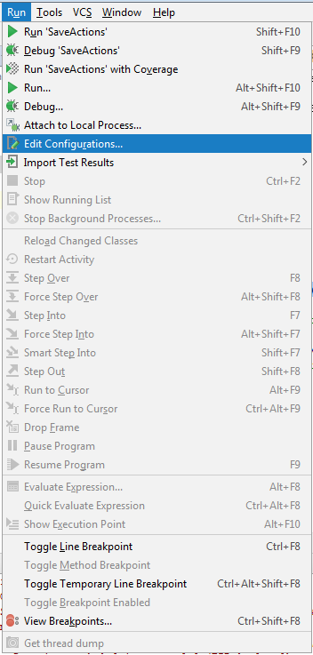
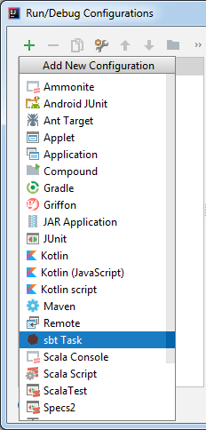
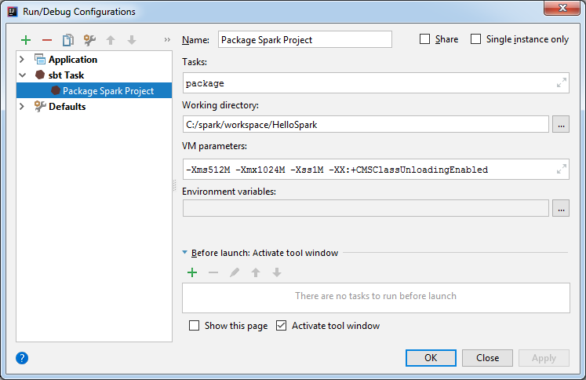
Packaging Procedure
1
3
4
2
Notes:
To package the application from inside Intellij IDEA we can run simple steps:
Run -> Edit Configuration
Select “sbt Task”
You can give this task a name (e.g. “Package Spark Project”)
And type in SBT tasks you want to perform; in our case it is just “package” which builds the application and creates (“packages”) a jar file out of it

Slide 52
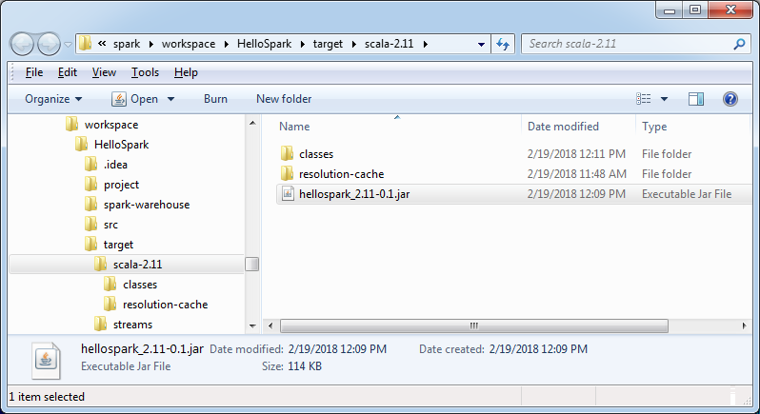
Spark application package
Notes:
Once ran, we can find a hellospark_2.11-0.1.jar file in target folder of our project sources. 2.11 is added to notify that this file was created to be ran by Scala 2.11, and 0.1 identifies the version of our application

Slide 53
Build Management at Glance
name := "HelloSpark" version := "0.1" scalaVersion := "2.11.12" val sparkVersion = "2.3.0" libraryDependencies ++= Seq( "org.apache.spark" %% "spark-core" % sparkVersion, "org.apache.spark" %% "spark-sql" % sparkVersion )
> mvn package
> sbt package
<project> <modelVersion>4.0.0</modelVersion> <groupId>com.epam</groupId> <artifactId>hellospark</artifactId> <version>0.1</version> <properties> <encoding>UTF-8</encoding> <scala.version>2.11.12</scala.version> <scala.compat.version>2.11</scala.compat.version> <spark.version>2.3.0</spark.version> </properties> <dependencies> <dependency> <groupId>org.scala-lang</groupId> <artifactId>scala-library</artifactId> <version>${scala.version}</version> </dependency> <dependency> <groupId>org.apache.spark</groupId> <artifactId>spark-core_${scala.compat.version}</artifactId> <version>${spark.version}</version> </dependency> <dependency> <groupId>org.apache.spark</groupId> <artifactId>spark-sql_${scala.compat.version}</artifactId> <version>${spark.version}</version> </dependency> </dependencies> <build> <plugins> <plugin> <groupId>org.scala-tools</groupId> <artifactId>maven-scala-plugin</artifactId> <version>2.15.2</version> <executions> <execution> <goals> <goal>compile</goal> </goals> </execution> </executions> </plugin> </plugins> </build> </project>
group 'com.epam' version '0.1' apply plugin: 'scala' def scalaVersion = '2.11.12' def scalaCompatVersion = '2.11' def sparkVersion = '2.3.0' repositories { mavenCentral() } dependencies { compile "org.scala-lang:scala-library:$scalaVersion" compile "org.apache.spark:spark-core_$scalaCompatVersion:$sparkVersion" compile "org.apache.spark:spark-sql_$scalaCompatVersion:$sparkVersion" }
> gradle jar
Notes:
We have showed you how to build a project using SBT, but chances are that you are familiar with other build management systems. Here we gonna show you how our build file would look if we use Gradle or Maven, and command line to make same package as we did with SBT.
Although going deeper into comparison of different build tools goes beyond this course, we would like to make a high level hints for you:
first goes already recognizable one – SBT. SBT was created specifically to be a main build tool for Scala, so no surprise it looks like the most minimalistic one, and uses Scala DSL. Although it stands for “Simple Build Tool”, some people don’t find it simple when project growth and your expectations from a build tool grow as well…
Gradle is another DSL build on top of Groovy language. Gradle comes across as an agnostic build tool, so we need a couple of lines to be added to reflect Scala language dependencies. But overall it still stays clean, very flexible and has bigger community to support you. Some big projects (like Spring) moved away from Maven to Gradle for its flexibility and minimalism (comparing to Maven build files).
Maven is quite a standard build tool in Java world. Although it can be used for other JVM languages as well (like Scala in this case). When we say Maven we think of XML, which is the most obvious difference comparing to SBT and Gradle. And therefore Maven feels like less flexible, but on the other hand Maven is here for a long time which results in better support, as well as many people use Maven say for “ages”, which is not the least when you decide on the build tool.
That was a brief comparison, in the end of the day you decide which way to go, and the best would be to try all of them and make your own impression on them.

Slide 54
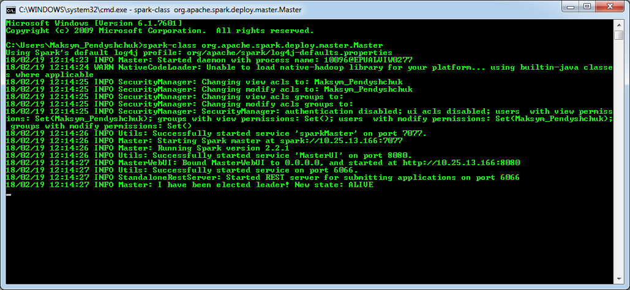
Running Master in Standalone Mode
Notes:
Now we are good to proceed. First of all we need to run Spark Cluster. In Linux there is a shell script to do it, on Windows we need to do it manually, meaning we should run Master and then Workers on our own. Here you can see a command line used to run Spark Master. At some point we can see a host Spark Master starts at, and then we see UI url of Spark Master.

Slide 55
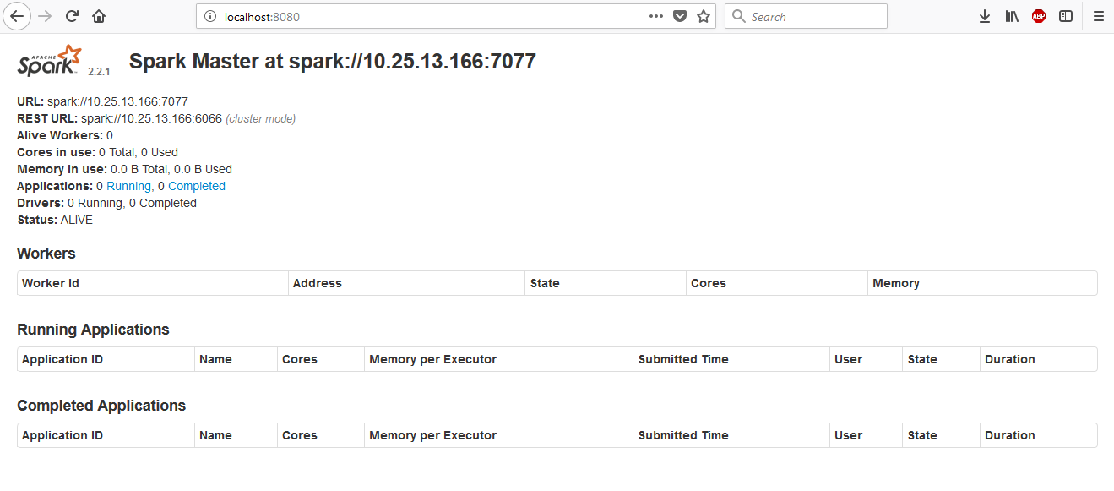
Spark Standalone Web UI
Notes:
If we open web UI we will see a screen similar to this one. It will also tell you where Spark Master is running (an IP with 7077 port by default). Please note, there are no workers yet…

Slide 56
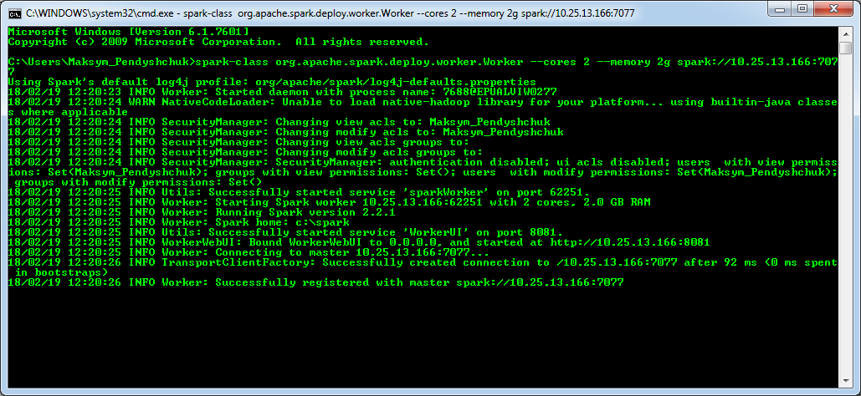
Running Worker in Standalone Mode
Notes:
To run Workers we should run another Spark Class and we can tune Worker up: assign number of CPU cores, memory to be used, and it is necessary to refer to Spark Master. At the end we will be notified that Worker successfully registered with our Master.

Slide 57
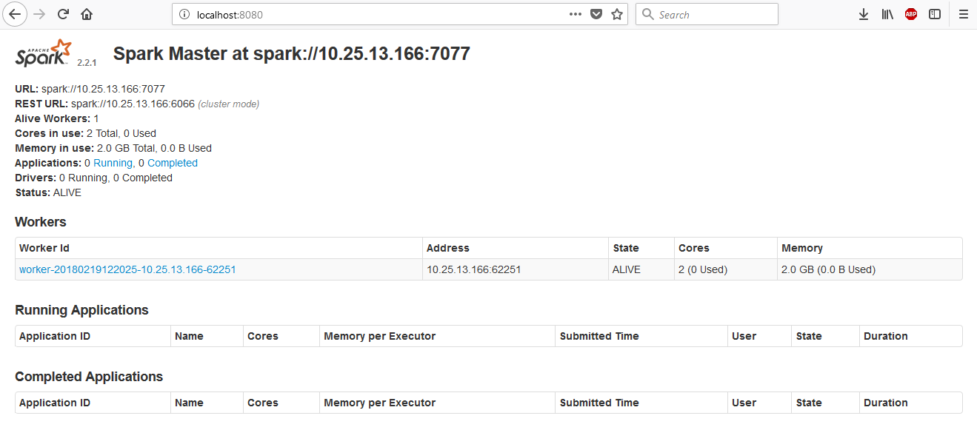
Spark Submit Standalone
Notes:
Let’s refresh our Spark Web UI, and we can see that our new Worker is already there.

Slide 58
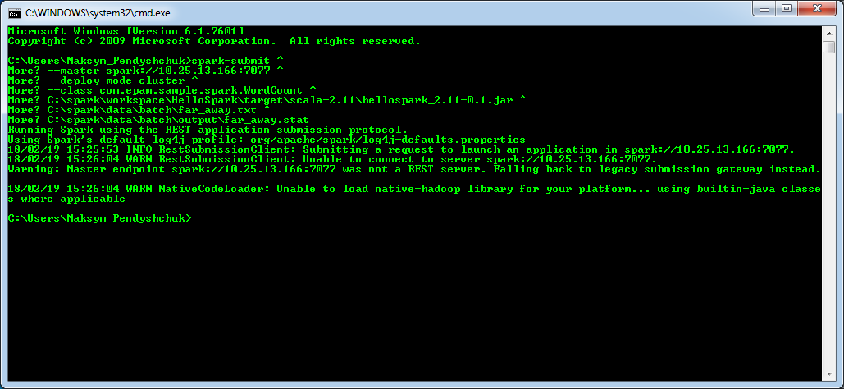
Submitting Spark Driver
Notes:
Now we can submit our application using spark-submit command line, pointing to our Spark Master; in this example we run our Word Counter application providing an input file to count words and where to store the result.

Slide 59
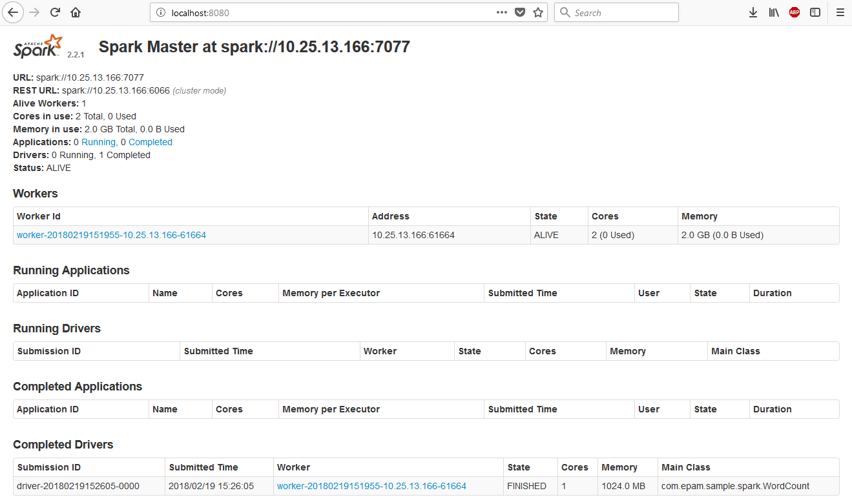
Driver Completed
Notes:
Spark Web UI will show all the drivers which are running or completed, so we can actually find its status and logs if needed. In this case our Driver had finished before we refreshed that page.

Slide 60
Submitting Spark Application
package com.epam.sample.spark import org.apache.spark.{SparkConf, SparkContext} object WordCount { def main(args: Array[String]): Unit = { val conf = new SparkConf() .setAppName("Word Count") // .setMaster("local[*]") val sc = new SparkContext(conf) val textFile = sc.textFile(args(0)) val counts = textFile.flatMap(line => line.split(" ")) .map(word => (word, 1)) .reduceByKey(_ + _) counts.saveAsTextFile(args(1))
sc.stop()
} }
Notes:
And did you notice that? We submitted our jar, but we kept it running in local mode, as it was hardcoded in our sources. Being back and commenting that line out, and rebuilding the jar we can submit it again, and in this time it should be run on cluster.

Slide 61
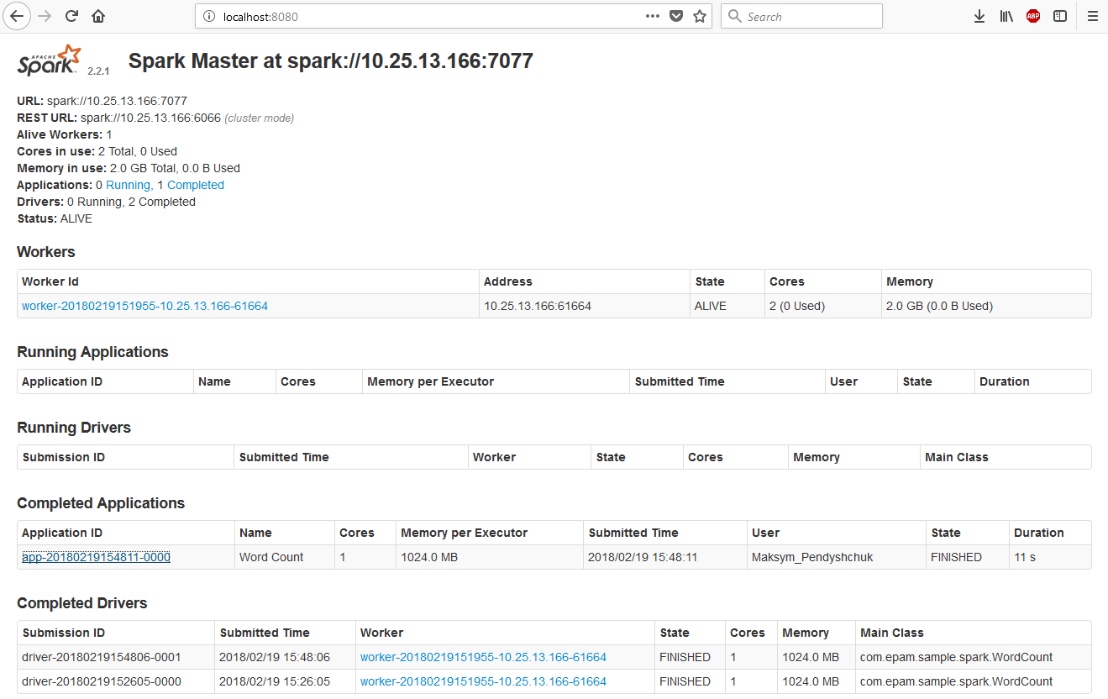
Application Completed
Notes:
You see? Now Spark UI has a row that we have one application completed, so finally we worked itout.

Slide 62
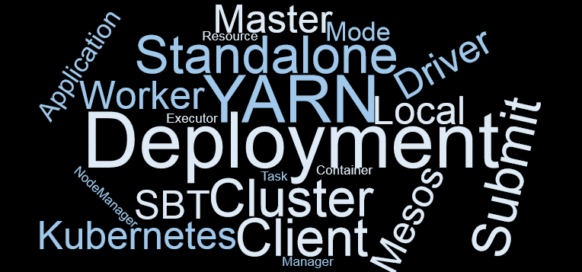
Summary
Notes:
You’ve learned:
Which Spark deployment modes exist
What are cluster managers, and what kind of architecture they have
Which cluster managers are supported by Spark
How to deploy Spark application
Brief overview of Spark Master Web UI

Slide 63
SPARK WEB UI

Slide 64
Submitting Spark application
package com.epam.sample.spark import org.apache.spark.{SparkConf, SparkContext} object WordCount { def main(args: Array[String]): Unit = { val conf = new SparkConf() .setAppName("Word Count") // .setMaster("local[*]") val sc = new SparkContext(conf) val textFile = sc.textFile(args(0)) val counts = textFile.flatMap(line => line.split(" ")) .map(word => (word, 1)) .reduceByKey(_ + _) counts.saveAsTextFile(args(1))
Thread.sleep(10 * 60 * 1000) // 10 minutes
sc.stop()
} }
Notes:
We still are going to use same word counting application to show Spark UI. Previously you’ve learned that Spark Master has a web application so you can see what’s going on overall. Remember, when we talked about Spark Driver, we told that it was responsible for UI as well? So it means each Spark application also has some UI, and we are going to take a look at it.
Spark UI is available only while Driver is running, and since our word counting app is very fast, for learning purpose we can “hack” it, and ask to sleep for 10 minutes when all the calculations get done.

Slide 65
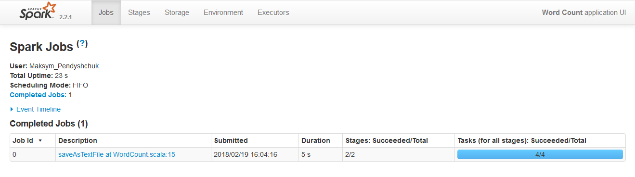
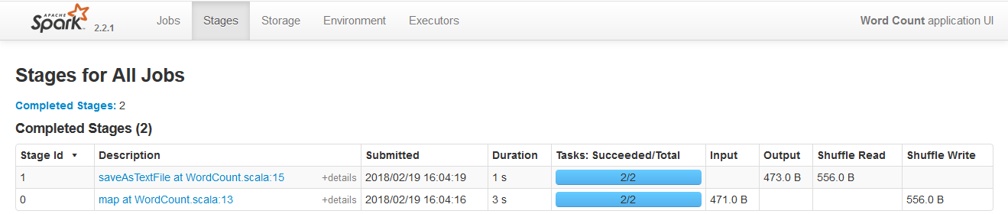
Spark application WebUI
Notes:
Now, when we run that application, we can navigate to Spark UI. It has a list of Jobs, and all the stages the Spark creates.

Slide 66
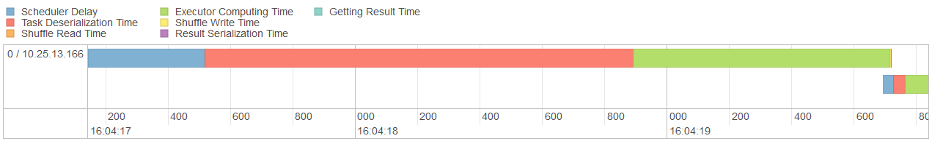
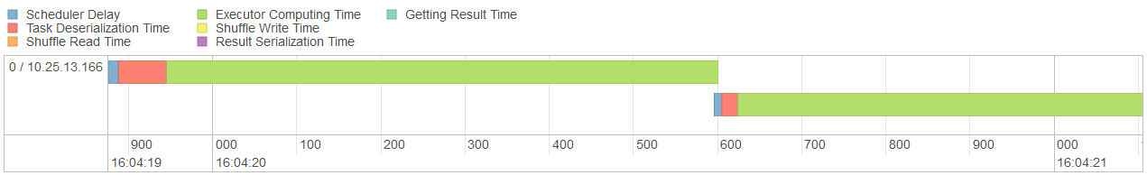
Stage event timeline
Stage 0:
Stage 1:
Notes:
Another useful view is Event Timeline, here we can analyze how much time where were spend, it might be helpful for twicking our Spark applications.

Slide 67
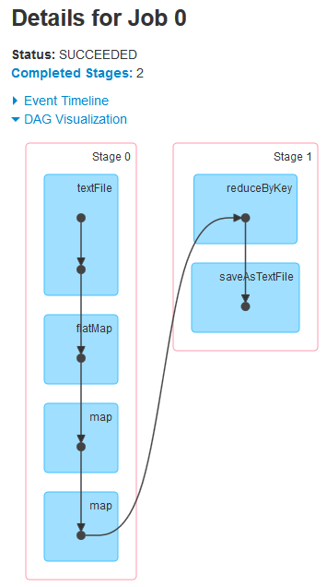
DAG visualization
package com.epam.sample.spark import org.apache.spark.{SparkConf, SparkContext} object WordCount { def main(args: Array[String]): Unit = { val conf = new SparkConf() .setAppName("Word Count") // .setMaster("local[*]") val sc = new SparkContext(conf) val textFile = sc.textFile(args(0)) val counts = textFile.flatMap(line => line.split(" ")) .map(word => (word, 1)) .reduceByKey(_ + _) counts.saveAsTextFile(args(1))
sc.stop()
} }
Notes:
It even creates a visualization for DAG built for that application. For instance our word counting application has 2 stages, firs stage creates an RDD from the input text file, splits the content by whitespaces, maps 1 to each word, and that’s all at this stage. Next stage runs reduceByKey task, and saves the result to a file.

Slide 68
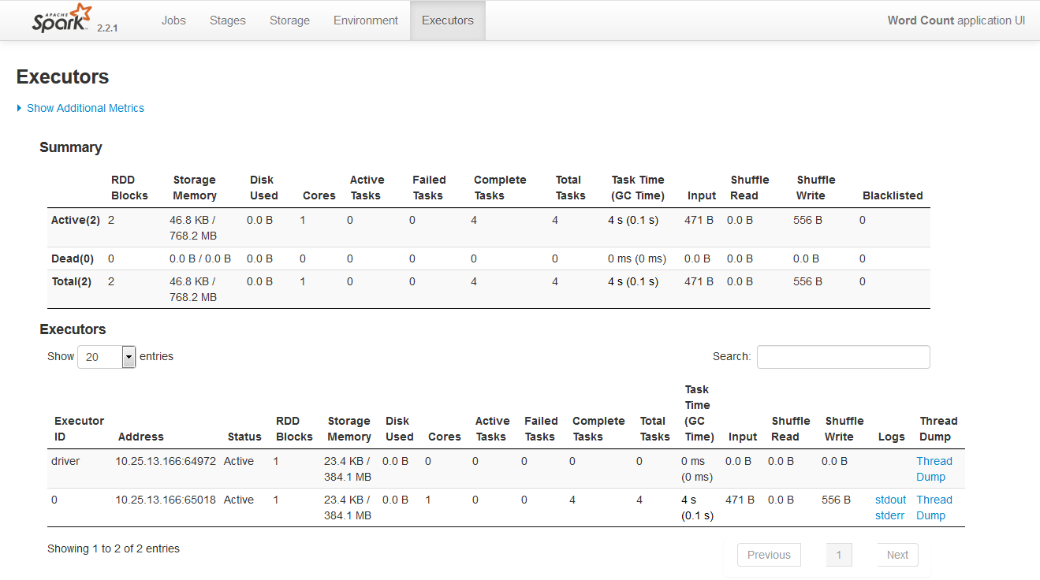
Executors summary
Notes:
Also we can see a summary by executors.

Slide 69
Spark REST API
package com.epam.sample.spark import java.text.SimpleDateFormat import org.json4s.jackson.JsonMethods.parse import scala.io.Source.fromURL import java.util.Date import org.json4s.DefaultFormats object SparkAppStats { val hostname = "localhost" val appId = "app-20180417180351-0014" val url = s"http://$hostname:4040/api/v1/applications/$appId/jobs" case class SparkJob(jobId: Int, name: String, submissionTime: Date, completionTime: Option[Date], stageIds: List[Int]) { def getDurationMillis: Option[Long] = completionTime.map(_.getTime - submissionTime.getTime) } implicit val formats = new DefaultFormats { override def dateFormatter = new SimpleDateFormat("yyyy-MM-dd'T'HH:mm:ss.SSSZ") } def main(args: Array[String]) { val json = fromURL(url).mkString val completedJobs: List[SparkJob] = parse(json) .extract[List[SparkJob]] .filter(_.getDurationMillis.isDefined) completedJobs .groupBy(_.name) .mapValues(list => (list.map(_.getDurationMillis.get).sum, list.size)) .foreach { case (name, (time, count)) => println(s"TIME: $time\tAVG: ${time / count}\tNAME: $name") } } }
TIME: 5953 AVG: 5953 NAME: saveAsTextFile at WordCount.scala:15
Notes:
The Spark UI in which our driver runs also has a REST API, so we can build other tools around and monitor our Spark Applications. In this example we calculate the time spent for all our jobs.

Slide 70

Summary
Notes:
You’ve learned about Spark Application Web UI and a possibility to use REST API.

Slide 71
THANK YOU!
MAKSYM_PENDYSHCHUK@EPAM.COM

