Slide 1
APPLICATION OF DATA-MINING TO BUILD RECOMMENDATION SYSTEM
FOR HOTEL REVIEW
PROJECT BY: GUIDED BY:
EKAMBER CHADDA 11-CSS-17 MR. FAIYAZ AHMAD
HATIM TAI 11-CSS-21

Slide 2
AIM OF THE PROJECT
To build a system capable of processing the
customers’ reviews for different 5 star hotels of
Delhi and mining some useful information
from it .
In particular the project focused on extracting
information on six predefined features :
“breakfast “ , “staff” , “service” , “location” ,
“swimming pool” and “rooms”

Slide 3
TOOLS USED
PYTHON Programming language used for building the system
NLTK (NATURAL LANGUAGE TOOL KIT) A leading platform for building python programs to work with human language data
STANFORD PARSER Parser to analyze grammatical structure of sentence
SENTIWORDNET A lexical resource for opinion mining

Slide 4
DATA SET
Data set comprised of reviews collected from various travelling websites like tripadvisor.com and booking .com of following hotels:
HYATT REGENCY | 30 REVIEWS
THE LALIT | 31 REVIEWS
TAJ PALACE | 30 REVIEWS
THE OBEROI | 30 REVIEWS
ITC MAURYA | 27 REVIEWS

Slide 5
FLOW CHART OF THE PROJECT
CLEANING THE DATA SET
POS TAGING THE REVIEWS USING NLTK AND STANDFORD PARSER
EXTRACTING THE FEATURES LINKED WITH THE PREDEFINED WORDS
SENTIMENT ANALYSIS OF THE EXTRACTED FEATURES USING SENTIWORDNET

Slide 6
POS TAGGING THE REVIEWS
“impeccable service yes it is pricey but the service makes it worth it the taj hotels are known for their warm indian hospitality certainly lived up to their reputation everywhere you went greeted with smiles i was not very well during my stay the reception staff could not do enough”
(after pos tagging)
[(u'impeccable', u'JJ'), (u'service', u'NN'), (u'yes', u'RB'), (u'it', u'PRP'), (u'is', u'VBZ'), (u'pricey', u'JJ'), (u'but', u'CC'), (u'the', u'DT'), (u'service', u'NN'), (u'makes', u'VBZ'), (u'it', u'PRP'), (u'worth', u'IN'), (u'it', u'PRP'), (u'the', u'DT'), (u'taj', u'NN'), (u'hotels', u'NNS'), (u'are', u'VBP'), (u'known', u'VBN'), (u'for', u'IN'), (u'their', u'PRP$'), (u'warm', u'JJ'), (u'indian', u'JJ'), (u'hospitality', u'NN'), (u'certainly', u'RB'), (u'lived', u'VBD'), (u'up', u'RP'), (u'to', u'TO'), (u'their', u'PRP$'), (u'reputation', u'NN'), (u'everywhere', u'RB'), (u'you', u'PRP'), (u'went', u'VBD'), (u'greeted', u'VBN'), (u'with', u'IN'), (u'smiles', u'NNS'), (u'i', u'FW'), (u'was', u'VBD'), (u'not', u'RB'), (u'very', u'RB'), (u'well', u'RB'), (u'during', u'IN'), (u'my', u'PRP$'), (u'stay', u'VB'), (u'the', u'DT'), (u'reception', u'NN'), (u'staff', u'NN'), (u'could', u'MD'), (u'not', u'RB'), (u'do', u'VB'), (u'enough', u'RB')]

Slide 7
EXTRACTING FEATURES
In order to extract the features linked with a predefined word (“breakfast” etc) we searched for the adjectives nearest to that word
“the buffet breakfast was incredible and delicious”
(u'the', u'DT'), (u'buffet', u'NN'), (u'breakfast', u'NN'), (u'was', u'VBD'), (u'incredible', u'JJ'), (u'and', u'CC'), (u'delicious', u'JJ')

Slide 8
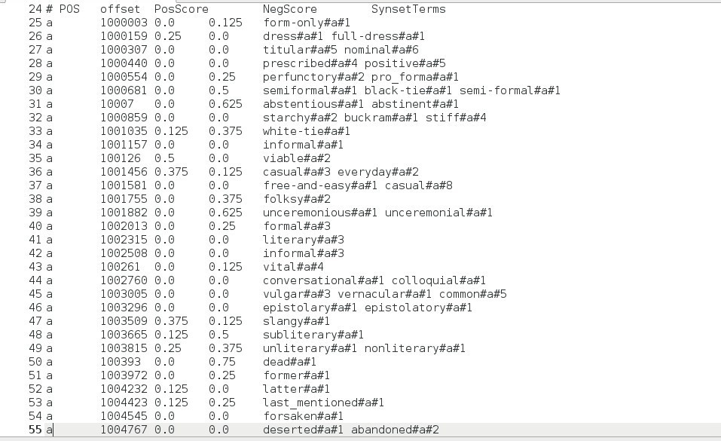
SENTIMENT ANALYSIS OF REVIEWS
A sentiwordnet data file looks like:

Slide 9
So the extracted features are searched in the sentiwordnet data file and a score is assigned to every feature according to the positive and negative score of the respective word
For example consider the word “good” it has following scores
Positive score =0.625
Negative score= 0.0
So the net score for this word becomes
positive score - negative score
(0.625) - (0.0) = 0.625
In this way every feature is assigned a score

Slide 10
CALCULATING THE FINAL SCORES
In order to calculate the final score for the predefined features , the scores of the extracted words for a common feature were added for a single hotel
HOTEL | BREAKFAST | STAFF | SERVICE | LOCATION | POOL | ROOM
ITC MAURYA | 4.25 | 5.625 | 7.0 | 3.25 | 1.0 | 5.75
HYATT | 2.5 | 5.0 | 1.0 | -0.875 | 3.125 | 0.375
LALIT | 2.75 | 6.5 | 4.25 | 0.375 | 0.75 | 3.75
TAJ | 5.25 | 8.625 | 2.625 | 2.75 | 6.75 | 6.125
OBEROI | 7.375 | 7.625 | 8.125 | 1.875 | 4.75 | 11.125

Slide 11
THINGS REMAINING
IMPROVEING THE FEATURE EXTRACTION PROCESS
TO DEAL WITH THE MODIFIERS OF THE ADJECTIVES
COLLECTING DATASET USING CRAWLER
IMPLEMENTING ALGORITHMS TO RANK HOTELS ACCORDING TO THEIR SCORES
MAKE INTERFACE FOR TAKING CUSTOMERS QUERIES

Slide 12
REFERENCES
A Study of Opinion Mining and Visualization
of Hotel Reviews
Eivind Bjørkelund, Thomas H. Burnett, Kjetil Nørvåg
Programming Collective Intelligence
By : Toby Segaran

