Slide 1

WomenTechWomenYes (WTWY)
Utilizing NYC’s Data for Optimizing Placement of Street Teams
Team Mtacular:
Eric Bassett
Erik Anderson
Eli T. Drumm
Joanna Nachman
January 10, 2020
Notes:
Speaker:

Slide 2

Motivation
Get attendees to the annual gala
Optimize street team work
End Goal:
Increase the participation of women in tech
Build awareness and reach
Notes:
Speaker:
WTWY hosts an annual gala at the beginning of each summer and they need attendees.
By optimizing their street team work, they can gather the most emails.
Those who sign up are sent free tickets to the gala.
This will increase the participation of women in tech and simultaneously build awareness and reach at WTWY.

Slide 3

Introduction
Means:
Analyze NYC MTA data
Determine the busiest stations across the city
Track daily patterns
Notes:
Speaker:
Means:
Analyze individual turnstile data from NYC subway stations to discern the busiest stations across the city and track their daily patterns.

Slide 4

Methodology Part 1
Data Used:
MTA turnstile data
Methodology:
Exploratory Data Analysis (EDA)
Skills:
Python and Pandas
Visualizations via Matplotlib
Notes:
Speaker:
We used data from the MTA turnstile data retrieved from the MTA developer site.
We used Exploratory Data Analysis as our approach to analyzing these data sets.
We employed Python and Pandas as our data analysis tools and used Matplotlib to publish our figures.

Slide 5
Methodology Part 2
Download and clean MTA data from March, April, May of 2018 & 2019
Group and sort data by certain columns, like entries and date/time
Aggregate MTA data by station to calculate the busiest stations per day
Notes:
Speaker:
We downloaded and cleaned MTA data sets from March, April, May of 2018 & 2019.
We then grouped and sorted our data by certain columns, like entries, date, time.
The columns “CA", "UNIT", "SCP", "STATION" were keys to the individual turnstiles.
We aggregateed the MTA data by station to calculate the busiest stations per day.

Slide 6
Results
Notes:
Speaker:

Slide 7
More Riders on Weekdays
DAY | INS | OUTS
M | 5.6 | 4.3
T | 6.0 | 4.6
W | 6.0 | 4.6
R | 6.0 | 4.6
F | 5.9 | 4.5
S | 3.4 | 2.8
S | 2.6 | 2.1
Weekdays similar, Mondays slightly less
Weekends significantly lower
Notes:
Speaker:
Ridership across weekdays, similarly comparable, with Mondays being slightly less.
Ridership on weekends is between roughly 40 and 60 percent that of weekdays.
“INS” represents average entries per day across all stations.
“OUTS” represent average exits per day across all stations

Slide 8
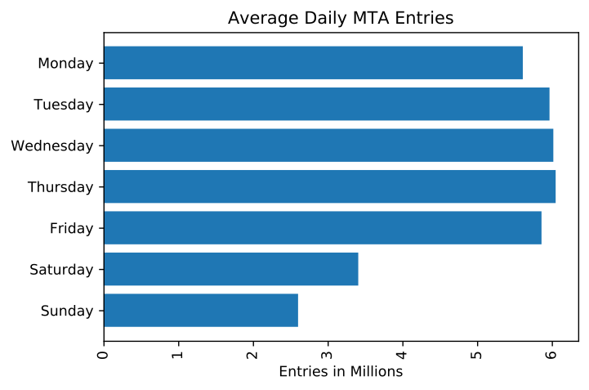
Notes:
Speaker:
This lovely bar plot shows the average daily MTA entries.
As you can see, Mondays are slightly less busy than the rest of the week days, with the majority of the hump taking place Tuesday, Wednesday, and Thursday.
And then we see a significant drop on the weekends. This makes sense as there should be less commuters on Saturday and Sunday.

Slide 9
Busiest Stations on
Weekdays
STATION | INS | OUTS
34 ST-PENN STA | 171,641.8 | 149,048.0
GRD CNTRL-42 ST | 156,236.2 | 137,458.3
23 ST | 120,611.1 | 86,982.0
34 ST-HERALD SQ | 116,479.1 | 108,184.5
14 ST-UNION SQ | 105,772.2 | 93,012.0
FULTON ST | 101,452.4 | 85,097.8
TIMES SQ-42 ST | 99,689.2 | 92,261.2
42 ST-PORT AUTH | 90,768.4 | 73,997.2
86 ST | 84,331.3 | 72,739.9
125 ST | 76,559.1 | 60,876.4
59 ST COLUMBUS | 76,224.3 | 61,198.0
CANAL ST | 71,865.2 | 56,979.1
96 ST | 65,934.5 | 49,772.2
CHAMBERS ST | 65,757.5 | 47,477.9
59 ST | 65,305.6 | 54,559.8
Observations:
All located in Manhattan
Majority located in Midtown – close to popular sites
Sprinkle in Flatiron & Financial Districts, Tribeca, Harlem & UWS
Notes:
Speaker:
All of our busiest stations are located in Manhattan, with the majority in Midwtown.
Midtown:
Time Square, Broadway, Madison Square Garden, Empire State Building
34th St Penn Station:
Pennsylvania station, across the street, is the busiest railroad station in the country.
We’ll see a plot of this data on the next slide.

Slide 10
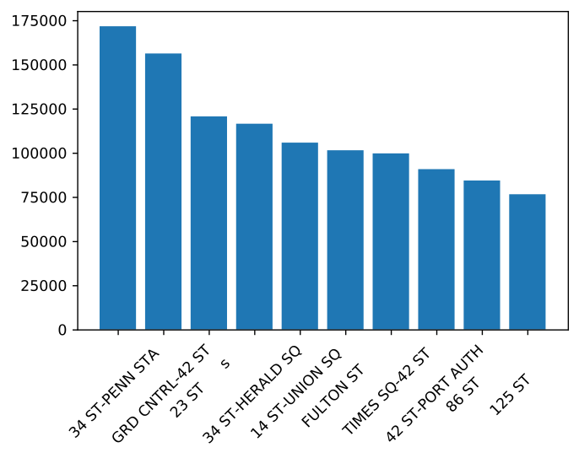
Busiest Stations on
Weekdays
Observations:
All located in Manhattan
Majority located in Midtown – close to popular sites
Sprinkle in Flatiron & Financial Districts, Tribeca, Harlem & UWS
Notes:
Speaker:
All of our busiest stations are located in Manhattan, with the majority in Midwtown.
Midtown:
Time Square, Broadway, Madison Square Garden, Empire State Building
34th St Penn Station:
Pennsylvania station, across the street, is the busiest railroad station in the country.
We’ll see a plot of this data on the next slide

Slide 11
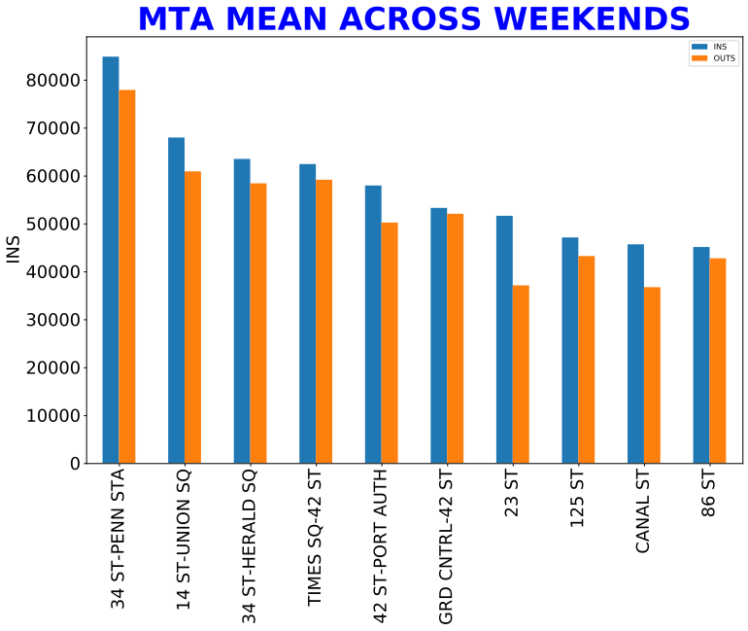
Notes:
Speaker:
In the case that WTWY is only able to send out their street teams on weekends, we’ve conveniently included this bar chart, which shows the average busiest MTA stations across weekends.
The ordering of the stations is similar to those we saw during weekends as well.

Slide 12

Conclusions
STATION | Percentage | Placement 20 Street Team Members
34 ST-PENN STA | 12% | 3
GRD CNTRL-42 ST | 11% | 3
23 ST | 8% | 2
34 ST-HERALD SQ | 8% | 2
14 ST-UNION SQ | 7% | 2
FULTON ST | 7% | 2
TIMES SQ-42 ST | 7% | 2
42 ST-PORT AUTH | 6 | 1
86 ST | 6 | 1
125 ST | 5 | 1
59 ST COLUMBUS | 5 | 1
Our Recommendations:
Place street teams at 10 busiest stations on Tuesday – Friday
What times?
Best Guess:
Rush Hour
Notes:
Speaker:
We recommend placing street teams at these top 10 busiest stations Tuesday, Wednesday, Thursday, & Friday.
Intuitively, we think the best times would be during peak hours, i.e. rush hour.

Slide 13
Thank You WTWY!
We hope your next stop is with cular!

Slide 14
Appendix
References:
(2020, January 4). Turnstile Data. Retrieved from http://web.mta.info/developers/turnstile.html

Slide 15
Next Steps to Continue Helping WTWY
Analyze Additional Data:
- NYC Census Data:
- Higher income residents
- Higher concentrations of women (ideally ages 25 – 40)
- NYC business data for higher concentrations of tech companies
Marketing beyond subway station outreach:
- Social media advertising and email marketing

