Slide 1

WomenTechWomenYes (WTWY)
Utilizing NYC’s Data for Optimizing Placement of Street Teams
Team Mtacular:
Eric Bassett
Erik Anderson
Eli T. Drumm
Joanna Nachman
January 10, 2020

Slide 2

Motivation
Get attendees to the annual gala
Optimize street team work
End Goal:
Increase the participation of women in tech
Build awareness and reach
Notes:
WTWY hosts an annual gala at the beginning of the summer and they need attendees.
By optimizing their street team work, they can gather the most signatures to increase the participation of women in tech and simultaneously build awareness and reach.

Slide 3

Introduction
Means:
Analyze NYC MTA data
Determine the busiest stations across the city
Track daily patterns
Notes:
Means:
Analyze individual turnstile data from NYC subway stations to discern the busiest stations across the city

Slide 4

Methodology Part 1
Data Used:
MTA turnstile data
Methodology:
Exploratory Data Analysis (EDA)
Skills:
Python and Pandas
Visualizations via Matplotlib

Slide 5
Methodology Part 2
Download and clean MTA data from March, April, May of 2018 & 2019
Group and sort data by certain columns, like entries and date/time
Aggregate MTA data by station to calculate the busiest stations per day

Slide 6
Results

Slide 7
More Riders on Weekdays
DAY | INS | OUTS
M | 5.6 | 4.3
T | 6.0 | 4.6
W | 6.0 | 4.6
R | 6.0 | 4.6
F | 5.9 | 4.5
S | 3.4 | 2.8
S | 2.6S | 2.1
Weekdays similar, Mondays slightly less
Weekends significantly lower
Notes:
Ridership across weekdays, similar is comparable, with Mondays, slightly less.
Ridership on weekends is between roughly 40 and 60 percent that of weekdays.

Slide 8
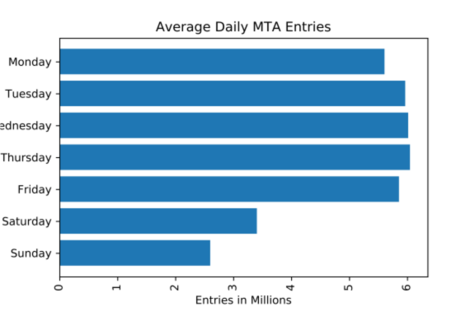

Slide 9
Busiest Stations
STATION | INS | OUTS
34 ST-PENN STA | 171,641.8 | 149048
GRD CNTRL-42 ST | 156,236.2 | 137458.3
23 ST | 120,611.1 | 86982
34 ST-HERALD SQ | 116,479.1 | 108184.5
14 ST-UNION SQ | 105,772.2 | 93012
FULTON ST | 101,452.4 | 85097.8
TIMES SQ-42 ST | 99,689.2 | 92261.2
42 ST-PORT AUTH | 90,768.4 | 73997.2
86 ST | 84,331.3 | 72739.9
125 ST | 76,559.1 | 60876.4
59 ST COLUMBUS | 76,224.3 | 61198
CANAL ST | 71,865.2 | 56979.1
96 ST | 65,934.5 | 49772.2
CHAMBERS ST | 65,757.5 | 47477.9
59 ST | 65,305.6 | 54559.8
Ideas:
All located in Manhattan
Majority located in Midtown – close to popular sites
Sprinkle in Flatiron & Financial Districts, Tribeca, Harlem & UWS
Ideas:
All located in Manhattan
Majority located in Midtown
Sprinkle in Flatiron & Financial Districts, Tribeca, Harlem & UWS
Notes:
34th St Penn Station:
Pennsylvania station, across the street, is the busiest railroad station in the country.
Midtown:
Time Square, Broadway, Madison Square Garden, Empire State Building

Slide 10
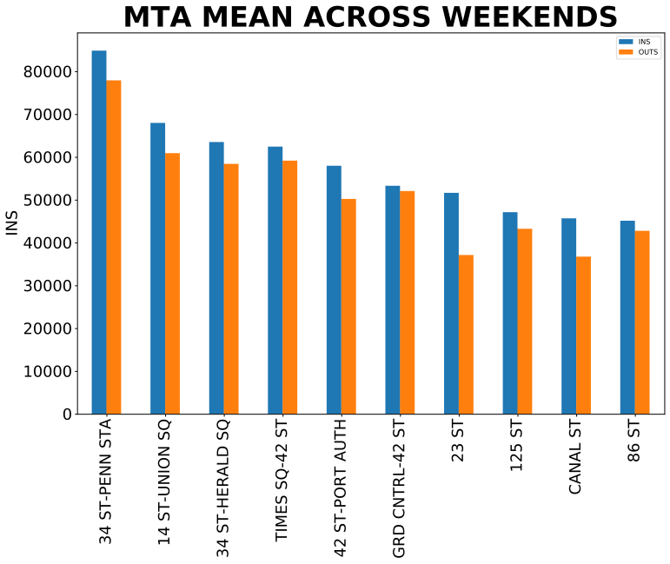

Slide 11

Conclusions
STATION | Percentage | Placement 20 Street Team Members
34 ST-PENN STA | 12% | 3
GRD CNTRL-42 ST | 11% | 3
23 ST | 8% | 2
34 ST-HERALD SQ | 8% | 2
14 ST-UNION SQ | 7% | 2
FULTON ST | 7% | 2
TIMES SQ-42 ST | 7% | 2
42 ST-PORT AUTH | 6 | 1
86 ST | 6 | 1
125 ST | 5 | 1
59 ST COLUMBUS | 5 | 1
Our Recommendations:
Place street teams at 10 busiest stations on Tuesday,
Wednesday, & Thursday
What times?
Best Guess:
Rush Hour

Slide 12
Next Steps to Continue Helping WTWY
Analyze Additional Data:
- NYC Census Data:
- Higher income residents
- Higher concentrations of women (ideally ages 25 – 40)
- NYC business data for higher concentrations of tech companies
Marketing beyond subway station outreach:
- Social media advertising and email marketing

Slide 13
Thank You WTWY!
We hope your next stop is with Mtacular!

Slide 14
Appendix
References:
(2020, January 4). Turnstile Data. Retrieved from http://web.mta.info/developers/turnstile.html

