Slide 1
Producing the Next Hit Record
Lessons from analysis of 600 albums.

Slide 2
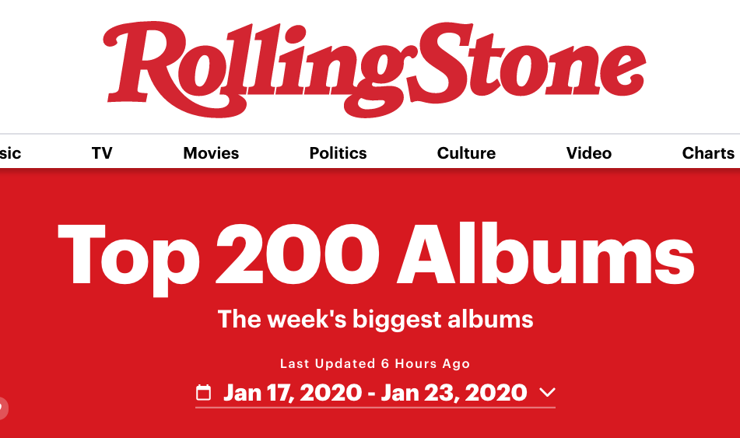
Data Sources
Rolling Stone Albums Chart
Chart position
Record label
Spotify Album Data
Volume, total tracks, release date

Slide 3
Target
Success on Rolling Stone 200 Albums Chart
My Metric: Sum over weeks of 201 minus chart position

Slide 4
Linear Regression Model? Nope!

Slide 5
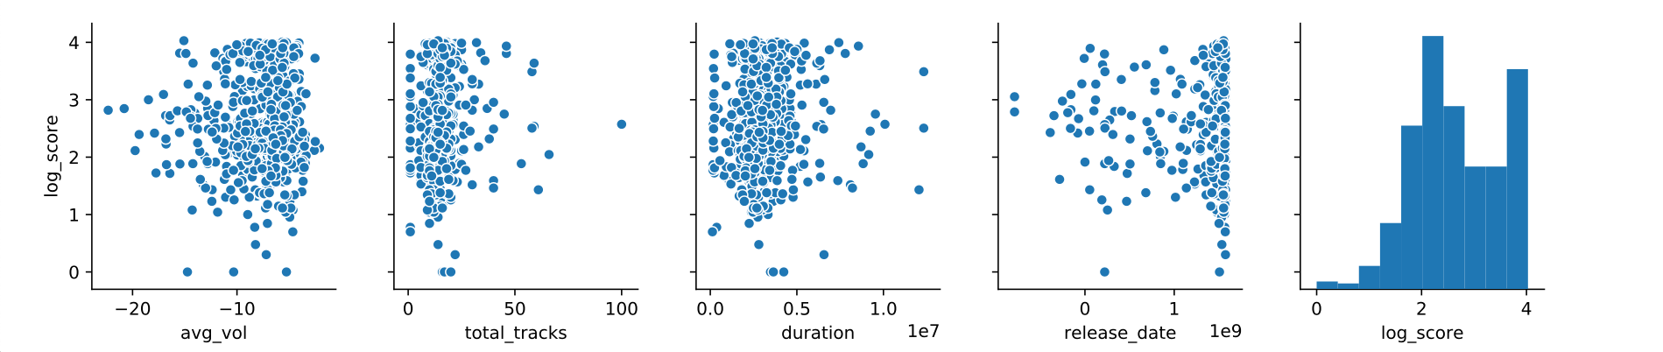
Pair Plot

Slide 6
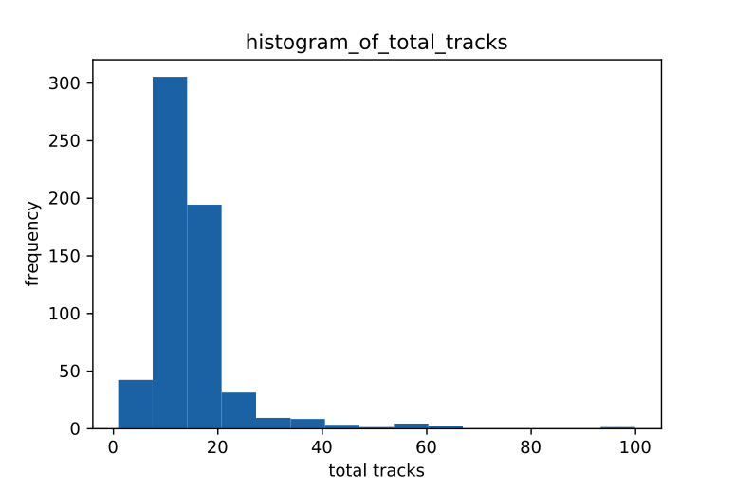
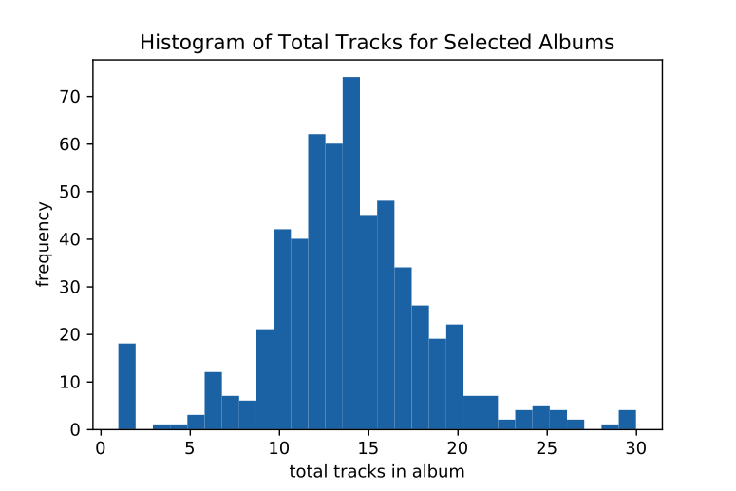
Popular Number of Tracks

Slide 7
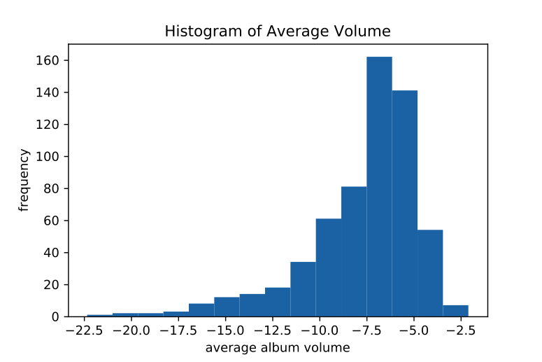
Popular Loudness

Slide 8
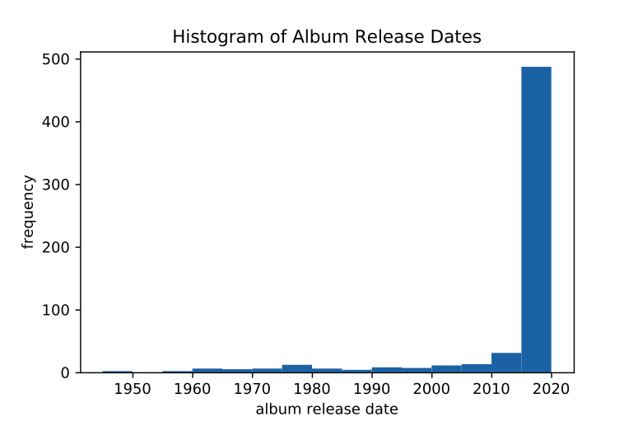
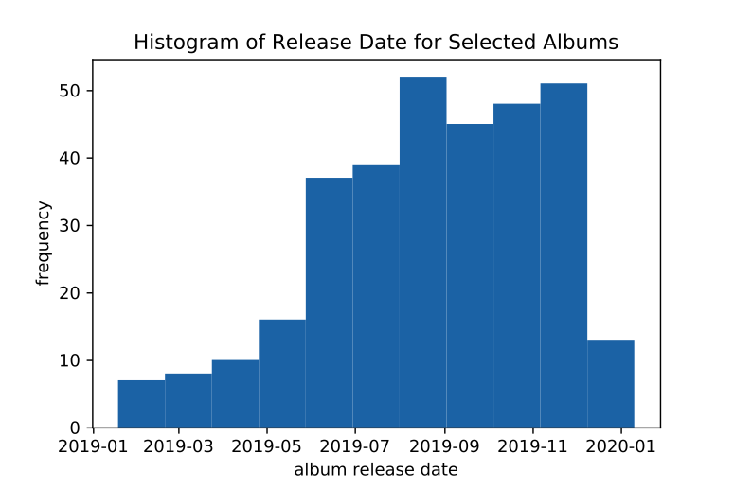
Popular Release Dates

Slide 9
Recommendations
15 Tracks
Loudness -7.5 to -5
Release Date: Second Half of Year

