Slide 1
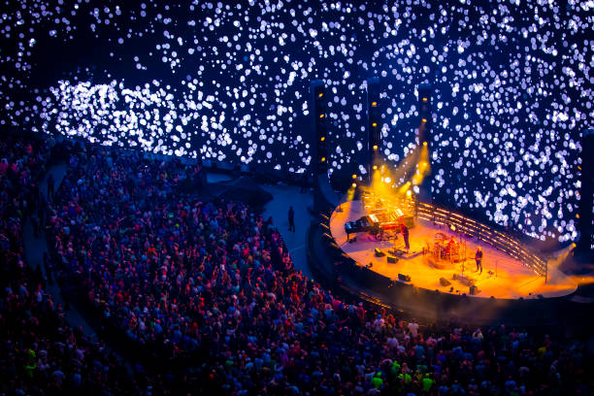
Background
Exploring the Music of Phish:
Patterns & Fan Sentiment
Erin Kane
MSDS692 Data Science Practicum I
27 June 2024
Problem Definition
Data Collection
Analysis
Findings & Outcomes
Notes:
Phish at the Sphere in Las Vegas.
Image curtesy of Getty Images

Slide 2
Background
Problem Definition
Phish + Data Science
Phish’s musical style
My connection to Phish
Why Phish + Data Science
What I aim to uncover
Data Collection
Analysis
Findings & Outcomes
Notes:
Phish at the Sphere in Las Vegas.
Image curtesy of Getty Images

Slide 3
Background
Given a dataset of Phish music recordings, fan interactions, and related data, the goal is to utilize data science methods to:
Visualize and analyze the music data to identify patterns, trends, and characteristics of Phish's improvisational style.
Conduct audio analysis to explore musical elements, such as chord progressions, tempo variations, and instrumental interactions.
Perform sentiment analysis on fan interactions, including social media posts, reviews, and forums, to understand the overall sentiment and engagement of the fan community.
Apply clustering or dimensionality reduction techniques to group similar songs or performances based on musical features or fan responses.
Phish + Data Science
Phish’s musical style
My connection to Phish
Why Phish + Data Science
What I aim to uncover
Problem Definition
Data Collection
Analysis
Findings & Outcomes
Notes:
Background Slide:
Set the Scene:
In my quest to combine my passion for data science and love for music, I came upon Phish, a band known for their improvisational and eclectic style. Having personally attended just over 40 Phish shows (which is small potatoes compared to many fans), I am always captivated by their unique approach of never playing the same setlist twice.
The thrill of going to multiple shows in a summer, knowing that I would never see the same show more than once, sparked my curiosity. Recognizing the immense potential in analyzing Phish's live concert recordings, fan interactions, and cultural impact, I decided to embark on a data science practicum project.
By applying data science techniques, I aim to uncover patterns, trends, and insights that shed light on the band's improvisational prowess, fan preferences, and the ever-evolving Phish community. This project not only allows me to delve into my passion but also contributes to the understanding of the dynamic relationship between musicians and their dedicated fan base in the digital age.
Phish at the Sphere in Las Vegas.
Image curtesy of Getty Images

Slide 4
Background
Problem Definition
Given a dataset of Phish music recordings, fan interactions, and related data, the goal is to utilize data science methods to:
Visualize and analyze the music data to identify patterns, trends, and characteristics of Phish's improvisational style.
Conduct audio analysis to explore musical elements, such as chord progressions, tempo variations, and instrumental interactions.
Perform sentiment analysis on fan interactions, including social media posts, reviews, and forums, to understand the overall sentiment and engagement of the fan community.
Apply clustering or dimensionality reduction techniques to group similar songs or performances based on musical features or fan responses.
Phish + Data Science
Phish’s musical style
My connection to Phish
Why Phish + Data Science
What I aim to uncover
Data Collection
Analysis
Findings & Outcomes
Setlists and show details: Phish.net & Phanalytix.csv
MIDI (Musical Instrument Digital Interface): Phish music files
Sentiment Analysis: courtesy of reddit.com r/phish subreddit API scrape
Notes:
Problem Definition:
This project aims to leverage data science techniques to gain a deeper understanding of Phish music and its impact on the fan community. The objective is to analyze Phish music data to uncover patterns, get a glimpse into what improvisation techniques look like in data form, and explore fan sentiment. The project will involve data visualization, audio analysis, sentiment analysis, and clustering or dimensionality reduction techniques.
Don’t read outloud:
The problem can be defined as follows: Given a dataset of Phish music recordings, fan interactions, and related data, the goal is to utilize data science methods to:
Visualize and analyze the music data to identify patterns, trends, and characteristics of Phish's improvisational style.
Conduct audio analysis to explore musical elements, such as chord progressions and tempo variations
Perform sentiment analysis on fan interactions, including social media posts, reviews, and forums, to understand the overall sentiment and engagement of the fan community.
Apply clustering or dimensionality reduction techniques to group similar songs or performances based on musical features or fan responses.
By addressing these tasks, the project aims to provide data-driven insights into Phish's music, improvisation techniques, and the relationship between the band and its fans. This collaboration between data scientists and music enthusiasts opens up new opportunities to explore the intersection of data science and music analysis.
Phish at the Sphere in Las Vegas.
Image curtesy of Getty Images

Slide 5
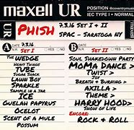
Background
Problem Definition
Data Collection
Given a dataset of Phish music recordings, fan interactions, and related data, the goal is to utilize data science methods to:
Visualize and analyze the music data to identify patterns, trends, and characteristics of Phish's improvisational style.
Conduct audio analysis to explore musical elements, such as chord progressions, tempo variations, and instrumental interactions.
Perform sentiment analysis on fan interactions, including social media posts, reviews, and forums, to understand the overall sentiment and engagement of the fan community.
Apply clustering or dimensionality reduction techniques to group similar songs or performances based on musical features or fan responses.
Setlists and show details: Phish.net & Phanalytix.csv
Musical Instrument Digital Interface (MIDI): Phish music files
Sentiment Analysis: courtesy of reddit.com r/phish subreddit API scrape
Analysis
Findings & Outcomes
Exploratory Data Analysis (EDA)
Apply Modeling Techniques
Data Visualization
Notes:
Data Collection:
Setlists and show details: Phish.net & Phanalytix.csv: Phish.net is a comprehensive online database that provides detailed setlists and show information for Phish concerts. It's a valuable resource to explore the songs played, the order of the setlist, and other show-specific details. Phanalytix.csv is a dataset that offers additional analytical insights and statistics about Phish performances, such as song frequencies, tour information, and more
Musical Instrument Digital Interface (MIDI): Phish music files: MIDI files are a digital representation of musical notes and instructions that can be played by various instruments. Phish MIDI files allow fans and musicians to recreate Phish songs, study their compositions, or even create remixes.
Sentiment Analysis: courtesy of reddit.com r/phish subreddit API scrape: The sentiment analysis of Phish fan discussions and comments, obtained through the r/phish subreddit API scrape, provides valuable insights into the emotional response and opinions of the Phish fan community. I can discuss how sentiment analysis helps understand fan reactions, preferences, and the overall sentiment towards Phish concerts, albums, or specific performances.
Phish at the Sphere in Las Vegas.
Image curtesy of Getty Images

Slide 6
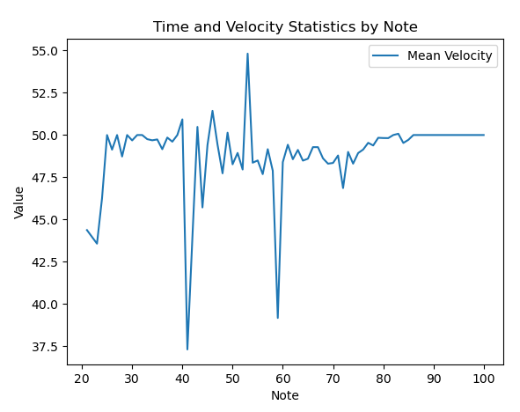
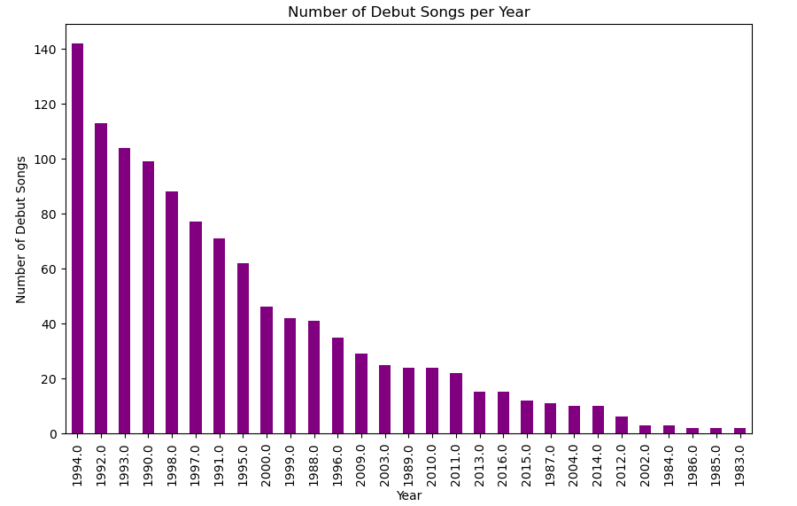
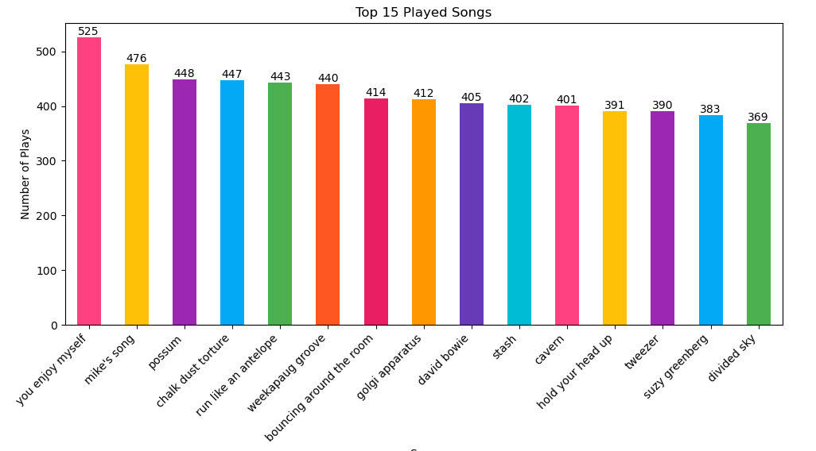
Setlists and show details: Phish.net & Phanalytix.csv
MIDI (Musical Instrument Digital Interface): Phish music files
Sentiment Analysis: courtesy of reddit.com r/phish subreddit API scrape
Background
Problem Definition
Data Collection
Analysis
Exploratory Data Analysis (EDA)
Apply Modeling Techniques
Data Visualization
Exploratory Data Analysis (EDA)
Findings & Outcomes
Apply Modeling Techniques
Data Visualization
MIDI Data: Each note is represented by its corresponding MIDI note number. The "Average Velocity" column shows that all notes have an average velocity of 100.0.
Phanalytix data: Number of Debut Phish Songs for 10 years
Phanalytix data : Top 15 Most Played Songs, with song count
Notes:
Analysis:
Types of Modeling Techniques:
Exploratory Data Analysis
Apply Modeling Techniques
Data Visualization
Data Visuals:
Phish at the Sphere in Las Vegas.
Image curtesy of Getty Images

Slide 7
Random Forest Classifier
Gradient Boosting Classifier
Optimized using: Support Vector Machines (SVM)
Imbalanced Data evaluating the Accuracy of predictions of both Venue and Date of Tours
Computing the ROC curve and AUC – ROC
Sentiment Analysis to determine Fan emotion
Background
Problem Definition
Data Collection
Analysis
Exploratory Data Analysis (EDA)
Apply Modeling Techniques
Data Visualization
MIDI Data: Each note is represented by its corresponding MIDI note number. The "Average Velocity" column shows that all notes have an average velocity of 100.0.
Phanalytix data: Number of Debut Phish Songs for 10 years
Phanalytix data : Top 15 Most Played Songs, with song count
Exploratory Data Analysis (EDA)
Apply Modeling Techniques
Data Visualization
Notes:
EDA :
Just as Phish lyrics can reveal hidden meanings, EDA helps us uncover hidden insights within our data.
During EDA, we carefully examine our data, just as Phish fans dissect the lyrics of their favorite songs. We look at the structure, size, and types of data, much like how Phish fans analyze the rhyme scheme, metaphors, and wordplay in their beloved lyrics.
EDA is like exploring the intricate connections between variables, much like how Phish weaves together different musical elements like melodies, harmonies, and rhythms, EDA helps us understand how different variables in our data interact and influence one another.
Visualizing the data during EDA is akin to experiencing the visual spectacle of a Phish concert. Just as Phish captivates their audience with lights, visuals, and stage presence, data visualizations captivate us with graphs, charts, and patterns that bring the data to life.
In essence, EDA is like delving into the lyrics of a Phish song, unraveling the layers of meaning and discovering the hidden gems. It allows us to understand our data better, identify interesting patterns, and guide us in making informed decisions or further analysis.
Phish at the Sphere in Las Vegas.
Image curtesy of Getty Images

Slide 8
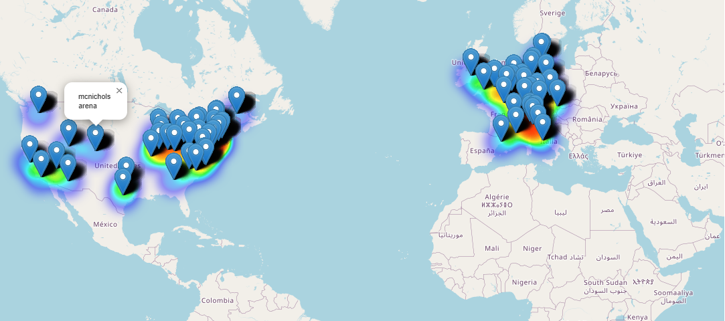
Background
Problem Definition
Data Collection
Analysis
Random Forest Classifier
Gradient Boosting Classifier
Optimized using: Support Vector Machines (SVM)
Imbalanced Data evaluating the Accuracy of predictions of both Venue and Date of Tours
Computing the ROC curve and AUC – ROC
Sentiment Analysis to determine Fan emotion
Apply Modeling Techniques
Data Visualization
Findings & Outcomes
Heat Map of Phish North American and European Tour 1997
Exploratory Data Analysis (EDA)
Data Visualization
MIDI Data: Each note is represented by its corresponding MIDI note number. The "Average Velocity" column shows that all notes have an average velocity of 100.0.
Phanalytix data: Number of Debut Phish Songs for 10 years
Phanalytix data : Top 15 Most Played Songs, with song count
Notes:
Apply Modeling Techniques:
Random Forest Classifier: Imagine I have a playlist of Phish songs, and I want to predict whether a song is from a particular album or not. The Random Forest Classifier is like a group of Phish fans who collectively make predictions based on different features of the songs, such as the lyrics, tempo, or instrumentation.
Gradient Boosting Classifier: Similar to the Random Forest Classifier, the Gradient Boosting Classifier is another group of Phish fans, but this time they learn from their previous mistakes. Each fan focuses on the songs that were misclassified by the previous fans, gradually improving the overall accuracy of the predictions.
Support Vector Machines (SVM): Think of SVM as a fan who draws a decision boundary between different types of Phish songs. This fan tries to find the best line that separates the songs based on their features, such as genre or duration.
Balancing data with oversampling and undersampling: Imagine I have a collection of Phish concert reviews, but I notice that there are more reviews from certain cities or tours. To make sure the analysis is fair, I can either oversample the reviews from underrepresented cities/tours or undersample the reviews from overrepresented cities/tours, so that each city/tour has a similar number of reviews.
ROC-AUC methods: ROC (Receiver Operating Characteristic) and AUC (Area Under the Curve) are ways to evaluate the performance of models. It's like measuring how well a Phish fan can predict if a concert will be a hit or a miss. The ROC curve shows the trade-off between true positive and false positive rates, while the AUC measures the overall performance of the fan's predictions.
Sentiment analysis using K-Means and HCA: Imagine I have collected Phish fan reviews about their concerts. K-Means and Hierarchical Clustering (HCA) are techniques that group similar reviews together based on their sentiment. It's like organizing fan reviews into clusters of "happy fans," "disappointed fans," or "excited fans.“
Term Frequency (TF) and Inverse Document Frequency (IDF): TF measures how often specific words appear in a fan's review, while IDF measures the importance of those words across all reviews. It's like highlighting important words in a fan's review, such as "amazing," "energetic," or "captivating," which contribute more to the sentiment analysis.
Hierarchical Clustering and Dendograms: Hierarchical Clustering is a way to organize Phish concerts into groups based on their similarities. It's like creating a family tree of concerts, where similar concerts are grouped together. Dendograms are visual representations of this hierarchy, showing the connections between different clusters.
Elbow Method: The Elbow Method helps find the optimal number of clusters in hierarchical clustering. It's like finding the sweet spot where the Phish concerts can be grouped into a reasonable number of categories without losing too much similarity within each group.
Silhouette Scores: Silhouette Scores evaluate the quality of the clustering results. It's like rating how well the Phish concerts are grouped together based on their similarities. A higher score means the concerts within a cluster are more similar to each other, while a lower score indicates less cohesion.
Phish at the Sphere in Las Vegas.
Image curtesy of Getty Images

Slide 9
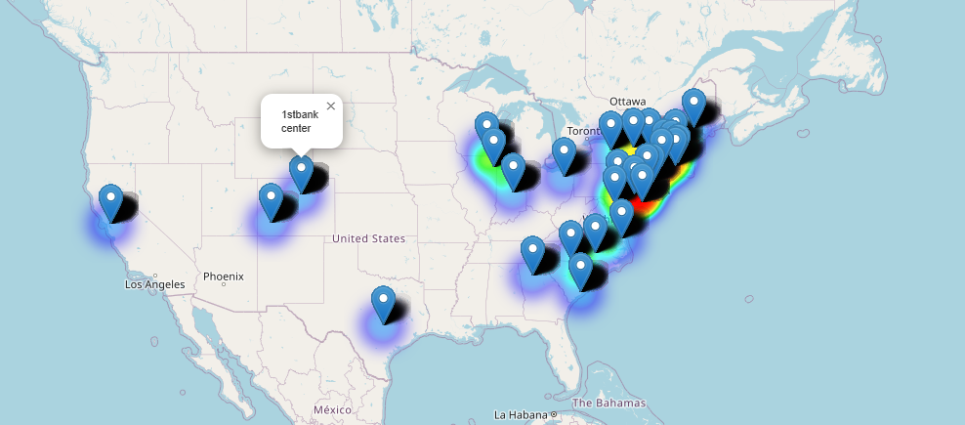
Background
Problem Definition
Data Collection
Analysis
Exploratory Data Analysis (EDA)
Data Visualization
Data Visualization
Findings & Outcomes
Apply Modeling Techniques
Heat Map of Phish tour was in my house – 1st Bank Center 2010
Heat Map of Phish North American and European Tour 1997
Random Forest Classifier
Gradient Boosting Classifier
Optimized using: Support Vector Machines (SVM)
Imbalanced Data evaluating the Accuracy of predictions of both Venue and Date of Tours
Computing the ROC curve and AUC – ROC
Sentiment Analysis to determine Fan emotion
Notes:
Data Visualization:
Using Folium is a Python library used for visualizing geospatial data.
With Folium, I can easily create maps, add markers, customize the appearance of the map and its elements, and overlay data on top of the map.
Phish at the Sphere in Las Vegas.
Image curtesy of Getty Images

Slide 10
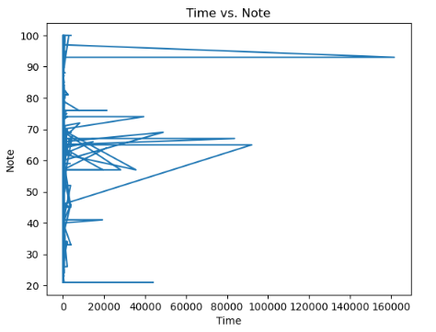
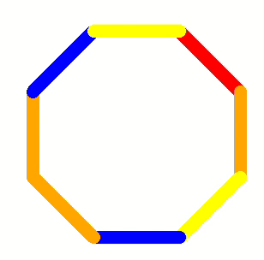

Background
Problem Definition
Data Collection
Analysis
Data Visualization
Heat Map of Phish tour was in my house – 1st Bank Center 2010
Heat Map of Phish North American and European Tour 1997
Phish song: Divided Sky MIDI Data
Notes:
Data Visualization
Phish at the Sphere in Las Vegas.
Image curtesy of Getty Images

Slide 11

Background
Problem Definition
Data Collection
Analysis
Data Visualization
Testing and Training Dataset – While I was not able to find great result in predicting the opening song with great probability, I was able to predict the next set of Tour Dates and Venues accuracy rates:
Venue Accuracy: 0.9998381091144568
Date Accuracy: 0.9135502671199611
Found out that Phish Fans are excited about:
Summer Tour
Most listened to jams
Mondegreen – Festival in the Fall
Phish Mexico – Next February
Groove Safe – a subgroup of fans that look out for the safety of concertgoers
Phellowship – Phish, sober community of fans
Findings & Outcomes
Heat Map of Phish tour was in my house – 1st Bank Center 2010
Phish song: Divided Sky MIDI Data
Notes:
Data Visualization
Spiro-graph that mapped out the average time vs. note, line chart, and turtle mp4 outputs
Phish at the Sphere in Las Vegas.
Image curtesy of Getty Images

Slide 12
Background
Problem Definition
Data Collection
Analysis
Data Visualization
Findings & Outcomes
Testing and Training Dataset – While I was not able to find great results in predicting the opening song with great probability, I was able to predict the next set of Tour Dates and Venues accuracy rates:
Venue Accuracy: 0.9998381091144568
Date Accuracy: 0.9135502671199611
Found out that Phish Fans are excited about:
Summer Tour
Most listened to jams
Mondegreen – Festival in the Fall
Phish Mexico – Next February
Groove Safe – a subgroup of fans that look out for the safety of concertgoers
Phellowship – Phish, sober community of fans
Thank I
Thank You
Phish song: Divided Sky MIDI Data
Notes:
Findings and Outcomes:
Phanalytix data:
Using Random Forest classifier GradientBoosting Classifier, SVMs, balancing data with oversampling, undersampling, ROC-AUC methods
Sentiment analysis using:
K-Means and HCA to cluster the collected data
Term Frequency (TF): It measures the frequency of a term (word) within a document. It helps to highlight the importance of words in individual documents.
Inverse Document Frequency (IDF): It measures how important a term is across all documents in the dataset. It helps in giving more weight to rare words and less weight to common words.
Hierarchical Clustering and Dendograms
Using the Elbow Method to optimize and identify the optimum number of clusters
Silhouette Scores to evaluate the quality of the clustering
Phish at the Sphere in Las Vegas.
Image curtesy of Getty Images

Slide 13
Background
Problem Definition
Data Collection
Analysis
Findings & Outcomes
Data Visualization
Testing and Training Dataset – While I was not able to find great result in predicting the opening song with great probability, I was able to predict the next set of Tour Dates and Venues accuracy rates:
Venue Accuracy: 0.9998381091144568
Date Accuracy: 0.9135502671199611
Found out that Phish Fans are excited about:
Summer Tour
Most listened to jams
Mondegreen – Festival in the Fall
Phish Mexico – Next February
Groove Safe – a subgroup of fans that look out for the safety of concertgoers
Phellowship – Phish, sober community of fans
Thank You
References:
Notes:
Thank you
Thank You all for joining me on this musical journey through the world of Phish band data and my integration with Data Science.
Just like a Phish concert leaves fans excited and excited about the next show, I hope this presentation has ignited your curiosity and appreciation for the insights I’ve uncovered.
Consider this closing moment as the encore, where we reflect on the harmonious blend of data analysis and the captivating energy of Phish concerts.
As the final chords fade away, let's carry the spirit of exploration and discovery with us, inspired by the boundless possibilities within the intersection of data and music.
Thank you, and may your future endeavors be as thrilling as a Phish concert experience!
Phish at the Sphere in Las Vegas.
Image curtesy of Getty Images

Slide 14
Background
Problem Definition
Data Collection
Analysis
Findings & Outcomes
Thank I
References:
Gupta, K. (2021, January). In-depth intuition of K-means clustering algorithm in machine learning. Analytics Vidhya. Retrieved from https://www.analyticsvidhya.com/blog/2021/01/in-depth-intuition-of-k-means-clustering-algorithm-in-machine-learning/
Lloyd, S. P. (1982). Least squares quantization in PCM. IEEE Transactions on Information Theory, 28(2), 129-137. doi:10.1109/TIT.1982.1056489
Patel, D. (2024). Aggregation of Reddit comments using a scikit-learn K-means clustering algorithm. Towards Data Science. Retrieved from https://towardsdatascience.com/aggregation-of-reddit-comments-using-a-scikit-learn-k-means-clustering-algorithm-b6fa6d451e19
Prasad, P. (2021, May). Hierarchical Clustering Eplained. Towards Data Science. Retrieved from https://towardsdatascience.com/hierarchical-clustering-explained-e59b13846da8
scikit-learn developers. (2024). sklearn.metrics.silhouette_score. scikit-learn: machine learning in Python. Retrieved from https://scikit-learn.org/stable/modules/generated/sklearn.metrics.silhouette_score.html
scikit-learn developers. (2024). sklearn.datasets.make_blobs. scikit-learn: machine learning in Python. Retrieved from https://scikit-learn.org/stable/modules/generated/sklearn.datasets.make_blobs.html
scikit-learn developers. (2024). Search results for "TF - IDF". scikit-learn: machine learning in Python. Retrieved from https://scikit-learn.org/stable/search.html?q=TF+-+IDF
Notes:
References:
Gupta, K. (2021, January). In-depth intuition of K-means clustering algorithm in machine learning. Analytics Vidhya. Retrieved from https://www.analyticsvidhya.com/blog/2021/01/in-depth-intuition-of-k-means-clustering-algorithm-in-machine-learning/
Lloyd, S. P. (1982). Least squares quantization in PCM. IEEE Transactions on Information Theory, 28(2), 129-137. doi:10.1109/TIT.1982.1056489
Patel, D. (2024). Aggregation of Reddit comments using a scikit-learn K-means clustering algorithm. Towards Data Science. Retrieved from https://towardsdatascience.com/aggregation-of-reddit-comments-using-a-scikit-learn-k-means-clustering-algorithm-b6fa6d451e19
Prasad, P. (2021, May). Hierarchical Clustering Eplained. Towards Data Science. Retrieved from https://towardsdatascience.com/hierarchical-clustering-explained-e59b13846da8
scikit-learn developers. (2024). sklearn.metrics.silhouette_score. scikit-learn: machine learning in Python. Retrieved from https://scikit-learn.org/stable/modules/generated/sklearn.metrics.silhouette_score.html
scikit-learn developers. (2024). sklearn.datasets.make_blobs. scikit-learn: machine learning in Python. Retrieved from https://scikit-learn.org/stable/modules/generated/sklearn.datasets.make_blobs.html
scikit-learn developers. (2024). Search results for "TF - IDF". scikit-learn: machine learning in Python. Retrieved from https://scikit-learn.org/stable/search.html?q=TF+-+IDF
Phish at the Sphere in Las Vegas.
Image curtesy of Getty Images

