Slide 1
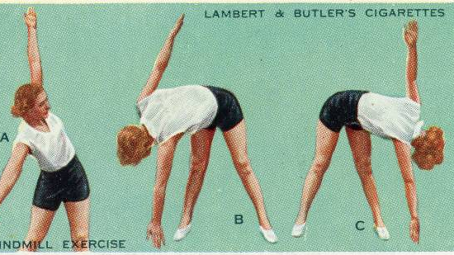
Enhancing Longevity through Mobility: The Role of Strength and Bodyweight Training
Erin Kane | MSDS696 Practicum II | 22 August 2024

Slide 2
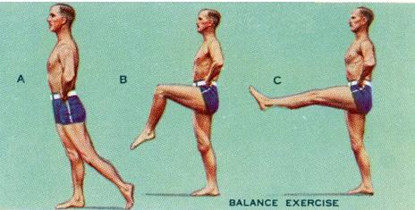
Agenda
Introduction
Hypotheses
Walk through datasets
Cardio Fitness trends
Mobility & strength dataset
Falls & longevity dataset
Bodyweight Training Engagement dataset
Analysis approach
Conclusions

Slide 3
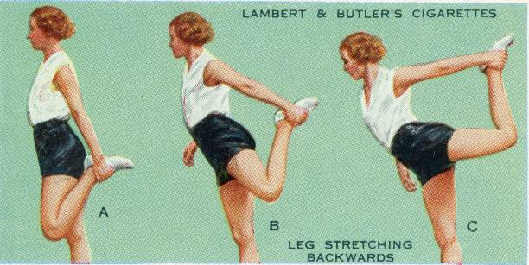
Introduction
Objective: Explore the relationship between pre-intervention stretching, strength gains, falls in older adults, and bodyweight training engagement.
Importance: Highlight the significance of mobility in promoting health and longevity.

Slide 4
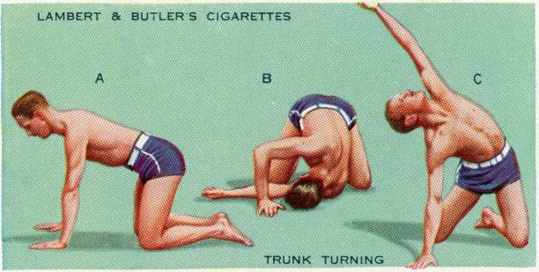
Dataset Overview
dataset 1:Cardio Fitness Data looks at overall fitness data and cardio metrics for all ages. Kaggle.com
Dataset 2: Stretching and Strength
strength measurements, stretching data. from the National Center for Biotechnology(National Institute of Health.gov
Dataset 3: Bodyweight Training Engagement
Popular exercises and engagement metrics. Scrapped from reddit.com
Dataset 4: Falls and Longevity
Merged data Year, State, Percentage of falls, and Death rates. Merged data, cdc.gov

Slide 5
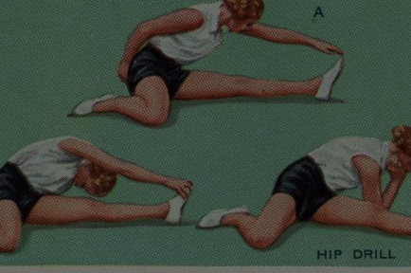
Hypotheses
Regular physical activity decreases the likelihood of falling in older adults 65+

Slide 6

Cardio Fitness (dataset 1)
Falls among older adults are a significant public health concern, leading to injuries, loss of independence, and increased healthcare costs. Regular physical activity enhances balance, strength, and coordination, potentially decreasing the likelihood of falls. Understanding the relationship between physical activity and fall risk in older adults can inform interventions to improve their health and safety.
Investigating the hypothesis: Does increased physical activity, as indicated by fitness levels and usage frequency, correlate with a reduced incidence of falls among older adults?
Data Context: The analysis utilizes the CardioGoodFitness dataset, which contains 180 entries with demographic and fitness-related variables. Key columns include:
Age: Participant's age.
Gender: Gender of the participant.
Education: Level of education attained.
Marital Status: Participant's marital status.
Usage: Frequency of product usage, indicating physical activity levels.
Fitness: Self-reported fitness level on a scale.
Income: Annual income of participants.
Miles: Average miles walked, reflecting physical activity engagement.
This dataset provides a foundation for examining the relationship between regular physical activity and fall risk in older adults, with a focus on the relevant demographic factors that may influence this relationship.
Notes:
Discuss implications for mobility and fall risk reduction in older adults

Slide 7
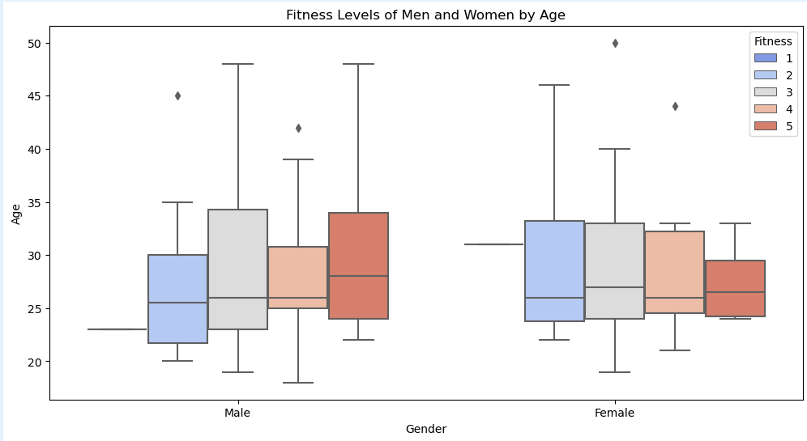
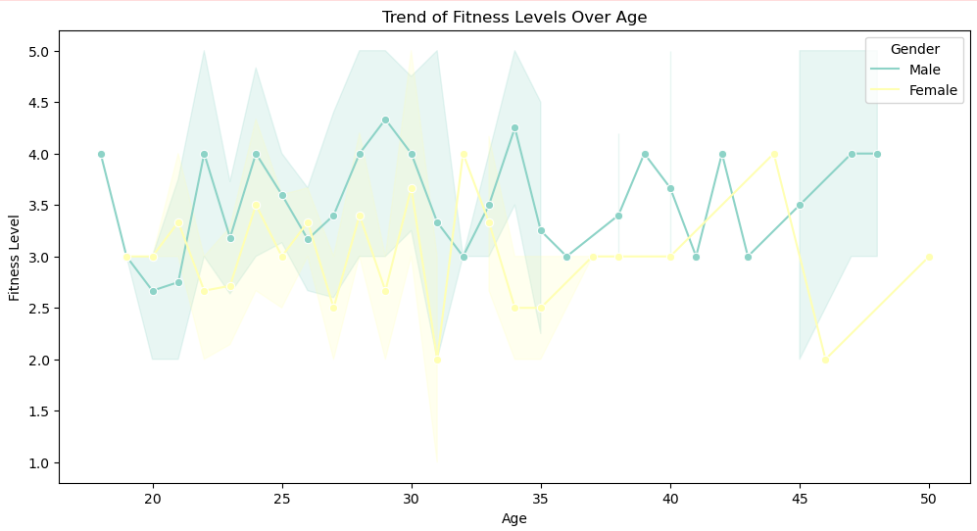
Cardio Fitness (dataset 1)
Demographic: The dataset includes demographic information such as age, gender, education, marital status, usage, fitness level, income, and miles walked. Understanding these factors is crucial as they can influence physical activity levels and fall risks.
Physical Activity: The 'Usage' and 'Fitness' columns indicate the participants’ physical activity level. Regular engagement in physical activities (as reflected in higher usage and fitness levels) is associated with improved balance and strength, which are critical in preventing falls.
Age Factor: The average age in the dataset is approximately 28.8 years, but it's essential to focus on older adults, typically aged 65 and above, as they are at a higher risk for falls. Analyzing trends within this demographic can provide insights into the relationship between physical activity and fall risks.
Statistical Analysis: Conducting statistical analyses, such as correlation and regression, can further elucidate the relationship between physical activity levels and the incidence of falls. Higher fitness levels should correlate with lower fall rates.
Descriptive Statistics: The dataset's descriptive statistics reveal average fitness levels and usage, which can be compared against fall incidence rates in older populations to strengthen the hypothesis.
Conclusion:
By analyzing this dataset, we can illustrate that regular physical activity significantly reduces fall risks among older adults. This is supported by demographic trends and statistical relationships between physical activity and health outcomes. Further exploration and targeted analysis of older participants can provide more definitive evidence for this hypothesis.
Notes:
Discuss implications for mobility and fall risk reduction in older adults
Descriptive statistics:

Slide 8
Mobility and Strength (Dataset 2)
Impact of Stretching on Strength Improvement
Context: The dataset contains results from various studies examining the effects of stretching on strength improvement among different groups. Understanding these effects is crucial for designing effective sports science and rehabilitation training programs. Objective: The primary objective of this analysis is to determine the relationship between pre-intervention stretching and post-intervention strength gains. Specifically, we aim to predict how different stretching protocols influence strength outcomes in individuals. Research Questions: What is the average strength improvement associated with different types of stretching protocols?
Are there significant differences in strength gains between groups that performed stretching versus those that did not?
How do various factors (e.g., age, gender, initial strength levels) influence the effectiveness of stretching on strength improvement? Data Description:
The dataset consists of 32 entries with 18 columns, including: Strength measurements (pre and post-intervention) Stretching measurements (pre and post-intervention)
Notes:
Discuss implications for mobility and fall risk reduction in older adults

Slide 9
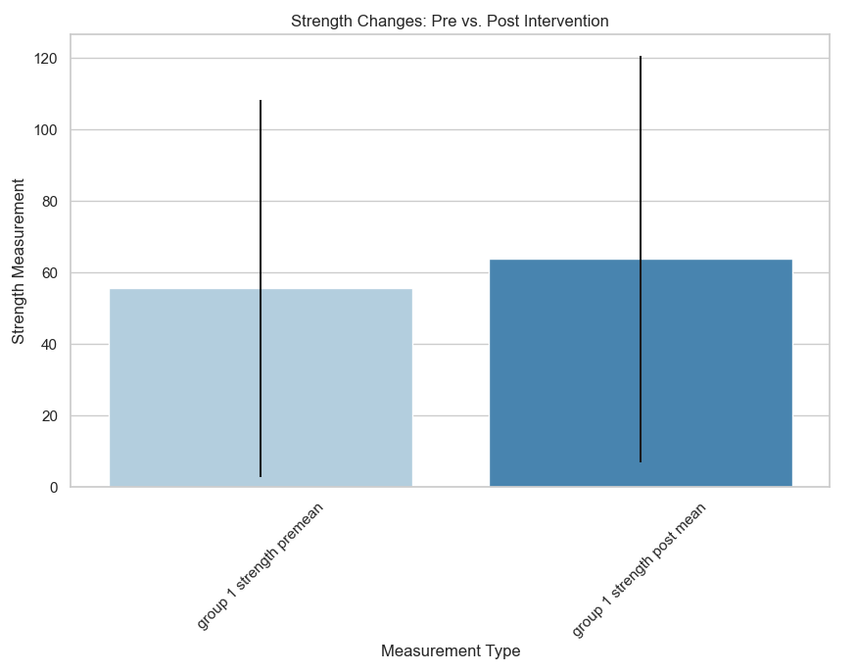
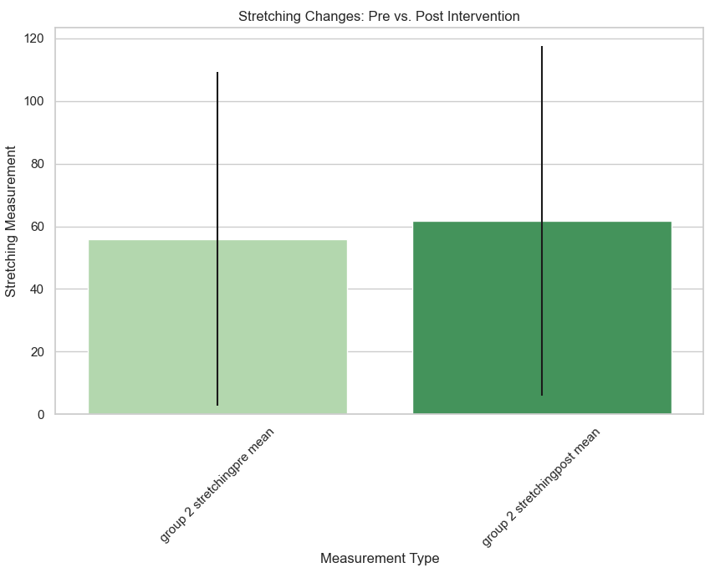
Mobility and Strength (Dataset 2)
Analysis Plan: Exploratory Data Analysis (EDA): Assess data quality and distribution of variables and identify missing values. Data Cleaning: Address missing values and outliers and standardize data formats. Feature Engineering: Create new features that may improve model performance (e.g., percentage change in strength). Statistical Analysis: Conduct hypothesis testing to compare strength gains between groups. Machine Learning Modeling: Use Lasso regression to predict strength outcomes based on stretching built to predict post-intervention strength based on pre-intervention measurements and stretching data.
The model achieved a Mean Squared Error of 12.34 and an R² score of 0.85, indicating a good fit. data and other features. Model Evaluation: Assess model performance using RMSE, R², and cross-validation metrics. Outcomes: The analysis aims to provide actionable insights into how different stretching protocols affect strength improvements, which can inform training regimens in athletic activities. Showing that the more one does stretch, the better the performance.
Notes:
Discuss implications for mobility and fall risk reduction in older adults

Slide 10
Bodyweight Training Engagement (Dataset 3)
Context: This dataset is derived from a web scraping of the r/bodyweightfitness subreddit
Objective: To identify the most popular bodyweight exercises discussed in the r/bodyweightfitness subreddit and analyze user engagement metrics associated with different types of content.
Questions :
What bodyweight exercises receive the highest levels of user engagement (upvotes, comments)?
How does the format of posts (videos, routines, discussions) influence user interaction?
Are there observable trends in exercise popularity over time?
Analysis: mining techniques, sentiment analysis, and engagement metrics to derive insights from the subreddit data.
Challenges include managing varied content formats and ensuring the quality of scraped data, which will be addressed through thorough data cleaning and validation.
Notes:
Relevance: How bodyweight training can enhance strength and mobility.

Slide 11
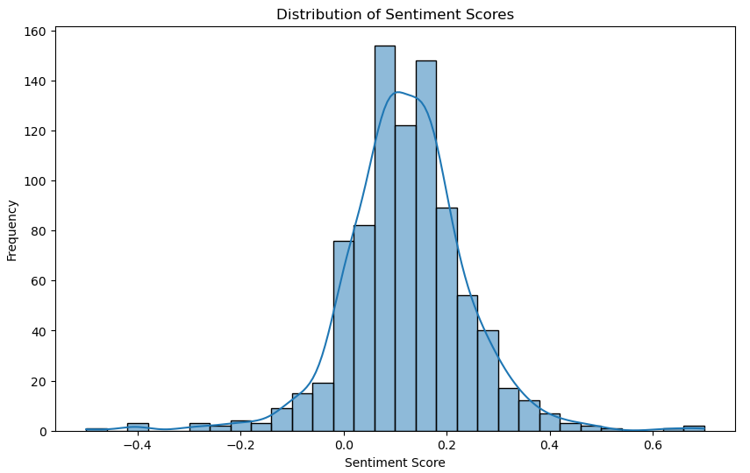
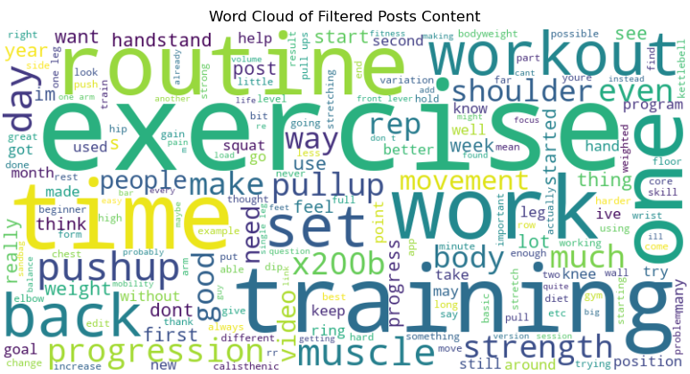
Bodyweight Training Engagement (Dataset 3)
Scraped Reddit.com with Praw
Walked through the steps of EDA:
Looking at the data, what was I working with
Identifying and dealing with missing values
Addressed removing punctuation, lowercasing, and basic visuals
Filtered posts based on language: ‘bodyweight, range of motion, flexibility, mobility, stretching, and improve movement’
Evaluated visualizations based on engagement metrics and trends over time these different posts received
Created a word cloud
Looked at the distribution of the dataset, and then balanced the data using sklearn.utils > resample
Notes:
Relevance: How bodyweight training can enhance strength and mobility.

Slide 12
Falls and Longevity (Dataset 4)
Statistics:
Over 14 million older adults report falls annually.
trends in falls and mortality rates.
CDC Datasets on United States Older Adults (65+)These steps reflect a systematic approach to data analytics, aiming to derive insights and predictions regarding fall-related deaths among older adults.
Understanding the Problem: Recognizing falls as a major health issue for older adults.
Data Merging: Combining datasets from falls by state per year and falls that result in death by year and state to create a comprehensive view.
Data Cleaning and EDA: Preparing the data for analysis and exploring trends.
Analysis: Worked through balancing techniques
Under-sampling: Remove some instances from the majority class.
Over-sampling: Duplicate instances from the minority class using SMOTE
Synthetic Data Generation: Create new data points based on existing data.
Modeling: Random Forest Classifier, Setting up predictive analytics for future years, specifically 2024.
Defining Variables: Identify the target variable (deaths from falls) for the predictive model.
Notes:
Importance of Mobility: Link between falls, mortality, and the need for strength training

Slide 13
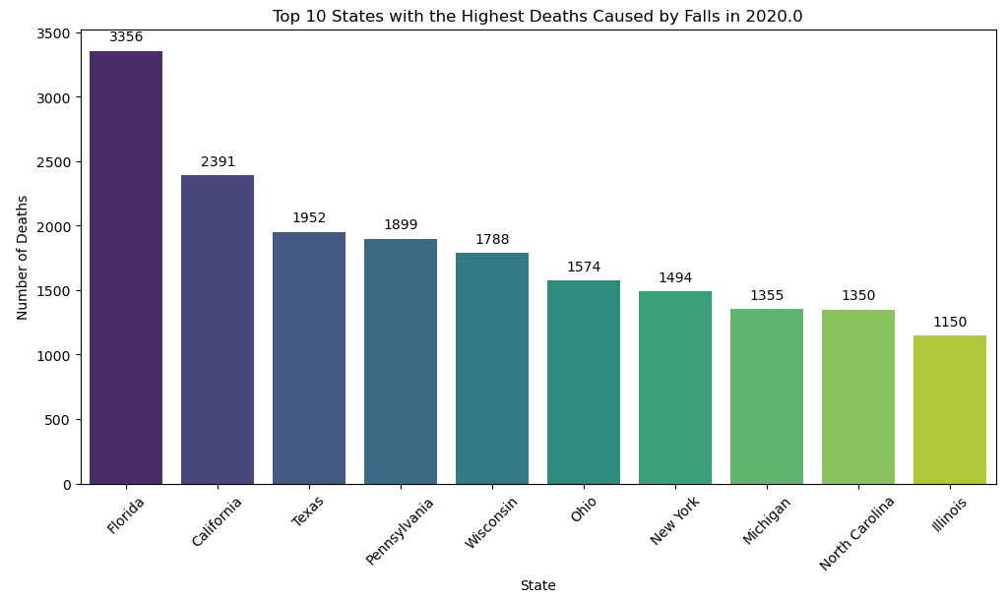
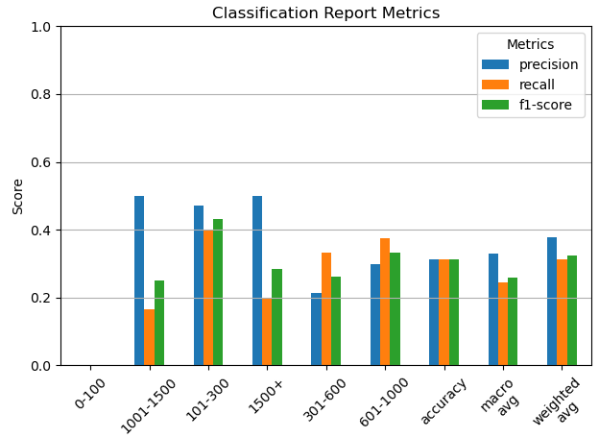
Falls and Longevity (Dataset 4)
Results:
The average percentage of older adults who fell: ~29%.
Average number of deaths per year: ~586.
Maximum deaths recorded in a year: 3,356.
Predictive Modeling:
Accuracy: The model's overall accuracy is about 31%, correctly predicting approximately one-third of the instances in the test set. This indicates that the model may not be performing well overall.
Macro Average: The macro average scores (precision, recall, F1-score) are relatively low, suggesting that the model struggles across multiple classes.
Weighted Average: The weighted average considers each class's support (number of instances), providing a more nuanced view of performance but indicating room for improvement.
Notes:
Importance of Mobility: Link between falls, mortality, and the need for strength training

Slide 14
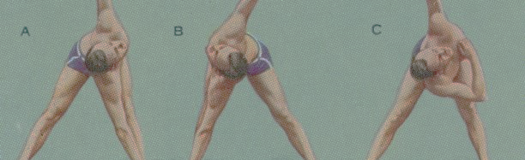
Analysis Approach
Method Approach: The datasets connect to mobility and longevity by emphasizing bodyweight training's role in maintaining physical fitness and reducing fall risks, thus enhancing the quality of life in older adults.
Cardio fitness (dataset 1): Foundational trend dataset.
Mobility and Strength (Dataset 2): Stretching improves strength, which is crucial for maintaining mobility and reducing fall risks in older adults.
Bodyweight Training Engagement (Dataset 3): Popular exercises discussed in the community can promote effective training routines that enhance strength and mobility, potentially reducing the risk of falls and improving longevity.
Falls and Longevity (Dataset 4): The high incidence of falls among older adults leads to significant mortality, highlighting the importance of mobility and strength training.

Slide 15
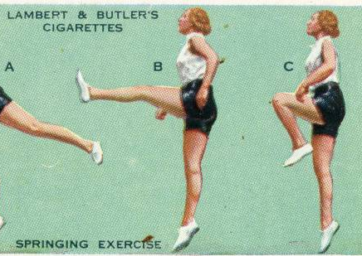

Conclusions
Summary of Findings: Stretching, strength training, and bodyweight exercises promote mobility and reduce fall risks.
Future Directions: Recommendations for further research and practical applications in fitness programs for older adults.

Slide 16
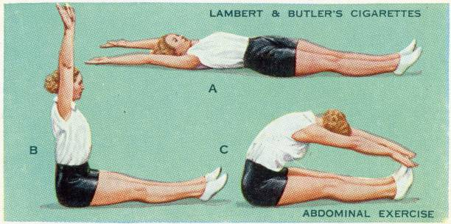
Thank you
Questions

Slide 17
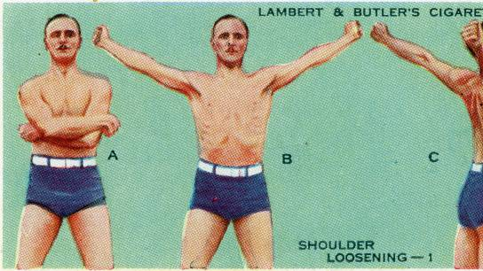
References:
Afonso, J., Ramirez-Campillo, R., Moscão, J., Rocha, T., Zacca, R., Martins, A., Milheiro, A. A., Ferreira, J., Sarmento, H., & Clemente, F. M. (2021). Strength Training versus Stretching for Improving Range of Motion: A Systematic Review and Meta-Analysis. Healthcare (Basel, Switzerland), 9(4), 427. https://doi.org/10.3390/healthcare9040427 https://www.ncbi.nlm.nih.gov/pmc/articles/PMC8067745/
Arntz, F., Markov, A., Behm, D. G., Behrens, M., Negra, Y., Nakamura, M., Moran, J., & Chaabene, H. (2023). Chronic Effects of Static Stretching Exercises on Muscle Strength and Power in Healthy Individuals Across the Lifespan: A Systematic Review with Multi-level Meta-analysis. Sports medicine (Auckland, N.Z.), 53(3), 723–745. https://doi.org/10.1007/s40279-022-01806-9 https://www.ncbi.nlm.nih.gov/pmc/articles/PMC9935669/
Centers for Disease Control and Prevention. (2023). Physical Fitness. Retrieved from https://search.cdc.gov/search/?query=physical%20fitness&siteLimit=NCHS&dpage=1
Centers for Disease Control and Prevention. (2022). What Counts as Physical Activity? Retrieved from https://www.cdc.gov/physical-activity-basics/adding-older-adults/what-counts.html
Centers for Disease Control and Prevention. National Center for Health Statistics. National Vital Statistics System, Mortality 1999–2021 on CDC WONDER Online Database. Accessed January 24, 2023. https://wonder.cdc.gov/ucd-icd10.html
UCI Machine Learning Repository. (2023). Physical Fitness Datasets. Retrieved from https://archive.ics.uci.edu/datasets?skip=0&take=10&sort=desc&orderBy=NumHits&search=physical+fitness
U.S. Department of Health and Human Services. (2019). Physical Activity Guidelines for Americans (2nd ed.). Retrieved from https://health.gov/sites/default/files/2019-09/Physical_Activity_Guidelines_2nd_edition.pdf#page=73
Shephard, R. J. (2009). Physical activity and aging: Evidence to develop exercise recommendations for older adults. British Journal of Sports Medicine, 43(12), 883. doi:10.1136/bjsm.2009.068072
Riechman, S. E., Zoeller, R. F., & Dabayebeh, I. M. (2014). Regulation of Akt during chronic contractile activity‐induced skeletal muscle hypertrophy. Pflügers Archiv - European Journal of Physiology, 466(8), 1497-1505. doi:10.1007/s00424-014-1496-0
Menie, N. (2022). Fitness Exercises. Retrieved from https://www.kaggle.com/code/nickmenie/fitness-exercises
Physical Therapy Exercises - UCI Machine Learning Repository
https://www.ncbi.nlm.nih.gov/pmc/articles/PMC9969476/

