Slide 1
Hormonal contraception & the resting brain
Aperiodic and oscillatory EEG signatures of cortical excitability
Dataset ds007615 · N = 69 women · resting-state EEG (eyes-closed / eyes-open)
Notes:
We ask whether current hormonal-contraceptive use leaves a signature in resting EEG — in both the aperiodic (1/f) component and oscillatory alpha — and whether it survives confound control.

Slide 2
01
A near-universal exposure, an understudied brain
hormonal contraception is one of the most widely used medications on earth
~874M
>20%
~50%
women use modern contraception worldwide
of reproductive-age women take the pill in 27 countries — highest across Europe
global contraceptive prevalence among women (65% of married women 15–49)
UN / WHO, 2021
UN World Contraceptive Use
2024 estimates
Hundreds of millions of women alter their hormonal milieu daily — yet the effects on brain excitability remain poorly characterized.
Notes:
Framing: enormous population exposure, small evidence base on brain effects. Sources: UN World Contraceptive Use / WHO / 2024 estimates.

Slide 3
02
Sex hormones tune cortical excitability
the excitation–inhibition (E/I) balance is hormone-sensitive
Estrogen
Progesterone
Enhances glutamate / NMDA signaling
Reduces GABAergic inhibition
→ shifts the balance toward EXCITATION
Metabolite allopregnanolone is a positive GABA-A modulator
Benzodiazepine-like inhibitory action
→ shifts the balance toward INHIBITION
Hormonal contraceptives suppress and replace this natural hormonal rhythm — so they should reshape the cortical E/I balance, and the aperiodic EEG lets us read it.
Notes:
Estrogen excitatory (glutamate up, GABA down); progesterone/allopregnanolone inhibitory (GABA-A PAM). HC alters this milieu → predicts E/I shifts readable via aperiodic EEG.

Slide 4
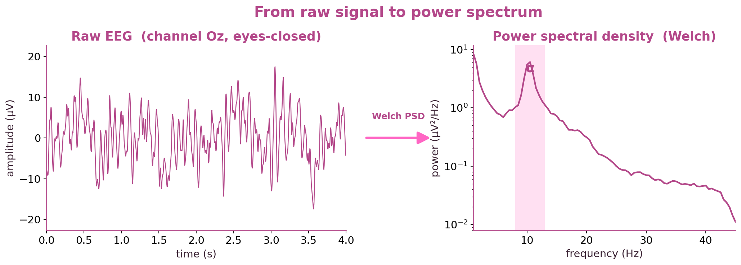
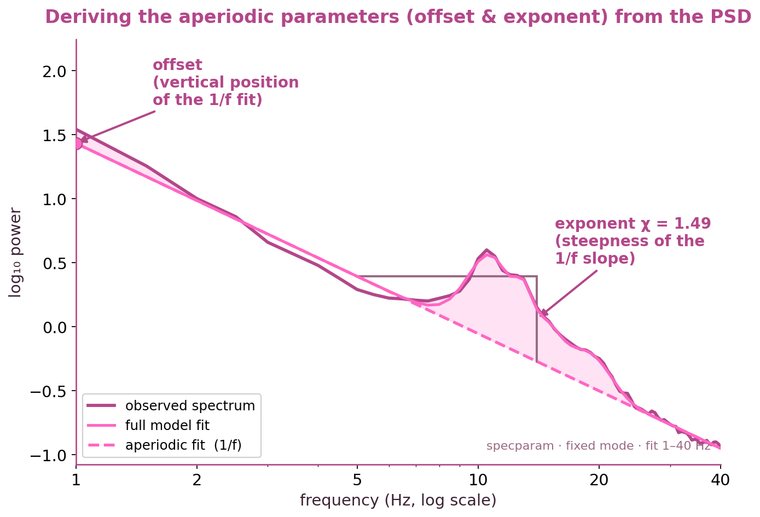
03
Reading excitability from the EEG spectrum
one recording yields two complementary signals
The resting power spectrum has an APERIODIC 1/f component — its exponent and offset index the excitation–inhibition balance.
Sitting on top are PERIODIC oscillatory peaks — most prominently the alpha rhythm (~10 Hz).
specparam separates the two, per channel, so we can study each independently — the core method of this project.
Notes:
Methods primer: raw EEG → PSD → specparam decomposition into aperiodic (exponent/offset) and periodic (alpha) parts. Both are analyzed downstream.

Slide 5
04
The question & the design
Can resting EEG decode current HC use — and is it neural signal, not confounds?
1
2
3
4
Confounds only
EEG only
EEG + confounds
EEG | confounds
age · nicotine · alcohol · education · BDI · cycle phase
exponent + offset, 64 ch, EC/EO
both feature sets together
confounds regressed out fold-wise + permutation
→ expect ≈ chance
→ reference decode
→ do they add?
→ the clean test
Notes:
Four LOSO models isolate whether the EEG decode is independent of confounds; the residualized model regresses confounds out within each training fold, then permutation-tests.

Slide 6
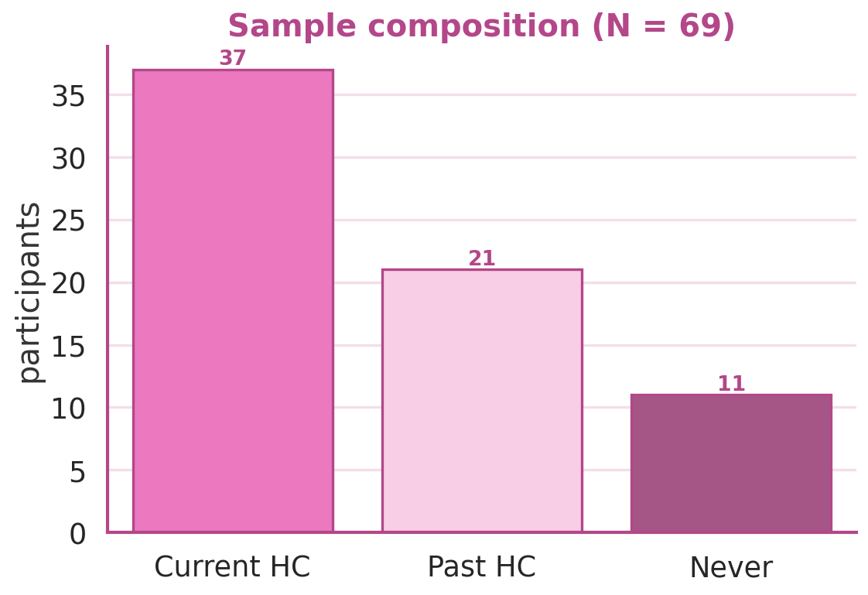
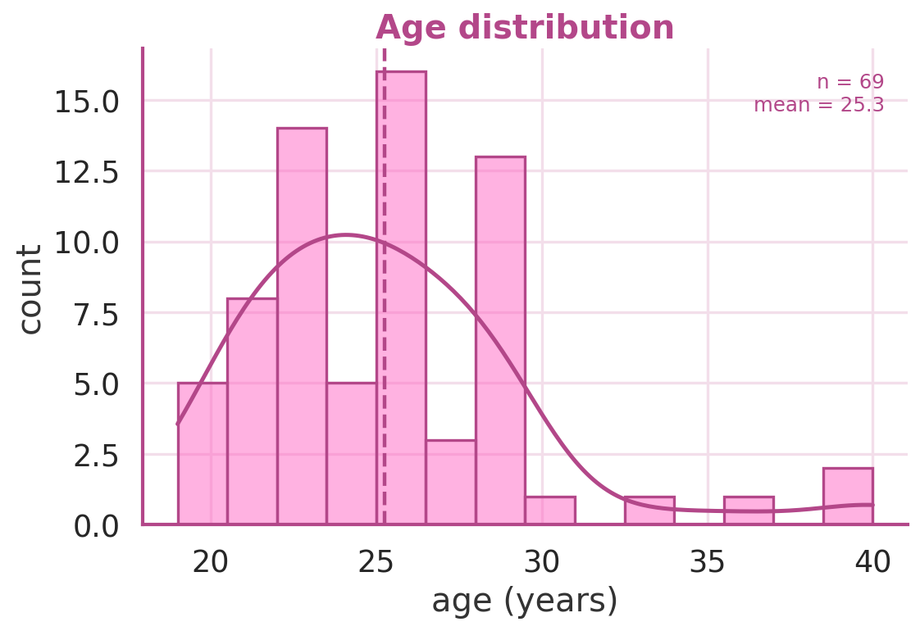
05
Sample
69
37 / 21 / 11
100%
participants
current / past / never
female
Notes:
69 women: 37 current HC users vs 32 non-current (21 past, 11 never). Decode target = current vs non-current.

Slide 7
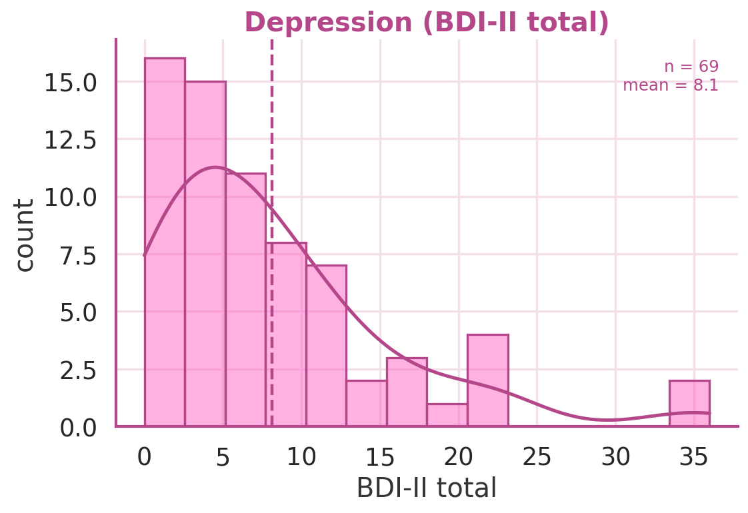
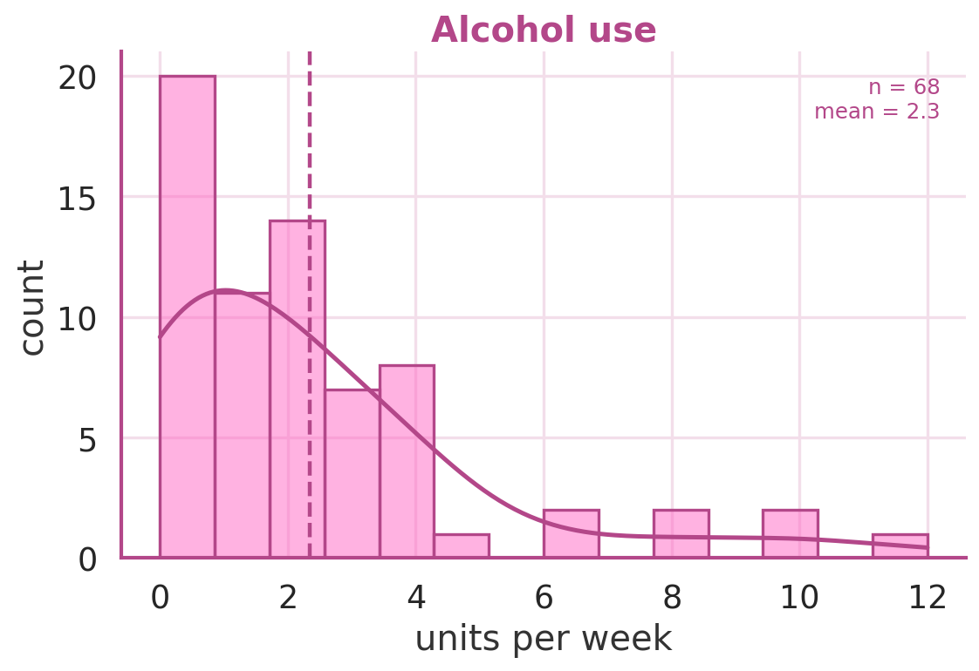
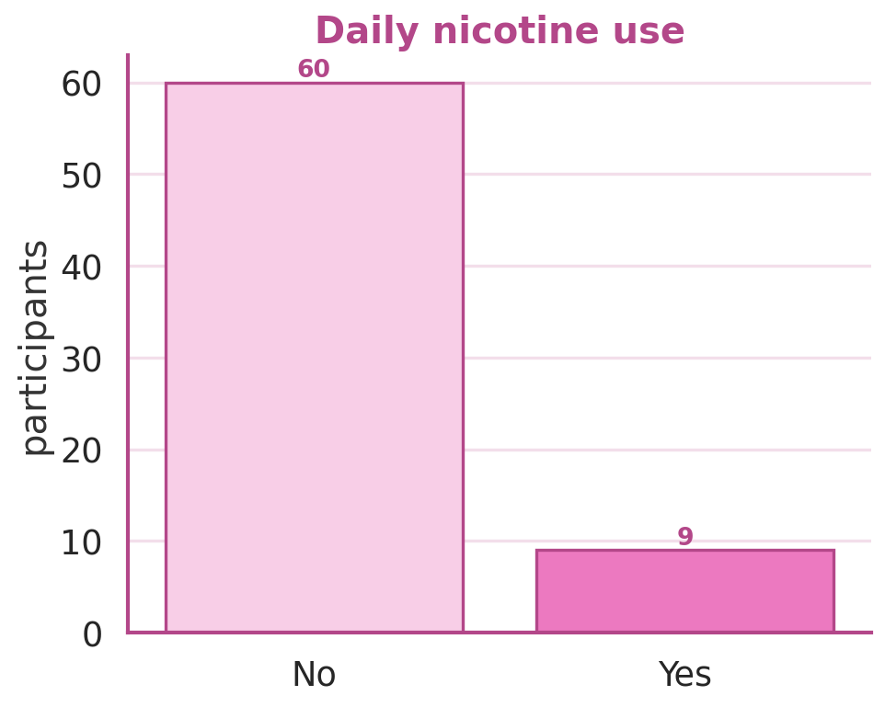
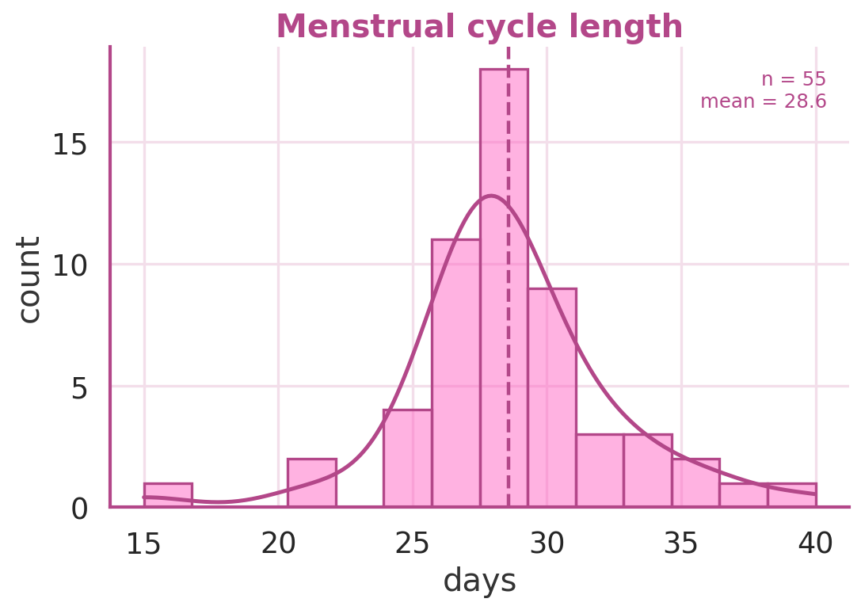
06
Variables we controlled for
distributions of the measured confounds (plus age & education)
Notes:
Confounds: BDI, alcohol, nicotine, cycle length, plus age and education.

Slide 8
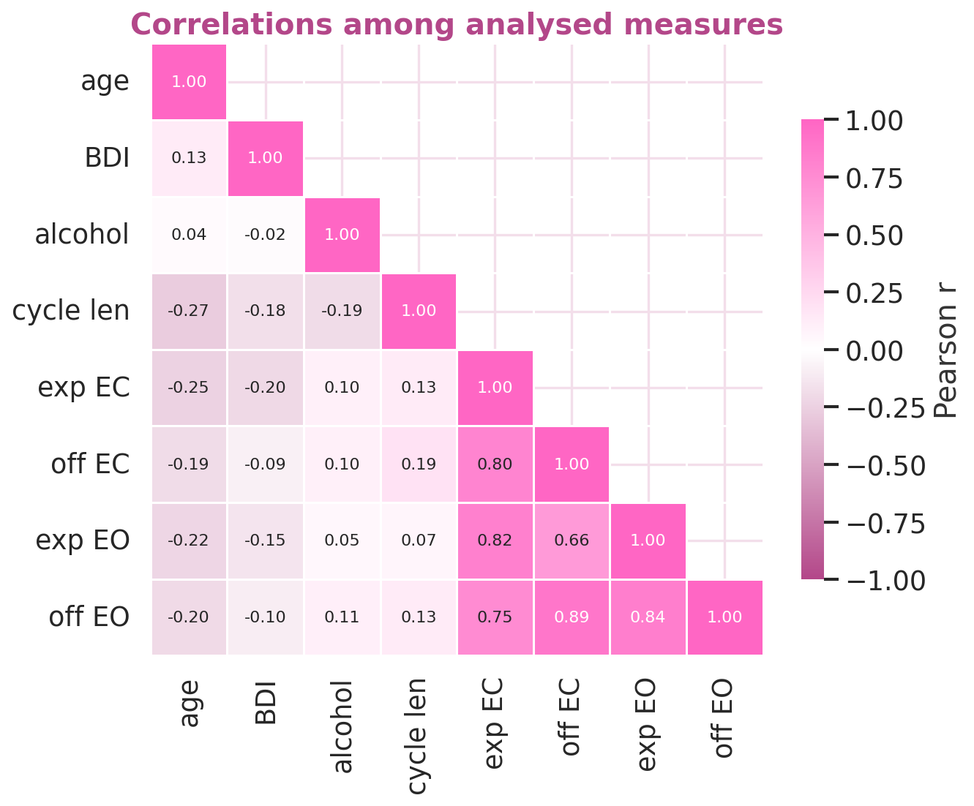
07
Methods
Features: specparam exponent + offset, eyes-closed and eyes-open, 64 channels (256 features).
Classifier: L2-regularized logistic regression, leave-one-subject-out cross-validation.
Confound control: fold-wise linear residualization — confounds regressed out of every EEG feature, fit on training data only (leakage-safe).
Significance: 500-run label-permutation test on the residualized model.
Notes:
Fold-wise residualization prevents leakage; heatmap shows measures are related but not redundant.

Slide 9
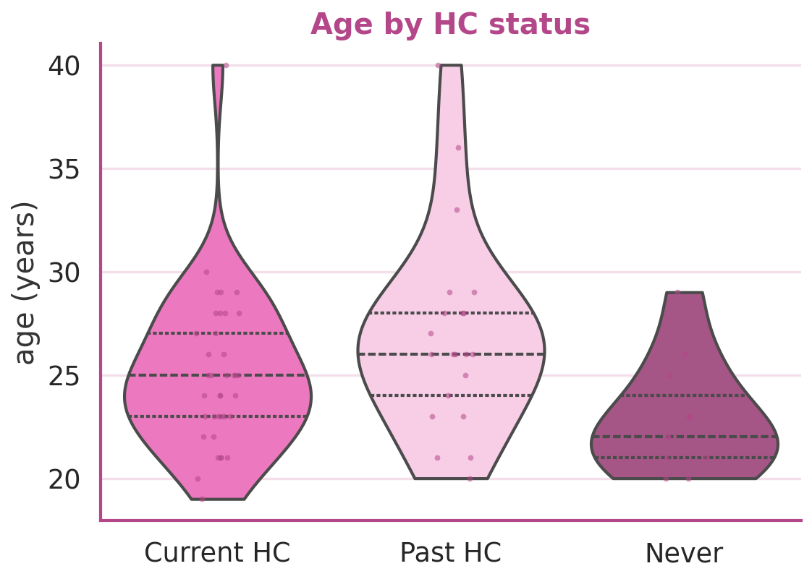
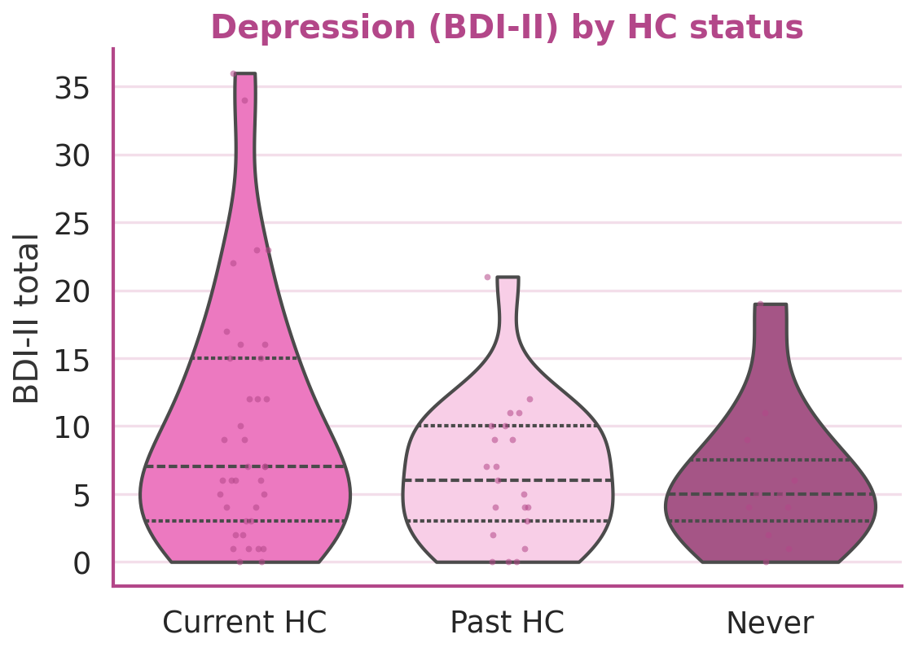
08
Confounds don't separate the groups
Groups are broadly comparable on the measured confounds — and a confounds-only classifier decodes HC use at roughly chance (AUC ≈ 0.51).
Notes:
Distributions overlap; covariates-only decode near chance.

Slide 10
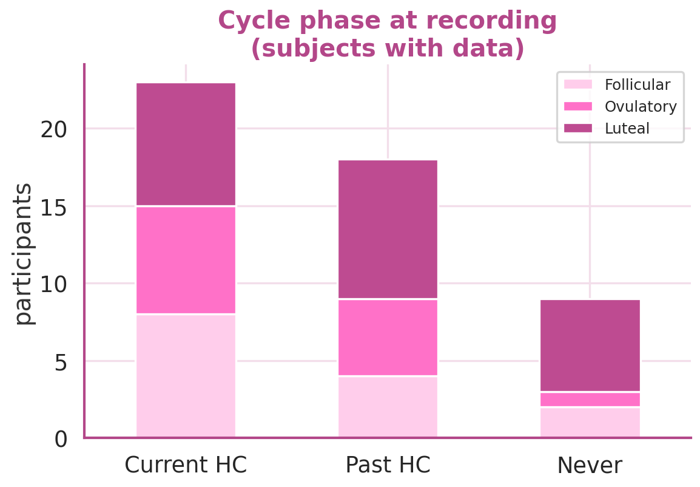
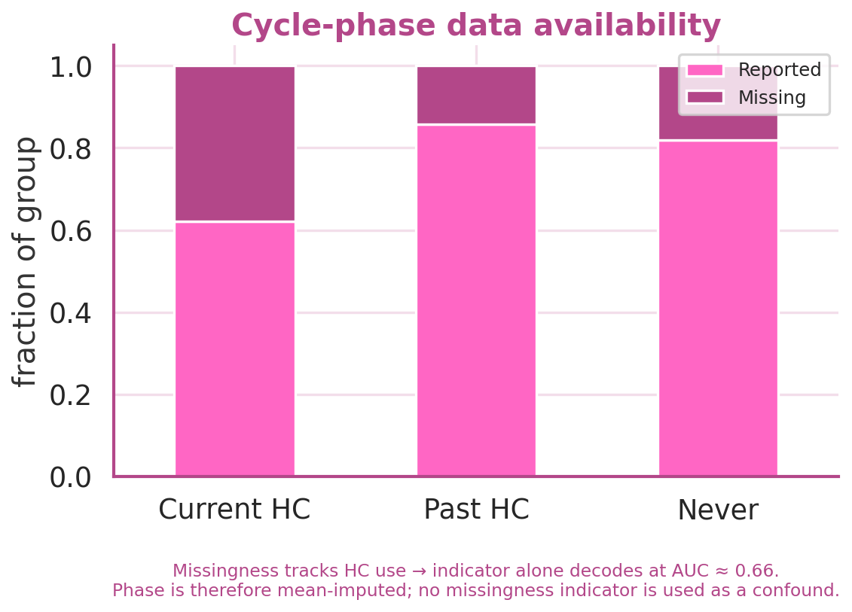
09
The menstrual cycle-phase question
Cycle phase itself barely predicts HC use — it is not a confound of the decode.
But phase is missing for ~28% of subjects, and missingness tracks HC use (indicator alone decodes at AUC ≈ 0.66).
Fix: phase is mean-imputed; the missingness indicator is NOT used as a confound (it would leak the label). A complete-case sensitivity analysis backs this up.
Notes:
Because non-menstruating HC users lack cycle data, missingness is a label proxy; we avoid using it as a confound and verify with complete-case analysis.

Slide 11
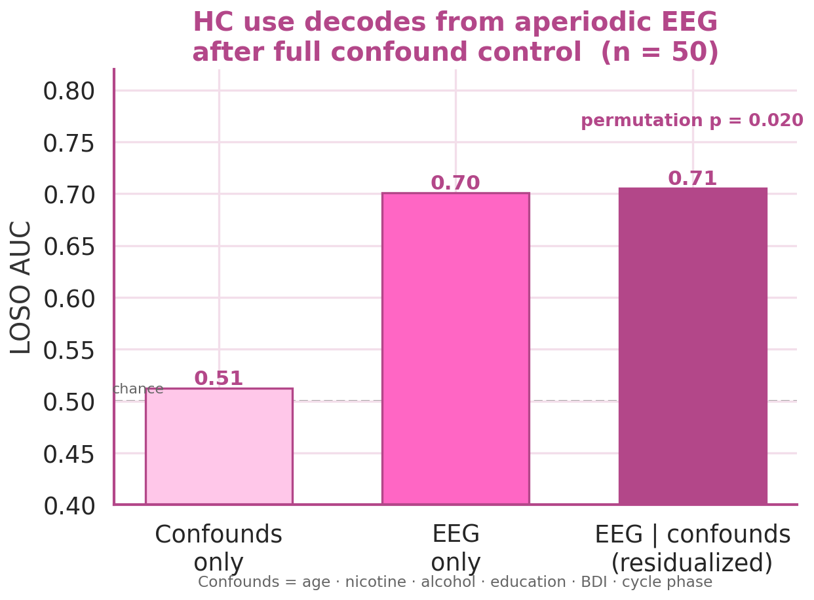
10
Result: the aperiodic decode survives full confound control
0.51
Confounds only ≈ chance
0.70
EEG only reference
0.71
EEG | confounds residualized
permutation p ≈ 0.02 (complete-case n = 50)
Notes:
Confounds alone at chance; EEG decodes 0.70; removing all confounds leaves 0.71 (p~0.02). Not a confound artifact.

Slide 12
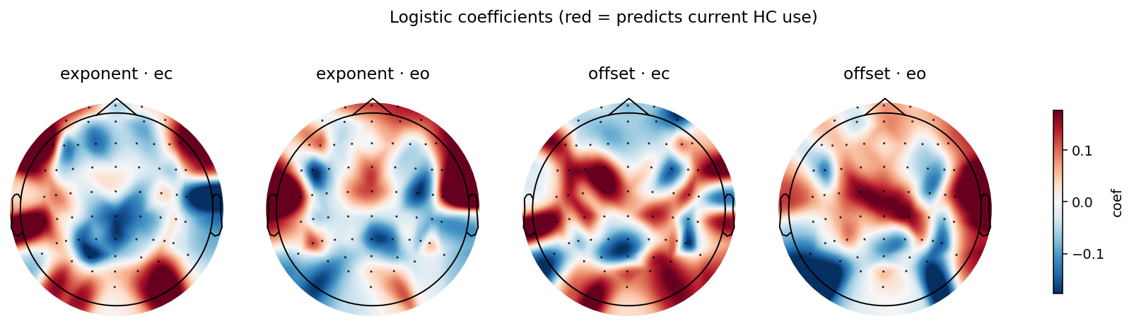
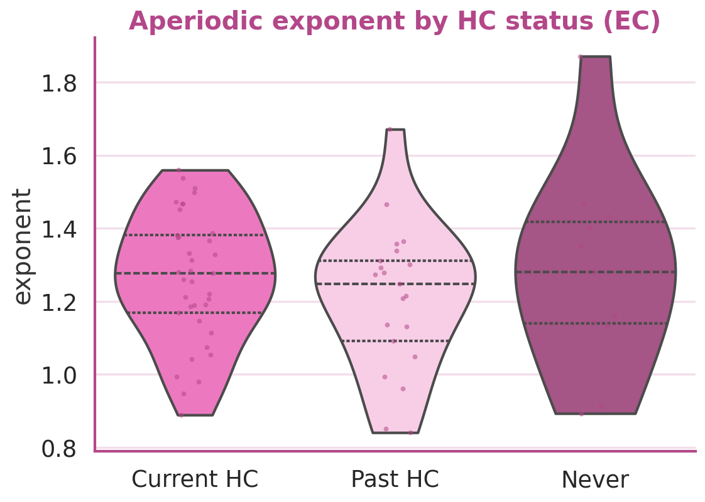
11
Where the aperiodic signal lives
Logistic coefficients spread across the scalp — the decode is distributed, not one electrode.
Exponent and offset in both eyes-closed and eyes-open contribute.
The scalp-average exponent shifts only modestly with HC status (left) — the decode is a pattern.
Notes:
Distributed topography across channels and exponent/offset in both conditions.

Slide 13
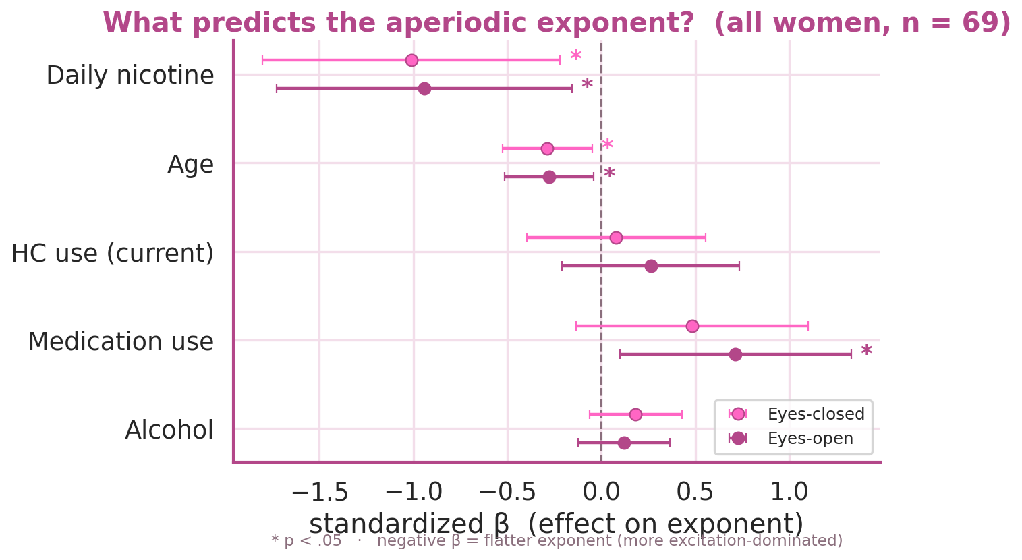
12
What shapes the aperiodic exponent?
exploratory model across all women (n = 69)
Age and daily nicotine are the dominant flatteners of the exponent — both significant, EC and EO.
Medication use pushes the exponent up (eyes-open).
Current HC use barely moves the scalp-average slope — its signal lives in the offset and the distributed pattern.
Alcohol shows no reliable effect here.
Notes:
Known drivers (age, nicotine) dominate the global exponent; HC acts on offset / distributed pattern.

Slide 14
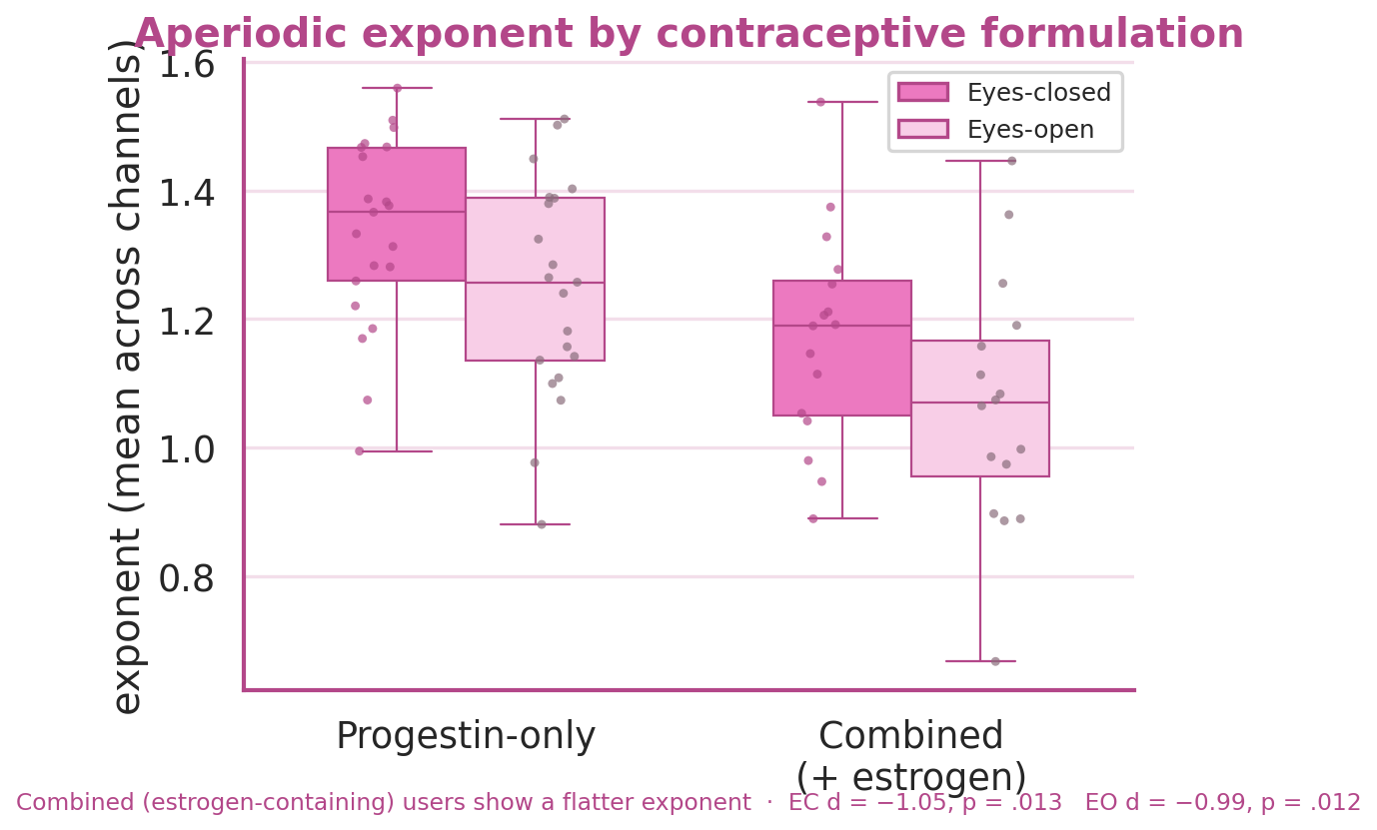
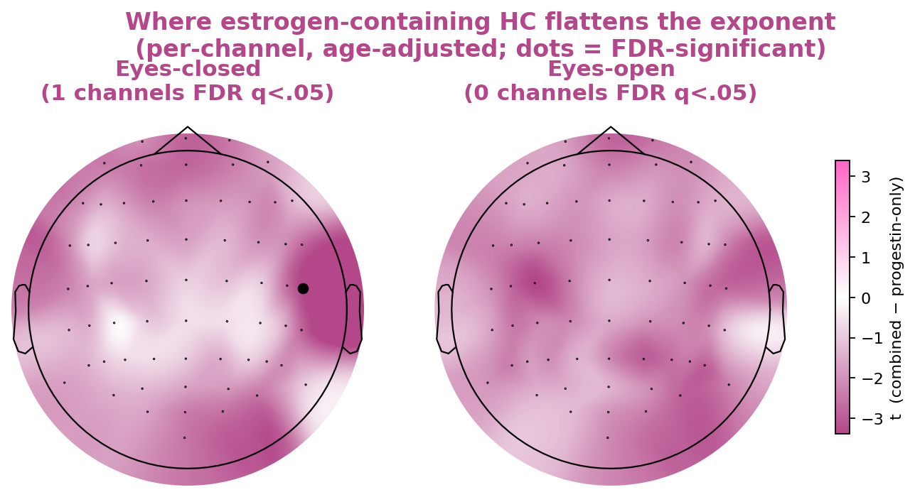
13
A hormonal lead: estrogen-containing contraceptives
exploratory · age-adjusted · uncorrected — needs replication
Among HC users, combined (estrogen-containing) formulations show a markedly flatter exponent than progestin-only (d ≈ 1.0, p ≈ .012) — consistent with estrogen's pro-excitatory action.
The effect is diffuse, not focal: nearly every channel points the same way, but only one survives FDR — a broad cortical shift best summarised by the whole-scalp mean.
Notes:
Combined vs progestin-only: large flatter-exponent effect, spatially diffuse. Exploratory.

Slide 15
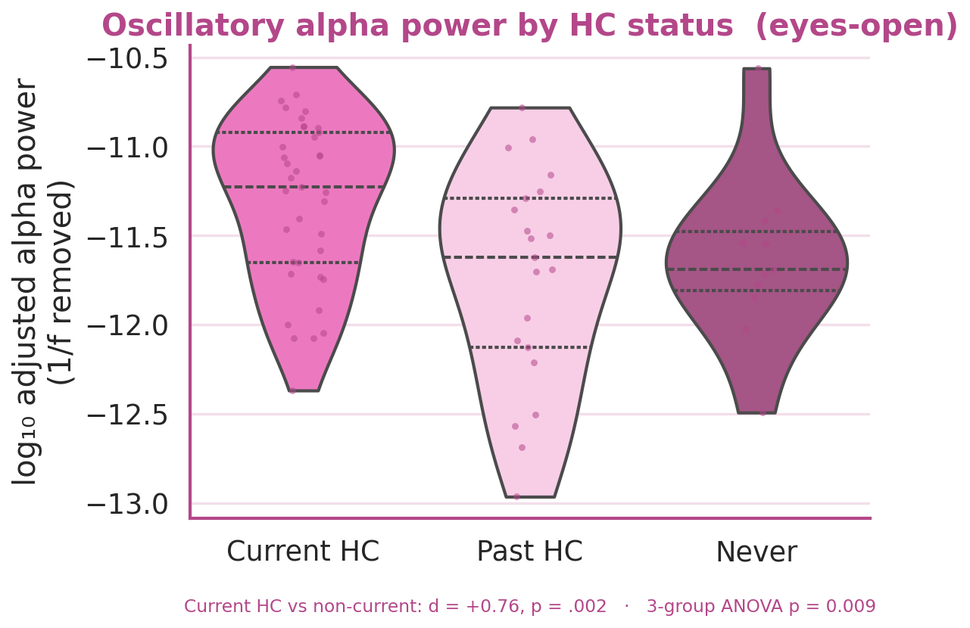
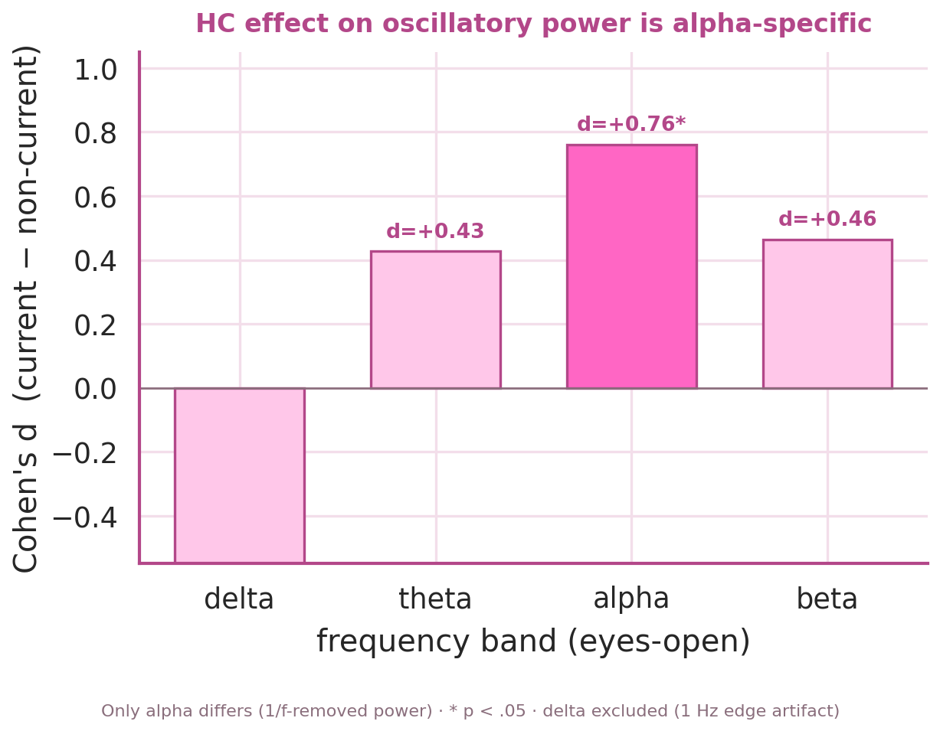
14
The periodic side: alpha power is elevated in HC users
Current HC users show higher oscillatory alpha power (d ≈ 0.76 eyes-open; robust to age and nicotine).
It survives 1/f removal → a genuine oscillation, not a by-product of the aperiodic shift — and it is alpha-specific.
Notes:
Alpha power elevated in current HC users, adjusted (1/f-removed), alpha-specific, robust to age+nicotine. The periodic complement to the aperiodic decode.

Slide 16
15
A double dissociation
the two hormonal contrasts act on different parts of the spectrum
HC use (vs non-use)
Formulation (estrogen vs progestin)
↑ Alpha oscillatory power (d ≈ 0.76, eyes-open)
Distributed aperiodic pattern → decodes at AUC ≈ 0.70
Scalp-average exponent: little change
↓ Aperiodic exponent — flatter 1/f (d ≈ 1.0)
Alpha & other band powers: no detectable effect
A shift in excitability background, not oscillations
HC use moves the oscillations; estrogen-containing formulation moves the aperiodic background. (Exploratory; formulation contrast underpowered at 16 vs 21.)
Notes:
Double dissociation: HC use vs non-use -> alpha oscillations; combined vs progestin formulation -> aperiodic exponent. Caveat: formulation comparison underpowered.

Slide 17
Takeaways
Current HC use leaves a two-part resting-EEG signature: a distributed aperiodic pattern (decodes at AUC ≈ 0.70) and elevated alpha oscillatory power (d ≈ 0.76).
Neither is explained by age, nicotine, alcohol, education, depression, or menstrual cycle phase — the aperiodic decode holds under leakage-safe residualization + permutation (p ≈ 0.02).
A double dissociation: HC use moves alpha; estrogen-containing formulation flattens the aperiodic exponent (d ≈ 1.0).
Limitations & next steps
Single dataset · all-female · cross-sectional · secondary analyses exploratory and uncorrected.
Cycle phase moved nothing here (underpowered) — a within-subject design is needed.
Replicate the estrogen-vs-progestin exponent effect in an independent, hormone-assayed sample.
Notes:
Two-part signature + double dissociation as the story; standard limitations and replication targets.

