Slide 1
Team Newbie
Harish Kumar, Ertugrul Karademir

Slide 2
Attempt 1
A solution only using parameters of the given case.
Argument is that number of people on a certain flight should not depend on the previous flights.

Slide 3
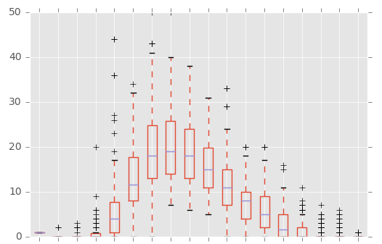
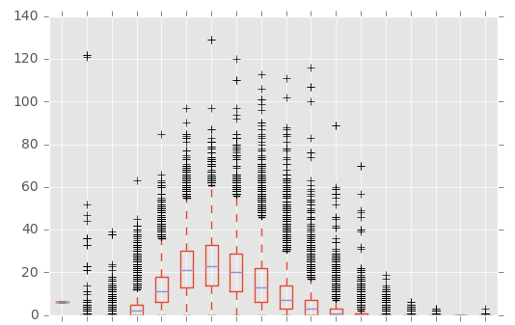
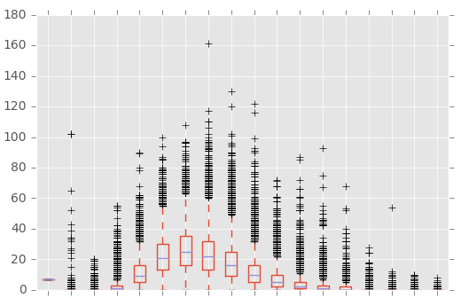
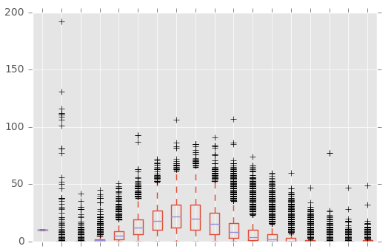
There is a certain pattern

Slide 4
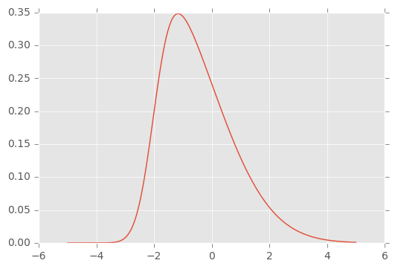
There is a certain pattern

Slide 5
Attempt 1
A solution only using parameters of the given case.
Argument is that number of people on a certain flight should not depend on the previous flights.
Used: Plane capacity, Destination, Flight Type in a Neural Network to fit into data.

Slide 6
Attempt 2

Slide 7
Understanding Data
2012
2013
2014
2015
2016
train flights
test Expl flights
target flights
(prediction dates)

Slide 8
Multiple runs
2012
2013
2014
2015
2016
dataset 1
dataset 2
dataset 3
Decision Tree Regression
Lots of things to tweak and
try out!

