Slide 1
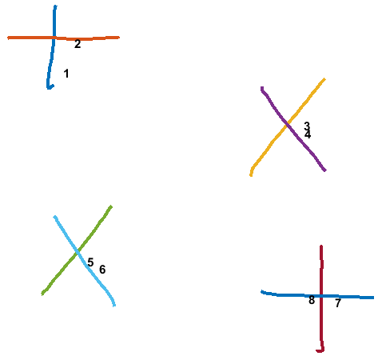

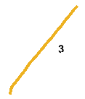


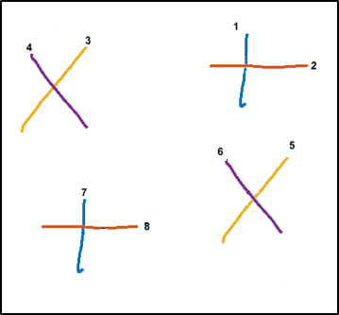
Sketch
Data Cost Matrix (D)
Jigsaw Label | Strokes
 | 1 | 2 | 3 | 4 | 5 | 6 | 7 | 8
1
2
3
4
Run
Min Cut Max Flow
Graph Cut
Converged
Canvas Size 800 x 1280
Jigsaw (J)
Compatibility Matrix (C)
J x N
Offset Map
N (# of Strokes) = 8
Regenerated Sketch
i
 | 1 | 2 | 3 | 4
1 | 0
2 |  | 0
3 |  |  | 0
4 |  |  |  | 0
Stroke | X Pos. | Y Pos. | X Offset | Y Offset | Jigsaw Element
1 | 500 | 40 | 0 | 0 | 1
2 | 500 | 40 | 8.5 | 18 | 2
3 | 80 | 50 | 0 | 0 | 3
4 | 87 | 58.5 | 0 | 0 | 4
5 | 530 | 450 | 0 | 0 | 3
6 | 525 | 445 | -12 | -13.5 | 4
7 | 100 | 480 | 0 | 0 | 2
8 | 105 | 487 | -2 | -1.5 | 1
j
Center of Strokes (S)
Stroke | X | Y
1 | 180 | 156
2 | 192 | 123
3 | 443 | 215
4 | 444 | 224
5 | 206 | 367
6 | 219 | 375
7 | 477 | 412
8 | 448 | 409
1 x 4 x 720
IDM Feat.
J(Jigsaw size) = 4
4 x 4 x 4
i = i th jigsaw element
j = j th jigsaw element
i,j,1 = mean of x displacement between strokes
that are assigned to jigsaw i and j.
i,j,2 = mean of y displacement between strokes
that are assigned to jigsaw i and j.
i,j,3 = variance of x displacement between strokes
that are assigned to jigsaw i and j.
i,j,4 = variance of y displacement between strokes
that are assigned to jigsaw i and j.
N x 6
N x 3

Slide 2
Compatibility Matrix (C)
i,j,1 = mean of x displacement between strokes
that are assigned to jigsaw i and j.
i,j,2 = mean of y displacement between strokes
that are assigned to jigsaw i and j.
Offset Map
i, j, 1
i, j, 2
Stroke | X Pos. | Y Pos. | X Offset | Y Offset | Jigsaw Element
1 | 500 | 40 | 0 | 0 | 1
2 | 500 | 40 | 8.5 | 18 | 2
3 | 80 | 50 | 0 | 0 | 3
4 | 87 | 58.5 | 0 | 0 | 4
5 | 530 | 450 | 0 | 0 | 3
6 | 525 | 445 | -12 | -13.5 | 4
7 | 100 | 480 | 0 | 0 | 2
8 | 105 | 487 | -2 | -1.5 | 1
 | 1 | 2 | 3 | 4
1 | 0 | -8.5 | -4 | 3
2 |  | 0 | 4.5 | 11.5
3 |  |  | 0 | 7
4 |  |  |  | 0
 | 1 | 2 | 3 | 4
1 | 0 | -18 | 11 | 3
2 |  | 0 | 25 | 33.5
3 |  |  | 0 | 8.5
4 |  |  |  | 0
i,j,3 = variance of x displacement between strokes
that are assigned to jigsaw i and j.
i,j,4 = variance of y displacement between strokes
that are assigned to jigsaw i and j.
Regenerated Sketch
i, j, 3
i, j, 4
 | 1 | 2 | 3 | 4
1 | 0 | 840.5 | 142578 | 136242
2 |  | 0 | 121520 | 115680
3 |  |  | 0 | 72
4 |  |  |  | 0
 | 1 | 2 | 3 | 4
1 | 0 | 648 | 4608 | 136242
2 |  | 0 | 8978 | 9112.5
3 |  |  | 0 | 0.5
4 |  |  |  | 0

Slide 3
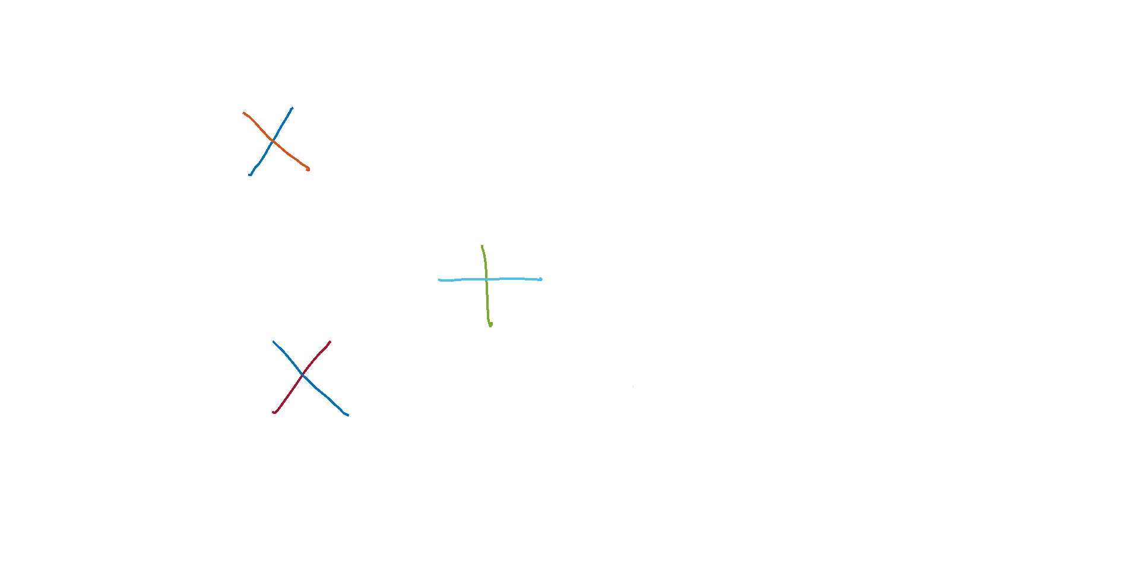
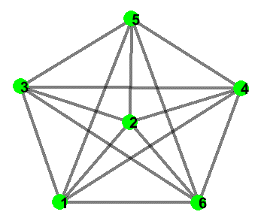
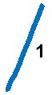
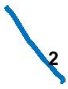
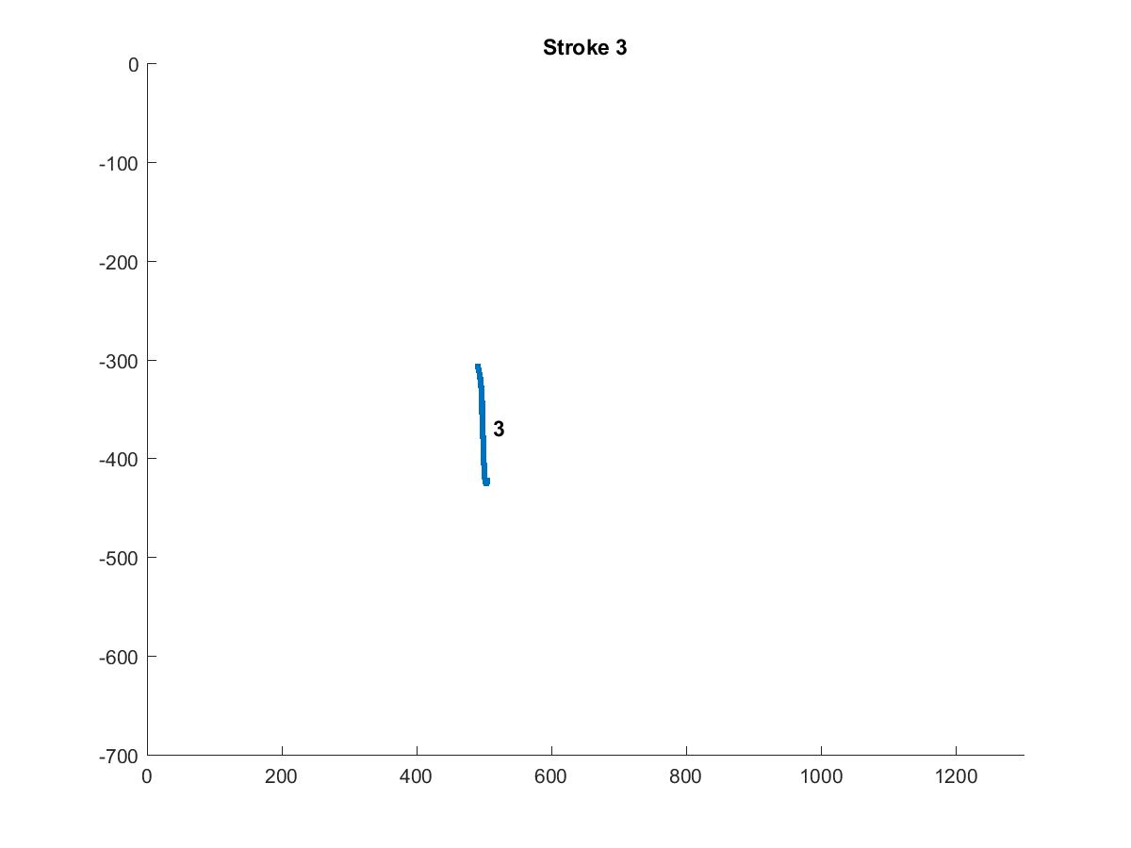
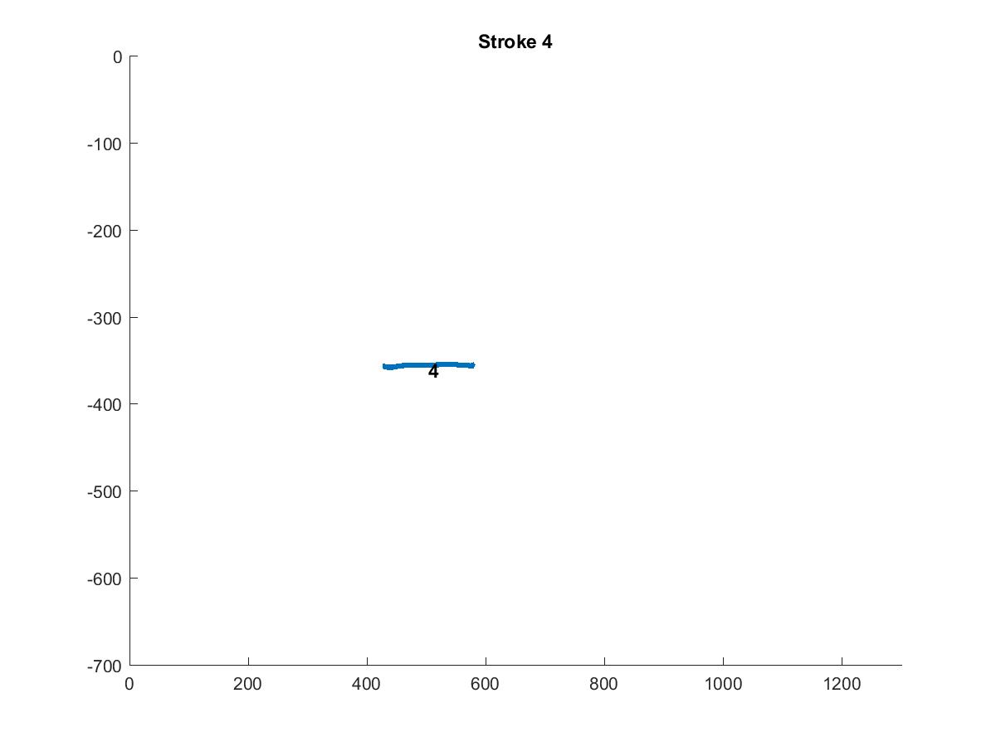
Sketch
Data Cost Matrix (D)
Run
Min Cut Max Flow
Graph Cut
Jigsaw Label | Strokes
 | 1 | 2 | 3 | 4 | 5 | 6 | 7 | 8
1
2
3
4
2
1
3
Converged
4
6
5
Canvas Size 800 x 1280
Jigsaw (J)
Compatibility Matrix (C)
J x N
N (# of Strokes) = 8
Regenerated Sketch
i
 | 1 | 2 | 3 | 4
1 | 0
2 |  | 0
3 |  |  | 0
4 |  |  |  | 0
j
Center of Strokes (S)
Offset Map
Stroke | X | Y
1 | 184 | 148
2 | 196 | 160
3 | 498 | 364
4 | 488 | 356
5 | 228 | 500
6 | 224 | 498
1 x 4 x 720
Stroke | X Pos. | Y Pos. | X Offset | Y Offset | Jigsaw Element
1 | 500 | 40 | 0 | 0 | 1
2 | 500 | 40 | 8.5 | 18 | 2
3 | 80 | 50 | 0 | 0 | 3
4 | 87 | 58.5 | 0 | 0 | 4
5 | 530 | 450 | 0 | 0 | 3
6 | 525 | 445 | -12 | -13.5 | 4
IDM Feat.
J(Jigsaw size) = 4
4 x 4 x 4
i = i th jigsaw element
j = j th jigsaw element
i,j,1 = mean of x displacement between strokes
that are assigned to jigsaw i and j.
i,j,2 = mean of y displacement between strokes
that are assigned to jigsaw i and j.
i,j,3 = variance of x displacement between strokes
that are assigned to jigsaw i and j.
i,j,4 = variance of y displacement between strokes
that are assigned to jigsaw i and j.
N x 3
N x 6

Slide 4
Compatibility Matrix (C)
i,j,1 = mean of x displacement between strokes
that are assigned to jigsaw i and j.
i,j,2 = mean of y displacement between strokes
that are assigned to jigsaw i and j.
Offset Map
i, j, 1
i, j, 2
Stroke | X Pos. | Y Pos. | X Offset | Y Offset | Jigsaw Element
1 | 500 | 40 | 0 | 0 | 1
2 | 500 | 40 | 8.5 | 18 | 2
3 | 80 | 50 | 0 | 0 | 3
4 | 87 | 58.5 | 0 | 0 | 4
5 | 530 | 450 | 0 | 0 | 3
6 | 525 | 445 | -12 | -13.5 | 4
7 | 100 | 480 | 0 | 0 | 2
8 | 105 | 487 | -2 | -1.5 | 1
 | 1 | 2 | 3 | 4
1 | 0 | -8.5 | -4 | 3
2 |  | 0 | 4.5 | 11.5
3 |  |  | 0 | 7
4 |  |  |  | 0
 | 1 | 2 | 3 | 4
1 | 0 | -18 | 11 | 3
2 |  | 0 | 25 | 33.5
3 |  |  | 0 | 8.5
4 |  |  |  | 0
i,j,3 = variance of x displacement between strokes
that are assigned to jigsaw i and j.
i,j,4 = variance of y displacement between strokes
that are assigned to jigsaw i and j.
Regenerated Sketch
i, j, 3
i, j, 4
 | 1 | 2 | 3 | 4
1 | 0 | 840.5 | 142578 | 136242
2 |  | 0 | 121520 | 115680
3 |  |  | 0 | 72
4 |  |  |  | 0
 | 1 | 2 | 3 | 4
1 | 0 | 648 | 4608 | 136242
2 |  | 0 | 8978 | 9112.5
3 |  |  | 0 | 0.5
4 |  |  |  | 0

Slide 5
2
1
3
4
6
5

