Slide 1

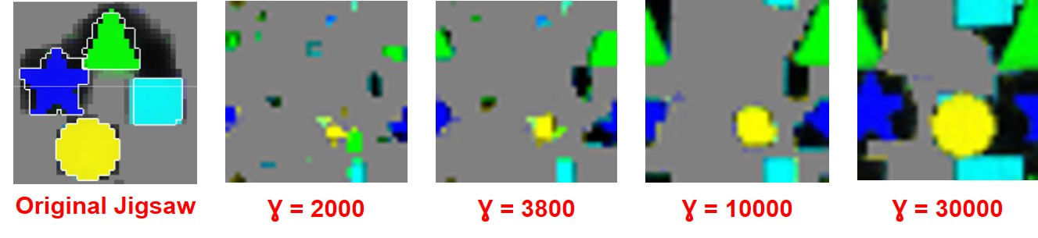
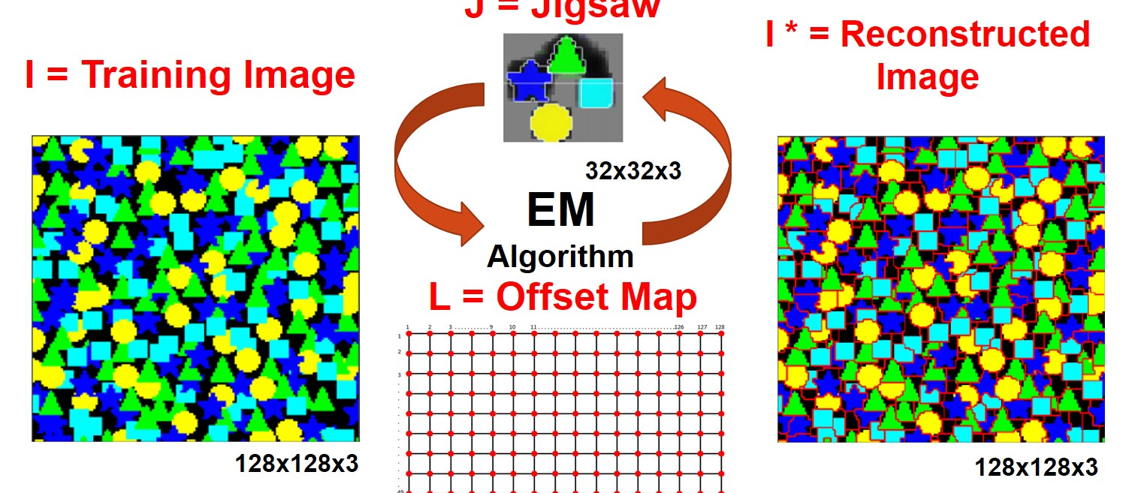
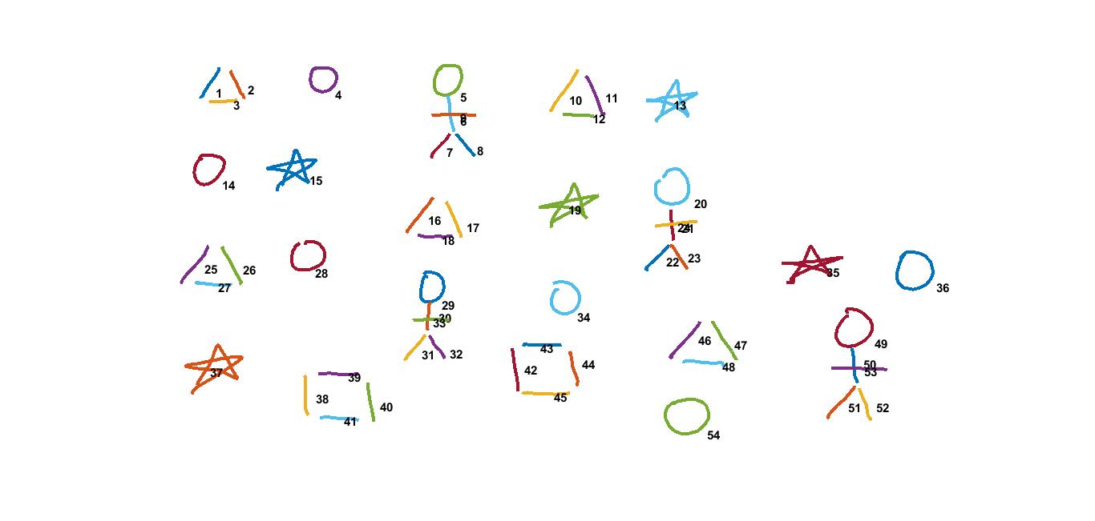
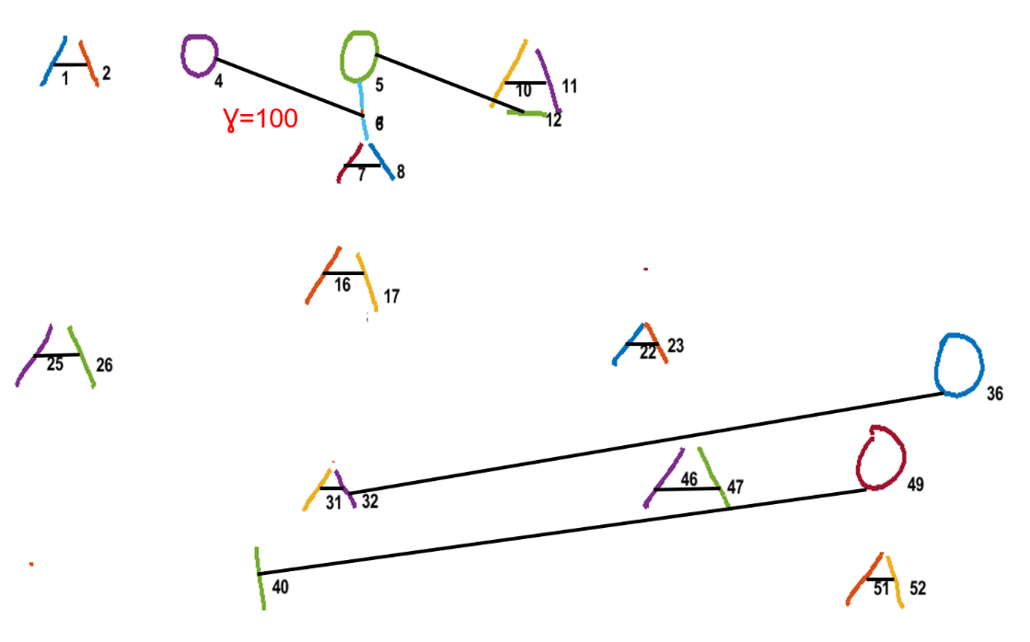
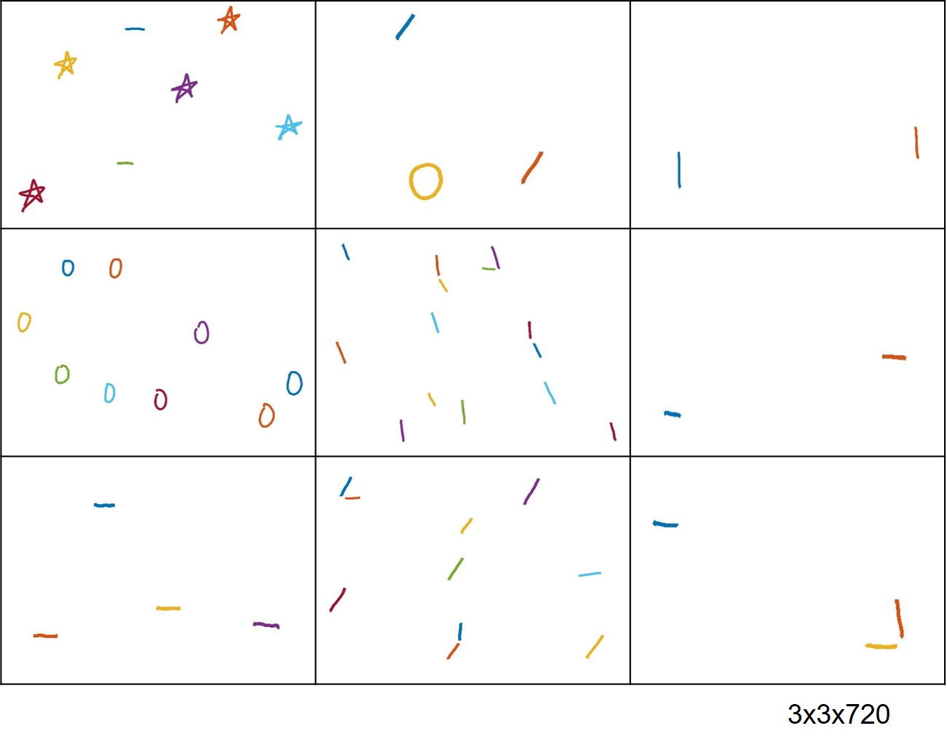
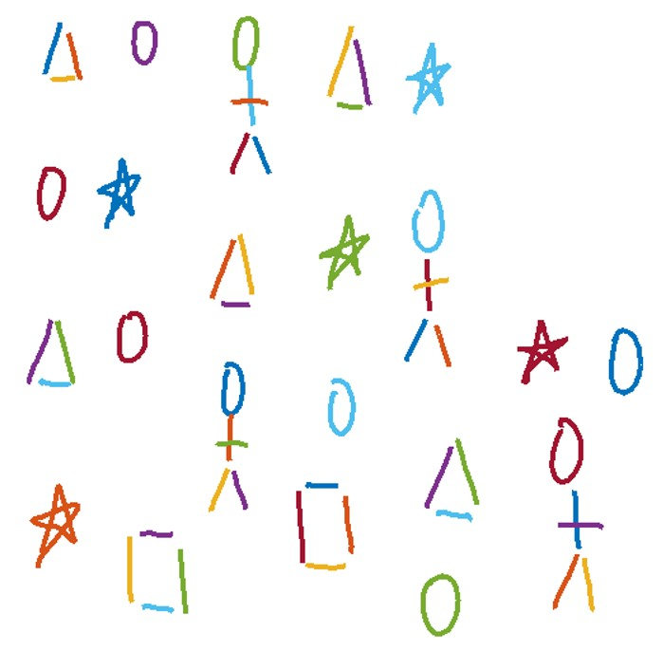
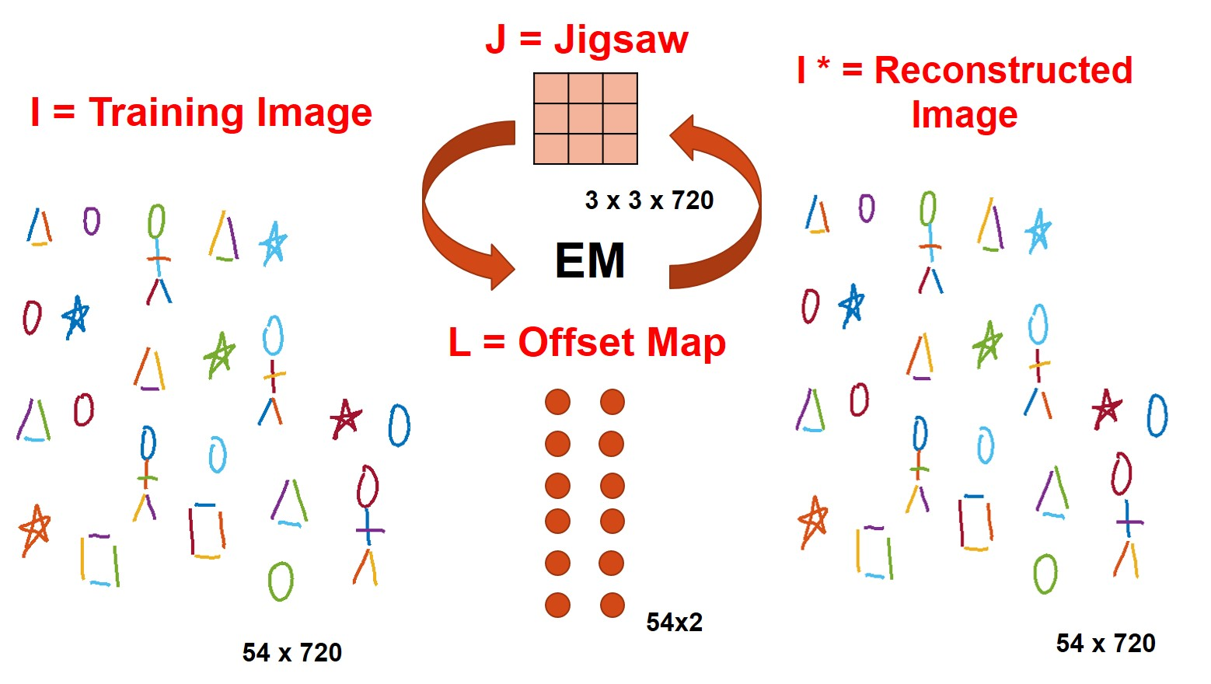

An Unsupervised Method for Sketch Recognition Using Jigsaw Framework
Emre Karaman and T. Metin Sezgin
Koç University, Istanbul, Turkey
{emrekaraman14, mtsezgin}@ku.edu.tr
ABSTRACT
RESULTS
The Jigsaw Model is a patch-based model which learns shape, size and appearance of patches automatically from the repeated structures without supervision. The model extracts irregularly sized and shaped patches from a latent image called jigsaw. In this project we propose how to apply the jigsaw model into sketch recognition domain to classify repeated strokes in a sketch scene without supervision. The results show that our newly model is able to learn and classify hand-crafted repeated structures in a sketch scene.
In the jigsaw model the hyperparameters especially interaction potential between adjacent pixels plays an important role to reach a consistent jigsaw image. The test results with different interaction potential values are shown in Figure 3.
METHOD
Figure 3. Jigsaw images with different parameters.
The Jigsaw Model
We tested our model with a hand-crafted training image which contains repeated structures. Our model create a connection between similar stroke pairs and adjust their origin to have the same displacement value. Thus, we can learn repeated structures and classify them into the same group.
Jigsaw Model learns repeated structures by running an EM algorithm iteratively. The model assigns each pixel of a training image to a jigsaw pixel by an offset map which enforce adjacent pixels in training image to be adjacent in the jigsaw. Finally, the training image is reconstructed from the jigsaw image by using the offset map.
Figure 4. Training image and connected graph.
Upon constructing the connected graph we run EM algorithm until convergence. The jigsaw of training sketch scene and its reconstruction from the jigsaw is shown in Figure 5.
Figure 1. The Jigsaw Model
The Jigsaw Model for Sketch Recognition
In our model pixels correspond to strokes and the strokes are represented as Image Deformation Model (IDM) features in a 1x720 feature vector.
The jigsaw model is founded on a 4 connected grid. However strokes in a sketch scene do not lie on a clear-cut grid. Thus we define a method to create grid between similar strokes. Additionally, we reposition strokes to make relative positions of similar stroke pairs same.
Figure 5. Sketch jigsaw and reconstruction.
When we learn jigsaw, we can reconstruct the training sketch from the jigsaw. Our model learns positions of strokes as well as repeated structures which is different than the original jigsaw model. Reconstructed sketch scene is shown in Figure 6.
Figure 6. Reconstructed image scene.
[1] Kannan, A., Winn, J., Rother, C., 2006. “Clustering appearance and shape by learning jigsaws”, Advances in Neural Information Processing Systems, 657–664.
[2] Ouyang, T.Y., Davis, R., 2009. “A visual approach to sketched symbol recognition”, Morgan Kaufmann Publishers Inc.
Figure 2. Sketch RecognitionUsing Jigsaw Framework

