Slide 1
Clustering Appearance and Shape by Learning Jigsaws Anitha Kannan, John Winn, Carsten Rother Microsoft Research Cambridge
COMP 508 FINAL PROJECT
Emre Karaman
Notes:
For my Final Project I implemented «Clustering Appearance and Shape by Learning Jigsaws» paper on Matlab.

Slide 2
Outline
Problem Statement
Implementation
Results and Evaluation
Future Work
Notes:
I present my Project by following the outline.

Slide 3
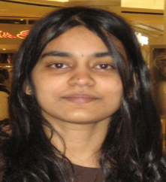


Clustering Appearance and Shape by Learning Jigsaws
Anitha Kannan
Research Scientist at Facebook AI Research
John Winn
Principal Researcher at Microsoft Research Cambridge
Carsten Rother
Senior Researcher at Microsoft Research Cambridge
Published at “Advances in Neural Information Processing Systems (NIPS)” in 2006.
Cited by: 44
Notes:
The paper was published at «Advances in Neural Information Processing Systems (NIPS)» conference in 2006 and has fourty four citation.

Slide 4















Aim of Jigsaw Model
Problem Statement
Cluster regions in images with similar appearance and shape.
Examples of clusters (jigsaw pieces)
Eye
Noses
Cheek
Eyebrows
Notes:
The aim of jigsaw is to cluster regions in images with similar appearance and shape. For instance the color of noses and cheeks are same however their shapes are different thus they are supposed to be group in different clusters. Jigsaw model is able to learn and cluster these jigsaw pieces from repeated structures in image with out supervision.

Slide 5
Aim of Jigsaw Model
Learn patches (jigsaw pieces) which are
Shared: each piece is similar in shape and appearance to many regions of the training images;
Discriminative: each piece is as large as possible;
Exhaustive: all parts of the training images can be reconstructed from the set of jigsaw pieces.
Notes:
Jigsaw model tries to learn patches called as jigsaw pieces which satisfy 3 important properties.

Slide 6

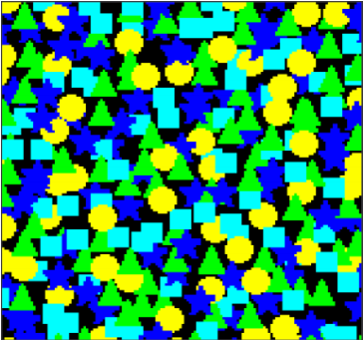
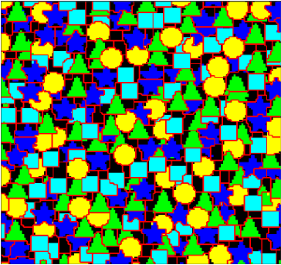
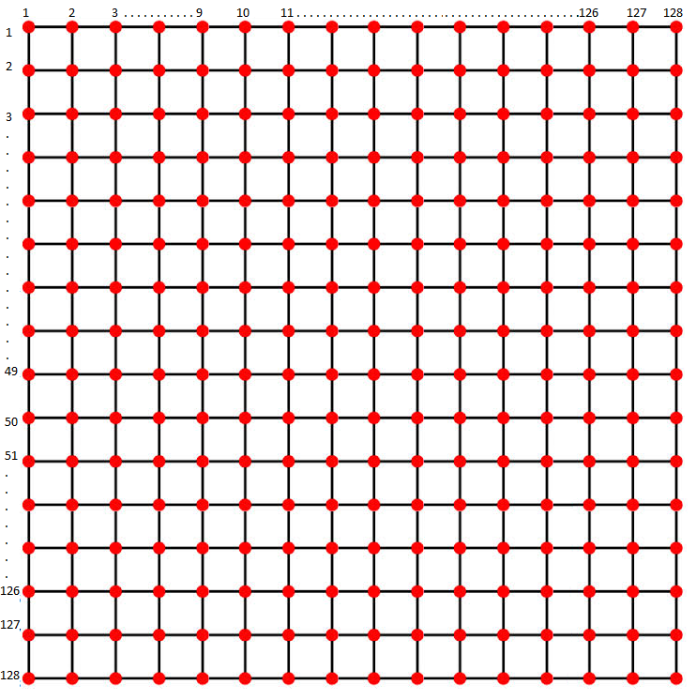
Aim of Jigsaw Model
J = Jigsaw
I * = Reconstructed Image
I = Training Image
Size = 36 x 36
EM
L = Offset Map
Size = 150 x 150
Size = 150 x 150
Size = 150 x 150
Notes:
Shared: each piece is similar in shape and appearance to many regions of the training images;
Discriminative: each piece is as large as possible;
Exhaustive: all parts of the training images can be reconstructed from the set of jigsaw pieces.

Slide 7
Aim of Jigsaw Model
J = Jigsaw
I * = Reconstructed Image
I = Training Image
Size = 36 x 36
EM
L = Offset Map
Size = 150 x 150
Size = 150 x 150
Size = 150 x 150
Notes:
Before deeping into probablistic model, I would like to Show big picture. We have a training image which is hand crafted. They choose hand crafted image so as to show Jigsaw Model properties clearly. The size of image is 150 by 150. We are trying to learn condensed image, jigsaw, which contains all the necessary information to reconstruct the image. The model applies Expectation Maximization algorithm iteratively. The offset map defines a position in the jigsaw for each pixel of image to reconstruct it.

Slide 8
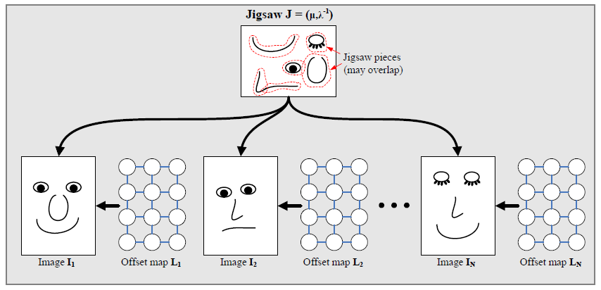
Generative Model
Notes:
Jigsaw model is a generative model which means we can create differenet image by mapping jigsaw pieces on different places.

Slide 9
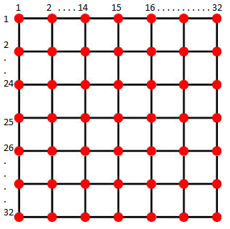


L = Offset Map
Implementation
Two dimensional offset
$$l_{i}=( l_{x} , l_{y})$$
J = Jigsaw
128x128
(image size)
Map a 2D point $i$ in the image to a
2D point $z$ in the jigsaw using:
$$z=\left( i − l_{i} \right) mod | J |$$
32 x 32 x 3
Notes:
Jigsaw Model define an offset map in other words label matrix which maps each image pixel to a jigsaw pixel in order to reconstruct image.
Z = Jigsaw Pixel
i = Image pixel
l = Offset value
J = size of jigsaw. Here 32.

Slide 10

L = Offset Map / J = Jigsaw
$$z=\left( i − l_{i} \right) mod | J |$$
If two adjacent pixels in the image have the same offset label, then they map to adjacent pixels in the jigsaw.
Notes:
The trick of this equation is that:
If two adjacent pixels in the image have the same offset label, then they map to adjacent pixels in the jigsaw.

Slide 11





L = Offset Map / J = Jigsaw
Image
Jigsaw
32 x 32
i = (50, 10) maps to z = (25, 15)
$$z=\left( i − l_{i} \right) mod | J |$$
25 = (50 - $l_{x}$ ) mod 32
$l_{x}$ = 25
15 = (10 - $l_{y}$ ) mod 32
$l_{y}$ = 27

Slide 12

L = Offset Map / J = Jigsaw
Image
Jigsaw
32 x 32
i = (50, 11) maps to z = (25, 16)
$$z=\left( i − l_{i} \right) mod | J |$$
25 = (50 - $l_{x}$ ) mod 32
$l_{x}$ = 25
i = (50, 10)
16 = (11 - $l_{y}$ ) mod 32
$l_{y}$ = 27

Slide 13

L = Offset Map / J = Jigsaw
Image
Jigsaw
32 x 32
i = (49, 11) maps to z = (24, 16)
$$z=\left( i − l_{i} \right) mod | J |$$
24 = (49 - $l_{x}$ ) mod 32
$l_{x}$ = 25
i = (50, 10)
i = (50, 11)
16 = (11 - $l_{y}$ ) mod 32
$l_{y}$ = 27

Slide 14


L = Offset Map / J = Jigsaw
Image
Jigsaw
i = (49, 11)
32 x 32
i = (51, 9) maps to z = (26, 14)
$$z=\left( i − l_{i} \right) mod | J |$$
26 = (51 - $l_{x}$ ) mod 32
$l_{x}$ = 25
i = (50, 10)
i = (50, 11)
14 = (9 - $l_{y}$ ) mod 32
$l_{y}$ = 27
Notes:
In Sum if neigbouring pixels have the same offset value, their relative position do not change in the jigsaw image.

Slide 15
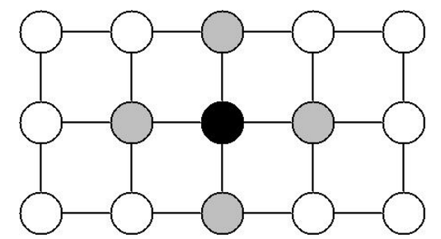

Markov Random Field (MRF)
A graphical model of a joint probability distribution.
Consists of an undirected graph $G=\left(N,E\right)$
C
C
A
C
B
C
Given the grey nodes, the black node is conditionally independent of all other nodes.
Notes:
Jigsaw Model defines Markov Random Field on Offset Map in order to represent joint probability distribution on a graphical model.
Jigsaw model defines MRF on 4 connected grid.

Slide 16
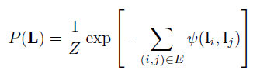

Jigsaw Model & MRF
MRF is defined on offset map to encourage neighboring pixels to have the same offset.
E = The set of edges in a 4-connected grid
Interaction Potential defines a Pott’s Model
Pott’s Model =
True 1
False 0
Local Interaction Strength
Ɣ = Influences the size of the learned jigsaw pieces
Notes:
Jigsaw model defines MRF in order to encourage neighboring pixels to have the same offset.
To meet this requirement Pott’s model is defined on MRF.
Pott’s model decrease optimality by the magnititude of local interaction strength if the neighboring pixel doe not have the same labels.
Gamma parameter is crucial for smoothness of jigsaw image. I will Show how this parameter inflluence jigsaw image in the next slides.

Slide 17

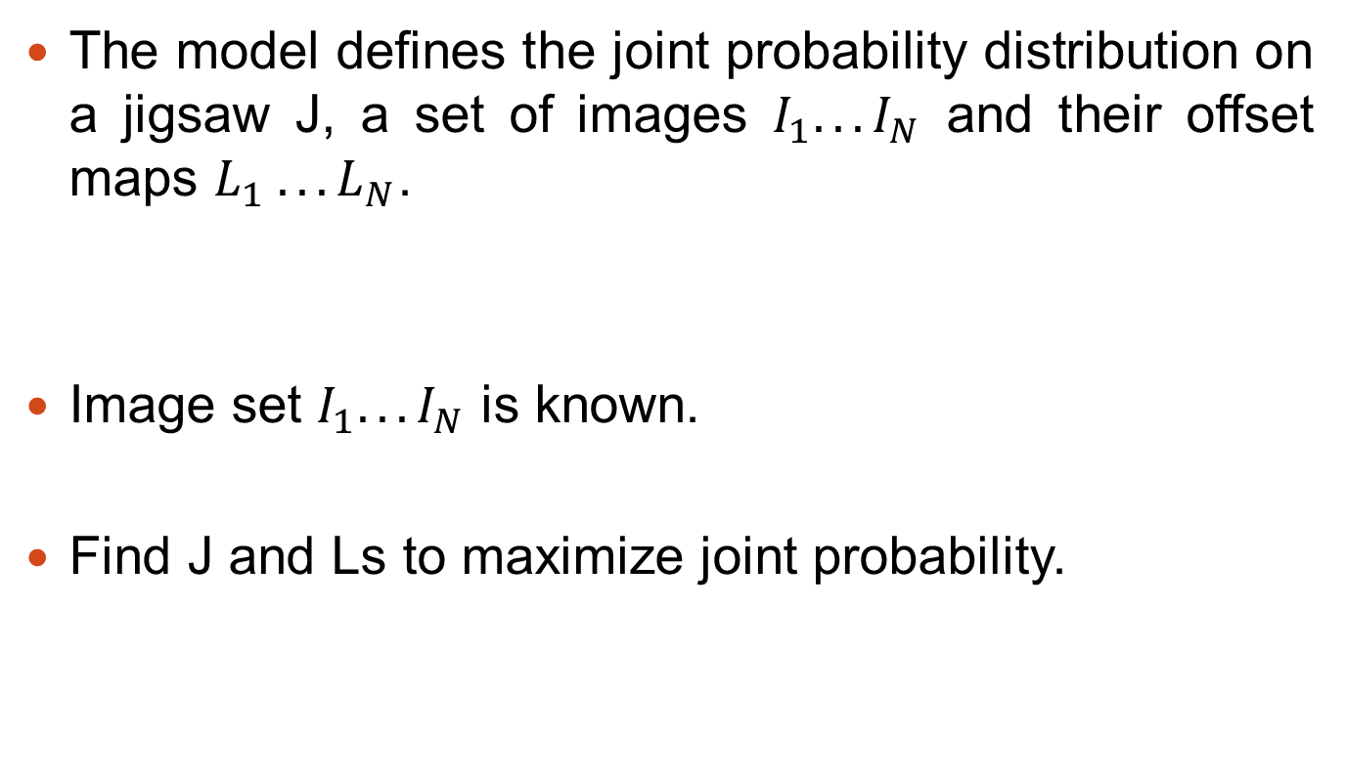
MAP Learning
The model defines the joint probability distribution on a jigsaw J, a set of images $I_{1}. . . I_{N}$ and their offset maps $L_{1} . . . L_{N}$.
Image set $I_{1}. . . I_{N}$ is known.
Find J and Ls to maximize joint probability.
Notes:
The jigsaw model defines the joint probability distribution on training image, jigsaw and offseet map. We know training image and by finding jigsaw and offset labels we try to maximize joint probability iteratively.

Slide 18

MAP Learning
Initialize jigsaw:
Set means μ to Gaussian noise with same mean and variance as the data
Guarantee to find at least a strong local minimum
Notes:
At the beginning of the algorthm we set the jigsaw intensity values to mean of trainning image intensity values. This gurantee to find at least a strong local minimum.

Slide 19
MAP Learning
Iteration Step 1
Given Jigsaw (J) and Image (I) update L
using α-expansion graph-cut algorithm [1]
[1] Y Boykov, O. Veksler, and R. Zabih. Fast approximate energy minimization via graph cuts. PAMI, 23(11), 2001.
Notes:
α-expansion graph-cut algorithm is a type of minimum cut maximum flow algorithm algorithm as we covered in the course.

Slide 20
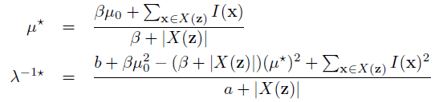
MAP Learning
Iteration Step 1
Given Jigsaw (J) and Image (I) update L
using α-expansion graph-cut algorithm
Iteration Step 2
Update Jigsaw
X(z) = the set of image pixels that are mapped to the jigsaw
pixel z across all images
Notes:
Update jigsaw mean and variance. Mean value is the intensities of each jigsaw pixel.

Slide 21
MAP Learning
Iteration Step 1
Given Jigsaw (J) and Image (I) update L
using α-expansion graph-cut algorithm
Repeat Until Convergence
Iteration Step 2
Update Jigsaw
X(z) = the set of image pixels that are mapped to the jigsaw
pixel z across all images

Slide 22
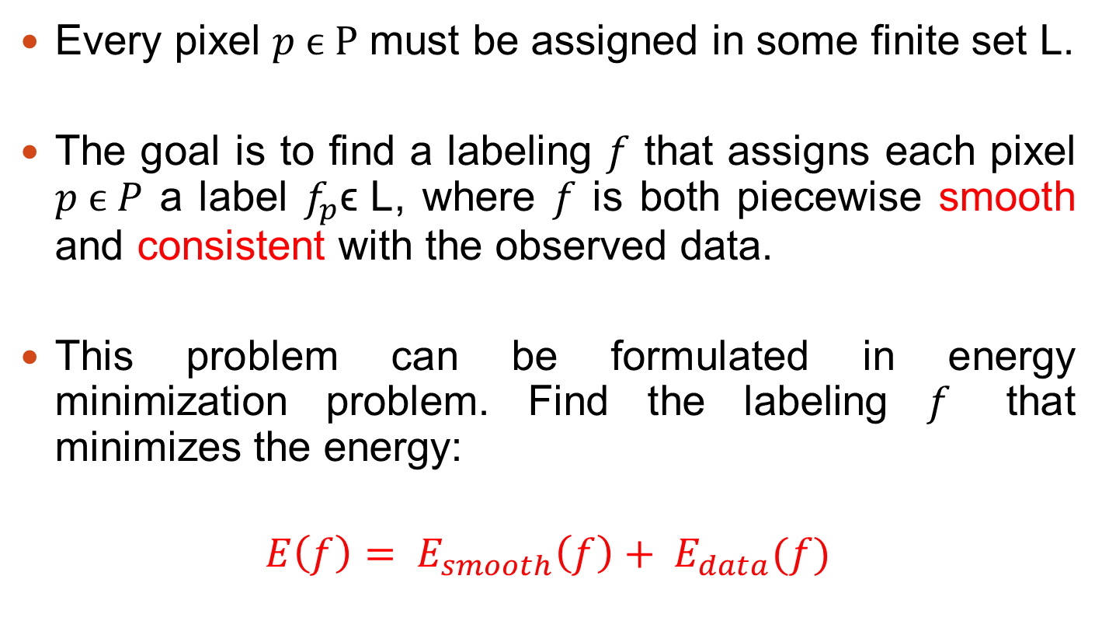
α-Expansion Graph-Cut Algorithm
Every pixel $p ϵ P$ must be assigned in some finite set L.
The goal is to find a labeling $f$ that assigns each pixel $p ϵ P$ a label $f_{p}\text{ϵ} \text{L}$, where $f$ is both piecewise smooth and consistent with the observed data.
This problem can be formulated in energy minimization problem. Find the labeling $f$ that minimizes the energy:
$$E\left(f\right)= E_{smooth}\left(f\right)+ E_{data}(f)$$
Notes:
Grap cut algorithm tries to find a labelling that is smooth and consistent with the tarining image.
The graph cut algorrithm convert this problem into Energy minimization problem.
Total energy equals to Data cost plus smooth cost and we are trying to minimize total energy.

Slide 23
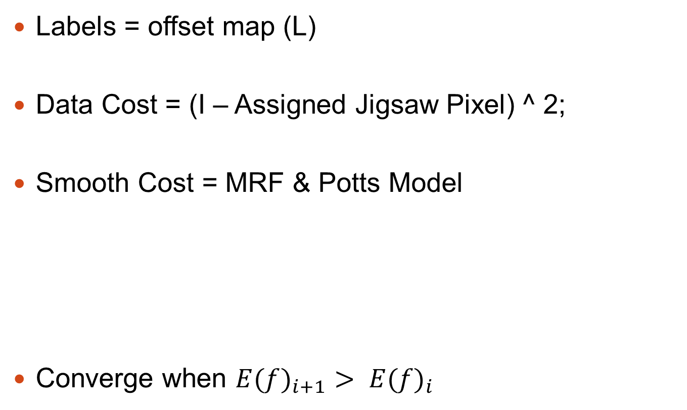
Jigsaw Model & α-Expansion GCA
Labels = offset map (L)
Data Cost = (I – Assigned Jigsaw Pixel) ^ 2;
Smooth Cost = MRF & Potts Model
Converge when ${E(f)}_{i+1}> {E(f)}_{i}$
Pott’s Model =
Local Interaction Strength
Ɣ = Influences the size of the learned jigsaw pieces
Notes:
Data cost is the distance between the assigned jigsaw pixel intensity and the original intensity value.
Smooth cost is defined by definning MRF and Potts model as I explained.
Smooth cost enforce the neighbouring pixels to have same label in order to keep them relatively in the same shape at the jigsaw image.
The algorithm converge when total cost starting to increase.

Slide 24
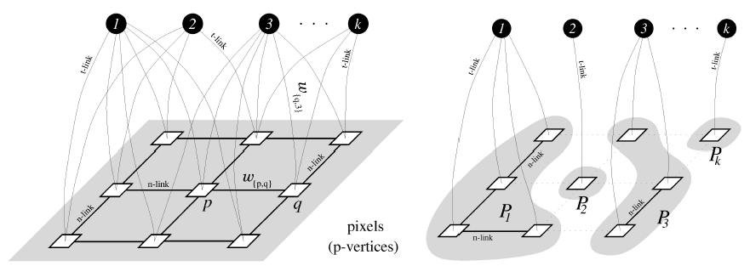
Jigsaw Model & α-Expansion GCA
First Step
After Convergence
Labels
Offset Map
Ɣ = Interaction Potential
Notes:
After converge we will have a mapping as shown.

Slide 25
Jigsaw Model & α-Expansion GCA
J = Jigsaw
I * = Reconstructed Image
I = Training Image
EM
L = Offset Map
Notes:
In sum, we have a training image and we are trying to learn jigsaw image which is consist of smooth and consistent pieces. Addiitionally the jigsaw image contains enough information to reconstruct image.
Model implements EM algorithm by definning MRF on offset map and applies min cut maximum flow algorithm. Finally reconstruct image by using offset map and jigsaw image.
At the right image, red borders shows the pieces which have the same offset value. By using this information we can recognize and cluster objects in the image.
Finally, as we can see in the jigsaw image, the jigsaw pieces correspoonds to repeated semantic object parts in the trainning image.

Slide 26
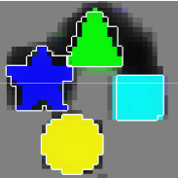



Importance of Ɣ = Interaction Potential
Ɣ | Original Jigsaw | My Jigsaw
500
1000
2000
Notes:
The interaction potential parameter which is defined in MRF is the most important parameter in the model. This parameter defines the smooth cost. When we increase this parameter, model force neigboring pixels to have same label and create smooth and consistent pieces in the jigsaw image.

Slide 27



Importance of Ɣ = Interaction Potential
Ɣ | Original Jigsaw | My Jigsaw
3825
10000
20000
Notes:
When we increase interaction potential jigsaw pieces starts to group in together in order to reduce smooth cost.

Slide 28



Importance of Ɣ = Interaction Potential
Ɣ | Original Jigsaw | My Jigsaw
25000
30000
35000
Notes:
The objects extended over borders of jigsaw however it is not a problem since algorithm uses mod operator.

Slide 29
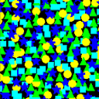
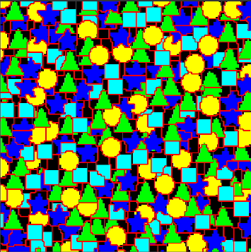
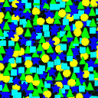
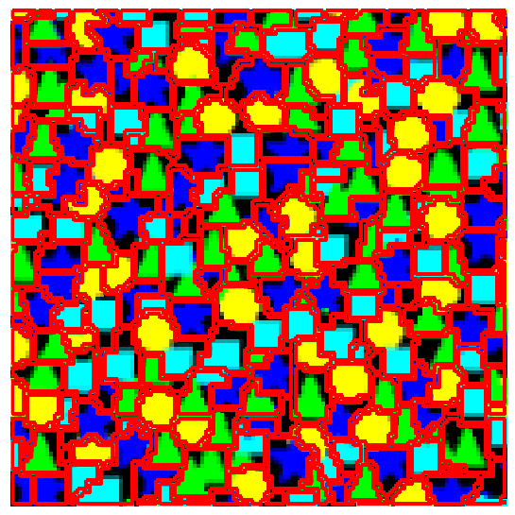
Original Image
Original Segmentation
Original Jigsaw
- - - - - - - - - - - - - - - - - - - - - - - - - - - - - - - - - - - - - - - - - - - - - - - - - - - - - - - - -
My Reconstructed Image
My Segmentation
My Jigsaw

Slide 30
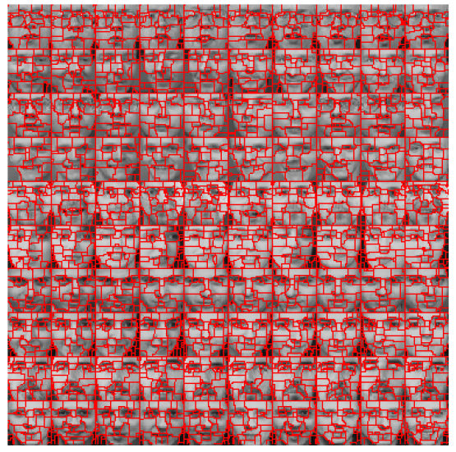
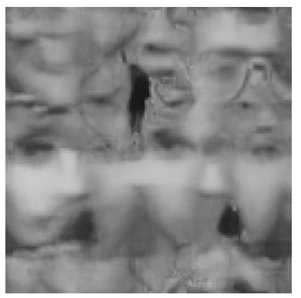
Olivetti Database
Notes:
In the paper they tested the model with Olivtti Database by selecting 10 different image for each 10 person.
As we can see in the jigsaw, some face parts are learned which are semantic object parts in the training image.

Slide 31
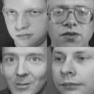

Olivetti Database
Notes:
Due to memory constraint I could not run the model for 100 face images choosen from the database. Instead I selected 4 face image and find jigsaw regarding these images.
Since we have not enough trainning set which means lack of repeated object structures, my jigsaw does not learn semantic object parts.

Slide 32
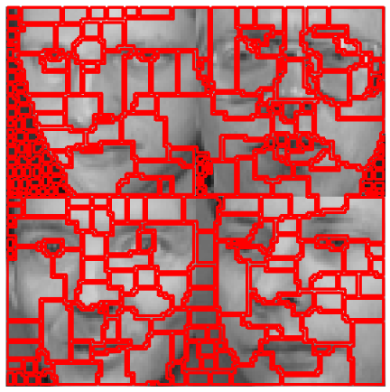
Olivetti Database
Notes:
However segmented pieces corresponds to semantic objects such as mouth, nose, eyes and cheeks.
If we increase the training set, my jigsaw will learn semantic object parts.

Slide 33
Questions?

