Slide 1
Jigsaw Model for Sketch Recognition
Emre Karaman

Slide 2

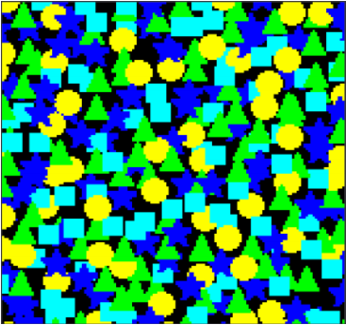
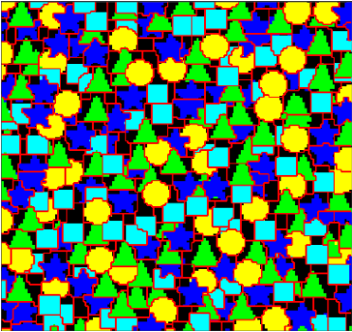
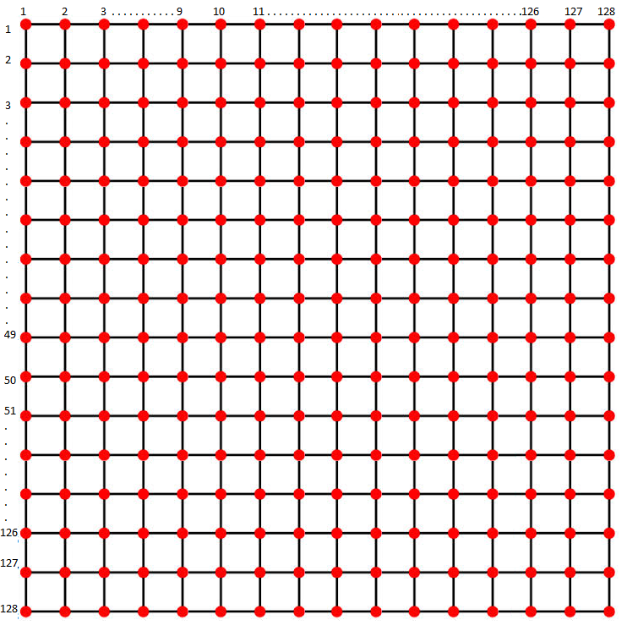
Jigsaw Model
J = Jigsaw
I * = Reconstructed Image
I = Training Image
32x32x3
EM
L = Offset Map
128x128x3
128x128x3
128x128x3

Slide 3
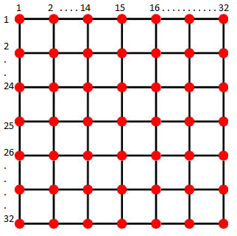


L = Offset Map
Two dimensional offset
$$l_{i}=( l_{x} , l_{y})$$
J = Jigsaw
128x128
(image size)
Map a 2D point $i$ in the image to a
2D point $z$ in the jigsaw using:
$$z=\left( i − l_{i} \right) mod | J |$$
32 x 32 x 3

Slide 4
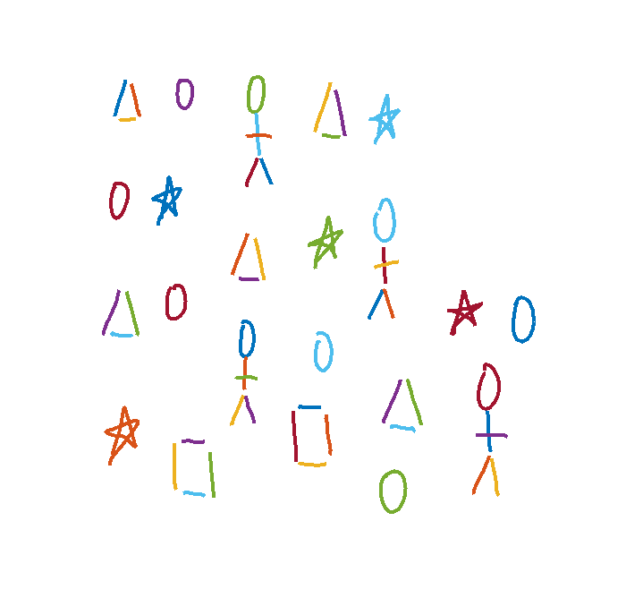
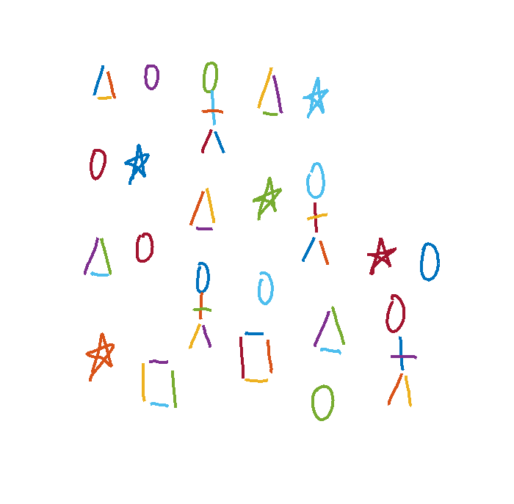
Jigsaw Model for Sketch Recognition
J = Jigsaw
I * = Reconstructed Image
I = Training Image
3 x 3 x 720
EM
L = Offset Map
54x2
54 x 720

Slide 5


L = Offset Map
Two dimensional offset
$$l_{i}=( l_{x} , l_{y})$$
J = Jigsaw
54x2
Map a 2D point $i$ in the image to a
2D point $z$ in the jigsaw using:
$$z=\left( i − l_{i} \right) mod | J |$$
3 x 3 x 720

Slide 6
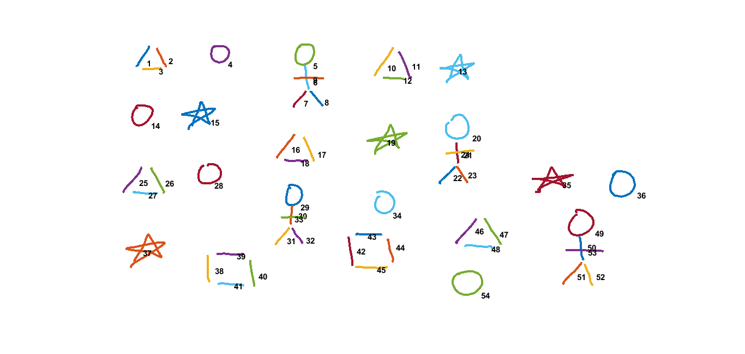
Training Image

Slide 7
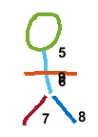

Displacement & Feature Distance
(x1, y1)
(97, 83)
(x2, y2)
(146, 78)
(x7, y7)
(451, 181)
(x8, y8)
(497, 178)
Displacement b/w 1 & 2
Displacement b/w 7 & 8
(x2-x1, y2-y1)
(49, -5)
(x8-x7, y8-y7)
(46, -3)
IDM Feature Distance b/w 1 & 7
IDM Feature Distance b/w 2 & 8
sqrt ((Feat(1) – Feat(7))^2)
sqrt ((Feat(2) – Feat(8))^2)

Slide 8
Find Stroke Pairs
µ (variance of displacement) < λ (50)
µ (feature distace) < ɸ (6)
Variance of feature distance < θ (2)

Slide 9
Training Image

Slide 10
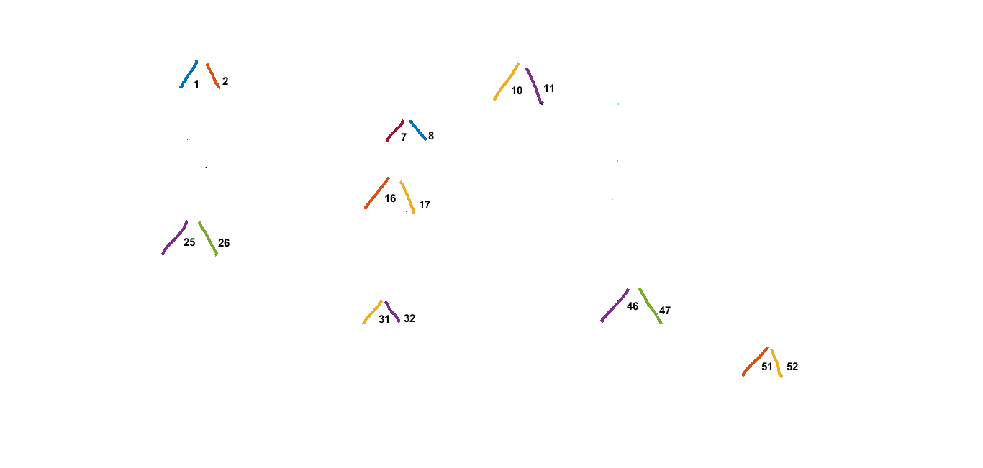
Selected Pairs

Slide 11
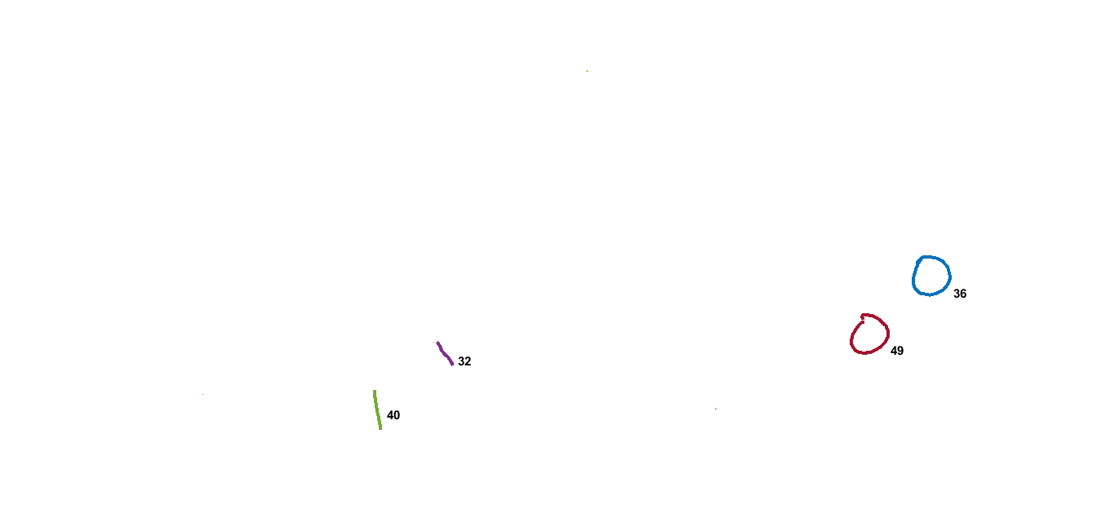
Selected Pairs

Slide 12
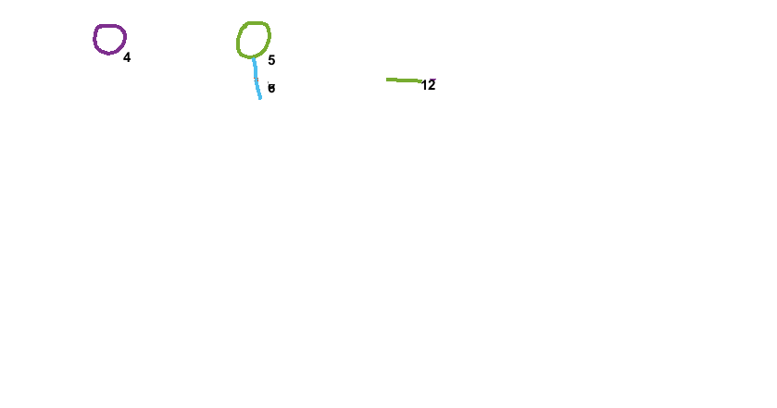
Selected Pairs

Slide 13
Update Centers and Connect
(x1, y1)
(97, 83)
(x2, y2)
(146, 78)
(x7, y7)
(451, 181)
(x8, y8)
(497, 178)
Displacement b/w 1 & 2
Displacement b/w 7 & 8
(x2-x1, y2-y1)
(49, -5)
(x8-x7, y8-y7)
(46, -3)
Mean of Displacement
(47, -4)
Updated Centers
(97, 83)
(144, 79)
(451, 181)
(498, 177)

Slide 14
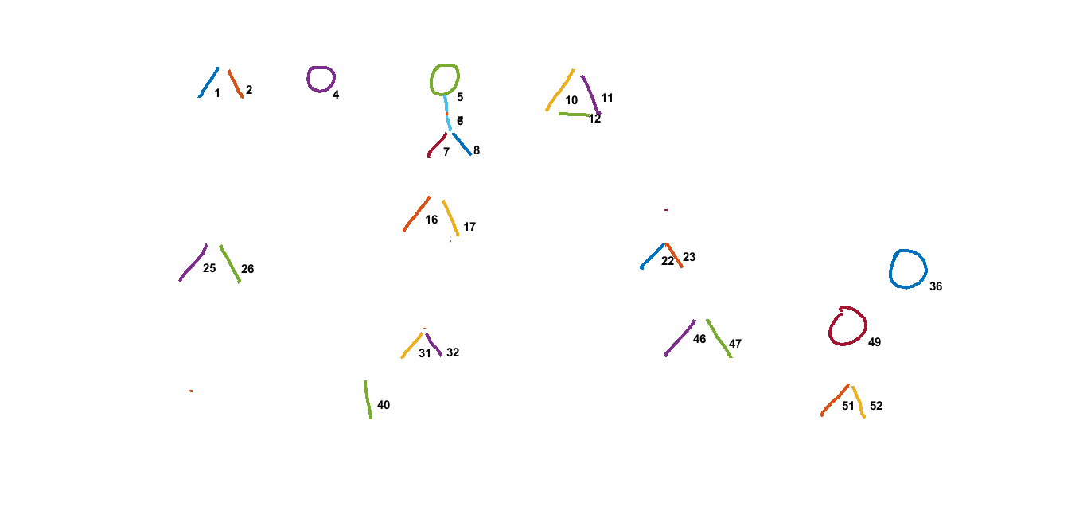
Connectivity / Smooth Cost (Ɣ = 100)
Ɣ

Slide 15

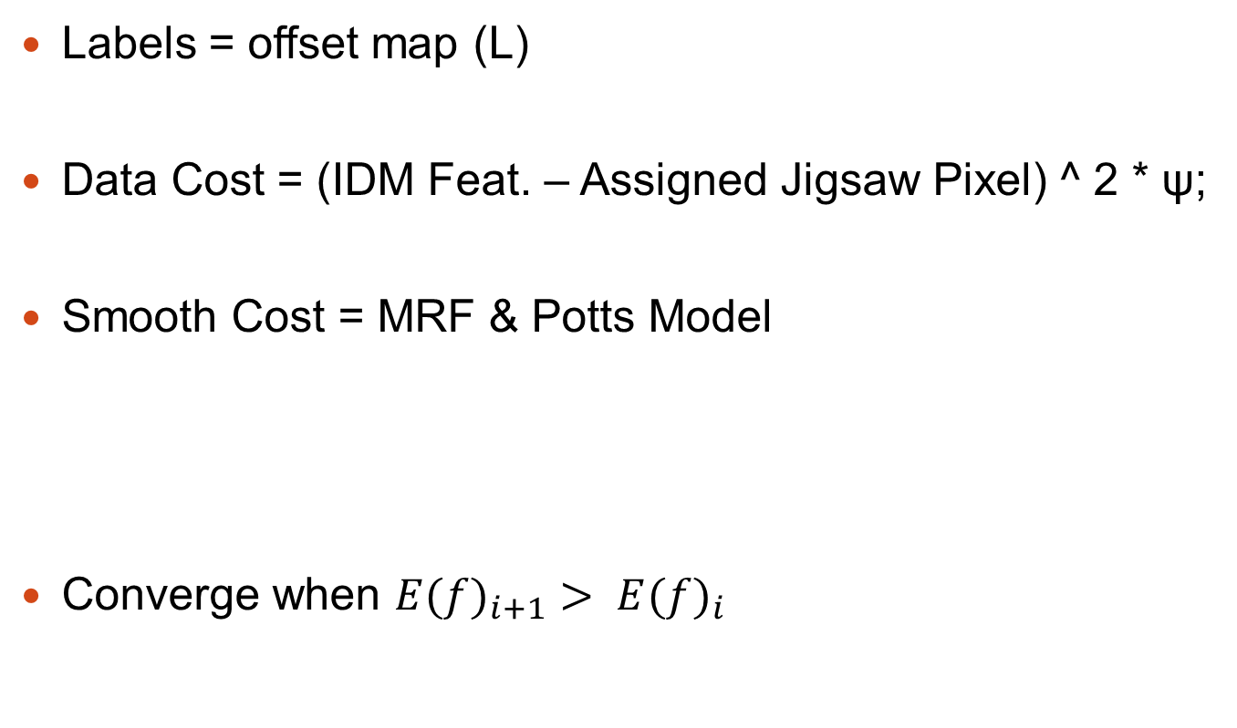
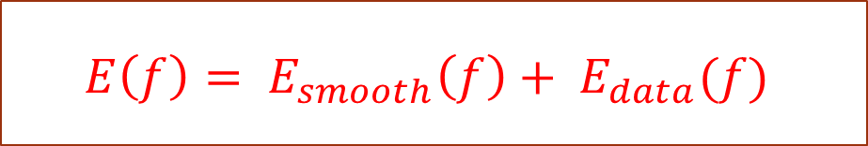
Jigsaw Model & α-Expansion GCA
Labels = offset map (L)
Data Cost = (IDM Feat. – Assigned Jigsaw Pixel) ^ 2 * ψ;
Smooth Cost = MRF & Potts Model
Converge when ${E(f)}_{i+1}> {E(f)}_{i}$
Pott’s Model =
Ɣ = Smooth Cost
$$E\left(f\right)= E_{smooth}\left(f\right)+ E_{data}(f)$$

Slide 16

EM Algorithm
Iteration Step 1
Given Jigsaw (J) and Image (I) update L
using α-expansion graph-cut algorithm
Repeat Until Convergence
Iteration Step 2
Update Jigsaw
I(x) = IDM Features
X(z) = The set of strokes that are mapped to the jigsaw
pixel z across all image

Slide 17
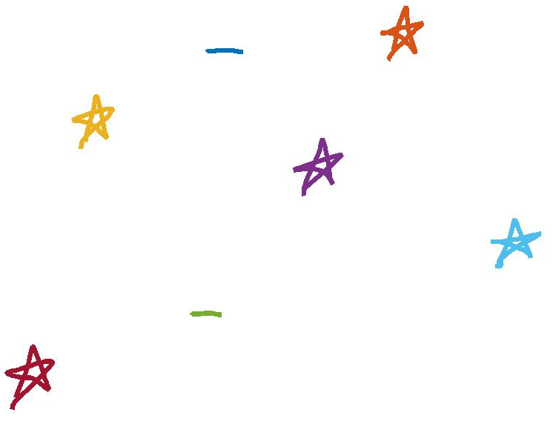
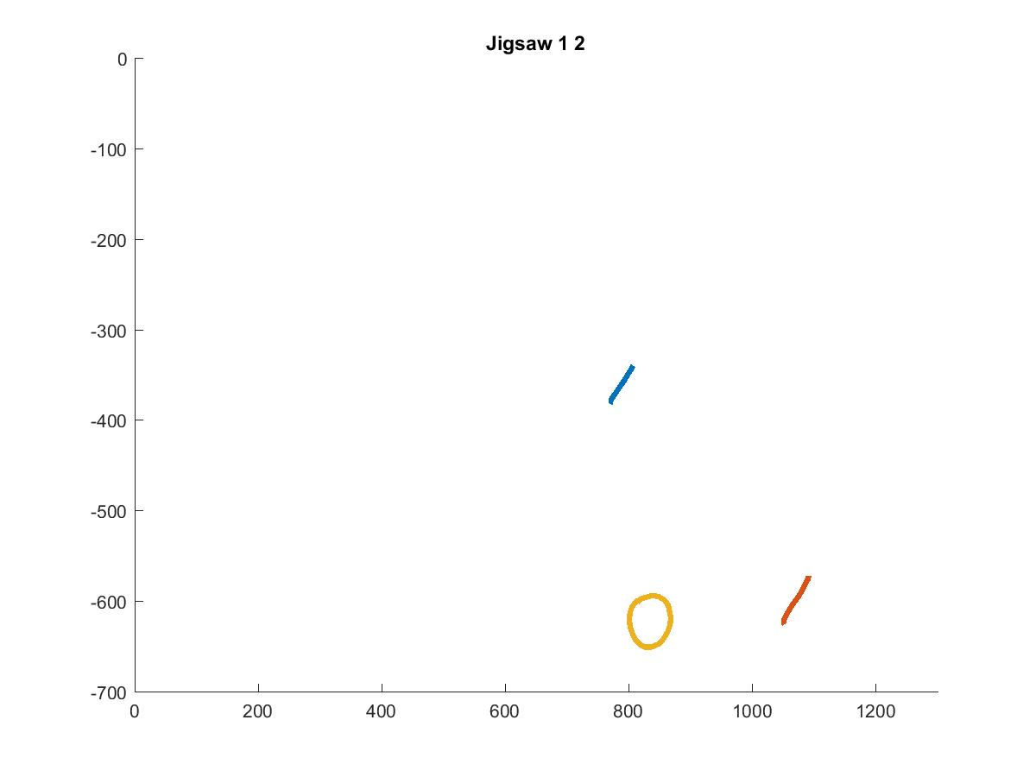
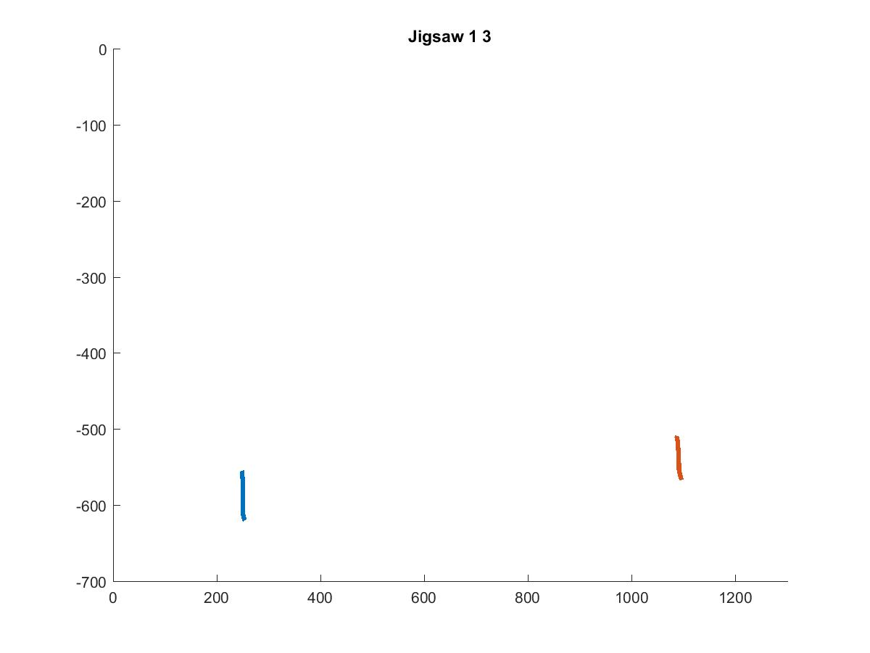
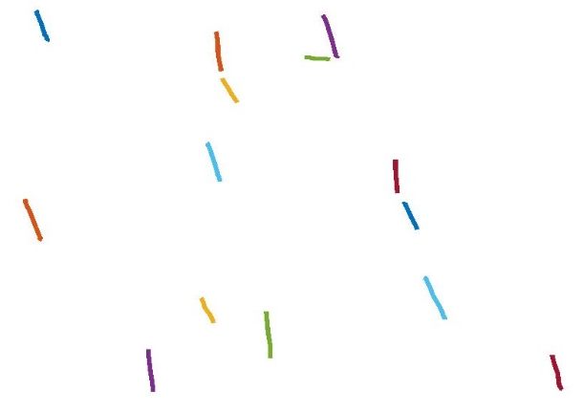
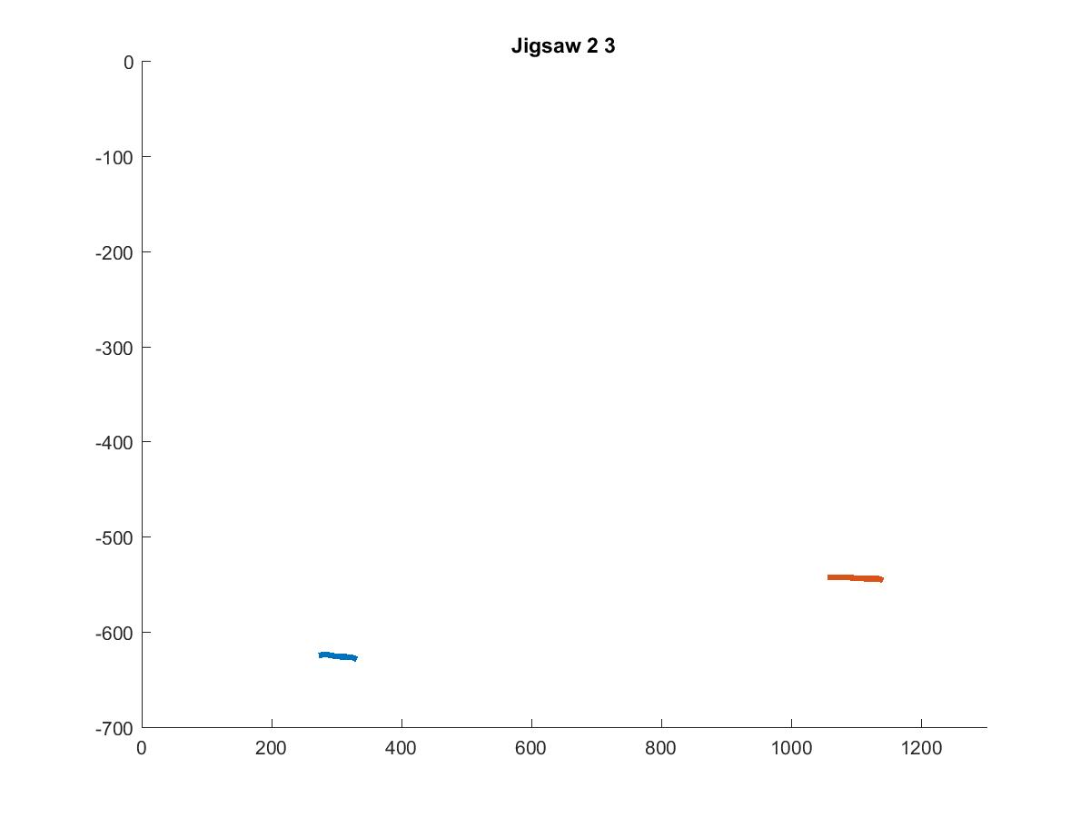
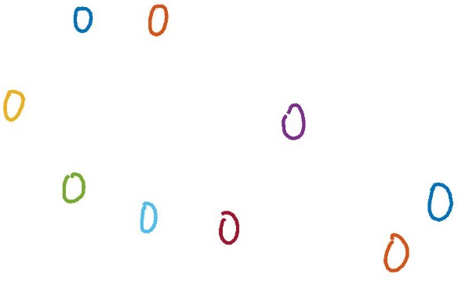
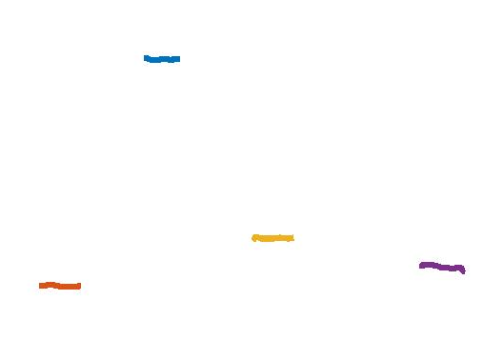
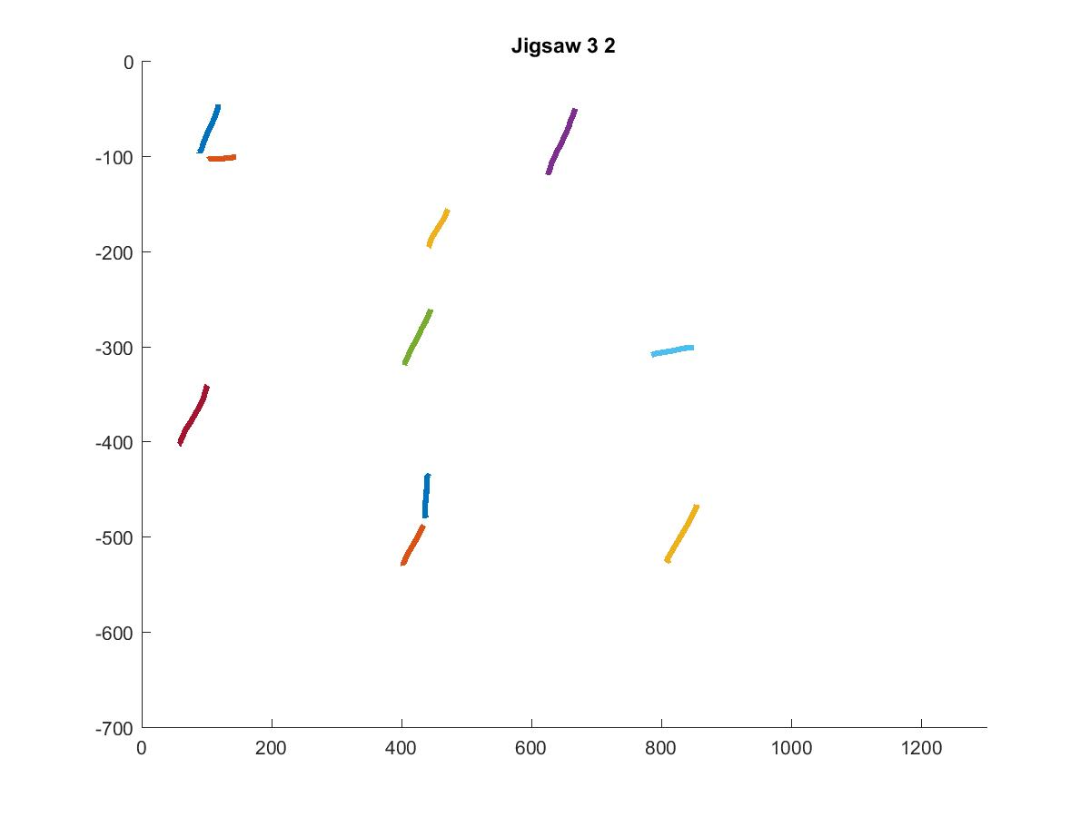
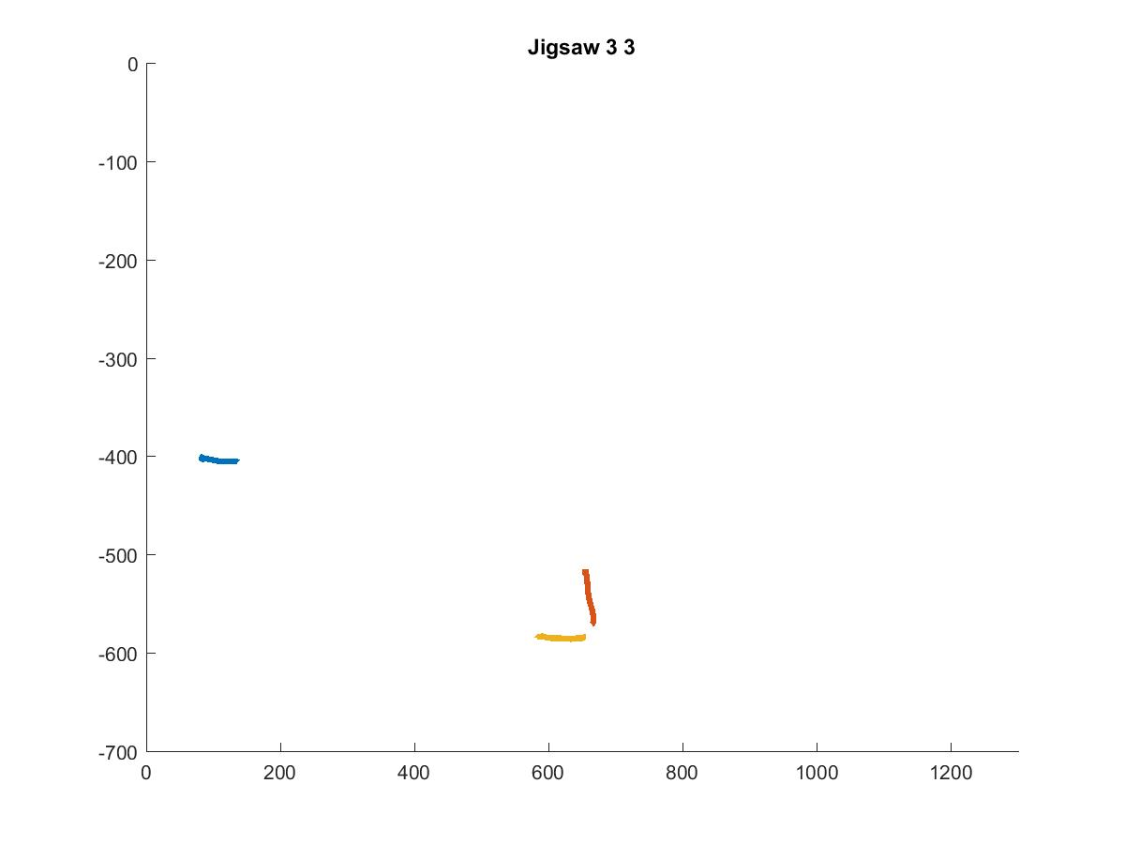
Jigsaw
Jigsaw (i) = Mean of IDM Features of
strokes assigned to Jigsaw(i)
3x3x720

Slide 18
Reconstruction

Slide 19
Training Image

Slide 20
Questions?

Slide 21
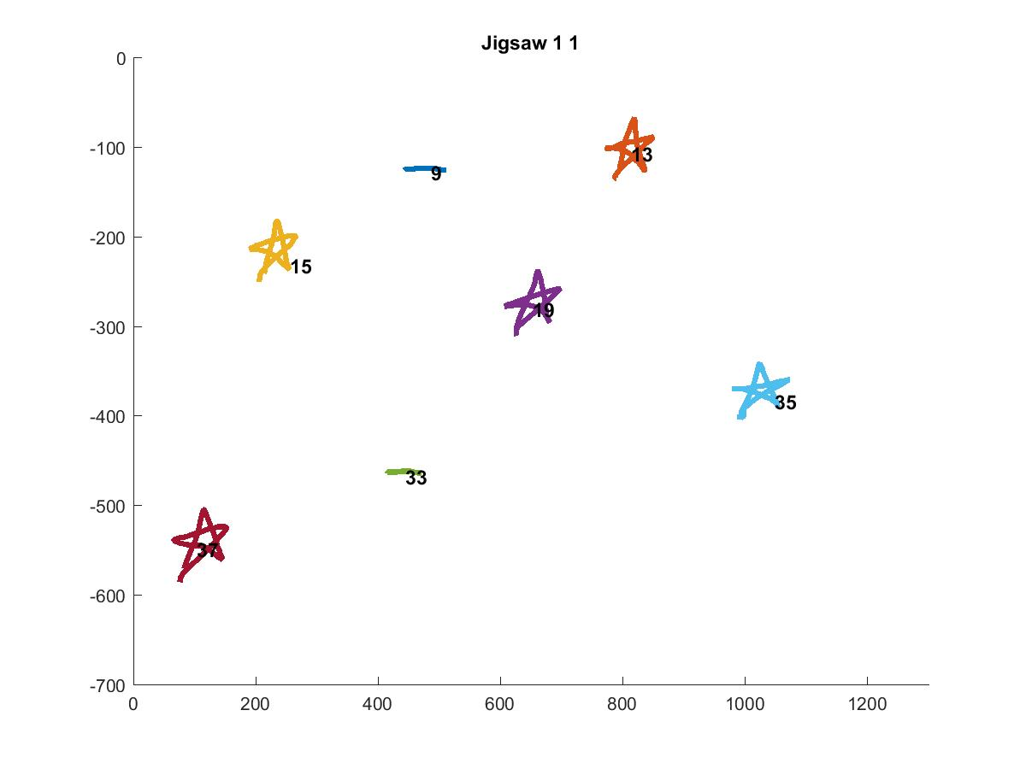
Jigsaw 11

Slide 22
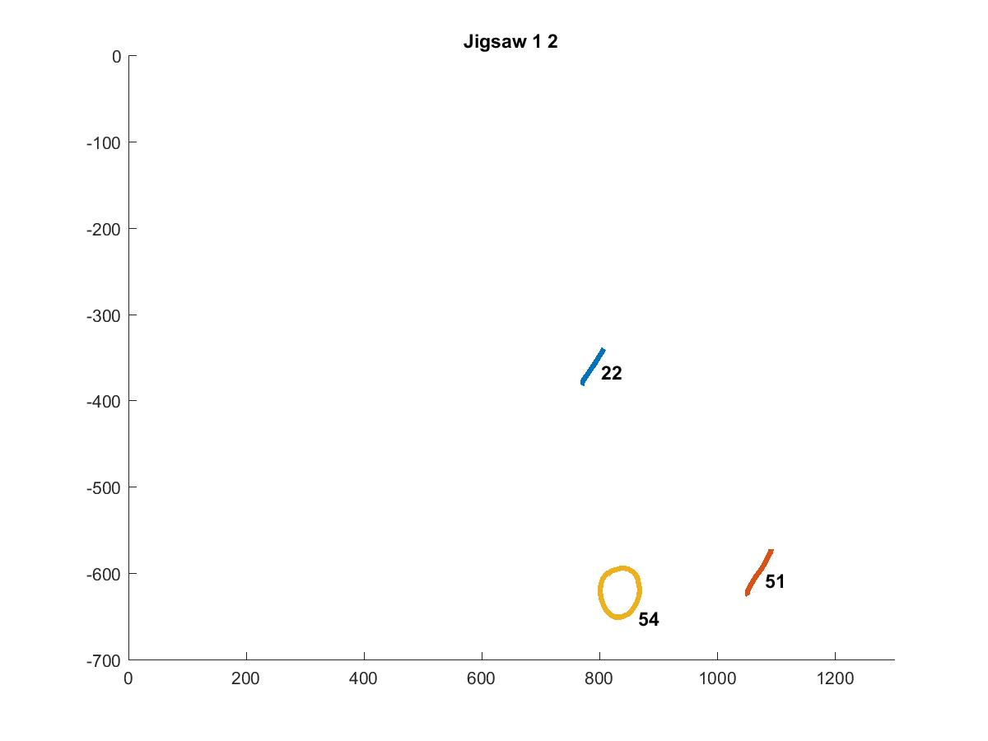
Jigsaw 12

Slide 23
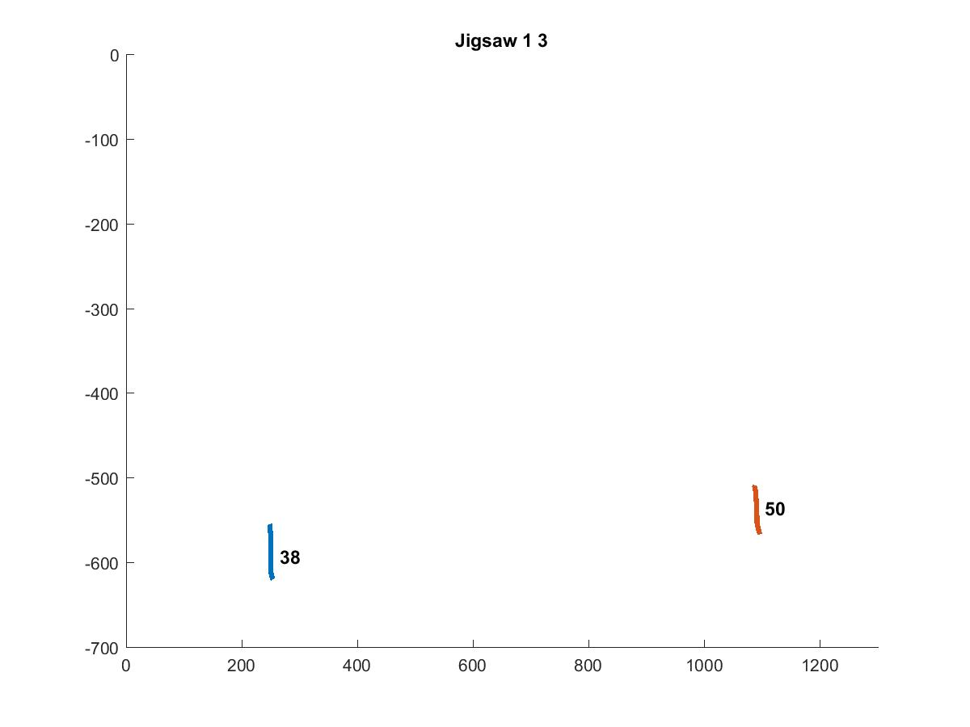
Jigsaw 13

Slide 24
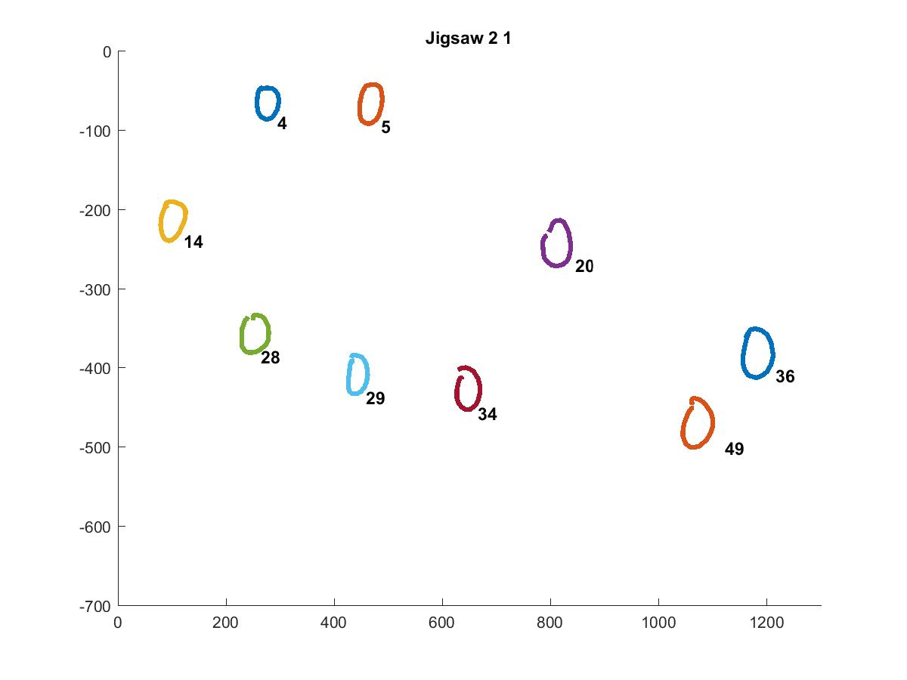
Jigsaw 21

Slide 25
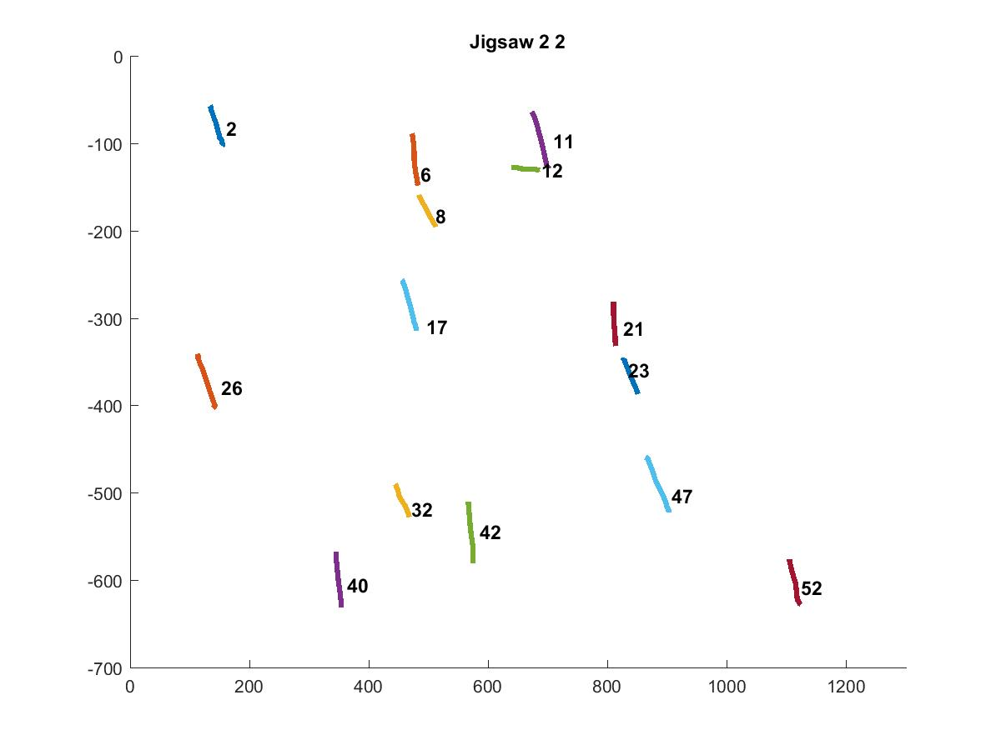
Jigsaw 22

Slide 26
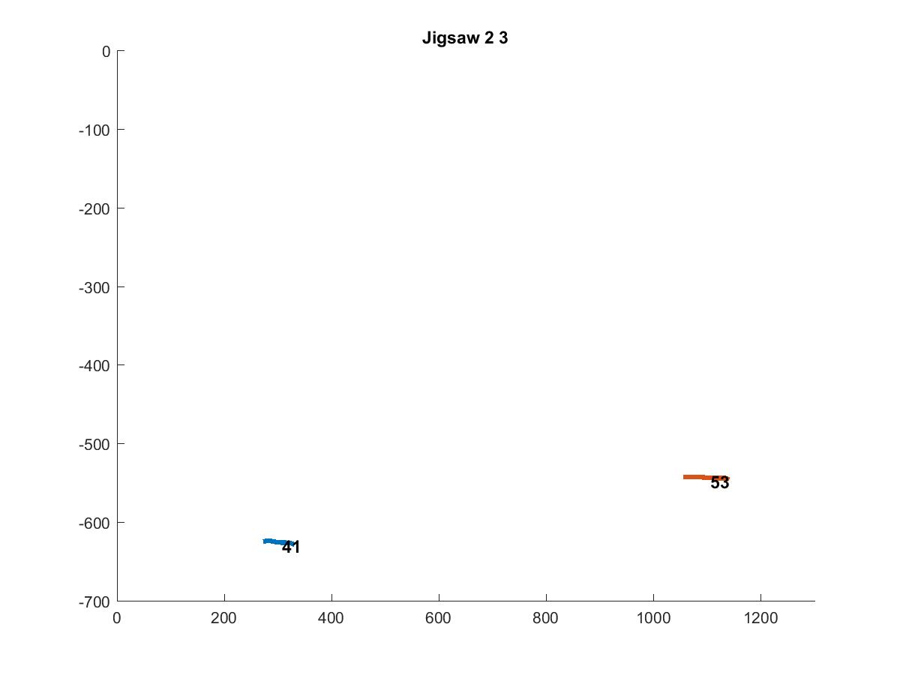
Jigsaw 23

Slide 27
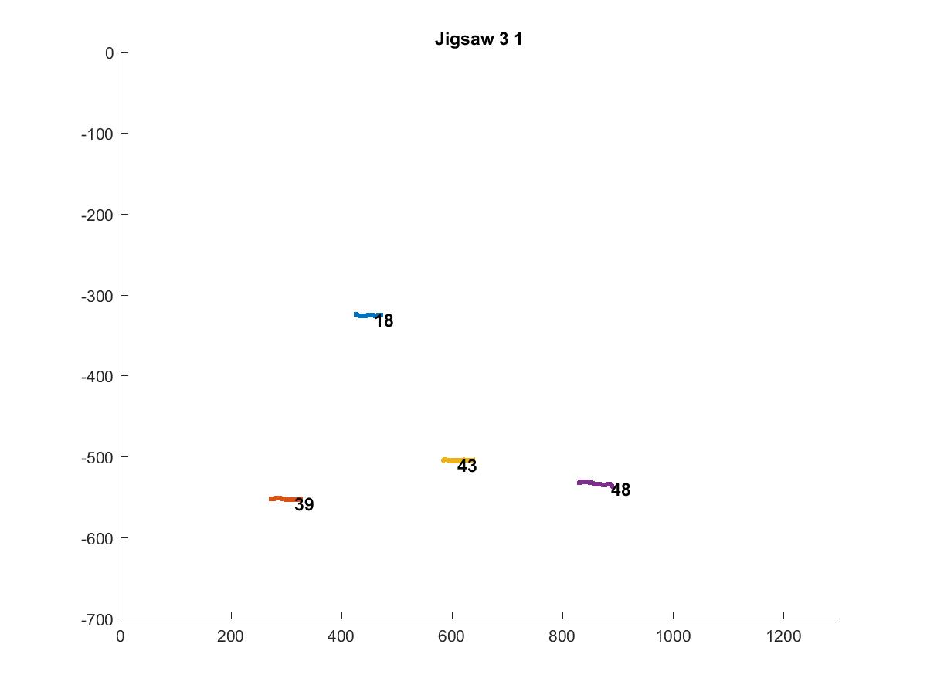
Jigsaw 31

Slide 28
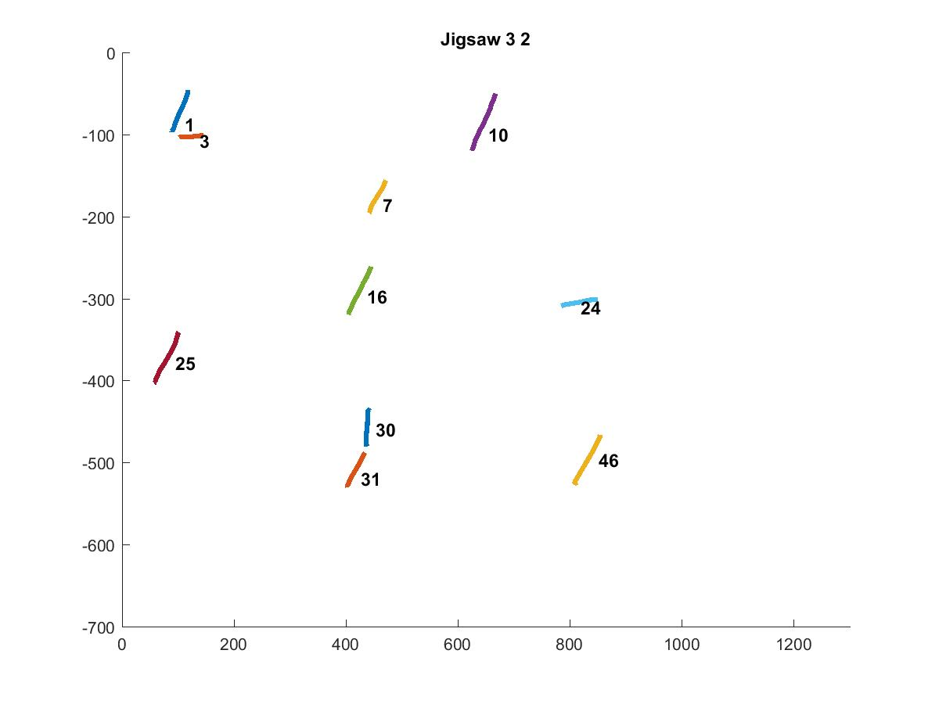
Jigsaw 32

Slide 29
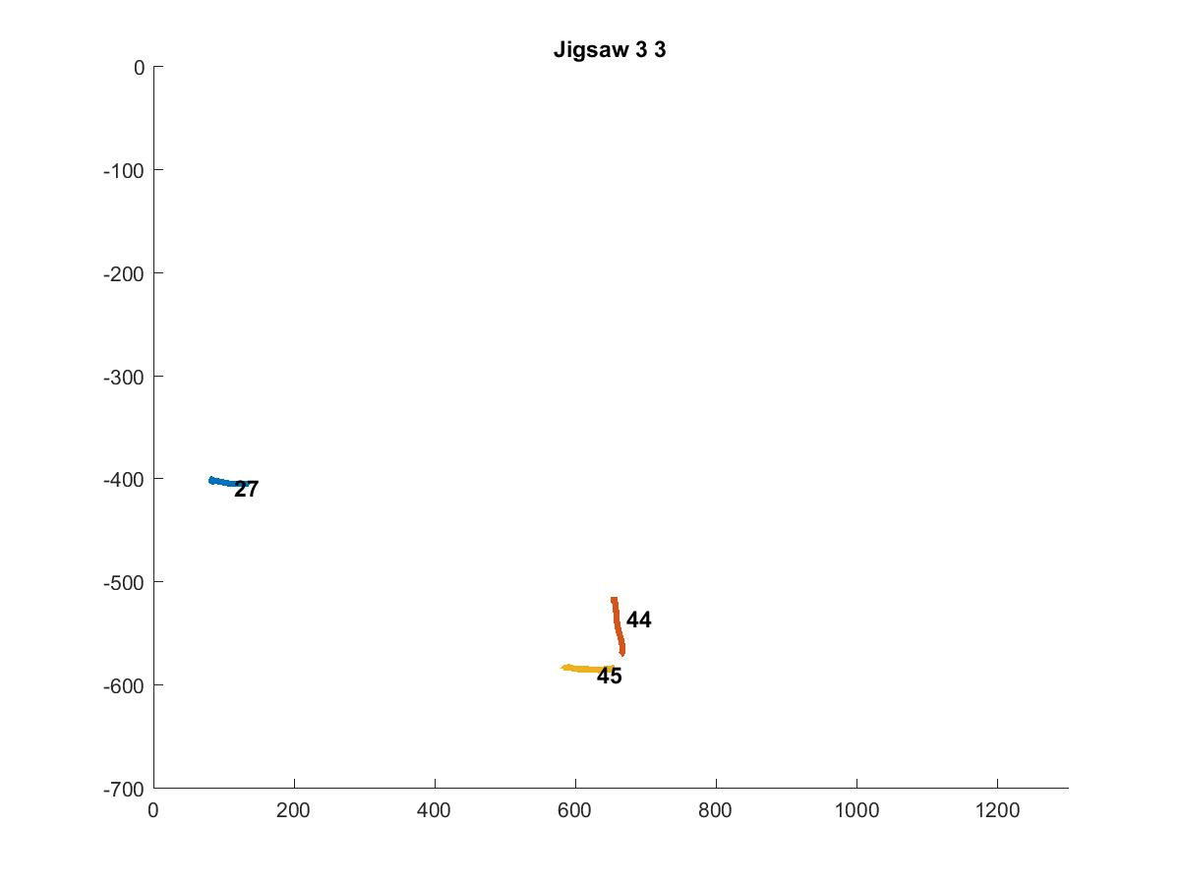
Jigsaw 33

