Slide 1
Clustering Appearance and Shape by Learning Jigsaws Anitha Kannan, John Winn, Carsten Rother Microsoft Research Cambridge
Emre Karaman

Slide 2
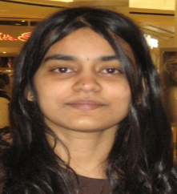


Clustering Appearance and Shape by Learning Jigsaws
Anitha Kannan
Research Scientist at Facebook AI Research
John Winn
Principal Researcher at Microsoft Research Cambridge
Carsten Rother
Senior Researcher at Microsoft Research Cambridge
Published at “Advances in Neural Information Processing Systems (NIPS)” in 2006.
Cited by: 44

Slide 3
Models for Appearance and Shape
Histograms
Discard spatial info
Templates
Articulation, deformation and variantion
Patch-based Approaches
Right balance between the two extremes

Slide 4















Aim of Jigsaw Model
Cluster regions in images with similar appearance and shape.
Examples of clusters (jigsaw pieces)
Eye
Noses
Cheek
Eyebrows

Slide 5
Aim of Jigsaw Model
Learn patches (jigsaw pieces) which are
Shared: each piece is similar in shape and appearance to many regions of the training images;
Discriminative: each piece is as large as possible;
Exhaustive: all parts of the training images can be reconstructed from the set of jigsaw pieces.

Slide 6
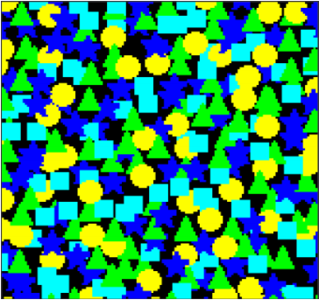
Aim of Jigsaw Model
I = Training Image

Slide 7

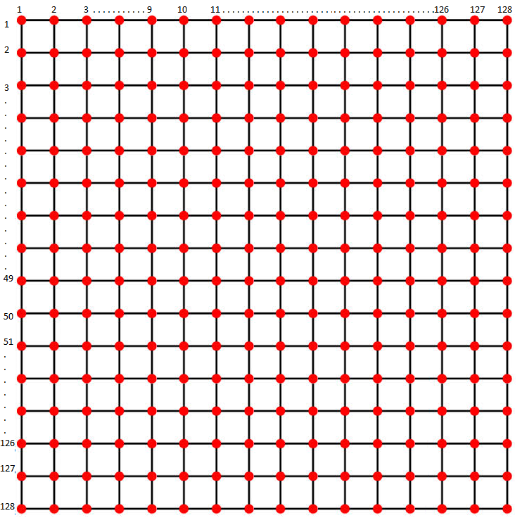
Aim of Jigsaw Model
J = Jigsaw
I = Training Image
EM
L = Offset Map

Slide 8
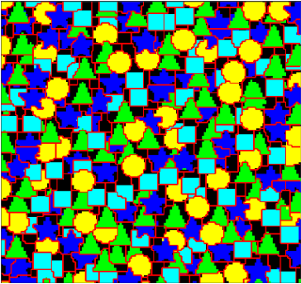
Aim of Jigsaw Model
J = Jigsaw
I * = Reconstructed Image
I = Training Image
EM
L = Offset Map

Slide 9
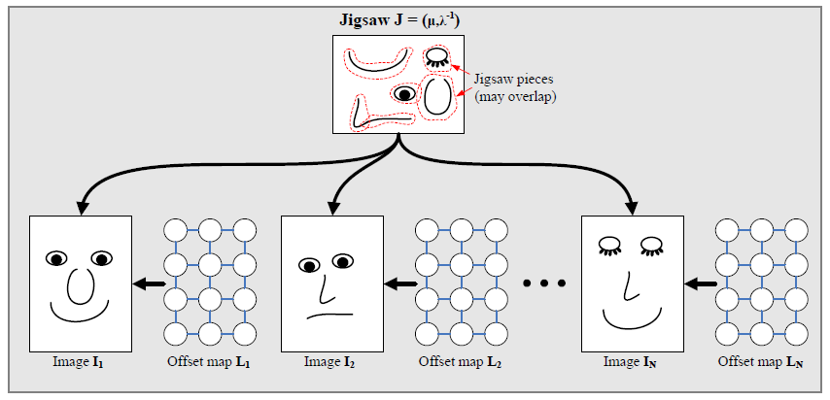
Generative Model

Slide 10
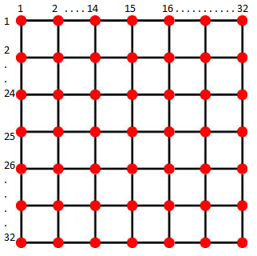


L = Offset Map
Two dimensional offset
$$l_{i}=( l_{x} , l_{y})$$
J = Jigsaw
128x128
(image size)
Map a 2D point $i$ in the image to a
2D point $z$ in the jigsaw using:
$$z=\left( i − l_{i} \right) mod | J |$$
32 x 32 x 3

Slide 11

L = Offset Map / J = Jigsaw
$$z=\left( i − l_{i} \right) mod | J |$$
If two adjacent pixels in the image have the same offset label, then they map to adjacent pixels in the jigsaw.

Slide 12





L = Offset Map / J = Jigsaw
Image
Jigsaw
32 x 32
i = (50, 10) maps to z = (25, 15)
$$z=\left( i − l_{i} \right) mod | J |$$
25 = (50 - $l_{x}$ ) mod 32
$l_{x}$ = 25
15 = (10 - $l_{y}$ ) mod 32
$l_{y}$ = 27

Slide 13

L = Offset Map / J = Jigsaw
Image
Jigsaw
32 x 32
i = (50, 11) maps to z = (25, 16)
$$z=\left( i − l_{i} \right) mod | J |$$
25 = (50 - $l_{x}$ ) mod 32
$l_{x}$ = 25
i = (50, 10)
16 = (11 - $l_{y}$ ) mod 32
$l_{y}$ = 27

Slide 14

L = Offset Map / J = Jigsaw
Image
Jigsaw
32 x 32
i = (49, 11) maps to z = (24, 16)
$$z=\left( i − l_{i} \right) mod | J |$$
24 = (49 - $l_{x}$ ) mod 32
$l_{x}$ = 25
i = (50, 10)
i = (50, 11)
16 = (11 - $l_{y}$ ) mod 32
$l_{y}$ = 27

Slide 15


L = Offset Map / J = Jigsaw
Image
Jigsaw
i = (49, 11)
32 x 32
i = (51, 9) maps to z = (26, 14)
$$z=\left( i − l_{i} \right) mod | J |$$
26 = (51 - $l_{x}$ ) mod 32
$l_{x}$ = 25
i = (50, 10)
i = (50, 11)
14 = (9 - $l_{y}$ ) mod 32
$l_{y}$ = 27

Slide 16
L = Offset Map / J = Jigsaw
Image Pixel | Mapped Jigsaw Pixel | Offset Value
( 50, 10 ) | ( 25, 15 ) | ( 25, 27 )
( 50, 11 ) | ( 25, 16 ) | ( 25, 27 )
( 49, 11 ) | ( 24, 16 ) | ( 25, 27 )
( 51, 9 ) | ( 26, 14 ) | ( 25, 27 )

Slide 17

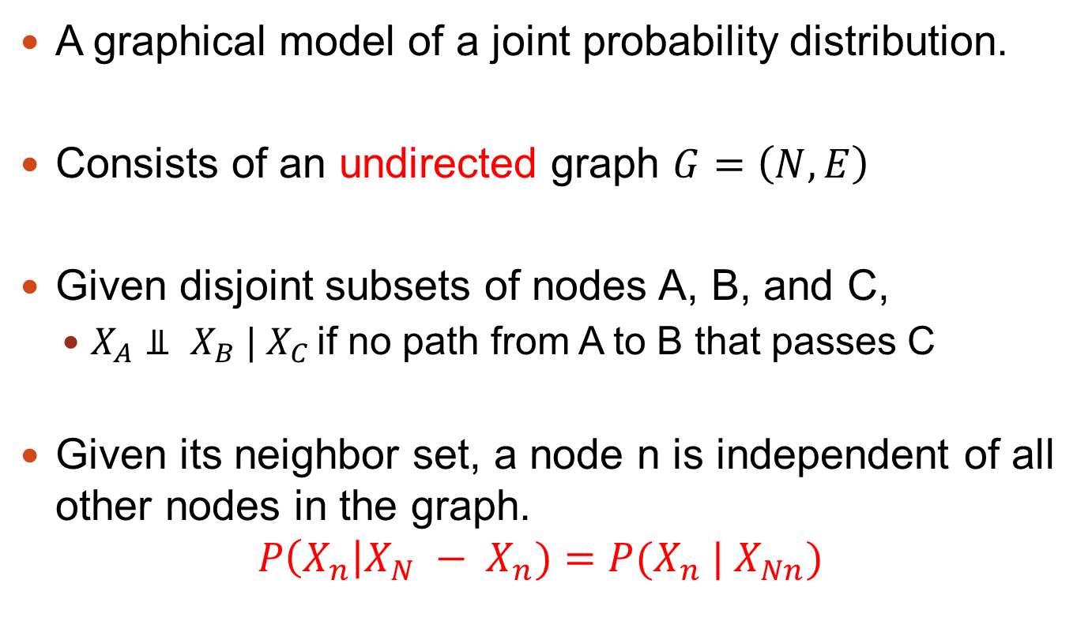
Markov Random Field (MRF)
A graphical model of a joint probability distribution.
Consists of an undirected graph $G=\left(N,E\right)$
Given disjoint subsets of nodes A, B, and C,
$X_{A}⫫ X_{B} | X_{C }$if no path from A to B that passes C
Given its neighbor set, a node n is independent of all other nodes in the graph.
$$P\left(X_{n}\right|X_{N} − X_{n})=P(X_{n} | X_{Nn})$$
Subset of nodes
All nodes
Neighbor Nodes of Subset $X_{n}$

Slide 18
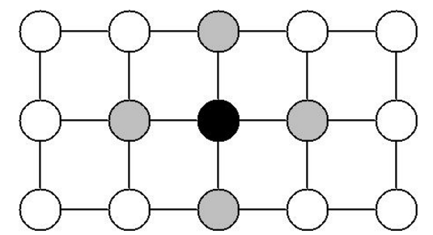
Markov Random Field (MRF)
C
C
A
C
B
C
Given the grey nodes, the black node is conditionally independent of all other nodes.
How to construct the global joint distribution from these local information?

Slide 19





Markov Random Field (MRF)
Gibbs Distribution (Boltzmann distribution)
Partition Function
Set of Maximal Cliques
Temperature
Often take as 1
where
Cliques potential

Slide 20
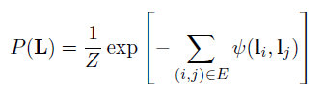

Jigsaw Model & MRF
MRF is defined on offset map to encourage neighboring pixels to have the same offset.
E = The set of edges in a 4-connected grid
Interaction Potential defines a Pott’s Model
Pott’s Model =
True 1
False 0
Local Interaction Strength
Ɣ = Influences the size of the learned jigsaw pieces

Slide 21

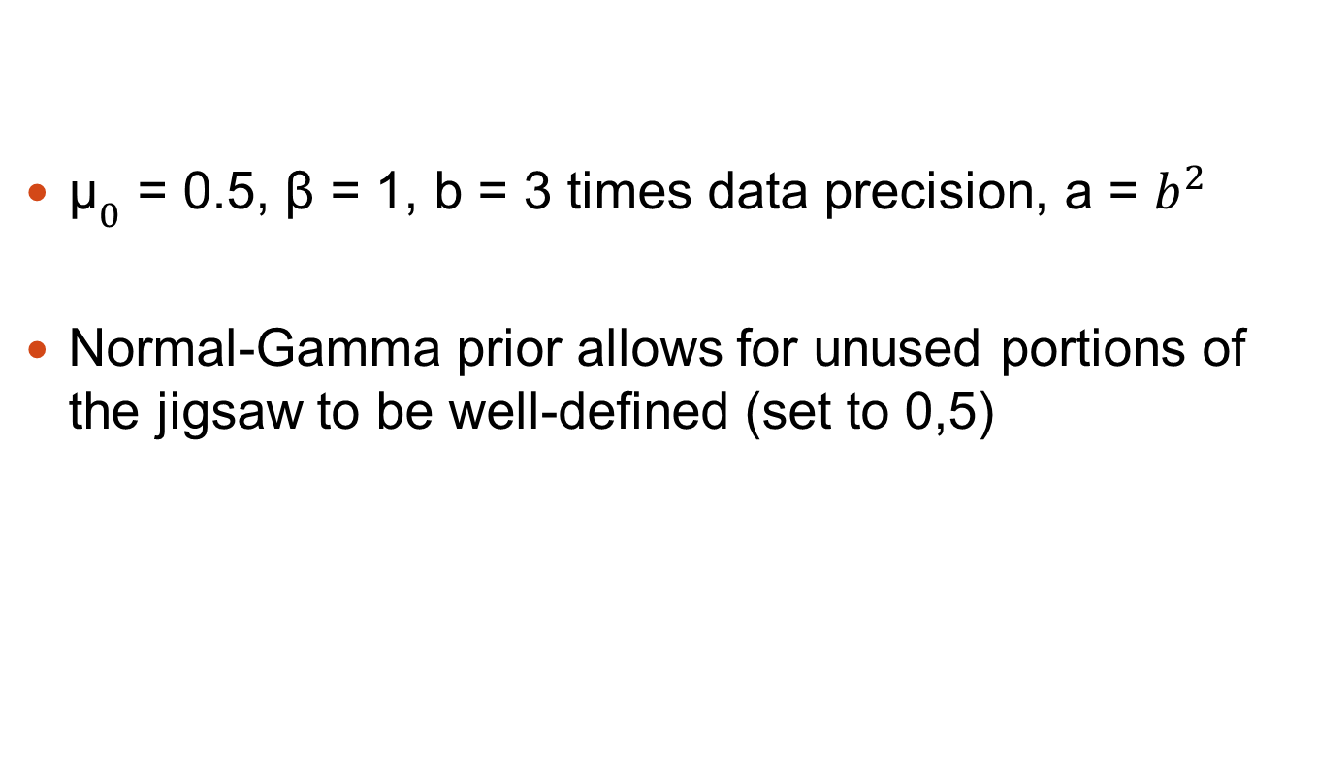
Generative Model
${\text{μ}}_{0}$ = 0.5, β = 1, b = 3 times data precision, a = $b^{2}$
Normal-Gamma prior allows for unused portions of the jigsaw to be well-defined (set to 0,5)

Slide 22

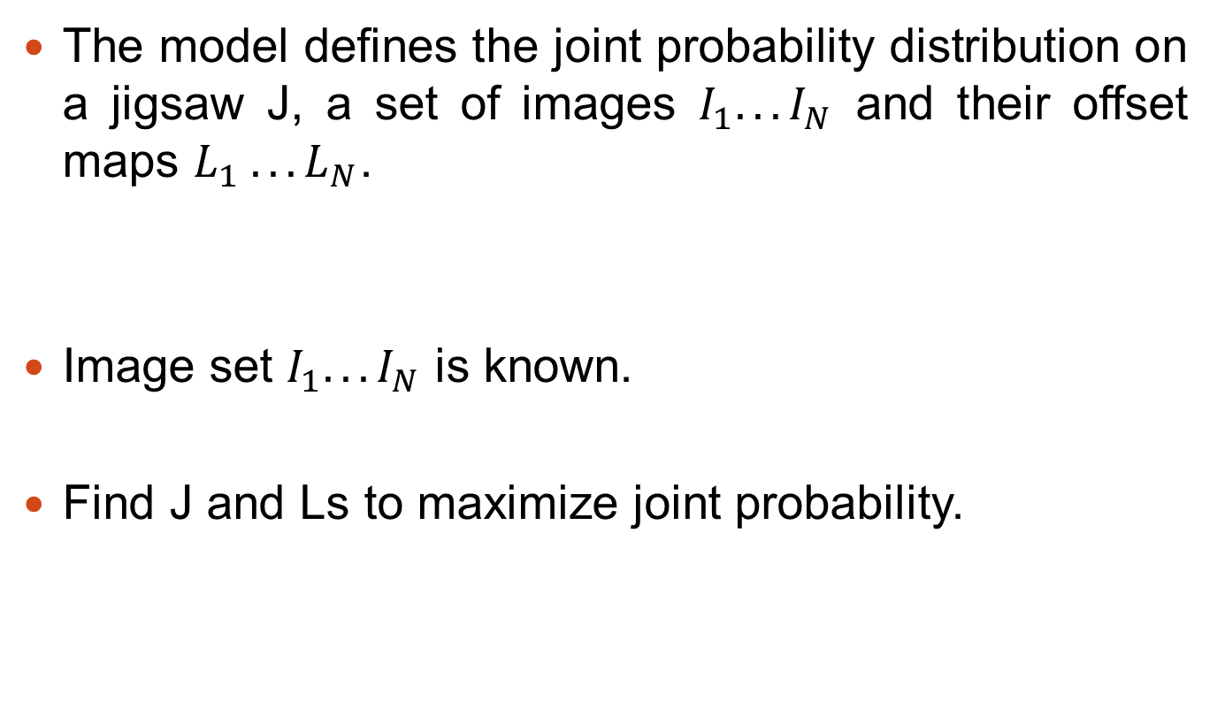
MAP Learning
The model defines the joint probability distribution on a jigsaw J, a set of images $I_{1}. . . I_{N}$ and their offset maps $L_{1} . . . L_{N}$.
Image set $I_{1}. . . I_{N}$ is known.
Find J and Ls to maximize joint probability.

Slide 23
MAP Learning
Initialize jigsaw:
Set means μ to Gaussian noise with same mean and variance as the data
Guarantee to find at least a strong local minimum

Slide 24
MAP Learning
Iteration Step 1
Given Jigsaw (J) and Image (I) update L
using α-expansion graph-cut algorithm

Slide 25
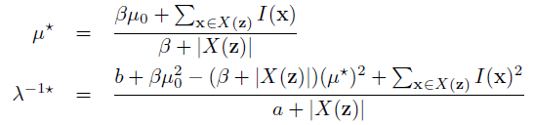
MAP Learning
Iteration Step 1
Given Jigsaw (J) and Image (I) update L
using α-expansion graph-cut algorithm
Iteration Step 2
Update Jigsaw
X(z) = the set of image pixels that are mapped to the jigsaw
pixel z across all images

Slide 26
MAP Learning
Iteration Step 1
Given Jigsaw (J) and Image (I) update L
using α-expansion graph-cut algorithm
Repeat Until Convergence
Iteration Step 2
Update Jigsaw
X(z) = the set of image pixels that are mapped to the jigsaw
pixel z across all images

Slide 27
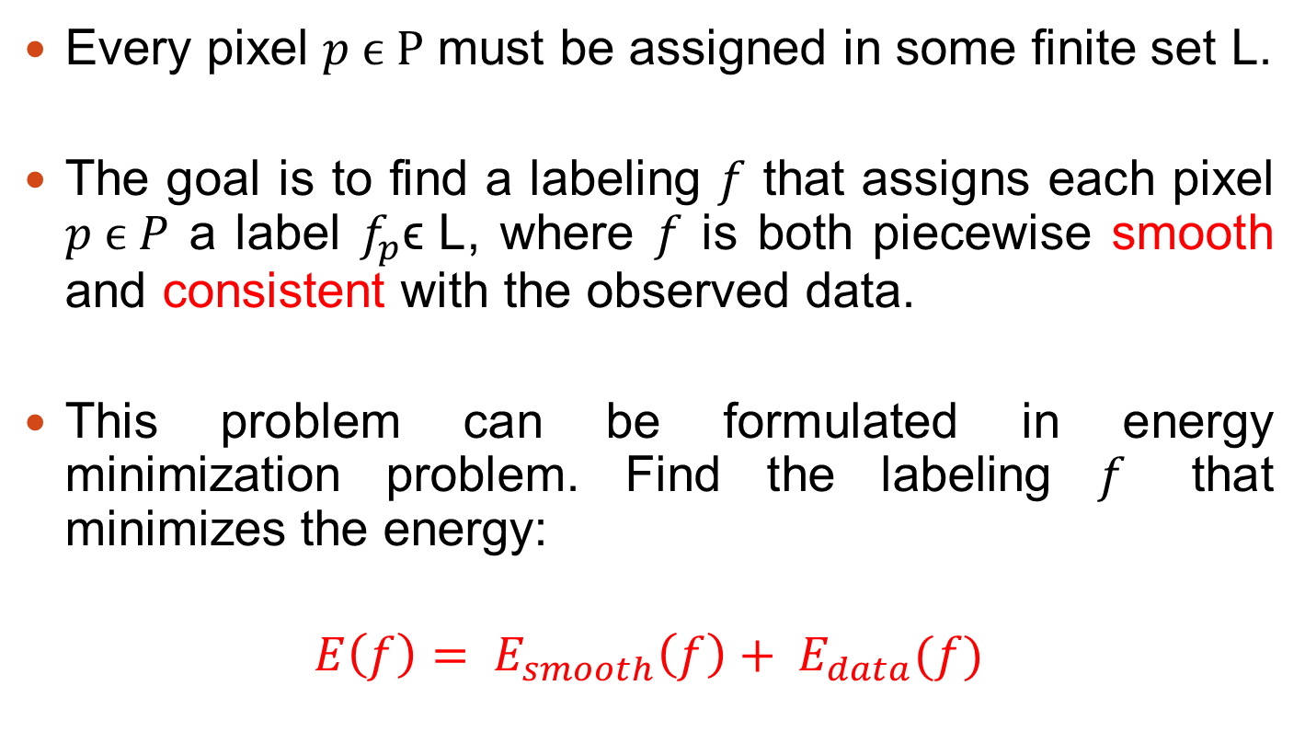
α-Expansion Graph-Cut Algorithm
Every pixel $p ϵ P$ must be assigned in some finite set L.
The goal is to find a labeling $f$ that assigns each pixel $p ϵ P$ a label $f_{p}\text{ϵ} \text{L}$, where $f$ is both piecewise smooth and consistent with the observed data.
This problem can be formulated in energy minimization problem. Find the labeling $f$ that minimizes the energy:
$$E\left(f\right)= E_{smooth}\left(f\right)+ E_{data}(f)$$

Slide 28
α-Expansion Graph-Cut Algorithm
Start with arbitrary labeling f
Loop:
For each label α:
Find f' = arg min E(f') among f' within one α- expansion of f
If E(f') < E(f), set f := f'
Else return f

Slide 29
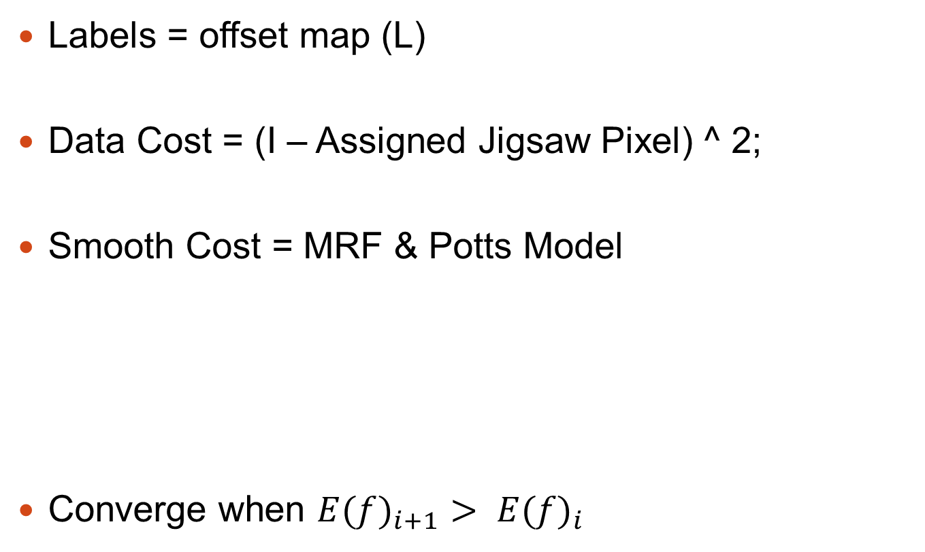
Jigsaw Model & α-Expansion GCA
Labels = offset map (L)
Data Cost = (I – Assigned Jigsaw Pixel) ^ 2;
Smooth Cost = MRF & Potts Model
Converge when ${E(f)}_{i+1}> {E(f)}_{i}$
Pott’s Model =
Local Interaction Strength
Ɣ = Influences the size of the learned jigsaw pieces

Slide 30
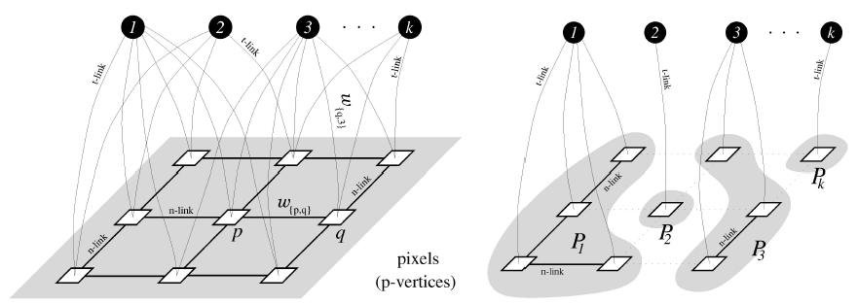
Jigsaw Model & α-Expansion GCA
First Step
After Convergence
Labels
Offset Map
Ɣ = Interaction Potential

Slide 31
Jigsaw Model & α-Expansion GCA
J = Jigsaw
I * = Reconstructed Image
I = Training Image
EM
L = Offset Map

Slide 32

What is Label Size ?
Mod operator trick:
Total # Labels = Jigsaw Size ^ 2
$$z=\left( i − l_{i} \right) mod | J |$$

Slide 33
What is Label Size ?
L = Offset Map
J = Jigsaw
Find labels to assign
this label to every single
pixel in jigsaw.
# labels = Jigsaw Size^2

Slide 34

What is Label Size ?
L = Offset Map
J = Jigsaw
Find labels to assign
this label to every single
pixel in jigsaw.
# labels = Jigsaw Size^2
Then use these labels without mod operator to get jigsaw correspondence of .
$$z=\left( i − l_{i} \right) mod | J |$$

Slide 35
What is Label Size ?
L = Offset Map
J = Jigsaw

Slide 36

What is Label Size ?
L = Offset Map
J = Jigsaw
If we use mod operator, last column move to the first column
$$z=\left( i − l_{i} \right) mod | J |$$

Slide 37
What is Label Size ?
L = Offset Map
J = Jigsaw
If we use mod operator, last column move to the first column
$$z=\left( i − l_{i} \right) mod | J |$$

Slide 38
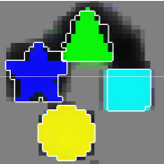



Importance of Ɣ = Interaction Potential
Ɣ | Original Jigsaw | My Jigsaw
50
100
200

Slide 39



Importance of Ɣ = Interaction Potential
Ɣ | Original Jigsaw | My Jigsaw
500
1000
2000

Slide 40



Importance of Ɣ = Interaction Potential
Ɣ | Original Jigsaw | My Jigsaw
3825
10000
20000

Slide 41



Importance of Ɣ = Interaction Potential
Ɣ | Original Jigsaw | My Jigsaw
25000
30000
35000

Slide 42
Future Work
How to implement Jigsaw Model to sketch recognition area?
Jigsaw model is massively parallel. Parallelize source code by CUDA.

Slide 43
Questions?

