Slide 1
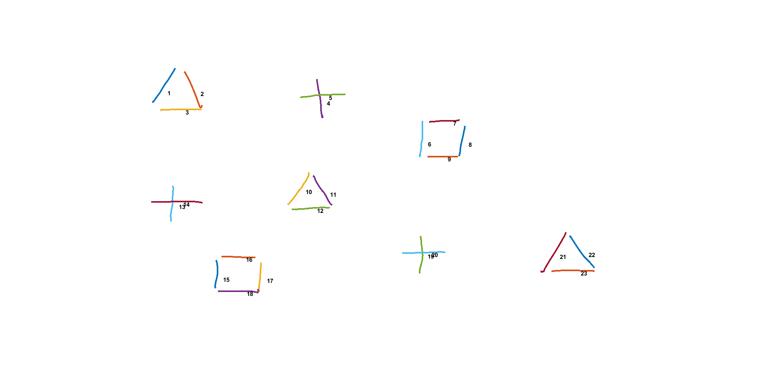
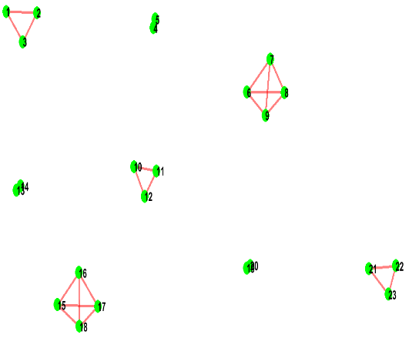
Data Cost Matrix (D)
Run
Min Cut Max Flow
Graph Cut
Sketch
Jigsaw Label | Strokes
 | 1 | 2 | 3 | 4 | . | . | . | 21 | 22 | 23
1
2
…
9
Converged
Jigsaw (J)
J x N (9 x 23)
Compatibility Matrix (C)
Canvas Size 800 x 1280
i
1 x 9 x 720
 | 1 | 2 | 3 | 4 | 5 | 6 | 7 | 8 | 9
1 | 0
2 |  | 0
3 |  |  | 0
4 |  |  |  | 0
5 |  |  |  |  | 0
6 |  |  |  |  |  | 0
7 |  |  |  |  |  |  | 0
8 |  |  |  |  |  |  |  | 0
9 |  |  |  |  |  |  |  |  | 0
N (# of Strokes) = 23
j
IDM Feat.
Offset Map
Regenerated Sketch
Center of Strokes (S)
Stroke | X Pos. | Y Pos. | X Offset | Y Offset | Jigsaw Element
1
2
3
4
.
.
21
22
23
J(Jigsaw size) = 9
Stroke | X | Y
1
2
3
4
.
.
.
21
22
23
9 x 9 x 4
i = i th jigsaw element
j = j th jigsaw element
i,j,1 = mean of x displacement between strokes
that are assigned to jigsaw i and j.
i,j,2 = mean of y displacement between strokes
that are assigned to jigsaw i and j.
i,j,3 = variance of x displacement between strokes
that are assigned to jigsaw i and j.
i,j,4 = variance of y displacement between strokes
that are assigned to jigsaw i and j.
N x 3
N x 6

Slide 2
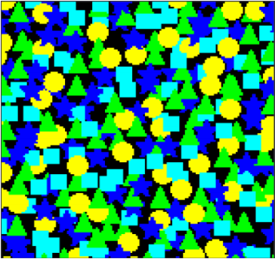
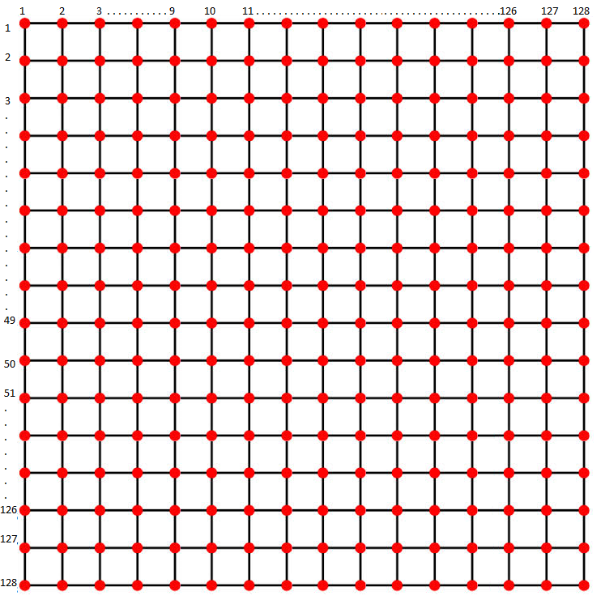

Graph for Min Cut-Max Flow

Slide 3
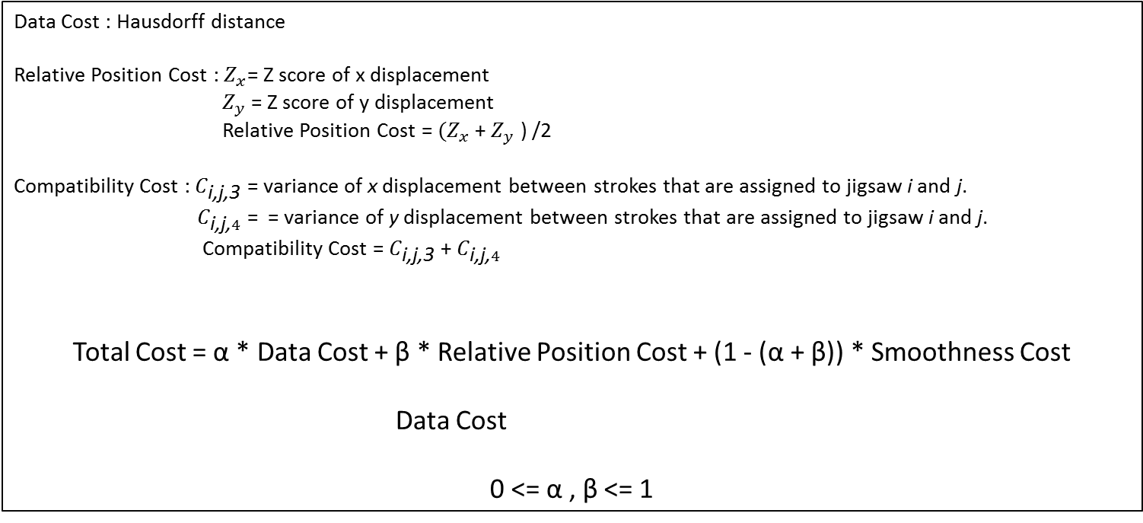
Total Cost
Data Cost : Hausdorff distance
Relative Position Cost : $Z_{x}$= Z score of x displacement
$Z_{y}$ = Z score of y displacement
Relative Position Cost = $(Z_{x}$ + $Z_{y}$ ) /2
Compatibility Cost : $C_{\text{i}\text{,}\text{j}\text{,3}}$ = variance of x displacement between strokes that are assigned to jigsaw i and j.
$C_{\text{i}\text{,}\text{j}\text{,}4}$ = = variance of y displacement between strokes that are assigned to jigsaw i and j.
Compatibility Cost = $C_{\text{i}\text{,}\text{j}\text{,3}}$ + $C_{\text{i}\text{,}\text{j}\text{,}4}$
Total Cost = α * Data Cost + β * Relative Position Cost + (1 - (α + β)) * Smoothness Cost
Data Cost
0 <= α , β <= 1

Slide 4
Data Cost & Smoothness Cost
Compatibility Cost
Smootness Cost Matrix
Weights Matrix
Data Cost Matrix (D)
Hausdorff Distance &
Relative Position Cost
Alpha Expansion Graph Cut Algorithm requires Smooth Cost (S) to be metric. Smooth Cost is called metric on the space of labels (L) if it satisfies:
S (α, β) = 0 ↔ α = β
S (α, β) = S (β, α) ≥ 0
S (α, β) ≤ S (α, ɣ) + S (ɣ, β)
 | 1 | 2 | 3 | 4 | 5 | 6 | 7 | 8 | 9
1 | 0
2 |  | 0
3 |  |  | 0
4 |  |  |  | 0
5 |  |  |  |  | 0
6 |  |  |  |  |  | 0
7 |  |  |  |  |  |  | 0
8 |  |  |  |  |  |  |  | 0
9 |  |  |  |  |  |  |  |  | 0
 | 1 | 2 | 3 | 4 | … | 21 | 22 | 23
1 |  | 1 | 1 | 0 | 0 | 0 | 0 | 0
2 |  |  | 1 | 0 | 0 | 0 | 0 | 0
3 |  |  |  | 0 | 0 | 0 | 0 | 0
4 |  |  |  |  | 0 | 0 | 0 | 0
… |  |  |  |  |  | 0 | 0 | 0
21 |  |  |  |  |  |  | 1 | 1
22 |  |  |  |  |  |  |  | 1
23
Jigsaw Label | Strokes
 | 1 | 2 | 3 | 4 | . | . | . | 21 | 22 | 23
1
2
.
.
.
9
9 x 9
Jigsaw Size x Jigsaw Size
(Label Size x Label Size)
23 x 23
# Strokes x # Strokes
We are able to satisfy metric constraint by using offset map.
SmoothCost(k,l) = the unweighted cost of assigning labels k and l to any neighboring sites.
Weights(i,j) > 0 indicates that sites i and j are neighbors
J x N (9 x 23)
CompatibilityCost(i,j) = For particular neighboring sites i,j the final weighted compatibility cost is:
Weights(i,j)*SmoothCost(k,l)

Slide 5

















Expected Jigsaw
Jigsaw (J)
1
2
3
4
5
6
7
8
9
1 x 9 x 720

Slide 6
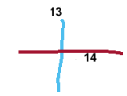
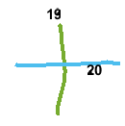
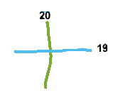







Problem 1- How to Assign Same Label to Compatible Primitives
$$z=\left( i − l_{i} \right) mod | J |$$
0
1
2
3
4
5
6
7
8
$l_{i}$ = 6
$l_{i}$ = 3
$$What if we change drawing order$$
${For Stroke \#19 l}_{i}$ = 2
$$Do not supply metric constraint$$
${For Stroke \#20 l}_{i}$ = 4
$$Additionally we cannot use stroke centers because centers are not celar cut as pixels.$$

Slide 7
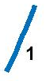
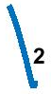

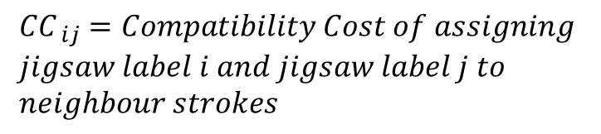



Problem 2- Compatibility Cost While Learning Jigsaw
Compatibility Matrix (C)
Iteration # T
Jigsaw (J)
i
 | 1 | 2 | 3 | 4 | 5 | 6 | 7 | 8 | 9
1 | 0
2 |  | 0
3 |  |  | 0
4 |  |  |  | 0
5 |  |  |  |  | 0
6 |  |  |  |  |  | 0
7 |  |  |  |  |  |  | 0
8 |  |  |  |  |  |  |  | 0
9 |  |  |  |  |  |  |  |  | 0
j
2
Calculate Compatibility Cost(CC) for each element of the set and find the minimum CC.
$${CC}_{ ij}=Compatibility Cost of assigning \\ jigsaw label i and jigsaw label j to \\ neighbour strokes$$
$${CC}_{i,j}= \frac{(C_{i,j,3}\text{ + }C_{i,j,4})}{2}$$
9 x 9 x 4
1
Find set of all possible pairs:
1-5, 1-6, 1-7
2-5, 1-6, 1-7
2-5, 2-6, 1-7
2-5, 2-6, 2-7
1-5, 2-6, 2-7
1-5, 2-6, 1-7
1-5, 1-6, 2-7
i = i th jigsaw element
j = j th jigsaw element
$C_{i,j,1}=$ $\text{mean} \text{of} \text{x} \text{displacement} \text{between} \text{matched}$ $\text{strokes} \text{that} \text{are} \text{assigned} \text{to} \text{jigsaw} \text{i} \text{and} \text{j}\text{.}$
$C_{i,j,2}=$ $\text{mean} \text{of} \text{y} \text{displacement} \text{between} \text{matched}$ $\text{strokes} \text{that} \text{are} \text{assigned} \text{to} \text{jigsaw} \text{i} \text{and} \text{j}\text{.}$
$C_{i,j,3}=$ $\text{variance} \text{of} \text{x} \text{displacement} \text{between} \text{matched} \text{strokes} \text{that} \text{are} \text{assigned} \text{to} \text{jigsaw} \text{i} \text{and} \text{j}\text{.}$
$C_{i,j,4}=$ $\text{variance} \text{of} \text{y} \text{displacement} \text{between} \text{matched} \text{strokes} \text{that} \text{are} \text{assigned} \text{to} \text{jigsaw} \text{i} \text{and} \text{j}\text{.}$
3
Set the minimum as ${CC}_{i,j}$

