Slide 1
Jigsaw Model for Sketch Recognition
Emre Karaman

Slide 2
Jigsaw
A jigsaw J is a stroke feature representation matrix such that each matrix element z in J has an IDM feature μ(z).
Jigsaw model is a generative model which generates a sketch by joining together strokes which are represented by IDM features in a jigsaw matrix element.
A set of grouped elements in J is a Jigsaw piece. We can combine many of these pieces to generate sketches. This is similar to using multiple strokes to draw a sketch.

Slide 3
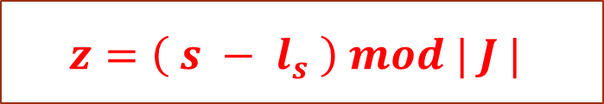
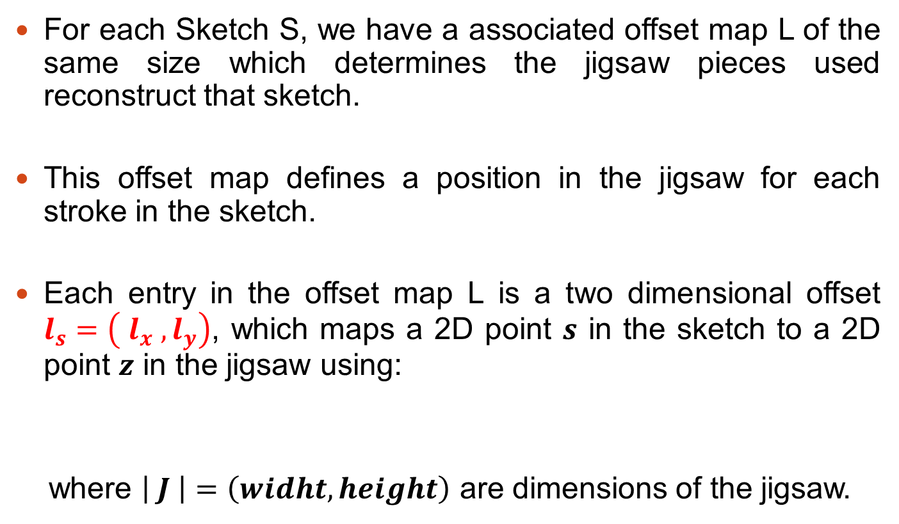
Offset Map (Label)
For each Sketch S, we have a associated offset map L of the same size which determines the jigsaw pieces used reconstruct that sketch.
This offset map defines a position in the jigsaw for each stroke in the sketch.
Each entry in the offset map L is a two dimensional offset $l_{s}=\left( l_{x} , l_{y}\right)$, which maps a 2D point $s$ in the sketch to a 2D point $z$ in the jigsaw using:
where $\left| J \right|=\left(widht, height\right)$ are dimensions of the jigsaw.
$$z=\left( s − l_{s} \right) mod | J |$$

Slide 4
Initial Conditions
N = Number of Strokes on canvas.
S (Sketch - Stroke Centers) = N x 2 matrix which keeps center positions of strokes.
L (Offset Map) = N x 2 matrix which contains assigned label to each stroke. Initially empty.
F (IDM Features) = N x 720 matrix which keeps IDM features of strokes.
J (Jigsaw) : m x m x 720 matrix. Each element, z, of jigsaw is intially set to mean of IDM features of all strokes in the sketch. I set m = 3 in my example.

Slide 5
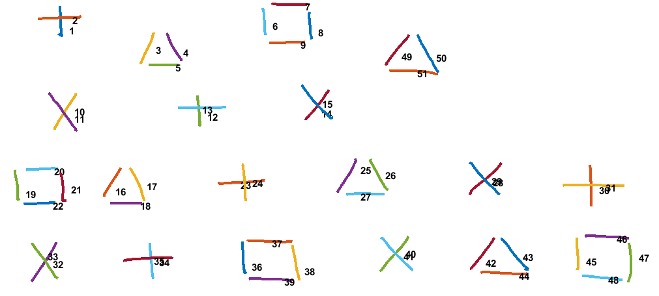


Generative Model
INPUT SKETCH ON CANVAS
800 x 1280
JIGSAW
JIGSAW REPRESANTATION AS STROKES
3x 3 x 720
Strokes are represented by IDM features (1x720 vector) in Jigsaw

Slide 6
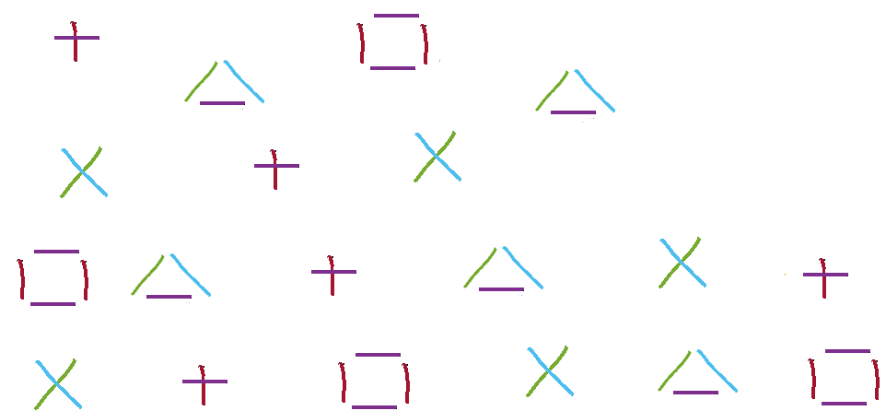
Generative Model
INPUT SKETCH ON CANVAS
800 x 1280
OFFSET MAP
RECONSTRUCTED SKETCH ON CANVAS
JIGSAW
3 x 3 x 720
51 x 2
800 x 1280

Slide 7




Generative Model
We are able to generate different sketches by using jigsaw and different offset maps.
OFFSET MAP
JIGSAW
11 x 2
3 x 3 x 720
11 x 2

Slide 8
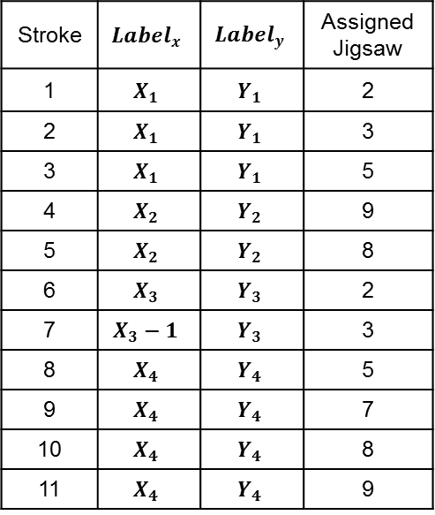
Generative Model
We are able to generate different sketches by using jigsaw and different offset maps.
OFFSET MAP
GENERATED SKETCH
Stroke | $${Label}_{x}$$ | $${Label}_{y}$$ | Assigned Jigsaw
1 | $$X_{1}$$ | $$Y_{1}$$ | 2
2 | $$X_{1}$$ | $$Y_{1}$$ | 3
3 | $$X_{1}$$ | $$Y_{1}$$ | 5
4 | $$X_{2}$$ | $$Y_{2}$$ | 9
5 | $$X_{2}$$ | $$Y_{2}$$ | 8
6 | $$X_{3}$$ | $$Y_{3}$$ | 2
7 | $$X_{3}−1$$ | $$Y_{3}$$ | 3
8 | $$X_{4}$$ | $$Y_{4}$$ | 5
9 | $$X_{4}$$ | $$Y_{4}$$ | 7
10 | $$X_{4}$$ | $$Y_{4}$$ | 8
11 | $$X_{4}$$ | $$Y_{4}$$ | 9
JIGSAW
1
2
1
2
3
4
6
7
3
4
5
6
5
8
7
8
9
9
11
3 x 3 x 720
10
800 x 1280
Stroke #:11
11 x 2

Slide 9
Graph Model
Sketch based Jigsaw graph model bases on similarity and relative positions of strokes.
Mid-point of each stroke represents graph node and its position.
To encourage similar stroke patterns have the same offset, we connect strokes that form the pattern and set the smoothness cost.
By setting the smoothness cost we enforce the stroke patterns to appear in the jigsaw (jigsaw pieces) as well.

Slide 10

Smoothness Cost
To set smoothness cost among strokes that consist patterns, we define define a Pott’s model on the offsets:
Pott’s model encourage connected strokes to relatively appear at the same positions in the jigasw as they are in the sketch.
Assigned Label
Pott’s Model =
True 1
False 0
Smoothness Cost

Slide 11
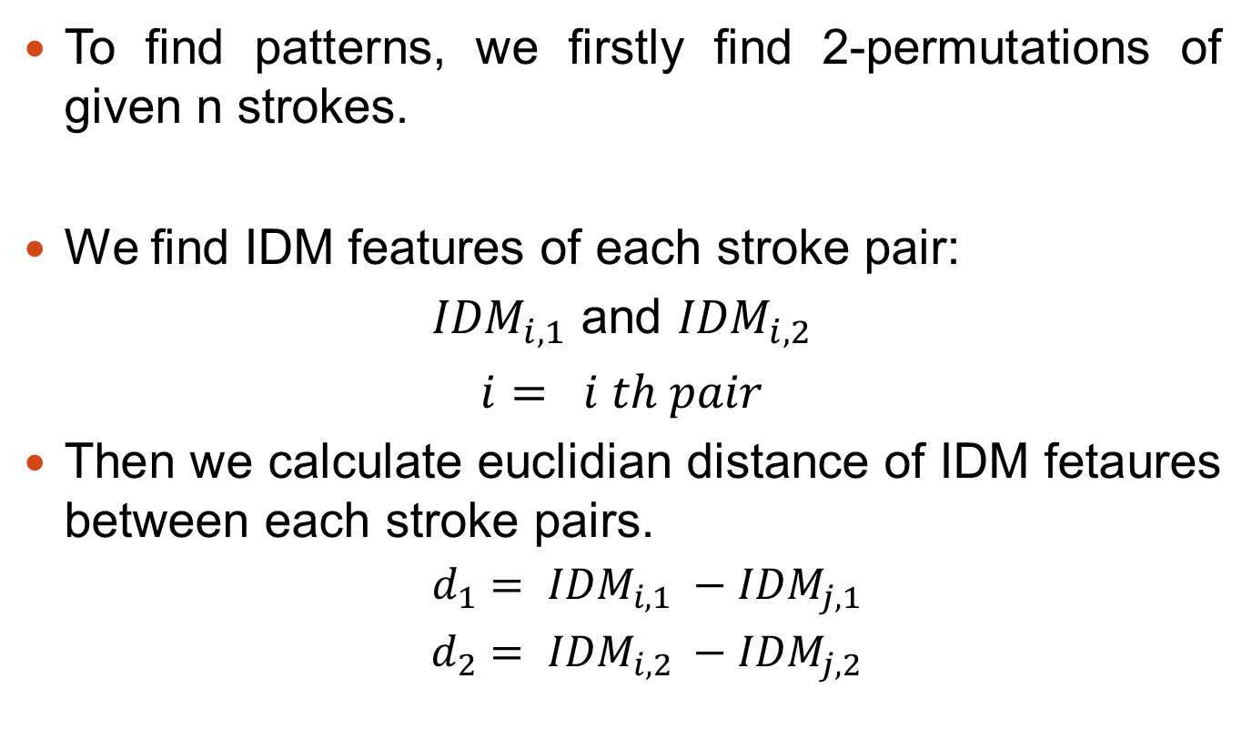
Connectivity
To find patterns, we firstly find 2-permutations of given n strokes.
We find IDM features of each stroke pair:
${IDM}_{i,1}$ and ${IDM}_{i,2}$
$i= i th pair$
Then we calculate euclidian distance of IDM fetaures between each stroke pairs.
$d_{1}=$ ${IDM}_{i,1} −{IDM}_{j,1}$
$d_{2}=$ ${IDM}_{i,2} −{IDM}_{j,2}$

Slide 12
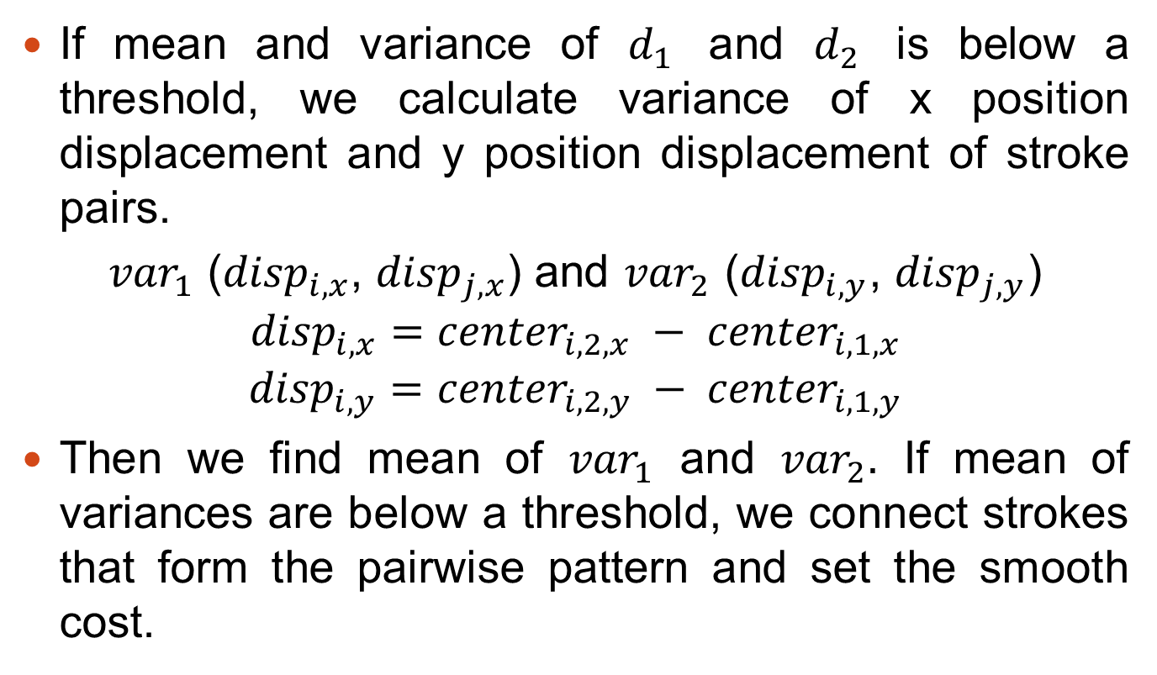
Connectivity
If mean and variance of $d_{1}$ and $d_{2}$ is below a threshold, we calculate variance of x position displacement and y position displacement of stroke pairs.
${var}_{1}$ (${disp}_{i,x}$, ${disp}_{j,x}$) and ${var}_{2}$ (${disp}_{i,y}$, ${disp}_{j,y}$)
$${disp}_{i,x}={center}_{i,2,x} − {center}_{i,1,x}$$
$${disp}_{i,y}={center}_{i,2,y} − {center}_{i,1,y}$$
Then we find mean of ${var}_{1}$ and ${var}_{2}.$ If mean of variances are below a threshold, we connect strokes that form the pairwise pattern and set the smooth cost.

Slide 13


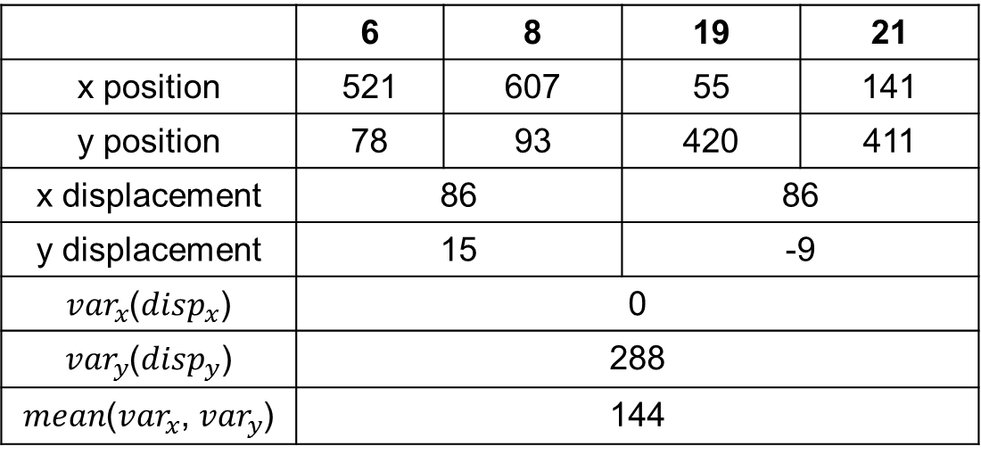
Example of Connectivity
Take into account (6,8) and (19,21)
 | 6 | 8 | 19 | 21
x position | 521 | 607 | 55 | 141
y position | 78 | 93 | 420 | 411
x displacement | 86 |  | 86
y displacement | 15 |  | -9
${var}_{x}$(${disp}_{x}$) | 0
${var}_{y}$(${disp}_{y}$) | 288
$mean$(${var}_{x}$, ${var}_{y}$) | 144

Slide 14

Example of Connectivity
If $mean$(${var}_{x}$, ${var}_{y})<threshold$, connect pairs and set the smooth cost (Ɣ) between connected pairs.
Ɣ
Ɣ

Slide 15
Update Centers
To enforce connected strokes relatively appear at the same position in the jigsaw, strokes displacement values should be equal.
Thus, we should apply offset to centers of connected strokes.

Slide 16
Learning
We firstly set jigsaw matrix to mean of IDM features of all strokes, then run alpha-expansion graph cut algorithm and update offset map matrix (label).
Update jigsaw matrix according to new assigned label to each stroke.
Iterate running alpha-expansion algorithm, updating offset map and jigsaw matrix until convergance.

Slide 17
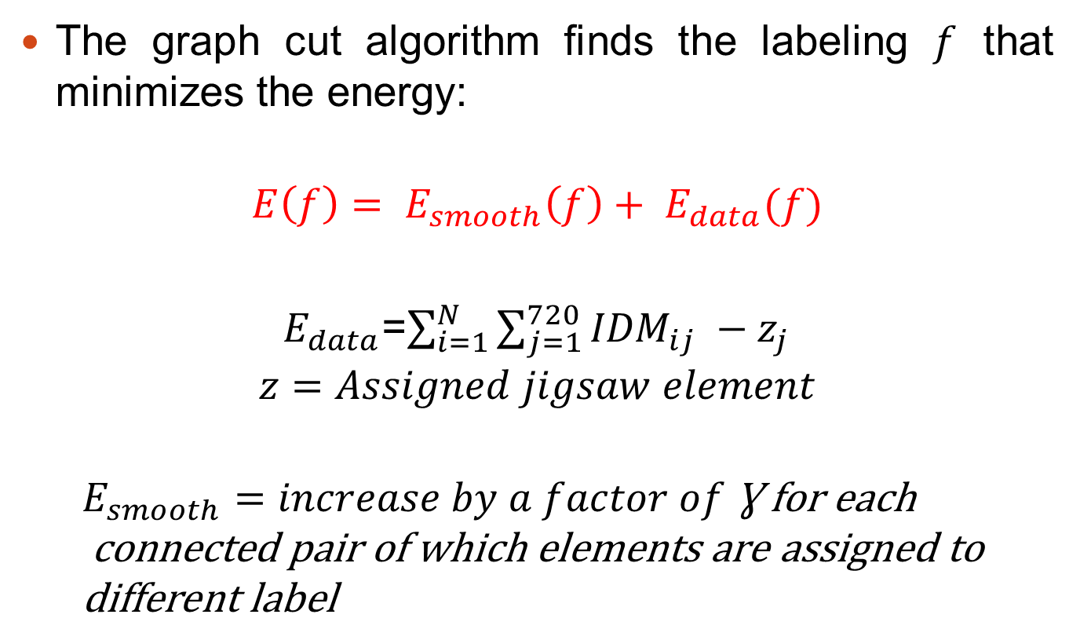
α-Expansion Graph-Cut Algorithm
The graph cut algorithm finds the labeling $f$ that minimizes the energy:
$$E\left(f\right)= E_{smooth}\left(f\right)+ E_{data}(f)$$
$E_{data}$=$\sum_{i=1}^{N}{\sum_{j=1}^{720}{{IDM}_{ij} −z_{j}}}$
$$z=Assigned jigsaw element$$
$$E_{smooth}=increase by a factor of \text{Ɣ} \text{for} \text{each} \\ \text{connected} \text{pair} \text{of} \text{which} \text{elements} \text{are} \text{assigned} \text{to} \text{different} \text{label}$$

Slide 18
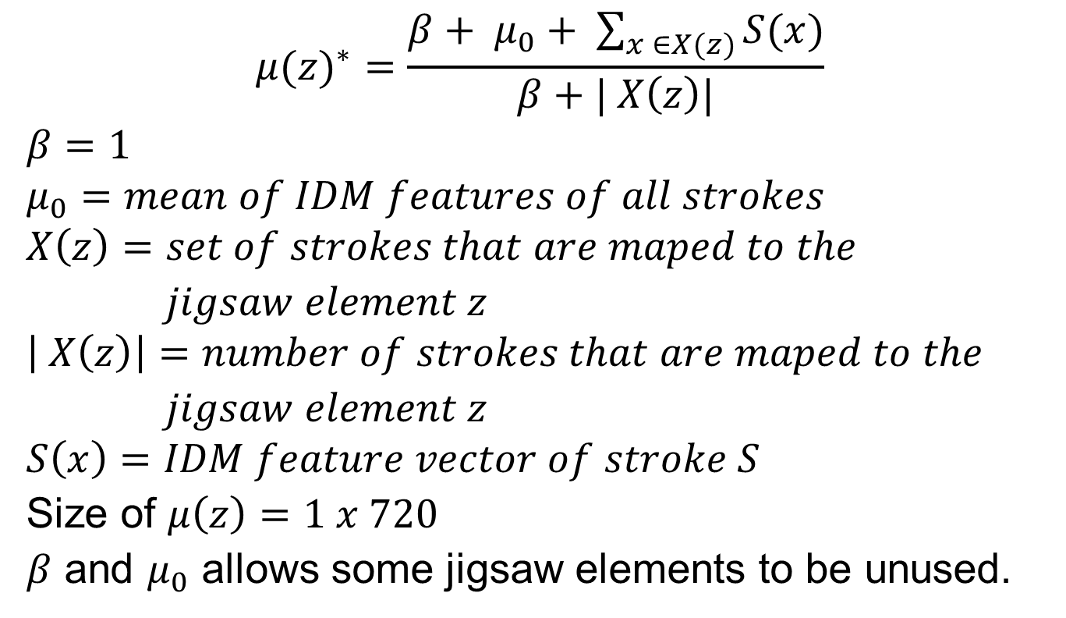
How to update Jigsaw Matrix
$${μ(z)}^{∗}=\frac{β+ μ_{0}+ \sum_{x ∈X(z)}{S(x)}}{β+| X\left(z\right)|}$$
$$β=1$$
$$μ_{0}=mean of IDM features of all strokes$$
$$X\left(z\right)=set of strokes that are maped to the$$
$jigsaw element z$
$$\left| X\left(z\right)\right|=number of strokes that are maped to the$$
$jigsaw element z$
$$S\left(x\right)=IDM feature vector of stroke S$$
Size of $μ\left(z\right)=1 x 720$
$β$ and $μ_{0}$ allows some jigsaw elements to be unused.

Slide 19
EM Algorithm Summary
Iteration Step 1
Given Jigsaw (J) and Sketch (S) update L
using α-expansion graph-cut algorithm
Repeat Until Convergence
Iteration Step 2
Update Jigsaw

Slide 20
Converged Jigsaw
A jigsaw J is a stroke feature representation matrix such that each matrix element z in J has an IDM feature μ(z).
Size of jigsaw is m x m x 720 where m can be set to any value depending on the sketch size.
Up on convergence, each element z in J is a vector of size 1 x 720 which is a mean of IDM features of assigned strokes to that jigsaw element.
Smoothness cost enforces Jigsaw matrix to keep compatibility of stroke patterns (relative positions) in sketch by assigning same offset label.

Slide 21
Reconstruction
Up on convergence we are able to reconstruct our sketch or generate different sketches by using jigsaw pieces in our jigsaw matrix.
To represent IDM features in jigsaw elements as a stroke, we try to find the best stroke among the allocated strokes to that jigsaw element z.
To achieve this goal we calculate euclidean distance between each stroke and its allocated jigsaw element.
Then for each jigsaw element we choose the stroke among the allocated ones with the smallest euclidean distance to represent jigsaw element as a stroke.

