Slide 1
Jigsaw Model for Sketch Recognition
Emre Karaman

Slide 2
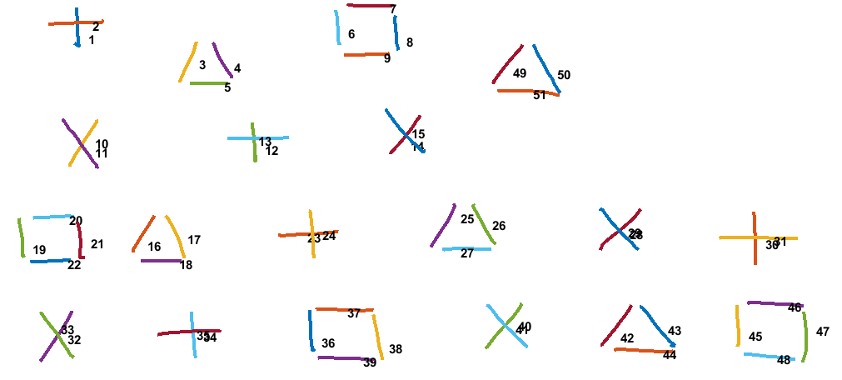
Input Sketch on Canvas
Number of Strokes = 51
Canvas Size 800 x 1280

Slide 3
Stroke Centers
Stroke # | X Coord. | Y Coord. | Stroke # | X Coord. | Y Coord.
1 | 137 | 88 | 27 | 686 | 425
2 | 143 | 66 | 28 | 936 | 396
3 | 301 | 127 | 29 | 934 | 394
4 | 352 | 133 | 30 | 1136 | 413
5 | 338 | 163 | 31 | 1148 | 407
6 | 521 | 78 | 32 | 107 | 563
7 | 582 | 39 | 33 | 97 | 547
8 | 607 | 92 | 34 | 307 | 559
9 | 574 | 116 | 35 | 297 | 556
10 | 147 | 252 | 36 | 481 | 568
11 | 147 | 267 | 37 | 519 | 521
12 | 398 | 263 | 38 | 581 | 577
13 | 388 | 249 | 39 | 543 | 598
14 | 613 | 256 | 40 | 771 | 542
15 | 614 | 237 | 41 | 768 | 547
16 | 225 | 415 | 42 | 923 | 560
17 | 284 | 405 | 43 | 992 | 549
18 | 271 | 444 | 44 | 985 | 587
19 | 55 | 420 | 45 | 1112 | 557
20 | 109 | 374 | 46 | 1169 | 512
21 | 141 | 411 | 47 | 1211 | 550
22 | 107 | 444 | 48 | 1153 | 595
23 | 461 | 402 | 49 | 764 | 140
24 | 483 | 398 | 50 | 829 | 143
25 | 687 | 371 | 51 | 794 | 1175
26 | 733 | 382

Slide 4
Initial Conditions
N = Number of Strokes on canvas.
S (Sketch - Stroke Centers) = N x 2 matrix which keeps center positions of strokes.
L (Offset Map) = N x 2 matrix which contains assigned label to each stroke. Initially empty.
F (IDM Features) = N x 720 matrix which keeps IDM features of strokes.
J (Jigsaw) : m x m x 720 matrix. Each element, z, of jigsaw is intially set to mean of IDM features of all strokes in the sketch. I set m = 3 in my example.

Slide 5
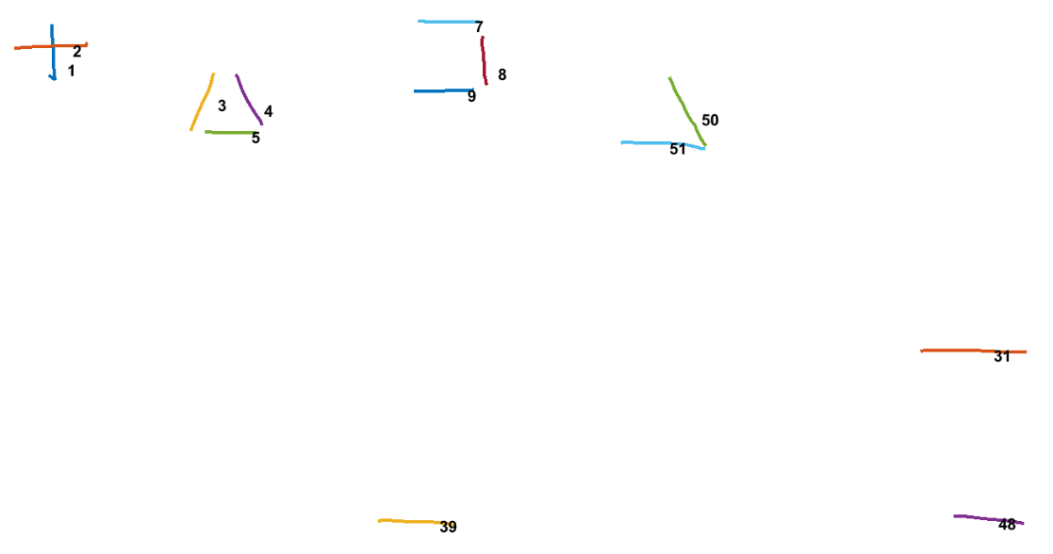
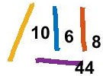
Find Similar Strokes
Euclidean Distance of IDM Features <= 7
314 Similar Stroke Pairs:
# | Stroke 1 | Stroke 2 | Euclidean Distance of IDM
1 | 2 | 3 | 5.6633
2 | 1 | 4 | 6.5001
3 | 5 | 7 | 6.7026
4 | 1 | 8 | 6.8301
5 | 4 | 8 | 6.5581
6 | 6 | 8 | 6.7229
7 | 2 | 9 | 6.4299
. . . | . . . | . . . | . . .
312 | 48 | 50 | 5.0063
313 | 31 | 51 | 6.1658
314 | 39 | 51 | 4.0050

Slide 6
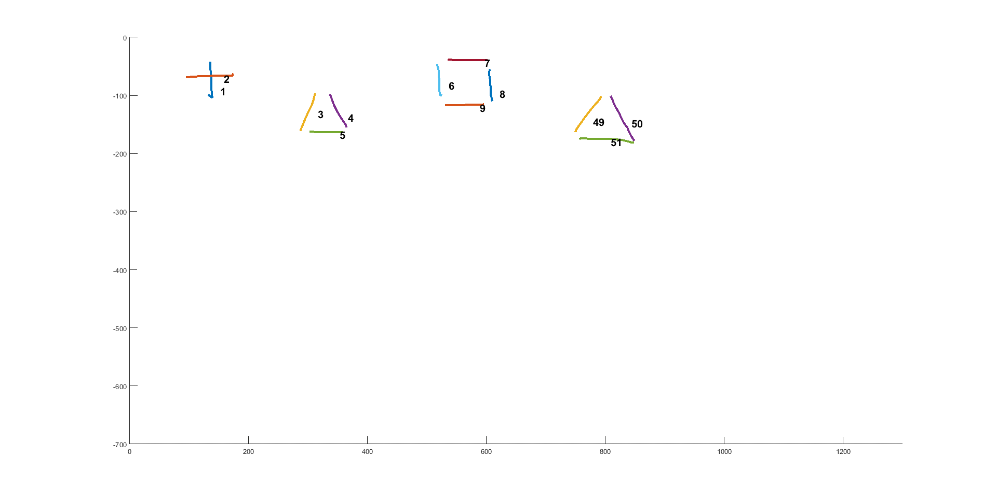
Find Patterns
Check whether similar stroke pairs create pattern with other stroke pairs based on their displacement.
If mean variance of displacement <= 50, then connect strokes that form the pattern.
# | Stroke 1 | Stroke 2 | Euclidean Distance of IDM
1 | 1 | 8 | 5.6633
2 | 4 | 50 | 6.5001
Stroke Pairs | Centers
 | X Coord. | Y Coord.
1 | 137 | 88
4 | 352 | 133
8 | 607 | 92
50 | 829 | 143
# | Stroke 1 | Stroke 2 | Displacement
 |  |  | X | Y
1 | 1 | 4 | 352 - 137 = 215 | 133 - 88 = 45
2 | 8 | 50 | 829 – 607 = 222 | 143 – 92 = 51
Variance |  |  | 24.5 | 18
Mean Variance |  |  | 21.25

Slide 7
Connect Strokes
# | Stroke 1 | Stroke 2 | Euclidean Distance of IDM
1 | 1 | 8 | 5.6633
2 | 4 | 50 | 6.5001
Stroke Pairs | Centers
 | X Coord. | Y Coord.
1 | 137 | 88
4 | 352 | 133
8 | 607 | 92
50 | 829 | 143
# | Stroke 1 | Stroke 2 | Displacement
 |  |  | X | Y
1 | 1 | 4 | 352 - 137 = 215 | 133 - 88 = 45
2 | 8 | 50 | 829 – 607 = 222 | 143 – 92 = 51
Variance |  |  | 24.5 | 18
Mean Variance |  |  | 21.25

Slide 8
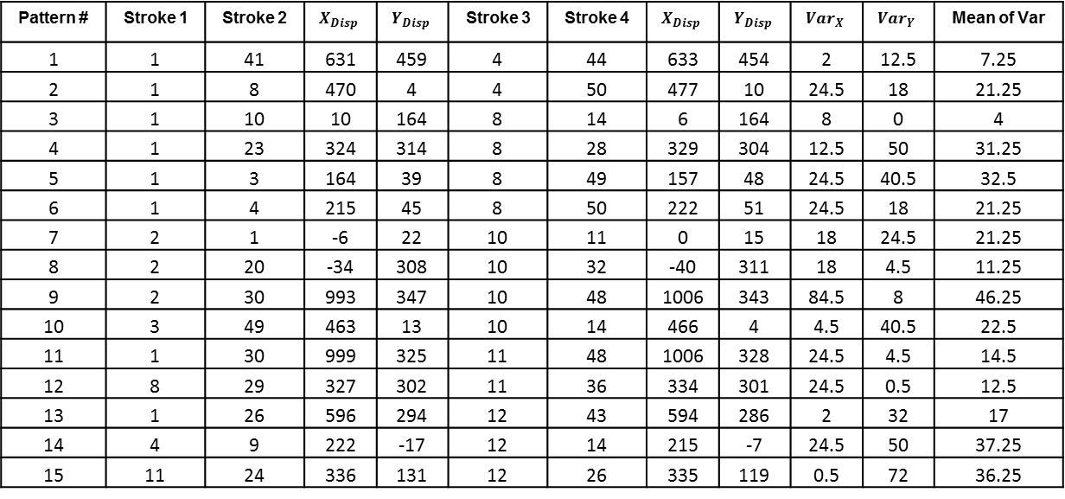
Patterns
Pattern # | Stroke 1 | Stroke 2 | $$X_{Disp}$$ | $$Y_{Disp}$$ | Stroke 3 | Stroke 4 | $$X_{Disp}$$ | $$Y_{Disp}$$ | $${Var}_{X}$$ | $${Var}_{Y}$$ | Mean of Var
1 | 1 | 41 | 631 | 459 | 4 | 44 | 633 | 454 | 2 | 12.5 | 7.25
2 | 1 | 8 | 470 | 4 | 4 | 50 | 477 | 10 | 24.5 | 18 | 21.25
3 | 1 | 10 | 10 | 164 | 8 | 14 | 6 | 164 | 8 | 0 | 4
4 | 1 | 23 | 324 | 314 | 8 | 28 | 329 | 304 | 12.5 | 50 | 31.25
5 | 1 | 3 | 164 | 39 | 8 | 49 | 157 | 48 | 24.5 | 40.5 | 32.5
6 | 1 | 4 | 215 | 45 | 8 | 50 | 222 | 51 | 24.5 | 18 | 21.25
7 | 2 | 1 | -6 | 22 | 10 | 11 | 0 | 15 | 18 | 24.5 | 21.25
8 | 2 | 20 | -34 | 308 | 10 | 32 | -40 | 311 | 18 | 4.5 | 11.25
9 | 2 | 30 | 993 | 347 | 10 | 48 | 1006 | 343 | 84.5 | 8 | 46.25
10 | 3 | 49 | 463 | 13 | 10 | 14 | 466 | 4 | 4.5 | 40.5 | 22.5
11 | 1 | 30 | 999 | 325 | 11 | 48 | 1006 | 328 | 24.5 | 4.5 | 14.5
12 | 8 | 29 | 327 | 302 | 11 | 36 | 334 | 301 | 24.5 | 0.5 | 12.5
13 | 1 | 26 | 596 | 294 | 12 | 43 | 594 | 286 | 2 | 32 | 17
14 | 4 | 9 | 222 | -17 | 12 | 14 | 215 | -7 | 24.5 | 50 | 37.25
15 | 11 | 24 | 336 | 131 | 12 | 26 | 335 | 119 | 0.5 | 72 | 36.25

Slide 9
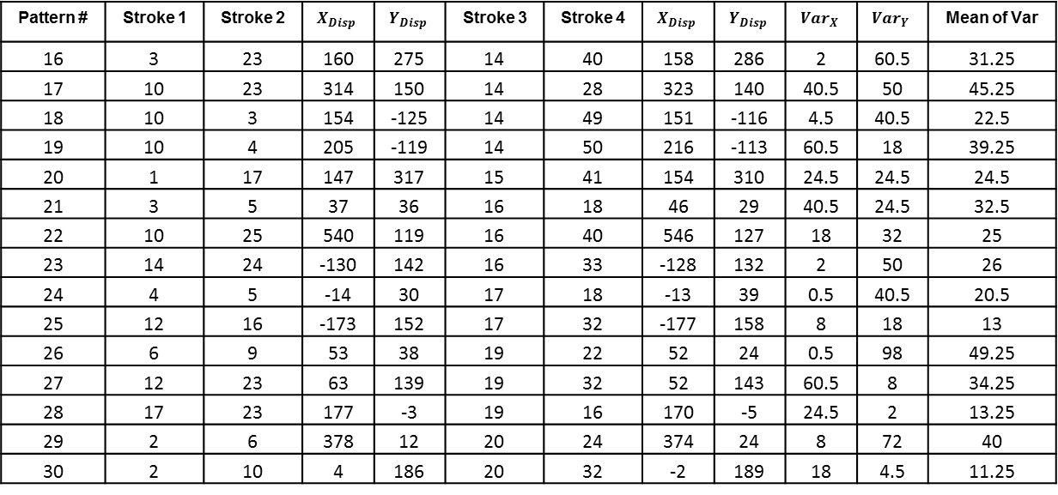
Patterns
Pattern # | Stroke 1 | Stroke 2 | $$X_{Disp}$$ | $$Y_{Disp}$$ | Stroke 3 | Stroke 4 | $$X_{Disp}$$ | $$Y_{Disp}$$ | $${Var}_{X}$$ | $${Var}_{Y}$$ | Mean of Var
16 | 3 | 23 | 160 | 275 | 14 | 40 | 158 | 286 | 2 | 60.5 | 31.25
17 | 10 | 23 | 314 | 150 | 14 | 28 | 323 | 140 | 40.5 | 50 | 45.25
18 | 10 | 3 | 154 | -125 | 14 | 49 | 151 | -116 | 4.5 | 40.5 | 22.5
19 | 10 | 4 | 205 | -119 | 14 | 50 | 216 | -113 | 60.5 | 18 | 39.25
20 | 1 | 17 | 147 | 317 | 15 | 41 | 154 | 310 | 24.5 | 24.5 | 24.5
21 | 3 | 5 | 37 | 36 | 16 | 18 | 46 | 29 | 40.5 | 24.5 | 32.5
22 | 10 | 25 | 540 | 119 | 16 | 40 | 546 | 127 | 18 | 32 | 25
23 | 14 | 24 | -130 | 142 | 16 | 33 | -128 | 132 | 2 | 50 | 26
24 | 4 | 5 | -14 | 30 | 17 | 18 | -13 | 39 | 0.5 | 40.5 | 20.5
25 | 12 | 16 | -173 | 152 | 17 | 32 | -177 | 158 | 8 | 18 | 13
26 | 6 | 9 | 53 | 38 | 19 | 22 | 52 | 24 | 0.5 | 98 | 49.25
27 | 12 | 23 | 63 | 139 | 19 | 32 | 52 | 143 | 60.5 | 8 | 34.25
28 | 17 | 23 | 177 | -3 | 19 | 16 | 170 | -5 | 24.5 | 2 | 13.25
29 | 2 | 6 | 378 | 12 | 20 | 24 | 374 | 24 | 8 | 72 | 40
30 | 2 | 10 | 4 | 186 | 20 | 32 | -2 | 189 | 18 | 4.5 | 11.25

Slide 10
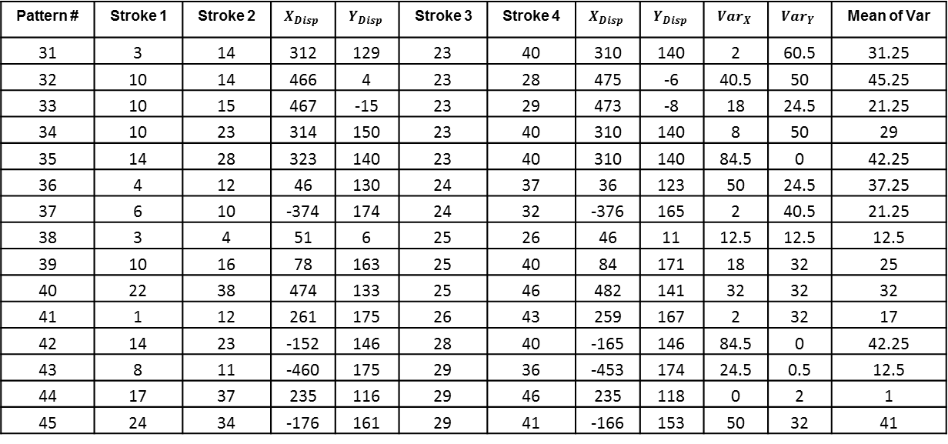
Patterns
Pattern # | Stroke 1 | Stroke 2 | $$X_{Disp}$$ | $$Y_{Disp}$$ | Stroke 3 | Stroke 4 | $$X_{Disp}$$ | $$Y_{Disp}$$ | $${Var}_{X}$$ | $${Var}_{Y}$$ | Mean of Var
31 | 3 | 14 | 312 | 129 | 23 | 40 | 310 | 140 | 2 | 60.5 | 31.25
32 | 10 | 14 | 466 | 4 | 23 | 28 | 475 | -6 | 40.5 | 50 | 45.25
33 | 10 | 15 | 467 | -15 | 23 | 29 | 473 | -8 | 18 | 24.5 | 21.25
34 | 10 | 23 | 314 | 150 | 23 | 40 | 310 | 140 | 8 | 50 | 29
35 | 14 | 28 | 323 | 140 | 23 | 40 | 310 | 140 | 84.5 | 0 | 42.25
36 | 4 | 12 | 46 | 130 | 24 | 37 | 36 | 123 | 50 | 24.5 | 37.25
37 | 6 | 10 | -374 | 174 | 24 | 32 | -376 | 165 | 2 | 40.5 | 21.25
38 | 3 | 4 | 51 | 6 | 25 | 26 | 46 | 11 | 12.5 | 12.5 | 12.5
39 | 10 | 16 | 78 | 163 | 25 | 40 | 84 | 171 | 18 | 32 | 25
40 | 22 | 38 | 474 | 133 | 25 | 46 | 482 | 141 | 32 | 32 | 32
41 | 1 | 12 | 261 | 175 | 26 | 43 | 259 | 167 | 2 | 32 | 17
42 | 14 | 23 | -152 | 146 | 28 | 40 | -165 | 146 | 84.5 | 0 | 42.25
43 | 8 | 11 | -460 | 175 | 29 | 36 | -453 | 174 | 24.5 | 0.5 | 12.5
44 | 17 | 37 | 235 | 116 | 29 | 46 | 235 | 118 | 0 | 2 | 1
45 | 24 | 34 | -176 | 161 | 29 | 41 | -166 | 153 | 50 | 32 | 41

Slide 11
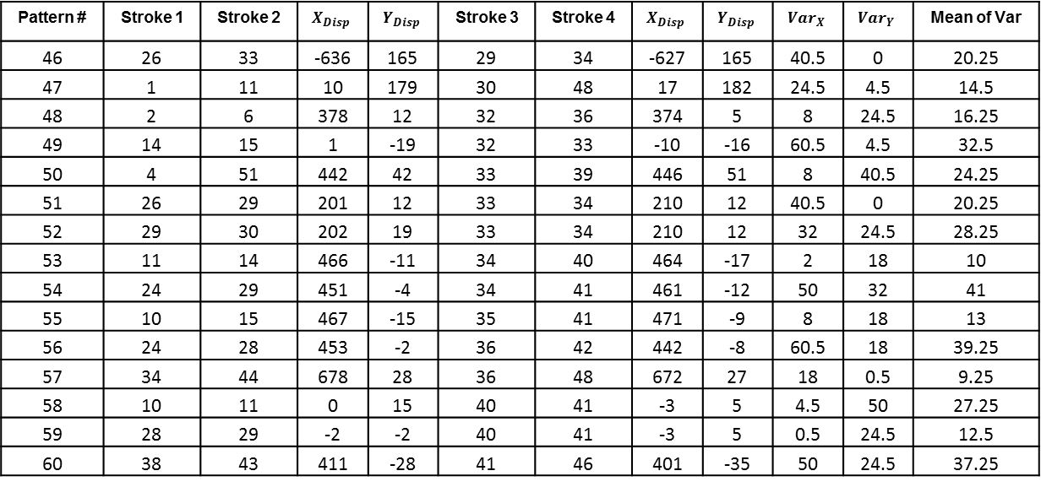
Patterns
Pattern # | Stroke 1 | Stroke 2 | $$X_{Disp}$$ | $$Y_{Disp}$$ | Stroke 3 | Stroke 4 | $$X_{Disp}$$ | $$Y_{Disp}$$ | $${Var}_{X}$$ | $${Var}_{Y}$$ | Mean of Var
46 | 26 | 33 | -636 | 165 | 29 | 34 | -627 | 165 | 40.5 | 0 | 20.25
47 | 1 | 11 | 10 | 179 | 30 | 48 | 17 | 182 | 24.5 | 4.5 | 14.5
48 | 2 | 6 | 378 | 12 | 32 | 36 | 374 | 5 | 8 | 24.5 | 16.25
49 | 14 | 15 | 1 | -19 | 32 | 33 | -10 | -16 | 60.5 | 4.5 | 32.5
50 | 4 | 51 | 442 | 42 | 33 | 39 | 446 | 51 | 8 | 40.5 | 24.25
51 | 26 | 29 | 201 | 12 | 33 | 34 | 210 | 12 | 40.5 | 0 | 20.25
52 | 29 | 30 | 202 | 19 | 33 | 34 | 210 | 12 | 32 | 24.5 | 28.25
53 | 11 | 14 | 466 | -11 | 34 | 40 | 464 | -17 | 2 | 18 | 10
54 | 24 | 29 | 451 | -4 | 34 | 41 | 461 | -12 | 50 | 32 | 41
55 | 10 | 15 | 467 | -15 | 35 | 41 | 471 | -9 | 8 | 18 | 13
56 | 24 | 28 | 453 | -2 | 36 | 42 | 442 | -8 | 60.5 | 18 | 39.25
57 | 34 | 44 | 678 | 28 | 36 | 48 | 672 | 27 | 18 | 0.5 | 9.25
58 | 10 | 11 | 0 | 15 | 40 | 41 | -3 | 5 | 4.5 | 50 | 27.25
59 | 28 | 29 | -2 | -2 | 40 | 41 | -3 | 5 | 0.5 | 24.5 | 12.5
60 | 38 | 43 | 411 | -28 | 41 | 46 | 401 | -35 | 50 | 24.5 | 37.25

Slide 12
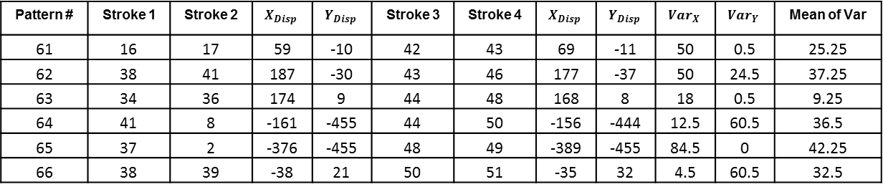
Patterns
Pattern # | Stroke 1 | Stroke 2 | $$X_{Disp}$$ | $$Y_{Disp}$$ | Stroke 3 | Stroke 4 | $$X_{Disp}$$ | $$Y_{Disp}$$ | $${Var}_{X}$$ | $${Var}_{Y}$$ | Mean of Var
61 | 16 | 17 | 59 | -10 | 42 | 43 | 69 | -11 | 50 | 0.5 | 25.25
62 | 38 | 41 | 187 | -30 | 43 | 46 | 177 | -37 | 50 | 24.5 | 37.25
63 | 34 | 36 | 174 | 9 | 44 | 48 | 168 | 8 | 18 | 0.5 | 9.25
64 | 41 | 8 | -161 | -455 | 44 | 50 | -156 | -444 | 12.5 | 60.5 | 36.5
65 | 37 | 2 | -376 | -455 | 48 | 49 | -389 | -455 | 84.5 | 0 | 42.25
66 | 38 | 39 | -38 | 21 | 50 | 51 | -35 | 32 | 4.5 | 60.5 | 32.5

Slide 13

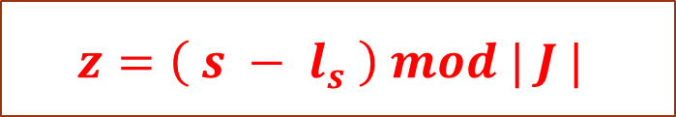
Map Strokes to Jigsaw
We assign strokes centers to a 2D jigsaw position by using the formula:
$$z=\left( s − l_{s} \right) mod | J |$$
$z=$ a 2D point in the jigsaw
s = a 2D point in the sketch canvas which is a center of a stroke
$l_{s}$ = maps a 2D point s in the sketch canvas to a 2D point z in the jigsaw ($l_{s}$ = $l_{x}$, $l_{y}$)
$J=$ 2D dimensions of the jigsaw (width, height)

Slide 14
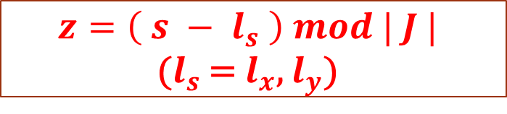

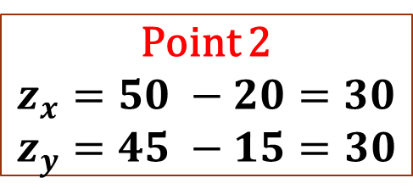
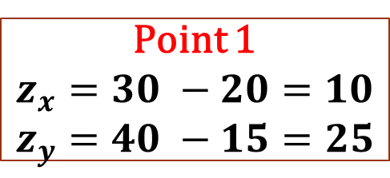
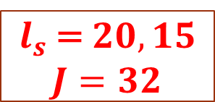
Map Strokes to Jigsaw
$$z=\left( s − l_{s} \right) mod | J |$$
($l_{s}$ = $l_{x}$, $l_{y}$)
Notice that if two connected strokes have the same offset label $l_{s}$ then they map to relatively same positions in the jigsaw. For instance:
Jigsaw Positions
Point 1
$$z_{x}=30 −20=10$$
$$z_{y}=40 −15=25$$
 | X Pos. | Y Pos.
Point 1 | 30 | 40
Point 2 | 50 | 45
$l_{s}$ = $20, 15$
$J=32$
Point 2
$$z_{x}=50 −20=30$$
$$z_{y}=45 −15=30$$

Slide 15
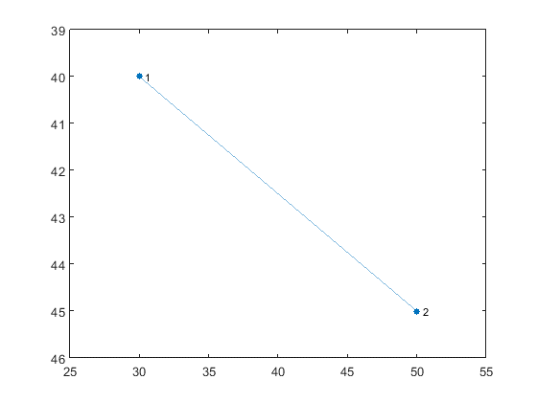
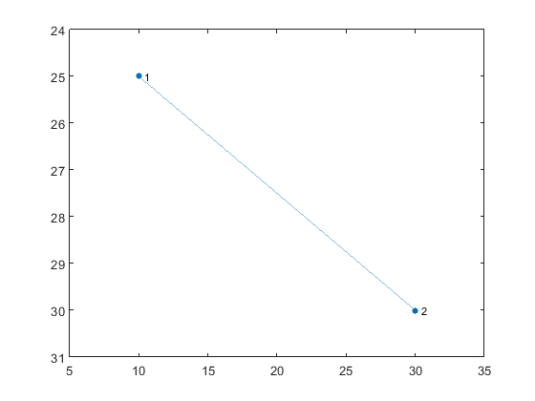



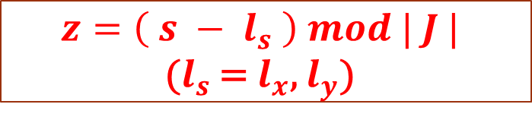

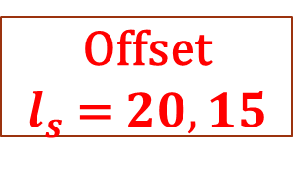

Map Strokes to Jigsaw
Offset
$l_{s}$ = $20, 15$
Stroke Positions on Canvas
Stroke Positions on Jigsaw
$$s_{1}(30,40)$$
$$z_{1} (10, 25)$$
$$s_{2} (50,45)$$
$$z_{2}=(30,30)$$
$$z=\left( s − l_{s} \right) mod | J |$$
($l_{s}$ = $l_{x}$, $l_{y}$)
$$J=32$$

Slide 16
Pixels vs. Strokes
The original jigsaw model assumes pixels as graph nodes and pixels are connected with neighbor pixels in a 4-connected grid.
In our model pixels maps to strokes and center of strokes are nodes of graph.
We cannot connect nodes (strokes) in a 4-connected grid as original jigsaw model because center of strokes are not located in a clear-cut graph as pixels.

Slide 17
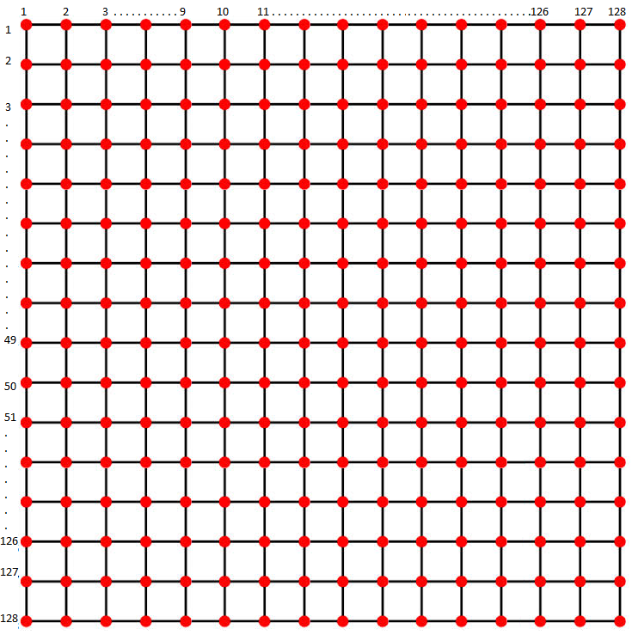
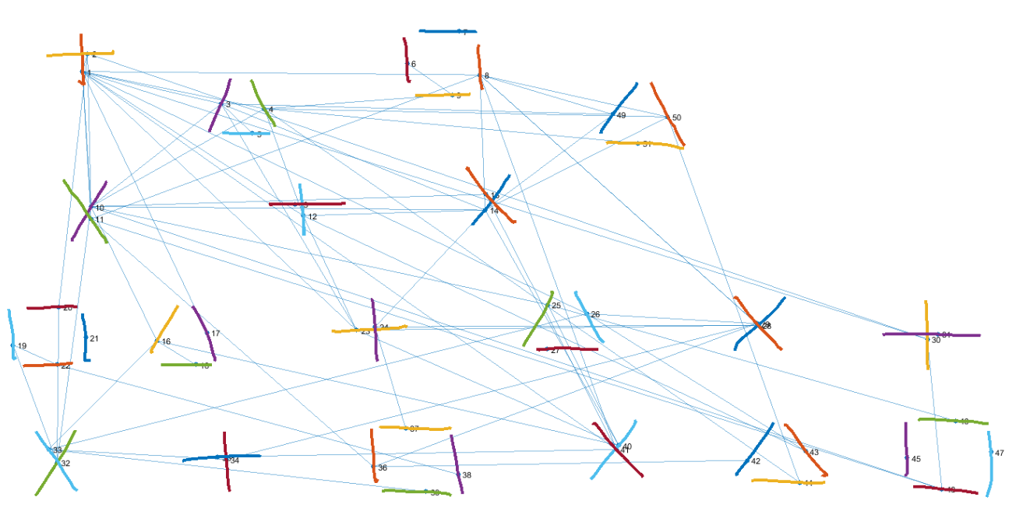
Pixels vs. Strokes
Image
Sketch

Slide 18
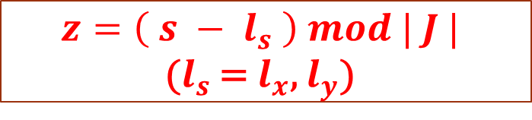
Pixels vs. Strokes
We keep relative positions of connected stroke patterns in the jigsaw by applying the formula:
However this formula needs clear cut graph to keep relative positions of stroke patterns.
To keep relative positions of patterns we should update centers of strokes such that the same patterns have equal displacement.
$$z=\left( s − l_{s} \right) mod | J |$$
($l_{s}$ = $l_{x}$, $l_{y}$)

Slide 19
Pixels vs. Strokes
Stroke Pairs | Centers |  | Displacement |  | Updated Centers |  | Updated Displacement
 | X Coord. | Y Coord. | X | Y | X Coord. | Y Coord. | X | Y
3 | 301 | 127 | 51 | 6 | 307 | 104 | 51 | 6
4 | 352 | 133 |  |  | 358 | 110
49 | 764 | 140 | 65 | 3 | 777 | 108 | 51 | 6
50 | 829 | 143 |  |  | 828 | 114

Slide 20
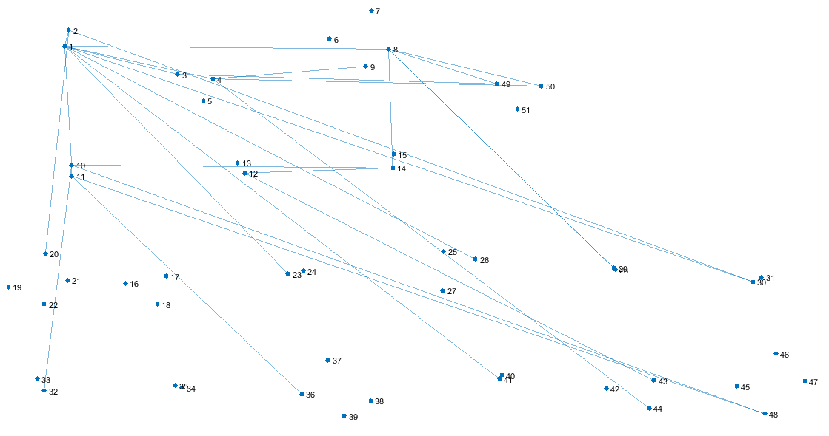
Update Centers
While updating the centers, the problem occurs when two strokes that are going to be connected are in the same connected component.

Slide 21
Update Centers
For instance, if we find pattern between 11-24 and and 12-26, we connect and update centers to fix the displacement.

Slide 22
Update Centers
However since 12 and 26 are in the same connected component, updating centers influence all nodes in the connected component and we cannot keep the displacement equal between 11-24 and 12-26 or between connected components.
Thus I disregard this kind of patterns in my model.

Slide 23
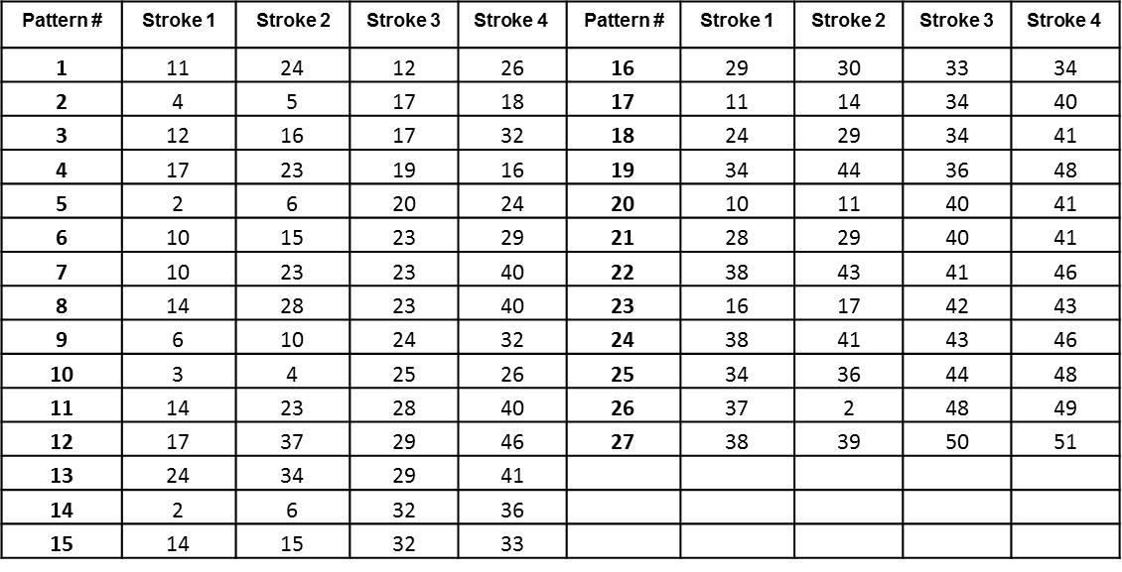
Update Centers
Due to this problem I disregard 27 patterns from total of 66 patterns. The disregarded patterns are:
Pattern # | Stroke 1 | Stroke 2 | Stroke 3 | $$\text{Stroke}\text{ 4}$$ | Pattern # | Stroke 1 | Stroke 2 | Stroke 3 | $$\text{Stroke}\text{ 4}$$
1 | 11 | 24 | 12 | 26 | 16 | 29 | 30 | 33 | 34
2 | 4 | 5 | 17 | 18 | 17 | 11 | 14 | 34 | 40
3 | 12 | 16 | 17 | 32 | 18 | 24 | 29 | 34 | 41
4 | 17 | 23 | 19 | 16 | 19 | 34 | 44 | 36 | 48
5 | 2 | 6 | 20 | 24 | 20 | 10 | 11 | 40 | 41
6 | 10 | 15 | 23 | 29 | 21 | 28 | 29 | 40 | 41
7 | 10 | 23 | 23 | 40 | 22 | 38 | 43 | 41 | 46
8 | 14 | 28 | 23 | 40 | 23 | 16 | 17 | 42 | 43
9 | 6 | 10 | 24 | 32 | 24 | 38 | 41 | 43 | 46
10 | 3 | 4 | 25 | 26 | 25 | 34 | 36 | 44 | 48
11 | 14 | 23 | 28 | 40 | 26 | 37 | 2 | 48 | 49
12 | 17 | 37 | 29 | 46 | 27 | 38 | 39 | 50 | 51
13 | 24 | 34 | 29 | 41
14 | 2 | 6 | 32 | 36
15 | 14 | 15 | 32 | 33

Slide 24
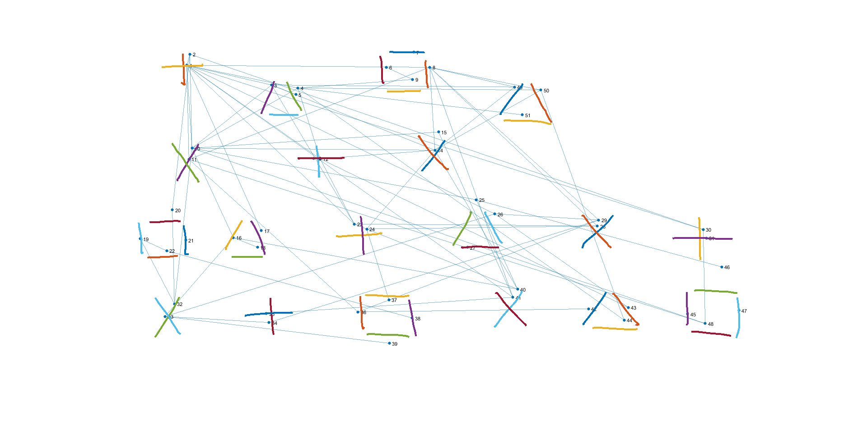
Final Graph

Slide 25
Learning
We firstly set jigsaw matrix to mean of IDM features of all strokes, find patterns and then run alpha-expansion graph cut algorithm and update offset map matrix (label).
Update jigsaw matrix according to new assigned label to each stroke.
Iterate running alpha-expansion algorithm, updating offset map and jigsaw matrix until convergance.

Slide 26
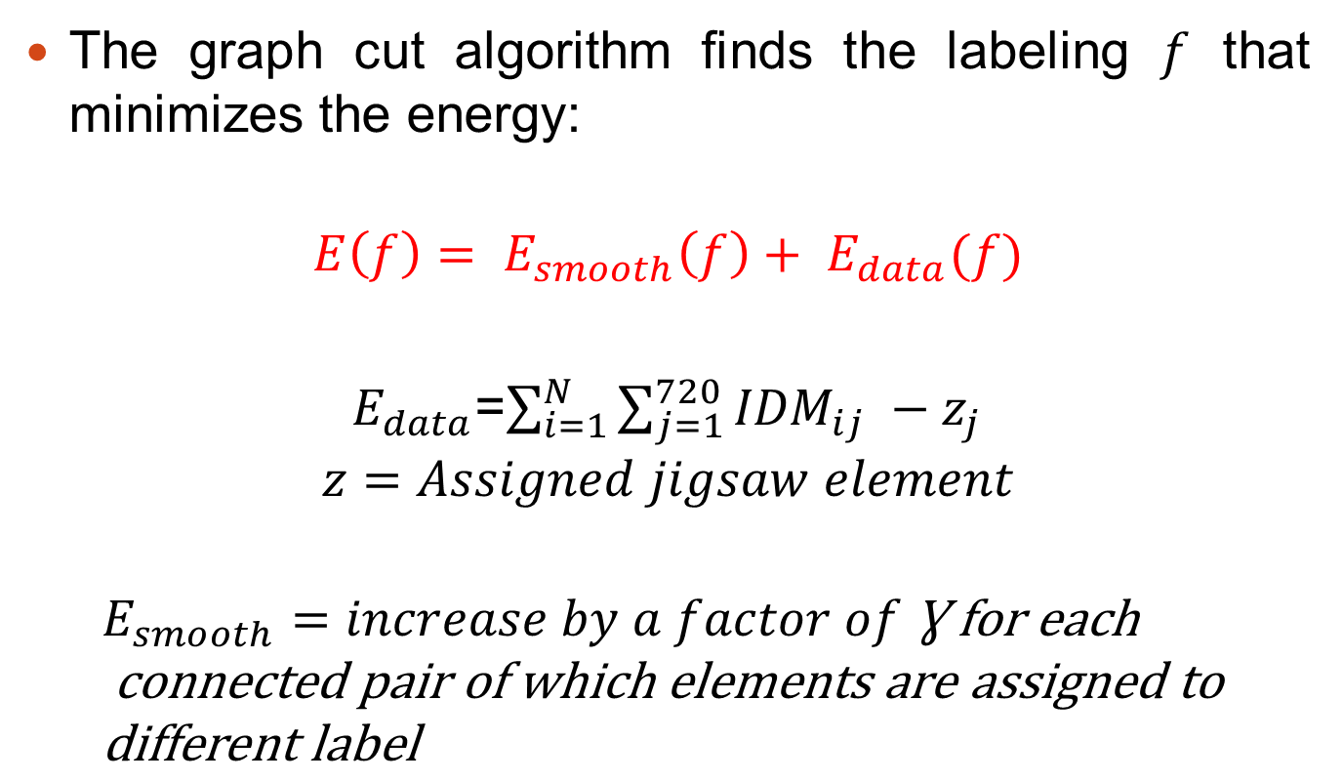
α-Expansion Graph-Cut Algorithm
The graph cut algorithm finds the labeling $f$ that minimizes the energy:
$$E\left(f\right)= E_{smooth}\left(f\right)+ E_{data}(f)$$
$E_{data}$=$\sum_{i=1}^{N}{\sum_{j=1}^{720}{{IDM}_{ij} −z_{j}}}$
$$z=Assigned jigsaw element$$
$$E_{smooth}=increase by a factor of \text{Ɣ} \text{for} \text{each} \\ \text{connected} \text{pair} \text{of} \text{which} \text{elements} \text{are} \text{assigned} \text{to} \text{different} \text{label}$$

Slide 27
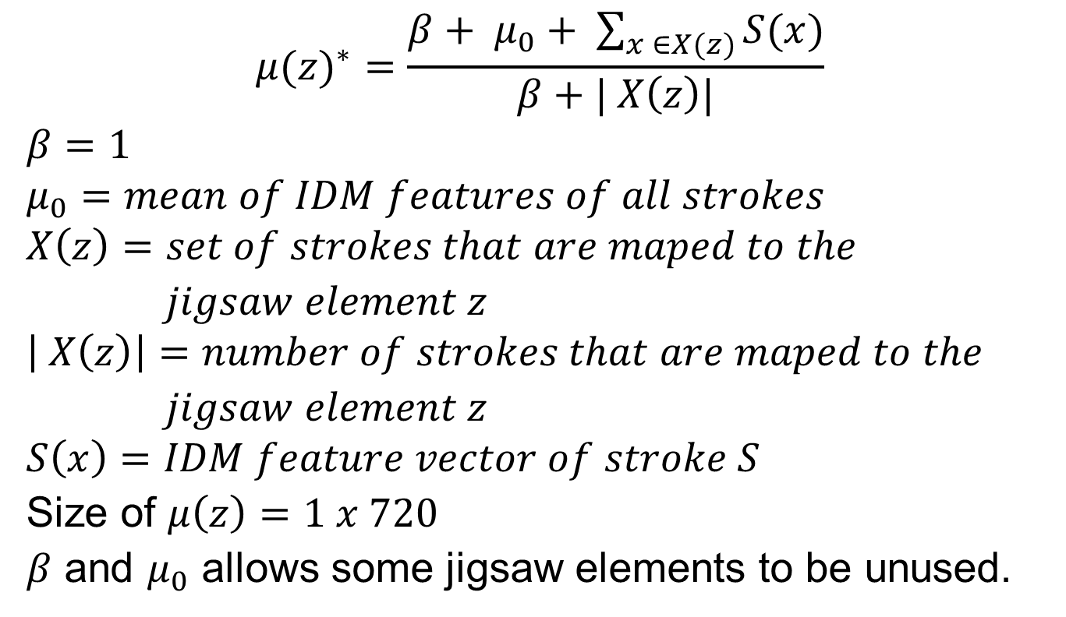
How to update Jigsaw Matrix
$${μ(z)}^{∗}=\frac{β+ μ_{0}+ \sum_{x ∈X(z)}{S(x)}}{β+| X\left(z\right)|}$$
$$β=1$$
$$μ_{0}=mean of IDM features of all strokes$$
$$X\left(z\right)=set of strokes that are maped to the$$
$jigsaw element z$
$$\left| X\left(z\right)\right|=number of strokes that are maped to the$$
$jigsaw element z$
$$S\left(x\right)=IDM feature vector of stroke S$$
Size of $μ\left(z\right)=1 x 720$
$β$ and $μ_{0}$ allows some jigsaw elements to be unused.

Slide 28
EM Algorithm Summary
Iteration Step 1
Given Jigsaw (J) and Sketch (S) update L
using α-expansion graph-cut algorithm
Repeat Until Convergence
Iteration Step 2
Update Jigsaw

Slide 29
Converged Jigsaw
A jigsaw J is a stroke feature representation matrix such that each matrix element z in J has an IDM feature μ(z).
Up on convergence, each element z in J is a vector of size 1 x 720 which is a mean of IDM features of assigned strokes to that jigsaw element.
Smoothness cost enforces Jigsaw matrix to keep compatibility of stroke patterns (relative positions) in sketch by assigning same offset label.

Slide 30

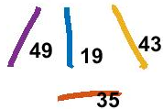

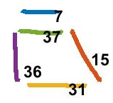
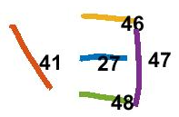

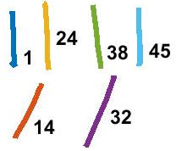
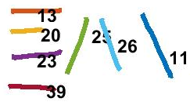

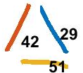



Jigsaw Elements Assigned to Strokes
4 x 4

Slide 31

How Keep Compatibility (Smoothness)
Pattern # | Stroke 1 | Label |  | Centers |  | Assigned Jigsaw |  | Stroke 2 | Label |  | Centers |  | Assigned Jigsaw |  | Stroke 3 | Label |  | Centers |  | Assigned Jigsaw |  | Stroke 4 | Label |  | Centers |  | Assigned Jigsaw
 |  | X | Y | X | Y | X | Y |  | X | Y | X | Y | X | Y |  | X | Y | X | Y |  |  |  | X | Y |  |  | X | Y
1 | 1 | 0 | -2 | 143 | 65 | 3 | 3 | 41 | 0 | -2 | 774 | 524 | 2 | 2 | 4 | 0 | -2 | 358 | 110 | 2 | 0 | 44 | 0 | -2 | 989 | 569 | 1 | 3
2 | 1 | 0 | -2 | 143 | 65 | 3 | 3 | 8 | 0 | -2 | 613 | 69 | 1 | 3 | 4 | 0 | -2 | 358 | 110 | 2 | 0 | 50 | 0 | -2 | 828 | 114 | 0 | 0
3 | 1 | 0 | -2 | 143 | 65 | 3 | 3 | 10 | 0 | -2 | 153 | 229 | 1 | 3 | 8 | 0 | -2 | 613 | 69 | 1 | 3 | 14 | 0 | -2 | 623 | 233 | 3 | 3
4 | 1 | 0 | -2 | 143 | 65 | 3 | 3 | 23 | 0 | -2 | 467 | 379 | 3 | 1 | 8 | 0 | -2 | 613 | 69 | 1 | 3 | 28 | 0 | -2 | 937 | 383 | 1 | 1
5 | 1 | 0 | -2 | 143 | 65 | 3 | 3 | 3 | 0 | -2 | 307 | 104 | 3 | 2 | 8 | 0 | -2 | 613 | 69 | 1 | 3 | 49 | 0 | -2 | 777 | 108 | 1 | 2
6 | 1 | 0 | -2 | 143 | 65 | 3 | 3 | 4 | 0 | -2 | 358 | 110 | 2 | 0 | 8 | 0 | -2 | 613 | 69 | 1 | 3 | 50 | 0 | -2 | 828 | 114 | 0 | 0
7 | 2 | 0 | -2 | 149 | 43 | 1 | 1 | 1 | 0 | -2 | 143 | 65 | 3 | 3 | 10 | 0 | -2 | 153 | 229 | 1 | 3 | 11 | 0 | -2 | 147 | 251 | 3 | 1
8 | 2 | 0 | -2 | 149 | 43 | 1 | 1 | 20 | 0 | -2 | 115 | 351 | 3 | 1 | 10 | 0 | -2 | 153 | 229 | 1 | 3 | 32 | 0 | -2 | 119 | 537 | 3 | 3
9 | 2 | 0 | -2 | 149 | 43 | 1 | 1 | 30 | 0 | -2 | 1142 | 390 | 2 | 0 | 10 | 0 | -2 | 153 | 229 | 1 | 3 | 48 | 0 | -2 | 1146 | 576 | 2 | 2
10 | 3 | 0 | -2 | 307 | 104 | 3 | 2 | 49 | 0 | -2 | 777 | 108 | 1 | 2 | 10 | 0 | -2 | 153 | 229 | 1 | 3 | 14 | 0 | -2 | 623 | 233 | 3 | 3
11 | 1 | 0 | -2 | 143 | 65 | 3 | 3 | 30 | 0 | -2 | 1142 | 390 | 2 | 0 | 11 | 0 | -2 | 147 | 251 | 3 | 1 | 48 | 0 | -2 | 1146 | 576 | 2 | 2
12 | 8 | 0 | -2 | 613 | 69 | 1 | 3 | 29 | 0 | -2 | 940 | 371 | 0 | 1 | 11 | 0 | -2 | 147 | 251 | 3 | 1 | 36 | 0 | -2 | 474 | 553 | 2 | 3
13 | 1 | 0 | -2 | 143 | 65 | 3 | 3 | 26 | 0 | -2 | 739 | 359 | 3 | 1 | 12 | 0 | -2 | 401 | 250 | 1 | 0 | 43 | 0 | -2 | 997 | 544 | 1 | 2
14 | 4 | 0 | -2 | 358 | 110 | 2 | 0 | 9 | 0 | -2 | 580 | 93 | 0 | 3 | 12 | 0 | -2 | 401 | 250 | 1 | 0 | 14 | 0 | -2 | 623 | 233 | 3 | 3
15 | 3 | 0 | -2 | 307 | 104 | 3 | 2 | 23 | 0 | -2 | 467 | 379 | 3 | 1 | 14 | 0 | -2 | 623 | 233 | 3 | 3 | 40 | 0 | -2 | 783 | 508 | 3 | 2
$$z=\left( s − l_{s} \right) mod | J |$$
Jisgaw Postion
Stroke Center
Assigned Label
Jigsaw Size

Slide 32
How Keep Compatibility (Smoothness)
Pattern # | Stroke 1 | Label |  | Centers |  | Assigned Jigsaw |  | Stroke 2 | Label |  | Centers |  | Assigned Jigsaw |  | Stroke 3 | Label |  | Centers |  | Assigned Jigsaw |  | Stroke 4 | Label |  | Centers |  | Assigned Jigsaw
 |  | X | Y | X | Y | X | Y |  | X | Y | X | Y | X | Y |  | X | Y | X | Y |  |  |  | X | Y |  |  | X | Y
16 | 10 | 0 | -2 | 153 | 229 | 1 | 3 | 23 | 0 | -2 | 467 | 379 | 3 | 1 | 14 | 0 | -2 | 623 | 233 | 3 | 3 | 28 | 0 | -2 | 937 | 383 | 1 | 1
17 | 10 | 0 | -2 | 153 | 229 | 1 | 3 | 3 | 0 | -2 | 307 | 104 | 3 | 2 | 14 | 0 | -2 | 623 | 233 | 3 | 3 | 49 | 0 | -2 | 777 | 108 | 1 | 2
18 | 10 | 0 | -2 | 153 | 229 | 1 | 3 | 4 | 0 | -2 | 358 | 110 | 2 | 0 | 14 | 0 | -2 | 623 | 233 | 3 | 3 | 50 | 0 | -2 | 828 | 114 | 0 | 0
19 | 1 | 0 | -2 | 143 | 65 | 3 | 3 | 17 | 0 | -2 | 287 | 392 | 3 | 2 | 15 | 0 | -2 | 630 | 197 | 2 | 3 | 41 | 0 | -2 | 774 | 524 | 2 | 2
20 | 3 | 0 | -2 | 307 | 104 | 3 | 2 | 5 | 0 | -2 | 354 | 123 | 2 | 1 | 16 | 0 | -2 | 233 | 406 | 1 | 0 | 18 | 0 | -2 | 280 | 425 | 0 | 3
21 | 10 | 0 | -2 | 153 | 229 | 1 | 3 | 25 | 0 | -2 | 703 | 331 | 3 | 1 | 16 | 0 | -2 | 233 | 406 | 1 | 0 | 40 | 0 | -2 | 783 | 508 | 3 | 2
22 | 14 | 0 | -2 | 623 | 233 | 3 | 3 | 24 | 0 | -2 | 491 | 389 | 3 | 3 | 16 | 0 | -2 | 233 | 406 | 1 | 0 | 33 | 0 | -2 | 101 | 562 | 1 | 0
23 | 6 | 0 | -2 | 529 | 69 | 1 | 3 | 9 | 0 | -2 | 580 | 93 | 0 | 3 | 19 | 0 | -2 | 53 | 408 | 1 | 2 | 22 | 0 | -2 | 104 | 432 | 0 | 2
24 | 12 | 0 | -2 | 401 | 250 | 1 | 0 | 23 | 0 | -2 | 467 | 379 | 3 | 1 | 19 | 0 | -2 | 53 | 408 | 1 | 2 | 32 | 0 | -2 | 119 | 537 | 3 | 3
25 | 2 | 0 | -2 | 149 | 43 | 1 | 1 | 10 | 0 | -2 | 153 | 229 | 1 | 3 | 20 | 0 | -2 | 115 | 351 | 3 | 1 | 32 | 0 | -2 | 119 | 537 | 3 | 3
26 | 3 | 0 | -2 | 307 | 104 | 3 | 2 | 14 | 0 | -2 | 623 | 233 | 3 | 3 | 23 | 0 | -2 | 467 | 379 | 3 | 1 | 40 | 0 | -2 | 783 | 508 | 3 | 2
27 | 10 | 0 | -2 | 153 | 229 | 1 | 3 | 14 | 0 | -2 | 623 | 233 | 3 | 3 | 23 | 0 | -2 | 467 | 379 | 3 | 1 | 28 | 0 | -2 | 937 | 383 | 1 | 1
28 | 4 | 0 | -2 | 358 | 110 | 2 | 0 | 12 | 0 | -2 | 401 | 250 | 1 | 0 | 24 | 0 | -2 | 491 | 389 | 3 | 3 | 37 | 0 | -2 | 534 | 529 | 2 | 3
29 | 10 | 0 | -2 | 153 | 229 | 1 | 3 | 16 | 0 | -2 | 233 | 406 | 1 | 0 | 25 | 0 | -2 | 703 | 331 | 3 | 1 | 40 | 0 | -2 | 783 | 508 | 3 | 2
30 | 22 | 0 | -2 | 104 | 432 | 0 | 2 | 38 | 0 | -2 | 579 | 565 | 3 | 3 | 25 | 0 | -2 | 703 | 331 | 3 | 1 | 46 | 0 | -2 | 1178 | 464 | 2 | 2
$$z=\left( s − l_{s} \right) mod | J |$$
Jisgaw Postion
Stroke Center
Assigned Label
Jigsaw Size

Slide 33

How Keep Compatibility (Smoothness)
Pattern # | Stroke 1 | Label |  | Centers |  | Assigned Jigsaw |  | Stroke 2 | Label |  | Centers |  | Assigned Jigsaw |  | Stroke 3 | Label |  | Centers |  | Assigned Jigsaw |  | Stroke 4 | Label |  | Centers |  | Assigned Jigsaw
 |  | X | Y | X | Y | X | Y |  | X | Y | X | Y | X | Y |  | X | Y | X | Y |  |  |  | X | Y |  |  | X | Y
31 | 1 | 0 | -2 | 143 | 65 | 3 | 3 | 12 | 0 | -2 | 401 | 250 | 1 | 0 | 26 | 0 | -2 | 739 | 359 | 3 | 1 | 43 | 0 | -2 | 997 | 544 | 1 | 2
32 | 8 | 0 | -2 | 613 | 69 | 1 | 3 | 11 | 0 | -2 | 147 | 251 | 3 | 1 | 29 | 0 | -2 | 940 | 371 | 0 | 1 | 36 | 0 | -2 | 474 | 553 | 2 | 3
33 | 26 | 0 | -2 | 739 | 359 | 3 | 1 | 33 | 0 | -2 | 101 | 562 | 1 | 0 | 29 | 0 | -2 | 940 | 371 | 0 | 1 | 34 | 0 | -2 | 302 | 574 | 2 | 0
34 | 1 | 0 | -2 | 143 | 65 | 3 | 3 | 11 | 0 | -2 | 147 | 251 | 3 | 1 | 30 | 0 | -2 | 1142 | 390 | 2 | 0 | 48 | 0 | -2 | 1146 | 576 | 2 | 2
35 | 4 | 0 | -2 | 358 | 110 | 2 | 0 | 51 | 0 | -2 | 792 | 163 | 0 | 1 | 33 | 0 | -2 | 101 | 562 | 1 | 0 | 39 | 0 | -2 | 535 | 615 | 3 | 1
36 | 26 | 0 | -2 | 739 | 359 | 3 | 1 | 29 | 0 | -2 | 940 | 371 | 0 | 1 | 33 | 0 | -2 | 101 | 562 | 1 | 0 | 34 | 0 | -2 | 302 | 574 | 2 | 0
37 | 10 | 0 | -2 | 153 | 229 | 1 | 3 | 15 | 0 | -2 | 630 | 197 | 2 | 3 | 35 | 0 | -2 | 297 | 556 | 1 | 2 | 41 | 0 | -2 | 774 | 524 | 2 | 2
38 | 24 | 0 | -2 | 491 | 389 | 3 | 3 | 28 | 0 | -2 | 937 | 383 | 1 | 1 | 36 | 0 | -2 | 474 | 553 | 2 | 3 | 42 | 0 | -2 | 920 | 547 | 0 | 1
39 | 41 | 0 | -2 | 774 | 524 | 2 | 2 | 8 | 0 | -2 | 613 | 69 | 1 | 3 | 44 | 0 | -2 | 989 | 569 | 1 | 3 | 50 | 0 | -2 | 828 | 114 | 0 | 0
$$z=\left( s − l_{s} \right) mod | J |$$
Jisgaw Postion
Stroke Center
Assigned Label
Jigsaw Size

Slide 34
Labels Assigned to Each Stroke
Stroke | Label |  | Stroke | Label |  | Stroke | Label |  | Stroke | Label
 | X | Y |  | X | Y |  | X | Y |  | X | Y
1 | 0 | -2 | 16 | 0 | -2 | 31 | -2 | 0 | 46 | 0 | -2
2 | 0 | -2 | 17 | 0 | -2 | 32 | 0 | -2 | 47 | -3 | 0
3 | 0 | -2 | 18 | 0 | -2 | 33 | 0 | -2 | 48 | 0 | -2
4 | 0 | -2 | 19 | 0 | -2 | 34 | 0 | -2 | 49 | 0 | -2
5 | 0 | -2 | 20 | 0 | -2 | 35 | 0 | -2 | 50 | 0 | -2
6 | 0 | -2 | 21 | -3 | -3 | 36 | 0 | -2 | 51 | 0 | -2
7 | 0 | 0 | 22 | 0 | -2 | 37 | 0 | -2
8 | 0 | -2 | 23 | 0 | -2 | 38 | 0 | -2
9 | 0 | -2 | 24 | 0 | -2 | 39 | 0 | -2
10 | 0 | -2 | 25 | 0 | -2 | 40 | 0 | -2
11 | 0 | -2 | 26 | 0 | -2 | 41 | 0 | -2
12 | 0 | -2 | 27 | 0 | -1 | 42 | 0 | -2
13 | -3 | 0 | 28 | 0 | -2 | 43 | 0 | -2
14 | 0 | -2 | 29 | 0 | -2 | 44 | 0 | -2
15 | 0 | -2 | 30 | 0 | -2 | 45 | -3 | -2
These nodes are not connected to another node.

Slide 35
Best Representative Strokes
4 x 4

Slide 36
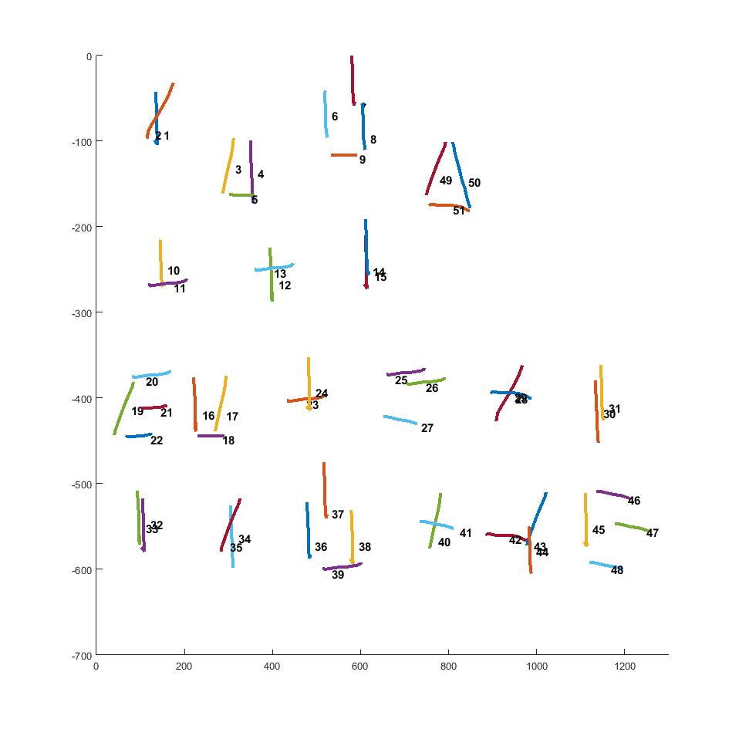
Reconstruction

Slide 37
Original Sketch

Slide 38
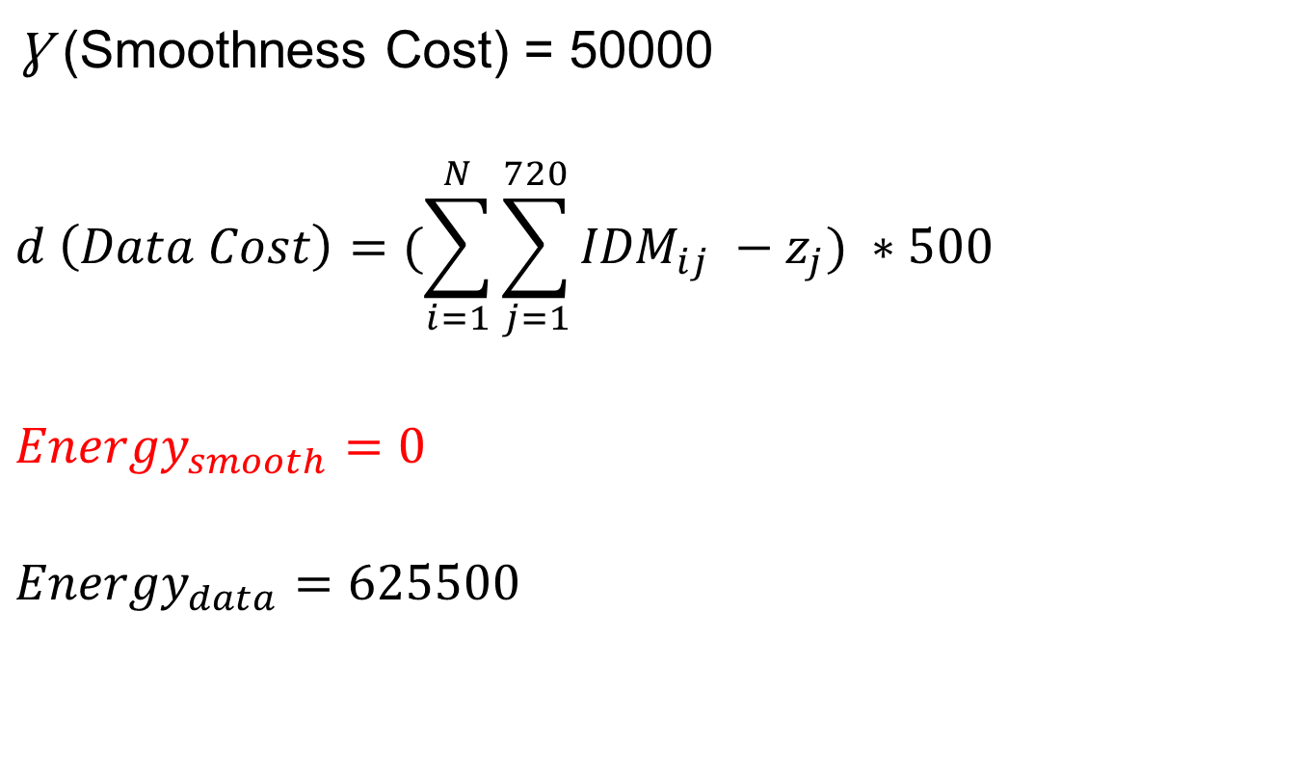
Energy Problem and Results
$\text{Ɣ}$ (Smoothness Cost) = 50000
$$d \left(Data Cost\right)=(\sum_{i=1}^{N}{\sum_{j=1}^{720}{{IDM}_{ij} −z_{j}) ∗500}}$$
$${Energy}_{smooth}=0$$
$${Energy}_{data}=625500$$

Slide 39
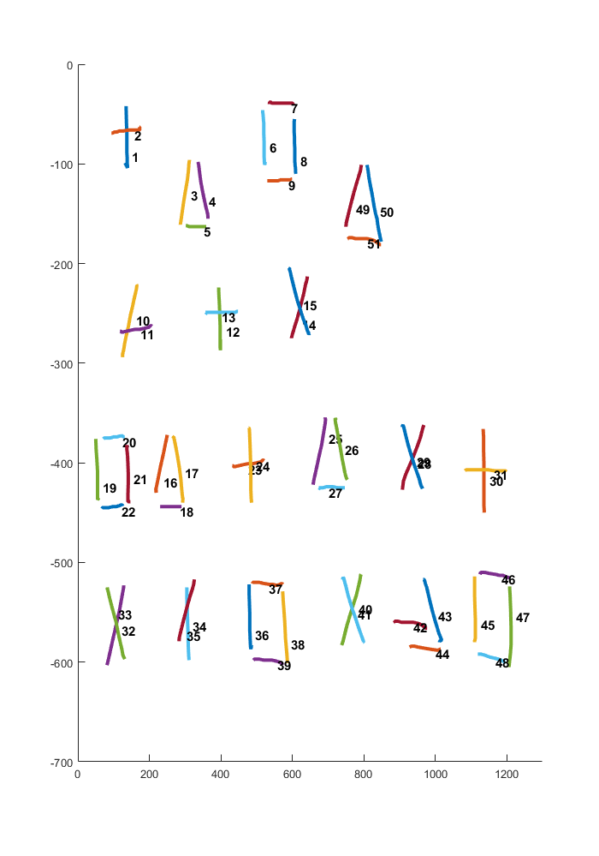
Increase Jigsaw Size to 32x32
Reconstructed Sketch

Slide 40
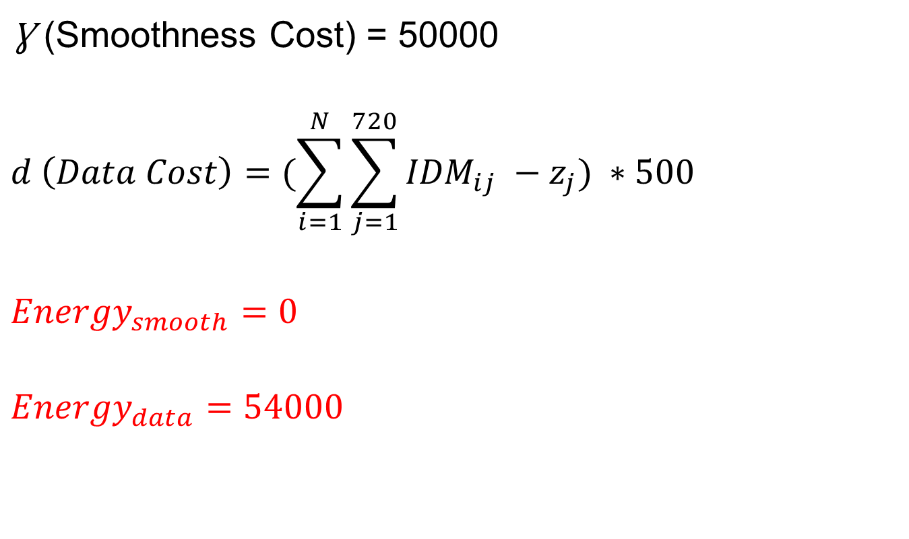
Energy Problem and Results
$\text{Ɣ}$ (Smoothness Cost) = 50000
$$d \left(Data Cost\right)=(\sum_{i=1}^{N}{\sum_{j=1}^{720}{{IDM}_{ij} −z_{j}) ∗500}}$$
$${Energy}_{smooth}=0$$
$${Energy}_{data}=54000$$

