Slide 1
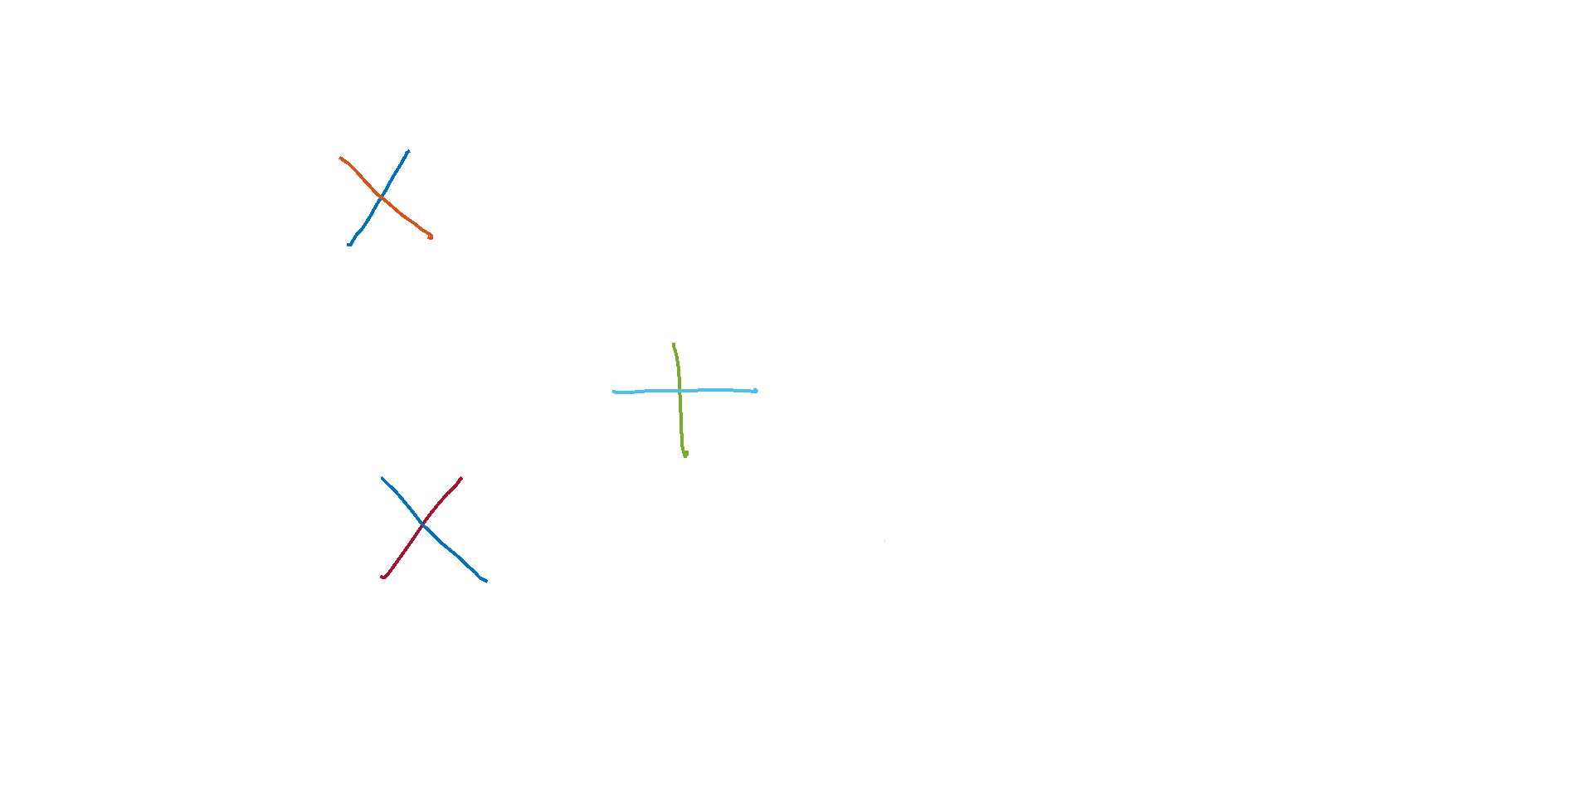
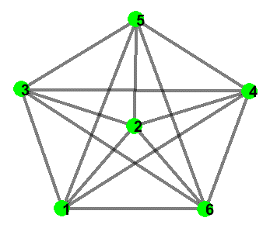
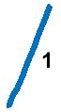
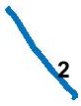
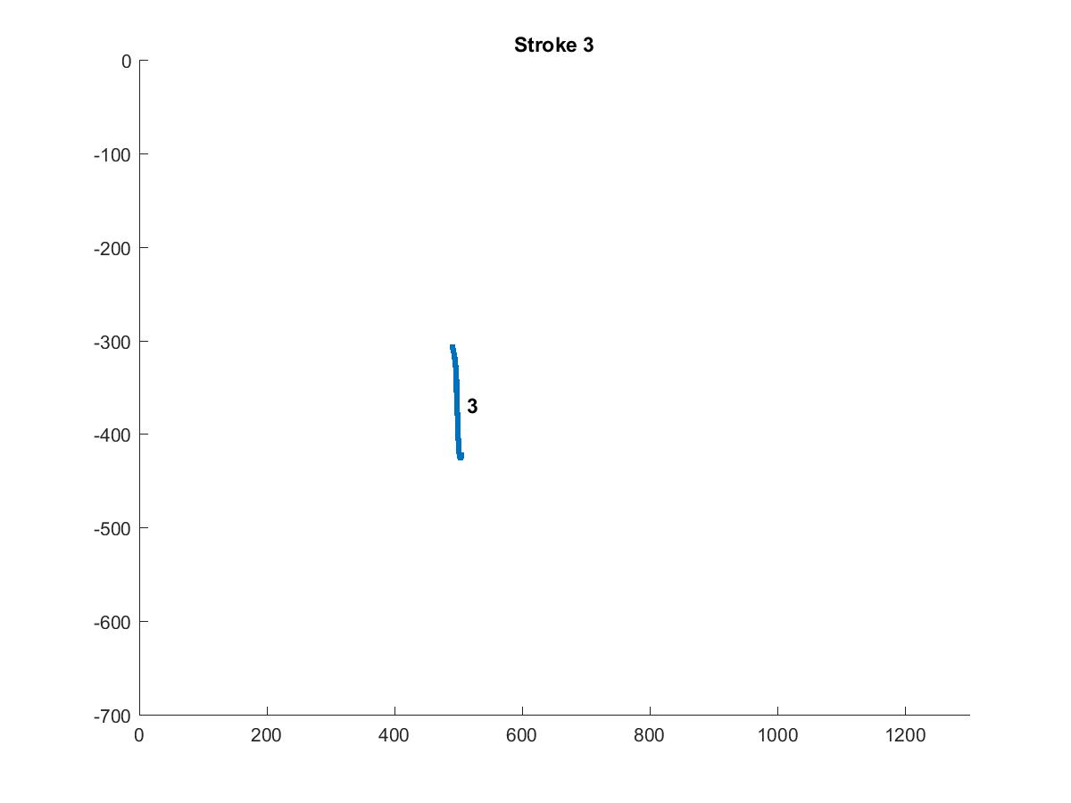
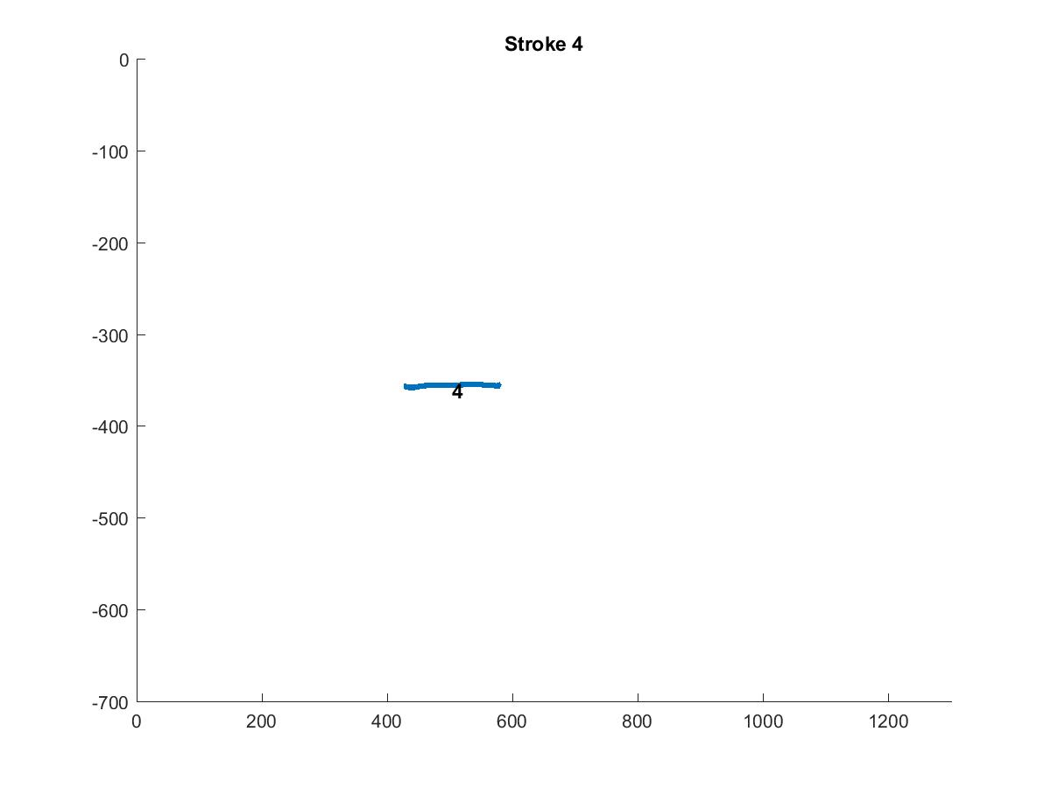
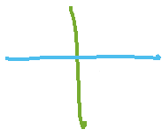
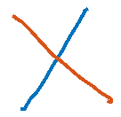
Sketch
Data Cost Matrix (D)
Run
Min Cut Max Flow
Graph Cut
Jigsaw Label | Strokes
 | 1 | 2 | 3 | 4 | 5 | 6 | 7 | 8
1
2
3
4
2
1
3
Converged
4
6
5
Canvas Size 800 x 1280
Jigsaw (J)
Compatibility Matrix (C)
J x N
N (# of Strokes) = 6
i
 | 1 | 2 | 3 | 4
1 | 0
2 |  | 0
3 |  |  | 0
4 |  |  |  | 0
j
Center of Strokes (S)
Offset Map
Regenerated Sketch
Stroke | X | Y
1 | 184 | 148
2 | 196 | 160
3 | 498 | 364
4 | 488 | 356
5 | 228 | 500
6 | 224 | 498
1 x 4 x 720
Stroke | X Pos. | Y Pos. | X Offset | Y Offset | Jigsaw Element
1 | 500 | 40 | 0 | 0 | 1
2 | 500 | 40 | -4 | -5 | 2
3 | 80 | 50 | 0 | 0 | 3
4 | 80 | 50 | 10 | 18 | 4
5 | 530 | 450 | 0 | 0 | 1
6 | 530 | 450 | -4 | -5 | 2
2
1
3
4
IDM Feat.
J(Jigsaw size) = 4
6
5
4 x 4 x 4
i = i th jigsaw element
j = j th jigsaw element
i,j,1 = mean of x displacement between strokes
that are assigned to jigsaw i and j.
i,j,2 = mean of y displacement between strokes
that are assigned to jigsaw i and j.
i,j,3 = variance of x displacement between strokes
that are assigned to jigsaw i and j.
i,j,4 = variance of y displacement between strokes
that are assigned to jigsaw i and j.
N x 3
N x 6

Slide 2
Compatibility Matrix (C)
Offset Map
i,j,1 = mean of x displacement between strokes
that are assigned to jigsaw i and j.
i,j,2 = mean of y displacement between strokes
that are assigned to jigsaw i and j.
Stroke | X Pos. | Y Pos. | X Offset | Y Offset | Jigsaw Element
1 | 500 | 40 | 0 | 0 | 1
2 | 500 | 40 | -4 | -5 | 2
3 | 80 | 50 | 0 | 0 | 3
4 | 80 | 50 | 10 | 18 | 4
5 | 530 | 450 | 0 | 0 | 1
6 | 530 | 450 | -4 | -5 | 2
i, j, 1
i, j, 2
 | 1 | 2 | 3 | 4
1 | 0 | 4 | 292 | 282
2 |  | 0 | 288 | 278
3 |  |  | 0 | -10
4 |  |  |  | 0
 | 1 | 2 | 3 | 4
1 | 0 | 5 | 40 | 32
2 |  | 0 | 35 | 27
3 |  |  | 0 | -8
4 |  |  |  | 0
Regenerated Sketch
i,j,3 = variance of x displacement between strokes
that are assigned to jigsaw i and j.
i,j,4 = variance of y displacement between strokes
that are assigned to jigsaw i and j.
i, j, 3
i, j, 4
 | 1 | 2 | 3 | 4
1 | 0 | 64 | 484 | 484
2 |  | 0 | 196 | 196
3 |  |  | 0 | 0
4 |  |  |  | 0
 | 1 | 2 | 3 | 4
1 | 0 | 49 | 30976 | 30976
2 |  | 0 | 28561 | 28561
3 |  |  | 0 | 0
4 |  |  |  | 0
Regenerated Sketch

Slide 3
Data Cost & Smoothness Cost
Data Cost Matrix (D)
Hausdorff Distance
Compatibility Cost
Jigsaw Label | Strokes
 | 1 | 2 | 3 | 4 | 5 | 6
1 | 1.8491 | 8.9143 | 8.9960 | 6.9944 | 1.8491 | 8.8065
2 | 8.8296 | 1.2253 | 5.9070 | 9.1517 | 9.1046 | 1.2253
3 | 8.9970 | 6.2264 | 0 | 9.7310 | 9.3674 | 4.8326
4 | 7.2788 | 9.2676 | 9.7310 | 0 | 7.1903 | 9.1990
Smooth Cost Matrix
Weights Matrix
 | 1 | 2 | 3 | 4 | 5 | 6
1 |  | 1 | 100 | 100 | 100 | 100
2 |  |  | 100 | 100 | 100 | 100
3 |  |  |  | 1 | 100 | 100
4 |  |  |  |  | 100 | 100
5 |  |  |  |  |  | 1
6
 | 1 | 2 | 3 | 4
1 | 1000 | 10 | 1000 | 1000
2 | 10 | 1000 | 1000 | 1000
3 | 1000 | 1000 | 1000 | 10
4 | 1000 | 1000 | 10 | 1000
4 x 4
Jigsaw Size x Jigsaw Size
(Label Size x Label Size)
6 x 6
Jigsaw Size x Jigsaw Size
SmoothCost(k,l) = the unweighted cost of assigning labels k and l to any neighboring sites.
Weights(i,j) > 0 indicates that sites i and j are neighbors
CompatibilityCost(i,j) = For particular neighboring sites i,j the final, weighted compatibility cost is:
Weights(i,j)*SmoothCost(k,l)

Slide 4
Compatibility Matrix (C)
i,j,1 = mean of x displacement between strokes
that are assigned to jigsaw i and j.
i,j,2 = mean of y displacement between strokes
that are assigned to jigsaw i and j.
Offset Map
i, j, 1
i, j, 2
Stroke | X Pos. | Y Pos. | X Offset | Y Offset | Jigsaw Element
1 | 500 | 40 | 0 | 0 | 1
2 | 510 | 30 | 6 | -15 | 2
3 | 80 | 50 | 0 | 0 | 3
4 | 86 | 54 | 16 | 12 | 4
5 | 530 | 450 | 0 | 0 | 1
6 | 540 | 460 | 6 | 5 | 2
 | 1 | 2 | 3 | 4
1 | 0 | 4 | 292 | 282
2 |  | 0 | 288 | 278
3 |  |  | 0 | -10
4 |  |  |  | 0
 | 1 | 2 | 3 | 4
1 | 0 | 5 | 40 | 64
2 |  | 0 | 35 | 27
3 |  |  | 0 | -8
4 |  |  |  | 0
Regenerated Sketch
i,j,3 = variance of x displacement between strokes
that are assigned to jigsaw i and j.
i,j,4 = variance of y displacement between strokes
that are assigned to jigsaw i and j.
i, j, 3
i, j, 4
 | 1 | 2 | 3 | 4
1 | 0 | 64 | 484 | 484
2 |  | 0 | 196 | 196
3 |  |  | 0 | 0
4 |  |  |  | 0
 | 1 | 2 | 3 | 4
1 | 0 | 49 | 30976 | 30976
2 |  | 0 | 28561 | 28561
3 |  |  | 0 | 0
4 |  |  |  | 0

Slide 5
Compatibility Matrix (C)
i,j,1 = mean of x displacement between strokes
that are assigned to jigsaw i and j.
i,j,2 = mean of y displacement between strokes
that are assigned to jigsaw i and j.
Offset Map
i, j, 1
i, j, 2
Stroke | X Pos. | Y Pos. | X Offset | Y Offset | Jigsaw Element
1 | 500 | 40 | 0 | 0 | 1
2 | 504 | 45 | 0 | 0 | 2
3 | 80 | 50 | 0 | 0 | 3
4 | 70 | 42 | 0 | 0 | 4
5 | 530 | 450 | 0 | 0 | 1
6 | 534 | 455s | 0 | 0 | 2
 | 1 | 2 | 3 | 4
1 | 0 | 4 | 292 | 282
2 |  | 0 | 288 | 278
3 |  |  | 0 | -10
4 |  |  |  | 0
 | 1 | 2 | 3 | 4
1 | 0 | 5 | 40 | 64
2 |  | 0 | 35 | 27
3 |  |  | 0 | -8
4 |  |  |  | 0
Regenerated Sketch
i,j,3 = variance of x displacement between strokes
that are assigned to jigsaw i and j.
i,j,4 = variance of y displacement between strokes
that are assigned to jigsaw i and j.
i, j, 3
i, j, 4
 | 1 | 2 | 3 | 4
1 | 0 | 64 | 484 | 484
2 |  | 0 | 196 | 196
3 |  |  | 0 | 0
4 |  |  |  | 0
 | 1 | 2 | 3 | 4
1 | 0 | 49 | 30976 | 30976
2 |  | 0 | 28561 | 28561
3 |  |  | 0 | 0
4 |  |  |  | 0

