Slide 1
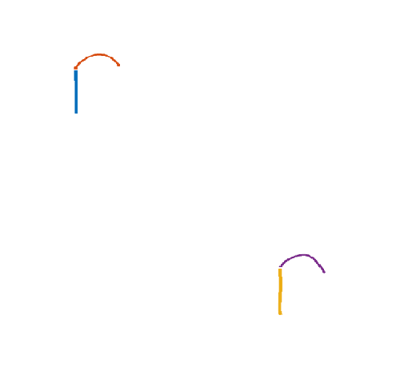
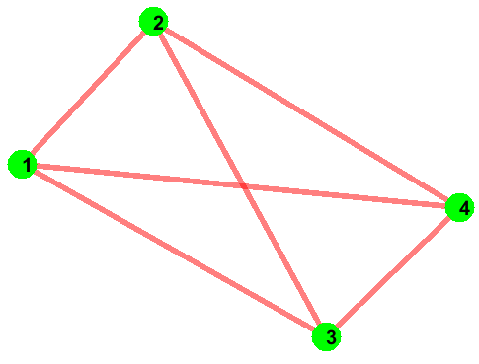


Data Cost Matrix (D)
Run
Min Cut Max Flow
Graph Cut
Sketch
Jigsaw Label | Strokes
 | 1 | 2 | 3 | 4
1
2
2
1
Converged
4
3
Jigsaw (J)
J x N
Canvas Size 800 x 1280
Compatibility Matrix (C)
N (# of Strokes) = 4
1 x 2 x 720
i
 | 1 | 2
1 | 0
2 |  | 0
j
Center of Strokes (S)
IDM Feat.
Offset Map
Regenerated Sketch
Stroke | X | Y
1 | 20 | 110
2 | 100 | 20
3 | 460 | 410
4 | 580 | 340
J(Jigsaw size) = 2
Stroke | X Pos. | Y Pos. | X Offset | Y Offset | Jigsaw Element
1 | 500 | 150 | 0 | 0 | 1
2 | 600 | 70 | 0 | 0 | 2
3 | 80 | 300 | 0 | 0 | 1
4 | 180 | 220 | 0 | 0 | 2
2 x 2 x 4
i = i th jigsaw element
j = j th jigsaw element
i,j,1 = mean of x displacement between strokes
that are assigned to jigsaw i and j.
i,j,2 = mean of y displacement between strokes
that are assigned to jigsaw i and j.
i,j,3 = variance of x displacement between strokes
that are assigned to jigsaw i and j.
i,j,4 = variance of y displacement between strokes
that are assigned to jigsaw i and j.
N x 3
N x 6

Slide 2
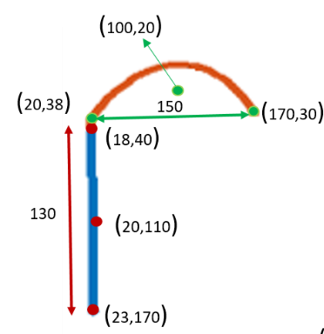

Original Sketch

Slide 3
Regenerated Sketch
Compatibility Matrix (C)
X Mean
Y Mean
(600,70)
 | 1 | 2
1 | 0 | 100
2 |  | 0
 | 1 | 2
1 | 0 | -80
2 |  | 0
(520,88)
(670,80)
150
(498,80)
130
(500,150)
(180,220)
(503,210)
X Variance
Y Variance
(100,238)
(250,230)
 | 1 | 2
1 | 0 | 400
2 |  | 0
 | 1 | 2
1 | 0 | 100
2 |  | 0
150
(78,230)
130
(80,300)
(83,360)
Offset Map
Stroke | X Pos. | Y Pos. | X Offset | Y Offset | Jigsaw Element
1 | 500 | 150 | 0 | 0 | 1
2 | 600 | 70 | 0 | 0 | 2
3 | 80 | 300 | 0 | 0 | 1
4 | 180 | 220 | 0 | 0 | 2

Slide 4

Latent Sketch
Compatibility Matrix (C)
X Mean
Y Mean
(610,75)
 | 1 | 2
1 | 0 | 100
2 |  | 0
 | 1 | 2
1 | 0 | -80
2 |  | 0
(205,205)
(510,155)
X Variance
Y Variance
 | 1 | 2
1 | 0 | 400
2 |  | 0
 | 1 | 2
1 | 0 | 100
2 |  | 0
(105,285)
Offset Map
Stroke | X Pos. | Y Pos. | X Offset | Y Offset | Jigsaw Element
1 | 500 | 150 | 10 | 5 | 1
2 | 620 | 80 | -10 | -5 | 2
3 | 90 | 290 | 15 | -5 | 1
4 | 220 | 200 | -15 | 5 | 2

Slide 5
Real Sketch
Compatibility Matrix (C)
X Mean
Y Mean
(620,80)
 | 1 | 2
1 | 0 | 100
2 |  | 0
 | 1 | 2
1 | 0 | -80
2 |  | 0
(220,200)
(500,150)
X Variance
Y Variance
 | 1 | 2
1 | 0 | 400
2 |  | 0
 | 1 | 2
1 | 0 | 100
2 |  | 0
(90,290)
Offset Map
Stroke | X Pos. | Y Pos. | X Offset | Y Offset | Jigsaw Element
1 | 500 | 150 | 0 | 0 | 1
2 | 620 | 80 | 0 | 0 | 2
3 | 90 | 290 | 0 | 0 | 1
4 | 220 | 200 | 0 | 0 | 2

