Slide 1
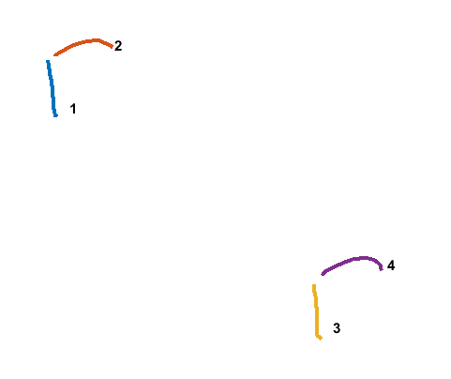
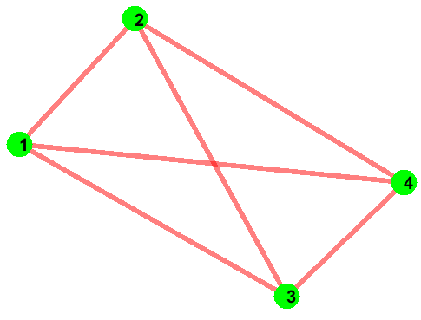
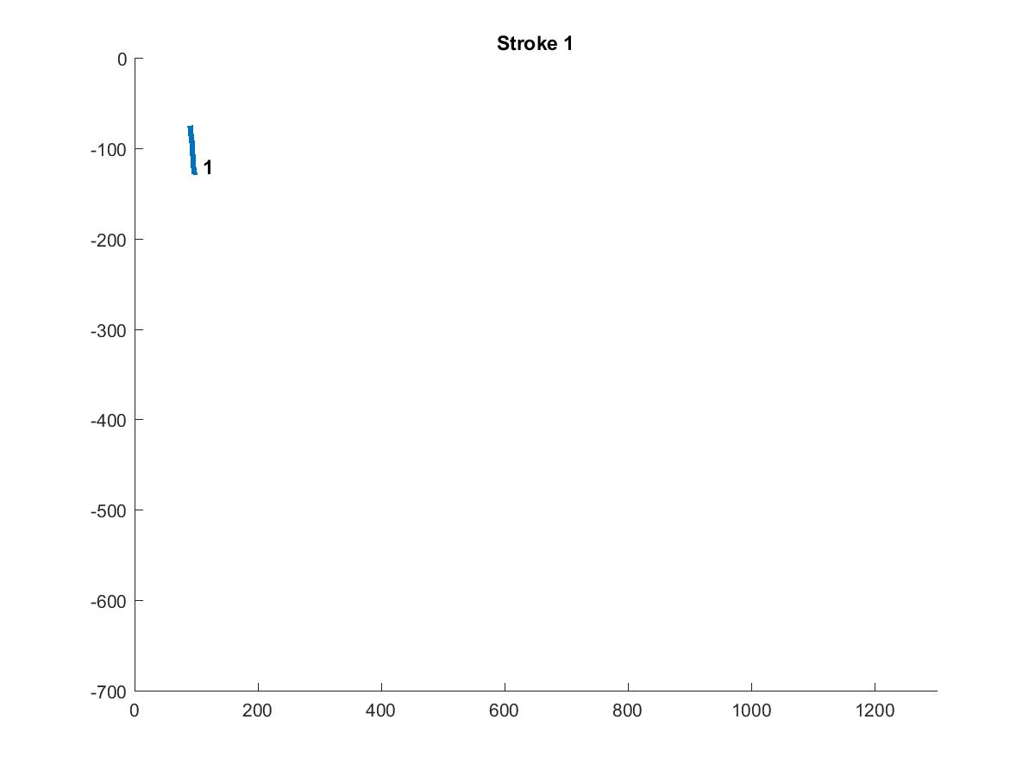
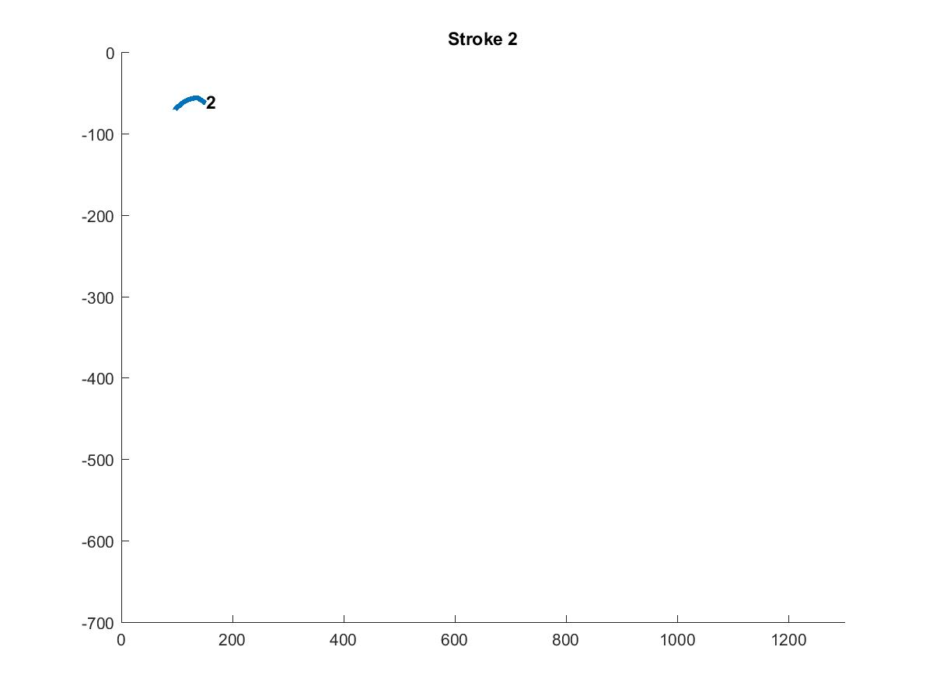
Data Cost Matrix (D)
Run
Min Cut Max Flow
Graph Cut
Sketch
Jigsaw Label | Strokes
 | 1 | 2 | 3 | 4
1
2
Converged
Jigsaw (J)
J x N
Canvas Size 800 x 1280
Compatibility Matrix (C)
N (# of Strokes) = 4
1 x 2 x 720
i
 | 1 | 2
1 | 0
2 |  | 0
j
Center of Strokes (S)
IDM Feat.
Offset Map
Regenerated Sketch
Stroke | X | Y
1 | 90 | 110
2 | 130 | 60
3 | 340 | 320
4 | 380 | 270
J(Jigsaw size) = 2
Stroke | X Pos. | Y Pos. | X Offset | Y Offset | Jigsaw Element
1 | 500 | 150 | 0 | 0 | 1
2 | 550 | 90 | 0 | 0 | 2
3 | 80 | 300 | 0 | 0 | 1
4 | 110 | 260 | 0 | 0 | 2
2 x 2 x 4
i = i th jigsaw element
j = j th jigsaw element
i,j,1 = mean of x displacement between strokes
that are assigned to jigsaw i and j.
i,j,2 = mean of y displacement between strokes
that are assigned to jigsaw i and j.
i,j,3 = variance of x displacement between strokes
that are assigned to jigsaw i and j.
i,j,4 = variance of y displacement between strokes
that are assigned to jigsaw i and j.
N x 3
N x 6

Slide 2
Original Sketch
(130,60)
(97,71)
(149,61)
(86,75)
52
51
(90,110)
Center of Strokes (S)
(94,126)
Stroke | X | Y
1 | 90 | 110
2 | 130 | 60
3 | 340 | 320
4 | 380 | 270
(380,270)
(346,280)
(401,275)
(338,288)
55
52
(340,320)
(345,340)

Slide 3
Regenerated Sketch
Compatibility Matrix (C)
X Mean
Y Mean
 | 1 | 2
1 | 0 | 40
2 |  | 0
 | 1 | 2
1 | 0 | -50
2 |  | 0
(550,90)
(500,150)
X Variance
Y Variance
 | 1 | 2
1 | 0 | 0
2 |  | 0
 | 1 | 2
1 | 0 | 0
2 |  | 0
(110,260)
(80,300)
Offset Map
Stroke | X Pos. | Y Pos. | X Offset | Y Offset | Jigsaw Element
1 | 500 | 150 | 0 | 0 | 1
2 | 550 | 90 | 0 | 0 | 2
3 | 80 | 300 | 0 | 0 | 1
4 | 110 | 260 | 0 | 0 | 2

Slide 4
Regenerated Sketch
Compatibility Matrix (C)
X Mean
Y Mean
 | 1 | 2
1 | 0 | 40
2 |  | 0
 | 1 | 2
1 | 0 | -50
2 |  | 0
(545,95)
(505,145)
X Variance
Y Variance
 | 1 | 2
1 | 0 | 0
2 |  | 0
 | 1 | 2
1 | 0 | 0
2 |  | 0
(115,255)
(75,305)
Offset Map
Stroke | X Pos. | Y Pos. | X Offset | Y Offset | Jigsaw Element
1 | 500 | 150 | 5 | -5 | 1
2 | 550 | 90 | -5 | 5 | 2
3 | 80 | 300 | -5 | 5 | 1
4 | 110 | 260 | 5 | -5 | 2

Slide 5
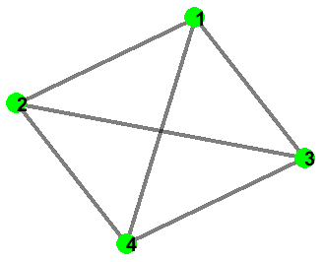
Data Cost & Smoothness Cost
Compatibility Cost
Data Cost Matrix (D)
Hausdorff Distance
Weights Matrix
Smooth Cost Matrix
 | 1 | 2 | 3 | 4
1 |  | 1 | 100 | 100
2 |  |  | 100 | 100
3 |  |  |  | 1
4
Jigsaw Label | Strokes
 | 1 | 2 | 3 | 4
1 | 2.3852 | 9.1573 | 2.3852 | 9.1040
2 | 8.9901 | 2.2331 | 9.3446 | 2.2331
 | 1 | 2
1 | 1000 | 10
2 | 10 | 1000
2 x 2
Jigsaw Size x Jigsaw Size
(Label Size x Label Size)
4 x 4
Jigsaw Size x Jigsaw Size
SmoothCost(k,l) = the unweighted cost of assigning labels k and l to any neighboring sites.
Weights(i,j) > 0 indicates that sites i and j are neighbors
CompatibilityCost(i,j) = For particular neighboring sites i,j the final, weighted compatibility cost is:
Weights(i,j)*SmoothCost(k,l)

