Slide 1
Jigsaw Model for Sketch Recognition
Emre Karaman

Slide 2
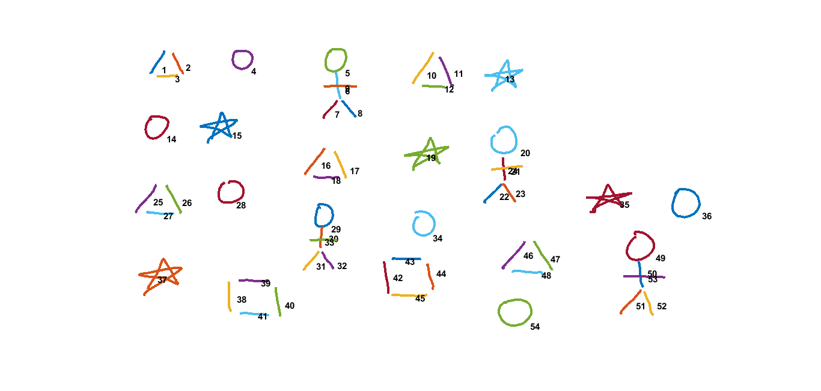
Training Image

Slide 3

Jigsaw Sketch Model
1. Extract IDM feature of each stroke.
2. Calculate displacement between each stroke pair.
(x1, y1)
(97, 83)
(x2, y2)
(146, 78)
Displacement b/w 1 & 2
(x2-x1, y2-y1)
(49, -5)

Slide 4
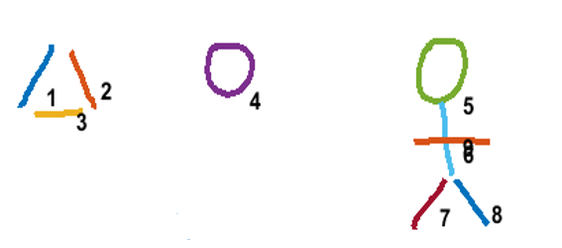
Jigsaw Sketch Model
4. Find variance of displacement between each stroke pairs.
(x2, y2)
(146, 78)
(x1, y1)
(97, 83)
Stroke Pair | Displacement | Variance of Disp. Between stroke pair (1,2) | Mean of Disp. Var.
(1, 2) | (49, -5) | -
(1, 4) | (183, 3) | (8978, 32) | 4505
(1, 5) | (375, 7) | (53138, 72) | 26605
(1, 6) | (275, 47) | (375, 47) | 211
(7, 8) | (46, -3) | (4.5, 2) | 3.25

Slide 5
Jigsaw Sketch Model
4. If the mean displacement variance is below a threshold (50), calculate euclidean distance of IDM features. For instance, find euclidean distance of 1-7 and 2-8.
dist (1-7) = 4.2177
dist (2-8) = 4.8971
mean_dist = 4.5574
variance_dist = 0.2308

Slide 6
Jigsaw Sketch Model
5. If the feature mean_dist and variance_dist are below a threshold connect centers of the stroke pairs by setting smooth cost.
6. According to jigsaw model;
“ If two adjacent pixels in the image have the same offset label, then they map to adjacent pixels in the jigsaw. ”

Slide 7
Jigsaw Sketch Model
To exploit this feature, we need clear-cut grid beween stroke pairs. That is, displacement of connected stroke pairs should be equal.
Thus we should update centers of stroke pairs to keep displacement of connected centers equal.

Slide 8
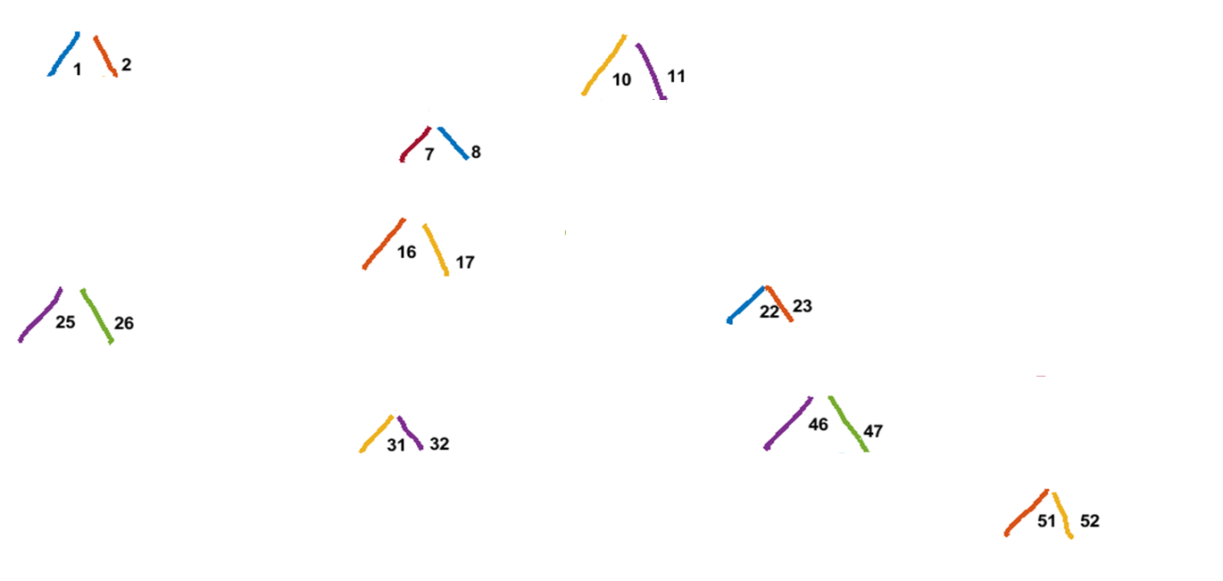
Stroke Pair | Displacement | Updated Disp.
(1,2) | (49,-5) | (49,0)
(7,8) | (46,-3)
(10,11) | (55,-3)
(16,17) | (58,12)
(22,23) | (33,-7)
(25,26) | (58,1)
(31,32) | (44,-1)
(46,47) | (56,7)
(51,52) | (43,0)

Slide 9
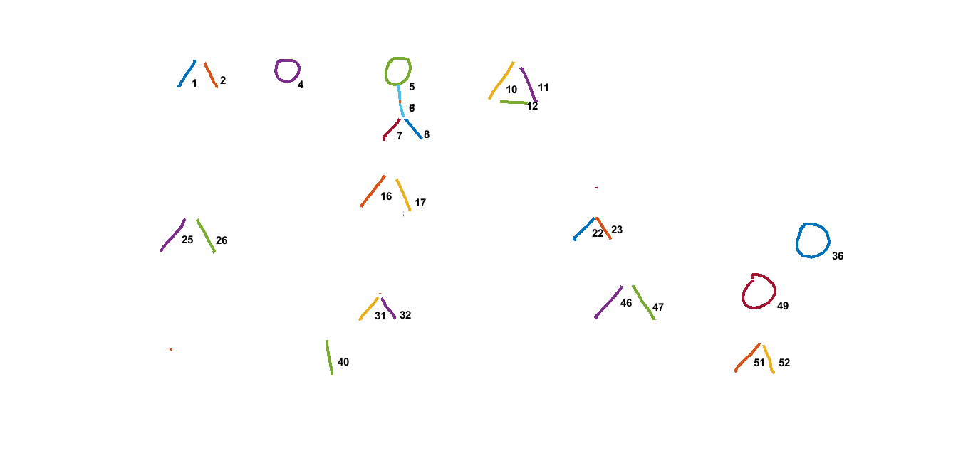
Jigsaw Sketch Model
7. Run EM graph-cut algorithm.
Ɣ

Slide 10
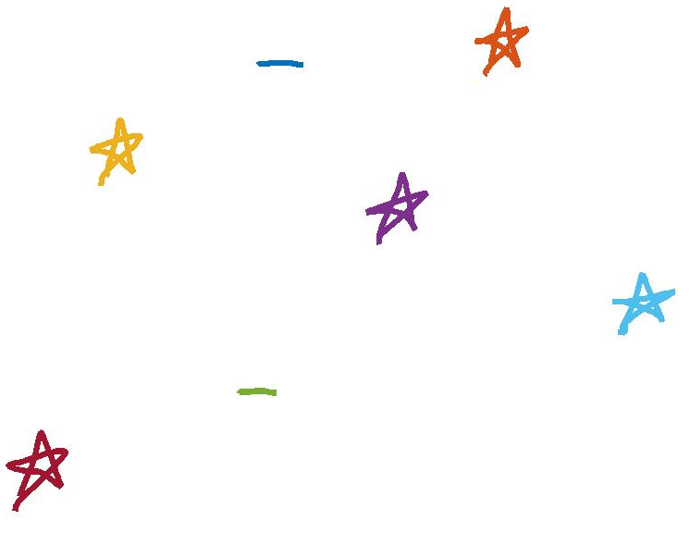
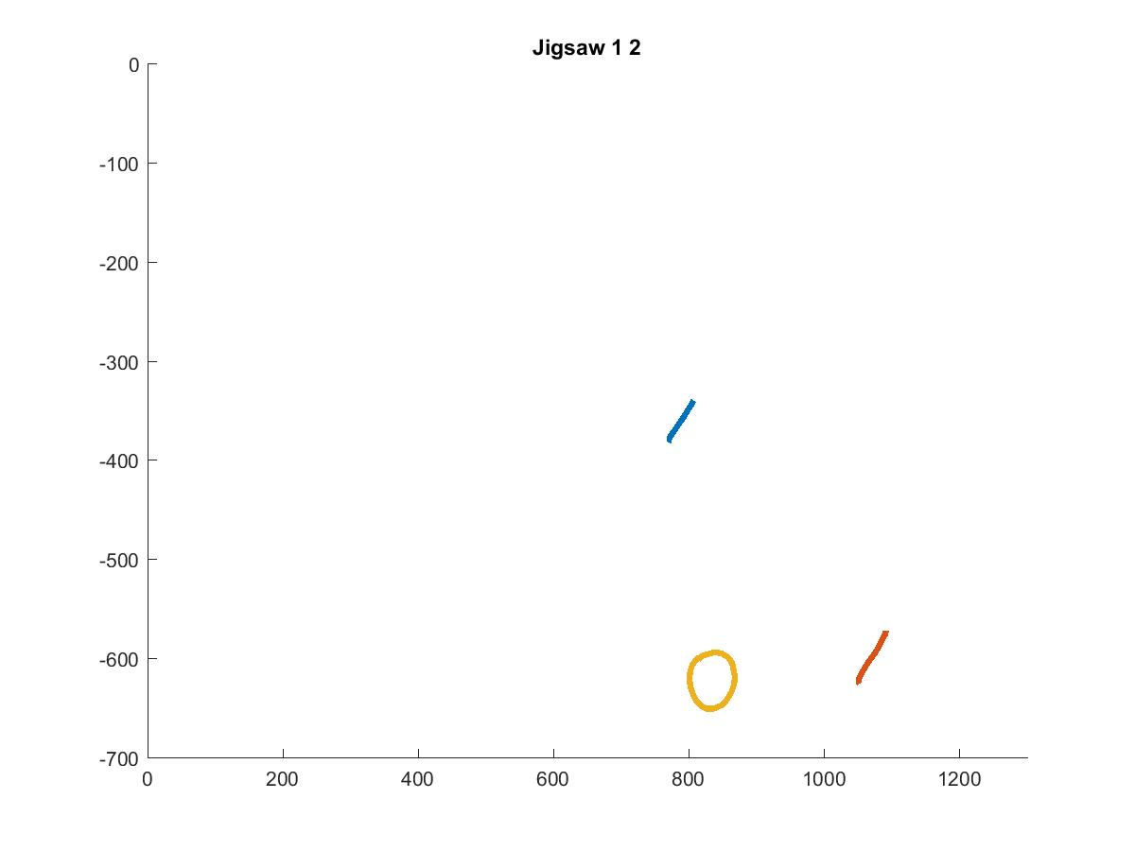
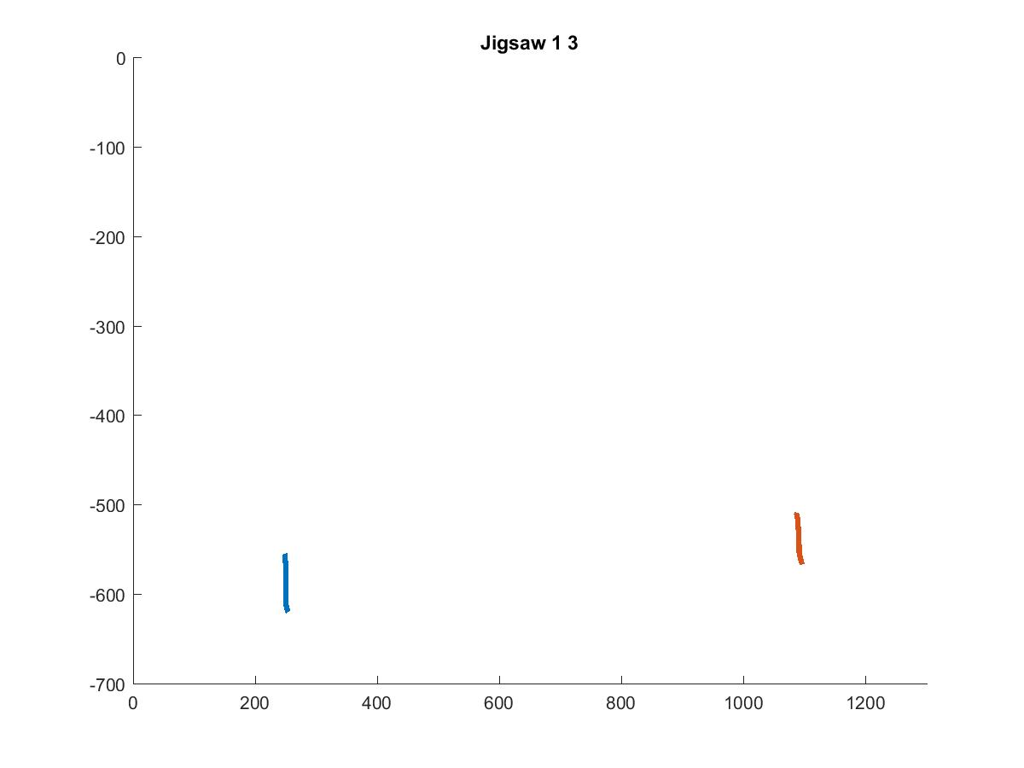
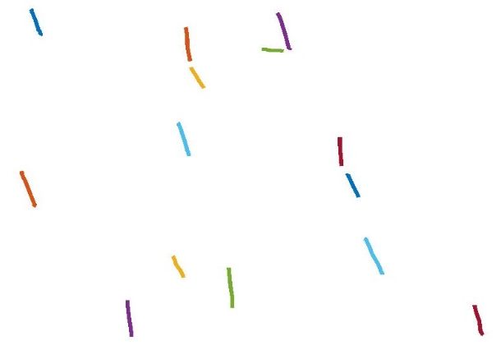
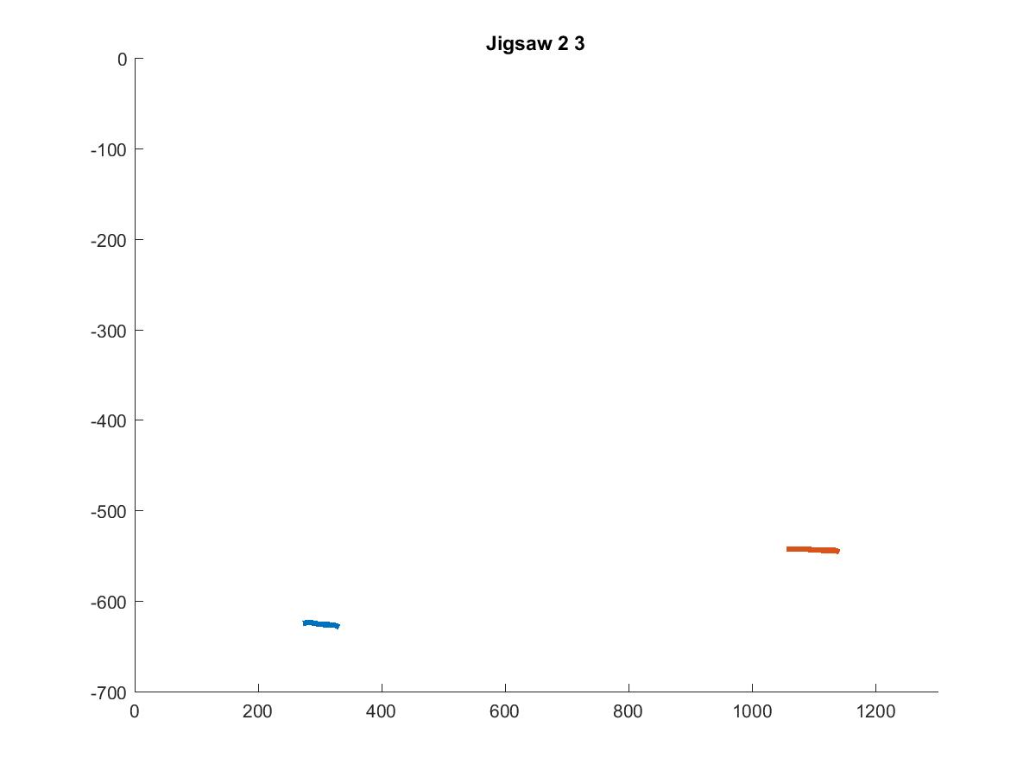
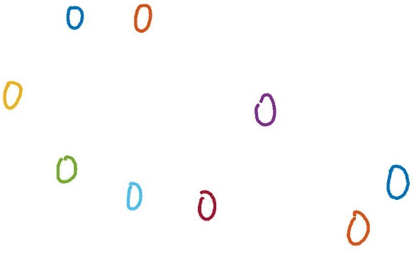
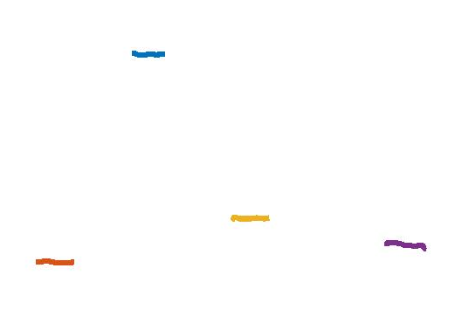
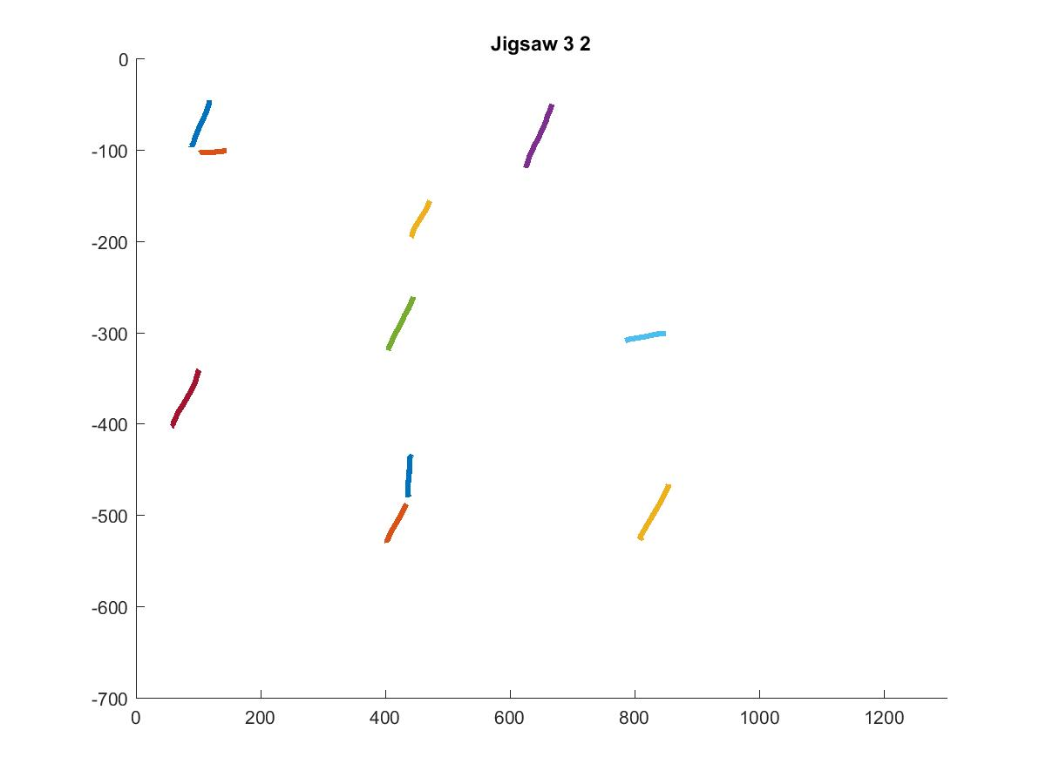
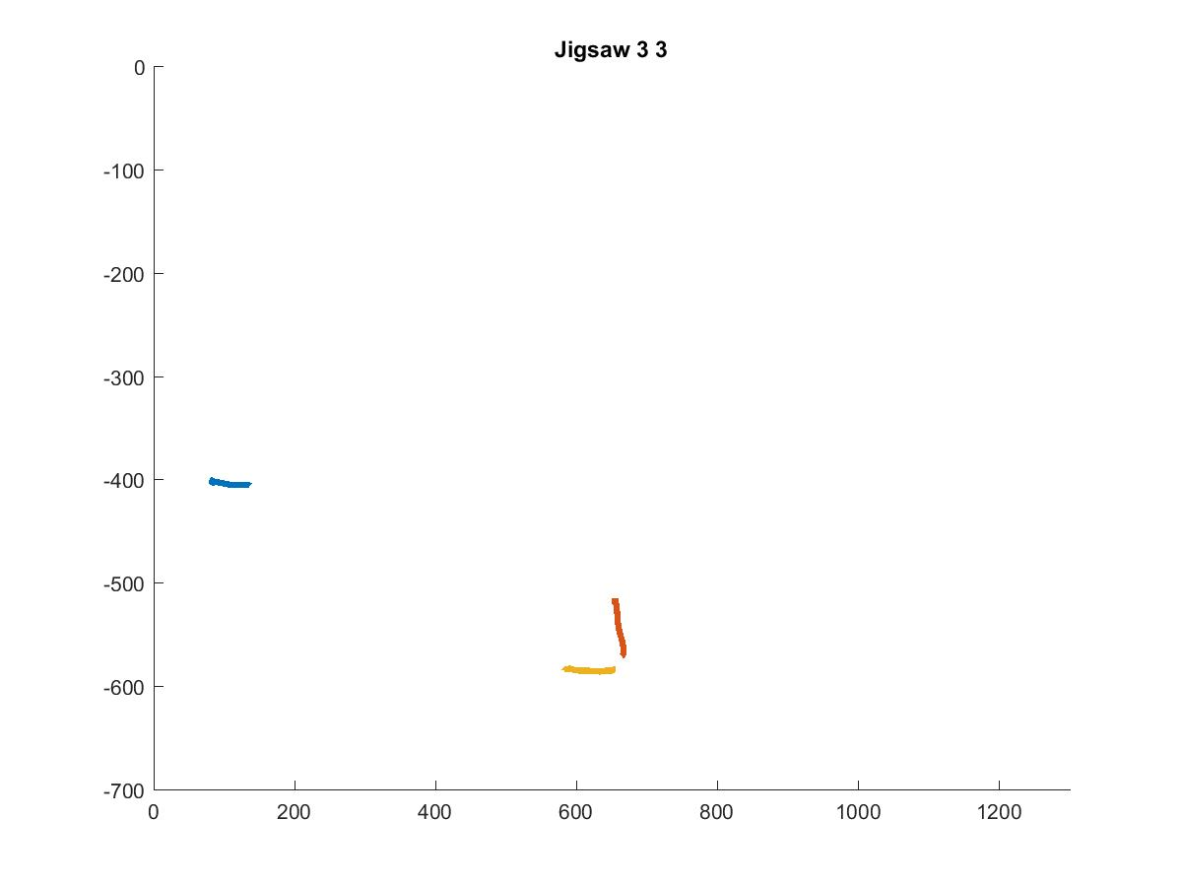
Jigsaw
Jigsaw (i) = Mean of IDM Features of
strokes assigned to Jigsaw(i)
3x3x720

Slide 11
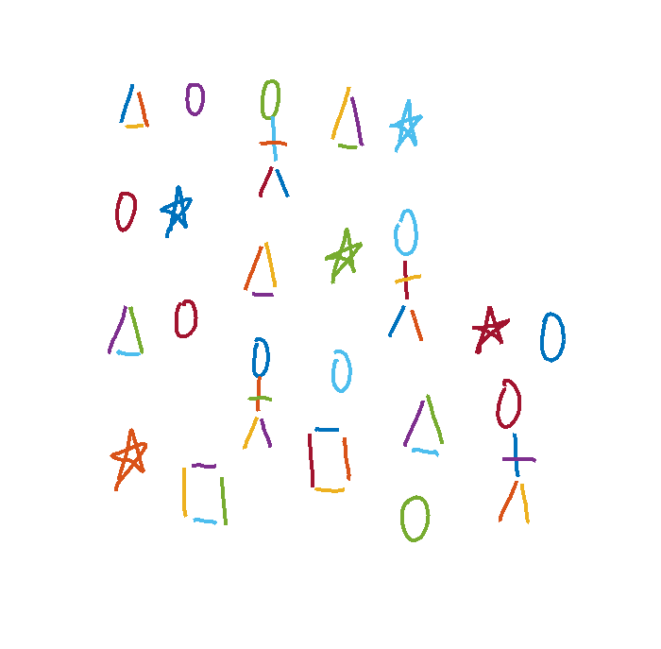
Reconstruction

Slide 12
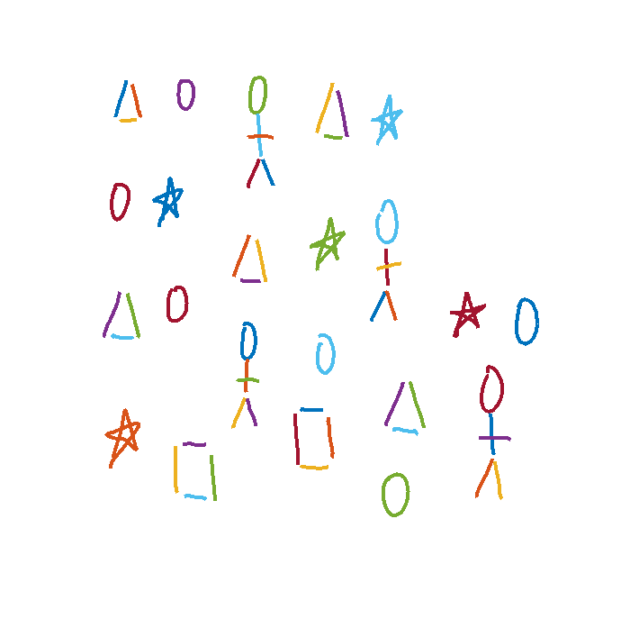
Training Image

