Slide 1
Jigsaw Model for Sketch Recognition
Emre Karaman

Slide 2
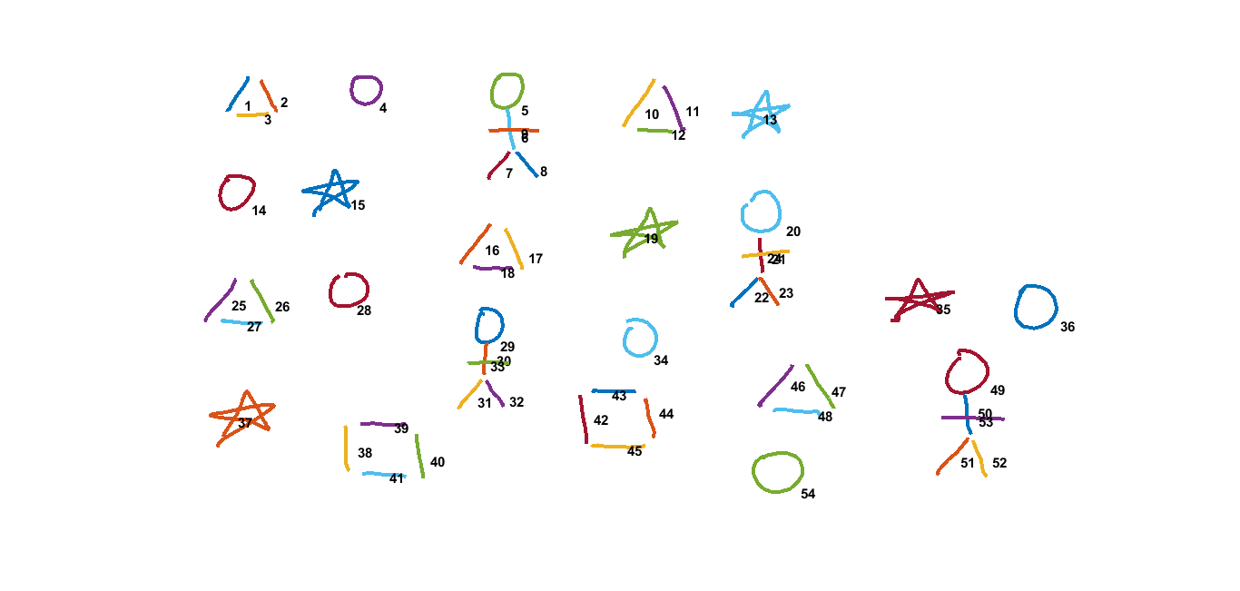
Training Image

Slide 3

Jigsaw Sketch Model
Extract IDM feature of each stroke.
Calculate displacement between each stroke pair.
(x1, y1)
(97, 83)
(x2, y2)
(146, 78)
Displacement b/w 1 & 2
(x2-x1, y2-y1)
(49, -5)

Slide 4
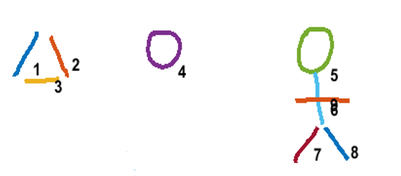
Jigsaw Sketch Model
4. Find variance of displacement between each stroke pairs.
Stroke Pair | Displacement | Variance of Disp. Between stroke pair (1,2) | Mean of Disp. Var.
(1, 2) | (49, -5) | -
(1, 4) | (183, 3) | (8978, 32) | 4505
(1, 5) | (375, 7) | (53138, 72) | 26605
(1, 6) | (275, 47) | (375, 47) | 211
(7, 8) | (46, -3) | (4.5, 2) | 3.25

Slide 5
Jigsaw Sketch Model
4. Find variance of displacement between each stroke pairs.

Slide 6

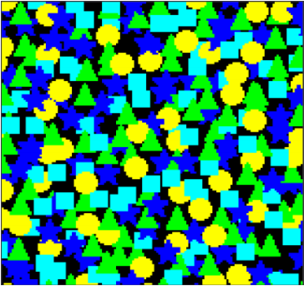
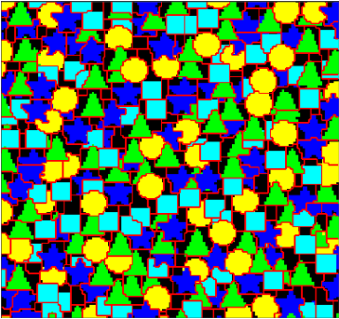
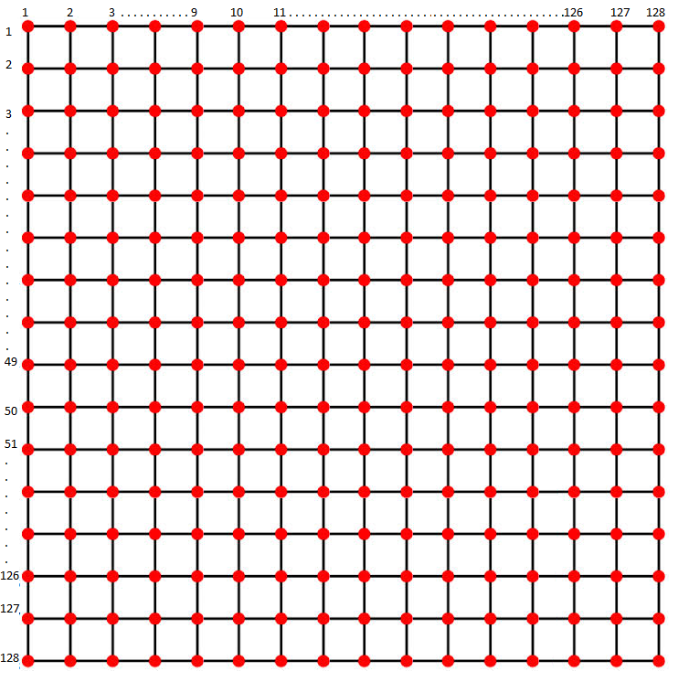
Jigsaw Model
J = Jigsaw
I * = Reconstructed Image
I = Training Image
32x32x3
EM
L = Offset Map
128x128x3
128x128x3
128x128x3

Slide 7
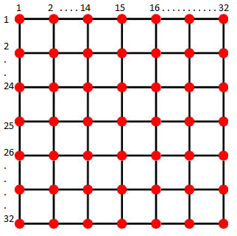


L = Offset Map
Two dimensional offset
$$l_{i}=( l_{x} , l_{y})$$
J = Jigsaw
128x128
(image size)
Map a 2D point $i$ in the image to a
2D point $z$ in the jigsaw using:
$$z=\left( i − l_{i} \right) mod | J |$$
32 x 32 x 3

Slide 8
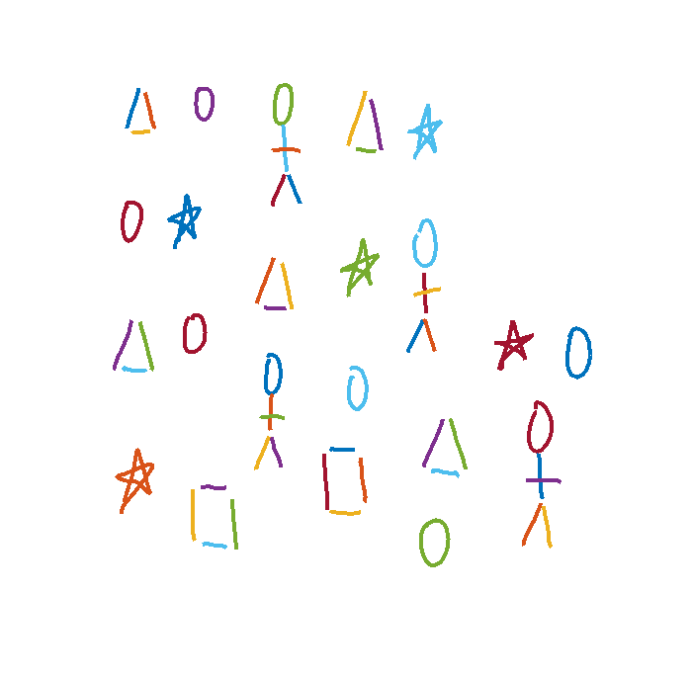
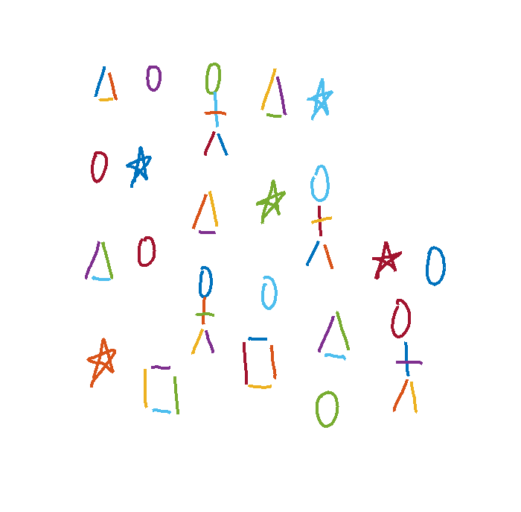
Jigsaw Model for Sketch Recognition
J = Jigsaw
I * = Reconstructed Image
I = Training Image
3 x 3 x 720
EM
L = Offset Map
54x2
54 x 720

Slide 9


L = Offset Map
Two dimensional offset
$$l_{i}=( l_{x} , l_{y})$$
J = Jigsaw
54x2
Map a 2D point $i$ in the image to a
2D point $z$ in the jigsaw using:
$$z=\left( i − l_{i} \right) mod | J |$$
3 x 3 x 720

Slide 10
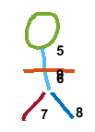
Displacement & Feature Distance
(x1, y1)
(97, 83)
(x2, y2)
(146, 78)
(x7, y7)
(451, 181)
(x8, y8)
(497, 178)
Displacement b/w 1 & 2
Displacement b/w 7 & 8
(x2-x1, y2-y1)
(49, -5)
(x8-x7, y8-y7)
(46, -3)
IDM Feature Distance b/w 1 & 7
IDM Feature Distance b/w 2 & 8
sqrt ((Feat(1) – Feat(7))^2)
sqrt ((Feat(2) – Feat(8))^2)

Slide 11
Find Stroke Pairs
µ (variance of displacement) < λ (50)
µ (feature distace) < ɸ (6)
Variance of feature distance < θ (2)

Slide 12
Training Image

Slide 13
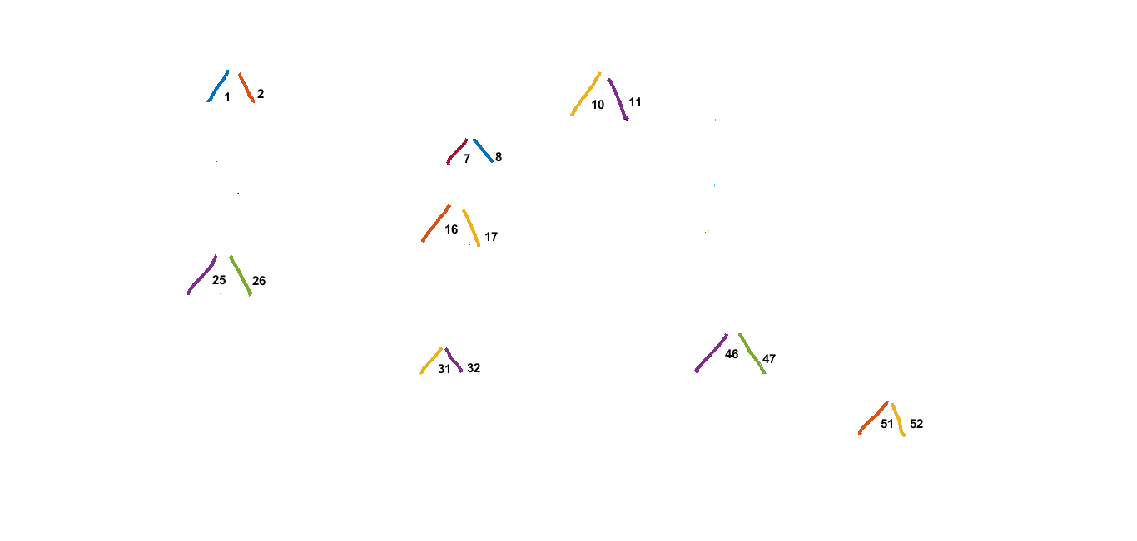
Selected Pairs

Slide 14
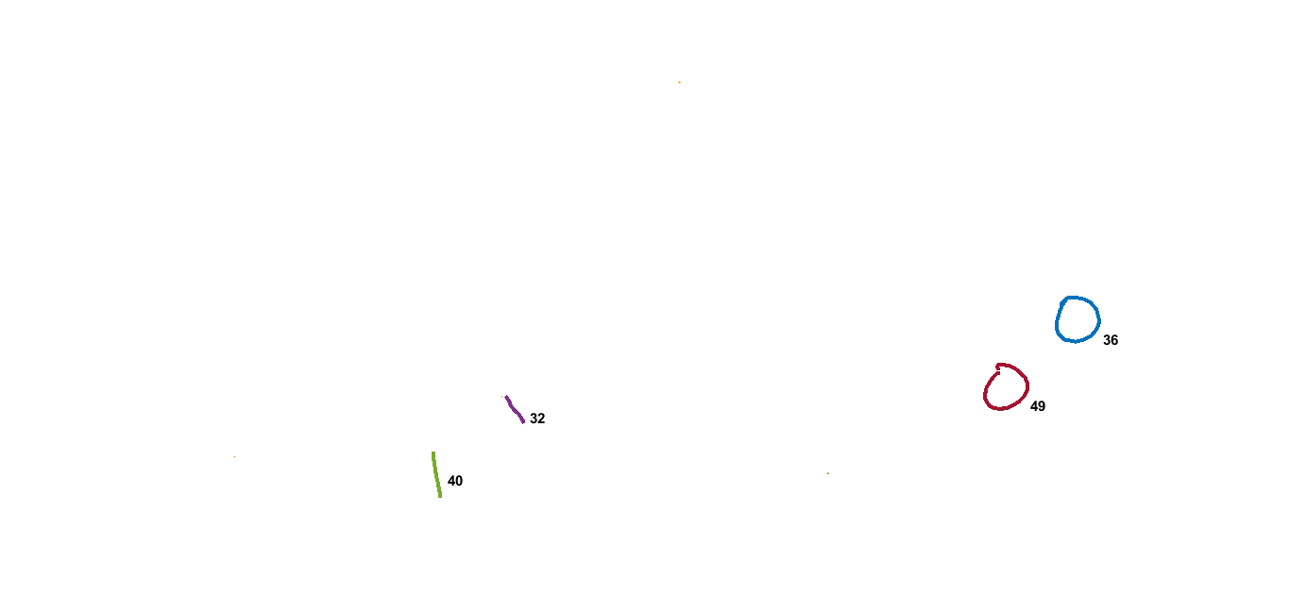
Selected Pairs

Slide 15
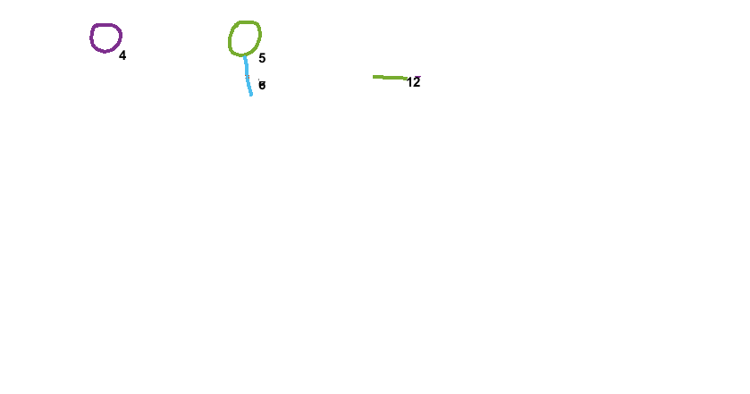
Selected Pairs

Slide 16
Update Centers and Connect
(x1, y1)
(97, 83)
(x2, y2)
(146, 78)
(x7, y7)
(451, 181)
(x8, y8)
(497, 178)
Displacement b/w 1 & 2
Displacement b/w 7 & 8
(x2-x1, y2-y1)
(49, -5)
(x8-x7, y8-y7)
(46, -3)
Mean of Displacement
(47, -4)
Updated Centers
(97, 83)
(144, 79)
(451, 181)
(498, 177)

Slide 17
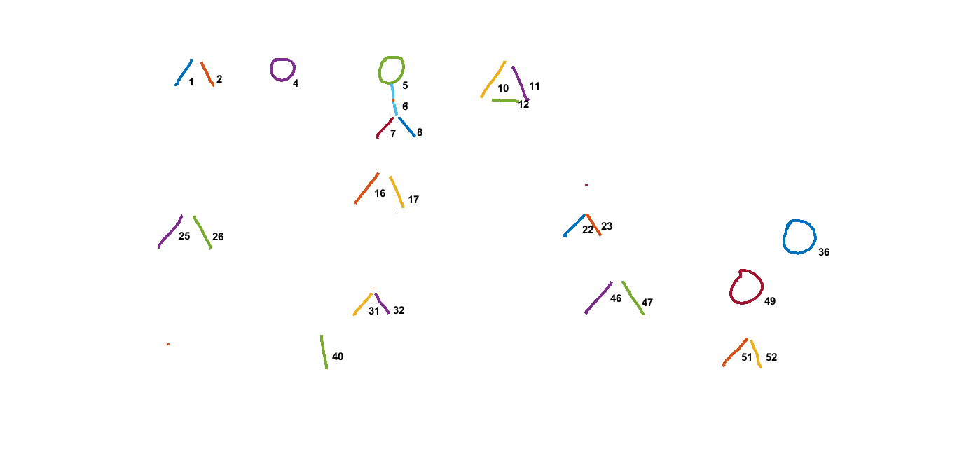
Connectivity / Smooth Cost (Ɣ = 100)
Ɣ

Slide 18

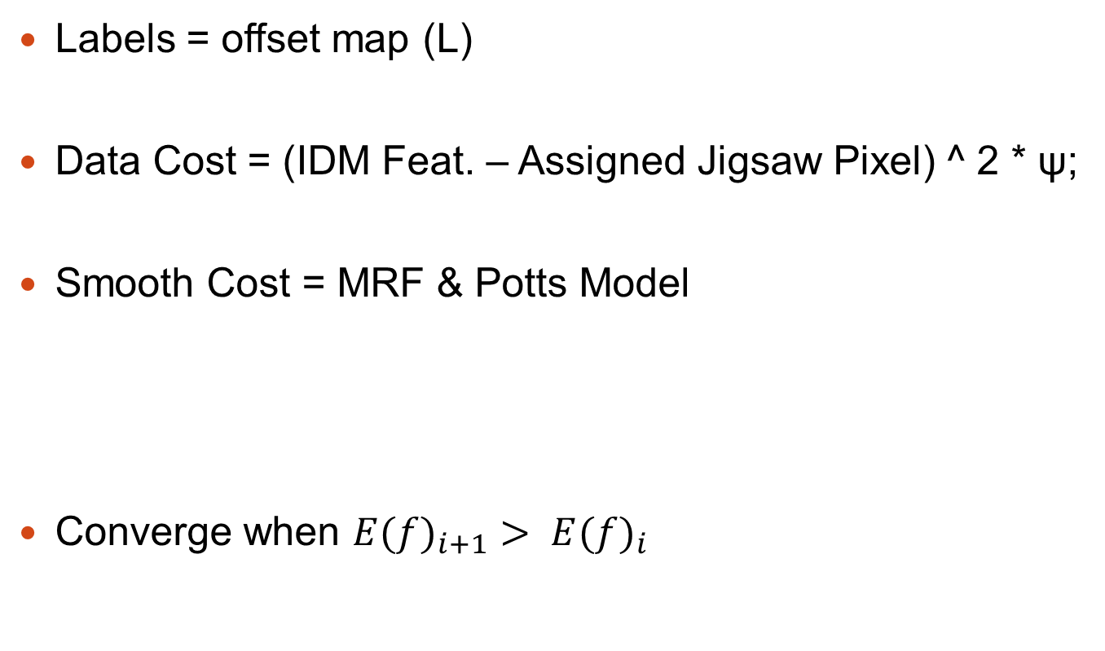
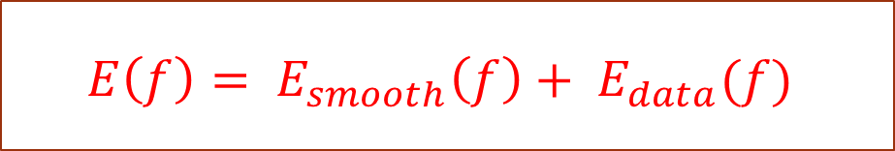
Jigsaw Model & α-Expansion GCA
Labels = offset map (L)
Data Cost = (IDM Feat. – Assigned Jigsaw Pixel) ^ 2 * ψ;
Smooth Cost = MRF & Potts Model
Converge when ${E(f)}_{i+1}> {E(f)}_{i}$
Pott’s Model =
Ɣ = Smooth Cost
$$E\left(f\right)= E_{smooth}\left(f\right)+ E_{data}(f)$$

Slide 19

EM Algorithm
Iteration Step 1
Given Jigsaw (J) and Image (I) update L
using α-expansion graph-cut algorithm
Repeat Until Convergence
Iteration Step 2
Update Jigsaw
I(x) = IDM Features
X(z) = The set of strokes that are mapped to the jigsaw
pixel z across all image

Slide 20
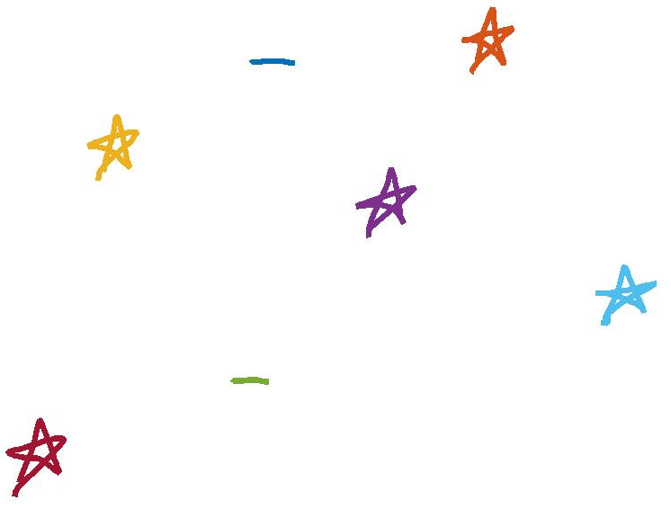
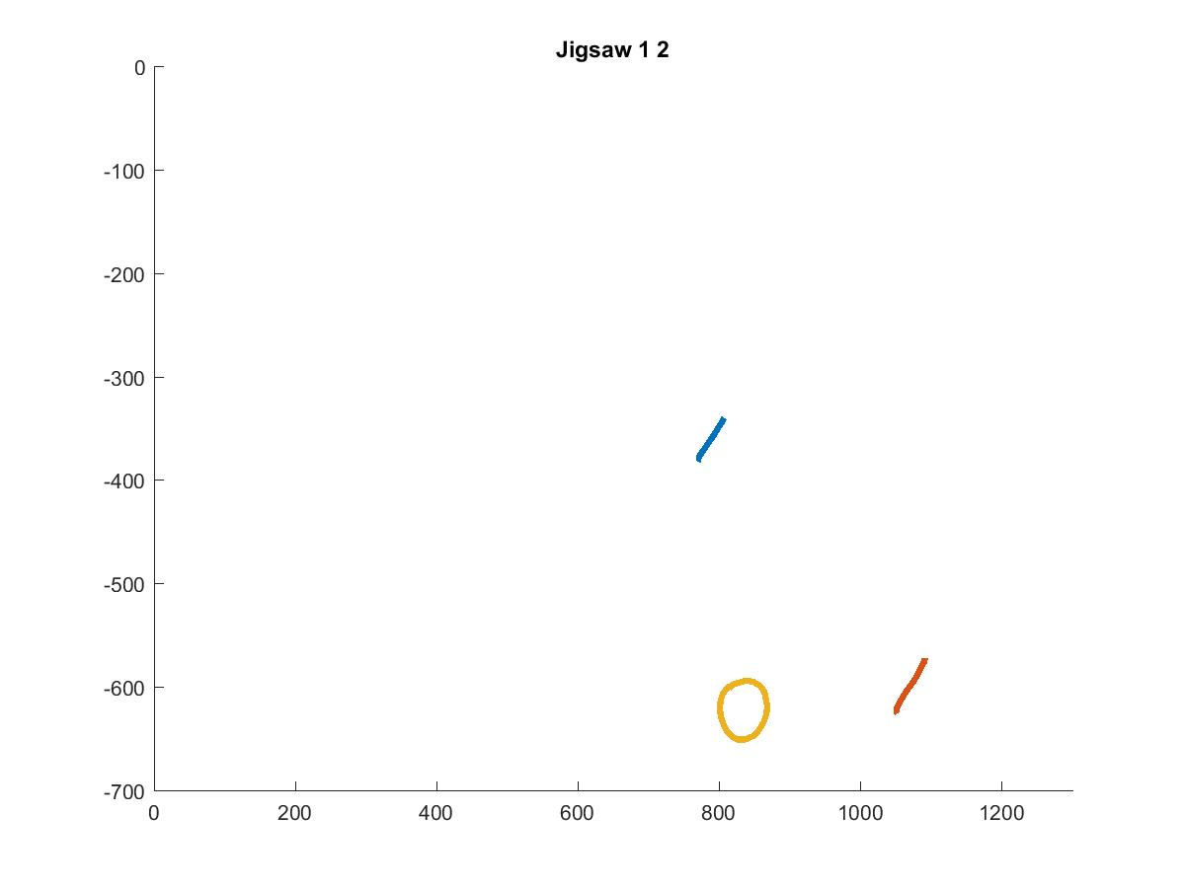
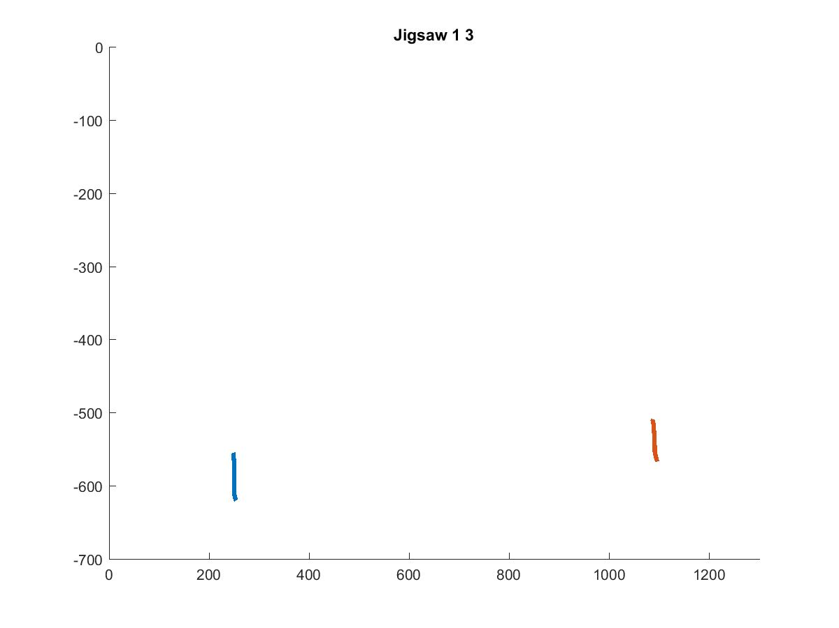
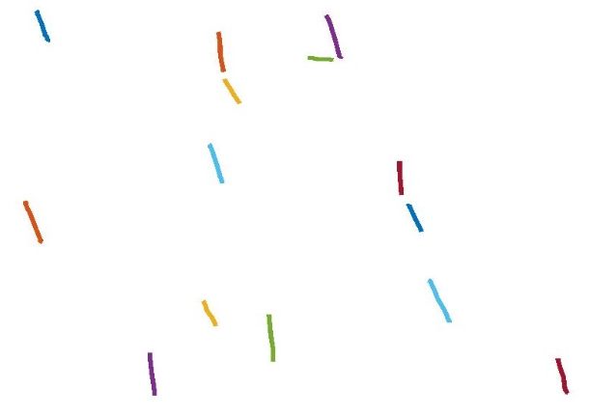
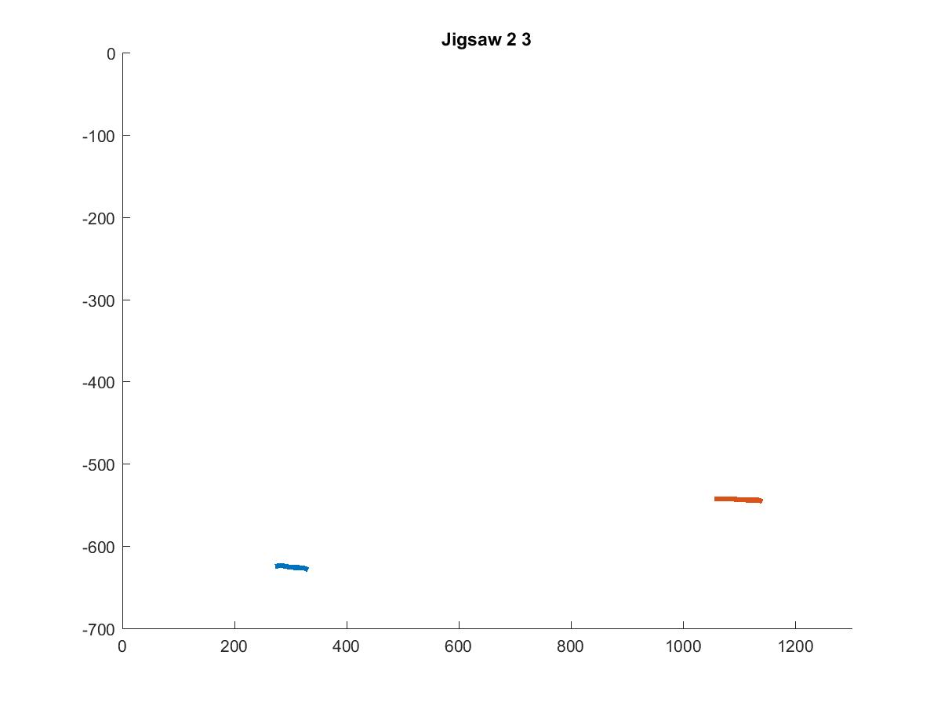
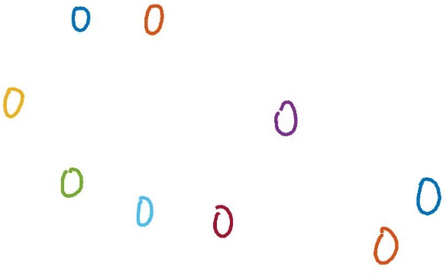
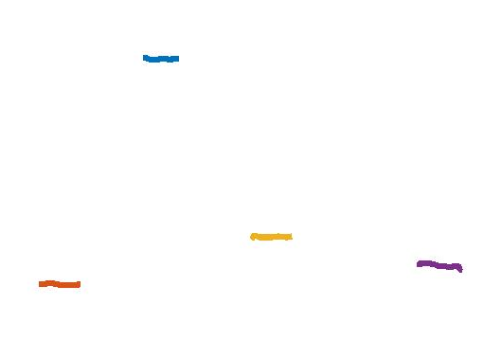
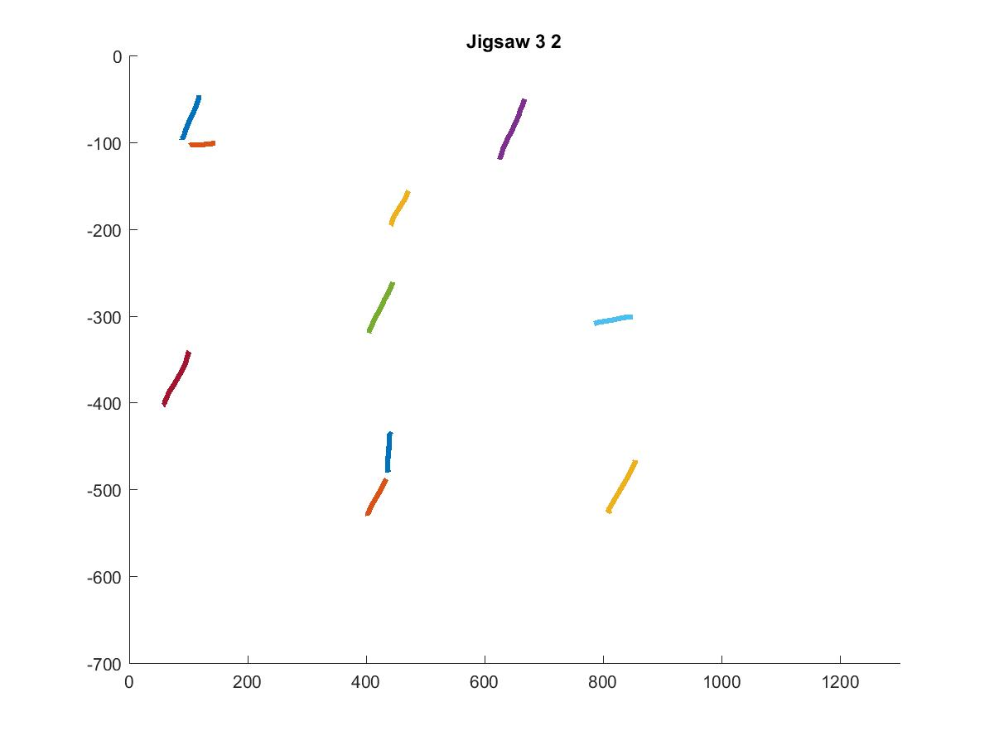
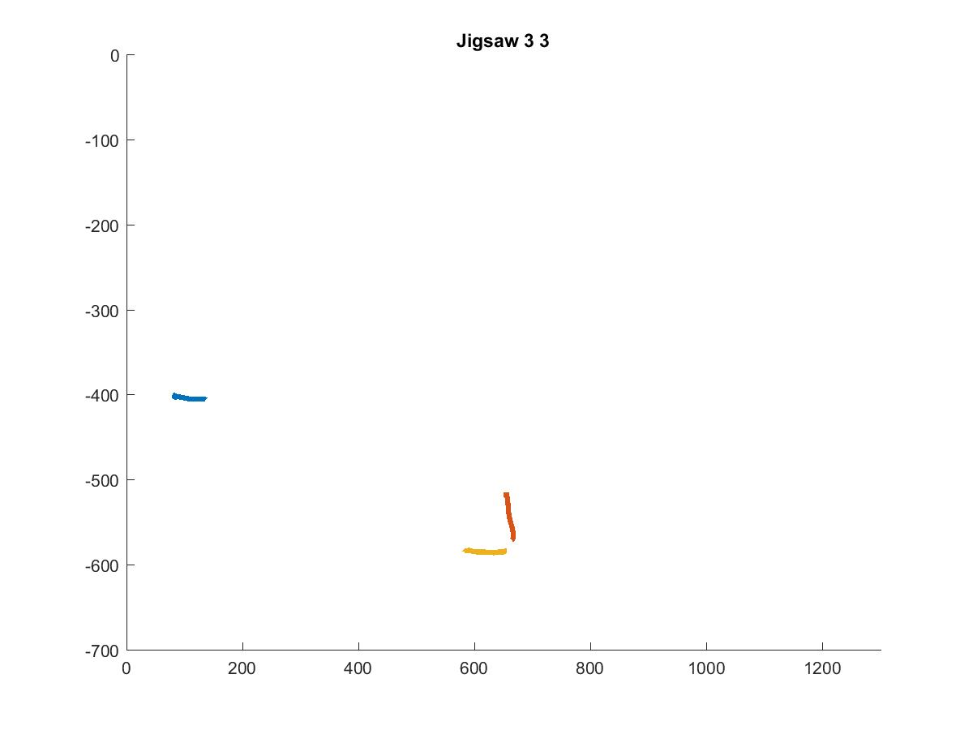
Jigsaw
Jigsaw (i) = Mean of IDM Features of
strokes assigned to Jigsaw(i)
3x3x720

Slide 21
Reconstruction

Slide 22
Training Image

Slide 23
Questions?

Slide 24
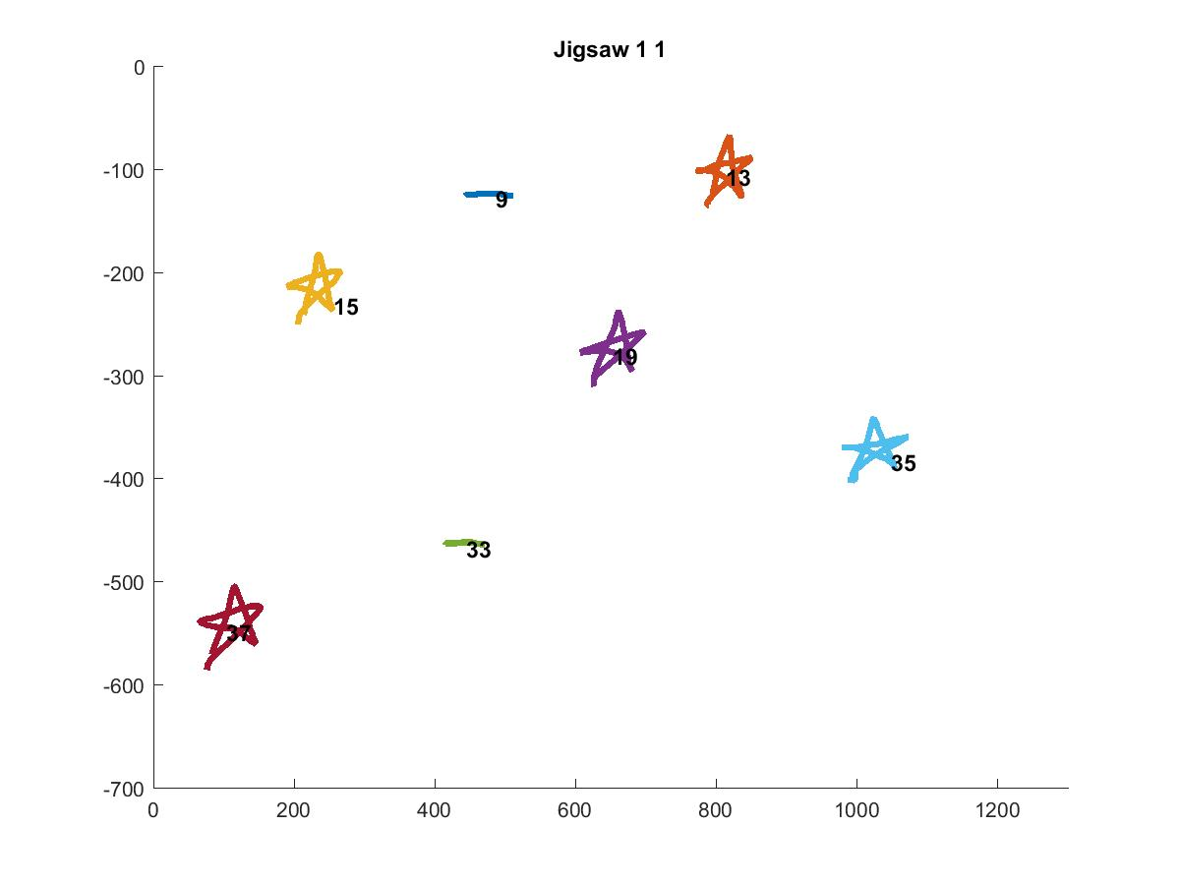
Jigsaw 11

Slide 25
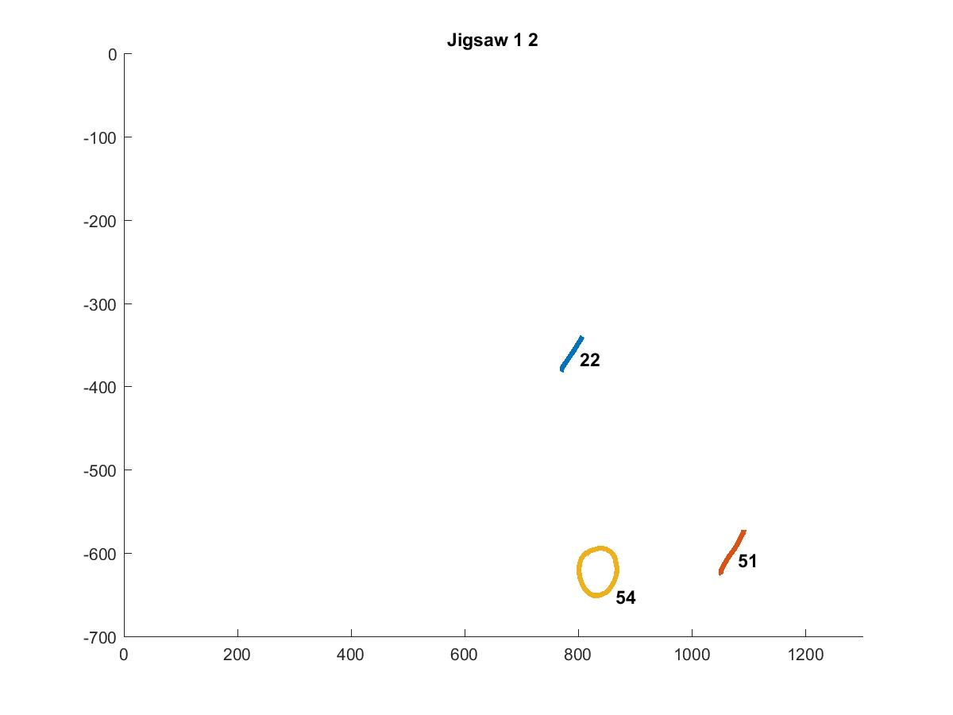
Jigsaw 12

Slide 26
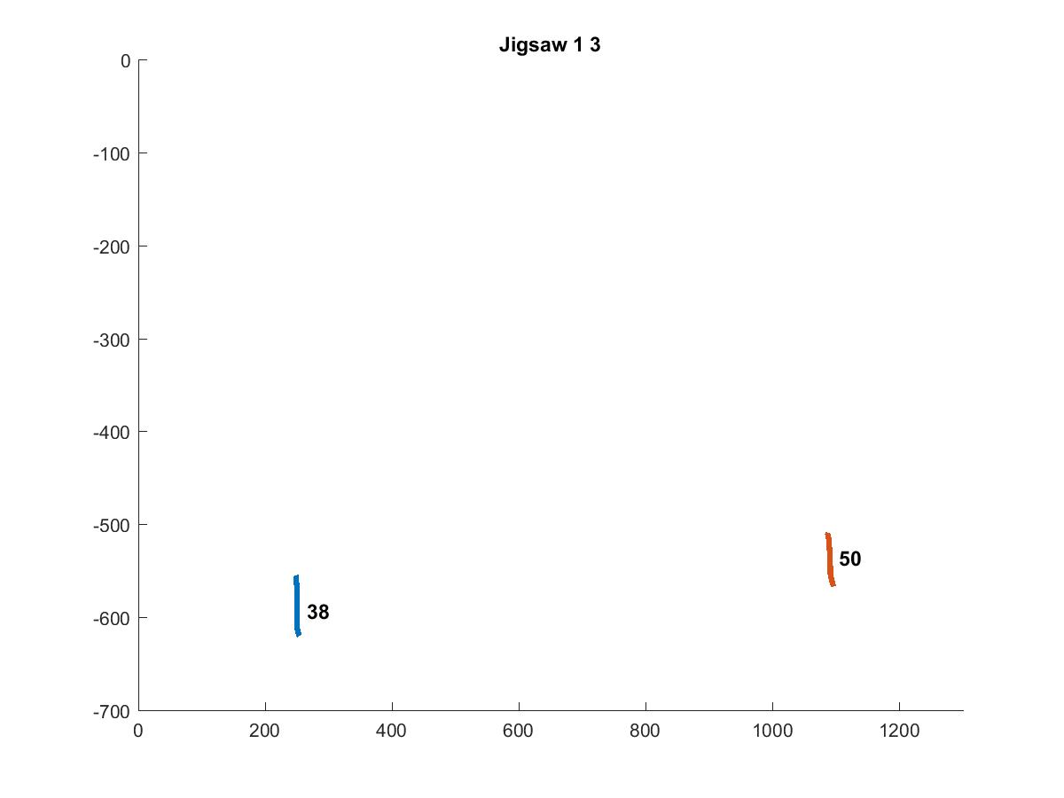
Jigsaw 13

Slide 27
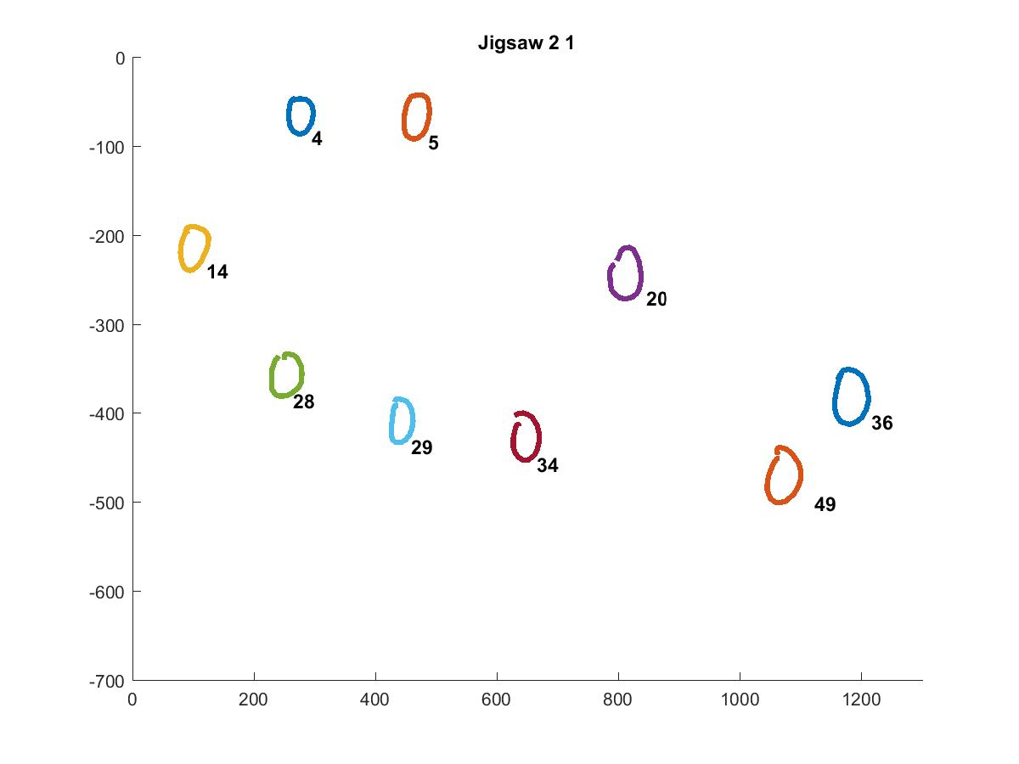
Jigsaw 21

Slide 28
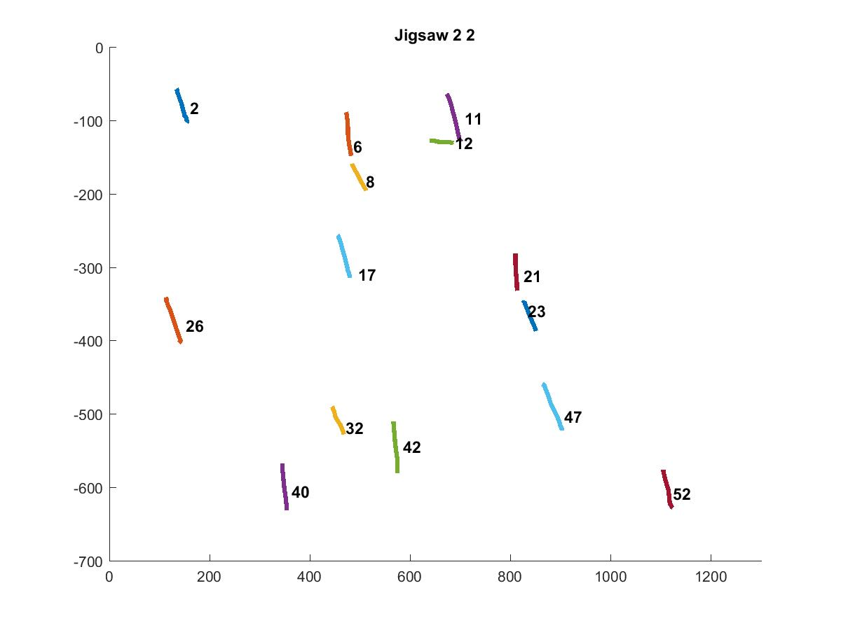
Jigsaw 22

Slide 29
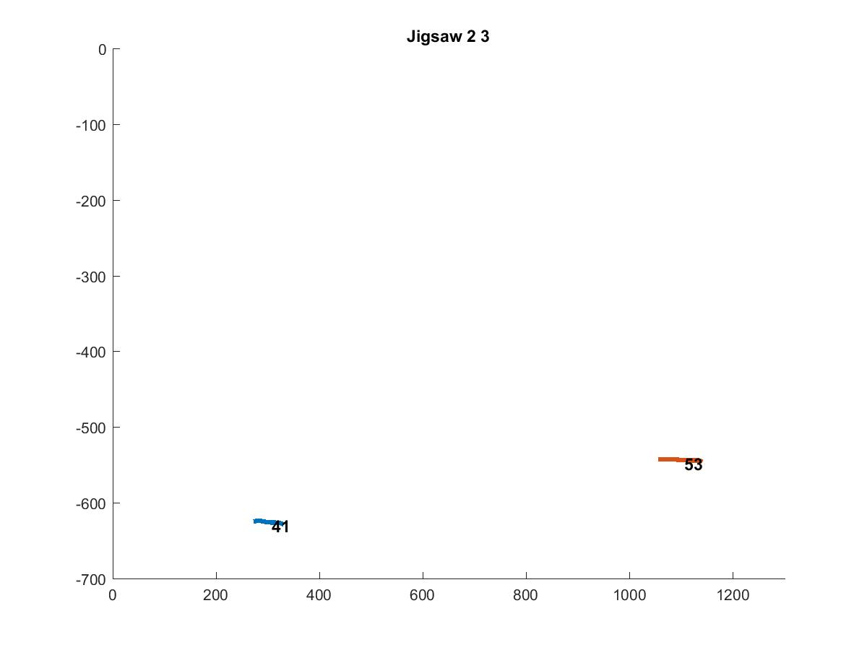
Jigsaw 23

Slide 30
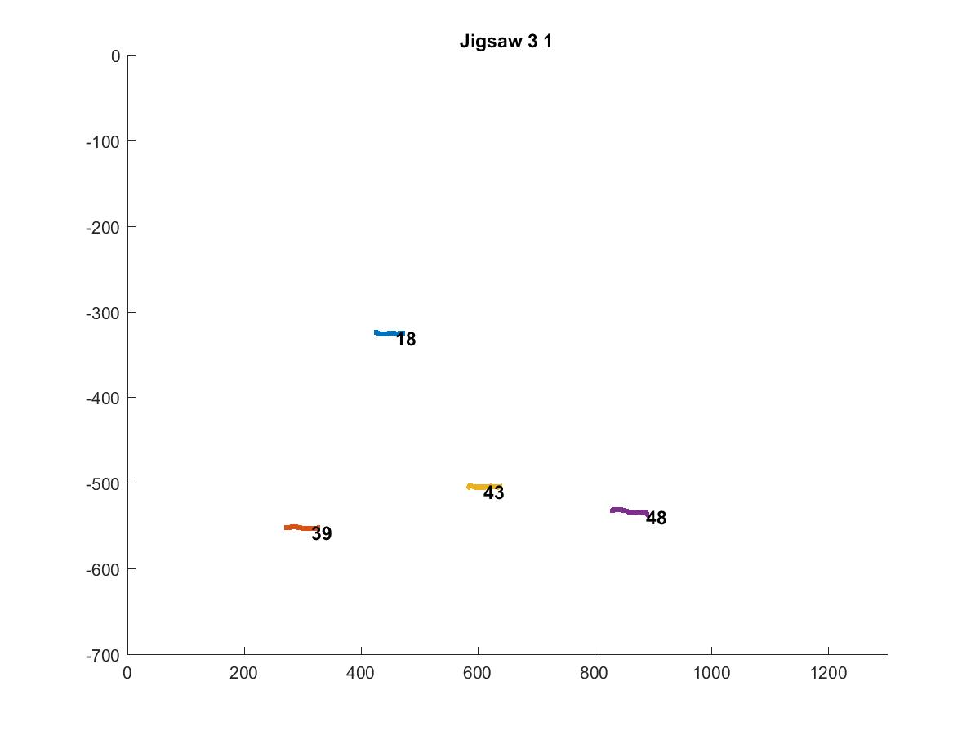
Jigsaw 31

Slide 31
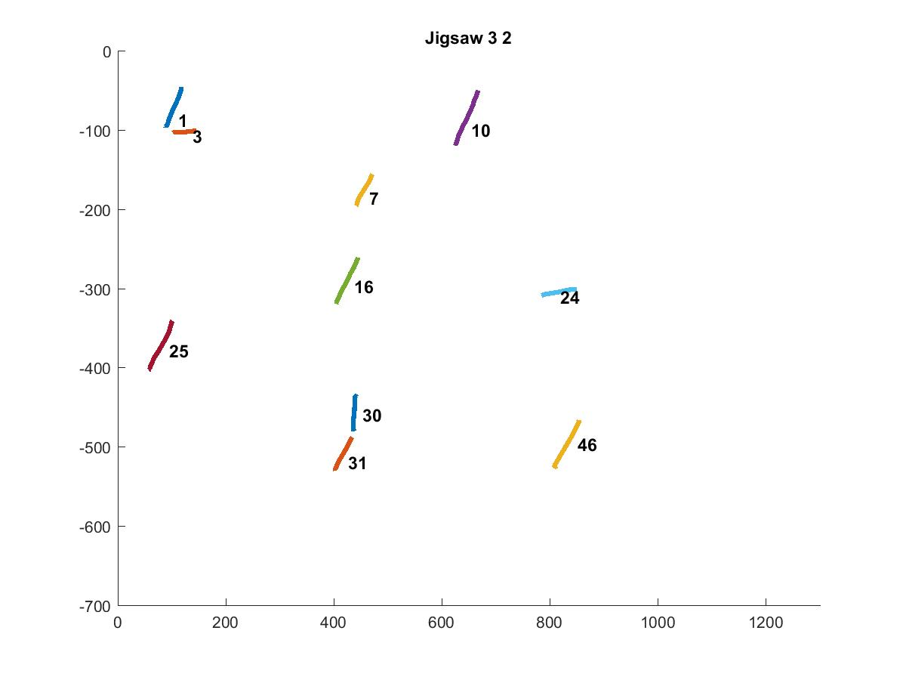
Jigsaw 32

Slide 32
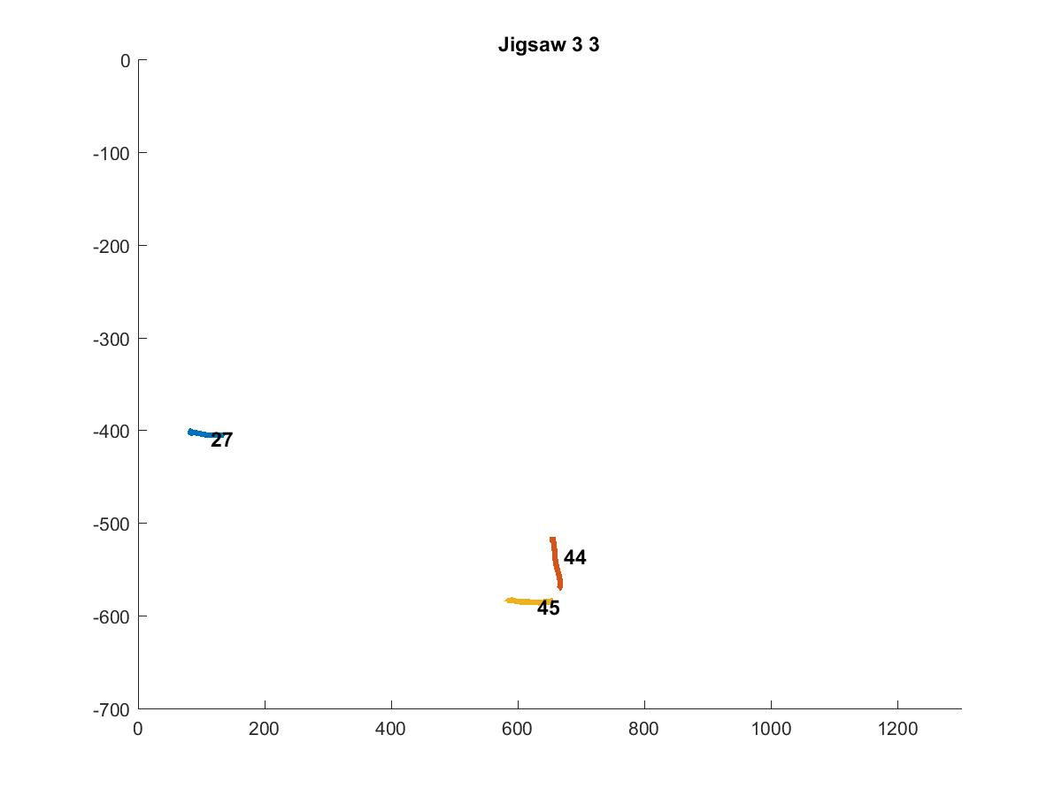
Jigsaw 33

