Slide 1

Exploratory Data Analysis
G2M-insight-for-Cab-Investment-firm
19.06.2022

Slide 2
Agenda
Executive Summary
Problem Statement
Approach
EDA
EDA summary and Recommendations
Some hypothesis testing

Slide 3
Executive Summary
XYZ is a private firm in US. Due to remarkable growth in the Cab Industry in last few years and multiple key players in the market, it is planning for an investment in Cab industry
Objective : Provide meaningful business insights to help XYZ firm in identifying the right company for making them the right investment.

Slide 4
Problem Statement
There is no one dataset to extract meaningful insights
So, before merging them(creating master dataset);
-Identify relationships across the files
-Field/feature transformations
-Determine which files should be joined versus which
ones should be appended…
After creating master dataset:
• Forecasting profit and number of rides for each cab type
• Finding the most profitable Cab company
• Recommendations for investment

Slide 5

Approach
• 21 Features( including 6 derived features)
• Timeframe of the data: 2016-01-31 to 2018-12-31
• Total data points : 359,854
Normally 4 data set given as csv files;
-Cab_Data.csv
-Customer_ID.csv
-Transaction_ID.csv
-City.csv
One external but related data set that is used;
-US Holiday Dates (2004-2021).csv
Merged Master data frame is created from these 5 files

Slide 6
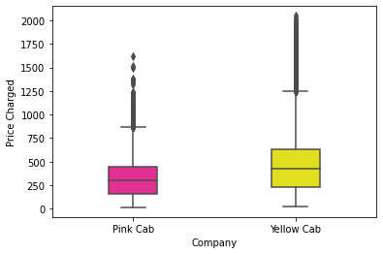
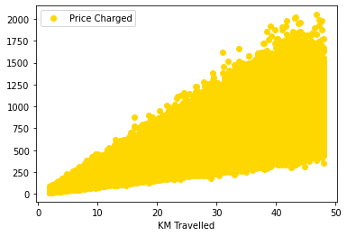
EDA
Plot box distributions of both companies, we can see that there are too many outliers
Correlation coefficient between Distance and Price charged:0.835…
Since there is a high correlation coefficient and we can also see visually traveling distance is one of the reasons for high prices that are charged. Also, since we do not have any further information about other causes, it is better to not treat high prices as outliers in the "Price Charged" column.

Slide 7
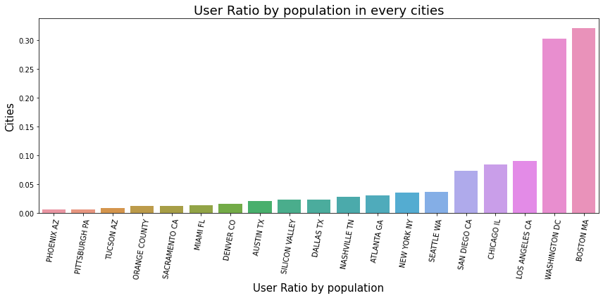
City based Analyses
This is just a general information that is extracted from data set, which represents how many of people(ratio) is using taxis, cabs in comparison with total population of that city.

Slide 8
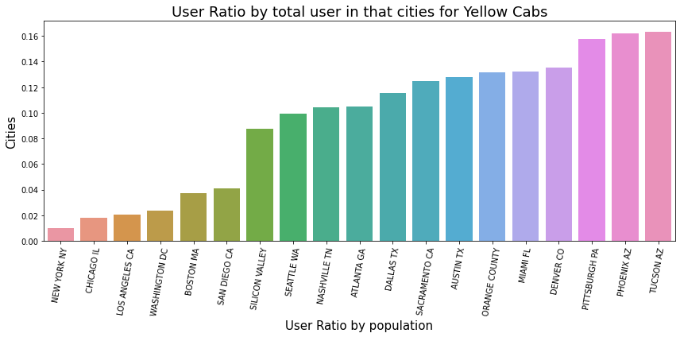
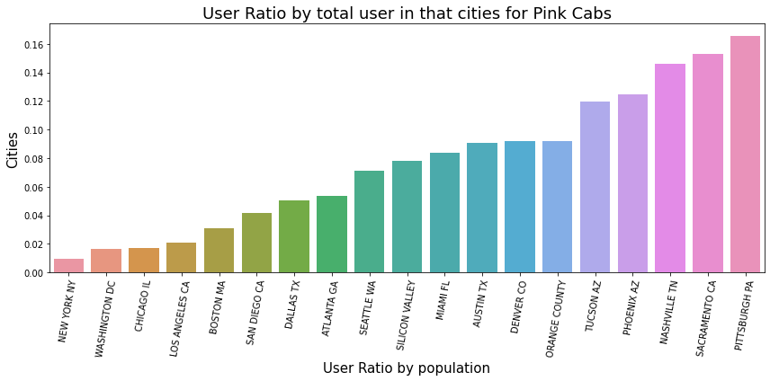
City based Analyses
On average yellow cabs has the 9.4% of the total users where they have service for stated cities.
On average pink cabs has the 7.6% of the total users where they have service for stated cities.
For both Yellow and Pink Cabs the cities that have least user proportion is common, they are "New York NY", "Chicago IL", "Los Angeles CA", "Washington DC", "Boston MA" and "San Diego CA". Assuming that these are very crowded and big cities and competition by other companies are also a very big threat.

Slide 9
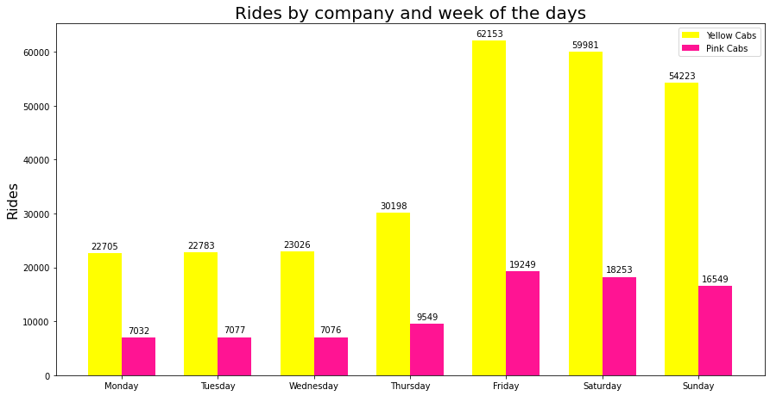
Rides vs Days of the week analysis
Yellow cabs have the by far higher rides in total and for everyday, also from this graph we can see that Fridays Saturdays and Sundays are very significant for cab industry.

Slide 10
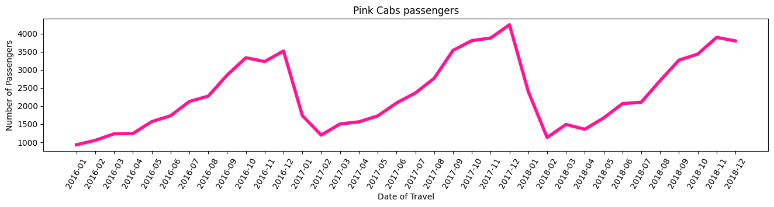
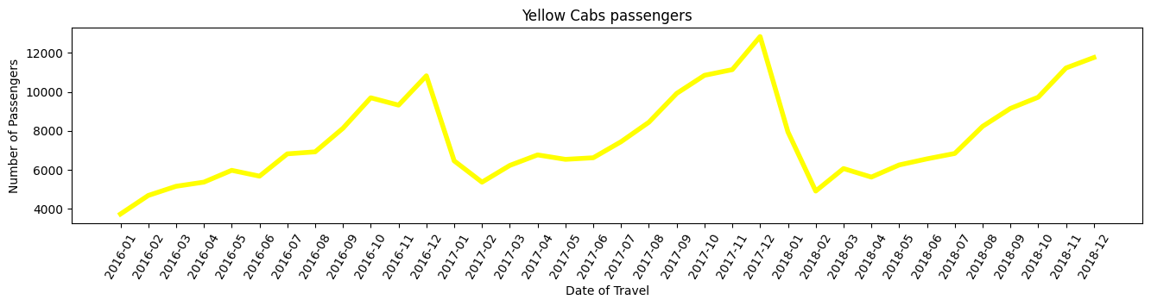
Seasonality analysis

Slide 11
Seasonality analysis
When we applied granger causality tests(to see if there is seasonality) to companies monthly passenger numbers:
-Pink Cabs
-Yellow Cabs
ssr based F test: F=6.1813 , p=0.0183 ,
ssr based chi2 test: chi2=6.7608 , p=0.0093 likelihood ratio test: chi2=6.1813 , p=0.0129
parameter F test: F=6.1813 , p=0.0183
ssr based F test: F=10.0768 , p=0.0033
ssr based chi2 test: chi2=11.0215 , p=0.0009
likelihood ratio test: chi2=9.5816 , p=0.0020
parameter F test: F=10.0768 , p=0.0033
In the above case, the p-values are close to 0("zero") for all tests. So the ‘month’ indeed can be used to forecast the values for pink cabs.
In the above case, the p-values are close to 0("zero") for all tests. So the ‘month’ indeed can be used to forecast the values for yellow cabs.
Most importantly both companies’ data show seasonality as the test results reviewed
**For both companies multiplicative, additive decomposition and autocorrelation methods are applied and visualised the results in python codes as well.

Slide 12
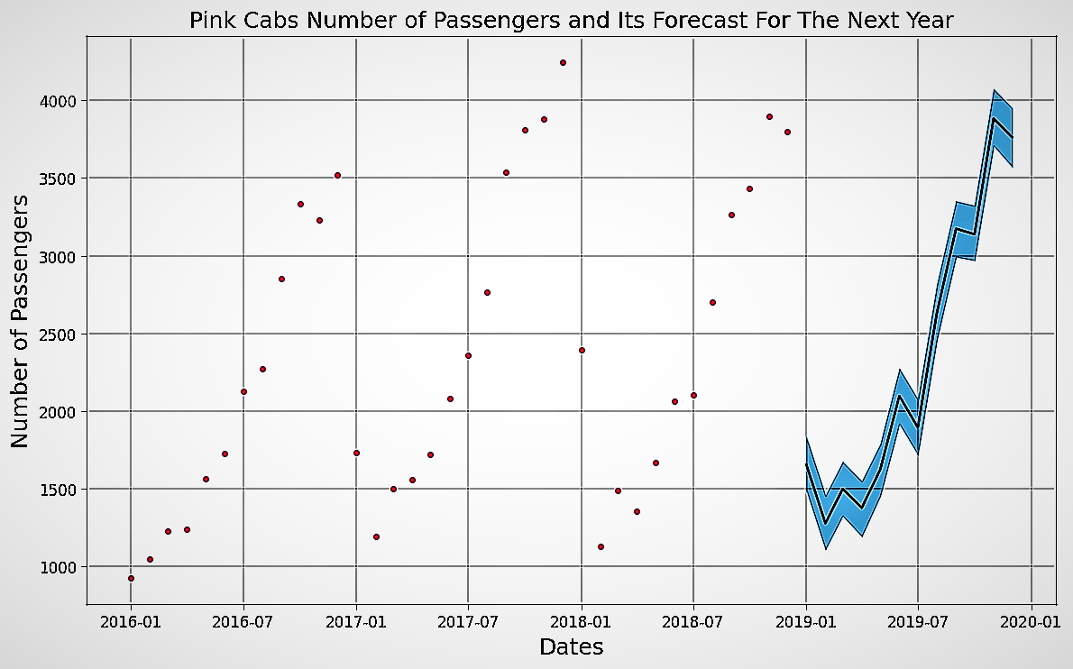
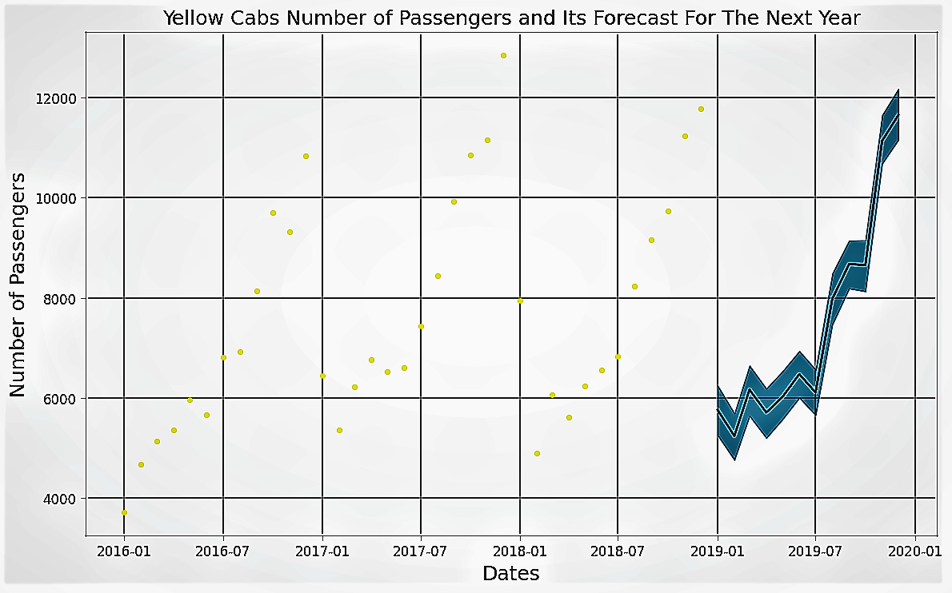
Forecasting
Since seasonality test we used are passed positively, we could try to forecast for the next year.
As it can be seen the number of passengers of Yellow cabs would have still around 2 times higher than the Pink ones.
**Forecasting done by Prophet model in python

Slide 13
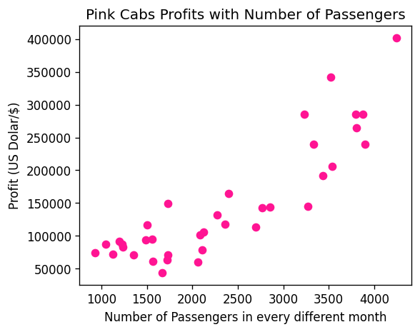
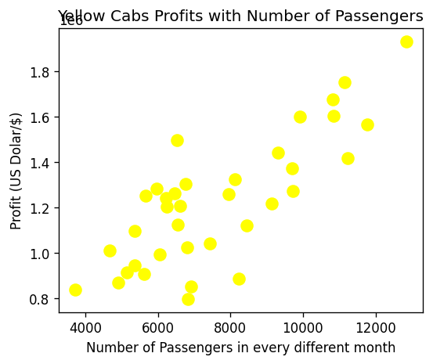
Relation between profit and rides/customers
Correlation coefficient: 0.87
Correlation coefficient: 0.79

Slide 14
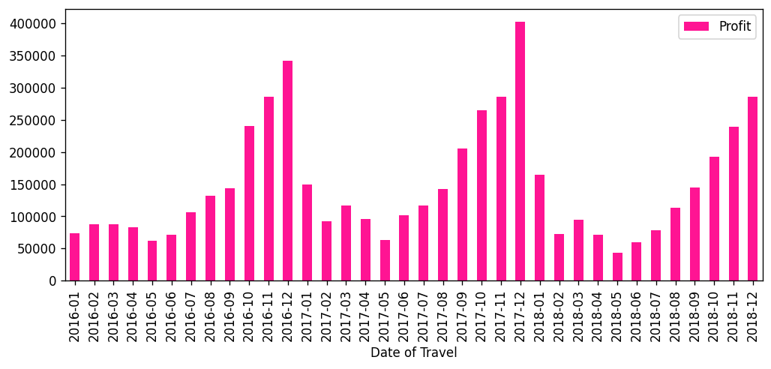
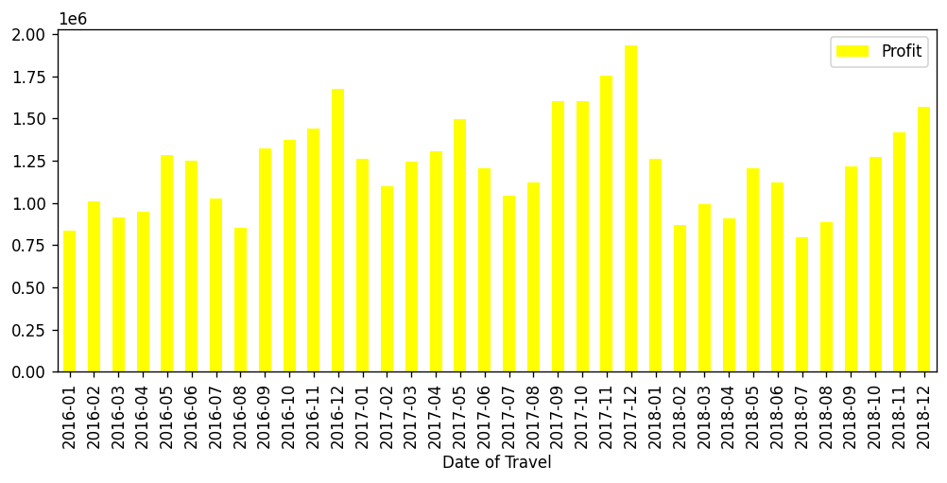
Profits
-Relative profit can be seen in the next slide

Slide 15
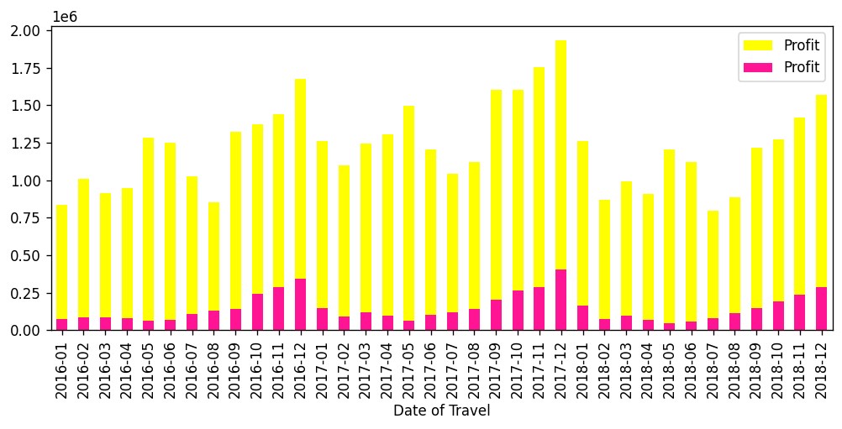
Profits
Average profit per month for Yellow cabs: $ 1,225,128.4
Average profit per month for Pink cabs: $ 147,522
Ratio between them Yellows/Pinks: $ 8.3
Total profit for Yellow cabs: $ 44,104,621
Total profit for Pink cabs: $ 5,310,794.7

Slide 16
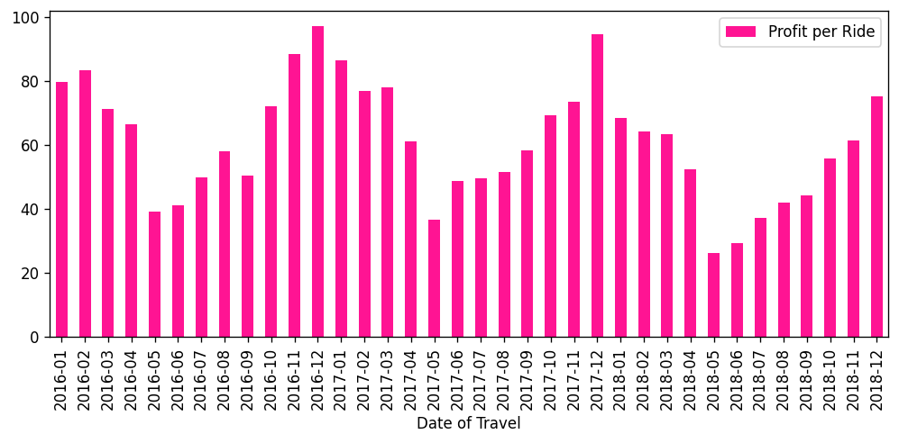
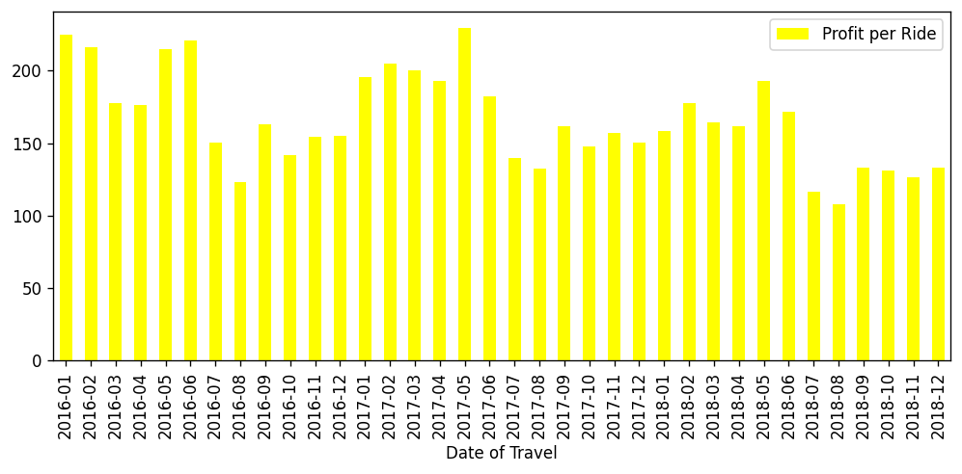
Profits per Ride
-Relative profit/ride can be seen in the next slide

Slide 17
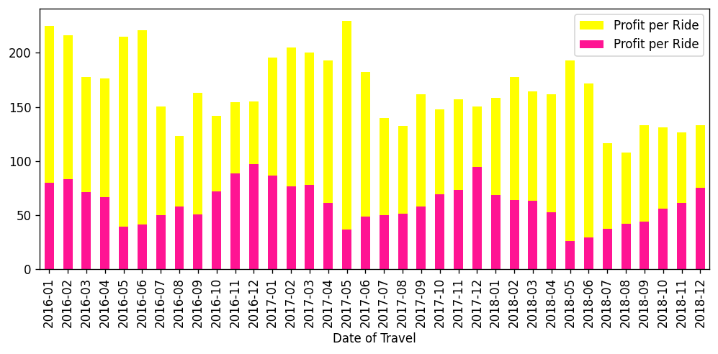
Profits per Ride
Average profit per ride and month for Yellow cabs: $ 166.26
Average profit per ride and month for Pink cabs: $ 61.18
Ratio between them Yellows/Pinks: $ 2.7

Slide 18
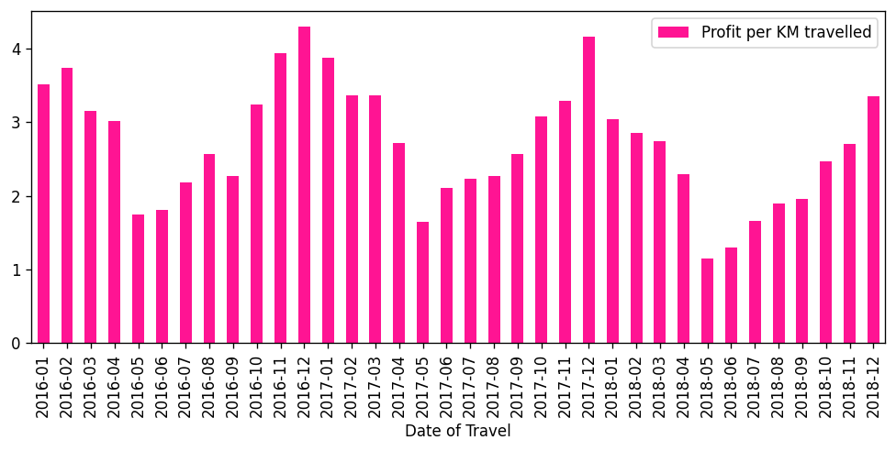
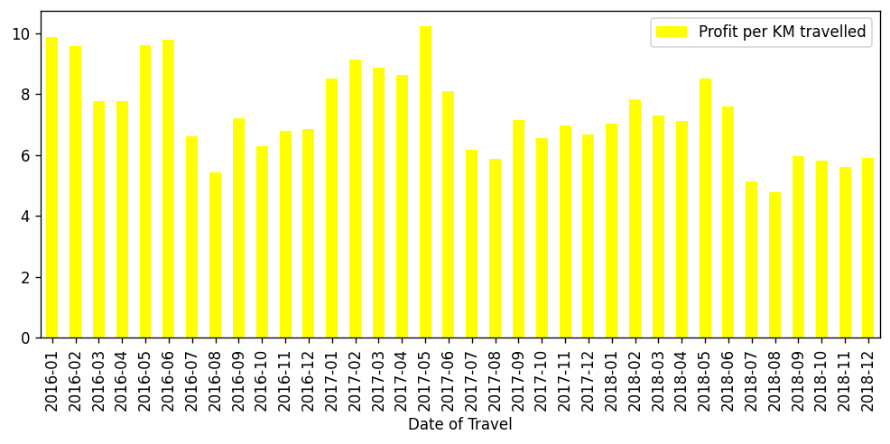
Profits per Distance(KM)
-Relative profit/ride can be seen in the next slide

Slide 19
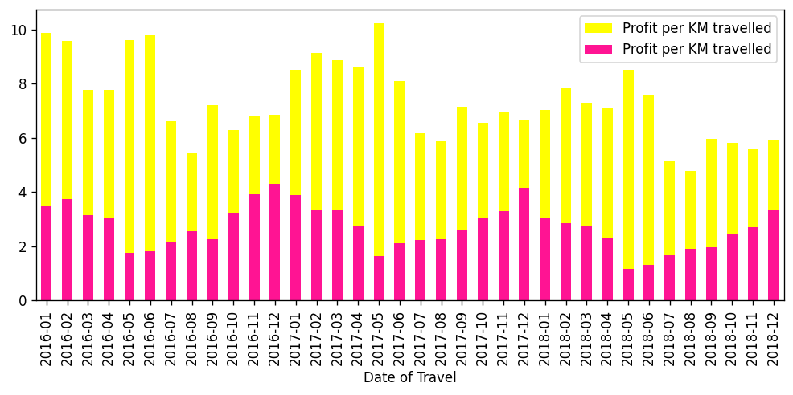
Profits per Ride
Average profit per Km that travelled for Yellow cabs: $ 7.36
Average profit per Km that travelled for Pink cabs:$ 2.71
Ratio between them Yellows/Pinks: $ 2.7

Slide 20
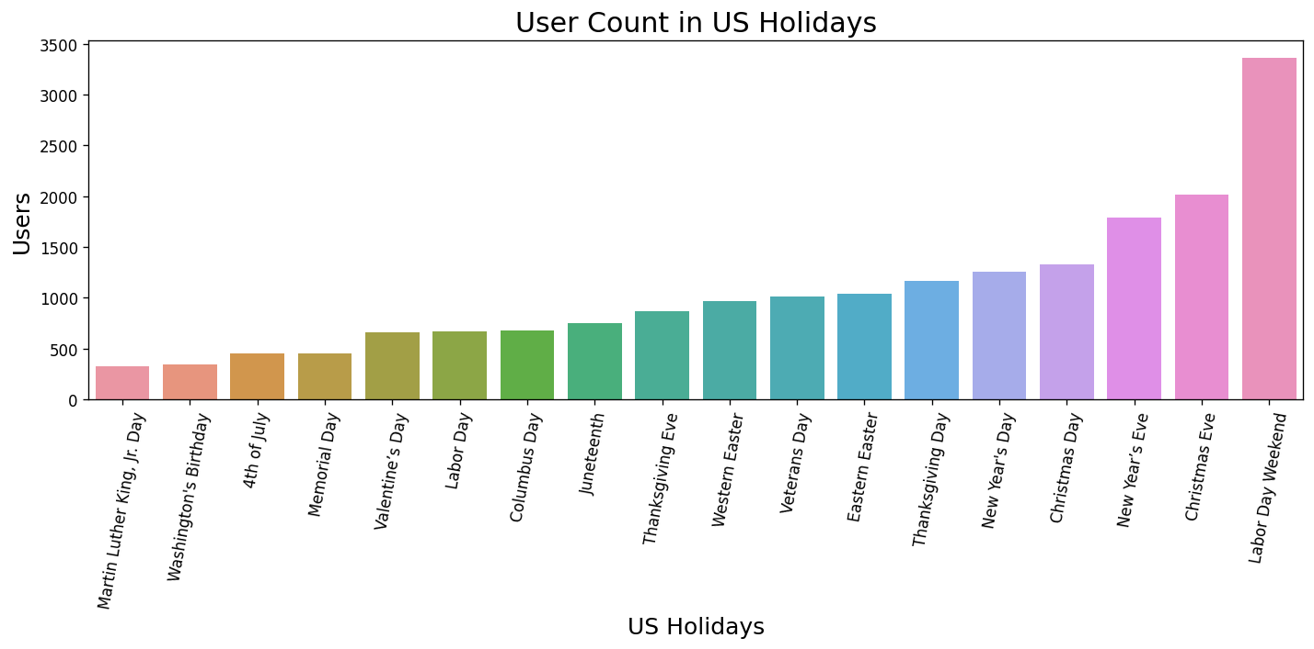
Rides in the US holidays

Slide 21
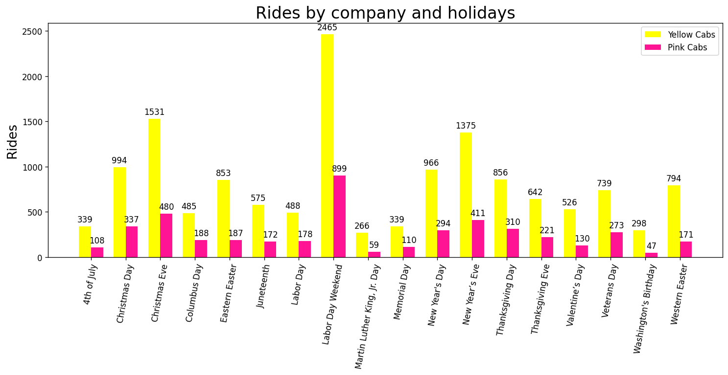
Rides in the US holidays

Slide 22
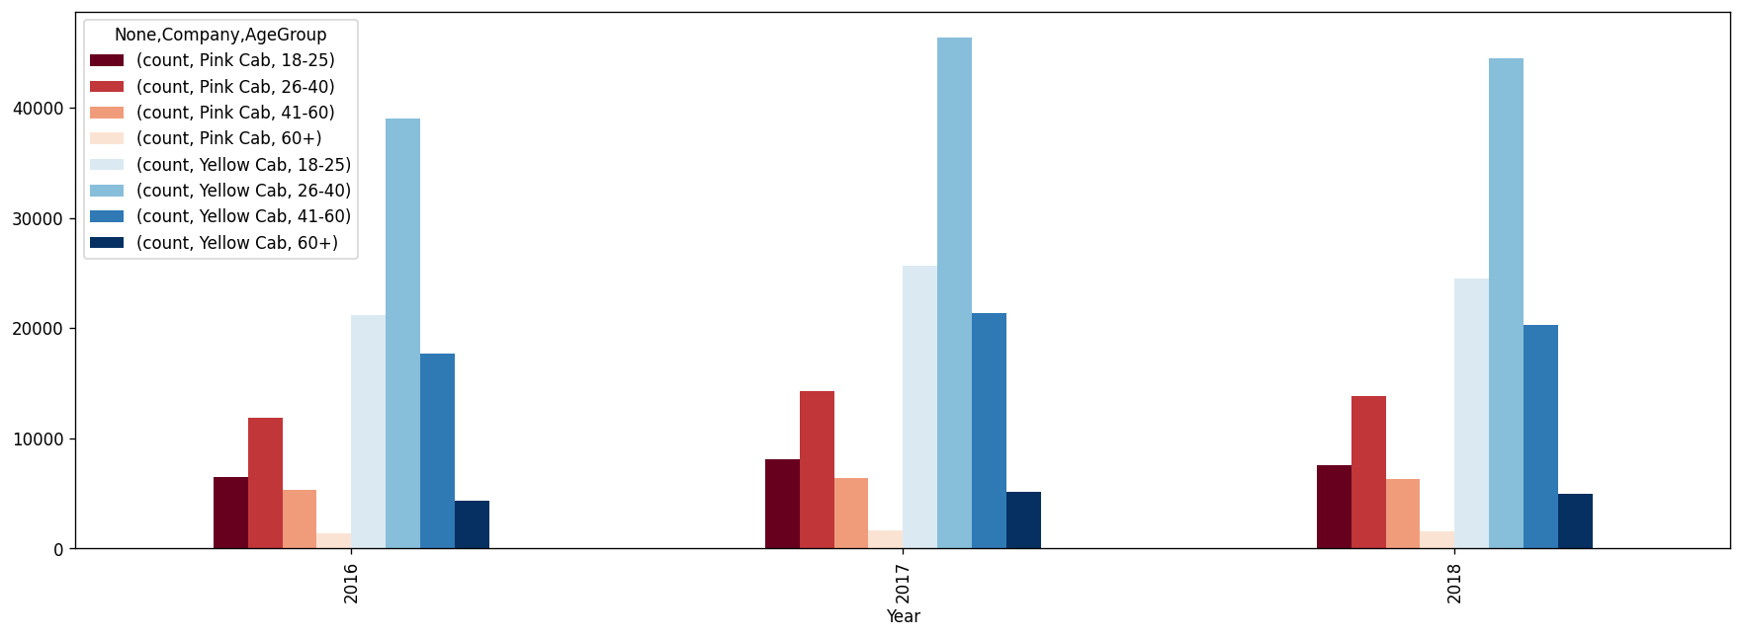
Customer Segmentation(Age)
-The most number of customers come from 26-40 age group for the two companies for every year

Slide 23
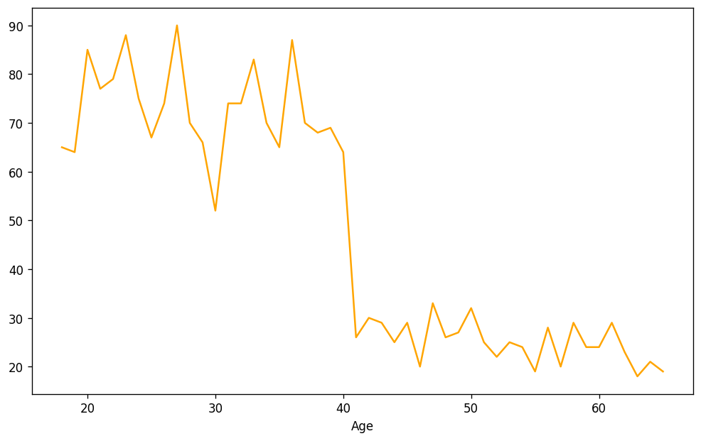
Customer Segmentation(Age)
#Customers amount that used cabs more than 30 times in given 3 years according to their age
-Customer retention is significantly decreasing after 40 years old

Slide 24
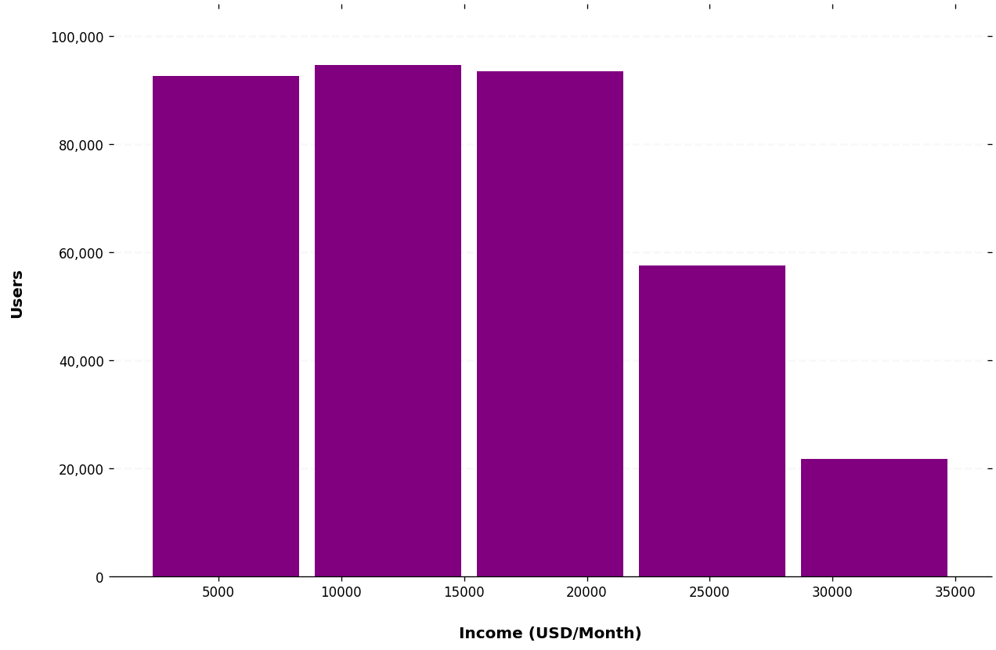
Customer Segmentation(Income)
-Income distribution of customers

Slide 25
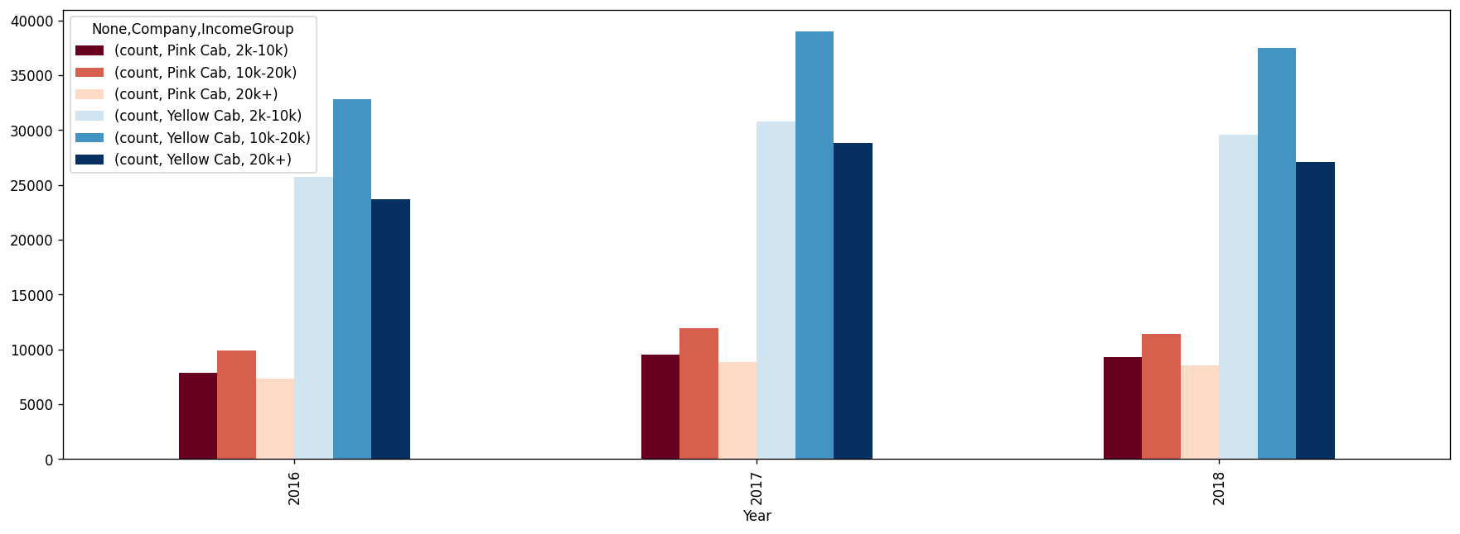
Customer Segmentation(Income)
-Total rides according to income groups of customers

Slide 26
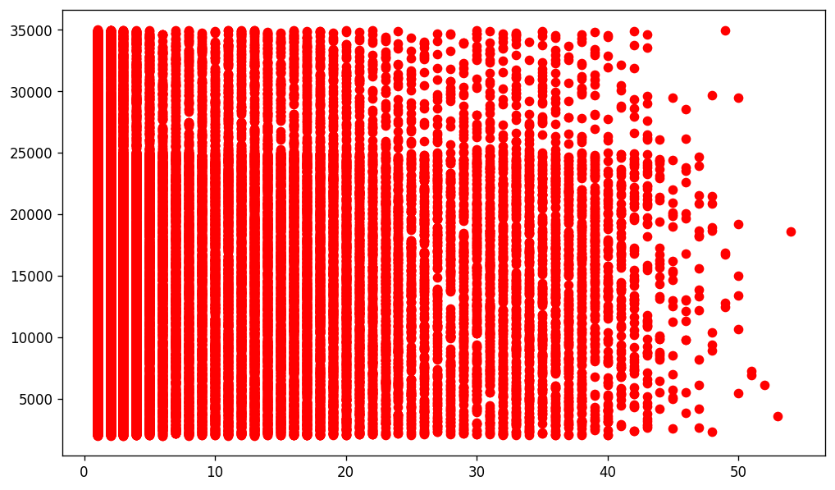
Customer Segmentation(Income)
Income per month USD($)
Total rides by customers in 3 years
-As we can see there is no correlation between income level and customer retention.
**Correlation coefficient 0.0053

Slide 27
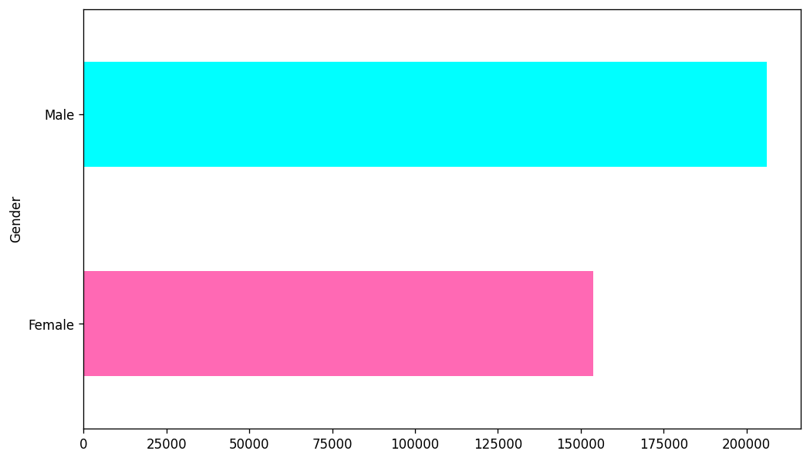
Retention of customers vs Gender
Female Male
Rides 153684 206170

Slide 28
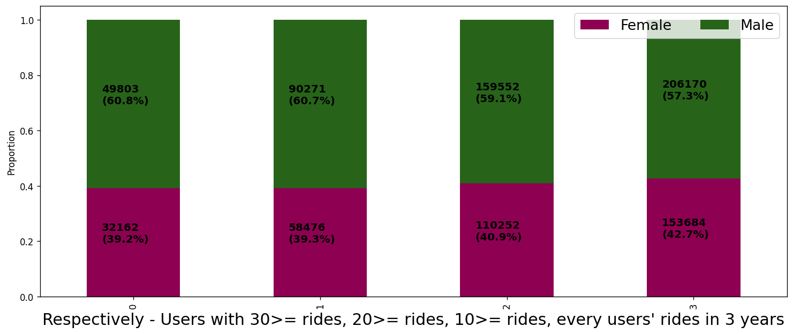
Retention of customers vs Gender
**As we can see if we filter users by their retention to these two firms by their gender, there is almost no change in proportion of gender distribution

Slide 29
EDA summary and Recommendations
Yellow cabs have much more customers, much more profitable per ride, per distance(KM) and in total profits. Even both companies year 2019 profits can be foreseen or forecasted since there is seasonality. This one also suggesting that Yellow cabs are much superior, so there are ratios of profitability etc in analyses, if XYZ company wants to invest in one of these companies(Pink or Yellow), they should go for Yellow.
Extra recommendation for business
-Customer retention is significantly decreasing after 40 years old **Slide 23
Cab companies can create special campaign for people that are older than 40 in this case to attract old people

Slide 30
Some hypothesis testings and results
Test
Result
Testing to see whether age of the customer affects the payment method(cash-card)
There is no difference in payment mode for both Yellow and Pink Cabs according to customer ages
Testing to see whether income of the customer affects the payment method(cash-card)
There is no difference in payment mode for both Yellow and Pink Cabs according to customer incomes
**T-test is used and p value(significance taken as 5%, 0.05)

Slide 31
Some hypothesis testings and results
Test
Result
Testing for Profits per distance(KM) and Age (Choosing age “40” as a threshold)
There is no difference regarding being younger/older than 40 years old for both Yellow Cab and Pink cabs
Testing for Profits per distance(KM) and Age (Choosing age “60” as a threshold)
There is no difference regarding being younger/older than 60 years old for Pink Cab
There is significant difference regarding being younger/older than 60 years old for Yellow Cab
**T-test is used and p value(significance taken as 5%, 0.05)

Slide 32
Some hypothesis testings and results
We have seen, there is significant difference regarding being younger/older than 60 years old for Yellow Cabs, in previous slide
Average profit from per KM, from younger people(<= 60) : $ 7.121
Average profit from per KM, from younger people(<= 60) : $ 6.825
Difference between profits per KM that are traveled for
the people that older or younger 60 years old: $ 0.295
Average KM traveled in one ride(All rides): 22.57 KM
Even it seems there is not significant profit difference between rides of older people when we look at the rides by their "per KM", if we multiply by average distance 22.5 KM with 0.3, almost 7$ profits are changing for yellow cabs.

Slide 33
Some hypothesis testings and results
Test
Result
Testing to see if two companies are taking different distances on average by the cities
There is no difference in distance taken between two companies by cities
# Average distance taken by Pink Cabs: 22.44 KM
# Average distance taken by Yellow Cabs: 22.57 KM
**T-test is used and p value(significance taken as 5%, 0.05)

Slide 34
Some hypothesis testings and results
Test
Result
Testing to see if two companies have different age levels of customers by cities
There is no difference in ages between two companies by cities
# Average age of Pink Cabs customers: 35.37 KM
# Average age of Yellow Cabs customers: 35.31 KM
**T-test is used and p value(significance taken as 5%, 0.05)

Slide 35
Thank You

