Slide 1
Handheld Application Development
Lec 3 : Activity lifecycle
Ekarat Rattagan, Ph.D.

Slide 2
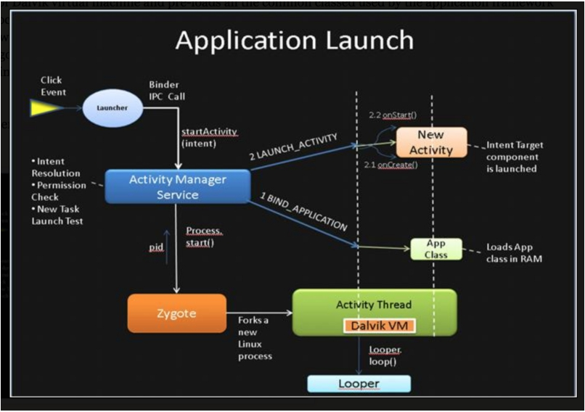
Reference : https://android.jlelse.eu/android-application-launch-explained-from-zygote-to-your-
activity-oncreate-8a8f036864b

Slide 3

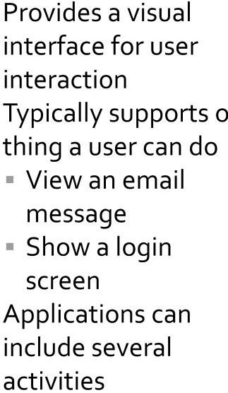
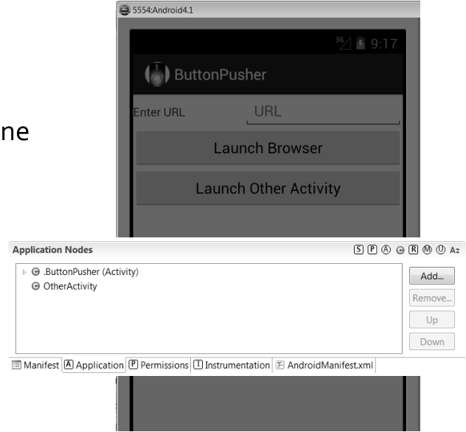

Slide 4

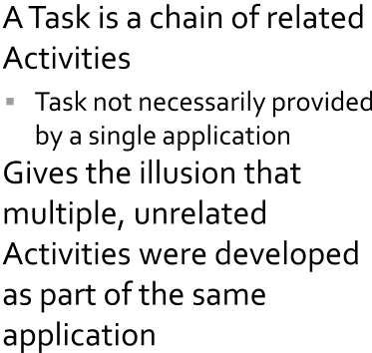
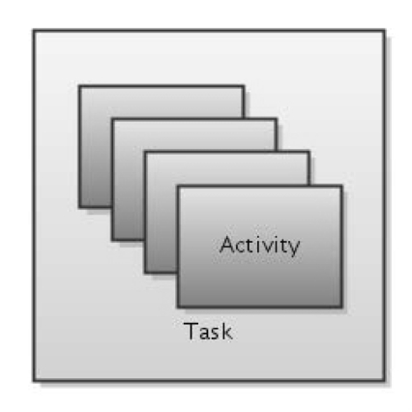

Slide 5





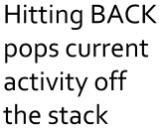
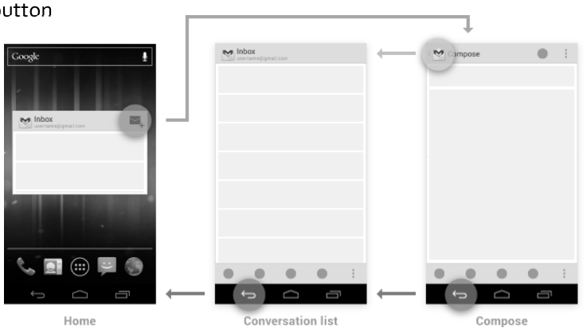

Slide 6

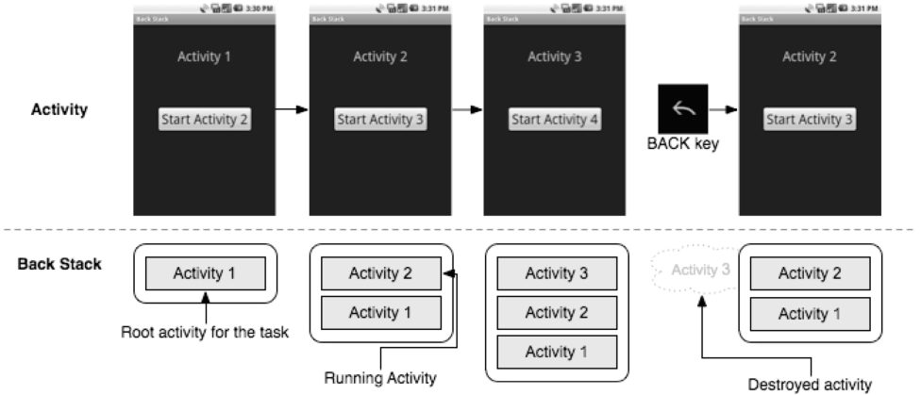


Slide 7
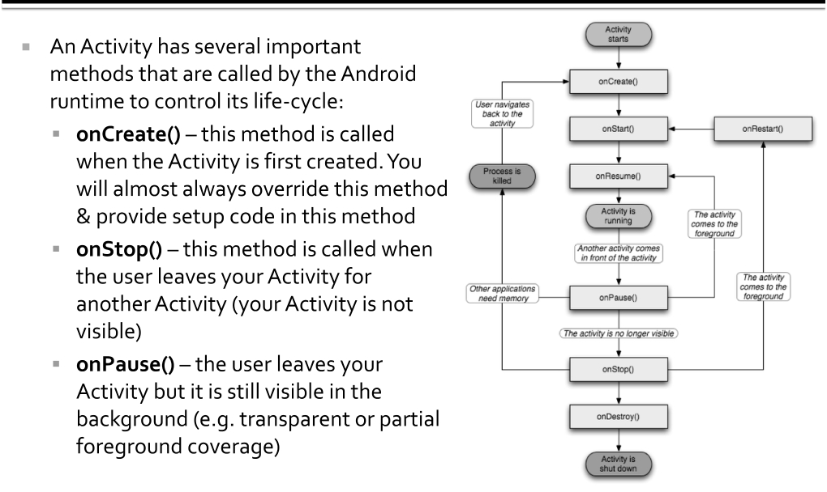
Why we need Activity lifecycle?
http://www.akexorcist.com/2016/04/why-do-we-need-to-know-about-activity-life-cycle-th.html

Slide 8
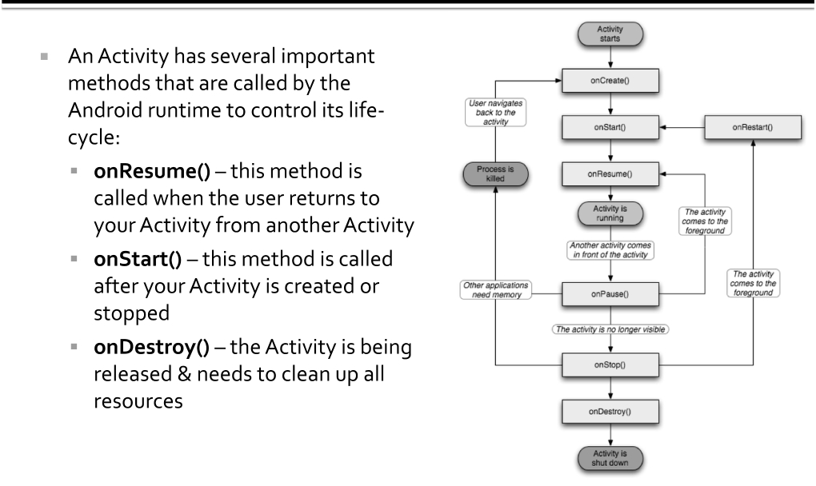

Slide 9
Reference
https://stackoverflow.com/questions/8515936/android-activity-life-cycle-what-are-all-these-methods-for

