Slide 1
Social Network Analysis: Gephi
ผศ. ดร. เอกรัฐ รัฐกาญจน์ (Ekarat Rattagan)
ผู้อำนวยการหลักสูตรวิทยาศาสตรมหาบัณฑิต
สาขาวิชาการวิเคราะห์ข้อมูลและวิทยาการข้อมูล
Data Analytics and Data Science (DADS)
คณะสถิติประยุกต์ นิด้า (NIDA, BKK, Thailand)

Slide 2
Social Network Analysis
The process of investigating social structures through the use of networks and graph theory
nodes (individual actors, people, or things within the network) and
ties, edges, or links (relationships or interactions) that connect them.
Examples of social structures commonly visualized through social network analysis include
social media networks
memes spread
information circulation
friendship and acquaintance networks
business networks
knowledge networks
difficult working relationships
https://en.wikipedia.org/wiki/Social_network_analysis

Slide 3
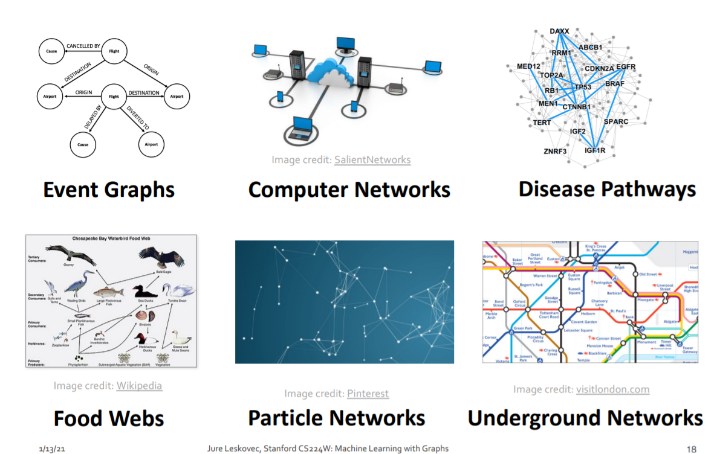

Slide 4
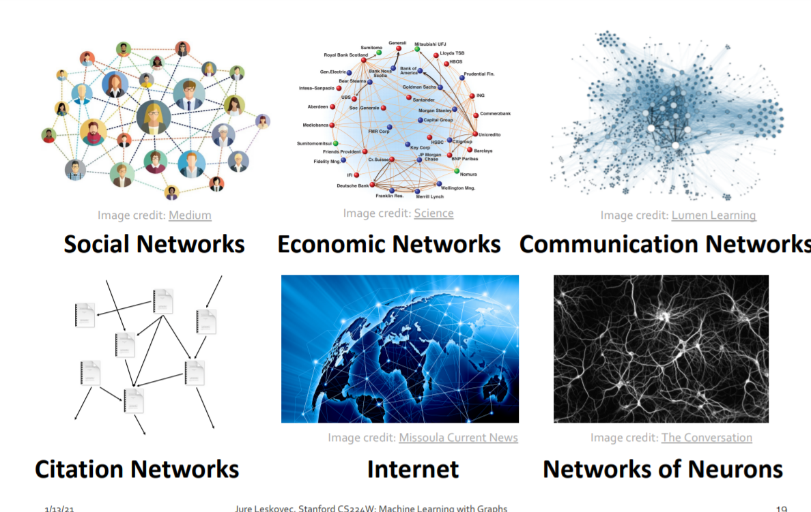

Slide 5
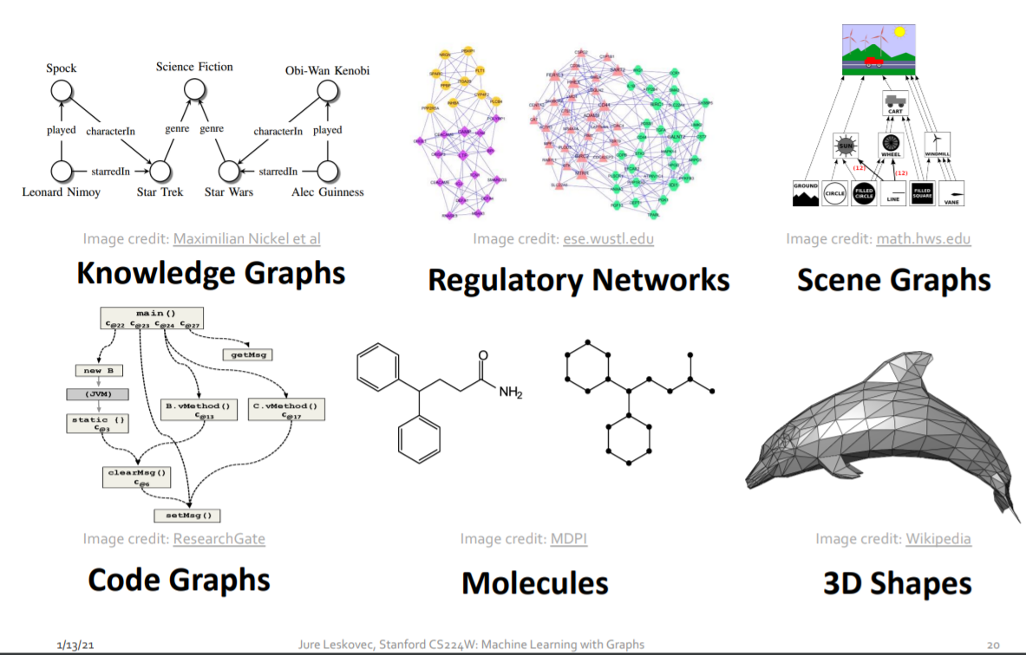

Slide 6

https://gephi.org/

Slide 7
Gephi features
https://gephi.org/features/

Slide 8
Let’s get started
Link:
https://gephi.org/tutorials/gephi-tutorial-quick_start.pdf
https://seinecle.github.io/gephi-tutorials/generated-pdf/simple-project- from-a-to-z-en.pdf

Slide 9
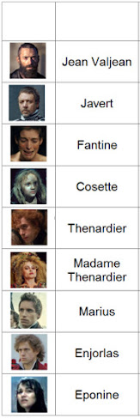
https://www.overthinkingit.com/2013/01/02/can-you-hear-the-people-graph-les-miserables/

Slide 10
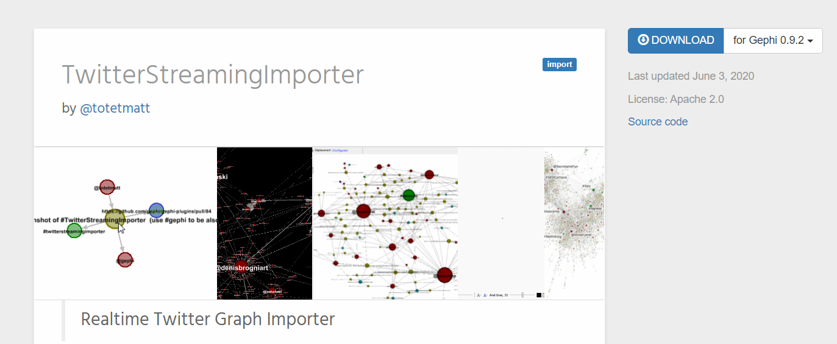
https://gephi.org/plugins/#/plugin/twitter-streaming-importer
https://github.com/seinecle/gephi-tutorials/blob/master/src/main/asciidoc/twitter-streaming-importer-en.adoc

Slide 11
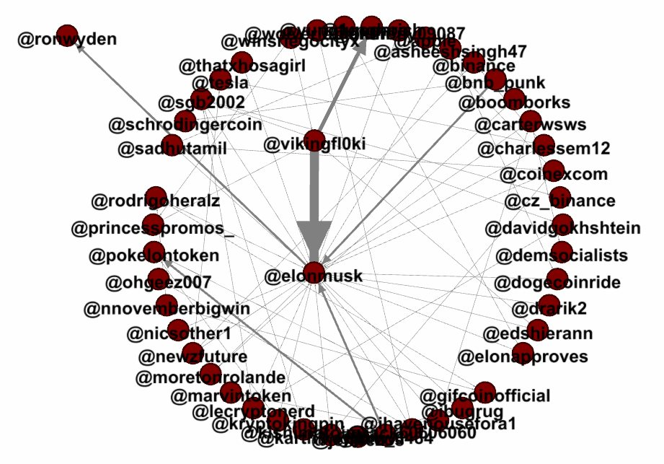

Slide 12


