Slide 1
Deep Learning with Python — Project 2
Cardiac MRI Segmentation on ACDC
A five-block pipeline, an ablation study and an honest result.
Selvinaz Sayın (220901755) ·
Ege Karaurgan (229910141) ·
Vedat Efe Gezer (229910158) ·
Mehmet Emin Akkaya (2309011036) ·
Bayram Selim Yılmaz (2309011053)
Department of Software Engineering — Istinye University
SWE012, Spring 2026 — Instructor: Asst. Prof. Dr. Yigit Bekir Kaya
Presenter speaks for 3:00.

Slide 2
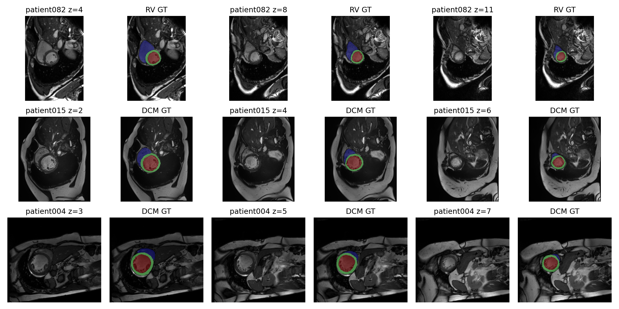
PROBLEM
What we are actually predicting
ACDC benchmark
150 patients · cine cardiac MRI · 5 phenotypes (NOR, MINF, DCM, HCM, ARV).
Targets
Voxel-wise 4-class segmentation: background, right ventricle, myocardium, left ventricle.
Numbers
100 / 50 train / test · ~28 cine frames per patient · severe foreground/background imbalance.
Cine MRI slices with expert ground-truth overlays (RV / MYO / LV).
Why it is hard. Only 100 labelled training patients — a small-data, high-capacity regime where the wins come from inductive bias and regularisation, not from extra parameters.
2 / 6

Slide 3
ARCHITECTURE
Five blocks, one model
1
2
3
4
5
3D U-Net backbone
Denoising AE pretrain
ConvLSTM bottleneck
Attention skip gates
VAE diagnosis head
Conv3d + InstanceNorm + LeakyReLU. Volumetric skips preserve inter-slice anatomy.
Self-supervised encoder init — reconstructs clean voxels from Gaussian + dropout corruption.
Gated recurrence over the cine cycle; convolutional gates keep spatial structure.
Additive gating re-weights encoder features before decoder concatenation.
Reparameterised latent then 5-class phenotype, KL-regularised against N(0,I).
Loss. Soft-Dice + cross-entropy on the segmentation head; classification CE + KL on the VAE head. Optim. Adam (1e-4), 5-epoch warm-up + cosine annealing, dropout 0.2, weight decay 1e-5, InstanceNorm, early stopping on validation Dice.
3 / 6

Slide 4
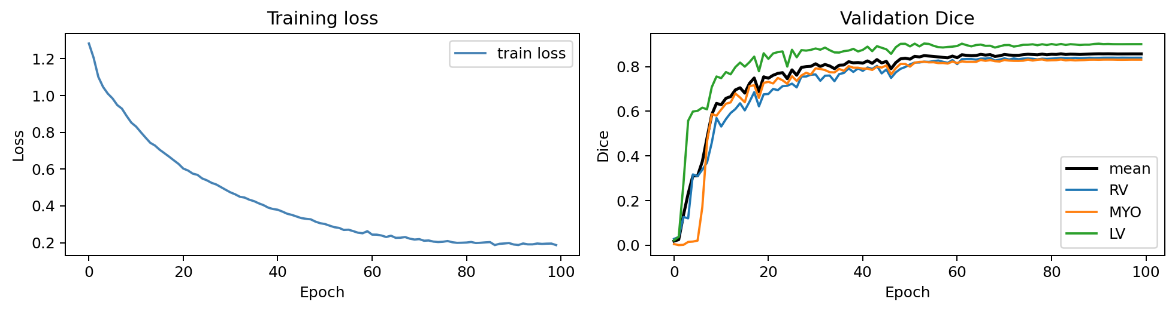
RESULT
The strongest completed model is the baseline
0.8576
Side by side
3D U-Net baseline
0.8576
Full five-block model
0.7412
mean validation Dice — 3D U-Net baseline, fold 0, seed 42, 100 epochs.
No autoencoder pretrain
0.8555
No ConvLSTM
0.7272
No attention gates
0.7244
No VAE branch
0.7364
100-epoch training loss and per-class validation Dice (RV / MYO / LV).
Takeaway. Capacity alone did not buy Dice — the simplest discriminative architecture wins this small-data regime.
4 / 6

Slide 5
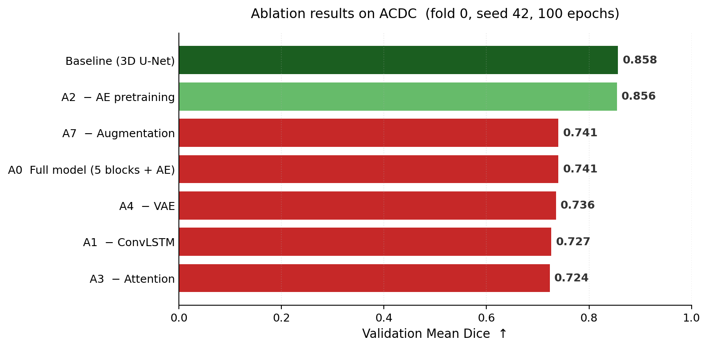
ANALYSIS
Why the heavy model loses to baseline
THE KEY ABLATION
A2 — remove AE pretraining:
0.7412 → 0.8555 Dice
Objective mismatch. The denoising MSE objective is a smoothness prior — it minimises pixel-wise reconstruction error, which biases the encoder toward low-frequency features. Cardiac segmentation depends on the high-frequency myocardial wall, so the pretrained init is a worse starting point than random + Kaiming for this loss surface.
A1 no ConvLSTM = 0.7272; A3 no attention = 0.7244. Main recovery comes from A2.
5 / 6

Slide 6
CONCLUSION
What we are willing to claim
WHAT THE EXPERIMENTS SUPPORT
WHAT WE ARE NOT CLAIMING
A clean 3D U-Net at 0.8576 mean Dice on fold 0.
Stacking auxiliary objectives can hurt the primary metric when the inductive biases disagree.
Removing AE pretraining recovers almost all of the baseline gap — the diagnostic signal is clear.
Single fold, single seed — no 5-fold variance estimate yet.
ConvLSTM tested on ED/ES frames, not the full cine sequence — the temporal claim is unsettled.
No cross-centre evaluation (e.g. M&Ms) — generalisation is open.
Thank you. Happy to take questions on the ablation or the training protocol.
6 / 6

