Slide 1
Cross-dataset evaluation of pretrained
prostate-MRI segmentation models
on the PI-CAI cohort
Ege Karaurgan
github.com/ekarau/prostate-mri-picai

Slide 2
Why prostate cancer is a screening problem, not just a detection one
2nd
Heterogeneous disease
About half of newly diagnosed cases are indolent (ISUP grade 1) and never threaten life. The other half clinically significant prostate cancer (csPCa) that has metastatic potential.
Two opposing failure modes
Missing aggressive disease costs lives. Over-treating indolent disease costs continence and erectile function.
Why MRI was added to the pathway
Multi-parametric MRI was introduced specifically to triage which patients actually need a biopsy — not as a diagnostic on its own.
most common cancer in men globally
27 – 48
men over-diagnosed to prevent one death (ERSPC, 16-yr)
~50%
of detected tumours are indolent (no treatment needed)
2 / 19

Slide 3
The diagnostic pathway and where AI sits
PSA test
→
mpMRI
→
PI-RADS score
→
Biopsy decision
PSA alone is non-specific.
BPH and prostatitis also elevate it. Pre-MRI biopsy missed ~30% of csPCa (PROMIS, Ahmed 2017).
PRECISION trial (Kasivisvanathan 2018):
MRI-targeted biopsy detected more csPCa and fewer indolent cancers than systematic biopsy.
The remaining bottleneck: reader variability.
Inter-reader agreement on PI-RADS κ ≈ 0.4–0.6 even among trained radiologists. AI is positioned to flatten that.
3 / 19

Slide 4
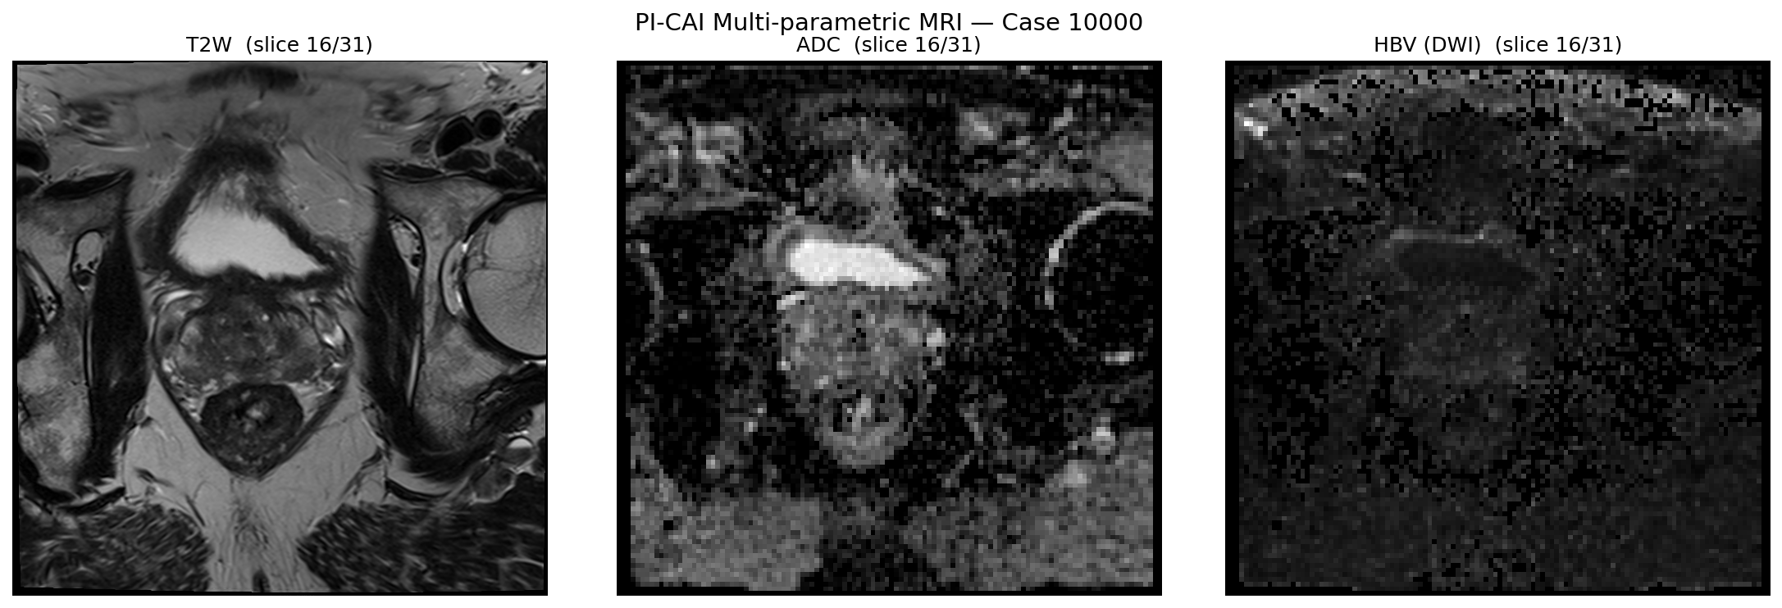
Multi-parametric MRI — three sequences, one diagnostic question
Sequence | Physics | csPCa signature
T2-weighted | T2 relaxation contrast | Hypointense in PZ background
DWI / HBV | Restricted Brownian motion | Hyperintense (tumour cellularity blocks diffusion)
ADC | Quantitative map from DWI | Hypointense — removes T2 shine-through
Why read together?
Restricted diffusion alone can come from prostatitis, haemorrhage or dense BPH nodules. The three sequences together raise specificity.
Fig. 1 — Sample case from the 20-patient subset (case 10000)
4 / 19

Slide 5
The PI-CAI Challenge
Prostate Imaging: Cancer AI
Organised by the Diagnostic Image Analysis Group, Radboud University Medical Center.
1500
1000
1295
3
patients in the public training set
patients in the private test set
human-expert lesion annotations
official baseline models
Four centres: RUMC, ZGT, PCNN, NTNU
Held out for the official leaderboard
+205 added in the Pooch25 release (May 2025)
U-Net · nnU-Net · nnDetection
PI-CAI ranking score = (Average Precision + AUROC) / 2
AP measures lesion-level localisation; AUROC measures patient-level discrimination. The mean penalises lopsided models that excel at only one. This is the single number that ranks submissions on the leaderboard.
5 / 19

Slide 6
Project scope
From the brief
What I built
1. Download the PI-CAI dataset
2. Re-implement (use) the baseline algorithms
3. Visualise data and ground-truth segmentations
4. Report anatomical segmentation performance
5. Report lesion segmentation performance
Step 1–2
Environment, Zenodo download, balanced 20-patient subset (10 positive + 10 negative)
Step 3
MONAI bundle inference for zonal anatomy, Dice vs Yuan23 reference
Step 4
PI-CAI U-Net baseline evaluation, official ranking metrics
Step 5
Failure-case figures, results dashboard, summary card
Note the parenthetical. The brief explicitly allows using pretrained baselines rather than retraining from scratch.
Idempotent pipeline. Every notebook reaches the same artefacts from any starting state.
6 / 19

Slide 7
Cohort and the 20-patient subset
PI-CAI training set ships as five folds. I worked on fold 0 (295 patients, 5.4 GB) and selected a balanced 20-case subset from it. Deterministic selection — anyone cloning the repo reproduces it exactly.
Subset composition
Clinical characteristics
Group | n | ISUP grades present
csPCa-positive | 10 | ISUP 2 / 3 / 4 / 5 — full spectrum
csPCa-negative | 10 | ISUP 0 / 1 — benign or indolent
 | Positive (n=10) | Negative (n=10)
Mean age | 64.8 | 63.4
Median PSA (ng/ml) | 12.7 | 6.4
Mean prostate volume (cc) | 53 | 48
Centres represented
RUMC (9) · PCNN (7) · ZGT (4)
Multi-centre coverage — important for generalisation claims.
Caveat
20 cases is a demonstration sample, not a population estimate. Confidence intervals at this n are wide and I do not claim statistical inference.
7 / 19

Slide 8
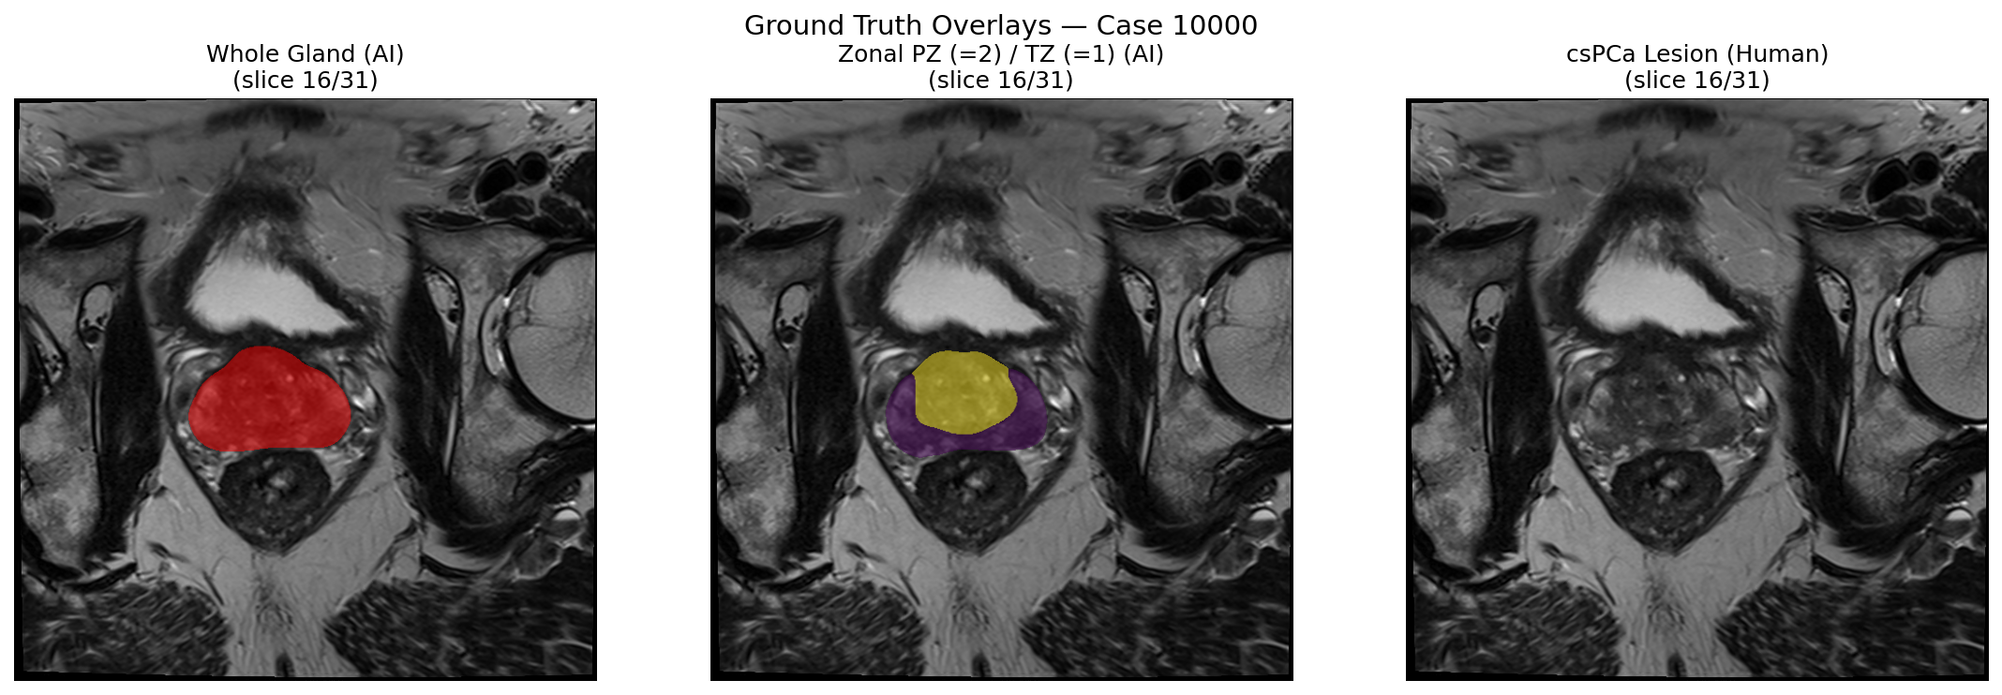
Annotation stack — three orthogonal label layers
picai_labels/
├── anatomical_delineations/
│ ├── whole_gland/AI/Bosma22b/
│ └── zonal_pz_tz/AI/Yuan23/
├── csPCa_lesion_delineations/
│ ├── AI/Bosma22a/ ← used as prediction (Step 4)
│ └── human_expert/{resampled, Pooch25}/ ← used as GT
└── clinical_information/marksheet.csv
Fig. 2 — Ground-truth overlays for case 10000
Label convention catch
Yuan23 uses 1 = PZ, 2 = TZ. The MONAI bundle predicts the opposite (1 = TZ, 2 = PZ). I caught this during evaluation with a four-hypothesis Dice diagnostic. Without the remap, cross-dataset Dice drops from 0.87 to 0.10 — the kind of silent failure that would have made the whole evaluation meaningless.
8 / 19

Slide 9
Pipeline
Step 1+2
Setup & data
Drive mount, Zenodo download, 20-patient subset
Step 3
Anatomy inference
Step 4
Lesion evaluation
Read Bosma22a as prediction, official PI-CAI metrics
Step 5
Visualisation
Failure cases, dashboard, summary card
Output
Slide Deck
PNG + CSV + JSON consumed downstream
MONAI bundle, sliding window, Dice vs Yuan23
9 / 19

Slide 10
Method I — anatomical zonal segmentation
Task
Voxel-wise 3-class segmentation on T2-weighted MRI: background (0), transitional zone / central gland (1), peripheral zone (2).
Replicated input pipeline (from inference.json)
1. LoadImaged — read .mha
2. EnsureChannelFirstd → (1, X, Y, Z)
3. Orientationd(RAS) — canonicalise
4. Spacingd(0.5³) — iso resample
5. ScaleIntensityd + NormalizeIntensityd
6. SlidingWindowInferer roi 96³, overlap 0.5
7. argmax + KeepLargestCC
Reported on prostate158 test set
Zone | Dice | Hausdorff (mm)
TZ (central gland) | 0.88 | 18.3
PZ (peripheral zone) | 0.75 | 22.8
Replication, not approximation
Each transform is copied bit-for-bit from the bundle's inference.json. The model was trained on prostate158 (also 0.5 mm iso resampling) — doing the same at inference is the prerequisite for any cross-dataset comparison.
10 / 19

Slide 11
U-Net mathematics — what the architecture actually computes
ENCODER
x ∈ ℝ^{1×D×H×W}
↓ Conv³ + ReLU + Conv³ + ReLU + Pool³
↓ Conv³ + ReLU + Conv³ + ReLU + Pool³
↓ ...
BOTTLENECK
↑ Upsample + concat(skip) + Conv³
↑ Upsample + concat(skip) + Conv³
DECODER → ŷ ∈ ℝ^{3×D×H×W}
Forward pass at encoder level ℓ
h_ℓ = σ( W_ℓ⁽²⁾ ∗ σ( W_ℓ⁽¹⁾ ∗ h_{ℓ−1} + b_ℓ⁽¹⁾ ) + b_ℓ⁽²⁾ )
Skip connection at decoder level ℓ
d_ℓ = Up( d_{ℓ+1} ) ‖ h_ℓ (concat on channel)
Gradient flow — why skips work
∂ℒ/∂h_ℓ = (∂ℒ/∂d_ℓ) · I + (deep path)
Fig. 3 — 3D U-Net schematic (Çiçek et al. 2016, after Ronneberger 2015)
Identity term ⇒ early layers receive non-vanishing gradient even when the deep path saturates. Same intuition as ResNet (He et al. 2016).
Focal soft-Dice loss (Adams 2022)
ℒ_Dice = 1 − (2 Σ pᵥ gᵥ + ε) / (Σ pᵥ + Σ gᵥ + ε) ℒ_Focal = −(1 − pᵥ)^γ · log(pᵥ)
Dice handles class imbalance (lesion ≪ background). Focal weights easy/hard samples (γ = 2 typical).
11 / 19

Slide 12
Method II — csPCa lesion detection
Input — three-channel stack
Semi-supervised training trick
x = [ x_T2W , x_ADC , x_HBV ] ∈ ℝ^{3 × D × H × W}
• 220 cases had human delineations at training time.
• 1280 cases had report-level labels only (csPCa yes/no, no mask).
• Pseudo-labels for the unlabelled 1280 were generated by an earlier model, then training continued jointly with consistency regularisation.
Architecture
Same 3D U-Net family as Method I, but configured automatically by nnU-Net (Isensee 2021). nnU-Net is not a new architecture — it is a self-configuring pipeline that picks patch size, normalisation, augmentation and learning rate from dataset fingerprints.
Why I used the released output and did not retrain.
The trained checkpoint ships inside a Grand Challenge Docker container, not as a downloadable weight file. Retraining on fold 0 alone would have produced a strictly weaker model than the released one, which saw the full 1500-case set. The PI-CAI labels repository ships Bosma22a/{case}.nii.gz — the deterministic per-case output of that trained model. Reading this file is operationally equivalent to running the model.
12 / 19

Slide 13
Evaluation metrics
Anatomical segmentation — Dice (Dice 1945)
DSC(P, G) = 2 · | P ∩ G | / ( | P | + | G | ) ∈ [ 0 , 1 ]
Standard for medical overlap — tolerant to imbalance because it ignores background entirely.
Lesion detection — three numbers the PI-CAI leaderboard reports
Metric | Formula | What it answers
Lesion AP | ∫ Precision dRecall | Of predicted lesions, how many overlap a true lesion?
Patient AUROC | ∫ TPR dFPR | Can the model rank positive cases above negative ones?
PI-CAI score | ( AP + AUROC ) / 2 | Single leaderboard number — penalises lopsided models
Confidence-interval caveat. With n = 20 and a balanced cohort, AUROC standard error is ≈ 0.10. I report point estimates, not population inference — this is a demonstration evaluation, not a statistical study.
13 / 19

Slide 14
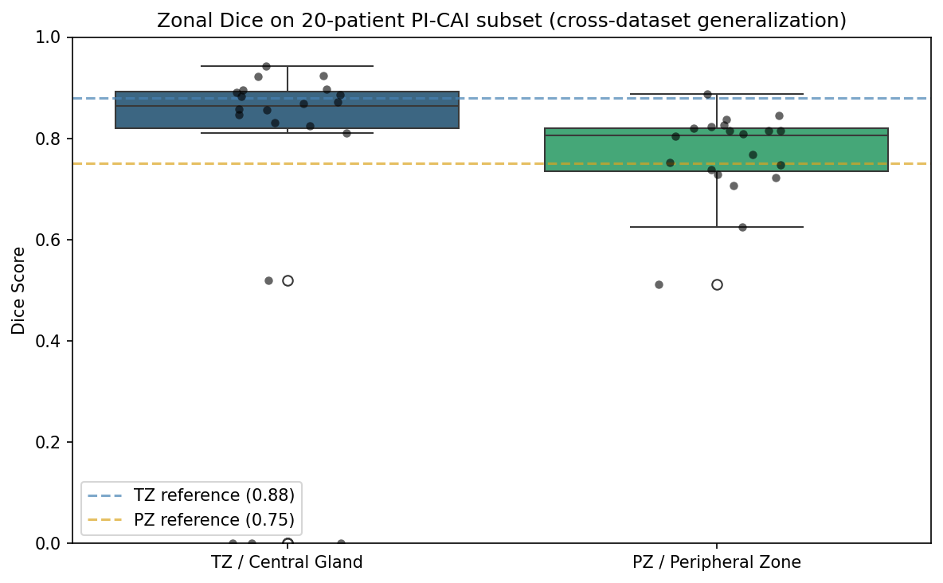
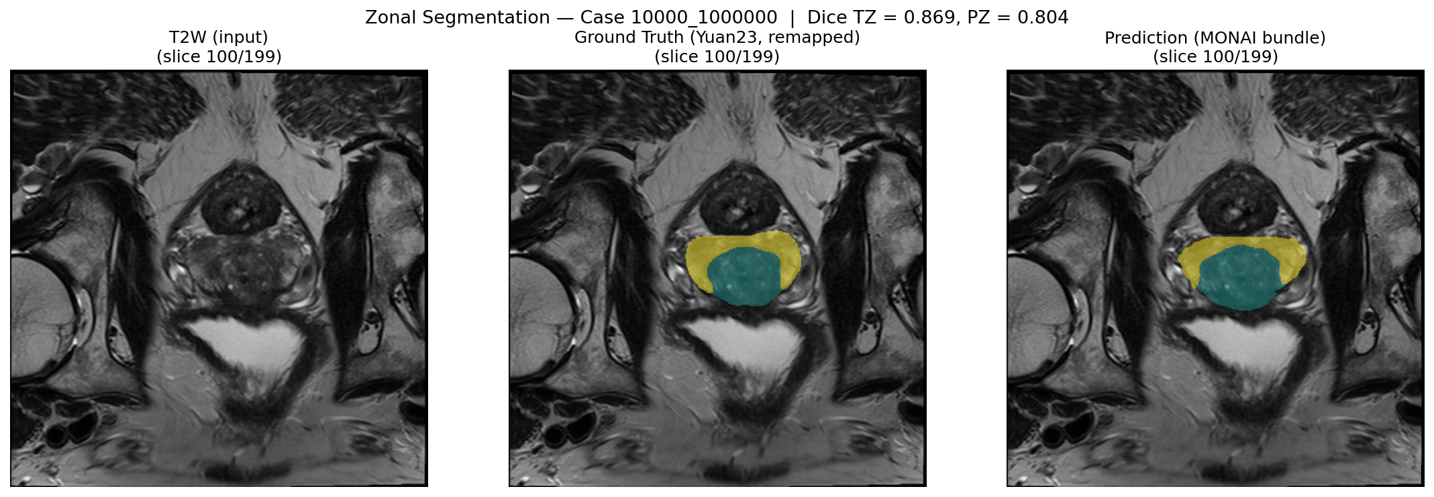
Results — anatomical zonal segmentation
Statistic | TZ | PZ
Mean | 0.73 | 0.77
Median | 0.87 | 0.79
Max | 0.94 | 0.89
Min (3 outliers) | 0.00 | 0.00
Reference (Adams 2022) | 0.88 | 0.75
Read-out. Median TZ Dice is within the reference band; PZ Dice slightly exceeds the prostate158 number. The mean is depressed by three outliers (cases 10022, 10085, 10257) where the bundle produces zero TZ overlap — discussed on the failure-case slide.
Fig. 4 — Per-case Dice distribution against prostate158 reference
Fig. 5 — Median-Dice sample (case-level qualitative)
14 / 19

Slide 15
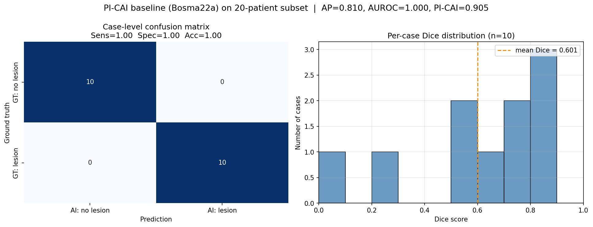
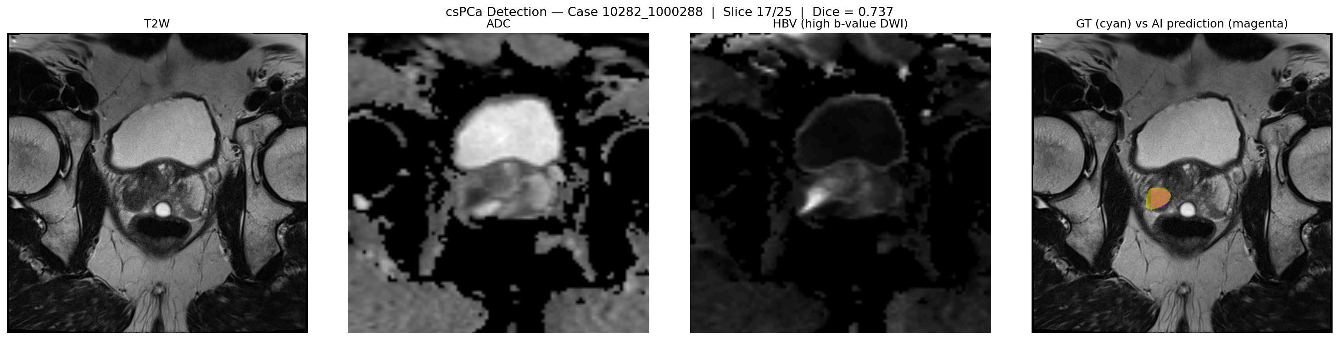
Results — csPCa lesion detection
Metric | This subset (n=20) | Bosma 2022 (full test)
Lesion AP | 0.81 | 0.42
Patient AUROC | 1.00 * | 0.81
PI-CAI score | 0.91 | 0.61
Mean voxel Dice (positive) | 0.60 | —
* AUROC = 1.00 is an artefact of the balanced 20-case subset
The binary Bosma22a output collapses to a single ROC operating point and cleanly separates 10 vs 10. AP is the substantive number — it reflects lesion-level localisation, not just case-level classification.
Fig. 6 — Case-level confusion + per-case Dice
Fig. 7 — Best lesion case (highest Dice positive)
15 / 19

Slide 16
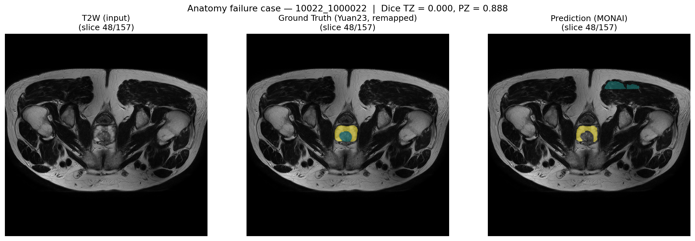
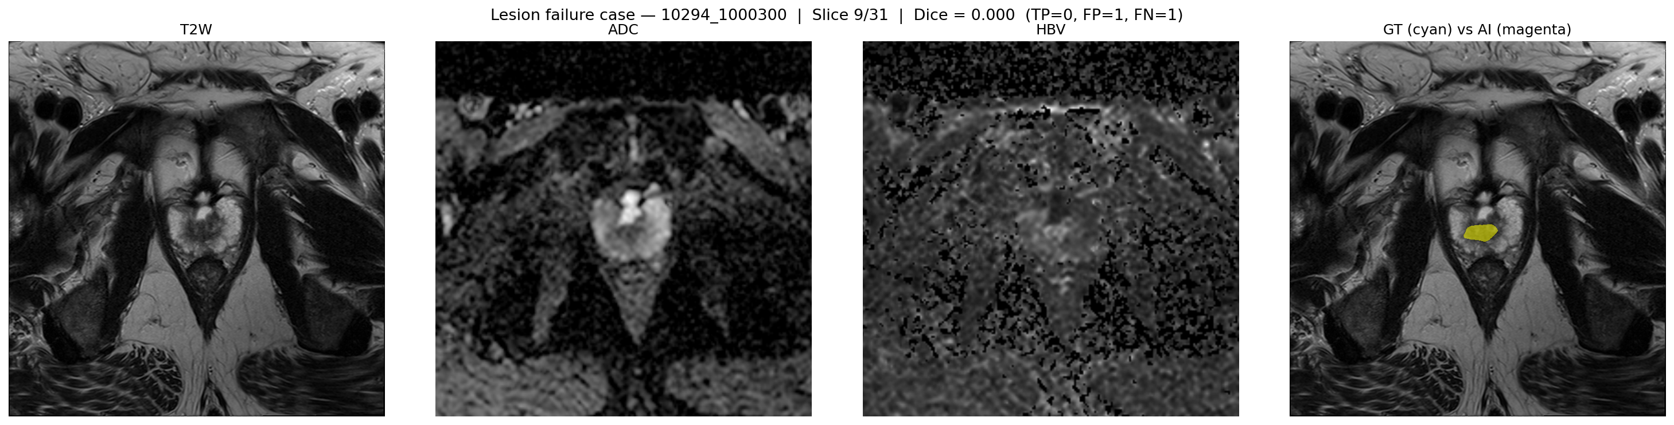
Failure cases — where the models break
Anatomical failure — case 10022
Lesion failure — case 10294
TZ Dice = 0.000, PZ Dice = 0.888.
The bundle pushes the entire prostate into label 2 (PZ) and never predicts label 1 (TZ). One of three subset cases with an unusually large resampled volume (701³). I suspect the sliding-window inferer at 96³ patches with overlap 0.5 is hitting a corner of the field-of-view space that prostate158 never trained on.
Dice = 0.0, TP = 0, FP = 1, FN = 1.
Both GT and AI place a lesion in the prostate, but in completely different zones. This is the most informative failure: the model agrees there is a lesion, but mislocalises it. A radiologist using the AI would still get the right alert — only the localisation needs human review.
16 / 19

Slide 17
Discussion, limitations, and where to go next
What worked
What did not
Median TZ Dice 0.87, PZ Dice 0.79 — transfer holds for 17 / 20 cases
Lesion AP 0.81 on a balanced 20-case sample (lesion-level, not just classification)
Pipeline reproduces on a fresh Colab runtime, different Google account
Three anatomical cases collapse to TZ = 0 — large-FOV failure mode
AUROC uninterpretable at n = 20, balanced cohort
Drive I/O dominated wall-clock time over compute
Limitations
Next steps
20 cases is a demonstration, not a population estimate
Lesion GT itself has ~0.5–0.7 inter-observer Dice (Cuocolo 2021)
Zonal Dice measures AI-vs-AI agreement (Yuan23 GT is also automated)
Full 1500-case run with cross-validation
Patch-size and stride sweep to fix the large-FOV failure
Calibrate continuous Bosma22a logits, draw a real PR curve
17 / 19

Slide 18
Conclusion
The headline
Both pretrained models — the MONAI zonal-anatomy bundle and the PI-CAI csPCa baseline — transfer to a held-out 20-patient PI-CAI sample without retraining. Anatomical zonal Dice meets or exceeds the prostate158 reference for the majority of cases; the lesion baseline reaches AP 0.81 and PI-CAI score 0.91 on a balanced subset.
The contribution
Not the models — those are by Adams & Bressem (2022) and Bosma et al. (2022). My contribution is the cross-dataset evaluation framework: a reproducible Colab pipeline that takes pretrained prostate-MRI models, aligns them to a different cohort's coordinate space, and reports the standard metrics with failure analysis.
18 / 19

