Slide 1


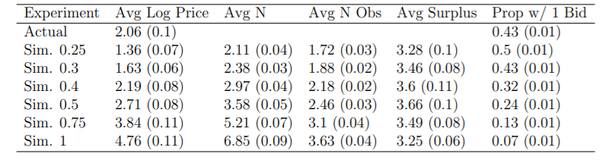
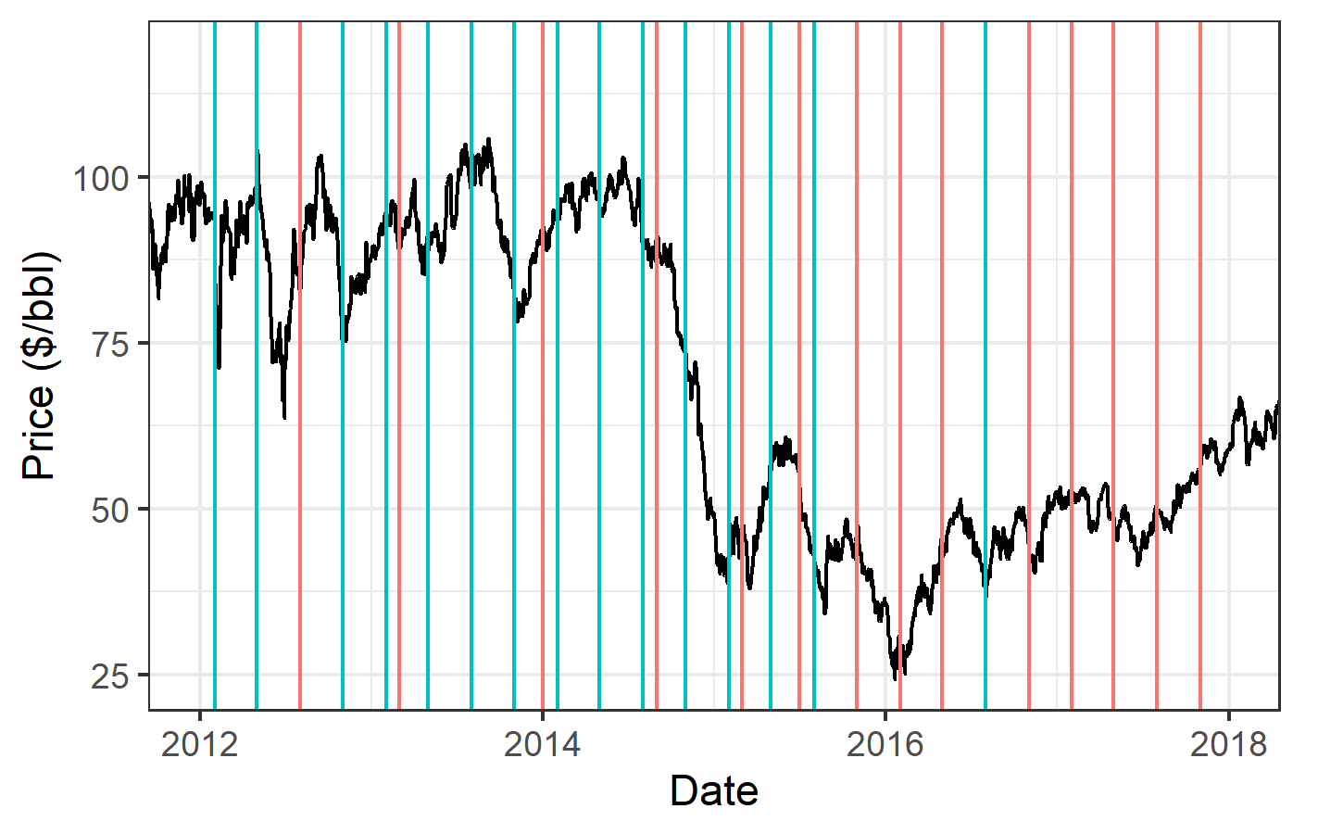
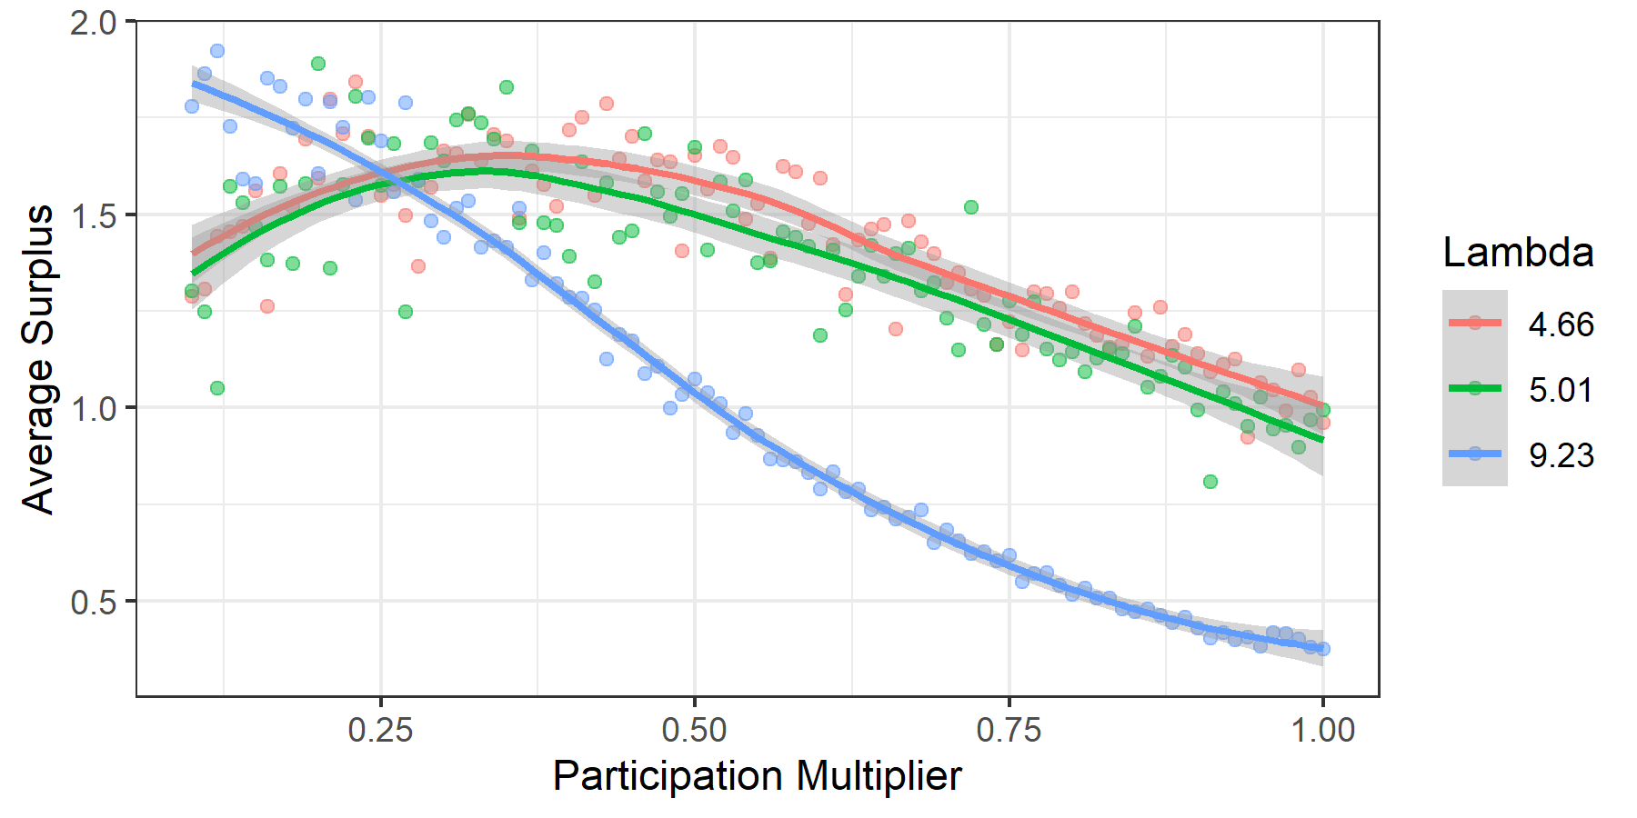
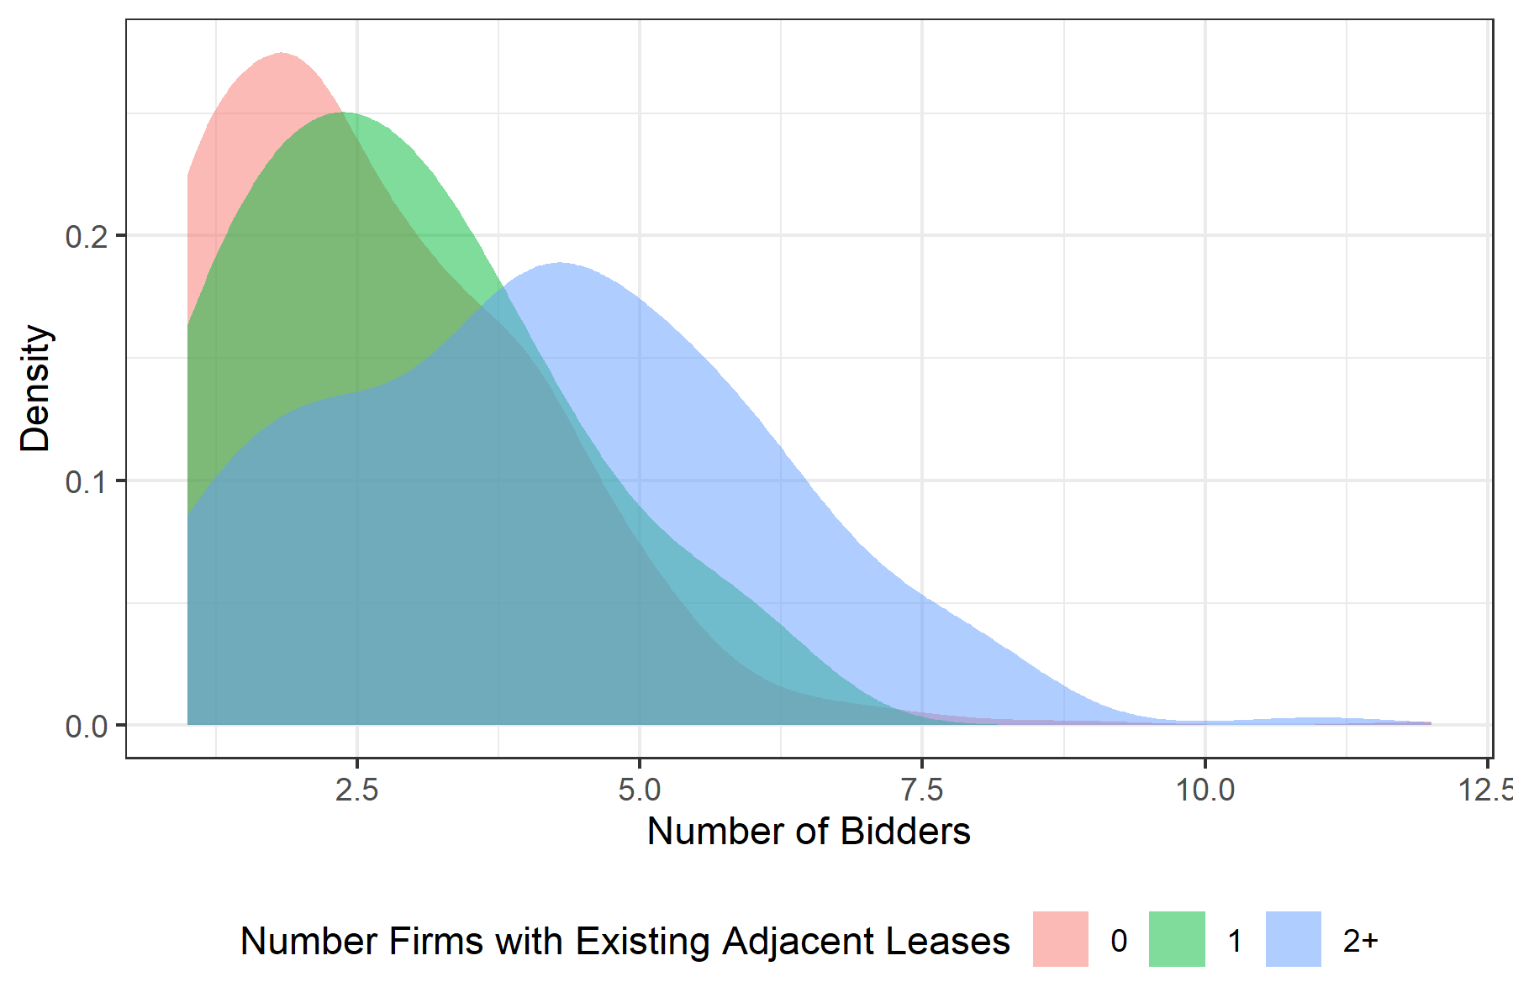
Comparing Open Outcry and Online Auctions:
Evidence from North Dakota Mineral Auctions
June 2020
Eric Karsten (ekarsten@uchicago.edu, www.github.com/ekarsten)
Master of Arts Program in the Social Sciences, Concentration in Economics, University of Chicago
1. Research Question
4. Results: What Entry Costs Explain Revenue Difference?
Conclusion
Why do online auctions have higher revenue than in-person auctions for similar leases?
Who are the winners and losers from the change in auction format?
Reduced for estimates show online auctions bring in 20% to 160% more revenue
Structural model suggests this could be attributed to reduced interest equivalent to 4 fewer bidders interested in the typical parcel
The proportion of auctions with one bidder is a useful outside moment that suggests the robustness of this structural model
2. Institutional Background
Actual open outcry auctions are best replicated by scaling interest in auctions to about 40% of what it would be in the online auctions
Equivalent to higher entry costs by about $2400 per parcel
Equivalent to about 4 fewer bidders considering the auction
North Dakota alternated online (Pink) and in-person (Blue) auctions for a period before switching to online
There was a big boom in hydraulic fracturing from 2005 to 2015 that occurred in North Dakota’s Bakken Shale formation, so allocation decisions matter for a big industry
Limitations
5. Results: Bidder Surplus Maximizing Entry Costs
Current version of the paper makes stronger parametric assumptions on bidder entry and value distributions than I would like given that these distributions are theoretically nonparametrically identified.
I cannot observe the number of bidder or the sequence of bids in open-outcry auctions which would improve the between-format comparison.
Figure on the left shows that for high quality parcels (Blue), bidders are best off with low interest, for typical parcels (Red and Green), bidders are best off with interest around .4. This is this is the level that replicated in-person auctions indicating they were optimal for bidder surplus for the typical parcel.
Directions for Future Work
Explore production and investment differences between wells drilled on leases allocated by each auction format
References
3. Methods
Hernandez, Cristian, Daniel Quint, and Christopher Turansick. 2020. “Estimation in English Auctions with Unobserved Heterogeneity.” RAND Journal of Economics Forthcoming.
I base my empirical strategy on Hernandez, Quint, and Turansick (2020)
Goal of estimation is to recover three structural objects:
  Effect of observables on auction values
  Distribution of unobserved heterogeneity
  Distribution of private values (think differences in costs)
Estimation process is as follows:
  Use nonlinear (spline) regression to recover observable effects
  Calibrate reduced form Poisson entry model for each of three levels of a participation shifter (number of adjacent leases). Kernel density estimates sown to the right for entry model.
  Use MLE conditional on participation shifter to recover quasi-parametric description of the distributions of unobserved heterogeneity and private value distribution.
Acknowledgements
I am grateful to Thomas Covert for advising the thesis on which this paper builds. I would like to thank Ali Hortacsu, Victor Lima, Yixin Sun, and the participants of the MAPSS micro seminar for their helpful commentary. Finally, I would like to thank Drew Combes, Susie Entzel, and Kristie McCusker at North Dakota Trust Lands as well as Gus Rivero at EnergyNet for their assistance in gathering and understanding the data used in this paper.

