Slide 1

Ekora
Gesture-Controlled Drawing Workspace
Think. Sketch. Create.
Python Project
Eka Shastri | 70022500328 | U049
Rehanshi Kinge | 70022500442 | U099
Python · OpenCV · MediaPipe · NumPy
Notes:
Ekora lets you draw in the air. A webcam sees your hand, and your fingertip becomes a pen. It is my 2nd-year B.Tech Computer Engineering project.

Slide 2
What is Ekora?
Draw in the air.
21
5
A webcam tracks your hand and your fingertip becomes a pen on a digital canvas.
hand points tracked
gestures
Skills it brings together
Computer vision
Gesture recognition
Digital drawing
3
3
OCR
Plugin system
camera modes
save / export formats
Notes:
A webcam sees your hand, MediaPipe tracks it, and the index fingertip works as a pen. The project keeps to a few reliable features.

Slide 3








Libraries used, and where
Python 3
OpenCV
MediaPipe
main.py, app/, plugins/
camera, canvas, UI, OCR prep
app/hand_tracker.py
MediaPipe
NumPy
pytesseract
MediaPipe is a free, open-source library from Google
strokes, canvas arrays
providers.py (OCR)
threading
json
tkinter
camera + tracker threads
settings, .ekora save
open/save, OCR preview
Notes:
All Python. The only outside install is the Tesseract OCR engine.

Slide 4



Tracking your hand
Index tip = pen
Capture
1280×720 camera, 30 FPS
Detect
MediaPipe finds 21 points
Draw
Index tip moves the pen
0.7
0.6
~3 MB
detect confidence
track confidence
model, cached
Notes:
MediaPipe finds 21 landmarks on the hand. The index fingertip is used as the pen. Tracking runs on its own thread so drawing never waits for it.

Slide 5



Five gestures, five actions
Point
Draw · index finger up
Why it feels solid
Pinch
Move · drag the whole drawing
Draw and pause react instantly
Move and clear need a few steady frames
Fist, then point: same stroke continues
Fist
Pause · freeze the stroke
Peace
Colour · switch to next colour
Open palm
Clear · hold palm 150 ms
Notes:
Point to draw, pinch to move, fist to pause, peace sign for colour, open palm to clear. Note: the open palm clears the canvas after a short hold.

Slide 6
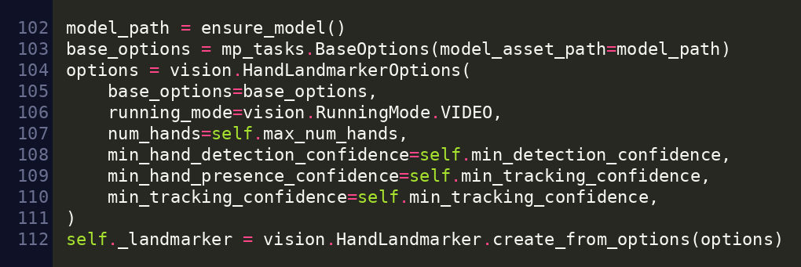
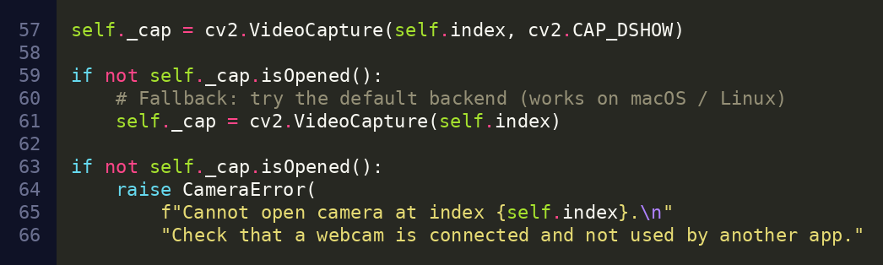
Code: capture and hand tracking
MediaPipe · app/hand_tracker.py
OpenCV · app/camera.py
cv2.VideoCapture opens the webcam, falls back to the default backend, and raises CameraError if no camera is found. Resolution and FPS are set right after with cap.set().
Hand Landmarker runs in VIDEO mode for one hand. The 0.7 / 0.6 confidence values come from config.py.
Both run on background threads (ThreadedCamera, ThreadedTracker), so drawing never waits for the webcam.

Slide 7
Making lines smooth
One Euro filter
calms hand shake
Curve fitting
fills gaps, no jagged corners
Spike trim
removes hooks at stroke ends
Saved as vectors
stays sharp when zoomed
Illustration only
Notes:
The chart is an illustration, not measured data: a shaky fingertip path (red) and the smoothed result (blue). Ekora uses a One Euro filter, curve interpolation and spike trimming.

Slide 8
System architecture
Webcam
Hand tracker
Pen
Gestures
Workspace
Renderer
camera thread
MediaPipe
smoothing
classifier
drawing + undo
OpenCV window
Event Bus — parts talk through events
main.py
Plugin manager
config.py
runs the main loop
loads add-ons
settings and tuning
Notes:
Each frame flows left to right. The event bus lets the parts talk without being tied together.

Slide 9
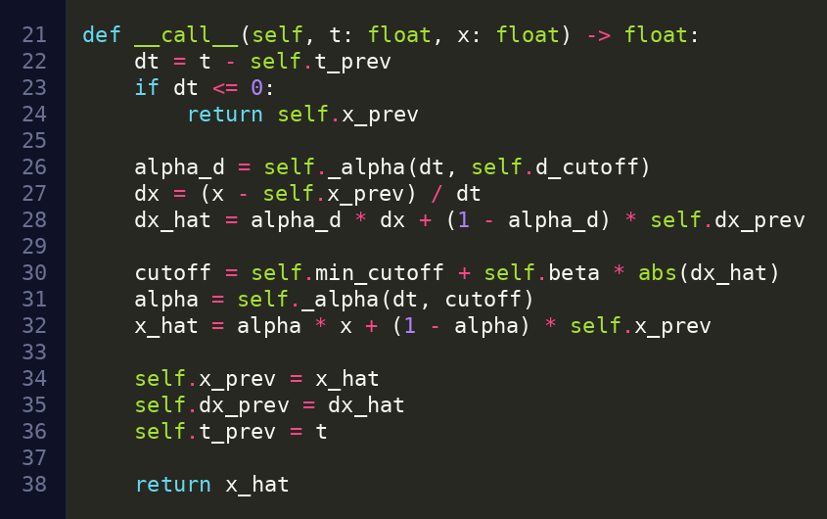
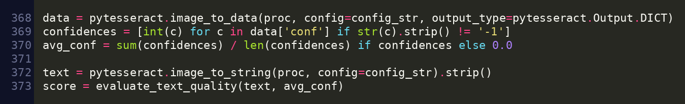
Code: smoothing and OCR
One Euro filter · app/virtual_pen.py
How a fingertip becomes a smooth pen
1. Dead zone: moves under 2 px are ignored, so a still hand does not jitter.
2. One Euro filter: heavy smoothing when slow, quick reaction when fast (min_cutoff 0.5, beta 0.01).
3. Prediction: the point is pushed ahead by 15 ms to hide lag.
pytesseract · app/services/providers.py
Tesseract reads each OpenCV-cleaned version of the selection. The best-scoring text is kept.

Slide 10
Thank you
Questions and live demo
Think. Sketch. Create.
github.com/ekashastri/Python-Project
Notes:
Thank you. Happy to run a live demo: point to draw, pinch to move, fist to pause, peace sign for colour, open palm to clear.

