Slide 1
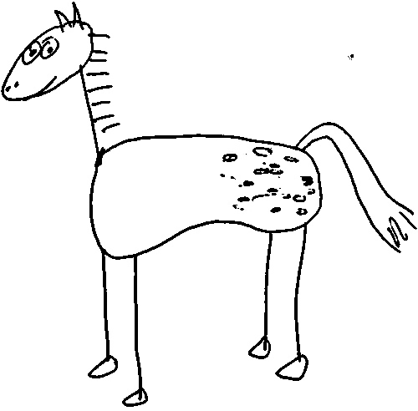

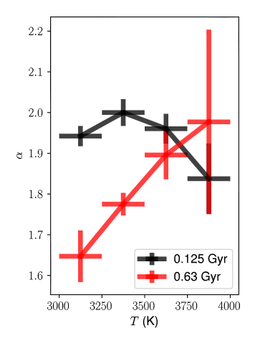
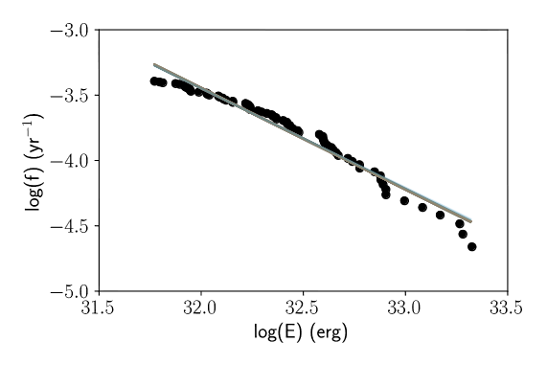
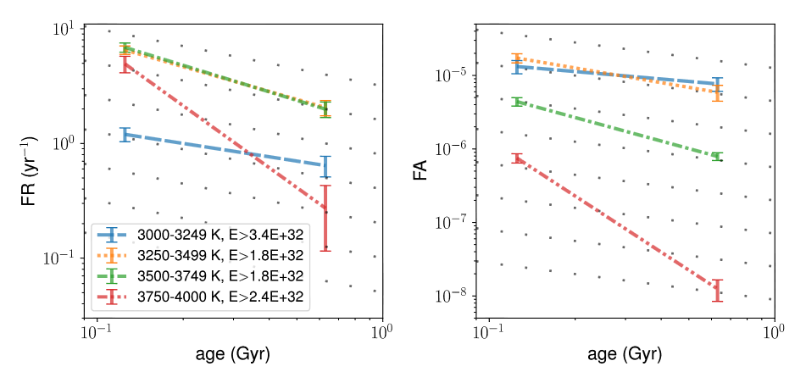

Exploring flaring activity as an age indicator using open cluster data
Ekaterina Ilin (1); Sarah J. Schmidt (1); James R. A. Davenport (2); Klaus G. Strassmeier (1)
1 Leibniz Institute for Astrophysics Potsdam (AIP), Germany 2 Western Washington University, WA, USA
Flaring activity - a stellar clock for cool stars?
Automated flare finding - Appaloosa
Flares on cool dwarfs are more frequent, energetic, and high-contrast compared to those on main-sequence stars of earlier spectral type. Since magnetic activity has long been known to decline as the star ages, we expect that a mass dependent flaring-age relation may be established as a stellar clock. We use photometric observations of populous open clusters with well-known ages to test this hypothesis.
Space missions like Kepler enable the continuous long-term photometric stellar monitoring that is required to measure flaring activity, especially on low-activity targets. Appaloosa is a flare detection and analysis pipeline designed for Kepler light curves by Davenport (2016) that can process large data sets from these surveys.
We enhanced its performance with a synthetic flare injection/recovery subroutine that allows us to characterize individual light curves with respect to flare detection. As we analyse photometry from Kepler’s follow up mission K2 (Howell et al. 2014), we remove the K2 systematics using the de-trended and variability cleared light curves from Aigrain et al. (2016).
By the numbers - K2 open cluster photometry
cluster | M45 - Pleiades | M44 - Praesepe | M67
age | 125 Myr (1) | 630 Myr (2) | 4.3 Gyr (3)
[Fe/H] | -0.01 (4) | 0.16 (4) | 0.03 (4)
distance | 135 pc (1) | 160 pc (2) | 908 pc (3)
#targets (membership) | 721 (5) | 740 (6,7) | 178 (8)
#flares | 558 | 201 | 0
RESULT #1
Appaloosa is open source!
Flares in the coolest stars age differently
M5
M3
M2
M1
K8
M 2.5-5.5 dwarfs release relatively more energy in larger flares in Praesepe than in the Pleiades.
(1) Bell et al. 2012, MNRAS 424, 3178-91 (2) Boudreault et al. 2012, MNRAS 426, 3419-34 (3) Dias et al. 2012, A&A 539, A125 (4) Netopil et al. 2016, A&A 585, A150 (5) Rebull et al. 2016, AJ 152, 113 (6) Kraus & Hillenbrand 2007, AJ 134, 2340-52 (7) Douglas et al. 2017, ApJ 842, 83 (8) Gonzalez 2016, MNRAS 459, 1060-68
Flare frequency distributions – an example
While the flare frequency distributions of late-K to early-M dwarfs have similar slopes, cooler stars appear to produce more high energy flares relative to weak ones at 630 Myr compared to 125 Myr.
What causes the change in flare production?
Possibilities include:
An entirely different dynamo below the full convection boundary.
Mass-dependent surface and large scale magnetic structures age differently, observable in flaring activity evolution.
Magnetic structures are in fact similar in the given mass range but flaring ages differently in increasingly neutral atmospheres.
The coolest Pleiades dwarfs have not yet begun to spin down, i.e. they have not yet reached the main sequence and rotate close to maximum speed.
Over a large range of energies, the frequency distributions of solar and stellar flares can be described by a power law with exponent α:
power law with slope -α+1
corresponds to the plot on the left
flare
Cumulative flare frequency distribution f(E) on stars with T=3250-3500K (M2.5-M3) at 630 Myr, based on 139 different K2 targets. 71 flares were detected, yielding α~1.78 .
Slopes of flare frequency distributions for Pleiades and Praesepe. No flare candidates were found in M67.
RESULT #2
Flaring activity declines with age (age^{-1/2} ?)
Outlook
We have shown that K2’s long cadence photometry contains valuable information about the aging of flaring activity as a function of stellar mass, and the mission’s observational treasury has not yet been fully tapped. K2 has so far observed around a dozen open clusters from pre-main sequence to solar age that can be investigated to disclose the nature of the flaring-age relation and its sensitivity not only to stellar mass but also to metallicity and multiplicity.
References
Left: Flare rate (FR). Right: total energy released in flares relative to stellar bolometric luminosity (FA). Dotted gray lines: Skumanich (1972) power law (slope -1/2). Line shapes/colors represent different T bins. Bin-wise energy detection thresholds are given in the legend.
Aigrain et al. 2016, MNRAS 459, 2408-2419
Davenport 2016, ApJ 829, 23
Howell et al. 2014, PASP 126, 398-408
Skumanich 1972, ApJ 171, 565
contact EI: @astroilin eilin@aip.de
EI acknowledges support from the German Academic Scholarship Foundation.
CoolStars20 Boston, MA, USA

