Slide 1
Research and Evaluation of the Robustness of Generative Models for Reconstructing Financial Time Series
Faculty of Computer Science
Data Science and Business Analytics
Moscow 2025
Prepared by Sushko Ekaterina Andreevna
Supervisor: Lukyanchenko Peter Pavlovich

Slide 2
Introduction
Faculty of Computer Science
Data Science and Business Analytics
Research and Evaluation of the Robustness of
Generative Models for Reconstructing
Financial Time Series
Financial time series are used for analysis, forecasting, and risk assessment, but data
are often insufficient. Generative models make it possible to create synthetic series
that realistically reproduce market properties and can be used to test trading strategies.
Glossary
· Financial Time Series —are sequences of numerical data ordered over time, reflecting the dynamics of various financial indicators such as stock prices, exchange rates, interest rates, trading volumes, and other market parameters.
· Generative Models — a class of machine learning models trained on real data and capable of generating new data with similar statistical characteristics.

Slide 3
Aim and Objectives
Faculty of Computer Science
Data Science and Business Analytics
Research and Evaluation of the Robustness of
Generative Models for Reconstructing
Financial Time Series
The aim of this work is to conduct a comparative analysis of different generative model architectures for the synthesis of financial time series.
Objectives:
• Review various architectures of generative models;
• Evaluate the effectiveness of data generation using several criteria
• Formulate conclusions and recommendations on the selection and application of generative models.

Slide 4
Road Map of the Research
Faculty of Computer Science
Data Science and Business Analytics
Research and Evaluation of the Robustness of
Generative Models for Reconstructing
Financial Time Series
6. Model Training and Evaluation
2. Literature review
2
6
7. Analyze the results
7
1
3. Overview of Generative Models
5
5. Visualization and Exploratory Analysis
1. Problem Statement and Research Goal
3
Conclusion from the research
4
4. Data collection
and pre-processing

Slide 5

Overview of generative models
Faculty of Computer Science
Data Science and Business Analytics
Research and Evaluation of the Robustness of
Generative Models for Reconstructing
Financial Time Series
• GAN
• Time-GAN
• MTSS-GAN
• Diffusion models

Slide 6
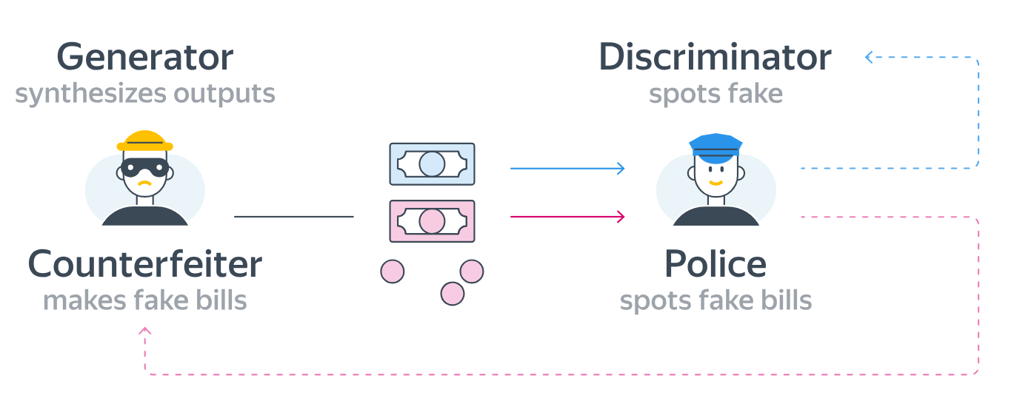
1) GAN
Faculty of Computer Science
Data Science and Business Analytics
Research and Evaluation of the Robustness of
Generative Models for Reconstructing
Financial Time Series
A GAN consists of two networks — a generator and a discriminator, that are trained simultaneously. The generator creates data from random noise, while the discriminator distinguishes between real and generated samples. Over time, both improve, enhancing the quality of the synthetic data.

Slide 7
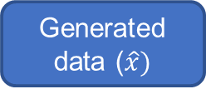
2) Time-GAN
Faculty of Computer Science
Data Science and Business Analytics
Research and Evaluation of the Robustness of
Generative Models for Reconstructing
Financial Time Series
Real data (x)
Encoder
Latent presentation (h)
Decoder
Generator
Supervisor
Generated data ($\hat{x})$
Discriminator
Time-GAN operates in two stages: first, the Encoder and Decoder learn to translate data into the latent space and back; then, within this latent space, the Generator, Supervisor, and Discriminator compete, creating realistic latent representations that are later transformed by the Decoder into synthetic time series.

Slide 8


3) MTSS-GAN
Faculty of Computer Science
Data Science and Business Analytics
Research and Evaluation of the Robustness of
Generative Models for Reconstructing
Financial Time Series
Real data (x)
Generated data ($\hat{x})$
Encoder 1
Generator 2
Discriminator 2
latent
features h
latent
features $\hat{h}$
Encoder 2
labels
Generator 1
Discriminator 1
MTSS-GAN learns in two stages: the first level reconstructs latent features, the second generates realistic time-series data

Slide 9

Faculty of Computer Science
Data Science and Business Analytics
Research and Evaluation of the Robustness of
Generative Models for Reconstructing
Financial Time Series
4) Diffusion models
Transformation to image presentation
Adding noise to data
Denoising network
Transformation to time series
In diffusion models, each time series can be represented as a separate “color channel.” This approach allows the model to process multiple assets or features simultaneously, learn their interdependencies, and generate coherent multidimensional series.

Slide 10
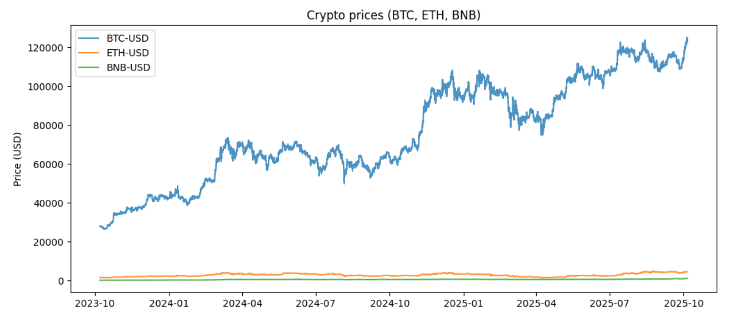
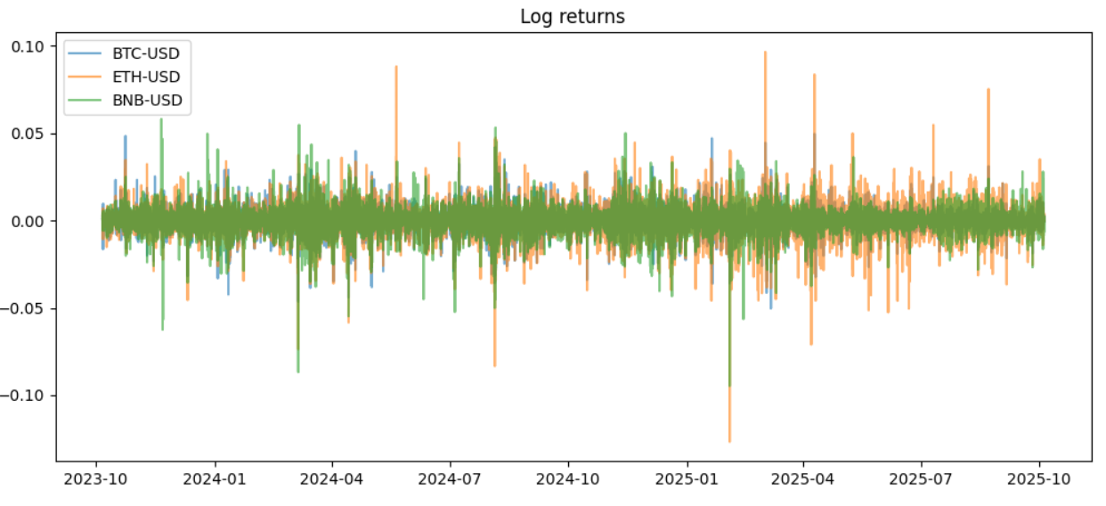
Data processing
Faculty of Computer Science
Data Science and Business Analytics
Research and Evaluation of the Robustness of
Generative Models for Reconstructing
Financial Time Series
Data collection
– Bitcoin, Ethereum, Binance Coin (hourly, 730 days)
– from Yahoo Finance library
Data preparation
– Data cleaning, normalization,
– Calculate log returns
Visualization
– Plotting graphs
– Verification of stylized facts

Slide 11
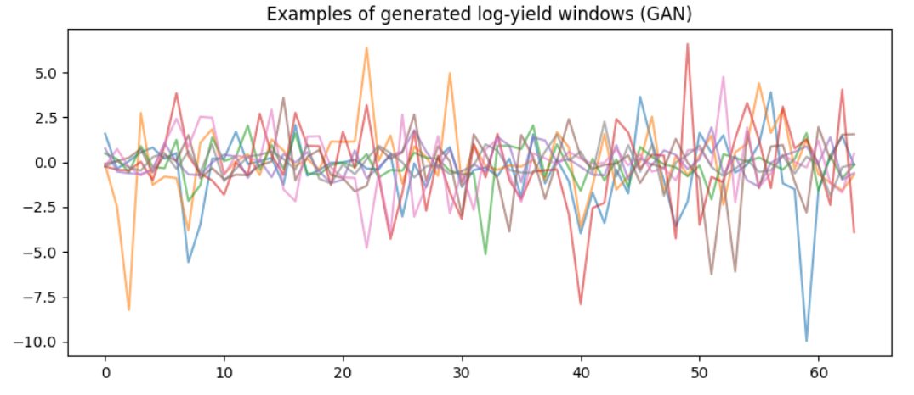
Learning
Faculty of Computer Science
Data Science and Business Analytics
Research and Evaluation of the Robustness of
Generative Models for Reconstructing
Financial Time Series
Loss functions
Sliding window method
GPU
WGAN-GP

Slide 12
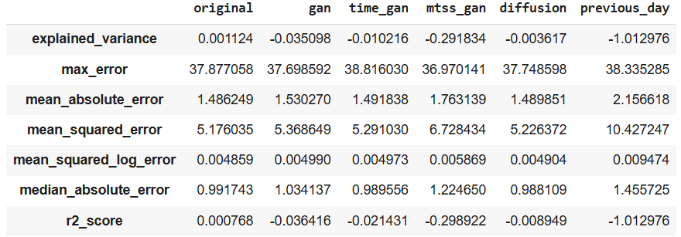
Faculty of Computer Science
Data Science and Business Analytics
Research and Evaluation of the Robustness of
Generative Models for Reconstructing
Financial Time Series
Analysis of results
Comparison of Models by Statistical Metrics

Slide 13

Future Research
Faculty of Computer Science
Data Science and Business Analytics
Research and Evaluation of the Robustness of
Generative Models for Reconstructing
Financial Time Series
Variational Autoencoders (VAE)
Autoregressive (AR) generators and etc.

Slide 14
Conclusions
Faculty of Computer Science
Data Science and Business Analytics
Research and Evaluation of the Robustness of
Generative Models for Reconstructing
Financial Time Series
- All the considered models successfully handled the data generation task.
- According to quantitative metrics, the diffusion model showed the best results.
- MTSS-GAN stands out for its ability to specify market regimes.
- Generative models open new opportunities for modeling and exploring financial markets.

Slide 15
Thank you for attention
Faculty of Computer Science
Data Science and Business Analytics
Research and Evaluation of the Robustness of
Generative Models for Reconstructing
Financial Time Series

