Slide 1
Capstone 1: “World Happiness Report Analysis”
Author: Katerina Zhurun

Slide 2
Agenda:
1. Context
2. Hypothesis
3. Metadata
4. Exploratory Analysis
5. Conclusion

Slide 3
Context:
The data used for this analysis comes from the rankings of World Happiness Reports from 2016 to 2020. The reports primarily use data from the Gallup World Poll.
The respondents are asked to rate their current lives on the scale from 0 to 10.
Typically, around 1,000 responses are gathered annually for each country.
6 factors - levels of GDP, health, generosity, social support, freedom, and corruption - are estimated to contribute to making life evaluations higher in each country than they are in Dystopia, a hypothetical country that has values equal to the world’s lowest national averages for each of the 6 factors.

Slide 4
Metadata Summary
Variable ’Happiness Score’ is the answer to the question “How do you rate your current life situation on a scale from 0 to 10?”.
Variable ‘GDP’ - the statistics of GDP per capita.
‘Family / Social support’ - the national average of the binary responses (either 0 or 1) to the question “If you were in trouble, do you have relatives or friends you can count on to help you whenever you need them, or not?”.
‘Health / Life Expectancy’ is calculated based on data from the World Health Organization (WHO), the World Development Indicators (WDI), and statistics published in journal articles.
‘Freedom to make life choices’ is the national average of responses to the question “Are you satisfied or dissatisfied with your freedom to choose what you do with your life?”.
‘Trust in Government’ is the national average of the survey responses to 2 questions in the GWP: “Is corruption widespread throughout the government or not” and “Is corruption widespread within businesses or not?” The overall perception is just the average of the two 0-or-1 responses.
‘Generosity’ is the residual of regressing national average of response to the GWP question “Have you donated money to a charity in the past month?” on GDP per capita.

Slide 5
The purpose of this work is
Research shows that happiness leads to a wide range of benefits for our performance, health, relationships and more. The purpose of this work is to find out:
1) how the happiness score is related to the other 6 variables;
2) what are the top 2 variables that explain the happiness score.

Slide 6
Exploratory Data Analysis

Slide 7
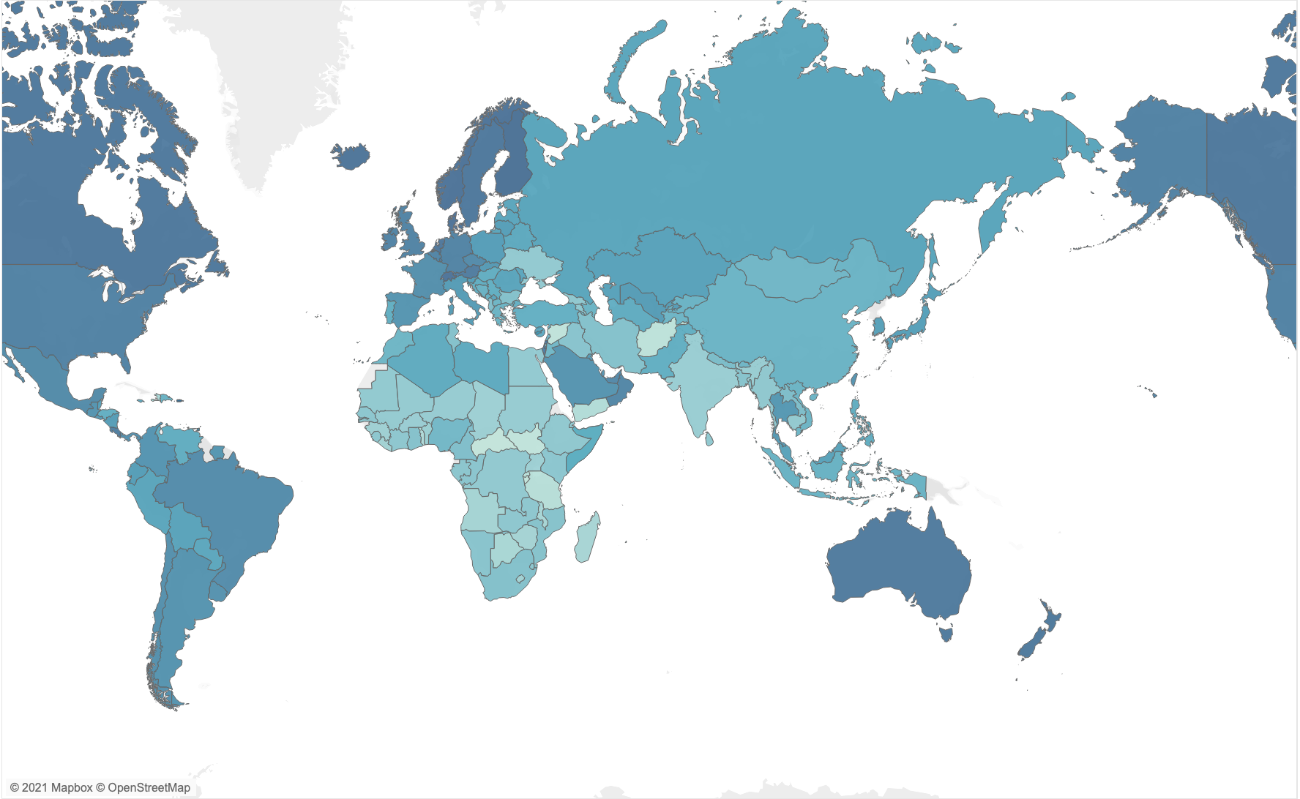
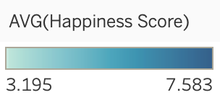
Happiness Score distribution around the world:

Slide 8
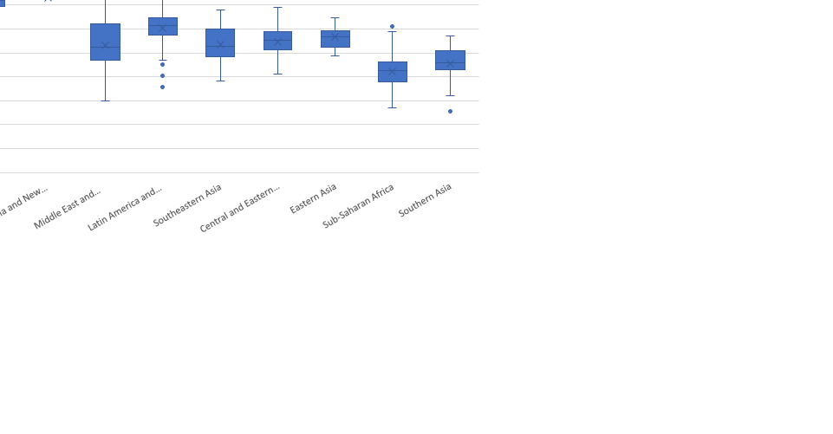
Distribution of happiness score across regions:
The World Happiness Report divides the world into 10 regions.
- The happiest regions on the planet are: Western Europe, North America, Australia and New Zealand.
- The least happy regions are Sub-Saharan Africa and Southern Asia.

Slide 9
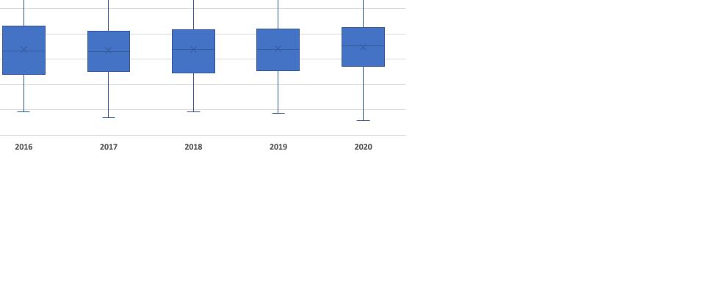
Distribution of happiness score across the years:
Surprisingly, 2020 had the highest median score as well as the highest maximum score, however it also had the lowest minimum score throughout the analyzed years.

Slide 10
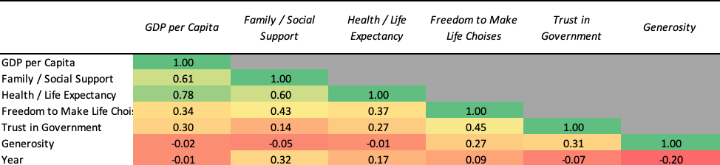
We can also see how are the six variables correlated with one another:
Using the Linear Regression method, we were able to get the correlation coefficients, which show that:
GDP is closely correlated to Health / Life expectancy which is obvious.
However, GDP and Generosity are negatively correlated, which is a little surprising.

Slide 11
All 6 categories are positively correlated to a country's happiness score. The 2 most strongly correlated factors are GDP and Health / Life Expectancy while the least correlated factor is Generosity.

Slide 12
Which of the six variables most affect a country’s “happiness”?
Using the Linear Regression method, we were able to get the correlation coefficients.
There is no doubt that GDP is the most determining factor followed by Health / Life Expectancy with only 0.3 points of difference between the two variables.

Slide 13
Conclusion:
GDP and Health / Life Expectancy influence the happiness score the most. The 2 factors are also closely correlated to each other, which absolutely makes sense: the wealthier the country – the better the healthcare system should be.
The least correlated to the happiness score variable is Generosity. Not so obvious, however we can conclude that people do not tend to donate money to charity more often if they have more resources.

