Slide 1
Capstone 1: “World Happiness Report Analysis”
Author: Katerina Zhurun

Slide 2
Agenda:
1. Context
2. Hypothesis
3. Metadata
4. Exploratory Analysis
5. Conclusion

Slide 3
Context:
The data used for this analysis comes from the rankings of World Happiness Reports from 2016 to 2020. The reports primarily use data from the Gallup World Poll.
The respondents are asked to rate their current lives on the scale from 0 to 10.
Typically, around 1,000 responses are gathered annually for each country.
The sub-bars show the estimated extent to which each of 6 factors - levels of GDP, health, generosity, social support, freedom, and corruption - are estimated to contribute to making life evaluations higher in each country than they are in Dystopia, a hypothetical country that has values equal to the world’s lowest national averages for each of the 6 factors.
The sub-bars have no impact on the total score reported for each country, but instead are just a way of explaining for each country the implications of the model.

Slide 4
The purpose of this work is:
1) to define what are the key factors that influence the happiness score;
2) to accurately forecast the top 10 happiest countries in 2021 based on those factors.

Slide 5
Metadata Summary
Variable ’Happiness Score’ is the answer to the question “How do you rate your current life situation on a scale from 0 to 10?”.
Variable ‘GDP’ - the statistics of GDP per capita.
‘Family / Social support’ - the national average of the binary responses (either 0 or 1) to the question “If you were in trouble, do you have relatives or friends you can count on to help you whenever you need them, or not?”.
‘Health / Life Expectancy’ is calculated based on data from the World Health Organization (WHO), the World Development Indicators (WDI), and statistics published in journal articles.
‘Freedom to make life choices’ is the national average of responses to the question “Are you satisfied or dissatisfied with your freedom to choose what you do with your life?”.
‘Trust in Government’ is the national average of the survey responses to 2 questions in the GWP: “Is corruption widespread throughout the government or not” and “Is corruption widespread within businesses or not?” The overall perception is just the average of the two 0-or-1 responses.
‘Generosity’ is the residual of regressing national average of response to the GWP question “Have you donated money to a charity in the past month?” on GDP per capita.

Slide 6
Exploratory Data Analysis

Slide 7
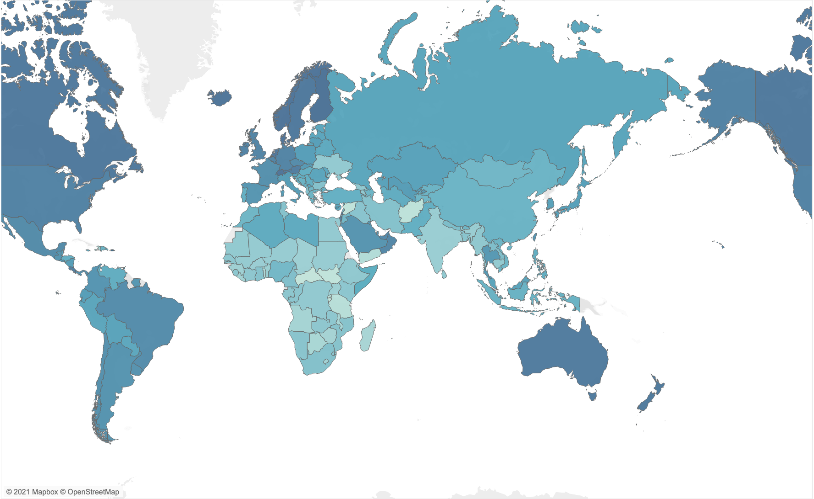
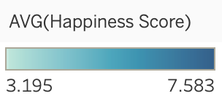
Happiness Score distribution around the world:

Slide 8
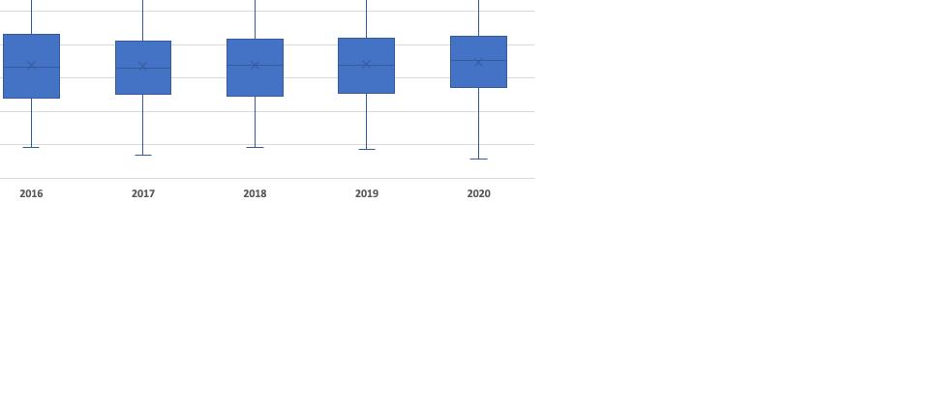
Distribution of happiness score across the years:
Surprisingly, 2020 had highest median score as well as the highest maximum score, however it also had the lowest score throughout the analyzed years.

Slide 9
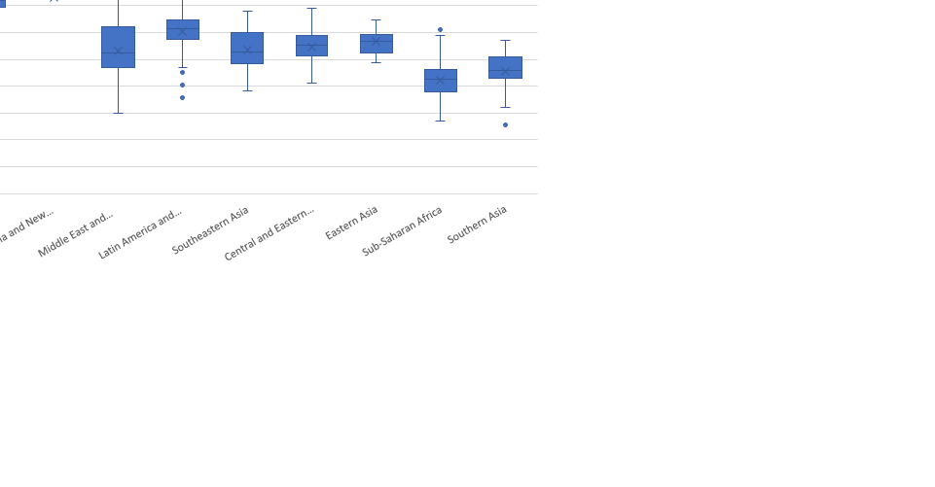
Distribution of happiness score across regions:
According to the chart below, the happiest regions on the planet are: Western Europe, North America, Australia and New Zealand.
The least happy regions are Sub-Saharan Africa and Southern Asia.

Slide 10
All 6 categories are positively correlated to a country's happiness score. The 2 most strongly correlated factors are GDP and Health / Life Expectancy while the least correlated factor is Generosity.

Slide 11
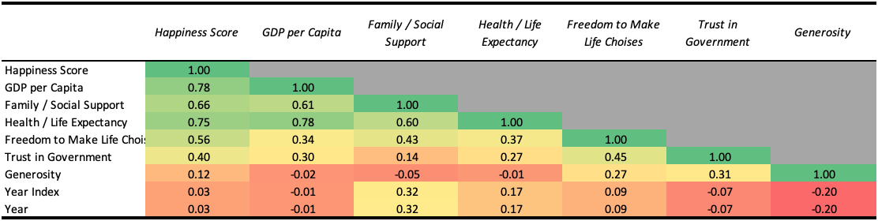
We can also see how correlated the six variables are with one another:
GDP is closely correlated to Health / Life expectancy which is obvious.
However, GDP and Generosity are negatively correlated, which is a little surprising.
Remove year index
ADD Scatter plot of GDP vs Health

Slide 12
Which of the six variables most affect a country’s “happiness”?
There is no doubt that GDP is the most determining factor followed by Health / Life Expectancy with only 0.3 points of difference between the two variables.

Slide 13
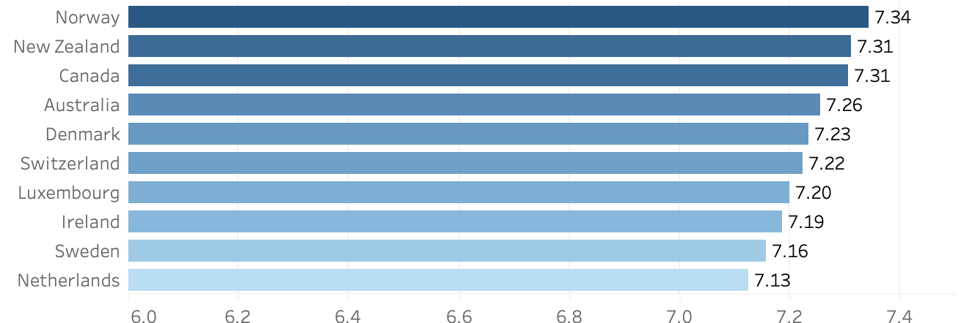
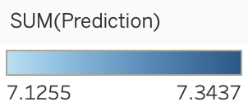
2021 Happiness Score Prediction (Top 10):
Give an explanation of how you calculated this: We decided to create regression model, etc.

Slide 14
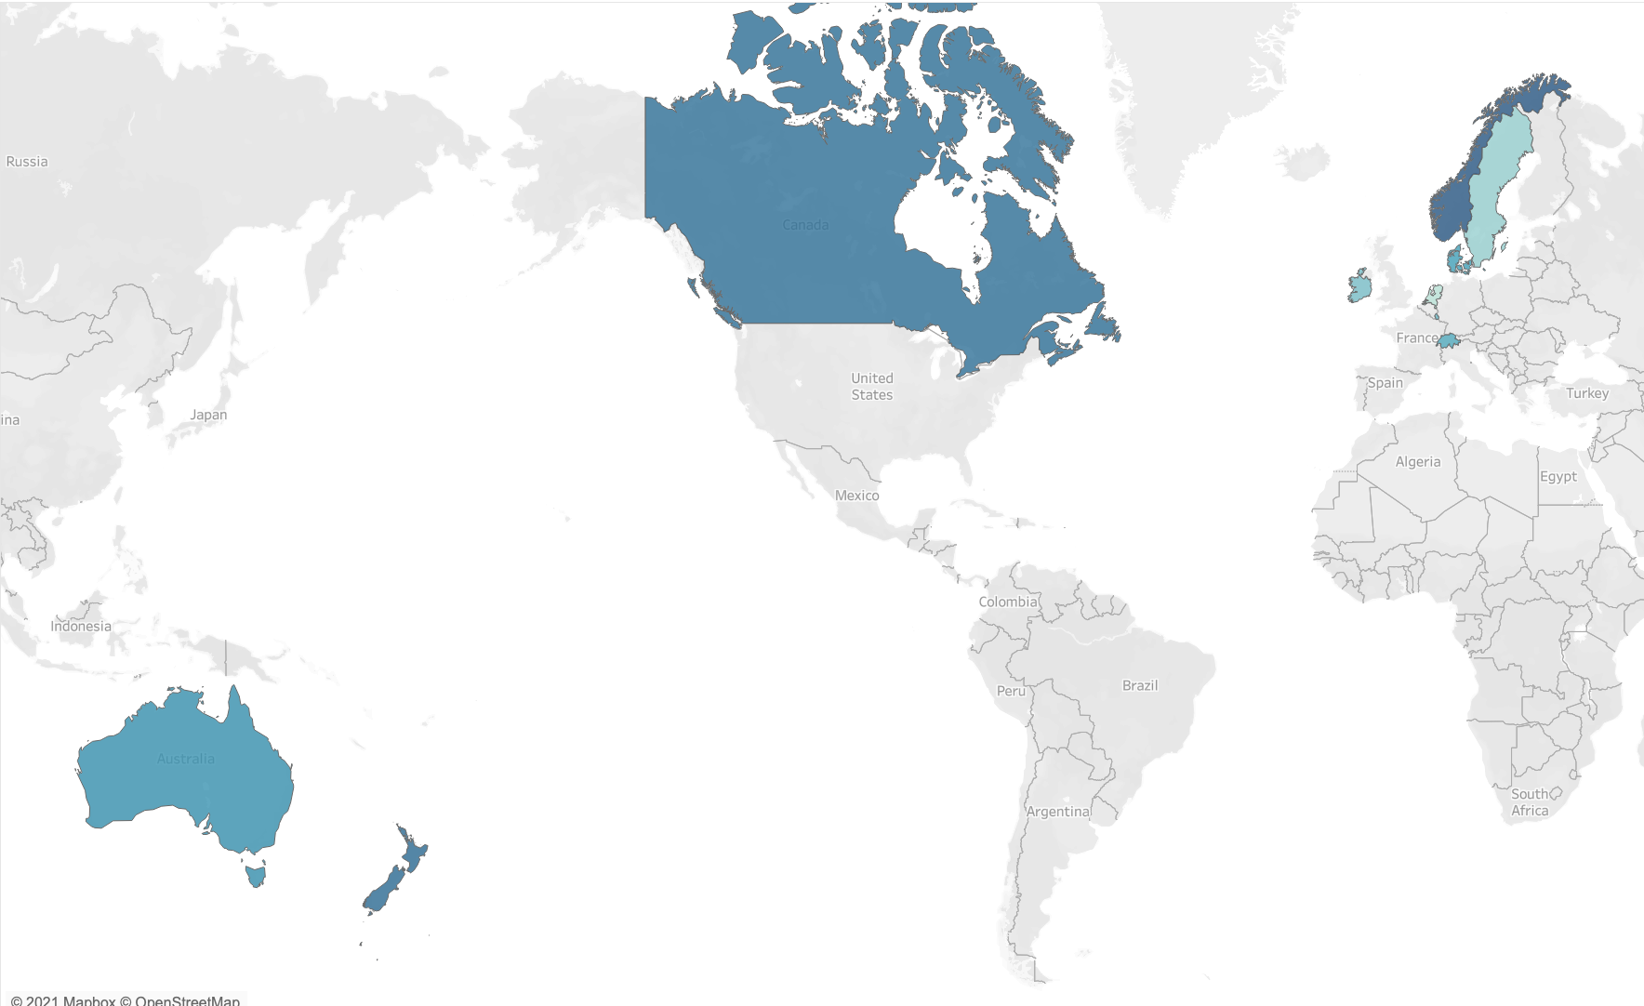
2021 Happiness Score Prediction (Top 10):

Slide 15
Conclusion:
The most important variables influencing the happiness score are GDP and Health / Life Expectancy
Western Europe, North America and Australia and New Zealand regions have the highest happiness scores on average
All 6 variables are positively correlated to happiness score. The 2 most strongly correlated variables are GDP and Health / Life Expectancy while the least correlated factor is Generosity
Top 10 happiest countries in 2021 will be:
1.Norway
2. New Zealand
3. Canada
4. Australia
5. Denmark
6. Switzerland
7. Luxemburg
8. Ireland
9. Sweden
10. Netherlands
HERE I WOULD COMPARE 2020 REAL VALUE
VERSUS THE PREDICTED VALUE just to show how good your model is
AND INSTEAD OF TRYING TO PREDICT FOR 2020,
I WOULD SIMPLY SAY THAT WE NOW HAVE A REGRESSION
MODEL TO ESTIMATE SCORES

