Slide 1

Tes fichiers sont dans le
CHAOS
?

Slide 2
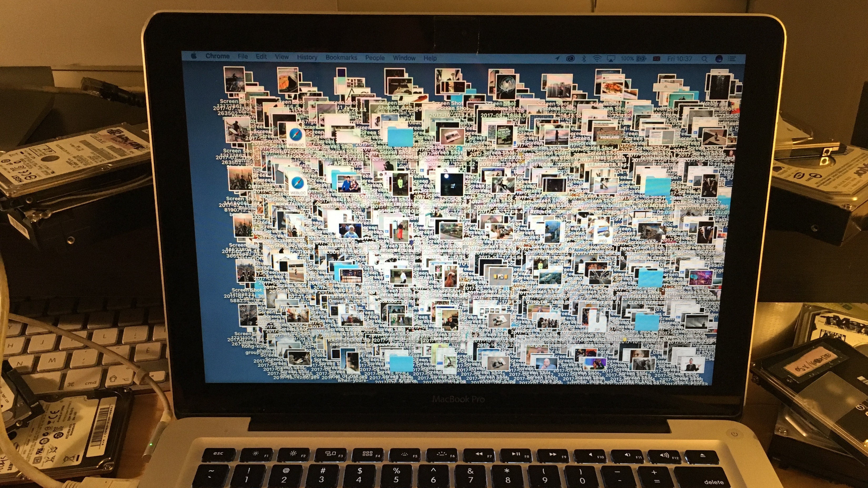
Quelques centaines de fichiers sur l’écran de bureau ?

Slide 3
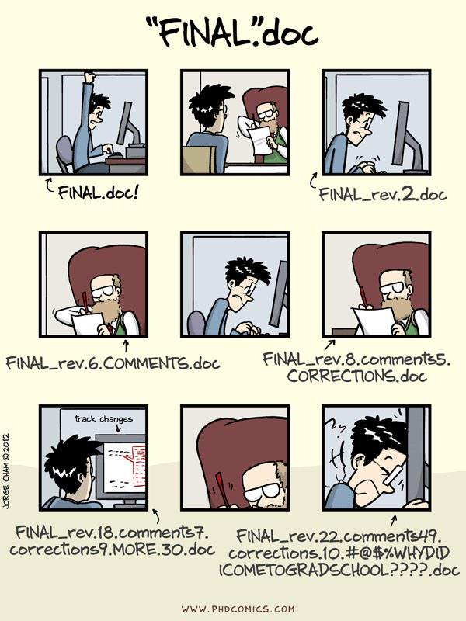

Slide 4
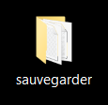
Tu décharges/caches des fichiers
dans des emplacements cryptés ?

Slide 5

Tu es prêt à brûler tout ton système « d'organisation » ?

Slide 6
Prépare-toi pour une solution !

Slide 7
Overview
Project folder structure (projects directory with individual project subdirectories)
File naming
Set up version control
READMEs
Licenses
DOI for code
Good practice, conventions

Slide 8
File chaos
How much time do you spend looking for files saved on your computer?
Once you’ve managed to find the file, are you faced with multiple files named for incremental versions?
Do you choose between “FILE_final” and “FILE_best_version” by opening up a dozen files?
Do deadlines or laziness exacerbate saving files on your Desktop (with the best intention of “organizing it later?”

Slide 9
Solution: Create an organized folder structure
Have a projects directory
Every project has its own directory (folder)
Subdirectories (subfolders) are named with keywords (e.g. data, output, scripts, figures)
Be consistent across project folder structures because to make things easy on yourself

Slide 10
Track file versions
“_v1”, “_v2,”, “_v12”, “_final”, “_final2” – where does it end?!
It ends with a file versioning system.
One file with a consistent file name
Modifications to the file are tracked by the versioning system
Earlier incarnations of the file are accessible if you decide you need to revert to an earlier version

